Slide 1
Two-view geometry

Slide 2
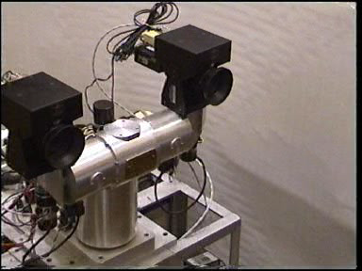
Stereo head
Kinect / depth cameras

Slide 3
Stereo with rectified cameras
Special case: cameras are parallel to each other and translated along X axis
X axis
Z axis

Slide 4
Perspective projection in rectified cameras
Without loss of generality, assume origin is at pinhole of 1st camera

Slide 5
Perspective projection in rectified cameras
Without loss of generality, assume origin is at pinhole of 1st camera
X coordinate differs by t_{x}/Z
Y coordinate is the same!

Slide 6
Perspective projection in rectified cameras
disparity = t_{x}/Z
If t_{x} is known, disparity gives Z
Otherwise, disparity gives Z in units of t_{x}
Small-baseline, near depth = large-baseline, far depth

Slide 7
Perspective projection in rectified cameras
For rectified cameras, correspondence problem is easier
Only requires searching along a particular row.

Slide 8
Rectifying cameras
Given two images from two cameras with known relationship, can we rectify them?

Slide 9
Rectifying cameras
Can we rotate / translate cameras?
Do we need to know the 3D structure of the world to do this?

Slide 10
Rotating cameras
Assume K is identity
Assume coordinate system at camera pinhole

Slide 11
Rotating cameras
Assume K is identity
Assume coordinate system at camera pinhole

Slide 12
Rotating cameras
What happens if the camera is rotated?

Slide 13
Rotating cameras
What happens if the camera is rotated?
No need to know the 3D structure
Rotation matrix
Homogenous coordinates of mapped pixel
Homogenous coordinates of original pixel

Slide 14
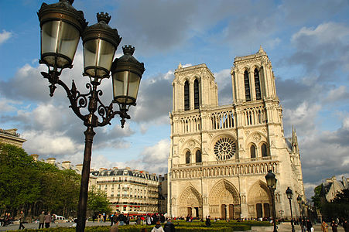

Rotating cameras

Slide 15
Rectifying cameras

Slide 16
Rectifying cameras

Slide 17
Rectifying cameras

Slide 18
Rectifying cameras

Slide 19
Perspective projection in rectified cameras
For rectified cameras, correspondence problem is easier
Only requires searching along a particular row.

Slide 20
Perspective projection in rectified cameras
What about non-rectified cameras?
Is there an equivalent?
For rectified cameras, correspondence problem is easier
Only requires searching along a particular row.

Slide 21
Epipolar constraint
Reduces 2D search problem to search along a particular line: epipolar line

Slide 22
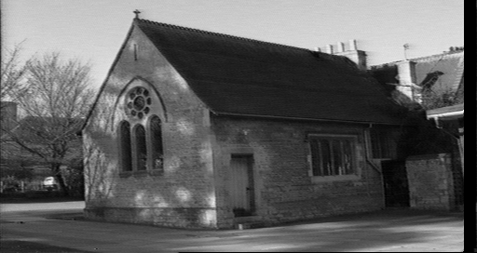
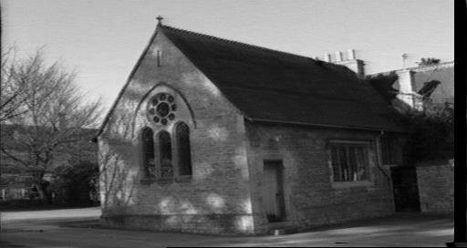
Epipolar constraint
True in general!
Given pixel (x,y) in one image, corresponding pixel in the other image must lie on a line
Line function of (x,y) and parameters of camera
These lines are called epipolar line

Slide 23
Epipolar geometry

Slide 24
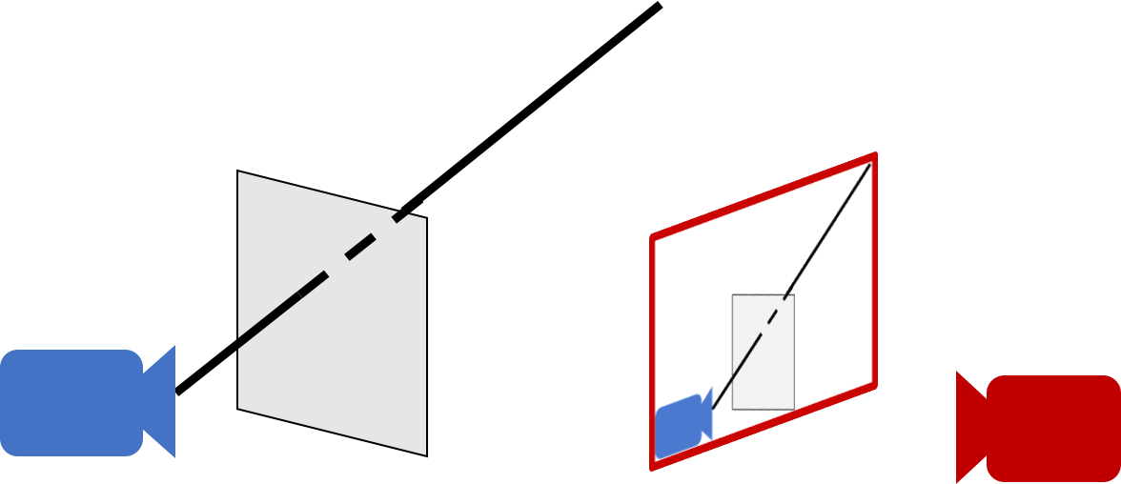
Epipolar geometry - why?
For a single camera, pixel in image plane must correspond to point somewhere along a ray

Slide 25
Epipolar geometry
When viewed in second image, this ray looks like a line: epipolar line
The epipolar line must pass through image of the first camera in the second image - epipole
Epipole
Epipolar line

Slide 26
Epipolar geometry
Given an image point in one view, where is the corresponding point in the other view?
?
epipolar line
C
C
/
epipole
baseline
A point in one view “generates” an epipolar line in the other view
The corresponding point lies on this line

Slide 27
Epipolar line
Epipolar constraint
Reduces correspondence problem to 1D search along an epipolar line

Slide 28

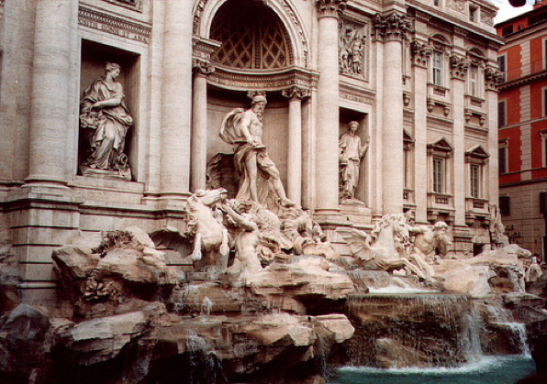
Epipolar lines

Slide 29
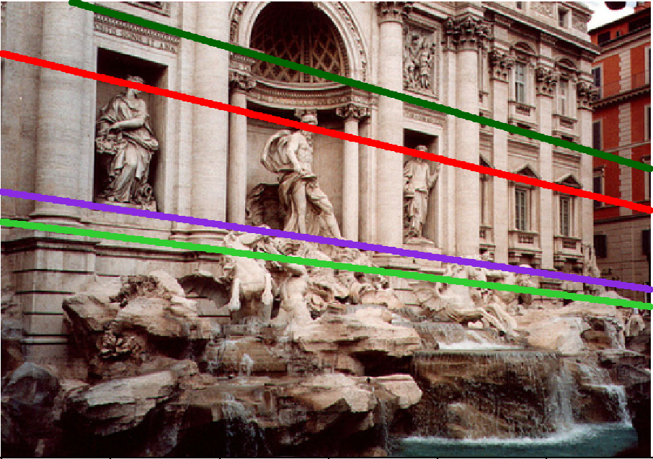
Epipolar lines

Slide 30
Epipolar lines
Epipole

Slide 31
Epipolar geometry continued
Epipolar geometry is a consequence of the coplanarity of the camera centres and scene point
X
x
x
/
C
C
/
The camera centres, corresponding points and scene point lie in a single plane, known as the epipolar plane

Slide 32
Nomenclature
X
l/
right epipolar line
left epipolar line
x
/
x
e
e
/
C
C
/
The epipolar line l/ is the image of the ray through x
The epipole e is the point of intersection of the line joining the camera centres with the image plane
this line is the baseline for a stereo rig, and
the translation vector for a moving camera
The epipole is the image of the centre of the other camera: e = PC/ , e/ = P/C

Slide 33
The epipolar pencil
X
e
/
e
baseline
As the position of the 3D point X varies, the epipolar planes “rotate” about the baseline. This family of planes is known as an epipolar pencil (a pencil is a one parameter family).
All epipolar lines intersect at the epipole.

Slide 34
The epipolar pencil
X
e
/
e
baseline
As the position of the 3D point X varies, the epipolar planes “rotate” about the baseline. This family of planes is known as an epipolar pencil (a pencil is a one parameter family).
All epipolar lines intersect at the epipole.

Slide 35
Epipolar geometry - the math
Assume intrinsic parameters K are identity
Assume world coordinate system is centered at 1st camera pinhole with Z along viewing direction

Slide 36
Epipolar geometry - the math
Assume intrinsic parameters K are identity
Assume world coordinate system is centered at 1st camera pinhole with Z along viewing direction

Slide 37
Epipolar geometry - the math
Assume intrinsic parameters K are identity
Assume world coordinate system is centered at 1st camera pinhole with Z along viewing direction

Slide 38
Epipolar geometry - the math
Assume intrinsic parameters K are identity
Assume world coordinate system is centered at 1st camera pinhole with Z along viewing direction

Slide 39
Epipolar geometry - the math
Assume intrinsic parameters K are identity
Assume world coordinate system is centered at 1st camera pinhole with Z along viewing direction

Slide 40
Epipolar geometry - the math
0
0

Slide 41
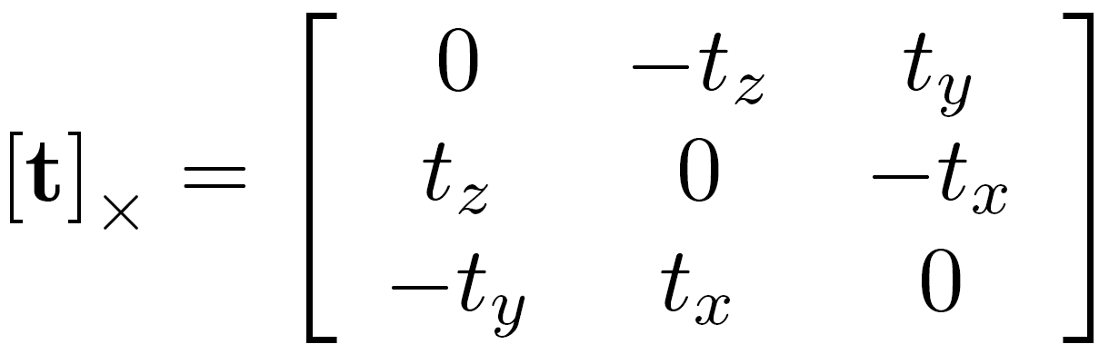
Epipolar geometry - the math
Can we write this as matrix vector operations?
Cross product can be written as a matrix

Slide 42
Epipolar geometry - the math
Can we write this as matrix vector operations?
Dot product can be written as a vector-vector times

Slide 43
Epipolar geometry - the math
Can we write this as matrix vector operations?
Dot product can be written as a vector-vector times

Slide 44
Epipolar geometry - the math

Slide 45
Epipolar geometry - the math
Homogenous coordinates of point in image 2
Homogenous coordinates of point in image 1
Essential matrix

Slide 46
Epipolar constraint and epipolar lines
Consider a known, fixed pixel in the first image
What constraint does this place on the corresponding pixel?
where
What kind of equation is this?

Slide 47
Epipolar constraint and epipolar lines
Consider a known, fixed pixel in the first image
where
Line!

Slide 48
Epipolar constraint: putting it all together
If p is a pixel in first image and q is the corresponding pixel in the second image, then: q^{T}Ep = 0
E = [t]_{X}R
For fixed p, q must satisfy: q^{T}l = 0, where l = Ep
For fixed q, p must satisfy: l^{T}p = 0 where l^{T} = q^{T}E, or l = E^{t}q
These are epipolar lines!
Epipolar line in 2nd image
Epipolar line in 1st image

Slide 49
Essential matrix and epipoles
E = [t]_{X}R
Ep is an epipolar line in 2nd image
All epipolar lines in second image pass through c₂
c₂ is epipole in 2nd image

Slide 50
Essential matrix and epipoles
E = [t]_{X}R
E^{T}q is an epipolar line in 1st image
All epipolar lines in first image pass through c₁
c₁ is the epipole in 1st image

