Slide 1
Stereo

Slide 2
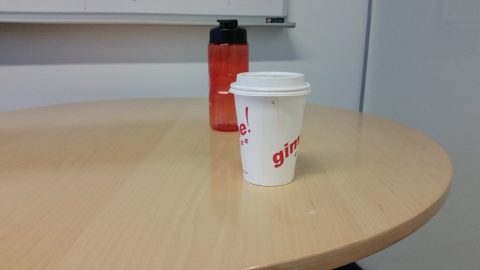
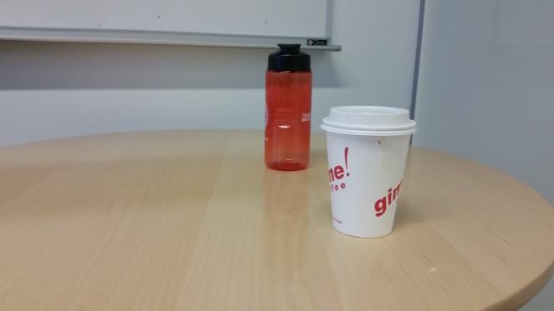
Triangulation
Suppose we have two cameras
  Calibrated: parameters known
And a pair of corresponding pixels
Find 3D location of point!
(x₁,y₁)
(x₂,y₂)

Slide 3
Binocular stereo
Given two calibrated cameras
  Find pairs of corresponding pixels
  Use corresponding image locations to set up equations on world coordinates
  Solve!

Slide 4
Binocular stereo
General case: cameras can be arbitrary locations and orientations

Slide 5
Binocular stereo
Special case: cameras are parallel to each other and translated along X axis
X axis
Z axis

Slide 6
Stereo with rectified cameras
Special case: cameras are parallel to each other and translated along X axis
X axis
Z axis

Slide 7
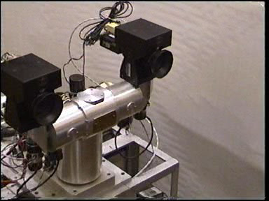
Stereo head
Kinect / depth cameras

Slide 8
Stereo with “rectified cameras”

Slide 9
Perspective projection in rectified cameras
Without loss of generality, assume origin is at pinhole of 1st camera

Slide 10
Perspective projection in rectified cameras
Without loss of generality, assume origin is at pinhole of 1st camera

Slide 11
Perspective projection in rectified cameras
Without loss of generality, assume origin is at pinhole of 1st camera

Slide 12
Perspective projection in rectified cameras
Without loss of generality, assume origin is at pinhole of 1st camera

Slide 13
Perspective projection in rectified cameras
Without loss of generality, assume origin is at pinhole of 1st camera

Slide 14
Perspective projection in rectified cameras
Without loss of generality, assume origin is at pinhole of 1st camera

Slide 15
Perspective projection in rectified cameras
Without loss of generality, assume origin is at pinhole of 1st camera

Slide 16
Perspective projection in rectified cameras
Without loss of generality, assume origin is at pinhole of 1st camera
X coordinate differs by t_{x}/Z
Y coordinate is the same!

Slide 17
Perspective projection in rectified cameras
X coordinate differs by t_{x}/Z
That is, difference in X coordinate is inversely proportional to depth
Difference in X coordinate is called disparity
Translation between cameras (tx) is called baseline
disparity = baseline / depth

Slide 18
The disparity image
For pixel (x,y) in one image, only need to know disparity to get correspondence
Create an image with color at (x,y) = disparity
right image
disparity
left image

Slide 19
Perspective projection in rectified cameras
For rectified cameras, correspondence problem is easier
Only requires searching along a particular row.

Slide 20
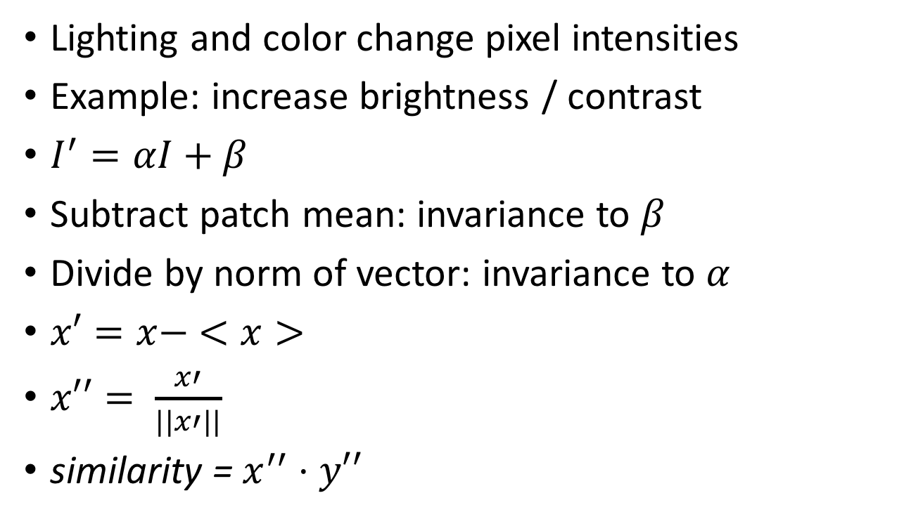
NCC - Normalized Cross Correlation
Lighting and color change pixel intensities
Example: increase brightness / contrast
$I^{′}=αI+β$
Subtract patch mean: invariance to $β$
Divide by norm of vector: invariance to $α$
$x′=x− <x>$
$x′′= \frac{x′}{||x′||}$
similarity = $x^{′′}⋅y′′$

Slide 21
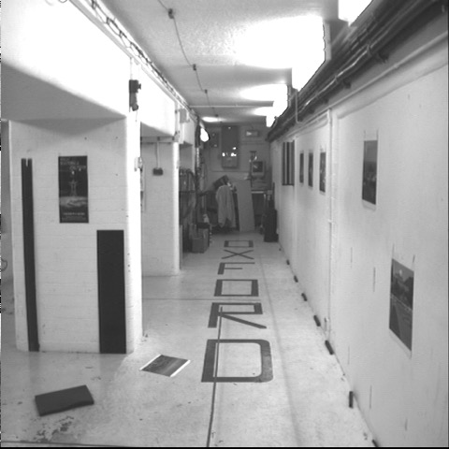
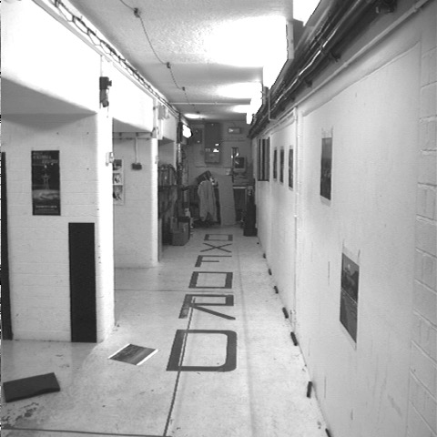


Cross-correlation of neighborhood
translate so that mean is zero

Slide 22

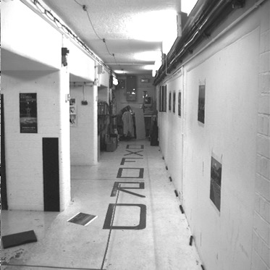
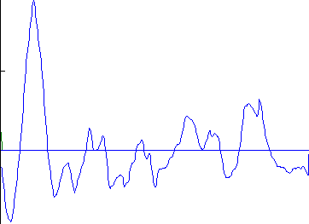
left image band
right image band
1
0.5
cross correlation
0
x

Slide 23
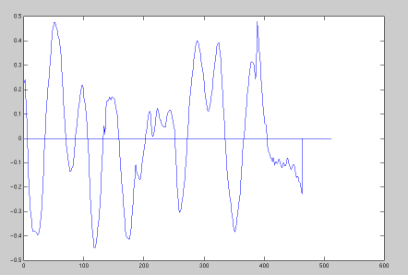
target region
left image band
right image band
1
0.5
cross correlation
0
x

Slide 24
The NCC cost volume
Consider M x N image
Suppose there are D possible disparities.
For every pixel, D possible scores
Can be written as an M x N x D array
To get disparity, take max along 3rd axis

Slide 25
Computing the NCC volume
For every pixel (x, y)
  For every disparity d
    Get normalized patch from image 1 at (x, y)
    Get normalized patch from image 2 at (x + d, y)
    Compute NCC

Slide 26
Computing the NCC volume
For every disparity d
  For every pixel (x, y)
    Get normalized patch from image 1 at (x, y)
    Get normalized patch from image 2 at (x + d, y)
    Compute NCC
Assume all pixels lie at same disparity d (i.e., lie on same plane) and compute cost for each
Plane sweep stereo

Slide 27
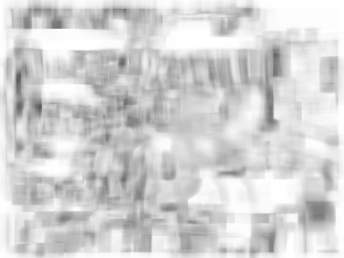
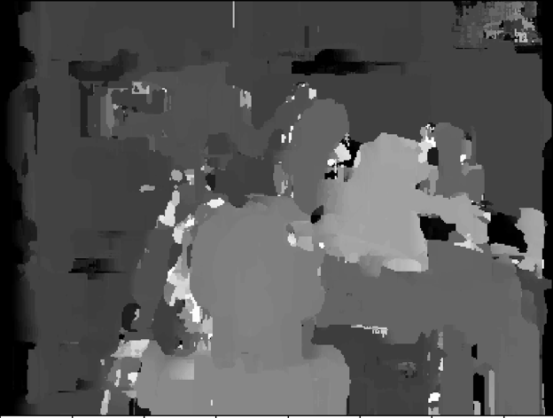

Slide 28
A similar special case
Fixating camera system
Eyes fixate on object
Angle at which they merge proportional to inverse depth
b
Z
a

Slide 29
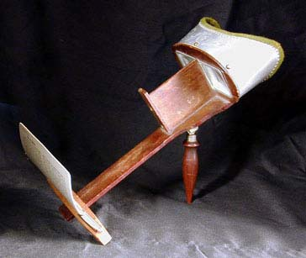
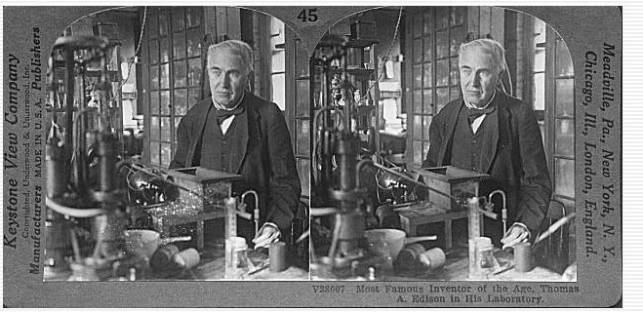
Stereograms
Invented by Sir Charles Wheatstone, 1838

Slide 30
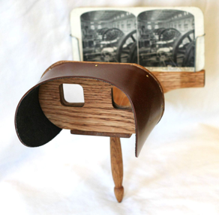
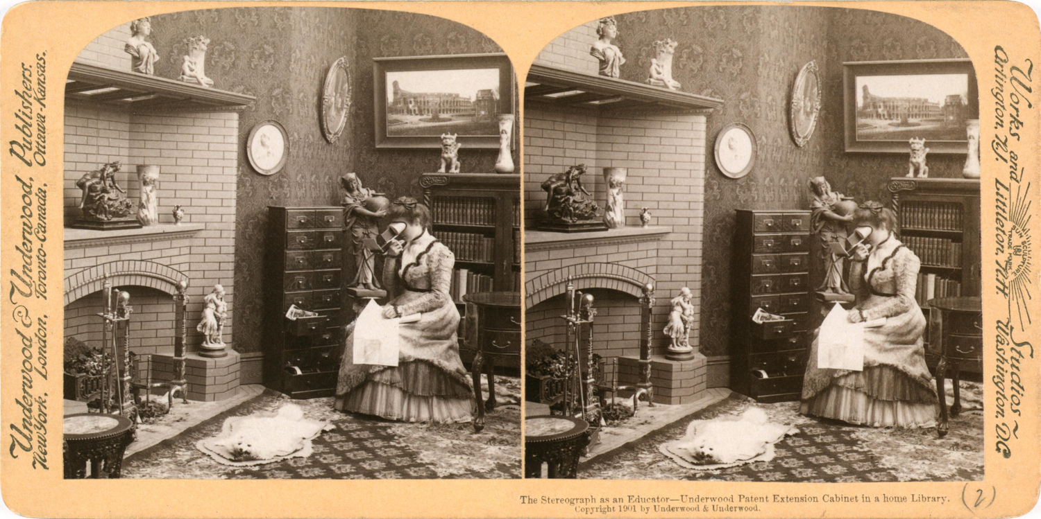

Slide 31
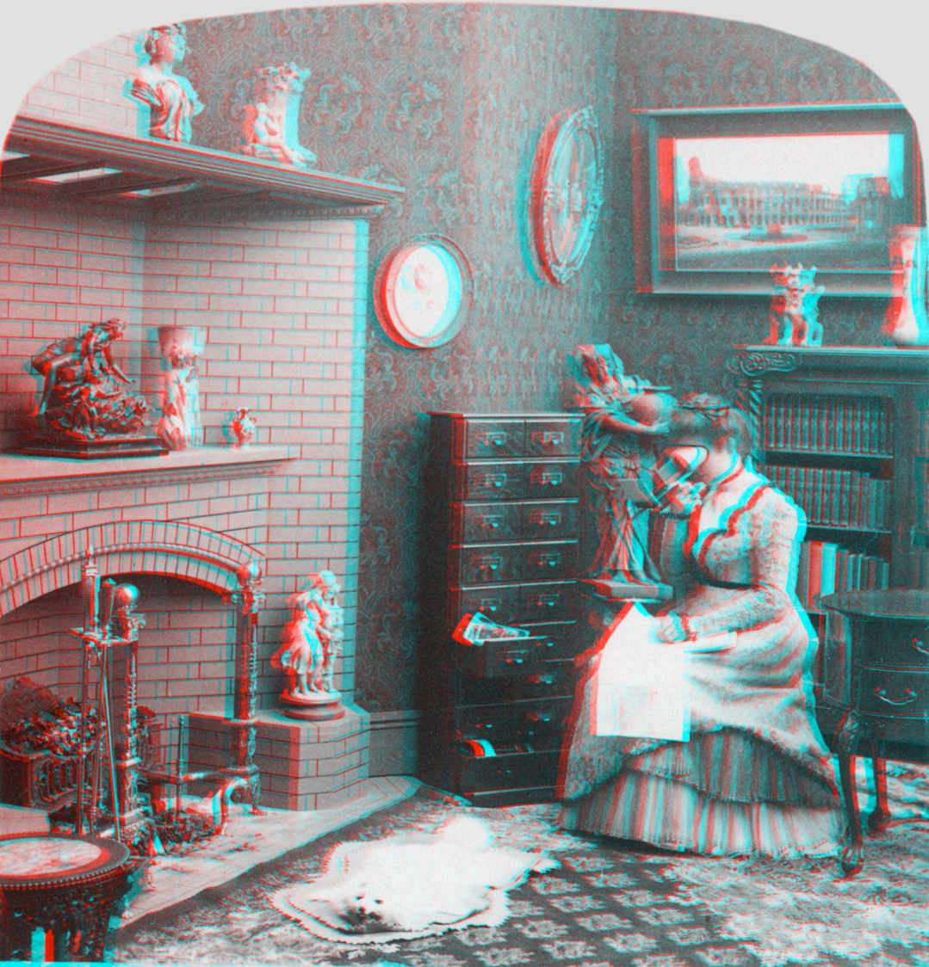
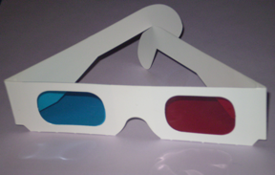
Notes:
Stereo monochrome image anaglyphed for red (left eye) and cyan (right eye) filters. 3D red cyan glasses are recommended to view this image correctly.

Slide 32
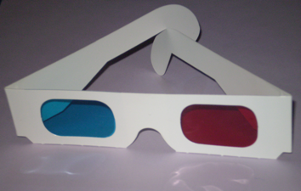
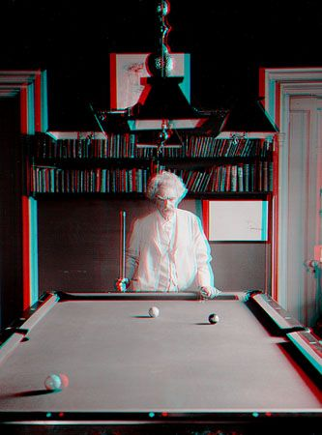
Mark Twain at Pool Table", no date, UCR Museum of Photography
Notes:
Special stereo viewer

Slide 33
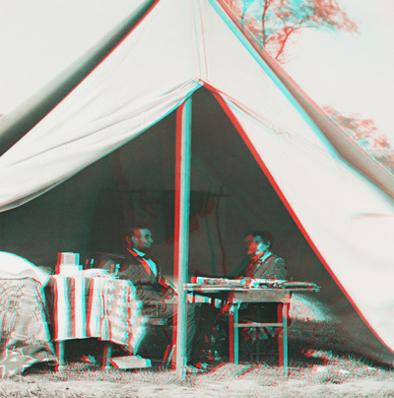
Notes:
Abraham Lincoln and General George McClellan in the generals tent near Antietam battlefield October 3, 1862

