Slide 1
RANSAC continued

Slide 2
Homography estimation
?
x_{w}

Slide 3
Homography estimation
?
x_{img}

Slide 4
Homography estimation
(0,0)
(1,0)
(6.4,2.8)
(8.0,2.9)
(5.6, 4.0)
(7.8, 4.2)
(0,1)
(1,1)

Slide 5
Homography estimation
(0,0)
(1,0)
(6.4,2.8)
(8.0,2.9)
(5.6, 4.0)
(7.8, 4.2)
(0,1)
(1,1)

Slide 6

Camera calibration
Y
Y’
Z
O
O’
X’
X
Z’
s.t

Slide 7
Homography estimation
(0,0)
(1,0)
correspondence
(6.4,2.8)
(8.0,2.9)
(5.6, 4.0)
(7.8, 4.2)
(0,1)
(1,1)

Slide 8
Homography estimation: obtaining correspondences

Slide 9
Homography estimation
Given images A and B
Compute image features for A and B
Match features between A and B
Compute homography between A and B
What do we do when correspondences are incorrect?

Slide 10
Homography fitting and incorrect correspondences
Correspondences create matrix A
What if many correspondences are actually incorrect?
Even true H cannot satisfy constraint!
Outliers

Slide 11
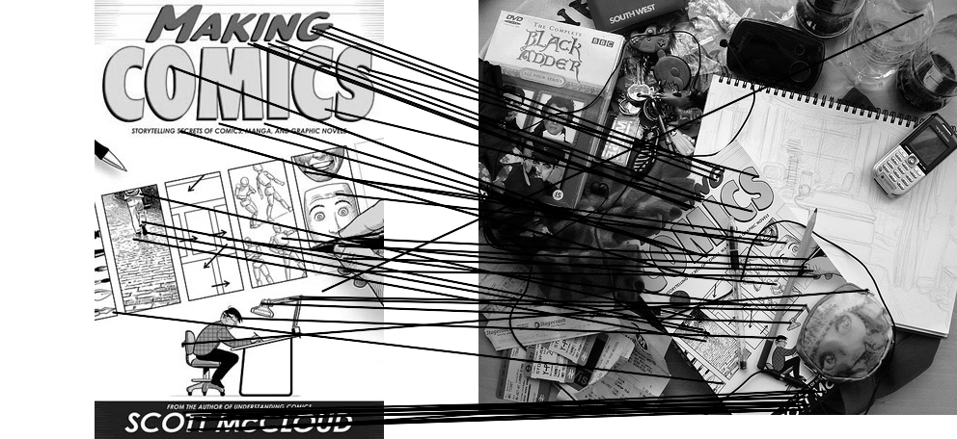
Outliers
outliers
inliers

Slide 12
A general class of problems
Need to “fit a model”, i.e., ”find parameters”
e.g., H for homography
Have some data points to find parameters
e.g. correspondences (xw, ximg)
Need at least k data points to find parameters
e.g., 4 correspondences for homography
Many data points might be completely incorrect, i.e., even correct model won’t fit them
e.g., incorrect correspondences

Slide 13
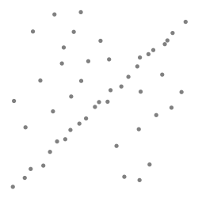
Another example
Need to “fit a model”, i.e., ”find parameters”
e.g., m,b for line fitting
Have some data points to find parameters
e.g. points (x, y)
Need at least k data points to find parameters
e.g., 2 points for line
Many data points might be completely incorrect, i.e., even correct model won’t fit them
y = mx + b

Slide 14
Robustness
Problem: Fit a line to these datapoints
Least squares fit

Slide 15
Robust model fitting
Correct data = “inliers”, incorrect data = “outliers”
If we knew inliers, fitting model is easy
e.g., for homography, set up matrix A
If we knew model, identifying inliers is easy
Inliers agree with model, outliers disagree
Chicken and egg problem!

Slide 16
Key idea
A single model will satisfy all inliers
No single model will satisfy all outliers
Outliers will all disagree on model they like
“Happy families are all alike; every unhappy family is unhappy in its own way.”
-Leo Tolstoy, Ana Karenina

Slide 17
Key idea
Identify model that agrees with most points
Given a hypothesized line
Count the number of points that “agree” with the line
“Agree” = within a small distance of the line
I.e., the inliers to that line
For all possible lines, select the one with the largest number of inliers

Slide 18
Counting inliers

Slide 19
Counting inliers
Inliers: 3

Slide 20
Counting inliers
Inliers: 20

Slide 21
How do we find the best line?
Unlike least-squares, no simple closed-form solution
Hypothesize-and-test
Try out many lines, keep the best one
Which lines?

Slide 22
RANSAC (Random Sample Consensus)
Line fitting example
Algorithm:
Sample (randomly) the number of points required to fit the model (#=2)
Solve for model parameters using samples
Score by the fraction of inliers within a preset threshold of the model
Repeat 1-3 until the best model is found with high confidence
Illustration by Savarese
Notes:
Let me give you an intuition of what is going on. Suppose we have the standard line fitting problem in presence of outliers.
We can formulate this problem as follows: want to find the best partition of points in inlier set and outlier set such that…
The objective consists of adjusting the parameters of a model function so as to best fit a data set.
"best" is defined by a function f that needs to be minimized.
Such that the best parameter of fitting the line give rise to a residual error lower that delta
as when the sum, S, of squared residuals

Slide 23
RANSAC
Line fitting example
Algorithm:
Sample (randomly) the number of points required to fit the model (#=2)
Solve for model parameters using samples
Score by the fraction of inliers within a preset threshold of the model
Repeat 1-3 until the best model is found with high confidence
Notes:
Let me give you an intuition of what is going on. Suppose we have the standard line fitting problem in presence of outliers.
We can formulate this problem as follows: want to find the best partition of points in inlier set and outlier set such that…
The objective consists of adjusting the parameters of a model function so as to best fit a data set.
"best" is defined by a function f that needs to be minimized.
Such that the best parameter of fitting the line give rise to a residual error lower that delta
as when the sum, S, of squared residuals

Slide 24
RANSAC
Line fitting example
Algorithm:
Sample (randomly) the number of points required to fit the model (#=2)
Solve for model parameters using samples
Score by the fraction of inliers within a preset threshold of the model
Repeat 1-3 until the best model is found with high confidence
Notes:
Let me give you an intuition of what is going on. Suppose we have the standard line fitting problem in presence of outliers.
We can formulate this problem as follows: want to find the best partition of points in inlier set and outlier set such that…
The objective consists of adjusting the parameters of a model function so as to best fit a data set.
"best" is defined by a function f that needs to be minimized.
Such that the best parameter of fitting the line give rise to a residual error lower that delta
as when the sum, S, of squared residuals

Slide 25
RANSAC
Algorithm:
Sample (randomly) the number of points required to fit the model (#=2)
Solve for model parameters using samples
Score by the fraction of inliers within a preset threshold of the model
Repeat 1-3 until the best model is found with high confidence
Notes:
Let me give you an intuition of what is going on. Suppose we have the standard line fitting problem in presence of outliers.
We can formulate this problem as follows: want to find the best partition of points in inlier set and outlier set such that…
The objective consists of adjusting the parameters of a model function so as to best fit a data set.
"best" is defined by a function f that needs to be minimized.
Such that the best parameter of fitting the line give rise to a residual error lower that delta
as when the sum, S, of squared residuals

Slide 26
RANSAC
Idea:
All the inliers will agree with each other on the translation vector; the (hopefully small) number of outliers will (hopefully) disagree with each other
RANSAC only has guarantees if there are < 50% outliers
“All good matches are alike; every bad match is bad in its own way.”
– Tolstoy via Alyosha Efros

Slide 27
RANSAC
Inlier threshold related to the amount of noise we expect in inliers
Often model noise as Gaussian with some standard deviation (e.g., 3 pixels)
Number of rounds related to the percentage of outliers we expect, and the probability of success we’d like to guarantee
Suppose there are 20% outliers, and we want to find the correct answer with 99% probability
How many rounds do we need?

Slide 28
How many rounds?
If we have to choose k samples each time
with an inlier ratio p
and we want the right answer with probability P
 | proportion of inliers p
k | 95% | 90% | 80% | 75% | 70% | 60% | 50%
2 | 2 | 3 | 5 | 6 | 7 | 11 | 17
3 | 3 | 4 | 7 | 9 | 11 | 19 | 35
4 | 3 | 5 | 9 | 13 | 17 | 34 | 72
5 | 4 | 6 | 12 | 17 | 26 | 57 | 146
6 | 4 | 7 | 16 | 24 | 37 | 97 | 293
7 | 4 | 8 | 20 | 33 | 54 | 163 | 588
8 | 5 | 9 | 26 | 44 | 78 | 272 | 1177
P = 0.99
Source: M. Pollefeys

Slide 29
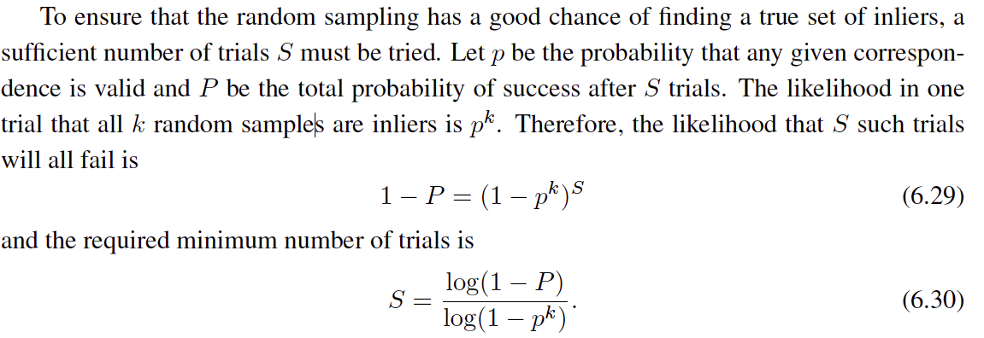
 | proportion of inliers p
k | 95% | 90% | 80% | 75% | 70% | 60% | 50%
2 | 2 | 3 | 5 | 6 | 7 | 11 | 17
3 | 3 | 4 | 7 | 9 | 11 | 19 | 35
4 | 3 | 5 | 9 | 13 | 17 | 34 | 72
5 | 4 | 6 | 12 | 17 | 26 | 57 | 146
6 | 4 | 7 | 16 | 24 | 37 | 97 | 293
7 | 4 | 8 | 20 | 33 | 54 | 163 | 588
8 | 5 | 9 | 26 | 44 | 78 | 272 | 1177
P = 0.99
Notes:
(1-(1-e)^s)^N = 1-p
(1-e)^s = all fail = 1-P

Slide 30
RANSAC pros and cons
Pros
Simple and general
Applicable to many different problems
Often works well in practice
Cons
Parameters to tune
Sometimes too many iterations are required
Can fail for extremely low inlier ratios

Slide 31
RANSAC
An example of a “voting”-based fitting scheme
Each hypothesis gets voted on by each data point, best hypothesis wins
There are many other types of voting schemes
E.g., Hough transforms…

Slide 32
Hough transform
What possible lines can this point lie on?
(m,b) must satisfy: y = mx + b
This is the equation of a line in m and b
y
m
x
b

Slide 33
Hough transform
P.V.C. Hough, Machine Analysis of Bubble Chamber Pictures, Proc. Int. Conf. High Energy Accelerators and Instrumentation, 1959
Given a set of points, find the curve or line that explains the data points best
y
m
x
b
Hough space
y = m x + b
Slide from S. Savarese
Notes:
• A line is represented as . Every line in the image corresponds to a point in the parameter space
Every point in m, b is a line in x, y.
Dual space.
Every point in x, y. Instantiate it and works out to a line in m, b
• Every point in the image domain corresponds to a line in the parameter
space (why ? Fix (x,y), (m,n) can change on the line . In other
words, for all the lines passing through (x,y) in the image space, their
parameters form a line in the parameter space)
• Points along a line in the space correspond to lines passing through the
same point in the parameter space (why ?)

Slide 34
Hough Transform: Outline
Create a grid of parameter values
Each point votes for a set of parameters, incrementing those values in grid
Find maximum or local maxima in grid

Slide 35
Hough transform
y
m
x
b
y
m
3
5
3
3
2
2
3
7
11
10
4
3
2
3
1
4
5
2
2
1
0
1
3
3
x
b
Slide from S. Savarese
Notes:
• Points along a line in the space correspond to lines passing through the same point in the parameter space (why ?)

Slide 36
Hough transform
y
m
x
b
Notes:
• Points along a line in the space correspond to lines passing through the same point in the parameter space (why ?)

Slide 37
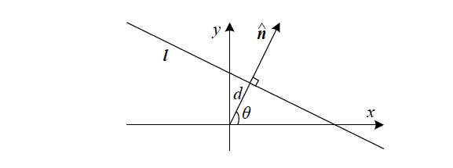


Slide 38

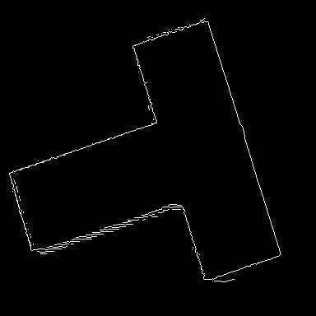
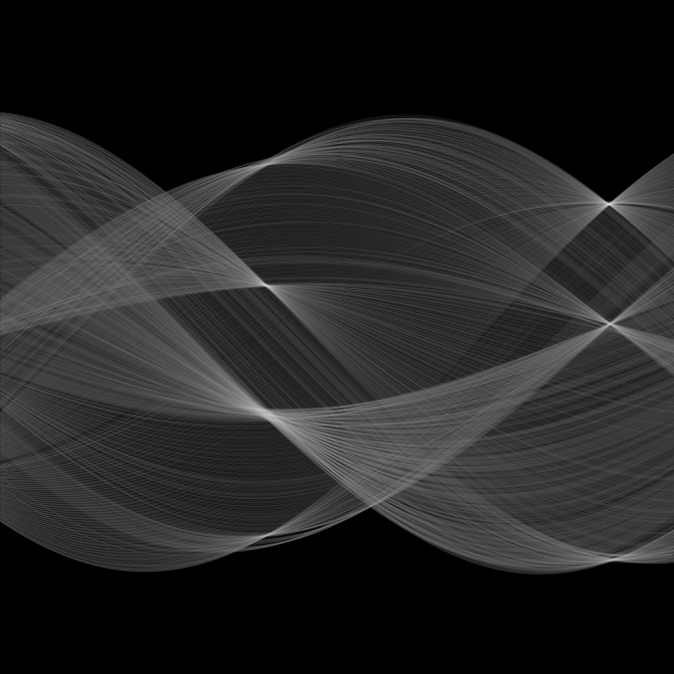
Hough transform
d
θ

Slide 39
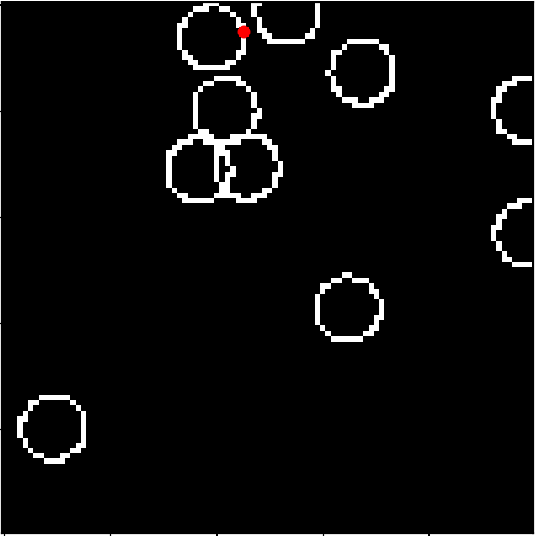

Hough transform : circles
Suppose we want to fit circles to points
Assume we know the radius, but don’t know the centres
Given a point (x,y), what possible circles of radius r can it lie on?
center (c_{x}, c_{y}) must satisfy (x - c_{x})² + (y-c_{y})² = r²
center must lie on a circle!

Slide 40
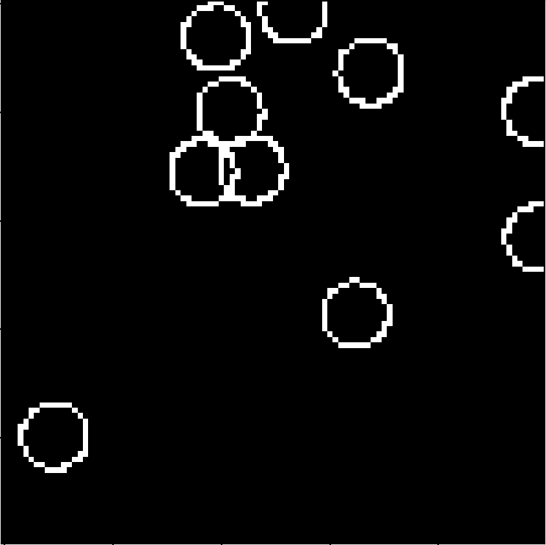
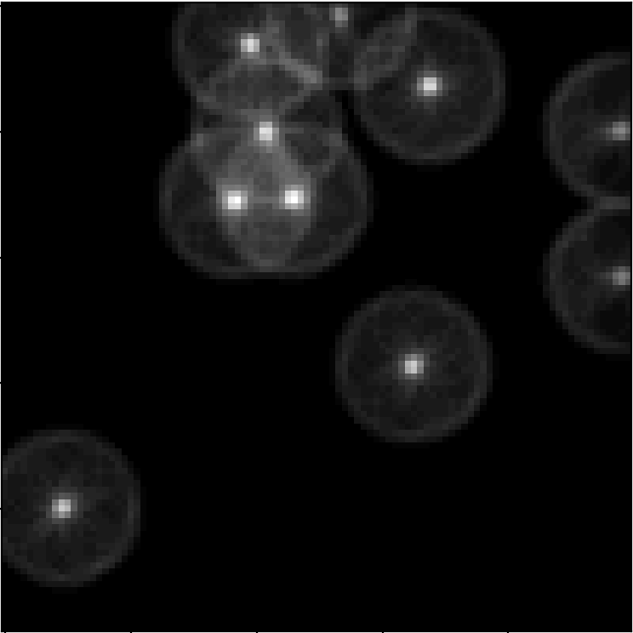
Hough transform : circles
Suppose we want to fit circles to points
Assume we know the radius, but don’t know the centres
Given a point (x,y), what possible circles of radius r can it lie on?
center (c_{x}, c_{y}) must satisfy (x - c_{x})² + (y-c_{y})² = r²
center must lie on a circle!

Slide 41
Hough transform: circles
What happens if we don’t know the radius of the circle?
How big should the Hough space be?

Slide 42
Hough transform: general form
Suppose we have to fit a model with some parameters to some data
Construct a grid of parameter values
d parameters with k possible values for each: k x k x … x k array
k^{d} elements
Each data point puts in a vote for all sets of parameter values it likes
Look for parameter settings with votes>threshold
d times

Slide 43
Hough transform
Simple
Can deal with multiple correct answers
Can only work if only a small number of parameters to fit (e.g. 2-3)
Can we use this for homography fitting?

