Slide 1
A special case of calibration

Slide 2

Camera calibration
Y
Y’
Z
O
O’
X’
X
Z’

Slide 3
Camera calibration = pose estimation
Estimating where camera is relative to object in world
= Estimating where object is relative to camera
Y
Y’
Z
O
O’
X’
X
Z’

Slide 4
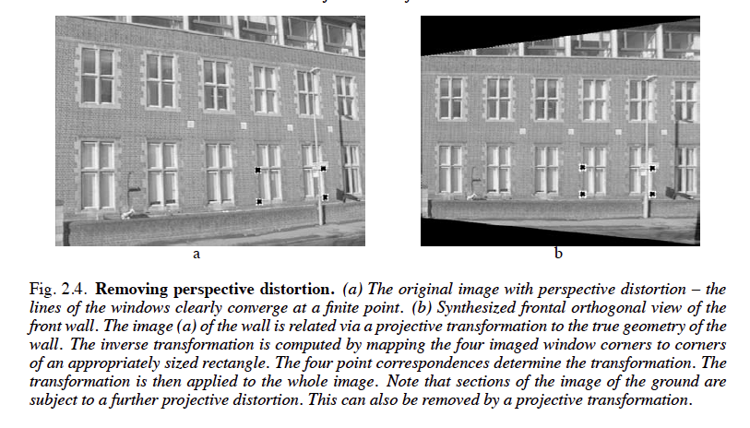
What if object of interest is plane?
Not that uncommon….

Slide 5
What if object of interest is plane?
Y
Z
O
X

Slide 6
What if object of interest is a plane?
Imagine that plane is equipped with two axes.
Points on the plane are represented by two euclidean coordinates
…Or 3 homogenous coordinates
3D object
2D object (plane)
3 x 4
3 x 3

Slide 7
What if object of interest is a plane?
Homography maps points on the plane to pixels in the image
Homography
3 x 3

Slide 8
Fitting homographies
How many parameters does a homography have?
Given a single point on the plane and corresponding image location, what does that tell us?

Slide 9
Fitting homographies
How many parameters does a homography have?
Given a single point on the plane and corresponding image location, what does that tell us?
Convince yourself that this gives 2 linear equations!

Slide 10
Fitting homographies
Homography has 9 parameters
But can’t determine scale factor, so only 8: 4 points!
Or because we will have noise:

Slide 11
Fitting homographies

Slide 12
Homographies for image alignment
A general mapping from one plane to another!
Can also be used to align one photo of a plane to another photo of the same plane
Image 2
Image 1
Original plane

Slide 13
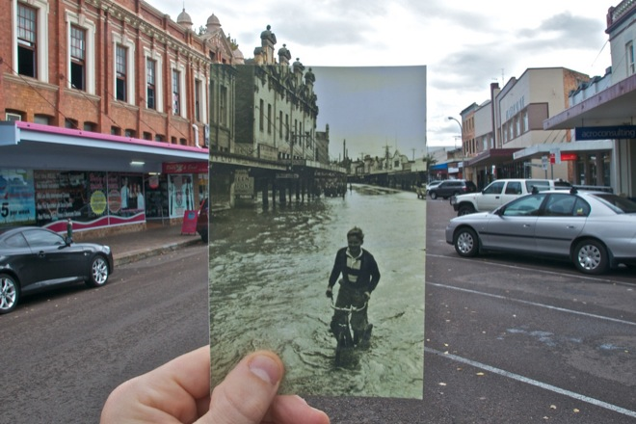
Homographies for image alignment
Can also be used to align one photo of a plane to another photo of the same plane
http://www.wired.com/gadgetlab/2010/07/camera-software-lets-you-see-into-the-past/

Slide 14
Image Alignment Algorithm
Given images A and B
Compute image features for A and B
Match features between A and B
Compute homography between A and B
What could go wrong?

Slide 15
Fitting in general
Fitting: find the parameters of a model that best fit the data
Other examples:
  least squares linear regression

Slide 16
Least squares: linear regression
(y_{i}, x_{i})
y = mx + b

Slide 17
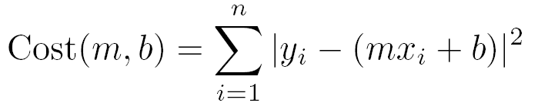
Linear regression
residual error

Slide 18
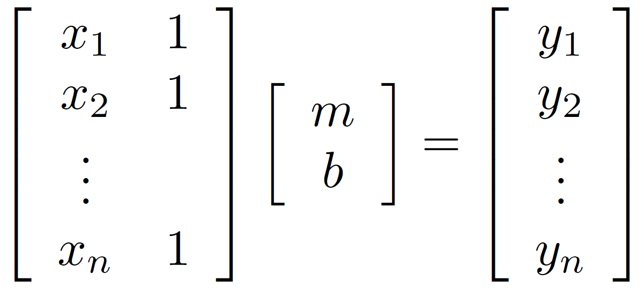
Linear regression

Slide 19
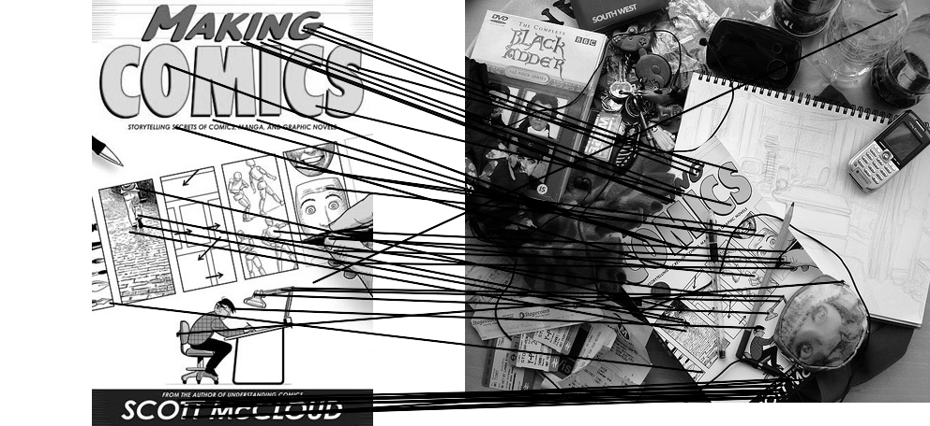
Outliers
outliers
inliers

Slide 20
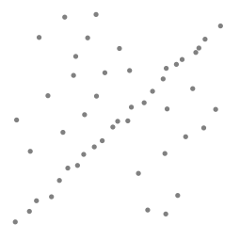
Robustness
Problem: Fit a line to these datapoints
Least squares fit

Slide 21
Idea
Given a hypothesized line
Count the number of points that “agree” with the line
  “Agree” = within a small distance of the line
  I.e., the inliers to that line
For all possible lines, select the one with the largest number of inliers

Slide 22
Counting inliers

Slide 23
Counting inliers
Inliers: 3

Slide 24
Counting inliers
Inliers: 20

Slide 25
How do we find the best line?
Unlike least-squares, no simple closed-form solution
Hypothesize-and-test
  Try out many lines, keep the best one
  Which lines?

Slide 26
RANSAC (Random Sample Consensus)
Line fitting example
Algorithm:
Sample (randomly) the number of points required to fit the model (#=2)
Solve for model parameters using samples
Score by the fraction of inliers within a preset threshold of the model
Repeat 1-3 until the best model is found with high confidence
Illustration by Savarese
Notes:
Let me give you an intuition of what is going on. Suppose we have the standard line fitting problem in presence of outliers.
We can formulate this problem as follows: want to find the best partition of points in inlier set and outlier set such that…
The objective consists of adjusting the parameters of a model function so as to best fit a data set.
"best" is defined by a function f that needs to be minimized.
Such that the best parameter of fitting the line give rise to a residual error lower that delta
as when the sum, S, of squared residuals

Slide 27
RANSAC
Line fitting example
Algorithm:
Sample (randomly) the number of points required to fit the model (#=2)
Solve for model parameters using samples
Score by the fraction of inliers within a preset threshold of the model
Repeat 1-3 until the best model is found with high confidence
Notes:
Let me give you an intuition of what is going on. Suppose we have the standard line fitting problem in presence of outliers.
We can formulate this problem as follows: want to find the best partition of points in inlier set and outlier set such that…
The objective consists of adjusting the parameters of a model function so as to best fit a data set.
"best" is defined by a function f that needs to be minimized.
Such that the best parameter of fitting the line give rise to a residual error lower that delta
as when the sum, S, of squared residuals

Slide 28
RANSAC
Line fitting example
Algorithm:
Sample (randomly) the number of points required to fit the model (#=2)
Solve for model parameters using samples
Score by the fraction of inliers within a preset threshold of the model
Repeat 1-3 until the best model is found with high confidence
Notes:
Let me give you an intuition of what is going on. Suppose we have the standard line fitting problem in presence of outliers.
We can formulate this problem as follows: want to find the best partition of points in inlier set and outlier set such that…
The objective consists of adjusting the parameters of a model function so as to best fit a data set.
"best" is defined by a function f that needs to be minimized.
Such that the best parameter of fitting the line give rise to a residual error lower that delta
as when the sum, S, of squared residuals

Slide 29
RANSAC
Algorithm:
Sample (randomly) the number of points required to fit the model (#=2)
Solve for model parameters using samples
Score by the fraction of inliers within a preset threshold of the model
Repeat 1-3 until the best model is found with high confidence
Notes:
Let me give you an intuition of what is going on. Suppose we have the standard line fitting problem in presence of outliers.
We can formulate this problem as follows: want to find the best partition of points in inlier set and outlier set such that…
The objective consists of adjusting the parameters of a model function so as to best fit a data set.
"best" is defined by a function f that needs to be minimized.
Such that the best parameter of fitting the line give rise to a residual error lower that delta
as when the sum, S, of squared residuals

Slide 30
RANSAC
Idea:
  All the inliers will agree with each other on the translation vector; the (hopefully small) number of outliers will (hopefully) disagree with each other
    RANSAC only has guarantees if there are < 50% outliers
  “All good matches are alike; every bad match is bad in its own way.”
  – Tolstoy via Alyosha Efros

Slide 31
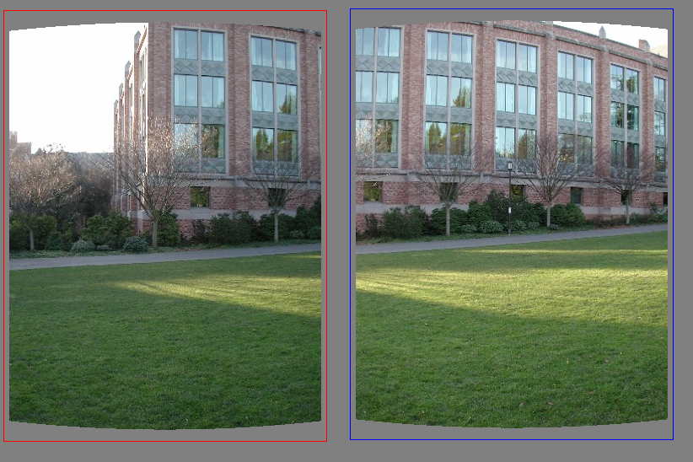
Translations

Slide 32
RAndom SAmple Consensus
Select one match at random, count inliers

Slide 33
RAndom SAmple Consensus
Select another match at random, count inliers

Slide 34
RAndom SAmple Consensus
Output the translation with the highest number of inliers

Slide 35
Final step: least squares fit
Find average translation vector over all inliers

Slide 36
RANSAC
Inlier threshold related to the amount of noise we expect in inliers
  Often model noise as Gaussian with some standard deviation (e.g., 3 pixels)
Number of rounds related to the percentage of outliers we expect, and the probability of success we’d like to guarantee
  Suppose there are 20% outliers, and we want to find the correct answer with 99% probability
  How many rounds do we need?

Slide 37
How many rounds?
If we have to choose k samples each time
  with an inlier ratio p
  and we want the right answer with probability P
 | proportion of inliers p
k | 95% | 90% | 80% | 75% | 70% | 60% | 50%
2 | 2 | 3 | 5 | 6 | 7 | 11 | 17
3 | 3 | 4 | 7 | 9 | 11 | 19 | 35
4 | 3 | 5 | 9 | 13 | 17 | 34 | 72
5 | 4 | 6 | 12 | 17 | 26 | 57 | 146
6 | 4 | 7 | 16 | 24 | 37 | 97 | 293
7 | 4 | 8 | 20 | 33 | 54 | 163 | 588
8 | 5 | 9 | 26 | 44 | 78 | 272 | 1177
P = 0.99
Source: M. Pollefeys

Slide 38
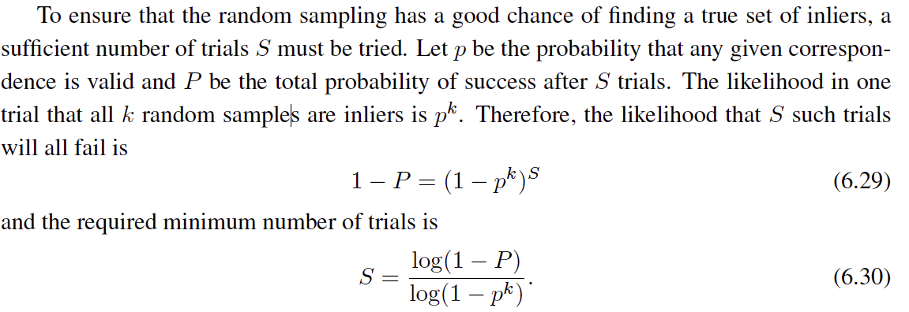
 | proportion of inliers p
k | 95% | 90% | 80% | 75% | 70% | 60% | 50%
2 | 2 | 3 | 5 | 6 | 7 | 11 | 17
3 | 3 | 4 | 7 | 9 | 11 | 19 | 35
4 | 3 | 5 | 9 | 13 | 17 | 34 | 72
5 | 4 | 6 | 12 | 17 | 26 | 57 | 146
6 | 4 | 7 | 16 | 24 | 37 | 97 | 293
7 | 4 | 8 | 20 | 33 | 54 | 163 | 588
8 | 5 | 9 | 26 | 44 | 78 | 272 | 1177
P = 0.99
Notes:
(1-(1-e)^s)^N = 1-p
(1-e)^s = all fail = 1-P

Slide 39
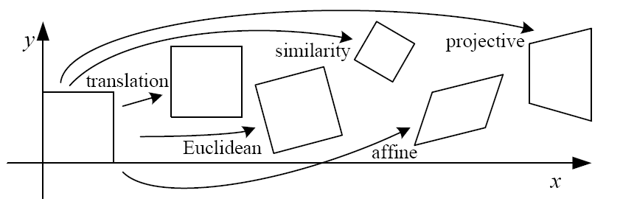
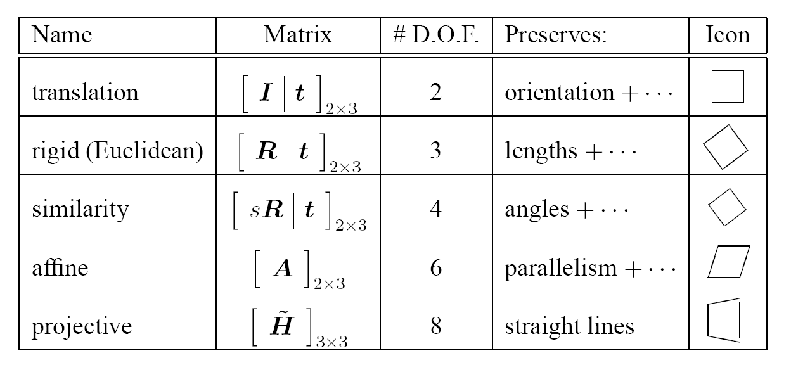
How big is k?
For alignment, depends on the motion model
  Here, each sample is a correspondence (pair of matching points)

Slide 40
RANSAC pros and cons
Pros
  Simple and general
  Applicable to many different problems
  Often works well in practice
Cons
  Parameters to tune
  Sometimes too many iterations are required
  Can fail for extremely low inlier ratios

Slide 41
RANSAC
An example of a “voting”-based fitting scheme
Each hypothesis gets voted on by each data point, best hypothesis wins
There are many other types of voting schemes
  E.g., Hough transforms…

Slide 42
Hough transform
P.V.C. Hough, Machine Analysis of Bubble Chamber Pictures, Proc. Int. Conf. High Energy Accelerators and Instrumentation, 1959
Given a set of points, find the curve or line that explains the data points best
y
m
x
b
Hough space
y = m x + b
Slide from S. Savarese
Notes:
• A line is represented as . Every line in the image corresponds to a point in the parameter space
Every point in m, b is a line in x, y.
Dual space.
Every point in x, y. Instantiate it and works out to a line in m, b
• Every point in the image domain corresponds to a line in the parameter
space (why ? Fix (x,y), (m,n) can change on the line . In other
words, for all the lines passing through (x,y) in the image space, their
parameters form a line in the parameter space)
• Points along a line in the space correspond to lines passing through the
same point in the parameter space (why ?)

Slide 43
Hough Transform: Outline
Create a grid of parameter values
Each point votes for a set of parameters, incrementing those values in grid
Find maximum or local maxima in grid

Slide 44
Hough transform
y
m
x
b
y
m
3
5
3
3
2
2
3
7
11
10
4
3
2
3
1
4
5
2
2
1
0
1
3
3
x
b
Slide from S. Savarese
Notes:
• Points along a line in the space correspond to lines passing through the same point in the parameter space (why ?)

Slide 45
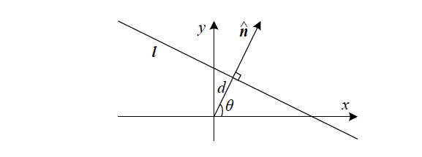


Slide 46

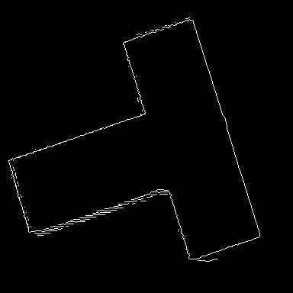
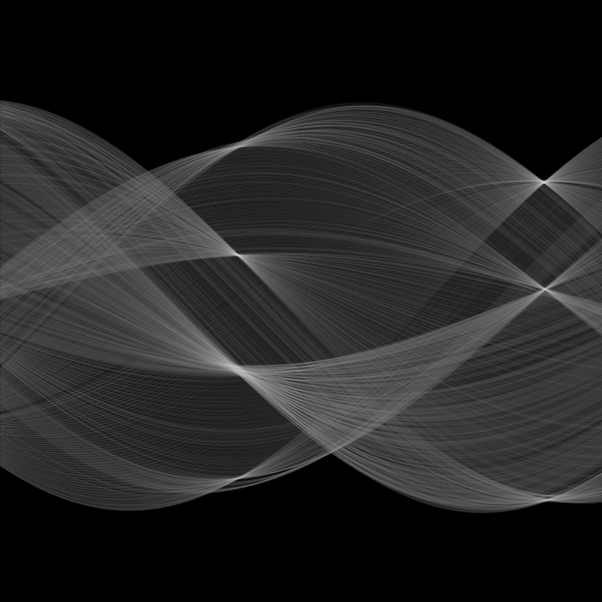
Hough transform
d
θ

