Slide 1
Camera calibration
Triangulation

Slide 2
Perspective projection in homogenous coordinates

Slide 3
Matrix transformations in 2D
Translation
Scaling of Image x and y (conversion from “meters” to “pixels”)
Added skew if image x and y axes are not perpendicular

Slide 4
Final perspective projection
Camera extrinsics: where your camera is relative to the world. Changes if you move the camera
Camera intrinsics: how your camera handles pixel. Changes if you change your camera

Slide 5
Final perspective projection
Camera parameters

Slide 6
Camera calibration
Goal: find the parameters of the camera
Why?
  Tells you where the camera is relative to the world/particular objects
  Equivalently, tells you where objects are relative to the camera
  Can allow you to ”render” new objects into the scene

Slide 7
Camera calibration
Y
Y’
Z
O
O’
X’
X
Z’

Slide 8
Camera calibration
Suppose we know that (X,Y,Z) in the world projects to (x,y) in the image.
How many equations does this provide?
Need to convert equivalence into equality.

Slide 9
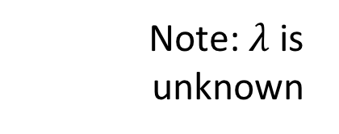
Camera calibration
Suppose we know that (X,Y,Z) in the world projects to (x,y) in the image.
How many equations does this provide?
Note: $λ$ is unknown

Slide 10
Camera calibration
Suppose we know that (X,Y,Z) in the world projects to (x,y) in the image.
How many equations does this provide?

Slide 11
Camera calibration
Suppose we know that (X,Y,Z) in the world projects to (x,y) in the image.
How many equations does this provide?

Slide 12
Camera calibration
Suppose we know that (X,Y,Z) in the world projects to (x,y) in the image.
How many equations does this provide?
2 equations!
Are the equations linear in the parameters?
How many equations do we need?

Slide 13
Camera calibration
In matrix vector form: Ap = 0
6 points give 12 equations, 12 variables to solve for
But can only solve upto scale

Slide 14
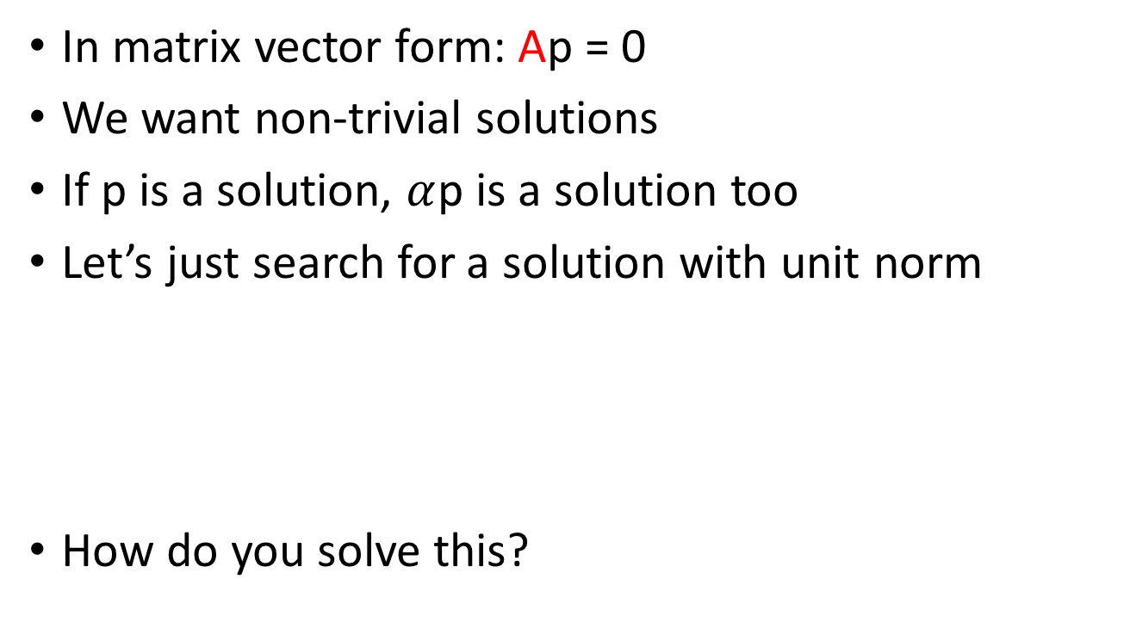
Camera calibration
In matrix vector form: Ap = 0
We want non-trivial solutions
If p is a solution, $α$p is a solution too
Let’s just search for a solution with unit norm
How do you solve this?
s.t

Slide 15

Camera calibration
In matrix vector form: Ap = 0
We want non-trivial solutions
If p is a solution, $α$p is a solution too
Let’s just search for a solution with unit norm
s.t

Slide 16
Camera calibration
What happens if there are more than 6 points?
What if there is noise in the point locations?
s.t

Slide 17
Camera calibration
What happens if there are more than 6 points?
What if there is noise in the point locations?
Look at eigenvector of A^{T}A with the smallest eigenvalue!
s.t

Slide 18
Camera calibration
>=6 points with known 3D coordinates + known image coordinates
In matrix vector form: want Ap = 0
Resilience to noise:
Look at eigenvector of A^{T}A with the smallest eigenvalue!
s.t

Slide 19
Camera calibration
We need 6 world points for which we know image locations
Would any 6 points work?
  What if all 6 points are the same?
Need at least 6 non-coplanar points!

Slide 20
Camera calibration
Y
Y’
Z
O
O’
X’
X
Z’

Slide 21
Camera calibration
How do we get K, R and t from P?
Need to make some assumptions about K
What if K is identity?

Slide 22
Camera calibration
How do we get K, R and t from P?
Need to make some assumptions about K
What if K is upper triangular?
Added skew if image x and y axes are not perpendicular

Slide 23
Camera calibration
How do we get K, R and t from P?
Need to make some assumptions about K
What if K is upper triangular?
P = K [ R t]
First 3 x 3 matrix of P is KR
“RQ” decomposition: decomposes an n x n matrix into product of upper triangular and rotation matrix

Slide 24
Camera calibration
How do we get K, R and t from P?
Need to make some assumptions about K
What if K is upper triangular?
P = K [ R t]
First 3 x 3 matrix of P is KR
“RQ” decomposition: decomposes an n x n matrix into product of upper triangular and rotation matrix
t = K⁻¹P[:,2] ← last column of P

Slide 25
Camera calibration and pose estimation

Slide 26
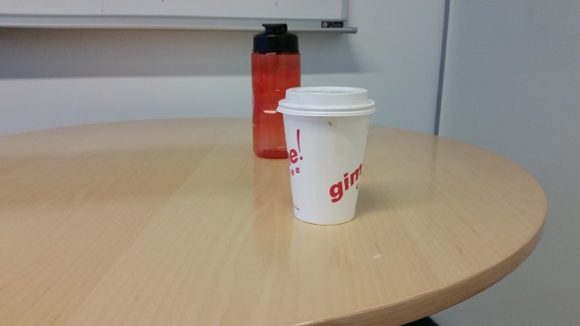
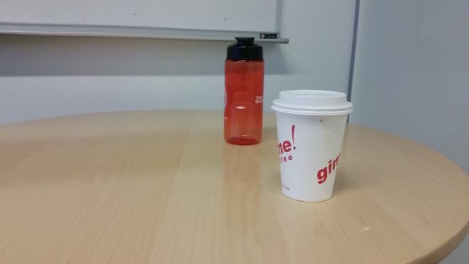
Triangulation
Suppose we have two cameras
  Calibrated: parameters known
And a pair of corresponding pixels
Find 3D location of point!

Slide 27
Triangulation
Suppose we have two cameras
  Calibrated: parameters known
And a pair of corresponding pixels
Find 3D location of point!
(x₁,y₁)
(x₂,y₂)

Slide 28
Triangulation

Slide 29
Triangulation

Slide 30
Triangulation
1 image gives 2 equations
Need 2 images!
Solve linear equations to get 3D point location

Slide 31
Linear vs non-linear optimization

Slide 32
Linear vs non-linear optimization
Reprojection error

Slide 33
Linear vs non-linear optimization
Reprojection error
Reprojection error is the squared error between the true image coordinates of a point and the projected coordinates of hypothesized 3D point
Actual error we care about
Minimize total sum of reprojection error across all images
Non-linear optimization

