Slide 1
Announcements
Prelim next Thursday 3/15 7:30 pm Klarman Hall G70
Syllabus: Until homogenous coordinates (excluding homogenous coordinates)
90 minutes
Closed book

Slide 2
Homogenous coordinates

Slide 3
Putting everything together
Change coordinate system so that center of the coordinate system is at pinhole and Z axis is along viewing direction
Perspective projection

Slide 4
The projection equation
Is this equation linear?
Can this equation be represented by a matrix multiplication?

Slide 5
Is projection linear?

Slide 6
Can projection be represented as a matrix multiplication?
Matrix multiplication
Perspective projection

Slide 7
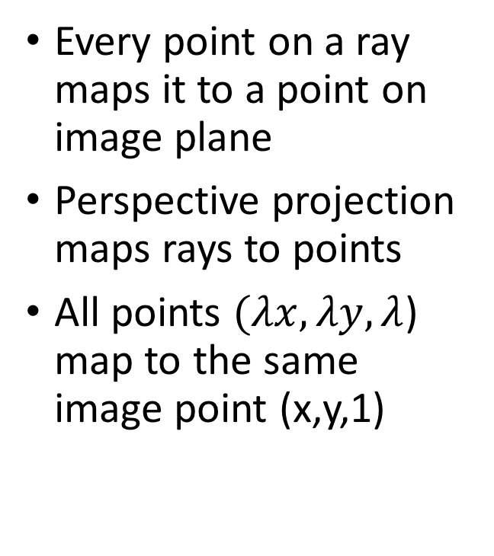

The space of rays
Every point on a ray maps it to a point on image plane
Perspective projection maps rays to points
All points $(λx, λy, λ$) map to the same image point (x,y,1)
($λx, λy, λ$)
(x,y,1)
O

Slide 8
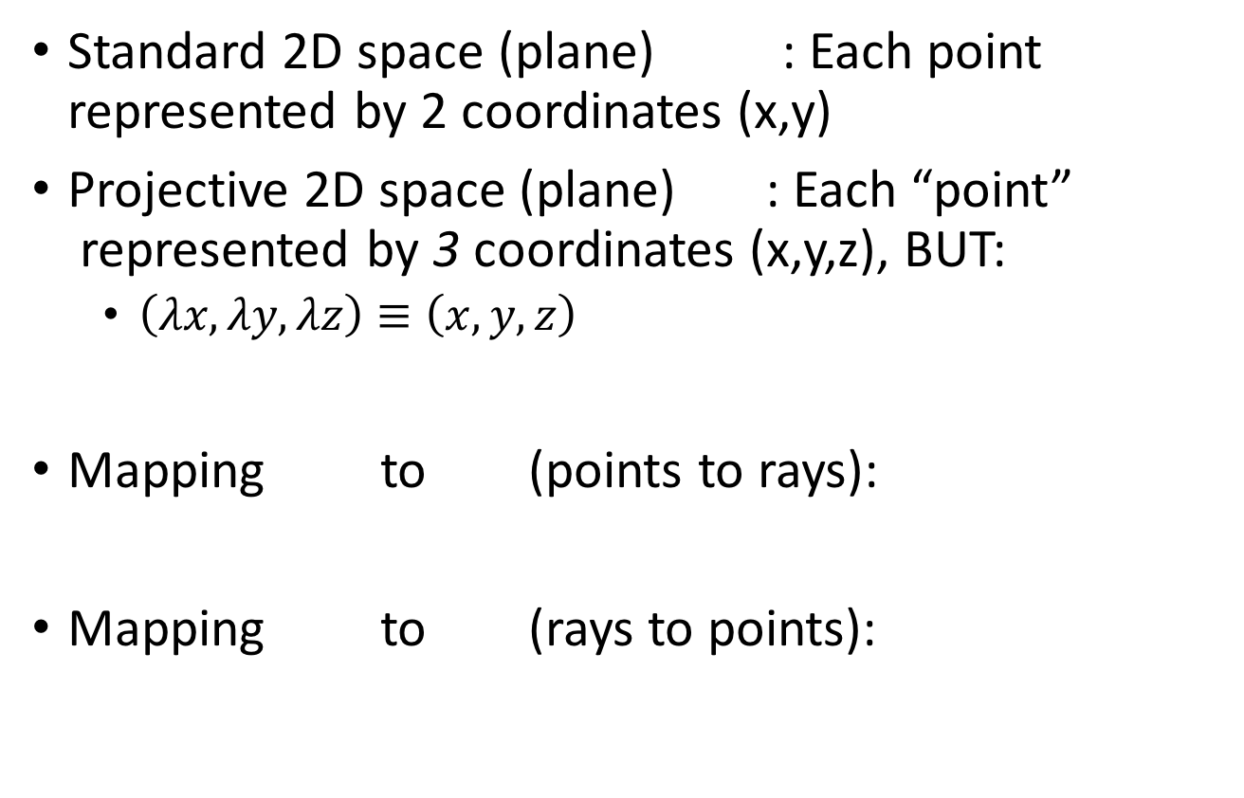
Projective space
Standard 2D space (plane) : Each point represented by 2 coordinates (x,y)
Projective 2D space (plane) : Each “point”
represented by 3 coordinates (x,y,z), BUT:
  $\left(λx, λy, λz\right)≡\left(x,y,z\right)$
Mapping to (points to rays):
Mapping to (rays to points):

Slide 9
Projective space and homogenous coordinates
Mapping to (points to rays):
Mapping to (rays to points):
A change of coordinates
Also called homogenous coordinates

Slide 10
Homogenous coordinates
In standard Euclidean coordinates
  2D points : (x,y)
  3D points : (x,y,z)
In homogenous coordinates
  2D points : (x,y,1)
  3D points : (x,y,z,1)

Slide 11
Why homogenous coordinates?
Homogenous coordinates of world point
Homogenous coordinates of image point

Slide 12
Why homogenous coordinates?
Perspective projection is matrix multiplication in homogenous coordinates!

Slide 13
Why homogenous coordinates?
Translation is matrix multiplication in homogenous coordinates!

Slide 14
Homogenous coordinates

Slide 15
Homogenous coordinates

Slide 16
Perspective projection in homogenous coordinates

Slide 17
More about matrix transformations
3 x 4 : Perspective projection
4 x 4 : Translation
4 x 4 : Affine transformation (linear transformation + translation)

Slide 18
More about matrix transformations
Euclidean

Slide 19
More about matrix transformations
Similarity transformation

Slide 20
More about matrix transformations
Anisotropic scaling and translation

Slide 21
More about matrix transformations
General affine transformation

Slide 22
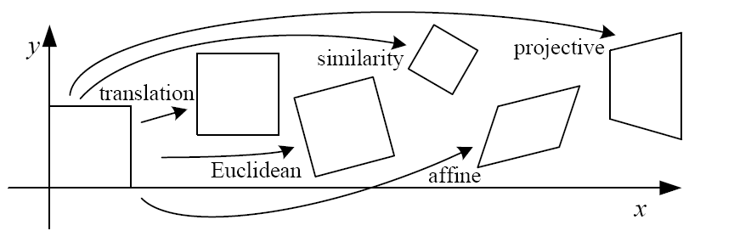
Matrix transformations in 2D

Slide 23
Perspective projection in homogenous coordinates

Slide 24
Matrix transformations in 2D
Translation
Scaling of Image x and y (conversion from “meters” to “pixels”)
Added skew if image x and y axes are not perpendicular

Slide 25
Final perspective projection
Camera extrinsics: where your camera is relative to the world. Changes if you move the camera
Camera intrinsics: how your camera handles pixel. Changes if you change your camera

Slide 26
Final perspective projection
Camera parameters

Slide 27
Camera calibration
Goal: find the parameters of the camera
Why?
  Tells you where the camera is relative to the world/particular objects
  Equivalently, tells you where objects are relative to the camera
  Can allow you to ”render” new objects into the scene

Slide 28
Camera calibration
Y
Y’
Z
O
O’
X’
X
Z’

Slide 29
Camera calibration
Need to estimate P
How many parameters does P have?
  Size of P : 3 x 4
  But:
  P can only be known upto a scale
  3*4 - 1 = 11 parameters

Slide 30
Camera calibration
Suppose we know that (X,Y,Z) in the world projects to (x,y) in the image.
How many equations does this provide?
Need to convert equivalence into equality.

Slide 31

Camera calibration
Suppose we know that (X,Y,Z) in the world projects to (x,y) in the image.
How many equations does this provide?
Note: $λ$ is unknown

Slide 32
Camera calibration
Suppose we know that (X,Y,Z) in the world projects to (x,y) in the image.
How many equations does this provide?

Slide 33
Camera calibration
Suppose we know that (X,Y,Z) in the world projects to (x,y) in the image.
How many equations does this provide?

Slide 34
Camera calibration
Suppose we know that (X,Y,Z) in the world projects to (x,y) in the image.
How many equations does this provide?
2 equations!
Are the equations linear in the parameters?
How many equations do we need?

Slide 35
Camera calibration
In matrix vector form: Ap = 0
6 points give 12 equations, 12 variables to solve for
But can only solve upto scale

Slide 36
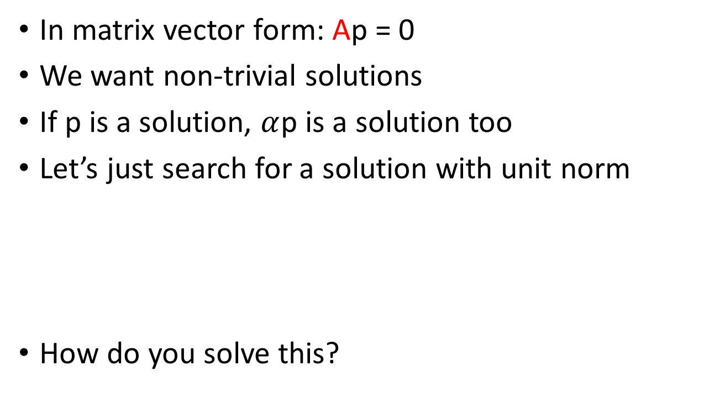
Camera calibration
In matrix vector form: Ap = 0
We want non-trivial solutions
If p is a solution, $α$p is a solution too
Let’s just search for a solution with unit norm
How do you solve this?
s.t

Slide 37
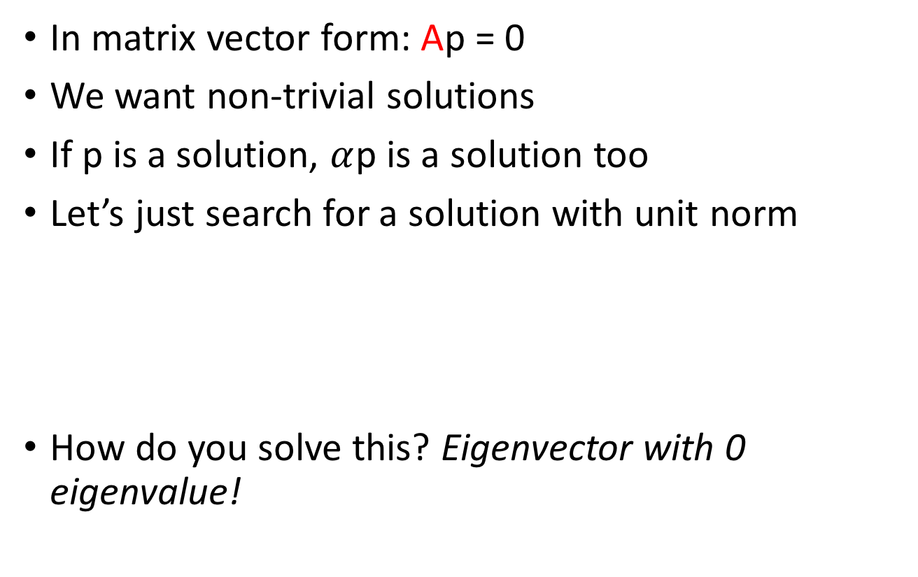
Camera calibration
In matrix vector form: Ap = 0
We want non-trivial solutions
If p is a solution, $α$p is a solution too
Let’s just search for a solution with unit norm
How do you solve this? Eigenvector with 0 eigenvalue!
s.t

Slide 38
Camera calibration
We need 6 world points for which we know image locations
Would any 6 points work?
  What if all 6 points are the same?
Need at least 6 non-coplanar points!

Slide 39
Camera calibration
Y
Y’
Z
O
O’
X’
X
Z’

