Slide 1
Perspective projection and Transformations

Slide 2
The pinhole camera

Slide 3


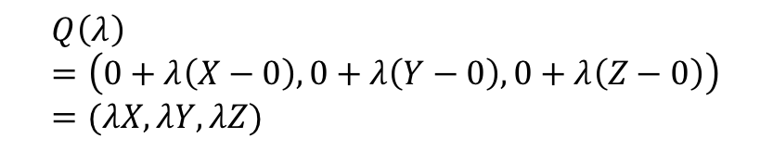
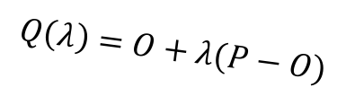
The pinhole camera
Y
P = (X,Y,Z)
$$Q\left(λ\right)=O+λ(P−O)$$
p = (x,y)
Z
O
$$λ=0⇒Q\left(λ\right)=O$$
$$λ=1⇒Q\left(λ\right)=P$$
Z=-1
X
$$Q\left(λ\right)=\left(0+λ\left(X−0\right), 0+λ\left(Y−0\right), 0+λ\left(Z−0\right)\right)=(λX, λY, λZ)$$

Slide 4
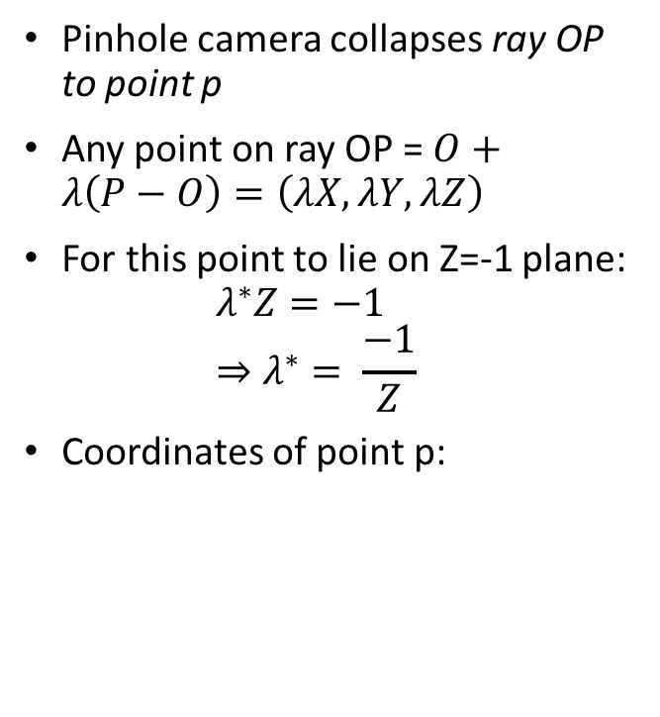
The pinhole camera
Pinhole camera collapses ray OP to point p
Any point on ray OP = $O+λ\left(P−O\right)=\left(λX, λY, λZ\right)$
For this point to lie on Z=-1 plane:
$λ^{∗}Z=−1$
$⇒λ^{∗}= \frac{−1}{Z}$
Coordinates of point p:
Y
p = (x,y)
P = (X,Y,Z)
Z
O
Z=-1
X

Slide 5
The projection equation
A point P = (X, Y, Z) in 3D projects to a point p = (x,y) in the image
But pinhole camera’s image is inverted, invert it back!

Slide 6
Another derivation
P = (X,Y,Z)
Y
1
O
Z
y
p = (x,y,z)

Slide 7
A virtual image plane
A pinhole camera produces an inverted image
Imagine a ”virtual image plane” in the front of the camera
P
P
Y
Y
y
1
Z
O
y
1
O
Z

Slide 8
The projection equation

Slide 9
Consequence 1: Farther away objects are smaller
(X, Y + h, Z)
(X, Y, Z)
Image of foot:
Image of head:

Slide 10
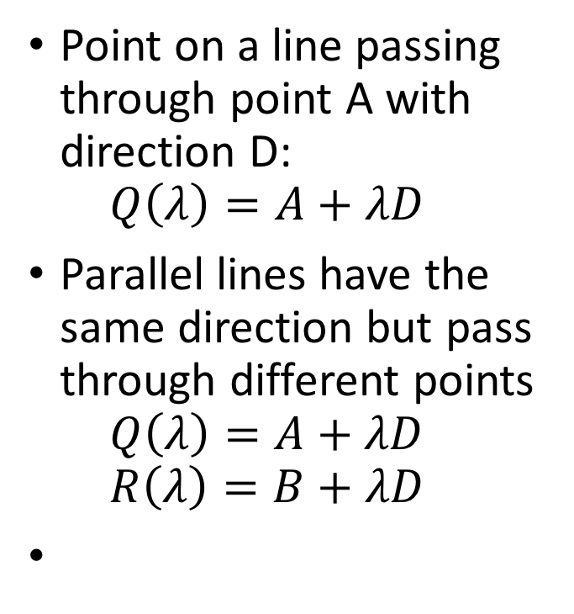
Consequence 2: Parallel lines converge at a point
Point on a line passing through point A with direction D:
$Q\left(λ\right)=A+λD$
Parallel lines have the same direction but pass through different points
$Q\left(λ\right)=A+λD$
$R\left(λ\right)=B+λD$

Slide 11
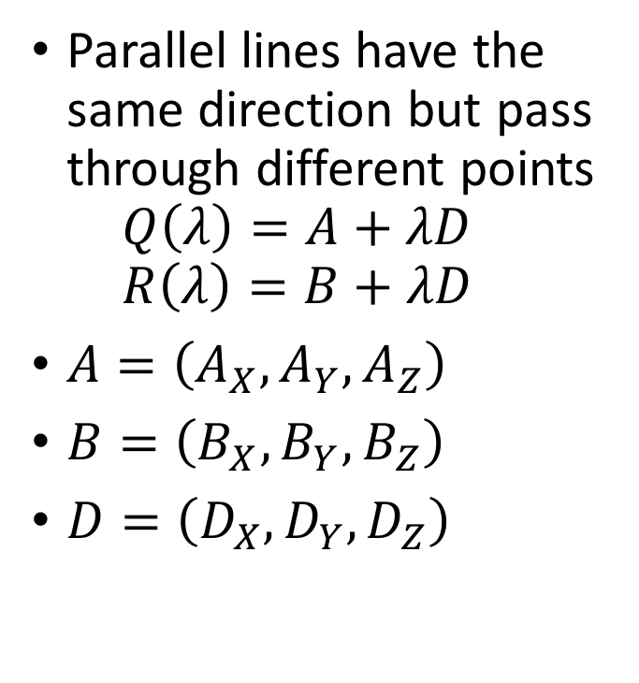
Consequence 2: Parallel lines converge at a point
Parallel lines have the same direction but pass through different points
$Q\left(λ\right)=A+λD$
$R\left(λ\right)=B+λD$
$A=\left(A_{X}, A_{Y}, A_{Z}\right)$
$B=\left(B_{X},B_{Y},B_{Z}\right)$
$D=\left(D_{X},D_{Y},D_{Z}\right)$

Slide 12
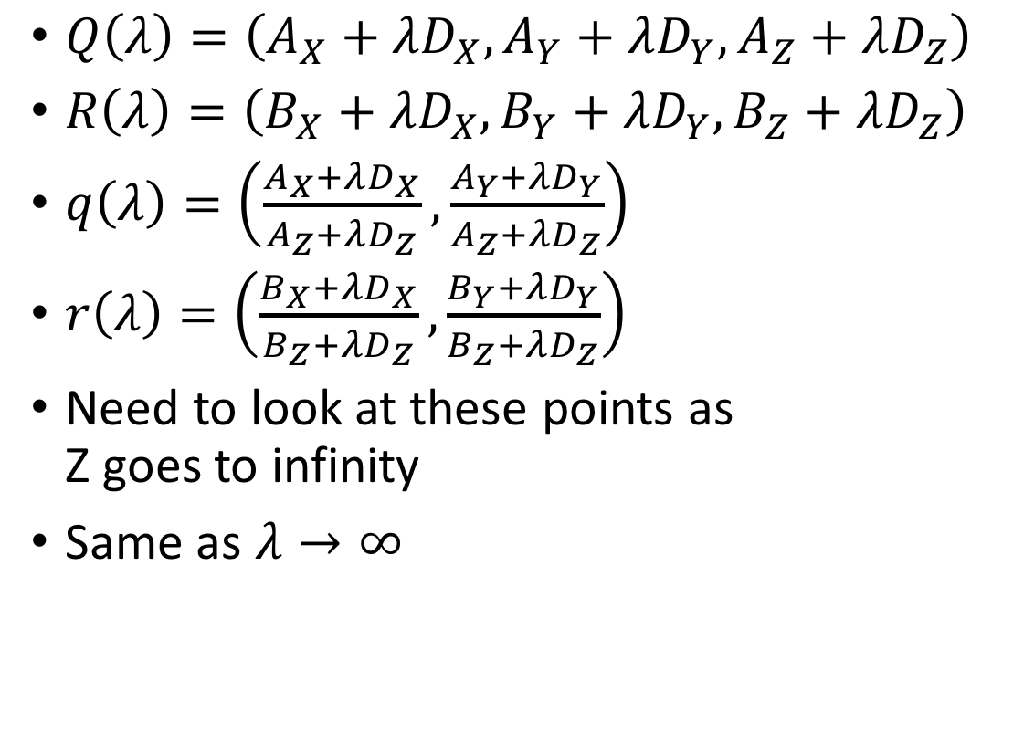
Consequence 2: Parallel lines converge at a point
$Q\left(λ\right)=\left(A_{X}+λD_{X}, A_{Y}+λD_{Y}, A_{Z}+λD_{Z}\right)$
$R\left(λ\right)=\left(B_{X}+λD_{X}, B_{Y}+λD_{Y}, B_{Z}+λD_{Z}\right)$
$q\left(λ\right)=\left(\frac{A_{X}+λD_{X}}{A_{Z}+λD_{Z}}, \frac{A_{Y}+λD_{Y}}{A_{Z}+λD_{Z}}\right)$
$r\left(λ\right)=\left(\frac{B_{X}+λD_{X}}{B_{Z}+λD_{Z}}, \frac{B_{Y}+λD_{Y}}{B_{Z}+λD_{Z}}\right)$
Need to look at these points as
Z goes to infinity
Same as $λ→∞$

Slide 13

Consequence 2: Parallel lines converge at a point
$q\left(λ\right)=\left(\frac{A_{X}+λD_{X}}{A_{Z}+λD_{Z}}, \frac{A_{Y}+λD_{Y}}{A_{Z}+λD_{Z}}\right)$
$r\left(λ\right)=\left(\frac{B_{X}+λD_{X}}{B_{Z}+λD_{Z}}, \frac{B_{Y}+λD_{Y}}{B_{Z}+λD_{Z}}\right)$

Slide 14
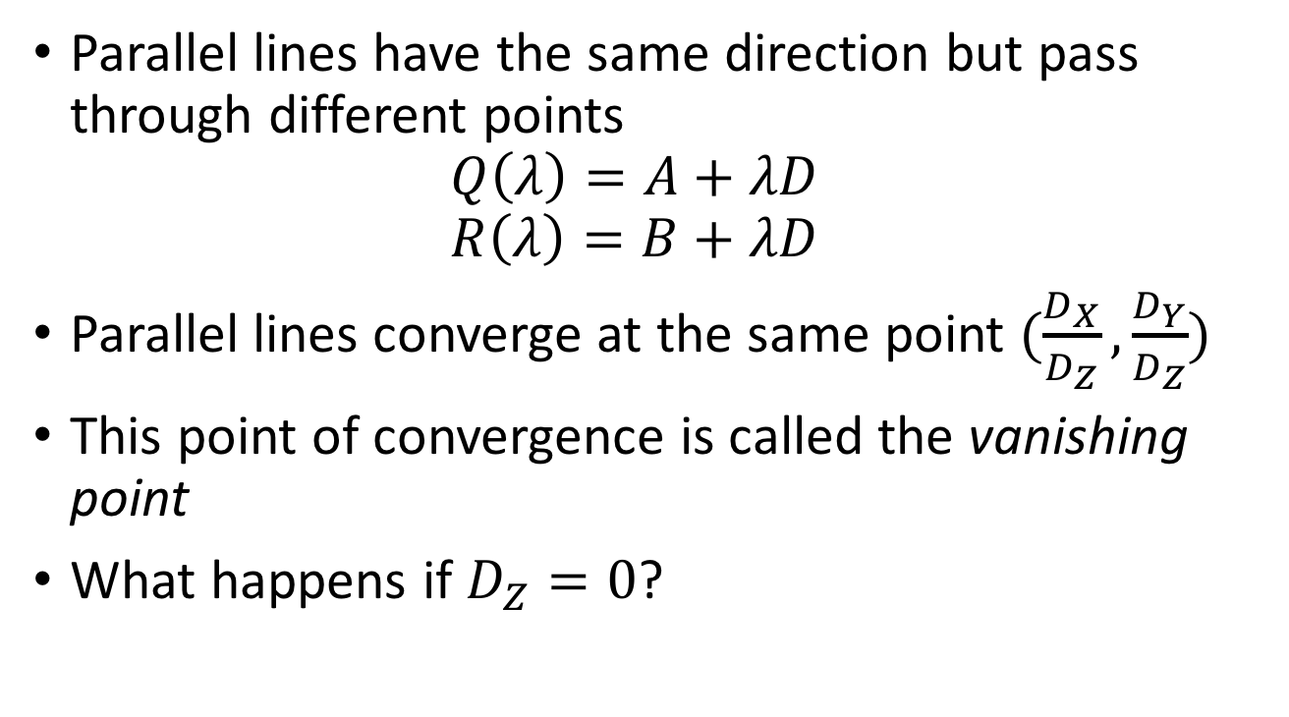
Consequence 2: Parallel lines converge at a point
Parallel lines have the same direction but pass through different points
$Q\left(λ\right)=A+λD$
$R\left(λ\right)=B+λD$
Parallel lines converge at the same point $(\frac{D_{X}}{D_{Z}},\frac{D_{Y}}{D_{Z}})$
This point of convergence is called the vanishing point
What happens if $D_{Z}=0$?

Slide 15
Consequence 2: Parallel lines converge at a point

Slide 16
What about planes?
Vanishing line of a plane
Take the limit as Z approaches infinity

Slide 17
Changing coordinate systems
Y
Y
P = (X,Y,Z)
Z
O
O’
X
X
Z

Slide 18
Changing coordinate systems
Y
Y
Z
O’
X
X
Z

Slide 19
Changing coordinate systems
Y
Y
Z
O’
X
Z
X

Slide 20
Changing coordinate systems
Y
Y
Z
O’
X
Z
X

Slide 21
Changing coordinate systems
Y
Y
Z
O’
X
Z
X

Slide 22
Changing coordinate systems
Y
Y
Z
O’
X
Z
X

Slide 23
Rotations and translations
How do you represent a rotation?
A point in 3D: (X,Y,Z)
Rotations can be represented as a matrix multiplication
What are the properties of rotation matrices?

Slide 24
Properties of rotation matrices
Rotation does not change the length of vectors

Slide 25
Properties of rotation matrices
Rotation
Reflection

Slide 26
Rotation matrices
Rotations in 3D have an axis and an angle
Axis: vector that does not change when rotated
Rotation matrix has eigenvector that has eigenvalue 1

Slide 27

Rotation matrices from axis and angle
Rotation matrix for rotation about axis $v$ and $θ$
First define the following matrix
Interesting fact: this matrix represents cross product

Slide 28

Rotation matrices from axis and angle
Rotation matrix for rotation about axis $v$ and $θ$
Rodrigues’ formula for rotation matrices

Slide 29
Translations
Can this be written as a matrix multiplication?

Slide 30
Putting everything together
Change coordinate system so that center of the coordinate system is at pinhole and Z axis is along viewing direction
Perspective projection

Slide 31
The projection equation
Is this equation linear?
Can this equation be represented by a matrix multiplication?

Slide 32
Is projection linear?

Slide 33
Can projection be represented as a matrix multiplication?
Matrix multiplication
Perspective projection

Slide 34
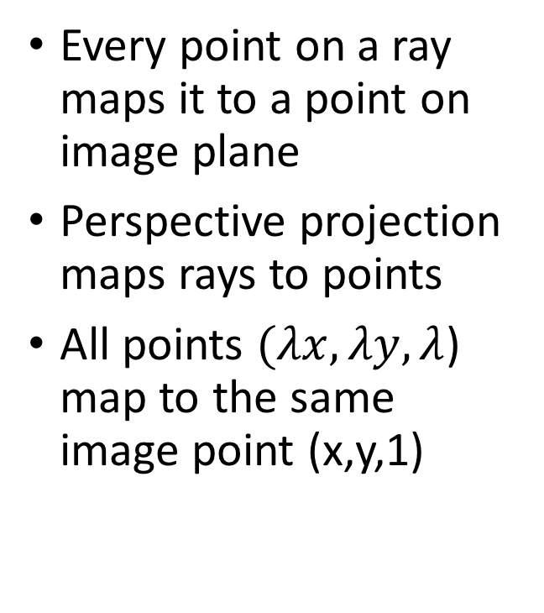

The space of rays
Every point on a ray maps it to a point on image plane
Perspective projection maps rays to points
All points $(λx, λy, λ$) map to the same image point (x,y,1)
($λx, λy, λ$)
(x,y,1)
O

Slide 35
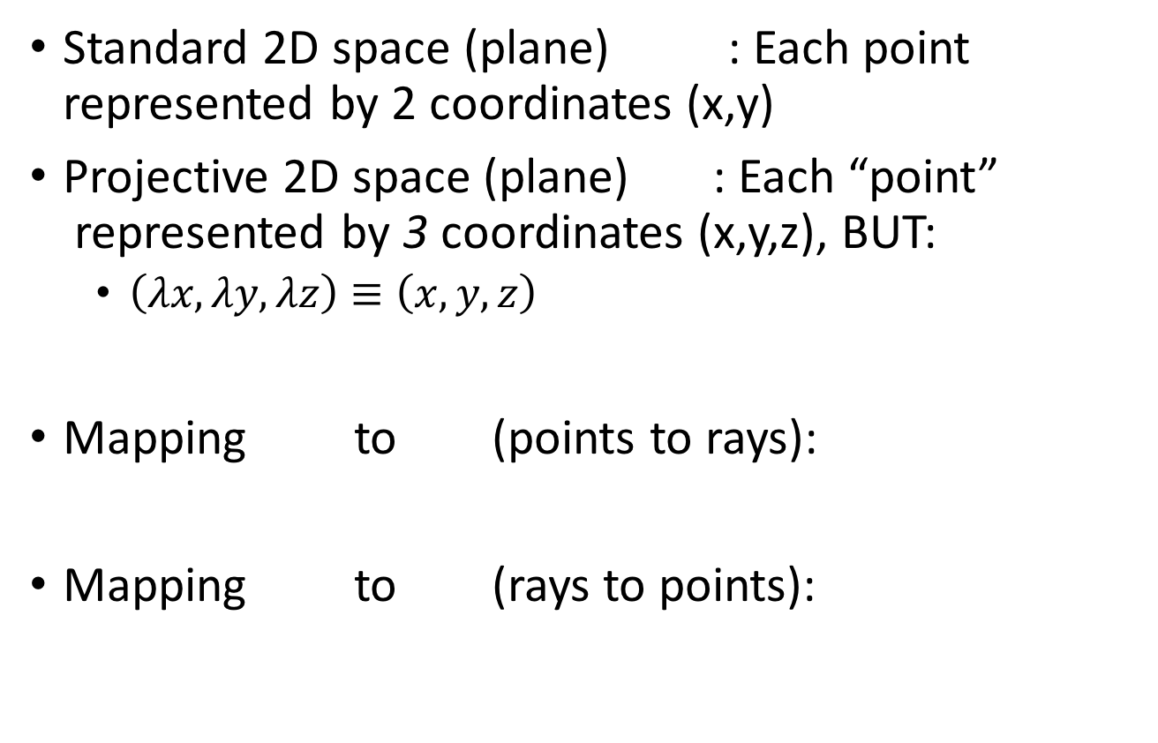
Projective space
Standard 2D space (plane) : Each point represented by 2 coordinates (x,y)
Projective 2D space (plane) : Each “point”
represented by 3 coordinates (x,y,z), BUT:
  $\left(λx, λy, λz\right)≡\left(x,y,z\right)$
Mapping to (points to rays):
Mapping to (rays to points):

Slide 36
Projective space and homogenous coordinates
Mapping to (points to rays):
Mapping to (rays to points):
A change of coordinates
Also called homogenous coordinates

Slide 37
Homogenous coordinates
In standard Euclidean coordinates
  2D points : (x,y)
  3D points : (x,y,z)
In homogenous coordinates
  2D points : (x,y,1)
  3D points : (x,y,z,1)

Slide 38
Why homogenous coordinates?
Homogenous coordinates of world point
Homogenous coordinates of image point

Slide 39
Why homogenous coordinates?
Perspective projection is matrix multiplication in homogenous coordinates!

Slide 40
Why homogenous coordinates?
Translation is matrix multiplication in homogenous coordinates!

Slide 41
Homogenous coordinates

Slide 42
Homogenous coordinates

Slide 43
Perspective projection in homogenous coordinates

Slide 44
More about matrix transformations
3 x 4 : Perspective projection
4 x 4 : Translation
4 x 4 : Affine transformation (linear transformation + translation)

Slide 45
More about matrix transformations
Euclidean

Slide 46
More about matrix transformations
Similarity transformation

Slide 47
More about matrix transformations
Anisotropic scaling and translation

Slide 48
More about matrix transformations
General affine transformation

Slide 49
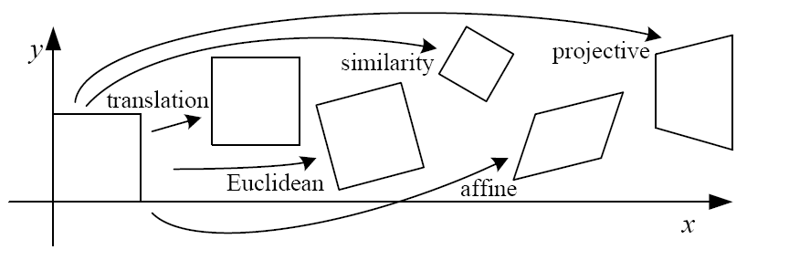
Matrix transformations in 2D

