Slide 1
Feature descriptors and matching

Slide 2
Detections at multiple scales

Slide 3
Invariance of MOPS
Intensity
Scale
Rotation

Slide 4
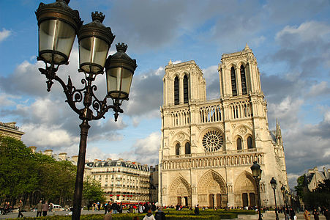
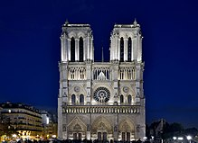
Color and Lighting

Slide 5
Out-of-plane rotation
Out-of-plane rotation

Slide 6
Better representation than color: Edges
Normal discontinuity
Depth Discontinuity
Albedo Edge
Shadow

Slide 7
Towards a better feature descriptor
Match pattern of edges
  Edge orientation – clue to shape
Be resilient to small deformations
  Deformations might move pixels around, but slightly
  Deformations might change edge orientations, but slightly

Slide 8
Invariance to deformation by quantization
37
42
Between 30 and 45

Slide 9
Invariance to deformation by quantization

Slide 10
Spatial invariance by histograms
2 blue balls, one red box
2
1
balls
boxes

Slide 11
Rotation Invariance by Orientation Normalization
[Lowe, SIFT, 1999]
Compute orientation histogram
Select dominant orientation
Normalize: rotate to fixed orientation
0
2
π

Slide 12
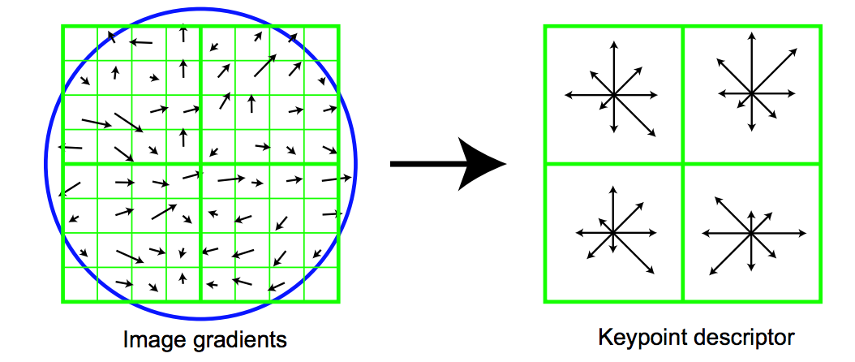
The SIFT descriptor
Compute edge magnitudes + orientations
Quantize orientations (invariance to def)
Divide into spatial cells
Compute orientation histogram in each cell (spatial invariance)
Distinctive Image Features from Scale-Invariant Keypoints. Lowe. In IJCV 2004

Slide 13
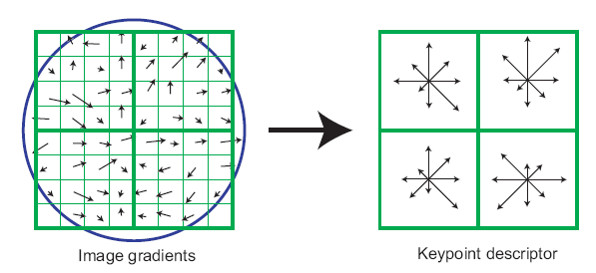
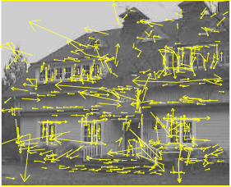
The SIFT descriptor
SIFT – Lowe IJCV 2004
Notes:
Do scale-space invariant feature detection using DoG.

Slide 14
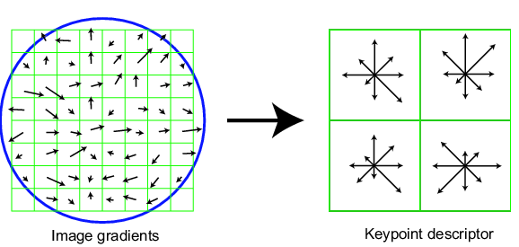
Scale Invariant Feature Transform
Basic idea:
  DoG for scale-space feature detection
  Take 16x16 square window around detected feature
    Compute gradient orientation for each pixel
    Throw out weak edges (threshold gradient magnitude)
    Create histogram of surviving edge orientations
0
2π
angle histogram
Adapted from slide by David Lowe

Slide 15
SIFT descriptor
Create histogram
  Divide the 16x16 window into a 4x4 grid of cells (2x2 case shown below)
  Compute an orientation histogram for each cell
  16 cells * 8 orientations = 128 dimensional descriptor
Adapted from slide by David Lowe

Slide 16
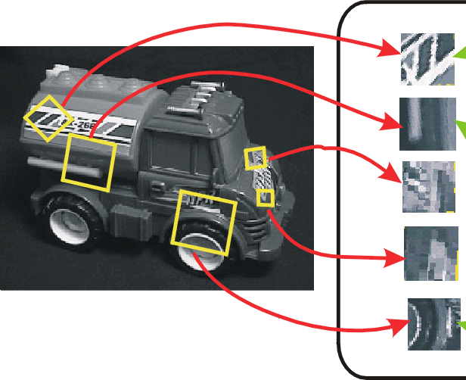
SIFT vector formation
Computed on rotated and scaled version of window according to computed orientation & scale
  resample the window
Based on gradients weighted by a Gaussian

Slide 17
Ensure smoothness
Trilinear interpolation
  a given gradient contributes to 8 bins:
  4 in space times 2 in orientation

Slide 18
Reduce effect of illumination
128-dim vector normalized to 1
Threshold gradient magnitudes to avoid excessive influence of high gradients
  after normalization, clamp gradients >0.2
  renormalize

Slide 19
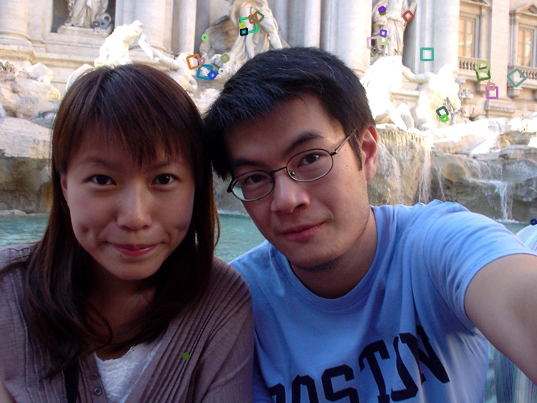
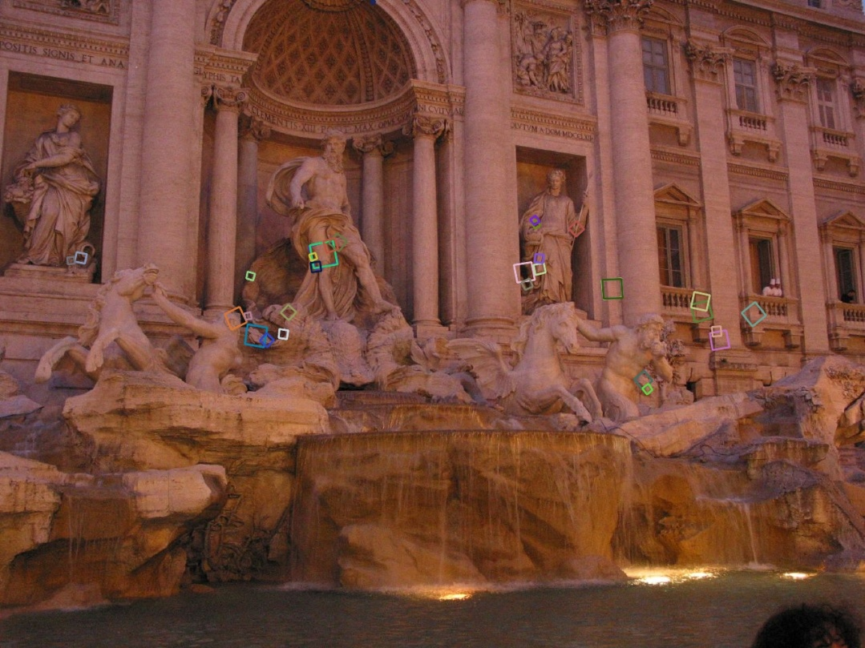
Properties of SIFT
Extraordinarily robust matching technique
  Can handle changes in viewpoint
    Up to about 60 degree out of plane rotation
  Can handle significant changes in illumination
    Sometimes even day vs. night (below)
  Fast and efficient—can run in real time
  Lots of code available: http://people.csail.mit.edu/albert/ladypack/wiki/index.php/Known_implementations_of_SIFT

Slide 20
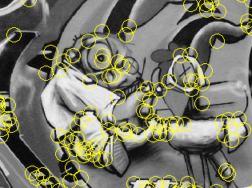
Summary
Keypoint detection: repeatable and distinctive
  Corners, blobs, stable regions
  Harris, DoG
Descriptors: robust and selective
  spatial histograms of orientation
  SIFT and variants are typically good for stitching and recognition
  But, need not stick to one

Slide 21
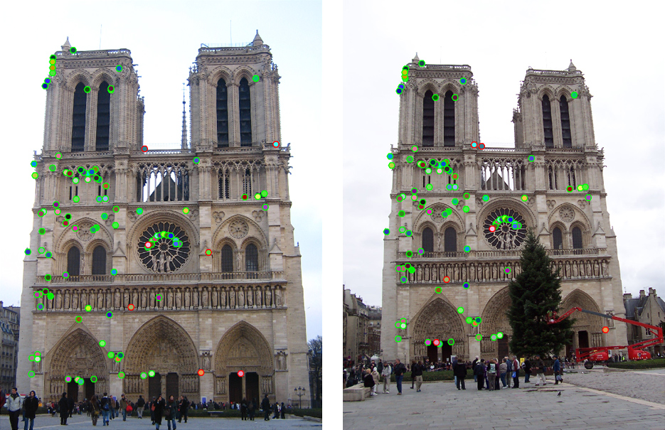
Which features match?

Slide 22
Feature matching
Given a feature in I₁, how to find the best match in I₂?
  Define distance function that compares two descriptors
  Test all the features in I₂, find the one with min distance

Slide 23
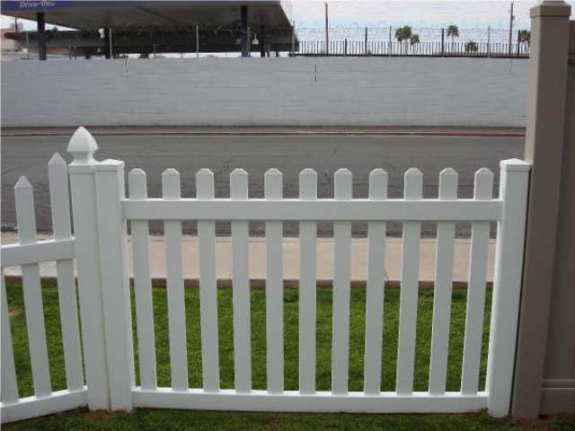
Feature distance
How to define the difference between two features f₁, f₂?
  Simple approach: L₂ distance, ||f₁ - f₂ ||
  can give good scores to ambiguous (incorrect) matches
f₁
f₂
I₁
I₂

Slide 24
Feature distance
How to define the difference between two features f₁, f₂?
  Better approach: ratio distance = ||f₁ - f₂ || / || f₁ - f₂’ ||
    f₂ is best SSD match to f₁ in I₂
    f₂’ is 2nd best SSD match to f₁ in I₂
    gives large values for ambiguous matches
f₁
f₂'
f₂
I₁
I₂

Slide 25
Geometry of Image Formation

Slide 26
The pinhole camera
Let’s get into the math

Slide 27
The pinhole camera

Slide 28
The pinhole camera

Slide 29
The pinhole camera
Y
P = (X,Y,Z)
p = (x,y)
Z
O
Z=-1
X

Slide 30
The pinhole camera
Y
P = (X,Y,Z)
p = (x,y)
Z
O
Z=-1
X

Slide 31


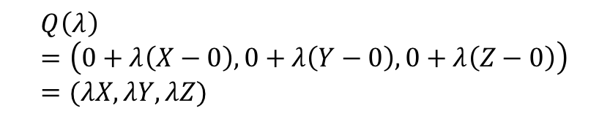
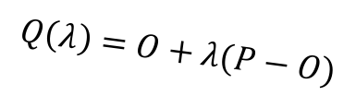
The pinhole camera
Y
P = (X,Y,Z)
$$Q\left(λ\right)=O+λ(P−O)$$
p = (x,y)
Z
O
$$λ=0⇒Q\left(λ\right)=O$$
$$λ=1⇒Q\left(λ\right)=P$$
Z=-1
X
$$Q\left(λ\right)=\left(0+λ\left(X−0\right), 0+λ\left(Y−0\right), 0+λ\left(Z−0\right)\right)=(λX, λY, λZ)$$

Slide 32
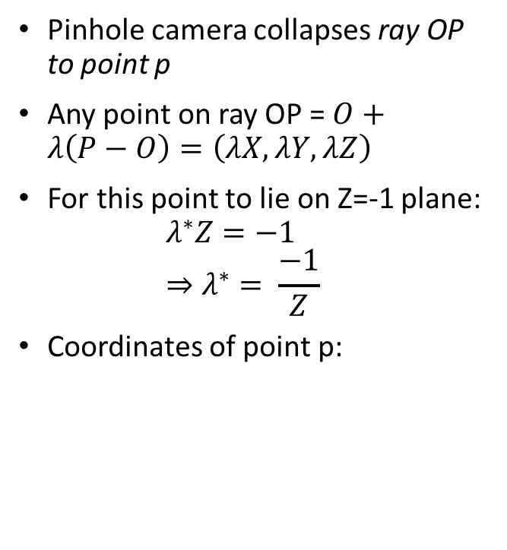
The pinhole camera
Pinhole camera collapses ray OP to point p
Any point on ray OP = $O+λ\left(P−O\right)=\left(λX, λY, λZ\right)$
For this point to lie on Z=-1 plane:
$λ^{∗}Z=−1$
$⇒λ^{∗}= \frac{−1}{Z}$
Coordinates of point p:
Y
p = (x,y)
P = (X,Y,Z)
Z
O
Z=-1
X

Slide 33
The projection equation
A point P = (X, Y, Z) in 3D projects to a point p = (x,y) in the image
But pinhole camera’s image is inverted, invert it back!

Slide 34
Another derivation
P = (X,Y,Z)
Y
1
O
Z
y
p = (x,y,z)

Slide 35
A virtual image plane
A pinhole camera produces an inverted image
Imagine a ”virtual image plane” in the front of the camera
P
P
Y
Y
y
1
Z
O
y
1
O
Z

Slide 36
The projection equation

Slide 37
Consequence 1: Farther away objects are smaller
(X, Y + h, Z)
(X, Y, Z)
Image of foot:
Image of head:

Slide 38
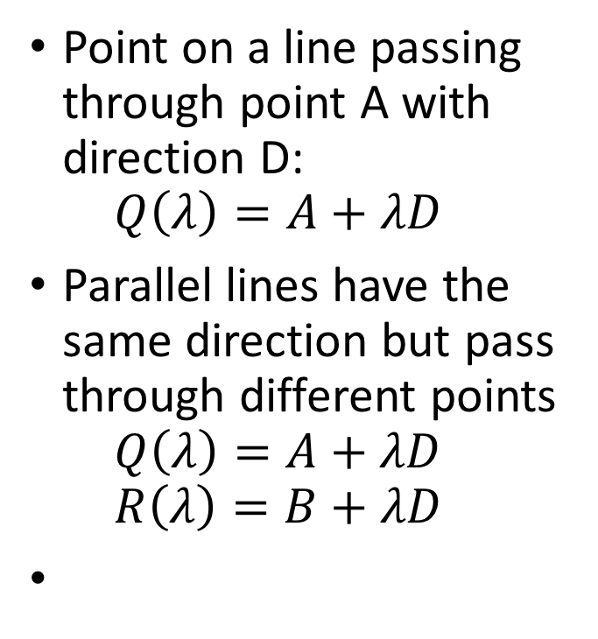
Consequence 2: Parallel lines converge at a point
Point on a line passing through point A with direction D:
$Q\left(λ\right)=A+λD$
Parallel lines have the same direction but pass through different points
$Q\left(λ\right)=A+λD$
$R\left(λ\right)=B+λD$

Slide 39
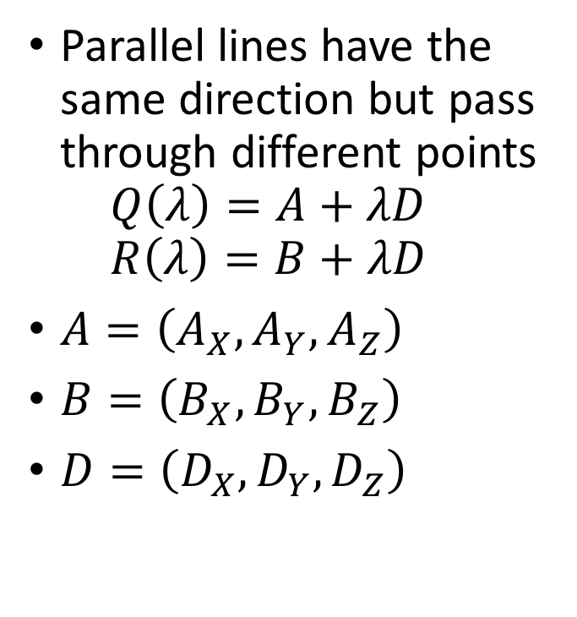
Consequence 2: Parallel lines converge at a point
Parallel lines have the same direction but pass through different points
$Q\left(λ\right)=A+λD$
$R\left(λ\right)=B+λD$
$A=\left(A_{X}, A_{Y}, A_{Z}\right)$
$B=\left(B_{X},B_{Y},B_{Z}\right)$
$D=\left(D_{X},D_{Y},D_{Z}\right)$

Slide 40
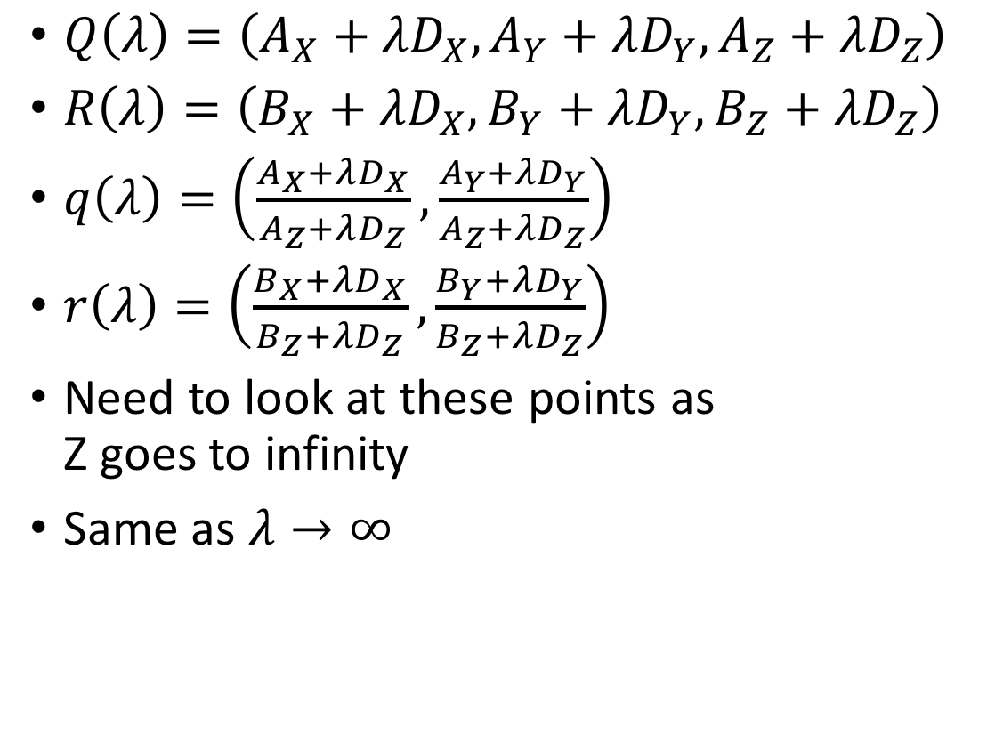
Consequence 2: Parallel lines converge at a point
$Q\left(λ\right)=\left(A_{X}+λD_{X}, A_{Y}+λD_{Y}, A_{Z}+λD_{Z}\right)$
$R\left(λ\right)=\left(B_{X}+λD_{X}, B_{Y}+λD_{Y}, B_{Z}+λD_{Z}\right)$
$q\left(λ\right)=\left(\frac{A_{X}+λD_{X}}{A_{Z}+λD_{Z}}, \frac{A_{Y}+λD_{Y}}{A_{Z}+λD_{Z}}\right)$
$r\left(λ\right)=\left(\frac{B_{X}+λD_{X}}{B_{Z}+λD_{Z}}, \frac{B_{Y}+λD_{Y}}{B_{Z}+λD_{Z}}\right)$
Need to look at these points as
Z goes to infinity
Same as $λ→∞$

Slide 41

Consequence 2: Parallel lines converge at a point
$q\left(λ\right)=\left(\frac{A_{X}+λD_{X}}{A_{Z}+λD_{Z}}, \frac{A_{Y}+λD_{Y}}{A_{Z}+λD_{Z}}\right)$
$r\left(λ\right)=\left(\frac{B_{X}+λD_{X}}{B_{Z}+λD_{Z}}, \frac{B_{Y}+λD_{Y}}{B_{Z}+λD_{Z}}\right)$

Slide 42
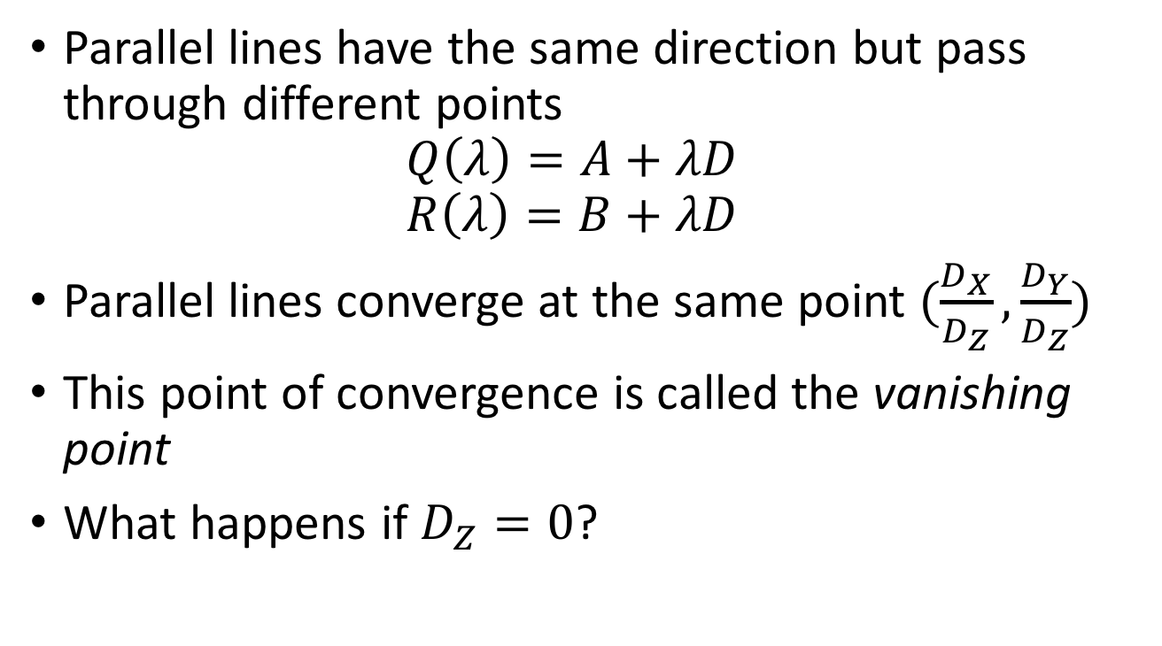
Consequence 2: Parallel lines converge at a point
Parallel lines have the same direction but pass through different points
$Q\left(λ\right)=A+λD$
$R\left(λ\right)=B+λD$
Parallel lines converge at the same point $(\frac{D_{X}}{D_{Z}},\frac{D_{Y}}{D_{Z}})$
This point of convergence is called the vanishing point
What happens if $D_{Z}=0$?

Slide 43
Consequence 2: Parallel lines converge at a point

Slide 44
What about planes?
Vanishing line of a plane
Take the limit as Z approaches infinity

Slide 45
What about planes?
Normal: (N_{X}, N_{Y}, N_{Z})
What do parallel planes look like?
Vanishing lines
Parallel planes converge!

Slide 46
Vanishing line
What happens if N_{X} = N_{Y} = 0?
Equation of the plane: Z = c
Vanishing line?

