Slide 1
Feature description and matching

Slide 2
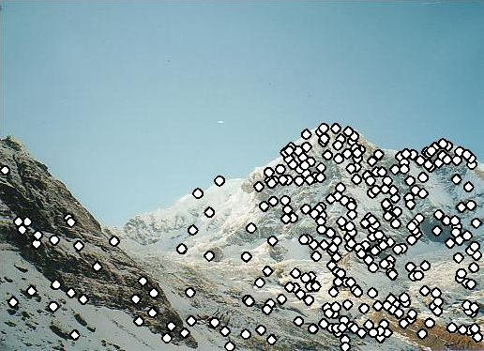
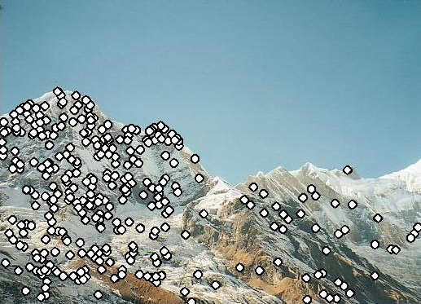
Matching feature points
We know how to detect good points
Next question: How to match them?
Two interrelated questions:
How do we describe each feature point?
How do we match descriptions?
?

Slide 3
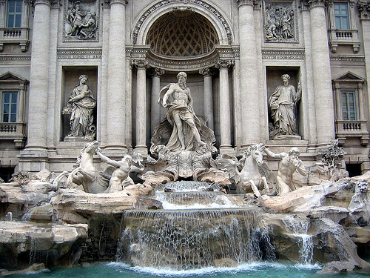
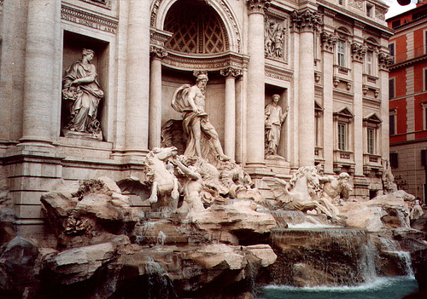




Feature descriptor
$$x_{1}$$
$$x_{2}$$
$$y_{1}$$
$$y_{2}$$

Slide 4
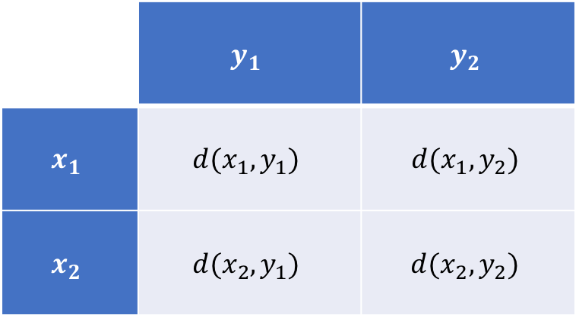
Feature matching
Measure the distance between (or similarity between) every pair of descriptors
 | $$y_{1}$$ | $$y_{2}$$
$$x_{1}$$ | $$d(x_{1},y_{1})$$ | $$d(x_{1},y_{2})$$
$$x_{2}$$ | $$d(x_{2},y_{1})$$ | $$d(x_{2},y_{2})$$

Slide 5
Invariance vs. discriminability
Invariance:
Distance between descriptors should be small even if image is transformed
Discriminability:
Descriptor should be highly unique for each point (far away from other points in the image)

Slide 6
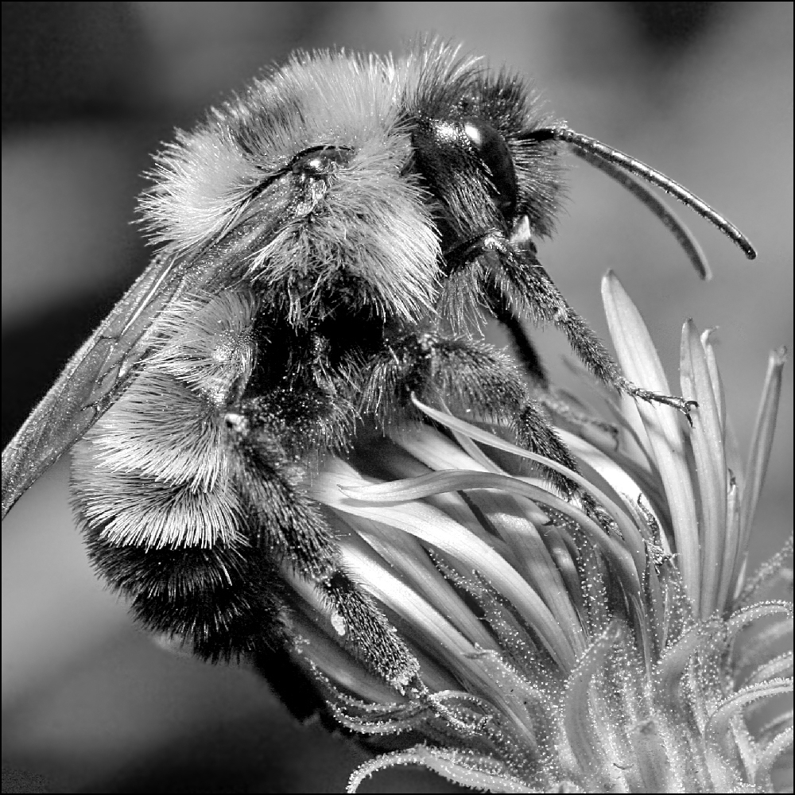
Image transformations
Geometric
Rotation
Scale
Photometric
Intensity change

Slide 7
Invariance
Most feature descriptors are designed to be invariant to
Translation, 2D rotation, scale
They can usually also handle
Limited 3D rotations (SIFT works up to about 60 degrees)
Limited affine transformations (some are fully affine invariant)
Limited illumination/contrast changes

Slide 8
How to achieve invariance
Design an invariant feature descriptor
Simplest descriptor: a single 0
What’s this invariant to?
Is this discriminative?
Next simplest descriptor: a single pixel
What’s this invariant to?
Is this discriminative?

Slide 9

The aperture problem

Slide 10
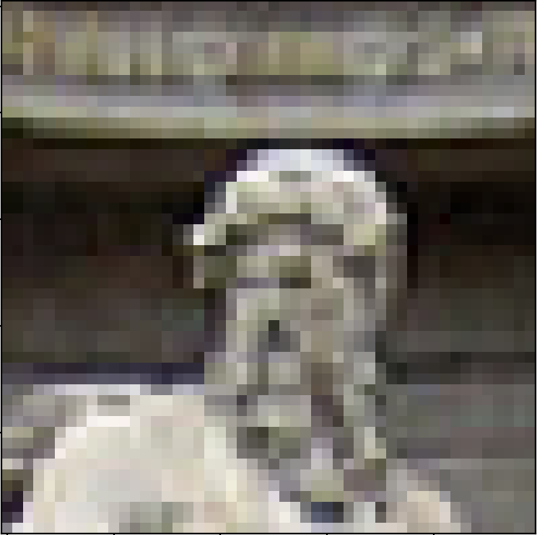
The aperture problem
Use a whole patch instead of a pixel?

Slide 11
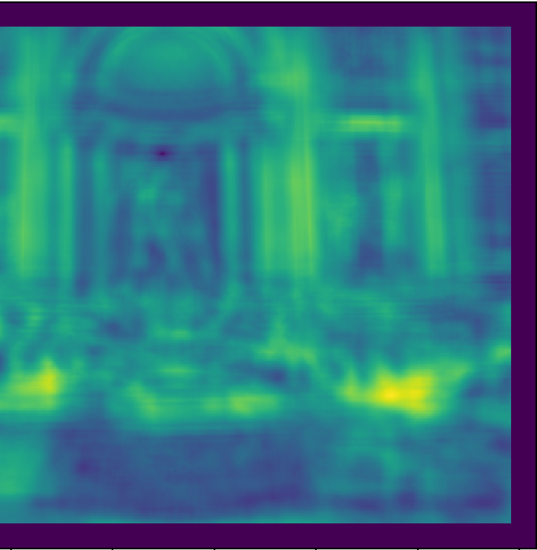

SSD
Use as descriptor the whole patch
Match descriptors using euclidean distance
$d\left(x,y\right)= ||x −y||^{2}$

Slide 12
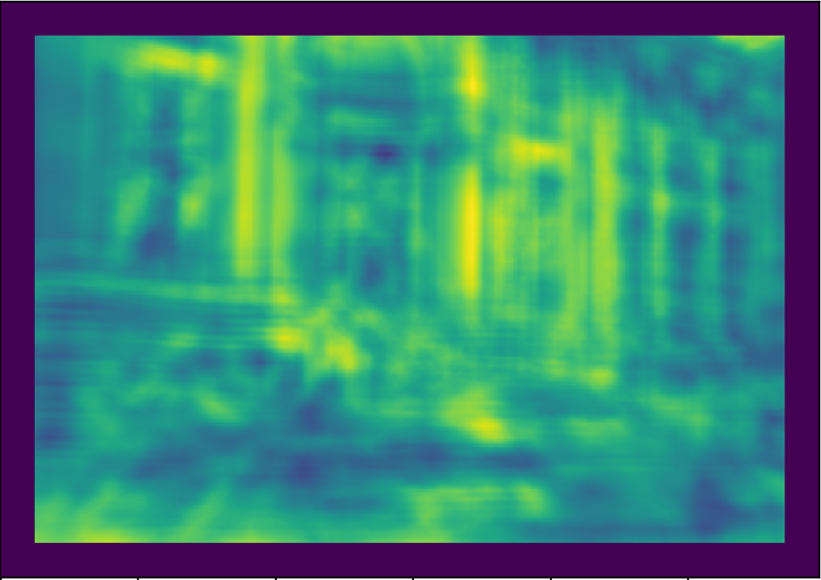
SSD

Slide 13
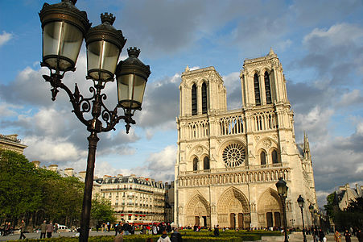
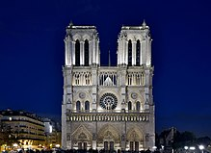
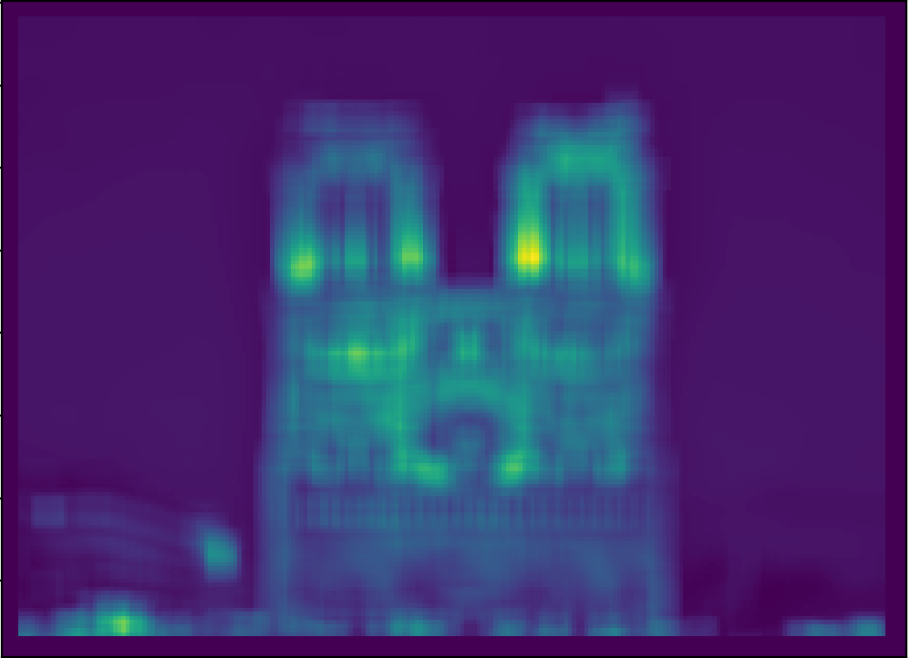

SSD

Slide 14
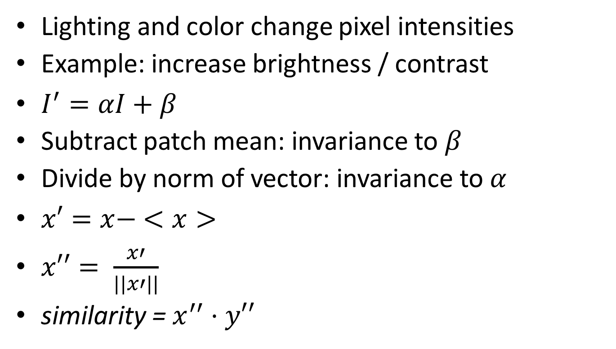
NCC - Normalized Cross Correlation
Lighting and color change pixel intensities
Example: increase brightness / contrast
$I^{′}=αI+β$
Subtract patch mean: invariance to $β$
Divide by norm of vector: invariance to $α$
$x′=x− <x>$
$x′′= \frac{x′}{||x′||}$
similarity = $x^{′′}⋅y′′$

Slide 15
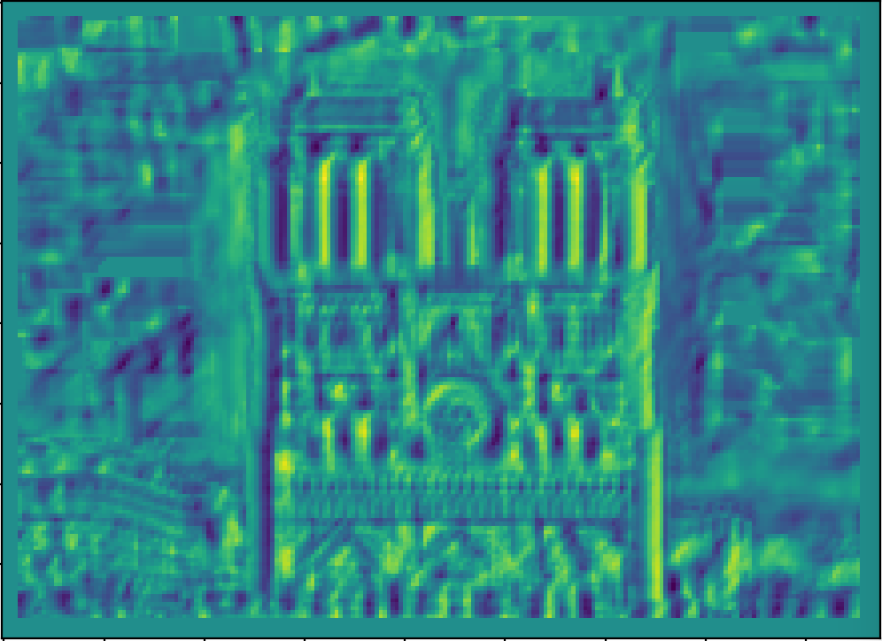
NCC - Normalized cross correlation

Slide 16
Basic correspondence
Image patch as descriptor, NCC as similarity
Invariant to?
Photometric transformations?
Translation?
Rotation?

Slide 17
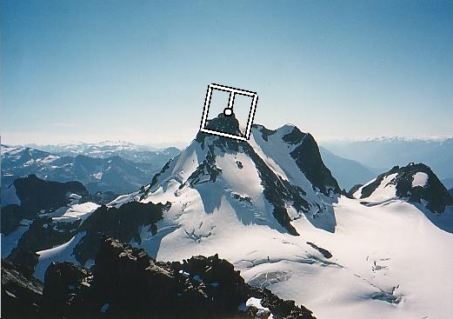
Rotation invariance for feature descriptors
Find dominant orientation of the image patch
This is given by x_{max}, the eigenvector of M corresponding to λ_{max} (the larger eigenvalue)
Rotate the patch according to this angle
Figure by Matthew Brown

Slide 18
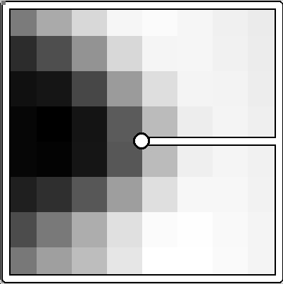
Multiscale Oriented PatcheS descriptor
Take 40x40 square window around detected feature
Scale to 1/5 size (using prefiltering)
Rotate to horizontal
Sample 8x8 square window centered at feature
Intensity normalize the window by subtracting the mean, dividing by the standard deviation in the window
40 pixels
8 pixels
Adapted from slide by Matthew Brown

Slide 19
Detections at multiple scales

Slide 20
Rotation invariance for feature descriptors
Find dominant orientation of the image patch
This is given by x_{max}, the eigenvector of M corresponding to λ_{max} (the larger eigenvalue)
Rotate the patch according to this angle
Figure by Matthew Brown

Slide 21
Detour: Image transformations
What does it mean to rotate a patch?
Each pixel has coordinates (x,y)
Rotation represented by a matrix R
Pixel’s new coordinates:
I’(x’,y’) = I(x,y)

Slide 22
Detour: Image transformations
What if destination pixel is fractional?
Flip computation: for every destination pixel figure out source pixel
Use interpolation if source location is fractional
I’(x’, y’) = I(x,y)

Slide 23
Multiscale Oriented PatcheS descriptor
Take 40x40 square window around detected feature
Scale to 1/5 size (using prefiltering)
Rotate to horizontal
Sample 8x8 square window centered at feature
Intensity normalize the window by subtracting the mean, dividing by the standard deviation in the window
40 pixels
8 pixels
Adapted from slide by Matthew Brown

Slide 24
MOPS descriptor
You can combine transformations together to get the final transformation
x
T = ?
y
Notes:
Pass this transformation matrix to cv2.warpAffine

Slide 25
Translate
x
y
T = M_{T1}

Slide 26
Rotate
x
y
T = M_{R}M_{T1}

Slide 27
Scale
x
y
T = M_{S}M_{R}M_{T1}

Slide 28
Translate
x
y
T = M_{T2}M_{S}M_{R}M_{T1}

Slide 29

Crop
x
y
Notes:
cv2.warpAffine also takes care of the cropping

Slide 30
Detections at multiple scales

Slide 31
Invariance of MOPS
Intensity
Scale
Rotation

Slide 32
Color and Lighting

Slide 33
Out-of-plane rotation
Out-of-plane rotation

Slide 34
Better representation than color: Edges
Normal discontinuity
Depth Discontinuity
Albedo Edge
Shadow

Slide 35
Towards a better feature descriptor
Match pattern of edges
Edge orientation – clue to shape
Be resilient to small deformations
Deformations might move pixels around, but slightly
Deformations might change edge orientations, but slightly

Slide 36
Invariance to deformation by quantization
37
42
Between 30 and 45

Slide 37
Invariance to deformation by quantization

Slide 38
Spatial invariance by histograms
2 blue balls, one red box
2
1
balls
boxes

Slide 39
Rotation Invariance by Orientation Normalization
[Lowe, SIFT, 1999]
Compute orientation histogram
Select dominant orientation
Normalize: rotate to fixed orientation
0
2
π

Slide 40
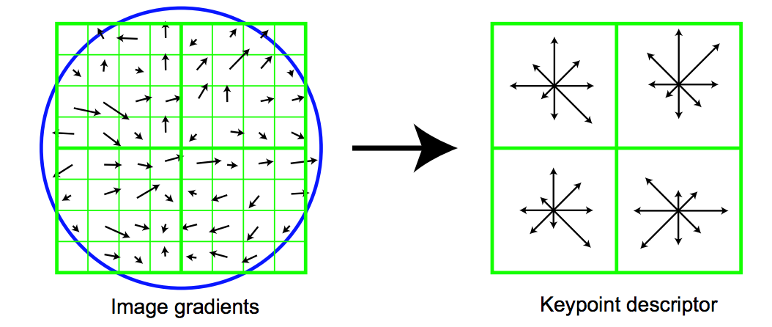
The SIFT descriptor
Compute edge magnitudes + orientations
Quantize orientations (invariance to def)
Divide into spatial cells
Compute orientation histogram in each cell (spatial invariance)
Distinctive Image Features from Scale-Invariant Keypoints. Lowe. In IJCV 2004

Slide 41
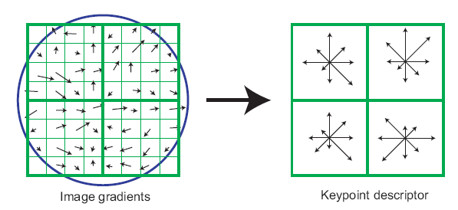
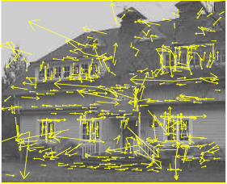
The SIFT descriptor
SIFT – Lowe IJCV 2004
Notes:
Do scale-space invariant feature detection using DoG.

Slide 42
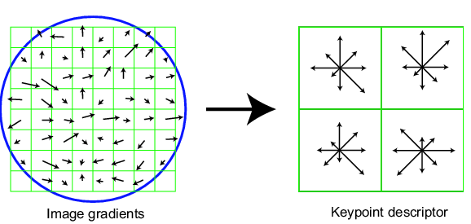
Scale Invariant Feature Transform
Basic idea:
DoG for scale-space feature detection
Take 16x16 square window around detected feature
Compute gradient orientation for each pixel
Throw out weak edges (threshold gradient magnitude)
Create histogram of surviving edge orientations
0
2π
angle histogram
Adapted from slide by David Lowe

Slide 43
SIFT descriptor
Create histogram
Divide the 16x16 window into a 4x4 grid of cells (2x2 case shown below)
Compute an orientation histogram for each cell
16 cells * 8 orientations = 128 dimensional descriptor
Adapted from slide by David Lowe

Slide 44
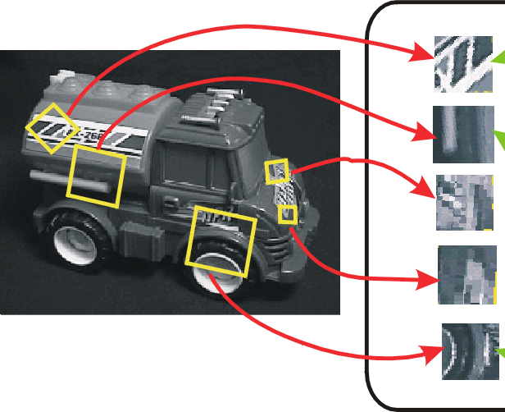
SIFT vector formation
Computed on rotated and scaled version of window according to computed orientation & scale
resample the window
Based on gradients weighted by a Gaussian

Slide 45
Ensure smoothness
Trilinear interpolation
a given gradient contributes to 8 bins: 4 in space times 2 in orientation

Slide 46
Reduce effect of illumination
128-dim vector normalized to 1
Threshold gradient magnitudes to avoid excessive influence of high gradients
after normalization, clamp gradients >0.2
renormalize

Slide 47
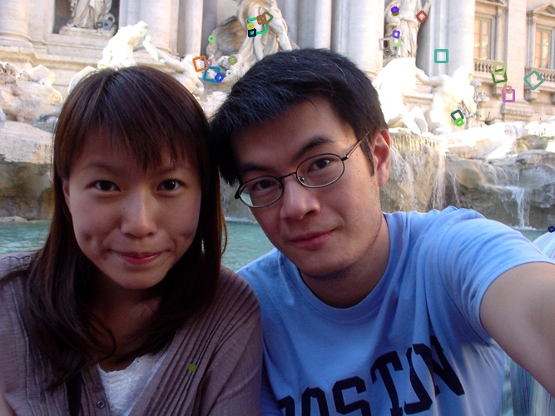
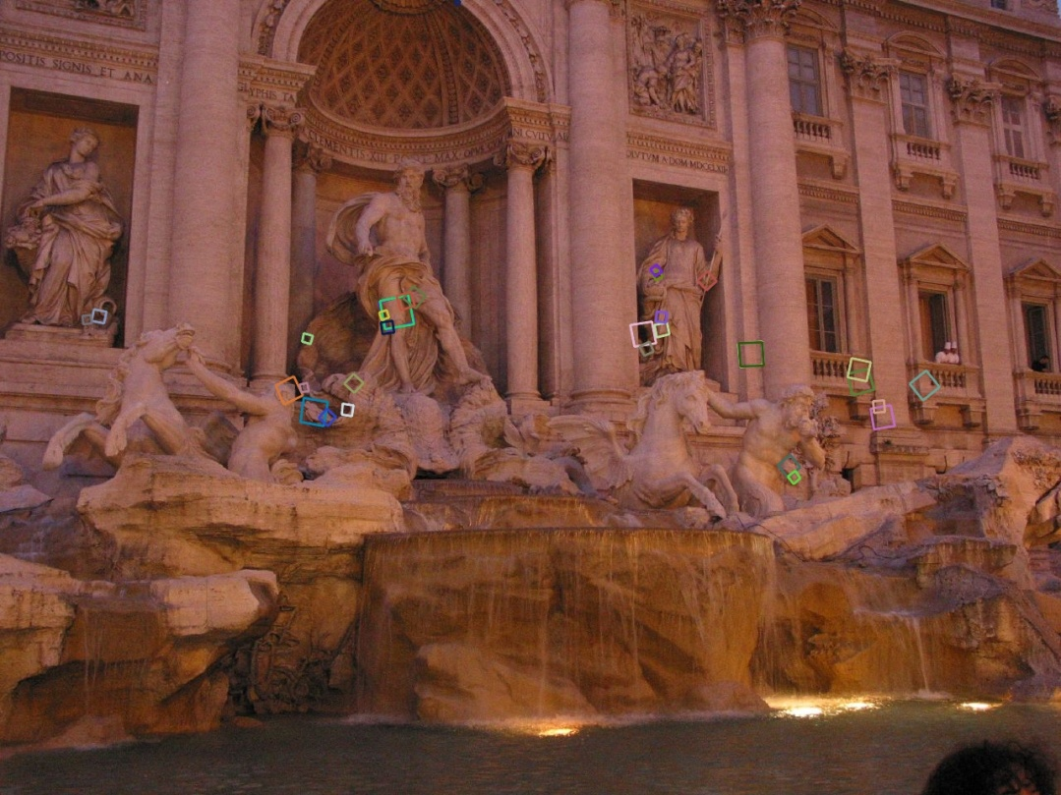
Properties of SIFT
Extraordinarily robust matching technique
Can handle changes in viewpoint
Up to about 60 degree out of plane rotation
Can handle significant changes in illumination
Sometimes even day vs. night (below)
Fast and efficient—can run in real time
Lots of code available: http://people.csail.mit.edu/albert/ladypack/wiki/index.php/Known_implementations_of_SIFT

Slide 48
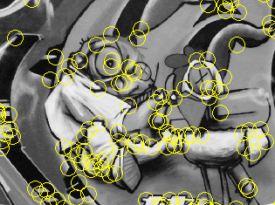
Summary
Keypoint detection: repeatable and distinctive
Corners, blobs, stable regions
Harris, DoG
Descriptors: robust and selective
spatial histograms of orientation
SIFT and variants are typically good for stitching and recognition
But, need not stick to one

Slide 49
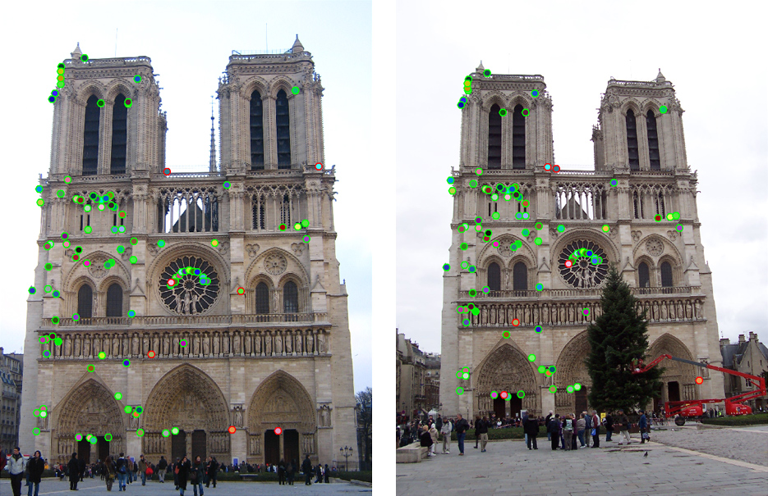
Which features match?

Slide 50
Feature matching
Given a feature in I₁, how to find the best match in I₂?
Define distance function that compares two descriptors
Test all the features in I₂, find the one with min distance

Slide 51
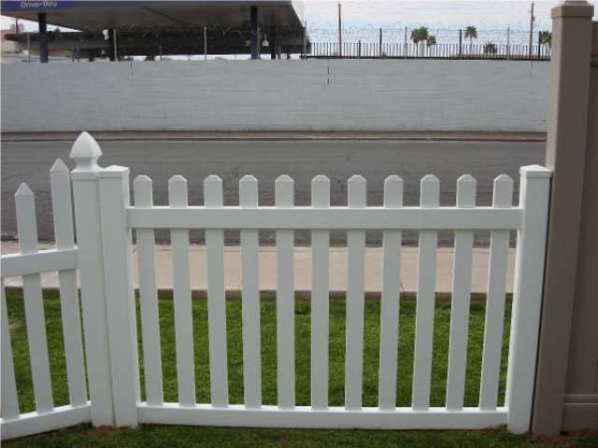
Feature distance
How to define the difference between two features f₁, f₂?
Simple approach: L₂ distance, ||f₁ - f₂ ||
can give good scores to ambiguous (incorrect) matches
f₁
f₂
I₁
I₂

Slide 52
Feature distance
How to define the difference between two features f₁, f₂?
Better approach: ratio distance = ||f₁ - f₂ || / || f₁ - f₂’ ||
f₂ is best SSD match to f₁ in I₂
f₂’ is 2nd best SSD match to f₁ in I₂
gives large values for ambiguous matches
f₁
f₂'
f₂
I₁
I₂

