Slide 1
The correspondence problem

Slide 2
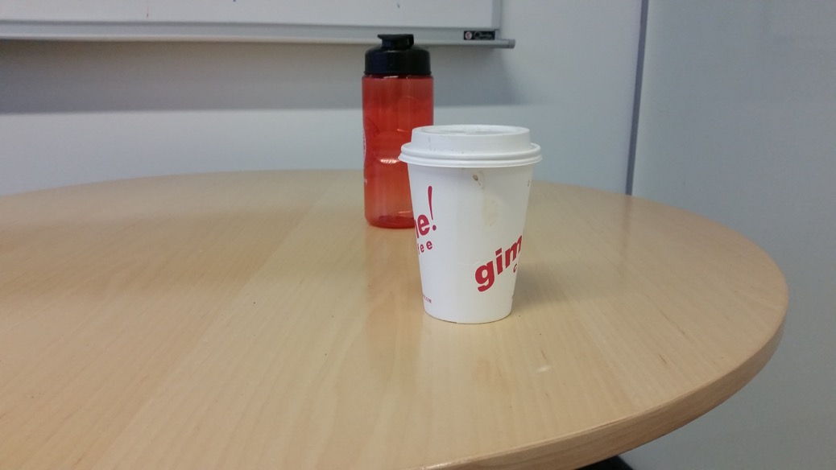
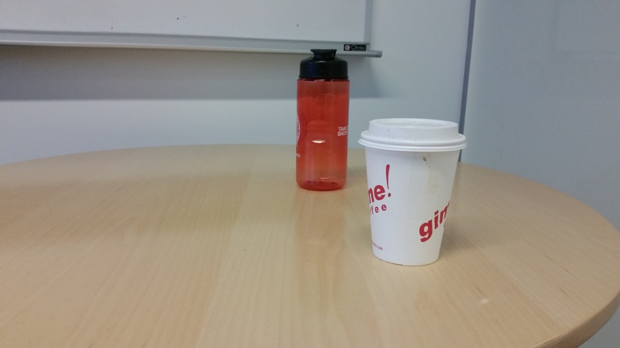
Why?
Multiple images can give a clue about 3D structure

Slide 3

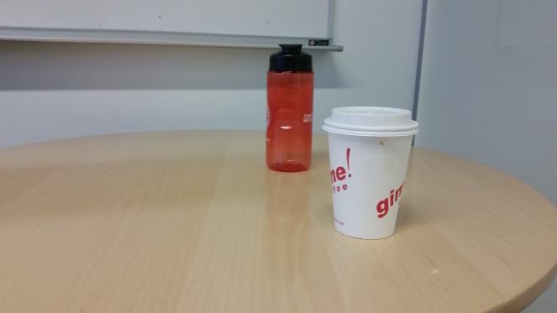
Why? Reconstruction
Need to find which pixel in image 2 matches which in image 1 - the correspondence problem

Slide 4
Reconstruction from correspondence
Given known cameras, correspondence gives the location of 3D point (Triangulation)

Slide 5
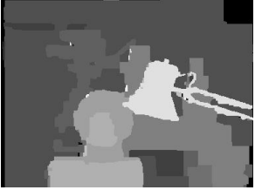
Reconstruction from correspondence

Slide 6
Reconstruction from correspondence
Specific application: depth cameras
https://realsense.intel.com/stereo/
Microsoft Kinect

Slide 7
Reconstruction from correspondence - Pose estimation
Given a 3D point, correspondence gives relationship between cameras (Pose estimation / camera calibration)

Slide 8
Pose-estimation

Slide 9
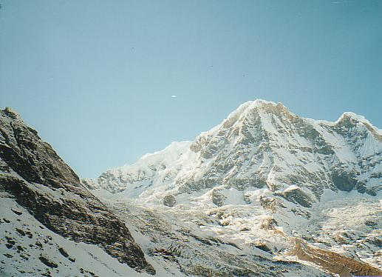
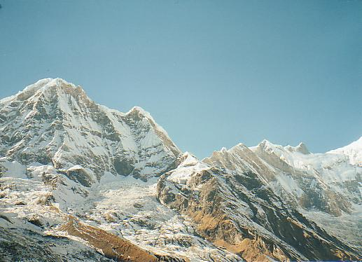
Pose-estimation / Camera calibration
Specific application: panorama stitching
We have two images – how do we combine them?

Slide 10
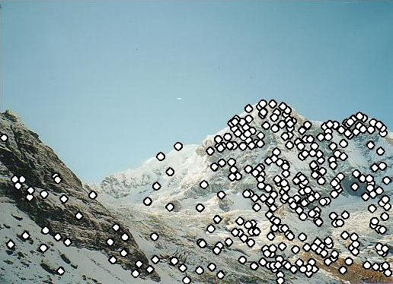
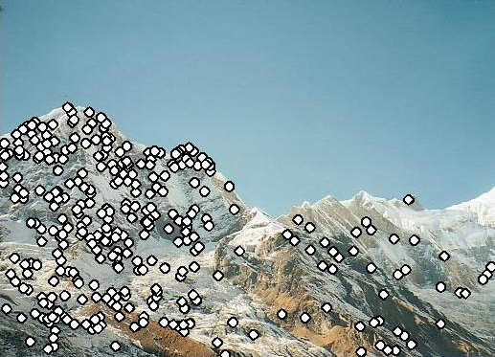
Pose-estimation / Camera calibration
Specific application: panorama stitching
We have two images – how do we combine them?
Step 1: extract correspondence

Slide 11
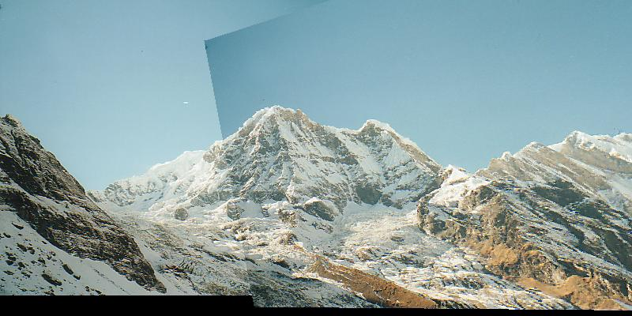
Pose-estimation / Camera calibration
Specific application: panorama stitching
We have two images – how do we combine them?
Step 1: extract correspondence
Step 2: align images

Slide 12
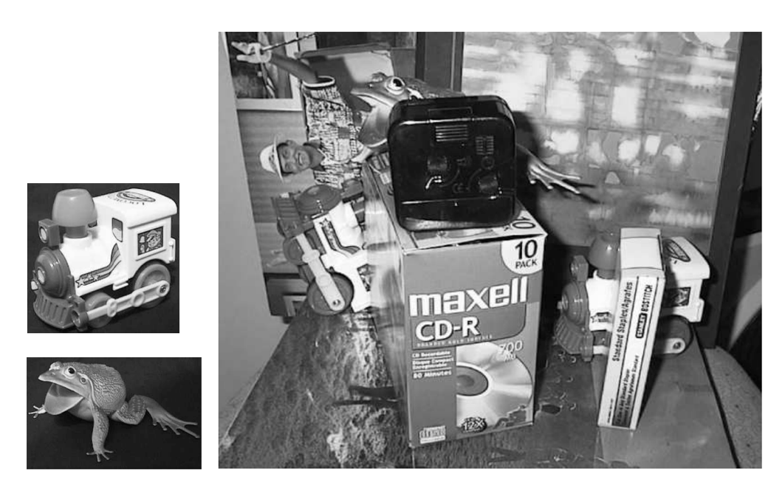
Other applications of correspondence
Recognition: Match image to product view
Lowe, IJCV 2004

Slide 13
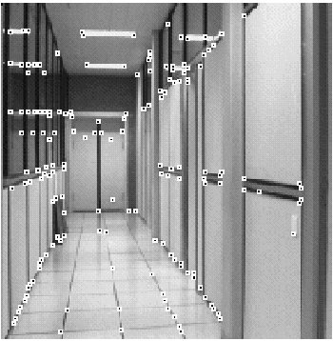
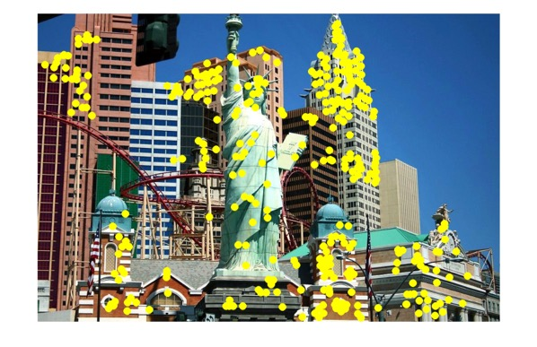
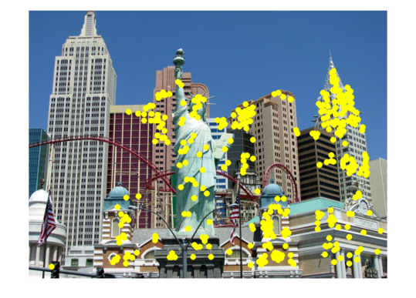
Other applications of correspondence
Image alignment
Motion tracking
Robot navigation

Slide 14
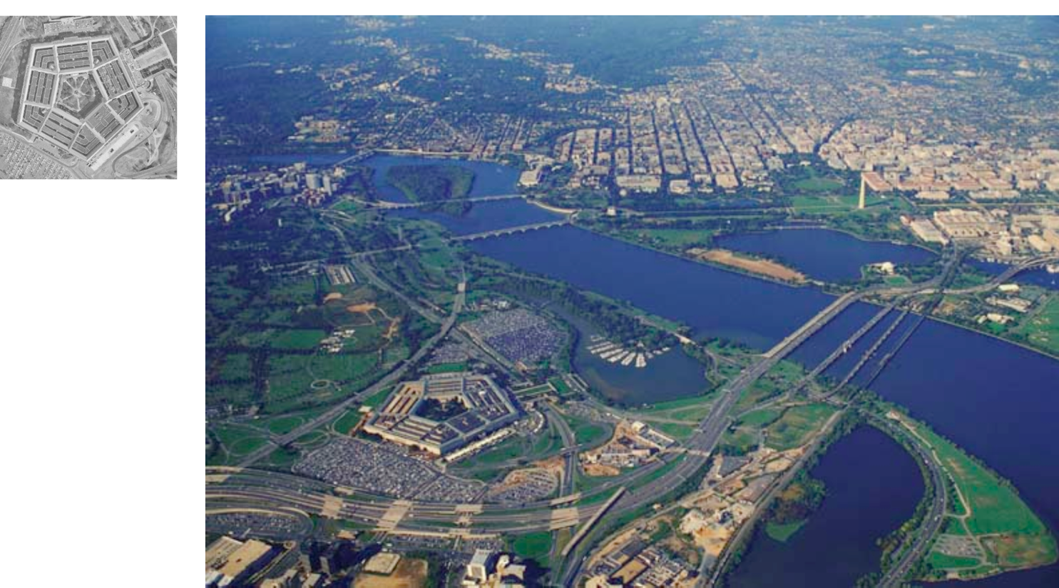
Correspondence can be challenging
Fei-Fei Li

Slide 15
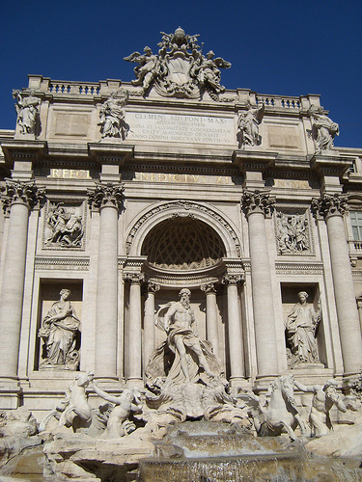
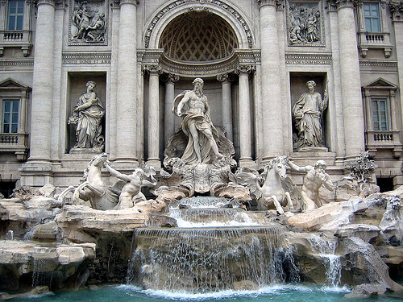
Correspondence
by Diva Sian
by swashford

Slide 16
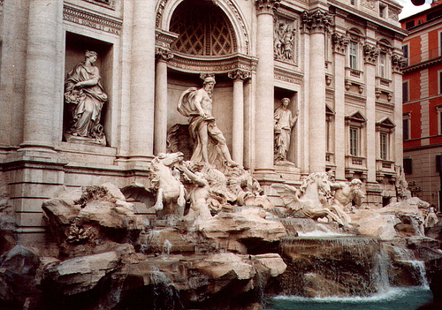
Harder case
by Diva Sian
by scgbt

Slide 17
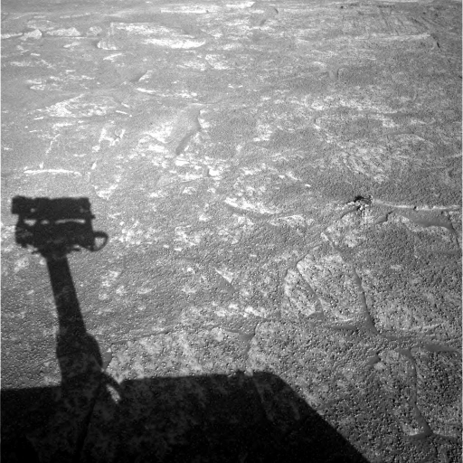
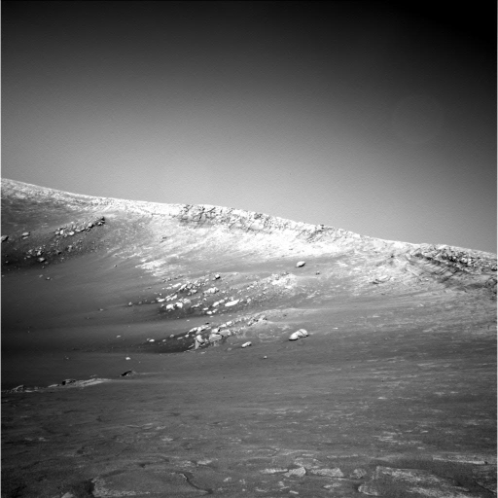
Harder still?

Slide 18
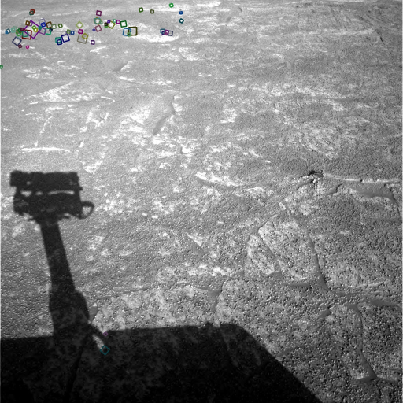
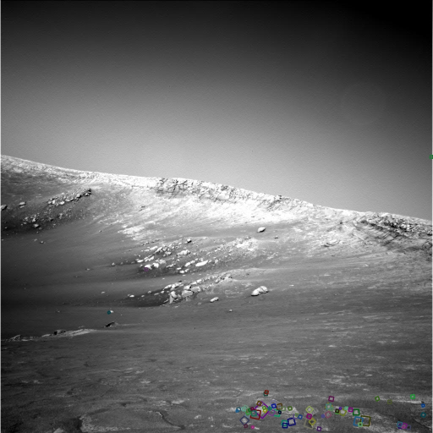
Answer below (look for tiny colored squares…)
NASA Mars Rover images
with SIFT feature matches

Slide 19
Dense correspondence
Some applications demand correspondence for every pixel
For example dense 3D reconstruction

Slide 20
Sparse correspondence
Sometimes a sparse set of correspondences are enough
E.g. estimating pose or camera relationships. Why?
Pose / camera relationships only consist of a small number of variables
Need only a little bit of information to recover it.

Slide 21
A general pipeline for correspondence
If sparse correspondences are enough, choose points for which we will search for correspondences (feature points)
For each point (or every pixel if dense correspondence), describe point using a feature descriptor
Find best matching descriptors across two images (feature matching)
Use feature matches to perform downstream task, e.g., pose estimation

Slide 22
A general pipeline for correspondence
If sparse correspondences are enough, choose points for which we will search for correspondences (feature points)
For each point (or every pixel if dense correspondence), describe point using a feature descriptor
Find best matching descriptors across two images (feature matching)
Use feature matches to perform downstream task, e.g., pose estimation

Slide 23
Sparse correspondence
Which pixels should be searching correspondence for?
Feature points / keypoints

Slide 24
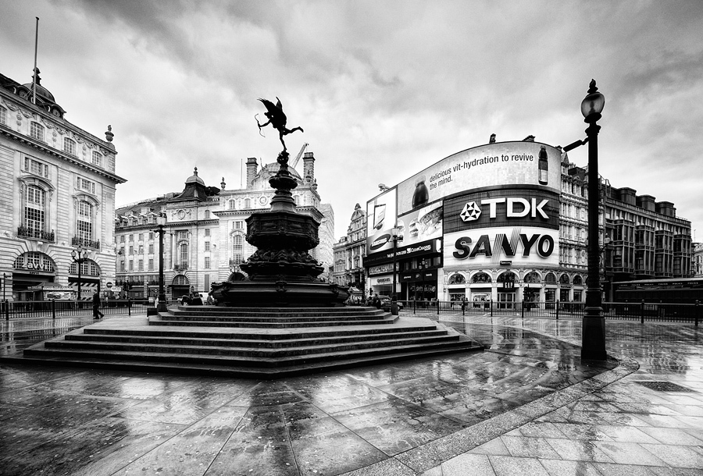
What makes a good feature point?
Snoop demo

Slide 25
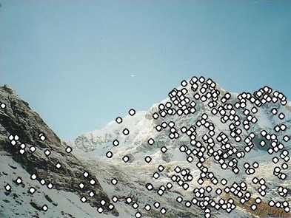
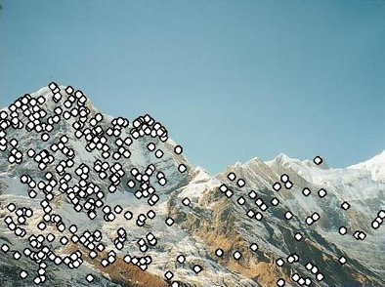
Characteristics of good feature points
Repeatability / invariance
The same feature point can be found in several images despite geometric and photometric transformations
Saliency / distinctiveness
Each feature point is distinctive
Fewer ”false” matches

Slide 26
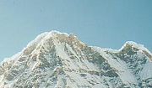

Goal: repeatability
We want to detect (at least some of) the same points in both images.
Yet we have to be able to run the detection procedure independently per image.
No chance to find true matches!
Kristen Grauman
Notes:
26

Slide 27
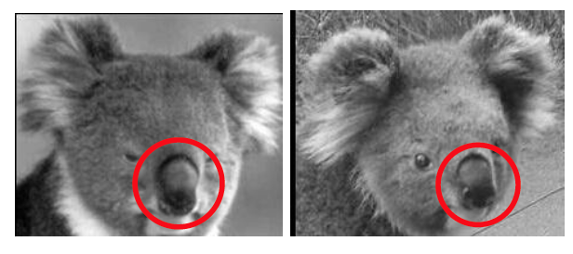
Repeatability / invariance
The feature detector should “fire” at consistent places in spite of rotation, translation etc.
Image credit : L. Fei-Fei

Slide 28
Repeatability / invariance

Slide 29
Goal: distinctiveness
The feature point should be distinctive enough that it is easy to match
Should at least be distinctive from other patches nearby
????

Slide 30
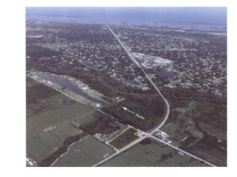
Where would you tell your friend to meet you?
Notes:
Corners!

Slide 31
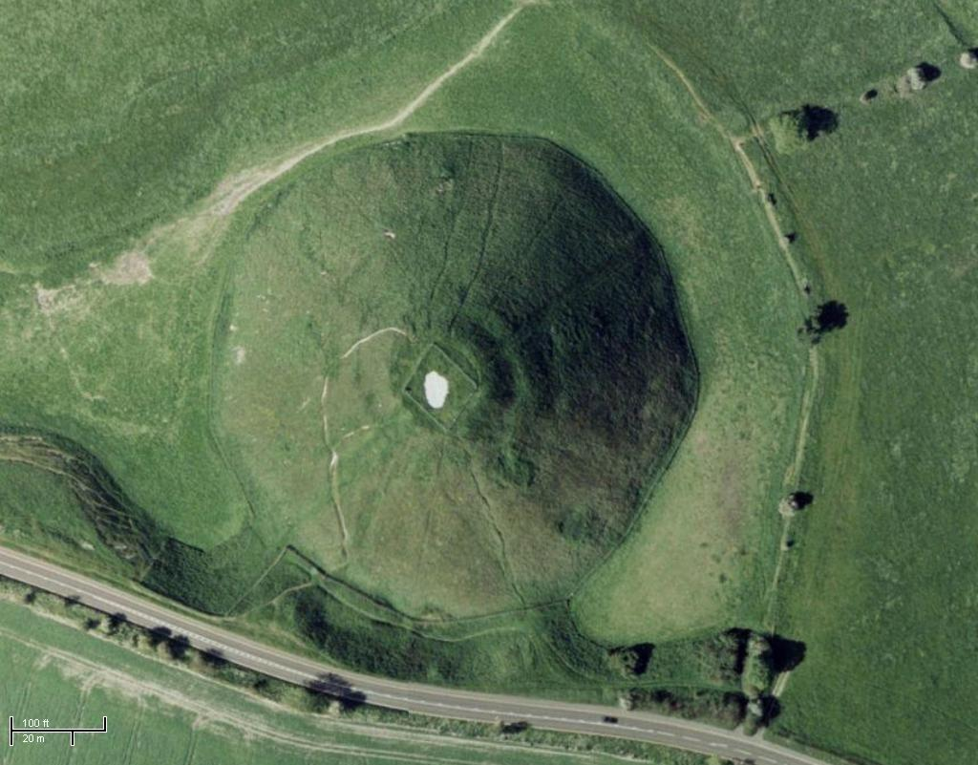
Where would you tell your friend to meet you?
Notes:
Blobs!

Slide 32
Choosing distinctive interest points
If you wanted to meet a friend would you say
“Let’s meet on campus.”
“Let’s meet on Green street.”
“Let’s meet at Green and Wright.”
Corner detection
Or if you were in a secluded area:
“Let’s meet in the Plains of Akbar.”
“Let’s meet on the side of Mt. Doom.”
“Let’s meet on top of Mt. Doom.”
Blob (valley/peak) detection

Slide 33
The aperture problem

Slide 34
The aperture problem
Individual pixels are ambiguous
Idea: Look at whole patches!

Slide 35
The aperture problem
Individual pixels are ambiguous
Idea: Look at whole patches!

Slide 36
The aperture problem
Some local neighborhoods are ambiguous

Slide 37
The aperture problem

Slide 38
Corner detection
Main idea: Translating window should cause large differences in patch appearance

Slide 39

Corner Detection: Basic Idea
We should easily recognize the point by looking through a small window
Shifting a window in any direction should give a large change in intensity
“flat” region: no change in all directions
“edge”: no change along the edge direction
“corner”: significant change in all directions
Source: A. Efros

Slide 40
Corner detection the math
Consider shifting the window W by (u,v)
how do the pixels in W change?
Write pixels in window as a vector:
W

Slide 41
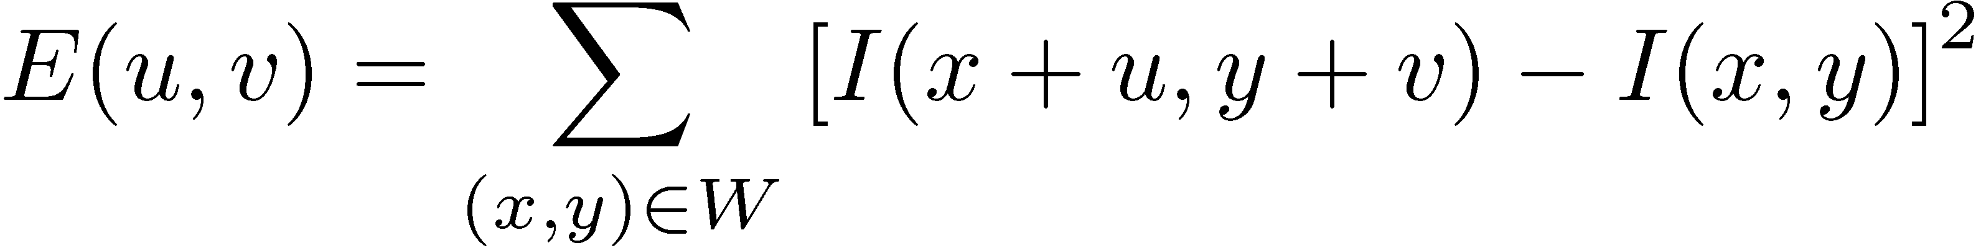
Corner detection: the math
Consider shifting the window W by (u,v)
how do the pixels in W change?
compare each pixel before and after by summing up the squared differences (SSD)
this defines an SSD “error” E(u,v):
We want E(u,v) to be as high as possible for all u, v!
W

Slide 42


Corner Detection: Mathematics
Change in appearance of window w(x,y)
for the shift [u,v]:
I(x, y)
E(u, v)
E(3,2)
w(x, y)

Slide 43
Corner Detection: Mathematics
Change in appearance of window w(x,y)
for the shift [u,v]:
Window function
Shifted intensity
Intensity
Window function w(x,y) =
or
1 in window, 0 outside
Gaussian
Source: R. Szeliski

Slide 44
Corner Detection: Mathematics
Change in appearance of window w(x,y)
for the shift [u,v]:
I(x, y)
E(u, v)
E(0,0)
w(x, y)

Slide 45
Corner Detection: Mathematics
Change in appearance of window w(x,y)
for the shift [u,v]:
We want to find out how this function behaves for small shifts
E(u, v)

Slide 46
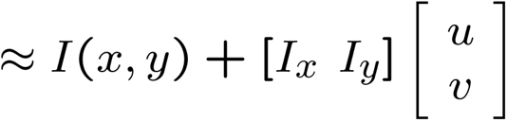
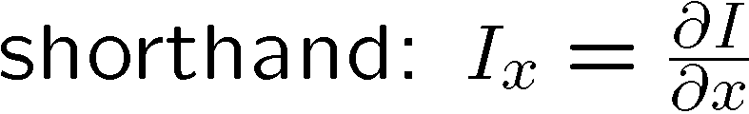
Small motion assumption
Taylor Series expansion of I:
If the motion (u,v) is small, then first order approximation is good
Plugging this into the formula on the previous slide…

Slide 47
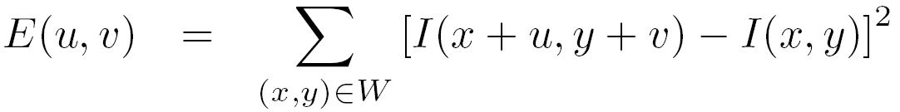
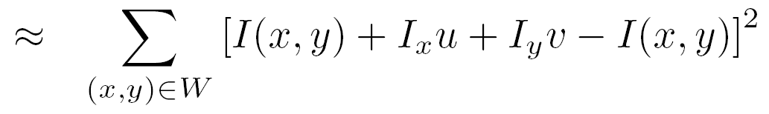
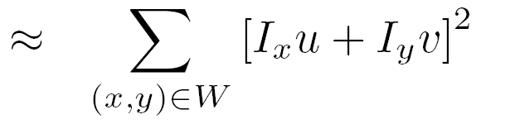
Corner detection: the math
Consider shifting the window W by (u,v)
define an SSD “error” E(u,v):
W

Slide 48
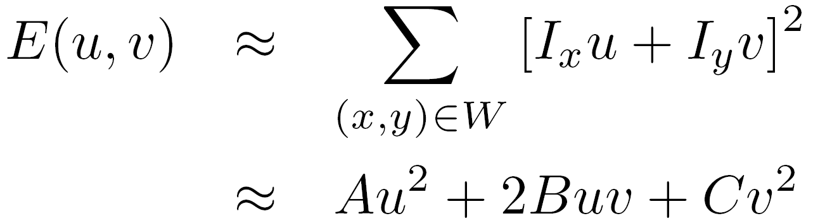
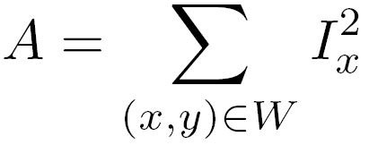
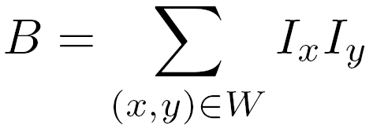
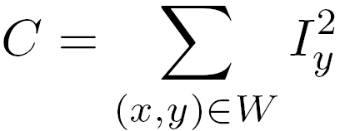
Corner detection: the math
Consider shifting the window W by (u,v)
define an “error” E(u,v):
W
Thus, E(u,v) is locally approximated as a quadratic error function

Slide 49
Interpreting the second moment matrix
Recall that we want E(u,v) to be as large as possible for all u,v
What does this mean in terms of M?
Second moment matrix

Slide 50
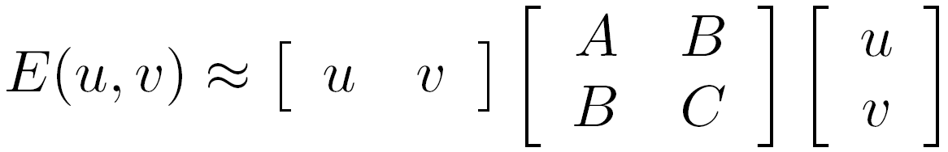


M
Flat patch:

Slide 51
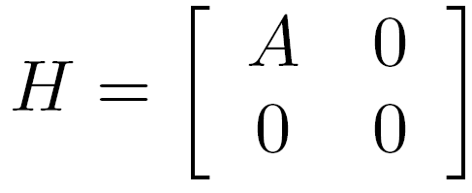
M
M
Vertical edge:

Slide 52
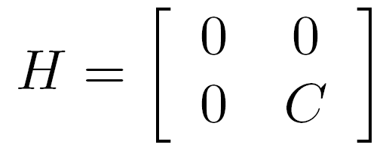
M
M
M
Horizontal edge:

Slide 53
What about edges in arbitrary orientation?

Slide 54
Solutions to Mx = 0 are directions for which E is 0: window can slide in this direction without changing appearance

Slide 55
Solutions to Mx = 0 are directions for which E is 0: window can slide in this direction without changing appearance
For corners, we want no such directions to exist

Slide 56
E(u,v)
E(u,v)
E(u,v)
E(u,v)
v
u
v
v
v
u
u
u

Slide 57
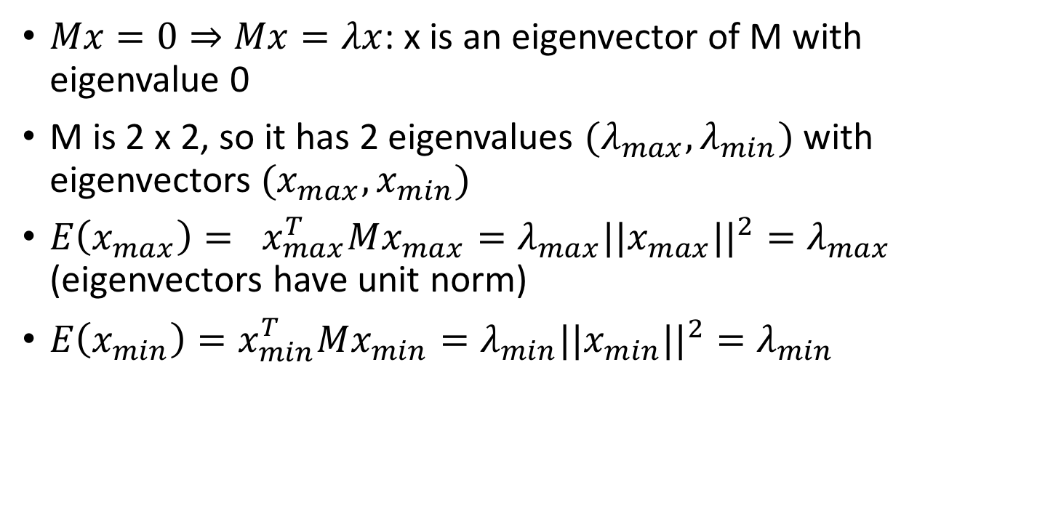
Eigenvalues and eigenvectors of M
$Mx=0⇒Mx=λx$: x is an eigenvector of M with eigenvalue 0
M is 2 x 2, so it has 2 eigenvalues $(λ_{max}, λ_{min})$ with eigenvectors ${(x}_{max}, x_{min})$
$E\left(x_{max}\right)= x_{max}^{T}Mx_{max}=λ_{max}||x_{max}||^{2}=λ_{max}$ (eigenvectors have unit norm)
$E\left(x_{min}\right)=x_{min}^{T}Mx_{min}=λ_{min}||x_{min}||^{2}=λ_{min}$

Slide 58
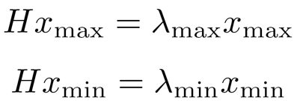
Eigenvalues and eigenvectors of M
x_{min}
M
x_{max}
M
Eigenvalues and eigenvectors of M
Define shift directions with the smallest and largest change in error
x_{max} = direction of largest increase in E
λ_{max} = amount of increase in direction x_{max}
x_{min} = direction of smallest increase in E
λ_{min} = amount of increase in direction x_{min}

Slide 59
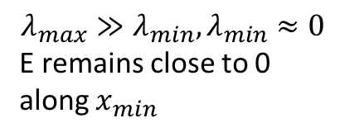
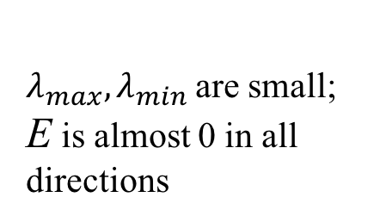



Interpreting the eigenvalues
$$λ_{min}$$
Corner
$$λ_{max}≈λ_{min} ≫0$$
E very high in all directions
$λ_{max}, λ_{min}$are small; E is almost 0 in all directions
Edge
$$λ_{max}≫λ_{min}, λ_{min}≈0$$
E remains close to 0 along $x_{min}$
Flat patch
$$λ_{max}$$

