Slide 1
Grouping

Slide 2
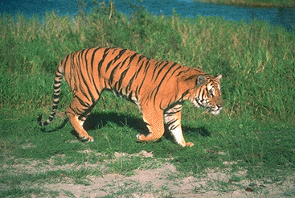
What is grouping?

Slide 3
Images as graphs
Each pixel is node
Edge between “similar pixels”
Proximity: nearby pixels are more similar
Similarity: pixels with similar color are more similar
Weight of edge = similarity

Slide 4
Segmentation is graph partitioning

Slide 5
Segmentation is graph partitioning
Every partition “cuts” some edges

Slide 6
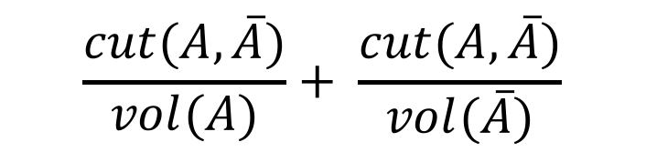
Normalized cut
$$\frac{cut(A, \overline{A})}{vol(A)}+ \frac{cut(A,\overline{A})}{vol(\overline{A})}$$

Slide 7
Graphs and matrices
1
6
2
7
3
4
8
9
5
W
0
E = D⁻¹W

Slide 8
Graphs and matrices
v₁
Ev₁
0:
1:
2:
3:
4:
5:
6:
7:
8:
9:
1
1
1
1
1
0
0
0
0
0
1
1
1
1
1
0
0
0
0
0
E = D⁻¹W

Slide 9
Graphs and matrices
v₁
Ev₁
0:
1:
2:
3:
4:
5:
6:
7:
8:
9:
1
1
1
1
1
0
0
0
0
0
1
1
1
1
1
0
0
0.2
0
0
E = D⁻¹W

Slide 10
Graphs and matrices
Define z so that

Slide 11
Graphs and matrices
is called the Normalized Graph Laplacian

Slide 12
Graphs and matrices
We want
Trivial solution: all nodes of graph in one cluster, nothing in the other
To avoid trivial solution, look for the eigenvector with the second smallest eigenvalue
Find z s.t.

Slide 13
A quick detour into eigenvalues and eigenvectors
Given vector x and matrix A, what does Ax look like?
x
Ax

Slide 14

A quick detour into eigenvalues and eigenvectors
Given a matrix A, x is an eigenvector with eigenvalue $λ$ if $Ax=λx$
x
Ax

Slide 15
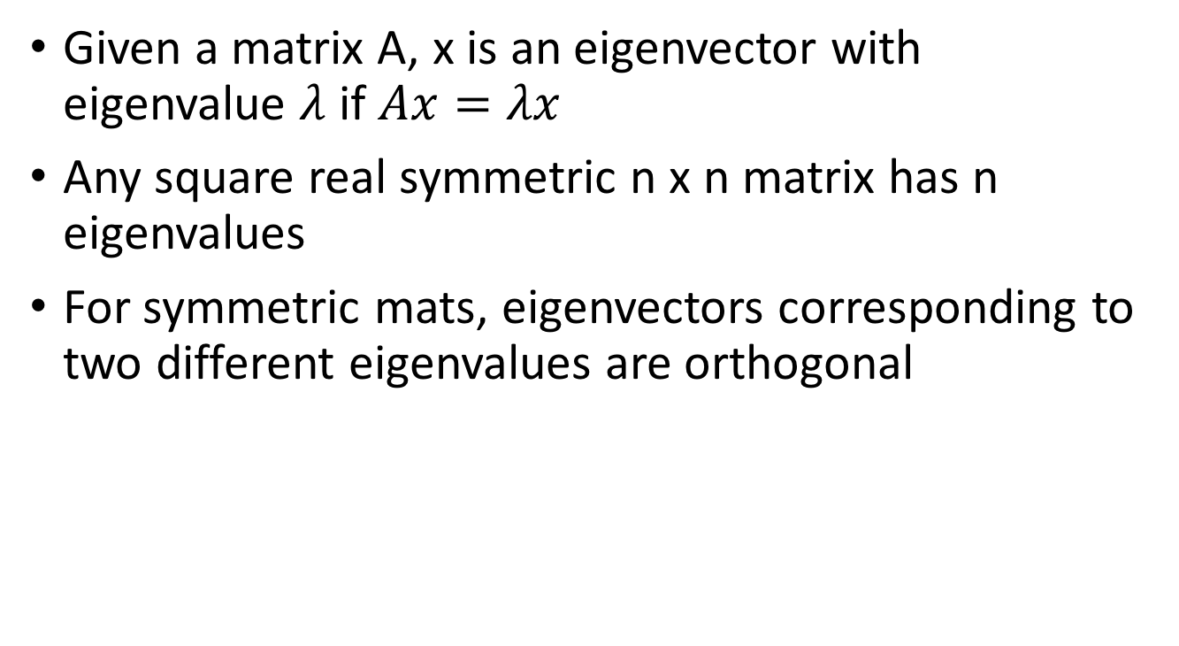
A quick detour into eigenvalues and eigenvectors
Given a matrix A, x is an eigenvector with eigenvalue $λ$ if $Ax=λx$
Any square real symmetric n x n matrix has n eigenvalues
For symmetric mats, eigenvectors corresponding to two different eigenvalues are orthogonal

Slide 16
Eigenvectors and the graph laplacian
We want
Trivial solution z₀: all nodes of graph in one cluster, nothing in the other
z0 is eigenvector with 0 eigenvalue
We want z^{T}z₀ = 0 and
Look for eigenvector with second-smallest eigenvalue

Slide 17
Normalized cuts
Approximate solution to normalized cuts
Construct matrix W and D
Construct normalized graph laplacian
Look for the second smallest eigenvector
Compute
Threshold y to get clusters
Ideally, sweep threshold to get lowest N-cut value

Slide 18
More than 2 clusters
Given graph, use N-cuts to get 2 clusters
Each cluster is a sub-graph
Re-run N-cuts on each sub-graph

Slide 19
Normalized cuts
NP Hard
But approximation using eigenvector of normalized graph laplacian
Smallest eigenvector : trivial solution
Second smallest eigenvector: good partition
Other eigenvectors: other partitions
An instance of “Spectral clustering”
Spectrum = set of eigenvalues
Spectral clustering = clustering using eigenvectors of (various versions of) graph laplacian

Slide 20
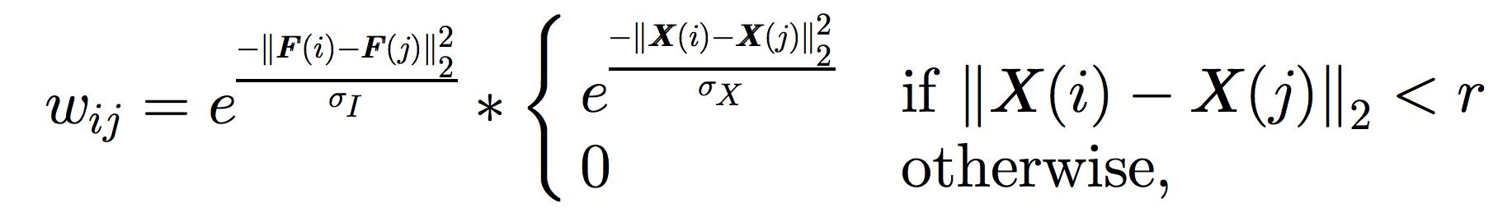
Images as graphs
Each pixel is a node
What is the edge weight between two nodes / pixels?
F(i): intensity / color of pixel i
X(i): position of pixel i

Slide 21
Computational complexity
A 100 x 100 image has 10K pixels
A graph with 10K pixels has a 10K x 10K affinity matrix
Eigenvalue computation of an N x N matrix is O(N³)
Very very expensive!

Slide 22



Eigenvectors of images
The eigenvector has as many components as pixels in the image
2nd Eigenvector
2nd Eigenvector

Slide 23


Recursive N-cuts
2nd eigenvector
First partition
2nd eigenvector of 1st subgraph
recursive partition

Slide 24


Eigenvectors as pixel representations
…
2nd eigenvector
3rd eigenvector
4th eigenvector

Slide 25
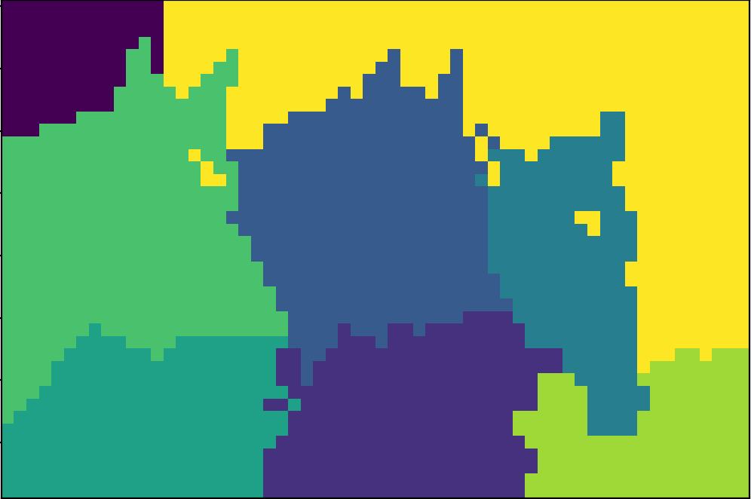
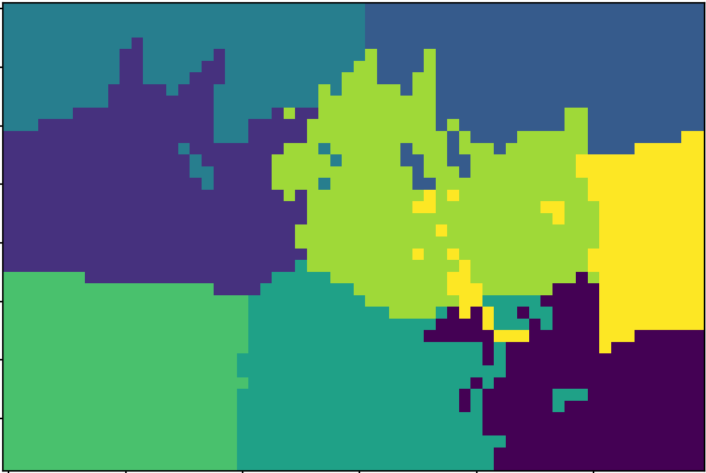
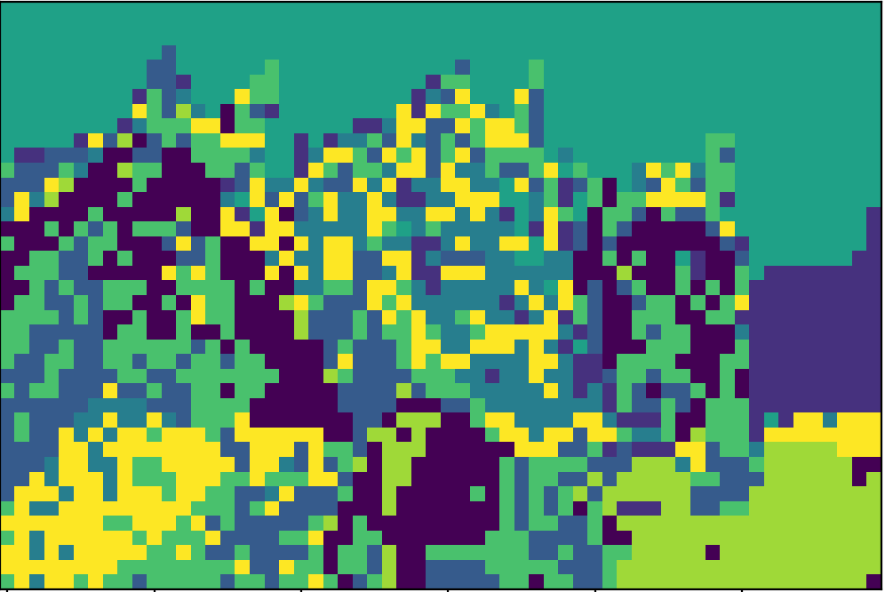
K-means
K-Means: Pixel represented using top 10 eigenvectors
K-Means: RGB + X,Y
K-Means: RGB

Slide 26
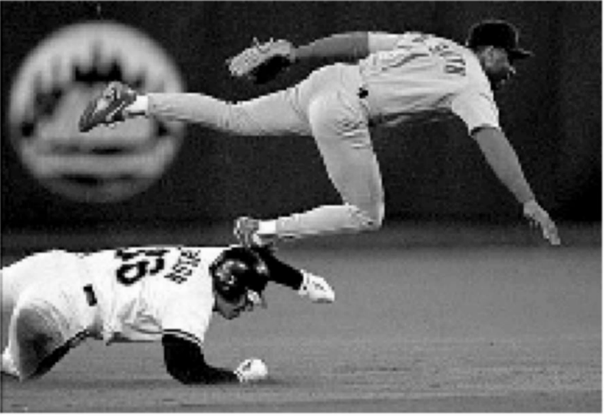
Another example

Slide 27
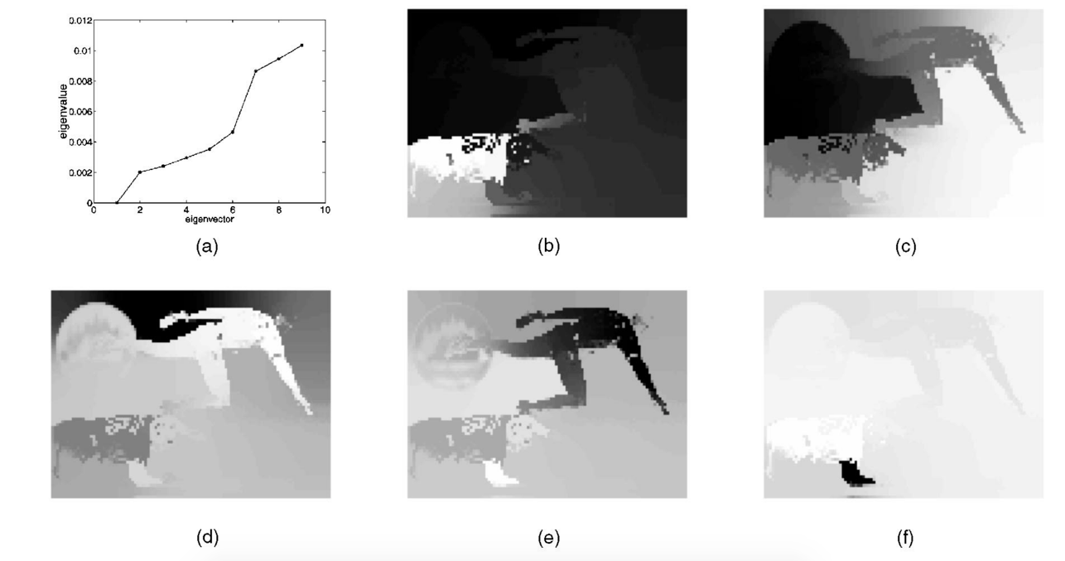
Eigenvectors of images

Slide 28
N-Cuts resources
http://scikit-learn.org/stable/modules/clustering.html#spectral-clustering
https://people.eecs.berkeley.edu/~malik/papers/SM-ncut.pdf

Slide 29
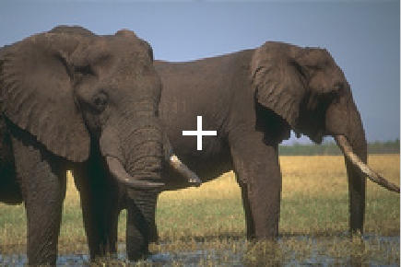
Images as graphs
Enhancement: edge between far away pixel, weight = 1 – magnitude of intervening contour

Slide 30
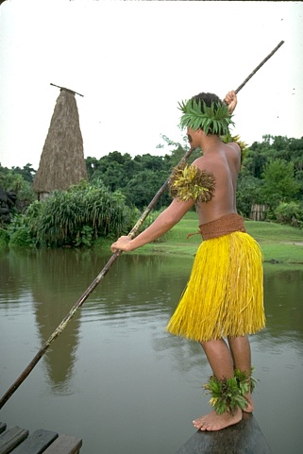
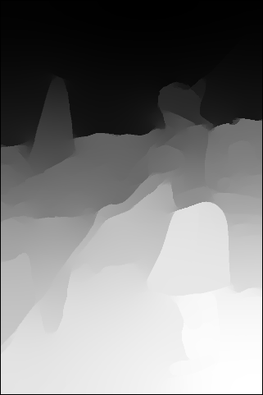
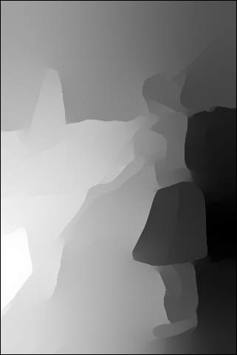
Eigenvectors of images

Slide 31
Grouping: a summary
Goal: group pixels into objects
Simple baselines based on color similarity and local reasoning: Canny, k-means
Complex solution to exploit contour continuity and global reasoning: N-Cuts
Challenges:
Texture
What is k?
Grouping still a research problem!

Slide 32
The correspondence problem

Slide 33
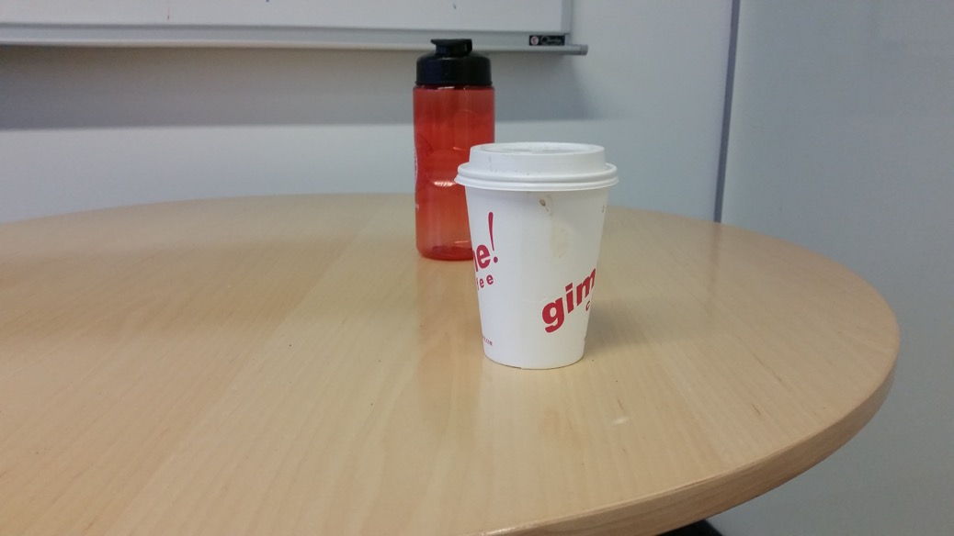
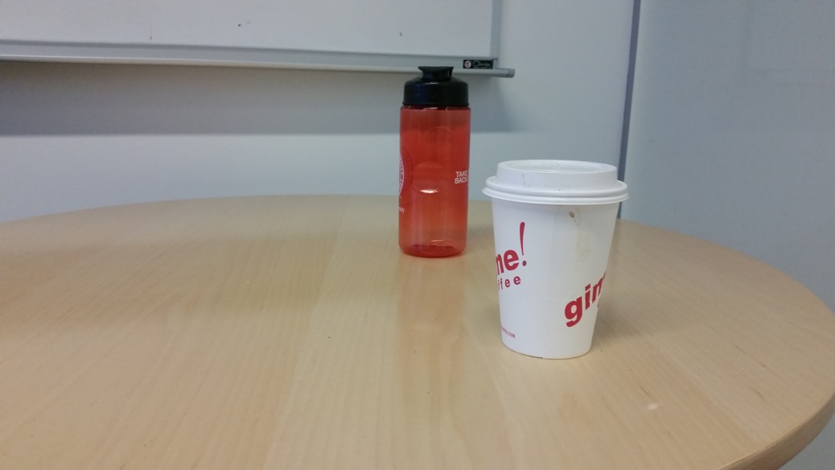
Why?
Multiple images can give a clue about 3D structure

Slide 34


Why? Reconstruction
Multiple images can give a clue about 3D structure

Slide 35

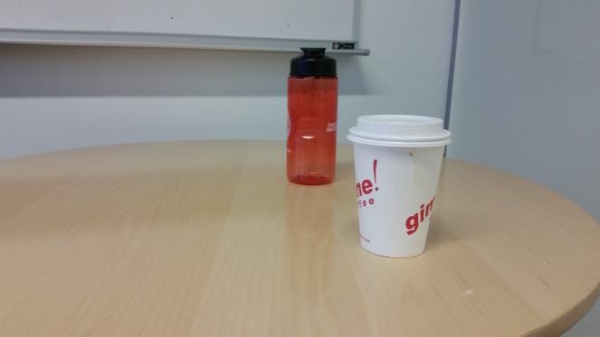
Why? Reconstruction
Need to find which pixel in image 2 matches which in image 1 - the correspondence problem

Slide 36
Reconstruction from correspondence
Given known cameras, correspondence gives the location of 3D point (Triangulation)

Slide 37
Reconstruction from correspondence
Given a 3D point, correspondence gives relationship between cameras (Pose estimation / camera calibration)

Slide 38
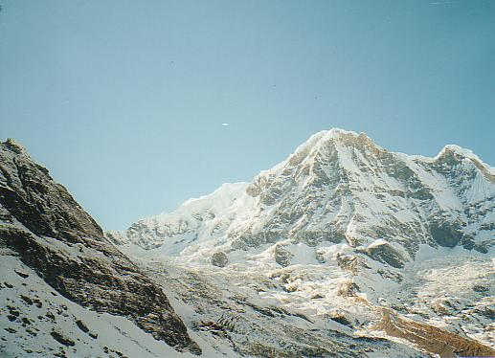
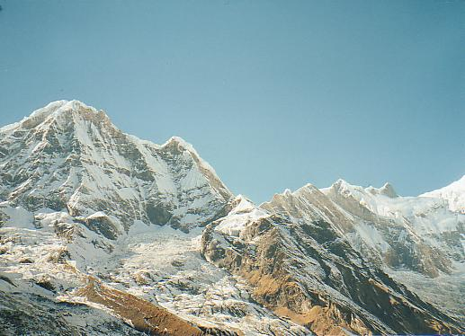
Pose-estimation / Camera calibration
Motivation: panorama stitching
We have two images – how do we combine them?

Slide 39
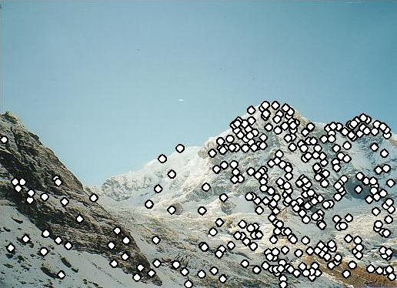
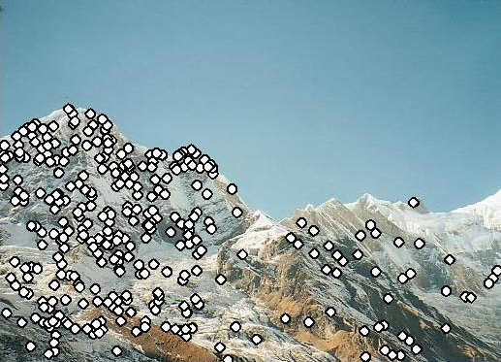
Pose-estimation / Camera calibration
Motivation: panorama stitching
We have two images – how do we combine them?
Step 1: extract correspondence

Slide 40
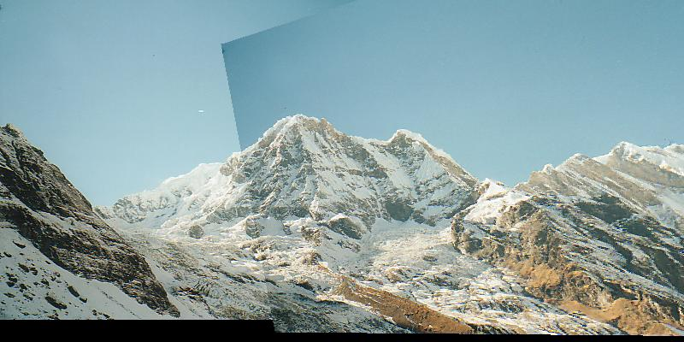
Pose-estimation / Camera calibration
Motivation: panorama stitching
We have two images – how do we combine them?
Step 1: extract correspondence
Step 2: align images

Slide 41
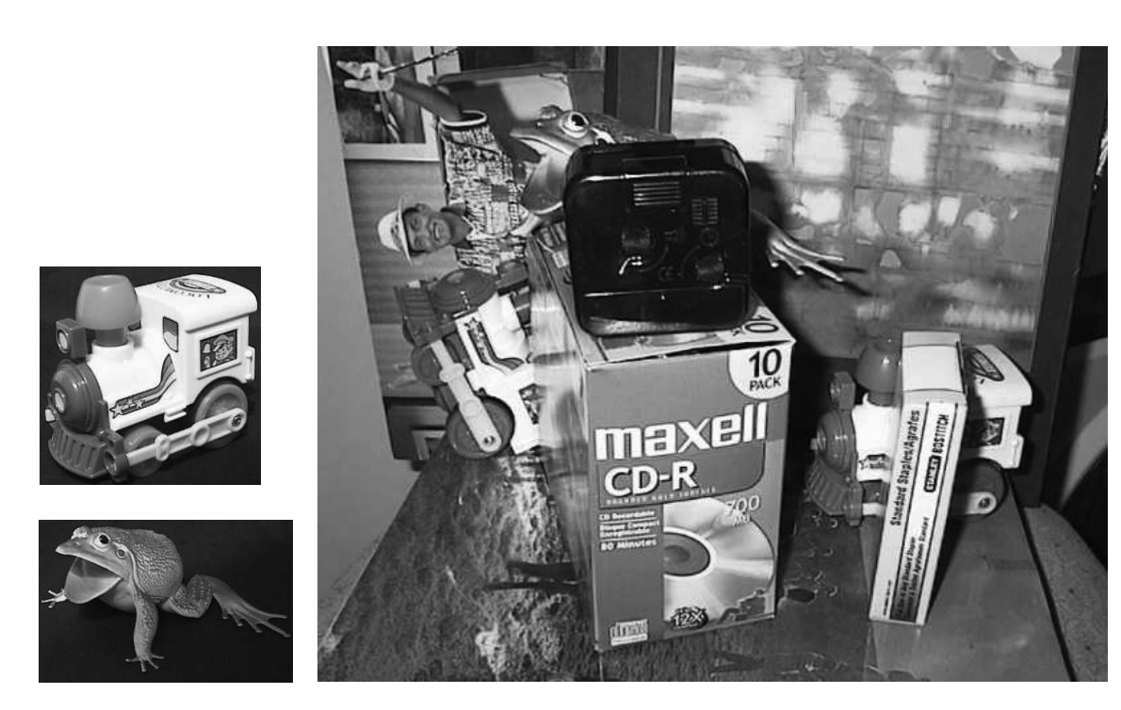
Why correspondence?
Recognition: Match image to product view
Lowe, IJCV 2004

Slide 42
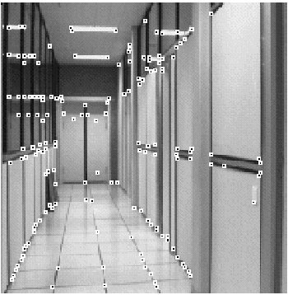
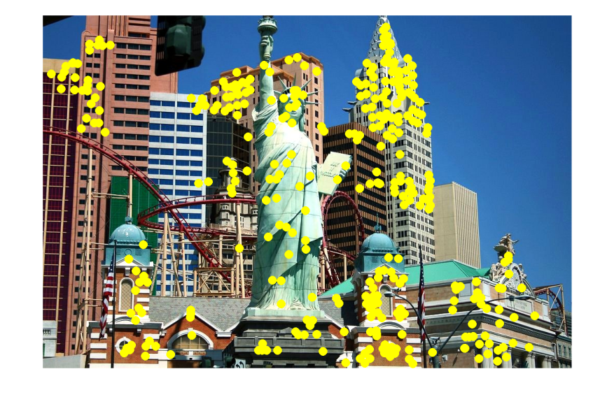
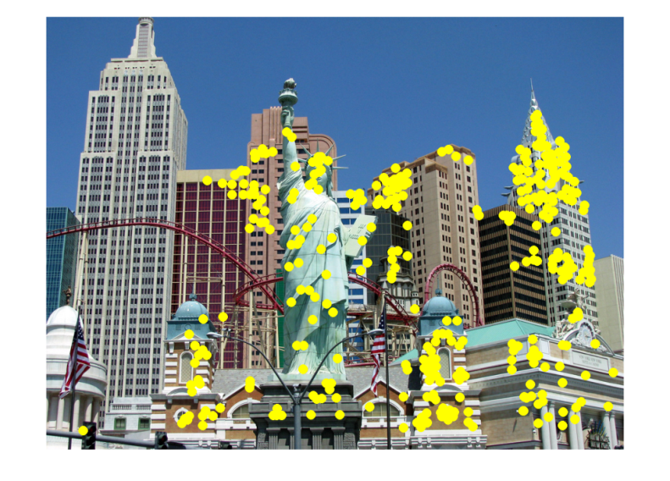
Other applications of correspondence
Image alignment
Motion tracking
Robot navigation

Slide 43
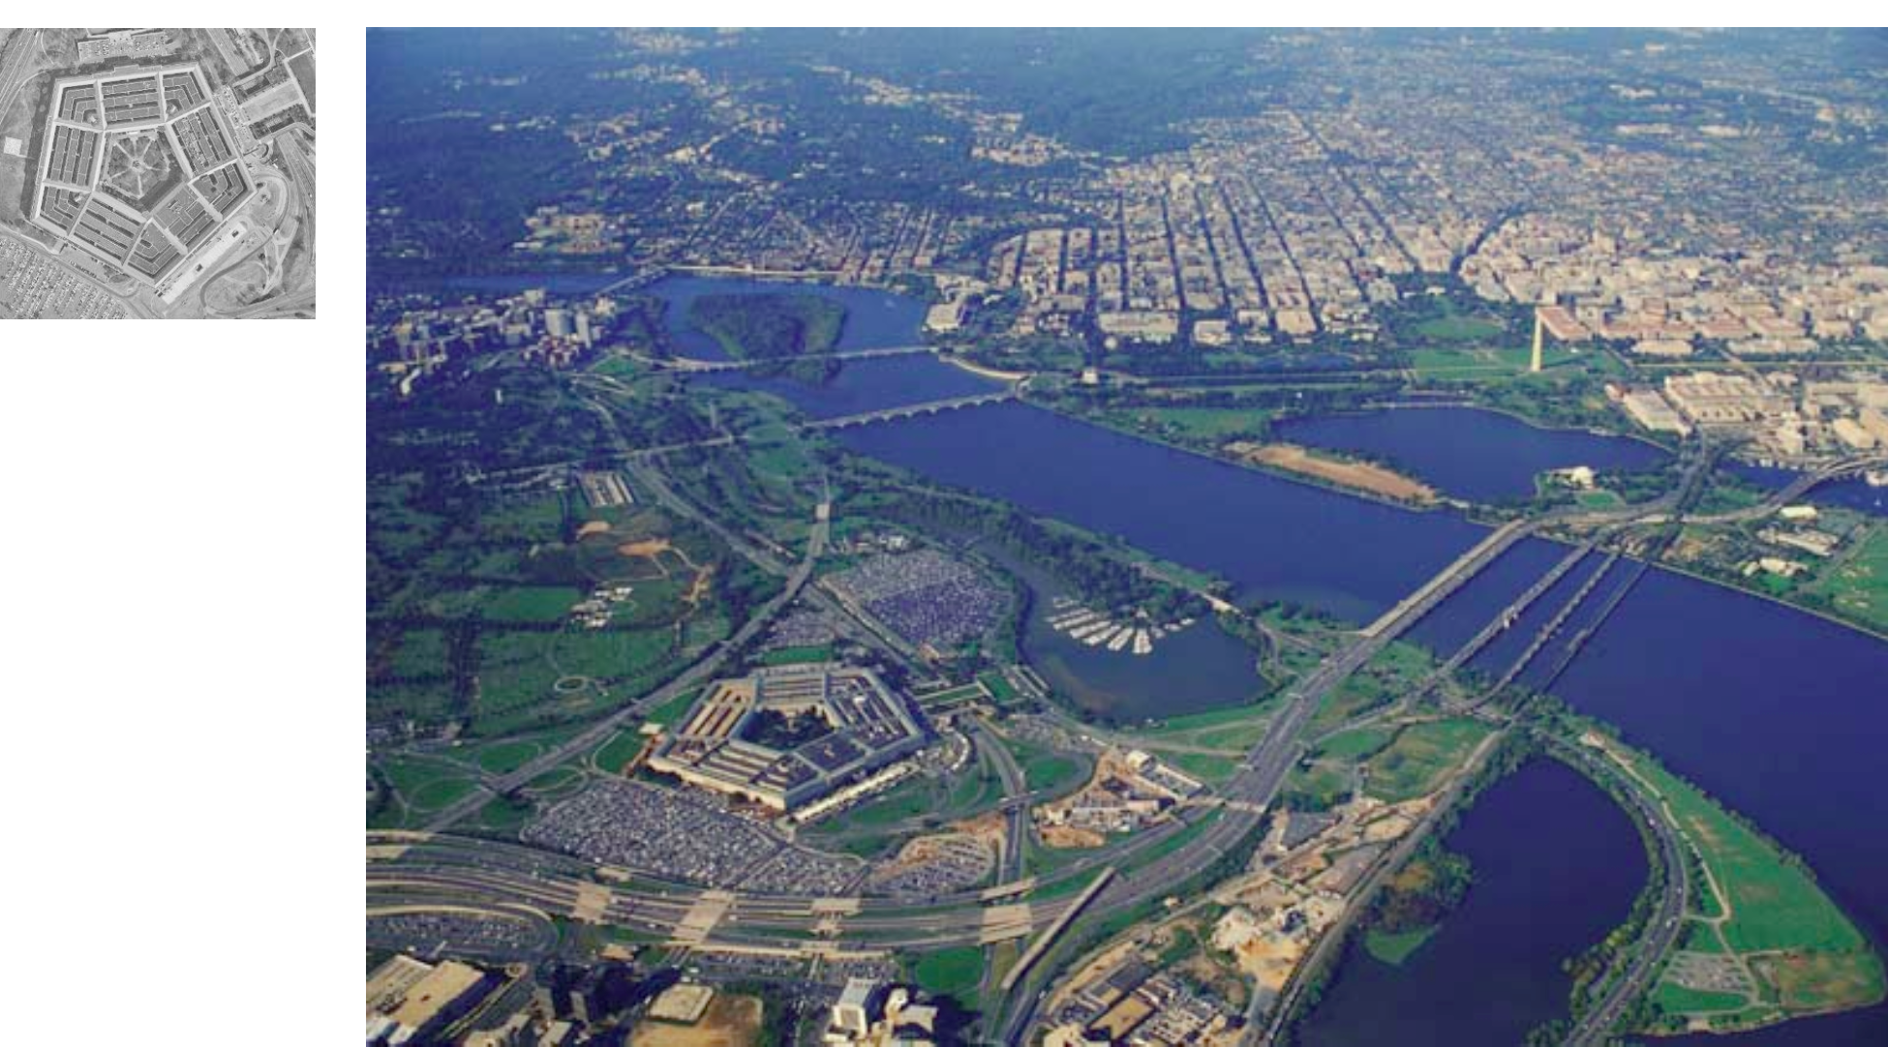
Correspondence can be challenging
Fei-Fei Li

Slide 44
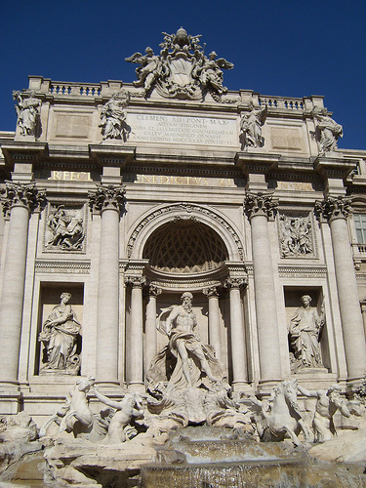
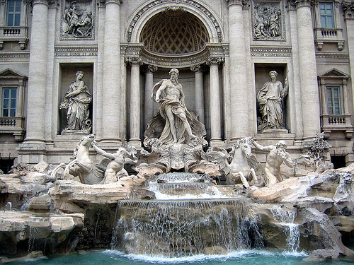
Correspondence
by Diva Sian
by swashford

Slide 45
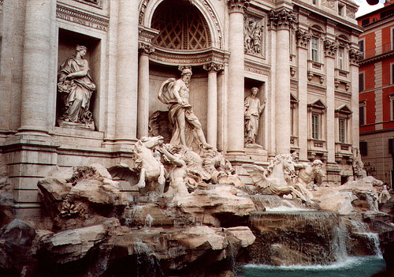
Harder case
by Diva Sian
by scgbt

Slide 46
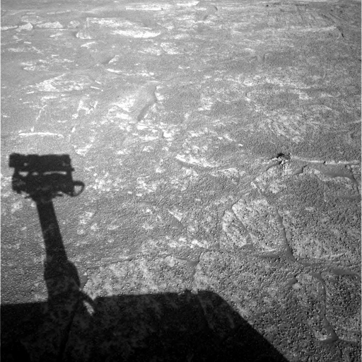
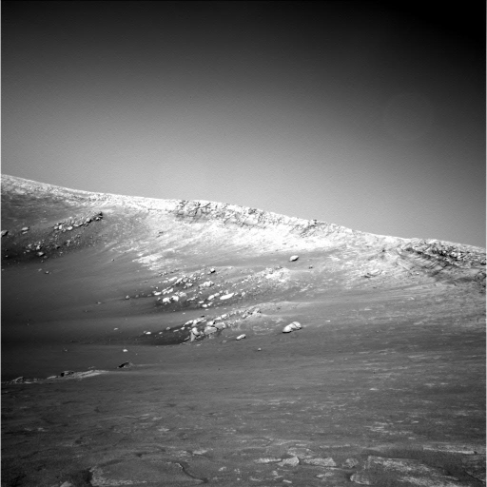
Harder still?

Slide 47
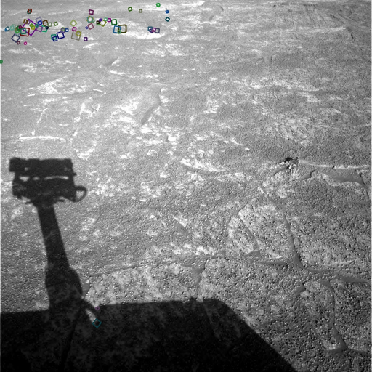
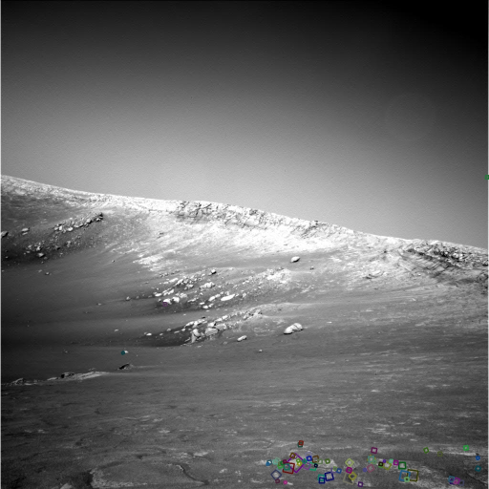
Answer below (look for tiny colored squares…)
NASA Mars Rover images
with SIFT feature matches

Slide 48
Sparse vs dense correspondence
Sparse correspondence: produce a few, high confidence matches
Good enough for estimating pose or relationship between cameras
Dense correspondence: try to match every pixel
Needed if we want 3D location of every pixel

Slide 49
Sparse correspondence
Which pixels should be searching correspondence for?
Feature points / keypoints

Slide 50
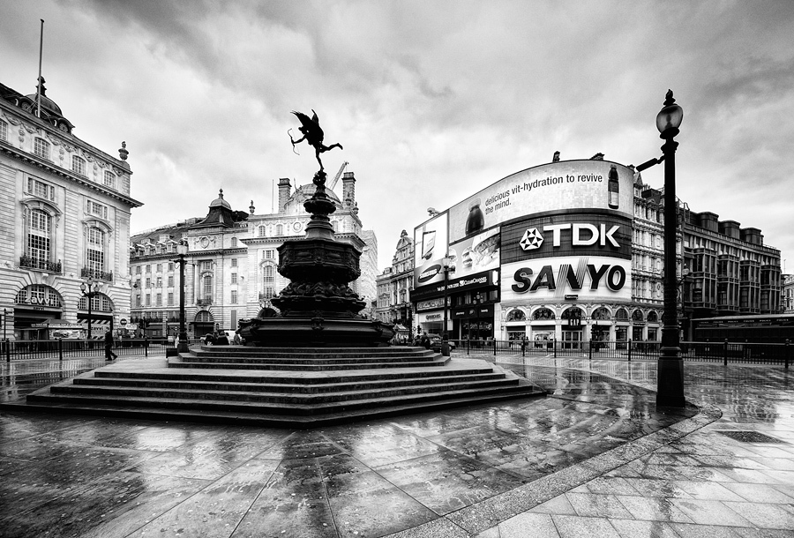
What makes a good feature point?
Snoop demo

Slide 51
Characteristics of good feature points
Repeatability / invariance
The same feature point can be found in several images despite geometric and photometric transformations
Saliency / distinctiveness
Each feature point is distinctive
Fewer ”false” matches

Slide 52
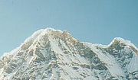

Goal: repeatability
We want to detect (at least some of) the same points in both images.
Yet we have to be able to run the detection procedure independently per image.
No chance to find true matches!
Kristen Grauman
Notes:
52

Slide 53
Repeatability / invariance

Slide 54
Goal: distinctiveness
The feature point should be distinctive enough that it is easy to match
Should at least be distinctive from other patches nearby
????

Slide 55
The aperture problem

Slide 56
The aperture problem
Individual pixels are ambiguous
Idea: Look at whole patches!

Slide 57
The aperture problem
Individual pixels are ambiguous
Idea: Look at whole patches!

Slide 58
The aperture problem
Some local neighborhoods are ambiguous

Slide 59
The aperture problem

