Slide 1
Grouping

Slide 2
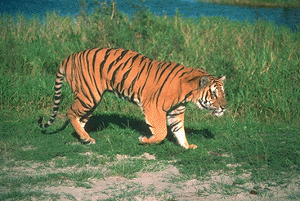
What is grouping?

Slide 3
K-means
Input: set of data points, k
Randomly pick k points as means
For i in [0, maxiters]:
  Assign each point to nearest center
  Re-estimate each center as mean of points assigned to it

Slide 4
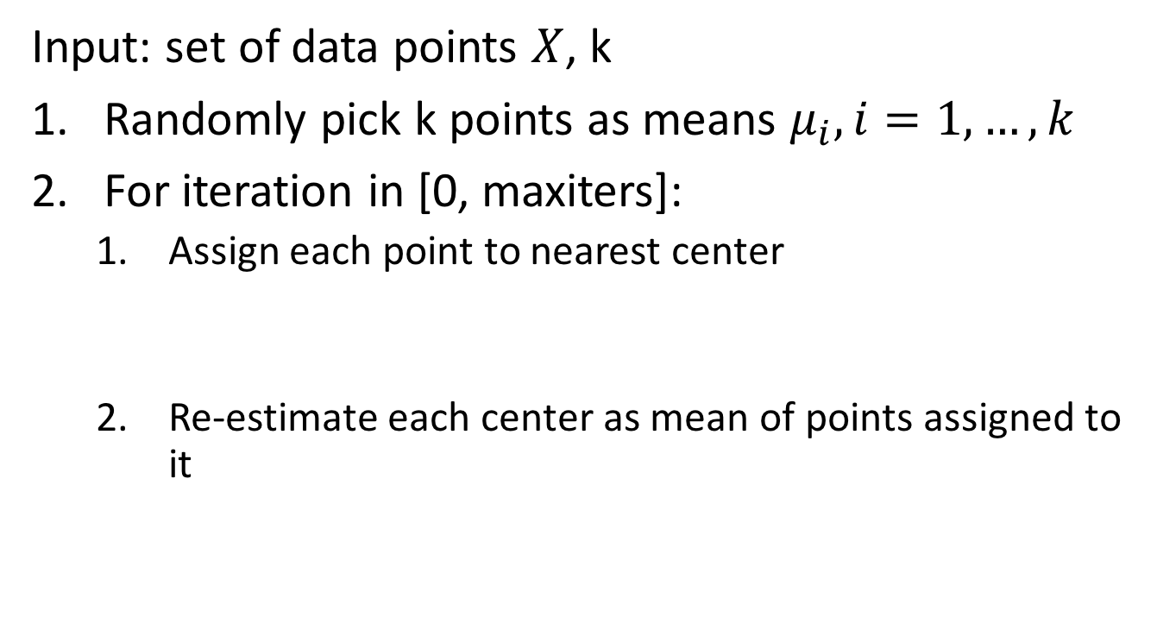
K-means - the math
Input: set of data points $X$, k
Randomly pick k points as means $μ_{i}, i=1,…, k$
For iteration in [0, maxiters]:
  Assign each point to nearest center
  Re-estimate each center as mean of points assigned to it

Slide 5
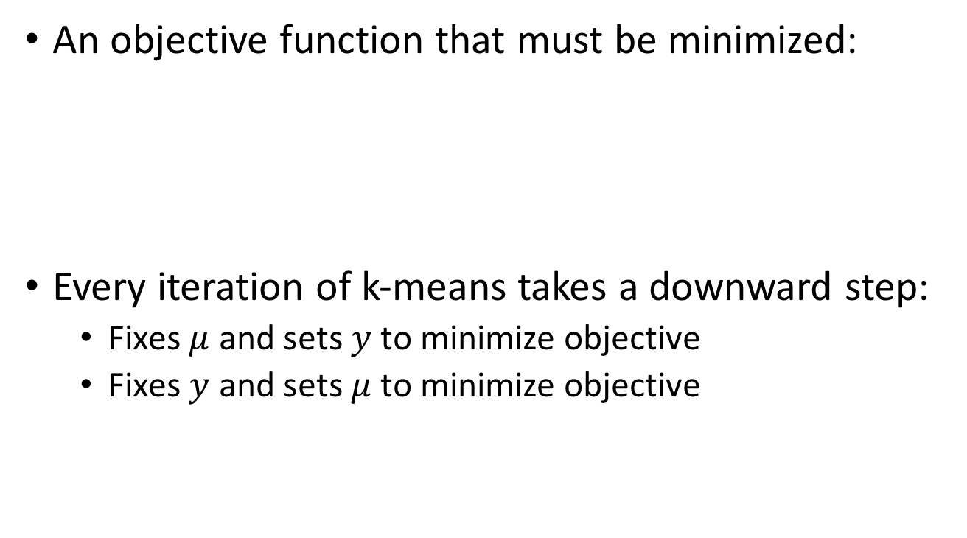
K-means - the math
An objective function that must be minimized:
Every iteration of k-means takes a downward step:
  Fixes $μ$ and sets $y$ to minimize objective
  Fixes $y$ and sets $μ$ to minimize objective

Slide 6

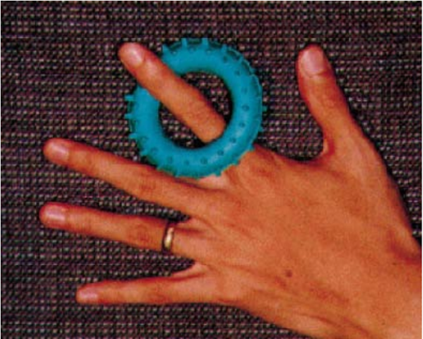
K-means on image pixels

Slide 7
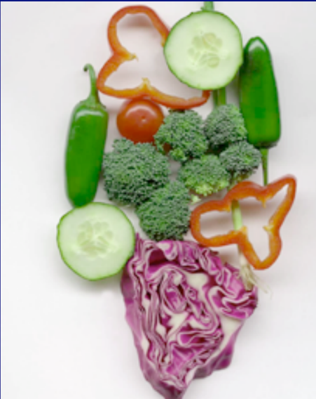
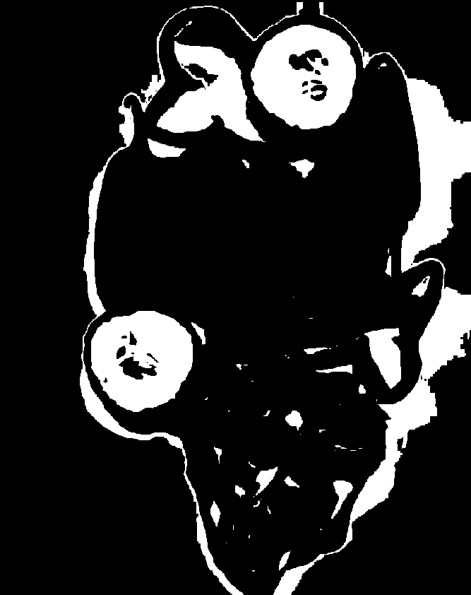
K-means on image pixels
Picture courtesy David Forsyth
One of the clusters from k-means

Slide 8

K-means on image pixels
What is wrong?
Pixel position
  Nearby pixels are likely to belong to the same object
  Far-away pixels are likely to belong to different objects
How do we incorporate pixel position?
  Instead of representing each pixel as (r,g,b)
  Represent each pixel as (r,g,b,x,y)

Slide 9

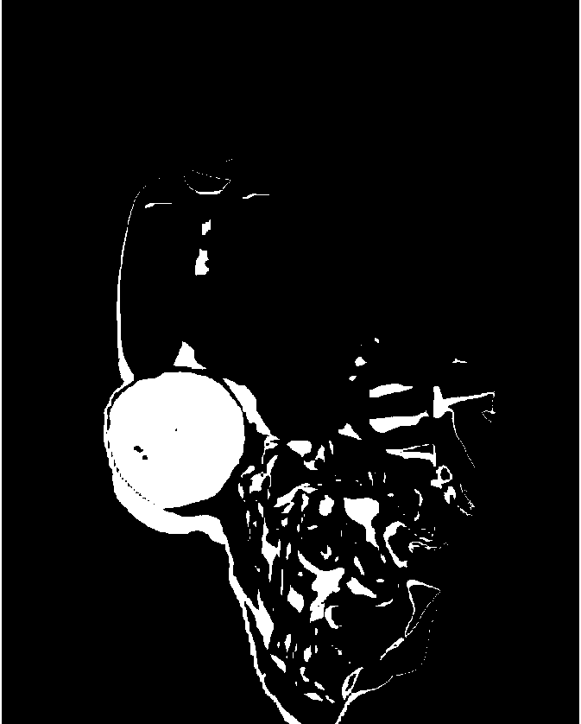
K-means on image pixels

Slide 10
The issues with k-means
Captures pixel similarity but
  Doesn’t capture continuity
  Captures proximity only weakly
  Can merge far away objects together
Requires knowledge of k!

Slide 11
Oversegmentation and superpixels
We don’t know k. What is a safe choice?
Idea: Use large k
  Can potentially break big objects, but will hopefully not merge unrelated objects
  Later processing can decide which groups to merge
  Called superpixels

Slide 12
Regions Boundaries

Slide 13
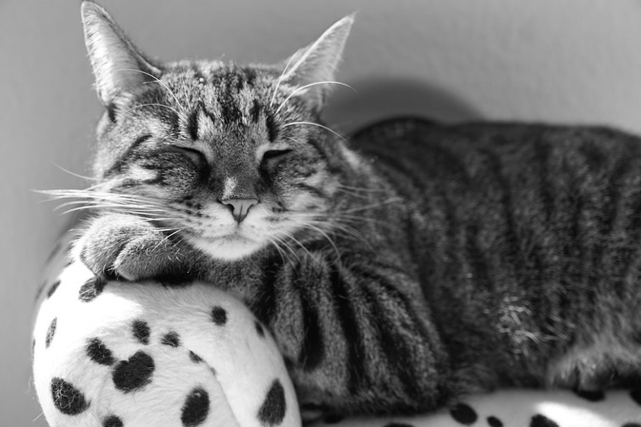
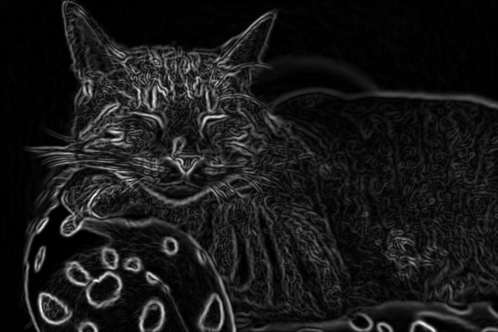
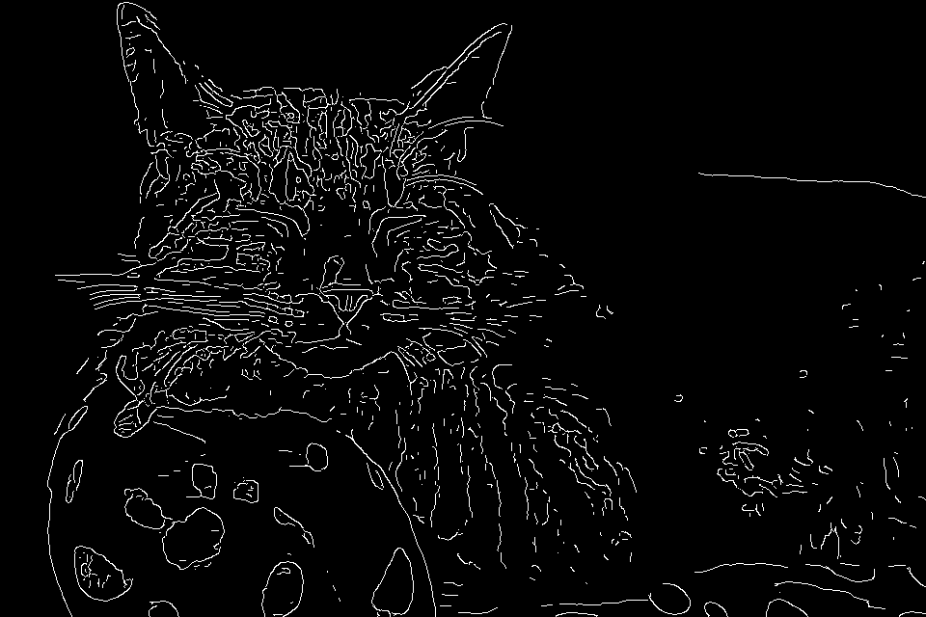
Does Canny always work?

Slide 14


The aperture problem

Slide 15
The aperture problem

Slide 16
“Globalisation”

Slide 17
Images as graphs
Each pixel is node
Edge between “similar pixels”
  Proximity: nearby pixels are more similar
  Similarity: pixels with similar color are more similar
Weight of edge = similarity

Slide 18
Segmentation is graph partitioning

Slide 19
Segmentation is graph partitioning
Every partition “cuts” some edges
Idea: minimize total weight of edges cut!

Slide 20
Criterion: Min-cut?
Min-cut carves out small isolated parts of the graph
In image segmentation: individual pixels

Slide 21
Normalized cuts
“Cut” = total weight of cut edges
Small cut means the groups don’t “like” each other
But need to normalize w.r.t how much they like themselves
“Volume” of a subgraph = total weight of edges within the subgraph

Slide 22
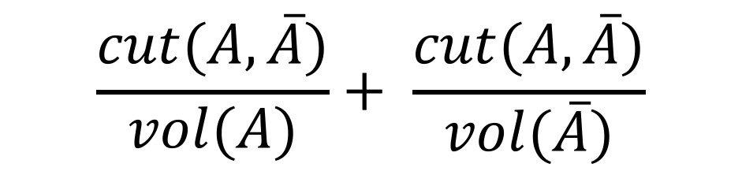
Normalized cut
$$\frac{cut(A, \overline{A})}{vol(A)}+ \frac{cut(A,\overline{A})}{vol(\overline{A})}$$

Slide 23
Min-cut vs normalized cut
Both rely on interpreting images as graphs
By itself, min-cut gives small isolated pixels
  But can work if we add other constraints
min-cut can be solved in polynomial time
  Dual of max-flow
N-cut is NP-hard
  But approximations exist!

Slide 24
Random walk

Slide 25
Random walk

Slide 26
Random walk

Slide 27
Random walk
Given that ghosts inhabit set A, how likely are they to stay in A?

Slide 28
Random walk
Given that ghosts inhabit set A, how likely are they to stay in A?

Slide 29
Random walk
Given that ghosts inhabit set A, how likely are they to stay in A?

Slide 30
Random walk
Given that ghosts inhabit set A, how likely are they to stay in A?

Slide 31
Random walk
Key idea: Partition should be such that ghost should be likely to stay in one partition
Normalized cut criterion is the same as this
But how do we find this partition?

Slide 32

Graphs and matrices
w(i,j) = weight between i and j (Affinity matrix)
d(i) = degree of i =$\sum_{j}{w(i,j)}$
D = diagonal matrix with d(i) on diagonal
W
N
D
N
N
N

Slide 33
Graphs and matrices
1
6
2
7
3
4
8
9
5
0
W

Slide 34
Graphs and matrices
1
6
2
7
3
4
8
9
5
W
0
E = D⁻¹W

Slide 35
Graphs and matrices
How do we represent a clustering?
A label for N nodes
  1 if part of cluster A, 0 otherwise
An N-dimensional vector!
v₁
0:
1:
2:
3:
4:
5:
6:
7:
8:
9:
1
1
1
1
1
0
0
0
0
0
1
6
2
7
3
4
8
9
5
0

Slide 36
Graphs and matrices
How do we represent a clustering?
A label for N nodes
  1 if part of cluster A, 0 otherwise
An N-dimensional vector!
v₁
v₂
0:
1:
2:
3:
4:
5:
6:
7:
8:
9:
1
1
1
1
1
0
0
0
0
0
0
0
0
0
0
1
1
1
1
1
1
6
2
7
3
4
8
9
5
0

Slide 37
Graphs and matrices
How do we represent a clustering?
A label for N nodes
  1 if part of cluster A, 0 otherwise
An N-dimensional vector!
v₁
v₂
v₃
0:
1:
2:
3:
4:
5:
6:
7:
8:
9:
1
1
1
1
1
0
0
0
0
0
0
0
1
1
1
1
1
0
0
0
0
0
1
1
1
1
1
0
0
0
1
6
2
7
3
4
8
9
5
0

Slide 38
Graphs and matrices
v₁
1
6
0:
1:
2:
3:
4:
5:
6:
7:
8:
9:
1
1
1
1
1
0
0
0
0
0
2
7
3
4
8
9
5
0
E = D⁻¹W

Slide 39
Graphs and matrices
v₁
Ev₁
0:
1:
2:
3:
4:
5:
6:
7:
8:
9:
1
1
1
1
1
0
0
0
0
0
1
1
1
1
1
0
0
0
0
0
E = D⁻¹W

Slide 40
Graphs and matrices
v₂
Ev₂
0:
1:
2:
3:
4:
5:
6:
7:
8:
9:
0
0
0
0
0
1
1
1
1
1
0
0
0
0
0
1
1
1
1
1
E = D⁻¹W

Slide 41
Graphs and matrices
v₃
Ev₃
0:
1:
2:
3:
4:
5:
6:
7:
8:
9:
0
0
1
1
1
1
1
0
0
0
0.7
0.8
0.6
0.5
0.6
0.3
0.2
0.5
0.5
0.7
E = D⁻¹W

Slide 42
Graphs and matrices
1
6
2
7
3
4
8
9
5
0
E = D⁻¹W

Slide 43
Graphs and matrices
v₁
Ev₁
0:
1:
2:
3:
4:
5:
6:
7:
8:
9:
1
1
1
1
1
0
0
0
0
0
1
1
1
1
1
0
0
0.2
0
0
E = D⁻¹W

Slide 44
Graphs and matrices
Define z so that

Slide 45
Graphs and matrices
is called the Normalized Graph Laplacian

Slide 46
Graphs and matrices
We want
Trivial solution: all nodes of graph in one cluster, nothing in the other
To avoid trivial solution, look for the eigenvector with the second smallest eigenvalue
Find z s.t.

Slide 47
Normalized cuts
Approximate solution to normalized cuts
Construct matrix W and D
Construct normalized graph laplacian
Look for the second smallest eigenvector
Compute
Threshold y to get clusters
  Ideally, sweep threshold to get lowest N-cut value

Slide 48
More than 2 clusters
Given graph, use N-cuts to get 2 clusters
Each cluster is a graph
  Re-run N-cuts on each graph

Slide 49
Normalized cuts
NP Hard
But approximation using eigenvector of normalized graph laplacian
  Smallest eigenvector : trivial solution
  Second smallest eigenvector: good partition
  Other eigenvectors: other partitions
An instance of “Spectral clustering”
  Spectrum = set of eigenvalues
  Spectral clustering = clustering using eigenvectors of (various versions of) graph laplacian

Slide 50
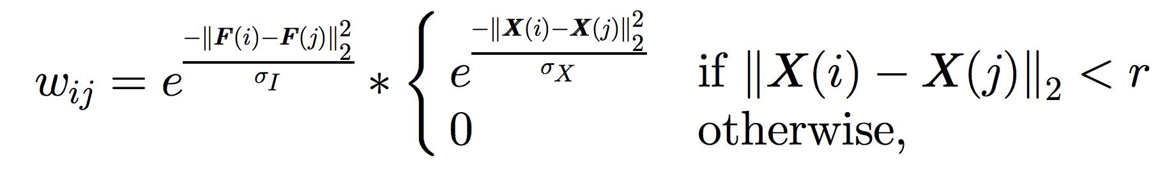
Images as graphs
Each pixel is a node
What is the edge weight between two nodes / pixels?
  F(i): intensity / color of pixel i
  X(i): position of pixel i

Slide 51
Computational complexity
A 100 x 100 image has 10K pixels
A graph with 10K pixels has a 10K x 10K affinity matrix
Eigenvalue computation of an N x N matrix is O(N³)
Very very expensive!

Slide 52
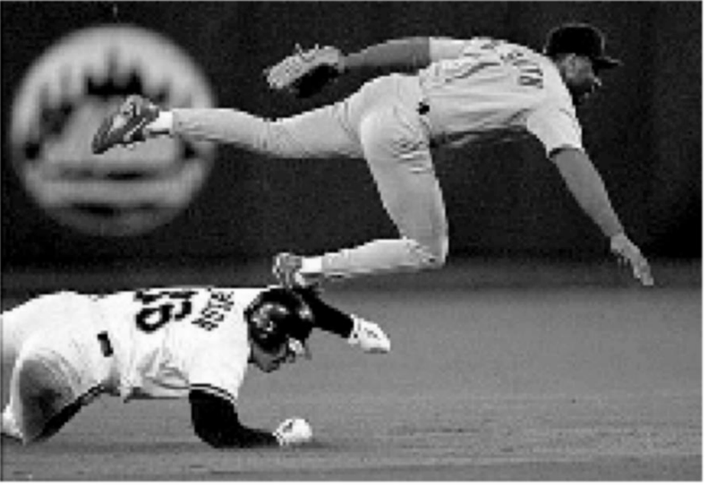
Eigenvectors of images
The eigenvector has as many components as pixels in the image

Slide 53
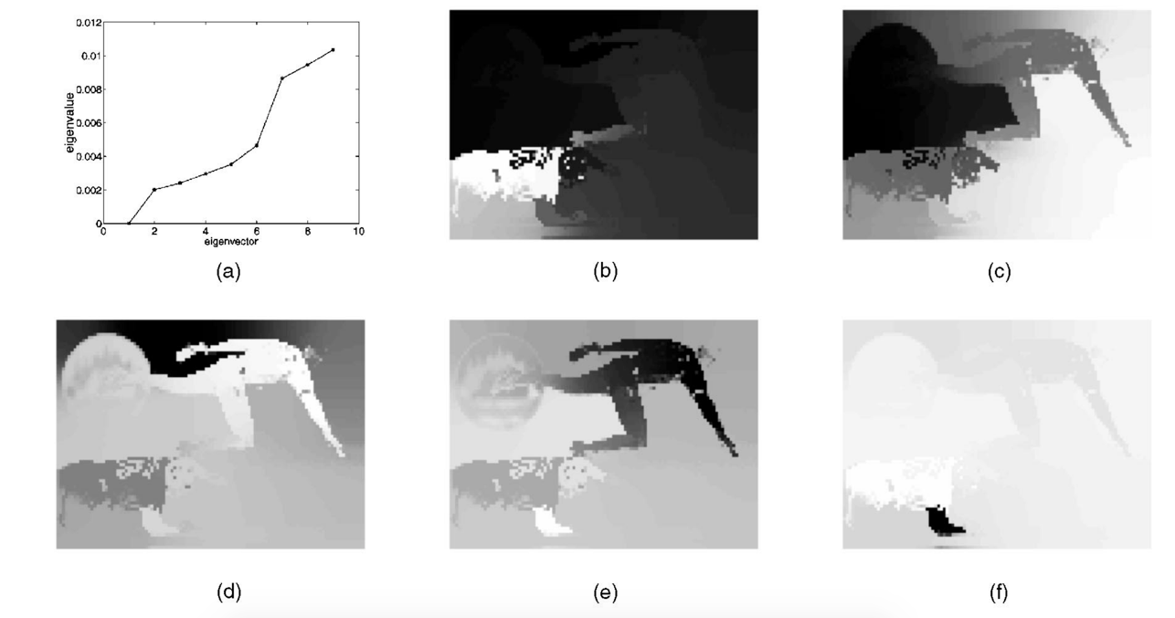
Eigenvectors of images
The eigenvector has as many components as pixels in the image

Slide 54




Another example
2nd eigenvector
3rd eigenvector
4th eigenvector

Slide 55



Recursive N-cuts
2nd eigenvector
First partition
2nd eigenvector of 1st subgraph
recursive partition

Slide 56
N-Cuts resources
http://scikit-learn.org/stable/modules/clustering.html#spectral-clustering
https://people.eecs.berkeley.edu/~malik/papers/SM-ncut.pdf

Slide 57
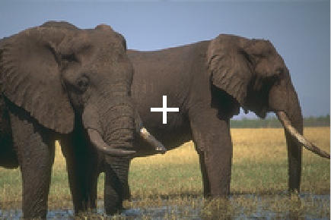
Images as graphs
Enhancement: edge between far away pixel, weight = 1 – magnitude of intervening contour

Slide 58
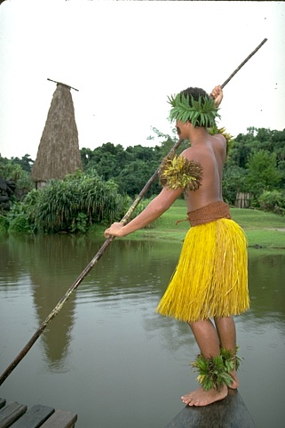
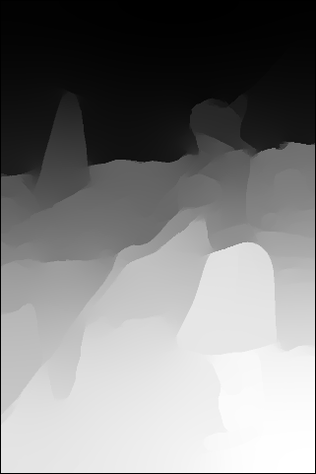
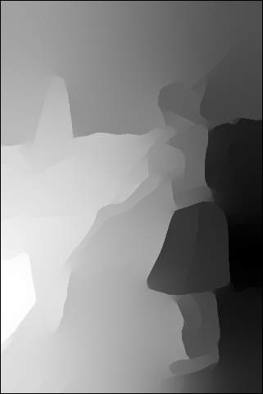
Eigenvectors of images

