Slide 1
Pyramids

Slide 2
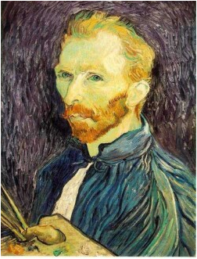







Gaussian pre-filtering
Solution: filter the image, then subsample
F₀
F₁
F₂
…
blur
subsample
blur
subsample
F₀ H
F₁ H
*
*

Slide 3
{
Gaussian pyramid
F₀
F₁
F₂
…
blur
subsample
blur
subsample
F₀ H
F₁ H
*
*

Slide 4
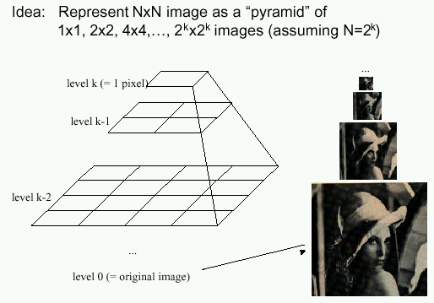
Gaussian pyramids
[Burt and Adelson, 1983]
In computer graphics, a mip map [Williams, 1983]
Gaussian Pyramids have all sorts of applications in computer vision
Source: S. Seitz

Slide 5
Gaussian pyramids - Searching over scales

Slide 6
Gaussian pyramids - Searching over scales

Slide 7
The Gaussian Pyramid
Low resolution
blur
sub-sample
blur
sub-sample
sub-sample
blur
sub-sample
blur
High resolution

Slide 8
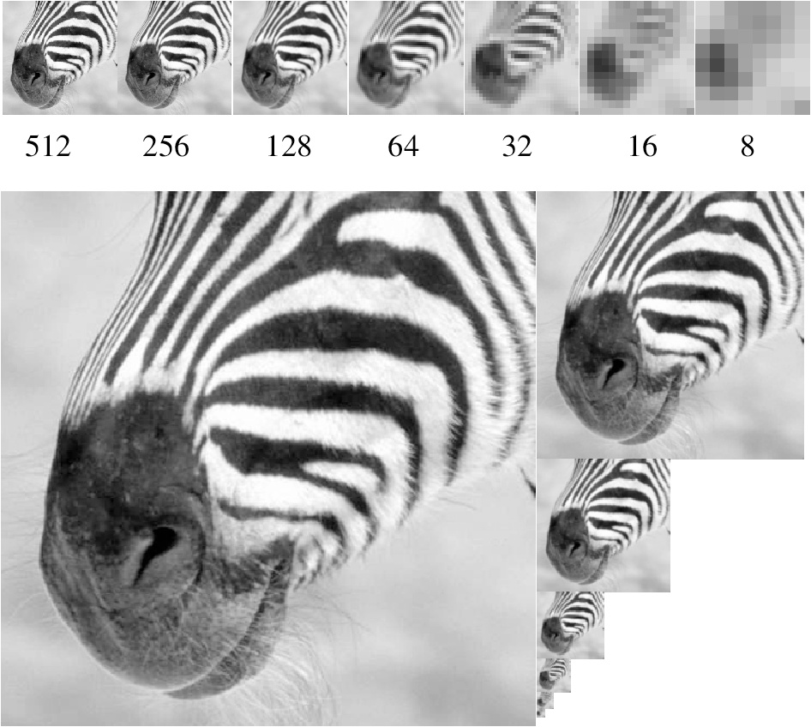
Gaussian pyramid and stack
Source: Forsyth

Slide 9
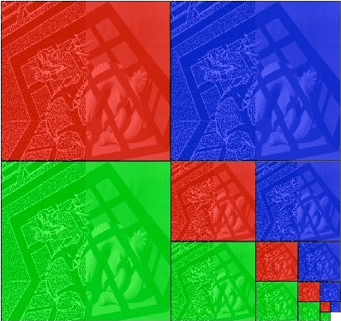
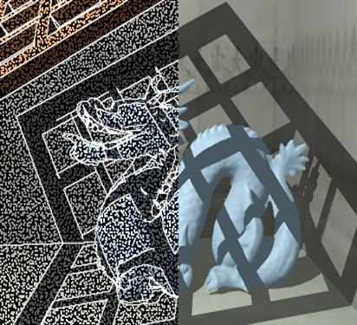
Memory Usage
What is the size of the pyramid?
Notes:
4/3

Slide 10





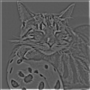

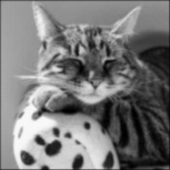
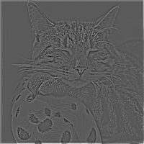


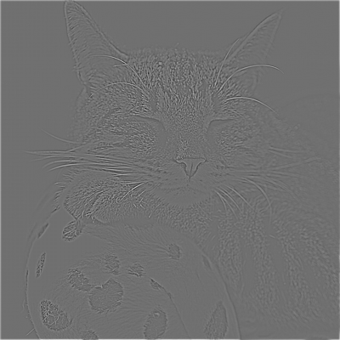
Laplacian pyramid
Expand (upsample + blur)
-
=
Expand (upsample + blur)
-
=
Expand (upsample + blur)
Re-duce
-
=
Expand (upsample + blur)
-
=

Slide 11
Laplacian pyramid
L₄ = G₄ =
L₃ = G₃ - expand(G₄) =
L₂ = G₂ - expand(G₃) =
L₁ = G₁ - expand(G₂) =
L₀ = G₀ - expand(G₁) =

Slide 12
Reconstructing the image from a Laplacian pyramid
Expand (upsample + blur)
+
=
Expand (upsample + blur)
+
=
Expand (upsample + blur)
+
=
Expand (upsample + blur)
+
=

Slide 13
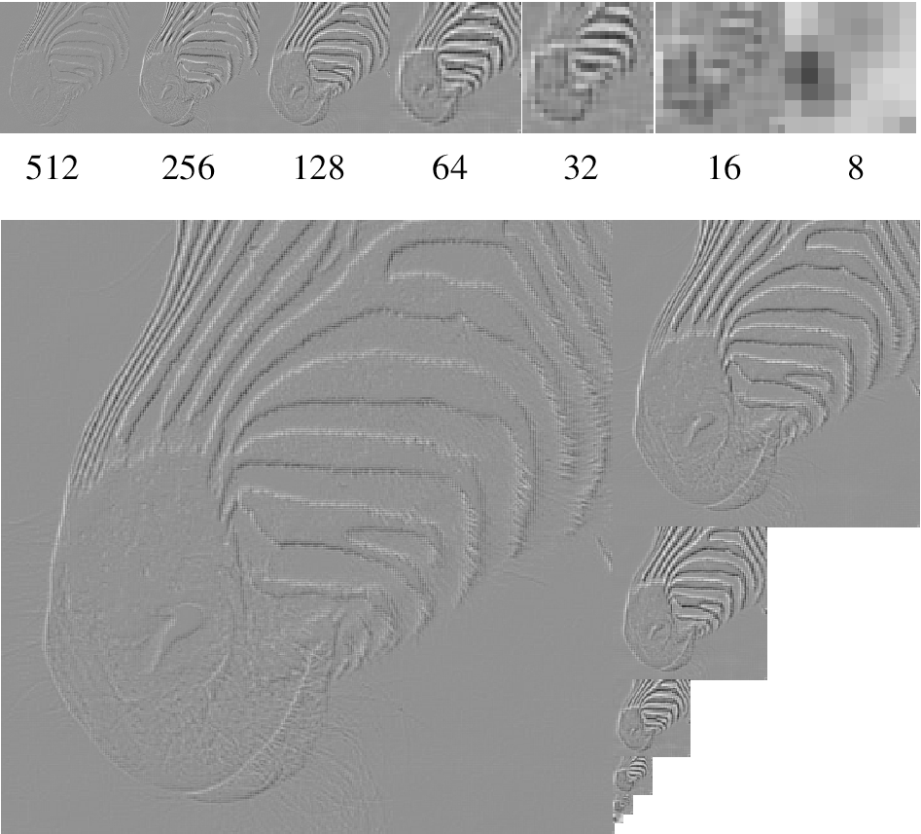
Laplacian pyramid
Source: Forsyth

Slide 14
Edge detection

Slide 15
Why edges?
Resilience to lighting and color
  useful for recognition, matching patches across images

Slide 16
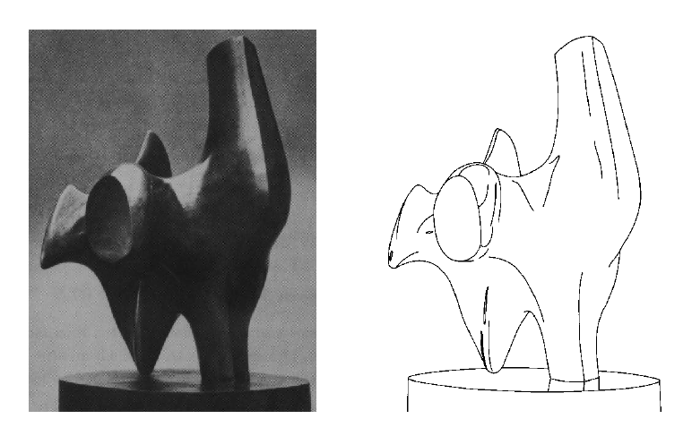
Why edges?
Humans are sensitive to edges
Convert a 2D image into a set of curves
  Extracts salient features of the scene, more compact
TexPoint fonts used in EMF.
Read the TexPoint manual before you delete this box.: AAA

Slide 17
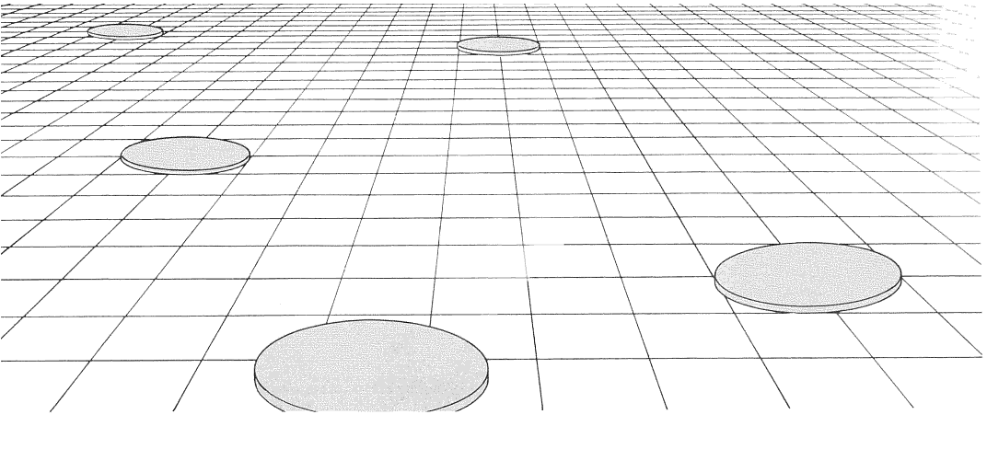
Why edges?
Cue to shape and geometry
  useful for recognition, understanding 3D structure
Credit: Jitendra Malik
Credit: Attneave

Slide 18
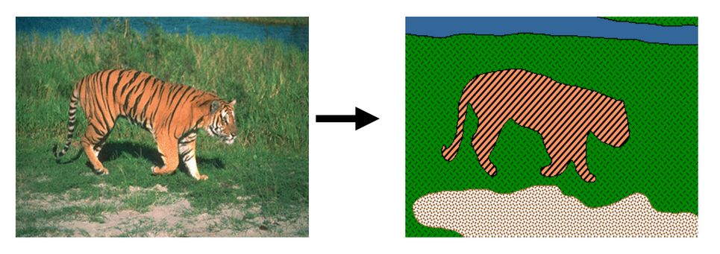
Why edges?
Grouping pixels into objects (“perceptual organization”)

Slide 19
This lecture
Edge detection in general
Edge detection for grouping

Slide 20
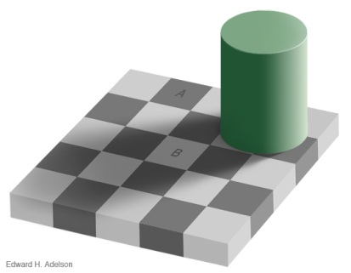
Edges
Edges are curves in the image, across which the brightness changes “a lot”
Corners/Junctions
Notes:
Reflctance edges
Shadow edges
Depth edges
Normal edges

Slide 21
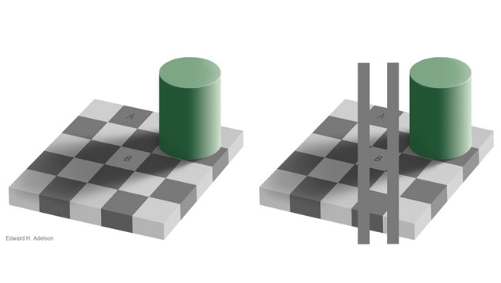
Aside

Slide 22
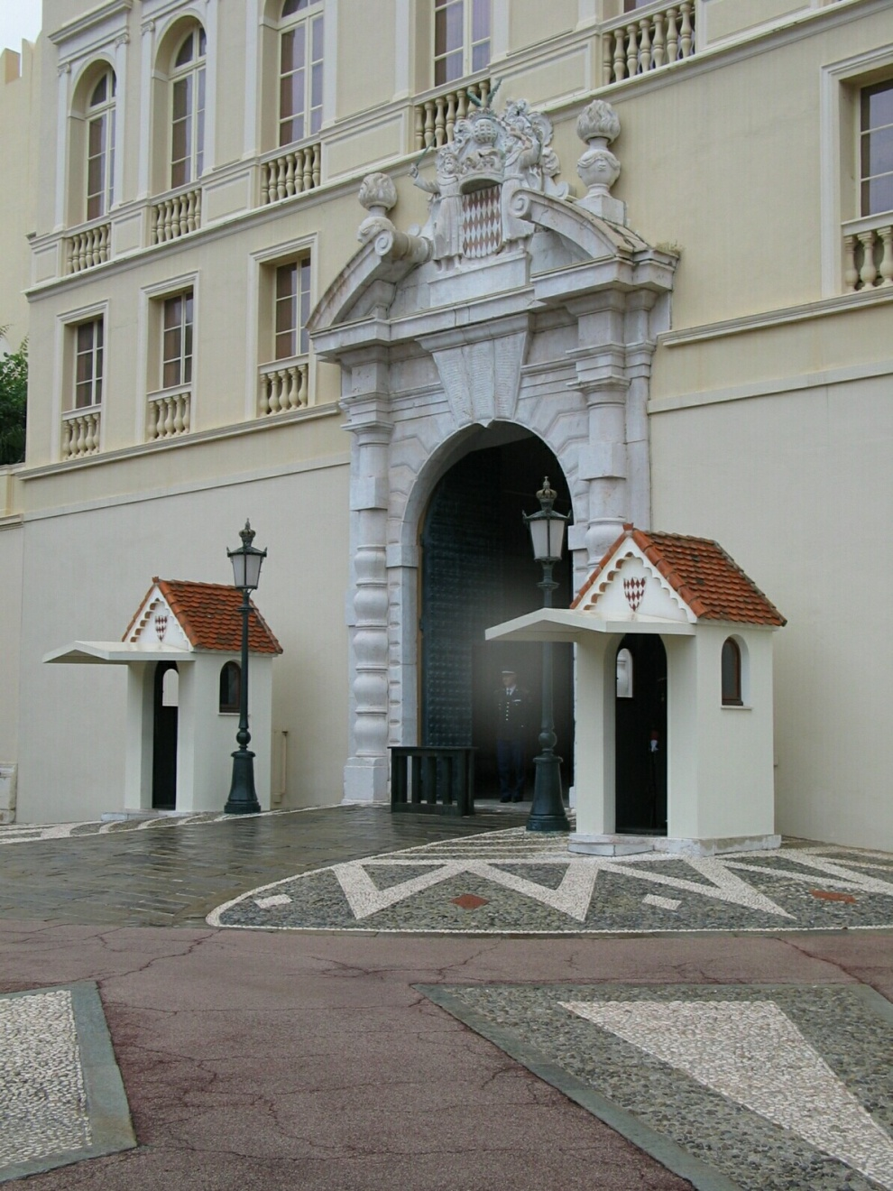
Closeup of edges
Source: D. Hoiem

Slide 23
Closeup of edges
Source: D. Hoiem

Slide 24
Closeup of edges
Source: D. Hoiem

Slide 25
Closeup of edges
Source: D. Hoiem

Slide 26

Characterizing edges
An edge is a place of rapid change in the image intensity function
intensity function
(along horizontal scanline)
image
first derivative
edges correspond to
extrema of derivative
Source: L. Lazebnik

Slide 27
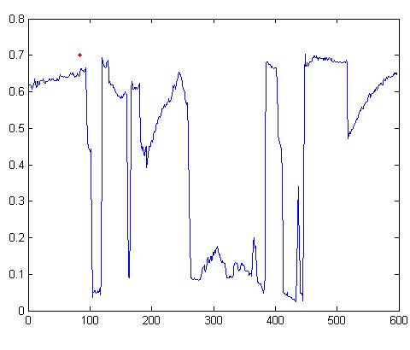

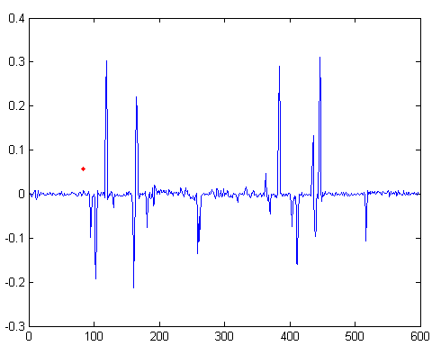
Intensity profile
Source: D. Hoiem

Slide 28
Derivatives and convolution
Differentiation is linear
Differentiation is shift-invariant
  Derivative of shifted signal is shifted derivative
Hence, differentiation can be represented as convolution!

Slide 29
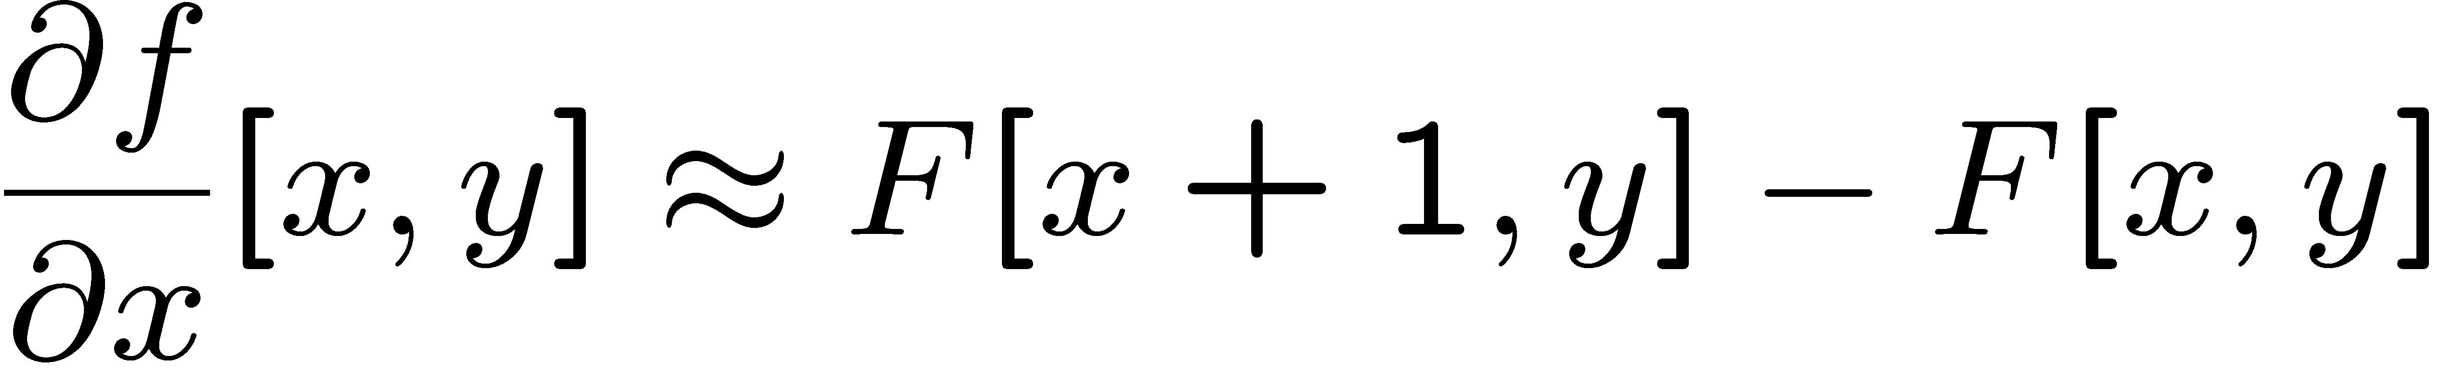




Image derivatives
How can we differentiate a digital image F[x,y]?
  Option 1: reconstruct a continuous image, f, then compute the derivative
  Option 2: take discrete derivative (finite difference)
How would you implement this as a linear filter?
1 | -1
 | -1
 | 1
:
:
Source: S. Seitz
Notes:
give definition of partial derivative: lim h->0 [f(x+h,y) – f(x,y)]/h

Slide 30





Image gradient
The gradient of an image:
The gradient points in the direction of most rapid increase in intensity
The edge strength is given by the gradient magnitude:
The gradient direction is given by:
  how does this relate to the direction of the edge?
Source: Steve Seitz
Notes:
give definition of partial derivative: lim h->0 [f(x+h,y) – f(x,y)]/h
Gradient direction perpendicular to edge direction

Slide 31
Image gradient
Source: L. Lazebnik
Notes:
Top right: gradient magnitude
x, y

Slide 32
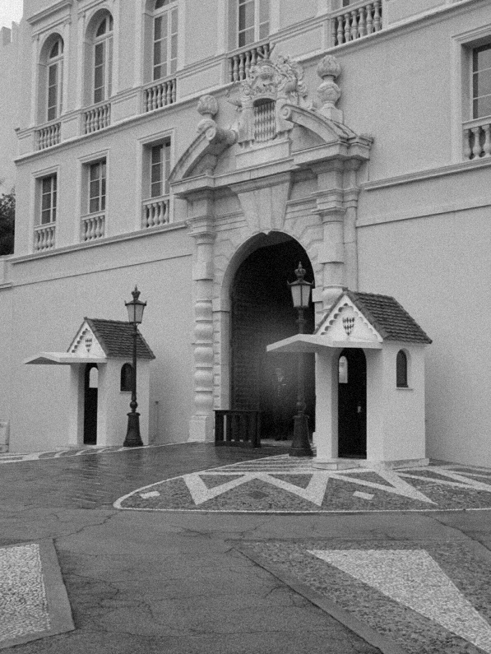
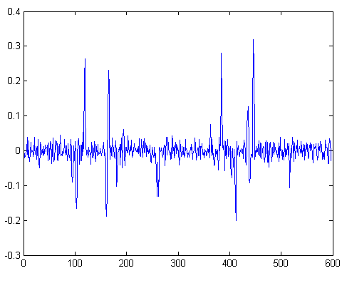
With a little Gaussian noise
Gradient
Source: D. Hoiem

Slide 33





Effects of noise
Noisy input image
Where is the edge?
Source: S. Seitz
Notes:
How to fix?

Slide 34
Effects of noise
Noise is high frequency
Differentiation accentuates noise

Slide 35
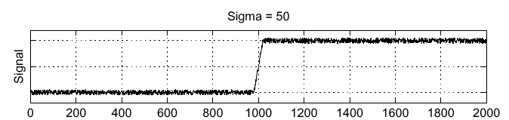
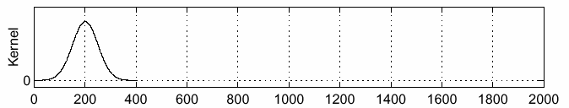
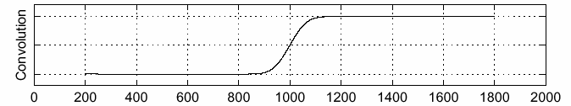
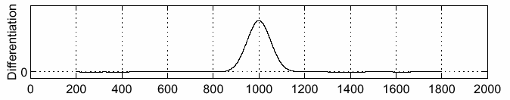
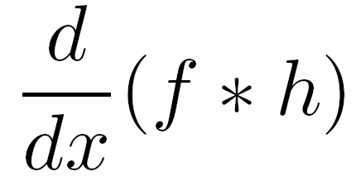
Solution: smooth first
f
h
f * h
To find edges, look for peaks in
Source: S. Seitz

Slide 36
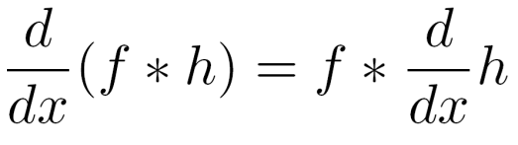
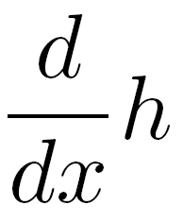
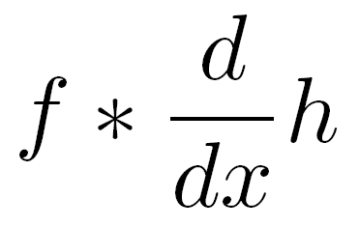

Associative property of convolution
Differentiation is a convolution
Convolution is associative:
This saves us one operation:
f
Source: S. Seitz

Slide 37




2D edge detection filters
derivative of Gaussian (x)
Gaussian
Notes:
How many 2nd derivative filters are there? There are four 2nd partial derivative filters.
In practice, it’s handy to define a single 2nd derivative filter—the Laplacian

Slide 38


Derivative of Gaussian filter
x-direction
y-direction

Slide 39
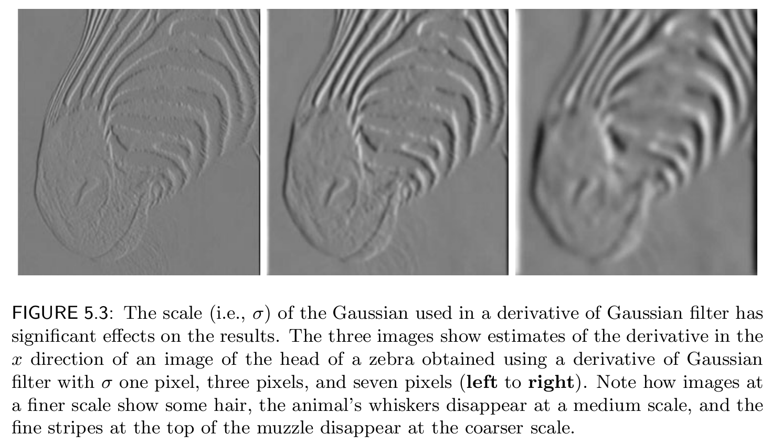

Slide 40
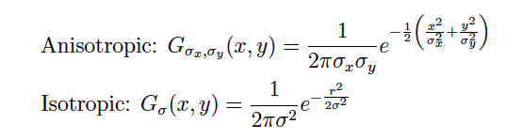
Two Dimensional Gaussian

Slide 41


Oriented Gaussian First and Second Derivatives

Slide 42
Grouping

Slide 43
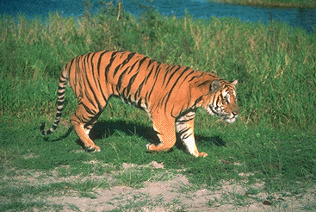
What is grouping?

Slide 44
Why grouping?
Pixels property of sensor, not world
Reasoning at object level (might) make things easy:
  objects at consistent depth
  objects can be recognized
  objects move as one
"I stand at the window and see a house, trees, sky. Theoretically I might say there were 327 brightnesses and nuances of colour. Do I have "327"? No. I have sky, house, and trees."
Max Wertheimer

Slide 45
Regions Boundaries

Slide 46
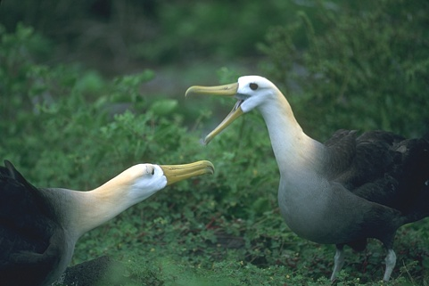
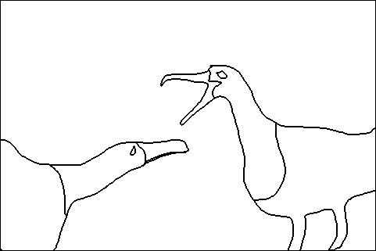
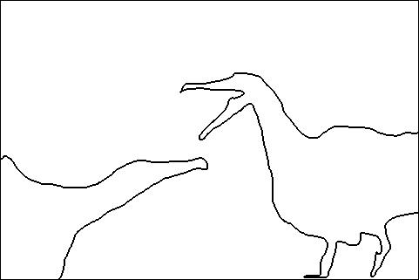
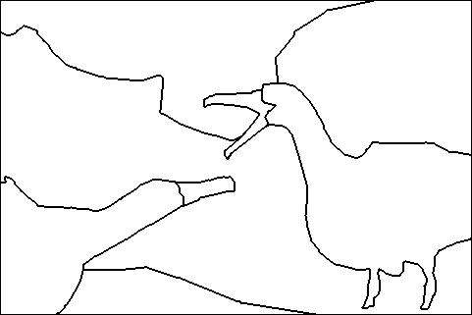
Is grouping well-defined?
Depends on purpose
  Object parts
  Background segmentation
A
B
C

Slide 47
Is grouping well-defined?
A
Perceptual organization forms a tree:
Image
A
B
BG
L-bird
R-bird
B
C
grass
bush
far
beak
body
beak
body
C
eye
head
eye
head
D. Martin, C. Fowlkes, D. Tal, J. Malik. "A Database of Human Segmented Natural Images and its Application to Evaluating Segmentation Algorithms and Measuring Ecological Statistics", ICCV, 2001

Slide 48
How do we group things?
Gestalt principles
Principle of proximity
https://courses.lumenlearning.com/wsu-sandbox/chapter/gestalt-principles-of-perception/

Slide 49
How do we group things?
Gestalt principles
Principle of similarity
https://courses.lumenlearning.com/wsu-sandbox/chapter/gestalt-principles-of-perception/

Slide 50
How do we group things?
Gestalt principles
Principle of continuity and closure
https://courses.lumenlearning.com/wsu-sandbox/chapter/gestalt-principles-of-perception/

Slide 51

How do we group things?
Gestalt principles
Principle of common fate

Slide 52
Gestalt principles in the context of images
Principle of proximity: nearby pixels are part of the same object
Principle of similarity: similar pixels are part of the same object
  Look for differences in color, intensity, or texture across the boundary
Principle of closure and continuity: contours are likely to continue
High-level knowledge?

Slide 53
Regions Boundaries

Slide 54
Designing a good boundary detector
Differences in color, intensity, or texture across the boundary
Continuity and closure
High-level knowledge

Slide 55
Criteria for a good boundary detector
Criteria for a good boundary detector:
  Good detection: Fire only on real edges, not anywhere else
  Good localization
    the edges detected must be as close as possible to the true edges
    the detector must return one point only for each true edge point
Source: L. Fei-Fei

Slide 56
Canny edge detector
The classic edge detector
Baseline for all later work on grouping
Theoretical model: step-edges corrupted by additive Gaussian noise
J. Canny, A Computational Approach To Edge Detection, IEEE Trans. Pattern Analysis and Machine Intelligence, 8:679-714, 1986.
22,000 citations!
Source: L. Fei-Fei

Slide 57
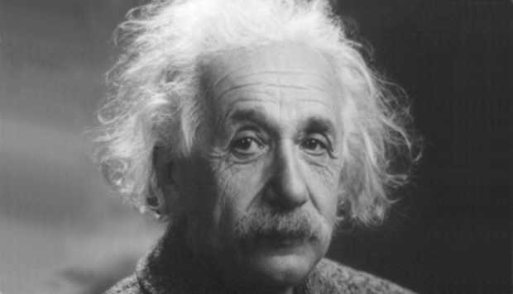
Example
original image

Slide 58
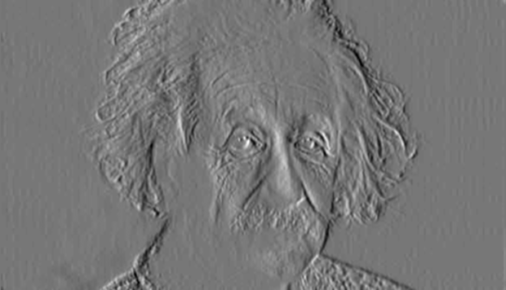
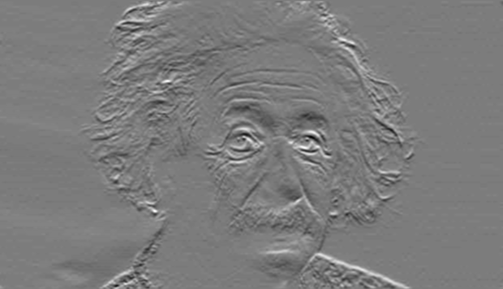
Compute Gradients (DoG)
X-Derivative of Gaussian
Y-Derivative of Gaussian

Slide 59
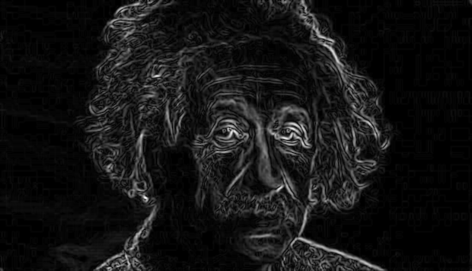
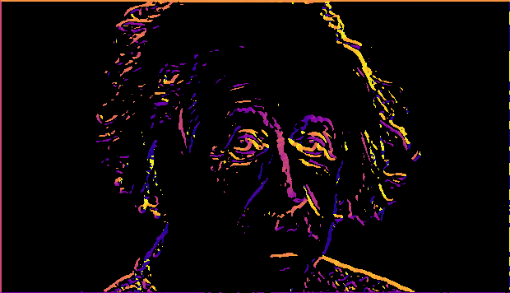
Gradient magnitude and orientation
Orientation is undefined at pixels with 0 gradient
Magnitude
Orientation
theta = numpy.arctan2(gy, gx)

Slide 60


Non-maximum suppression for each orientation
At q, we have a maximum if the value is larger than those at both p and at r. Interpolate to get these values.
Source: D. Forsyth

Slide 61
Before Non-max Suppression

Slide 62
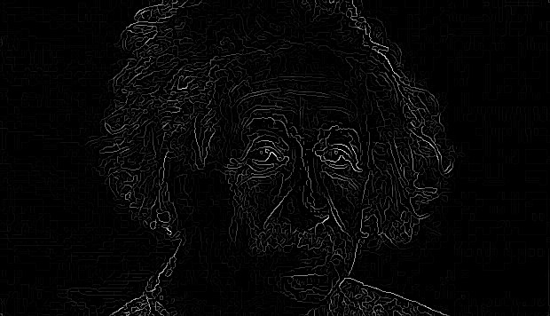
After Non-max Suppression

Slide 63
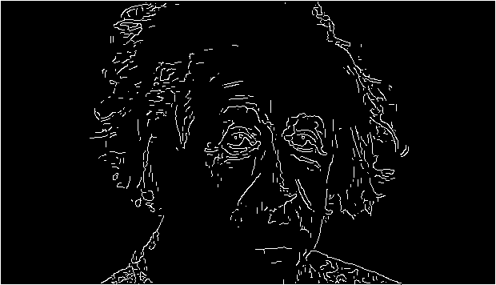
Hysteresis thresholding
Threshold at low/high levels to get weak/strong edge pixels
Do connected components, starting from strong edge pixels

Slide 64
Final Canny Edges

Slide 65
Canny edge detector
Filter image with x, y derivatives of Gaussian
Find magnitude and orientation of gradient
Non-maximum suppression:
  Thin multi-pixel wide “ridges” down to single pixel width
Thresholding and linking (hysteresis):
  Define two thresholds: low and high
  Use the high threshold to start edge curves and the low threshold to continue them
Source: D. Lowe, L. Fei-Fei

Slide 66

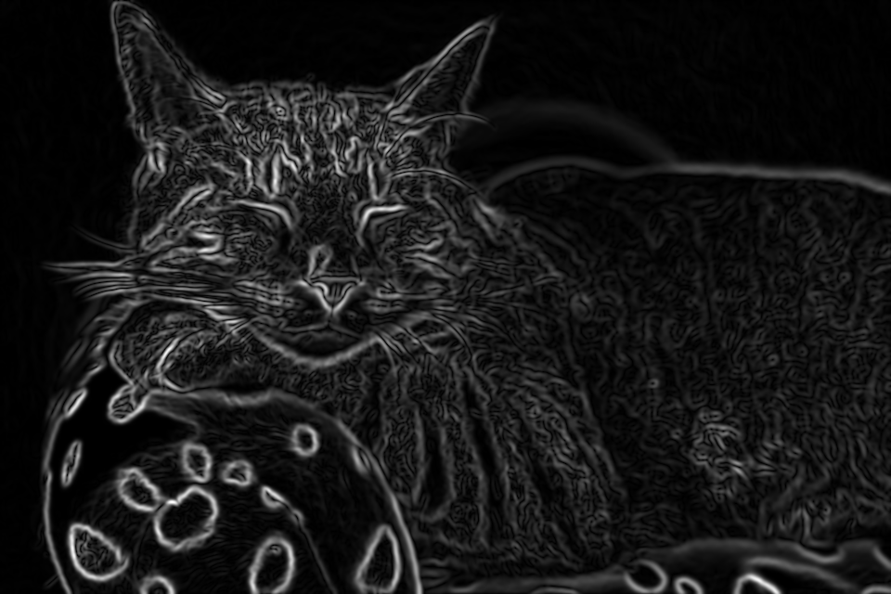
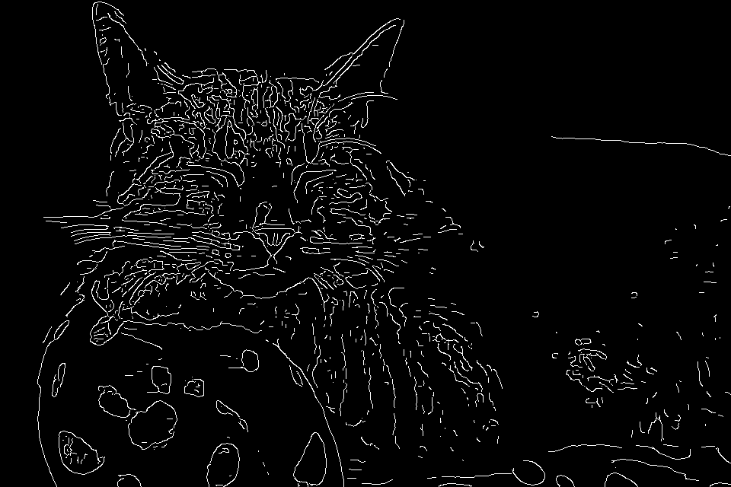
Does Canny always work?

Slide 67
The challenges of edge detection
Texture
Low-contrast boundaries

