Slide 1
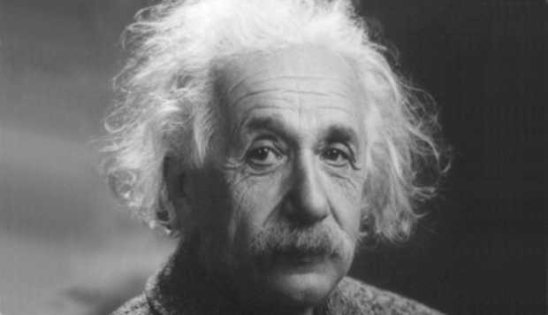
Images have structure at various scales

Slide 2
Frequency
Frequency of a signal is how fast it changes
  Reflects scale of structure

Slide 3
A combination of frequencies
0.1 X
+
0.3 X
+
0.5 X
=

Slide 4
Fourier transform
Can we figure out the canonical single-frequency signals that make up a complex signal?
  Yes!
Can any signal be decomposed in this way?
  Yes!

Slide 5
Fourier transform for periodic signals
Suppose x is periodic with period T
All components must be periodic with period T/k for some integer k
  Only frequencies are of the form k/T
Thus:
Given a signal x(t), Fourier transform gives us the coefficients a_{k} (we will denote these as X[k])
”Pure” signal

Slide 6
Fourier transform for aperiodic signals
What if signal is not periodic?
Can still decompose into sines and cosines!
But no restriction on frequency
Now need a continuous space of frequencies
Fourier transform gives us the function X(v)
”Pure” signal

Slide 7
Fourier transform
Note: X can in principle be complex: we often look at the magnitude |X(v)|

Slide 8
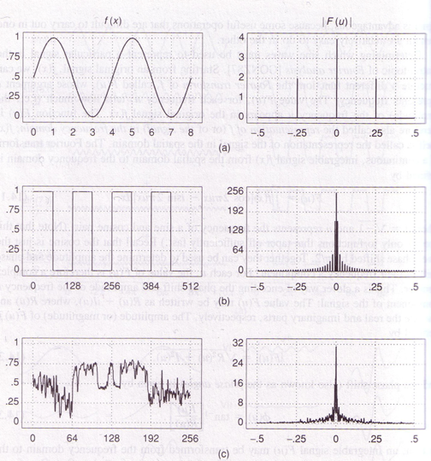
Time
Frequency
Why is there a peak at 0?

Slide 9
Fourier transform

Slide 10
Dual domains
Signal: time domain (or spatial domain)
Fourier Transform: Frequency domain
  Amplitudes are called spectrum
For any transformations we do in time domain, there are corresponding transformations we can do in the frequency domain
And vice-versa
Spatial Domain

Slide 11
Dual domains
Convolution in time domain = Point-wise multiplication in frequency domain
Convolution in frequency domain = Point-wise multiplication in time domain

Slide 12
Proof (if curious)

Slide 13
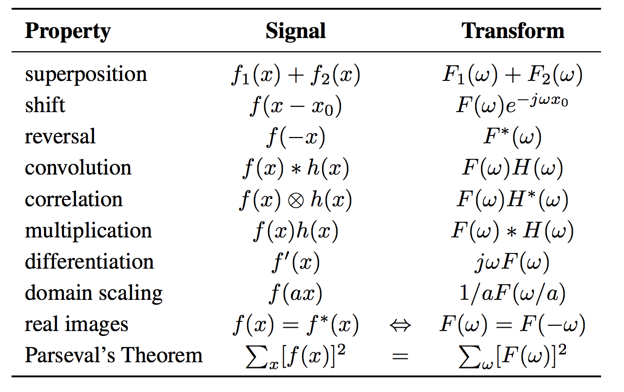
Properties of Fourier transforms

Slide 14
Back to 2D images
Images are 2D signals
Discrete, but consider as samples from continuous function
Signal: f(x,y)
Fourier transform F(v_{x}, v_{y}): contribution of a “pure” signal with frequency v_{x} in x and v_{y} in y

Slide 15
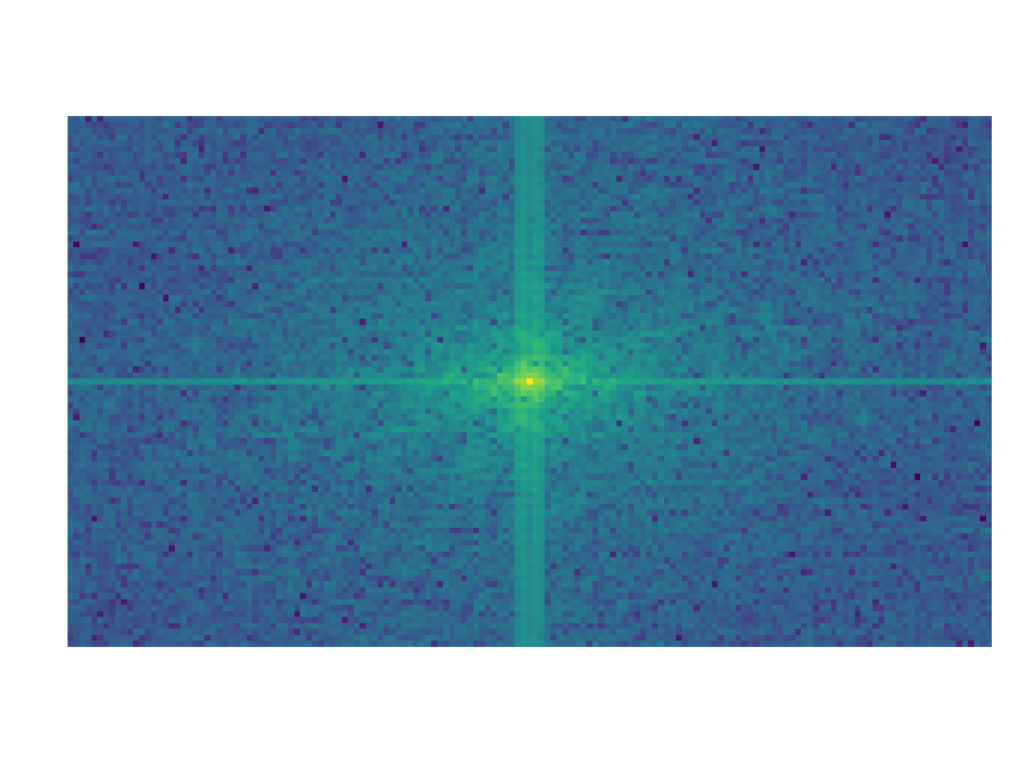

Back to 2D images

Slide 16
Signals and their Fourier transform
Spatial
Sine
Gaussian
Box
Frequency
Impulse
Gaussian
Sinc

Slide 17
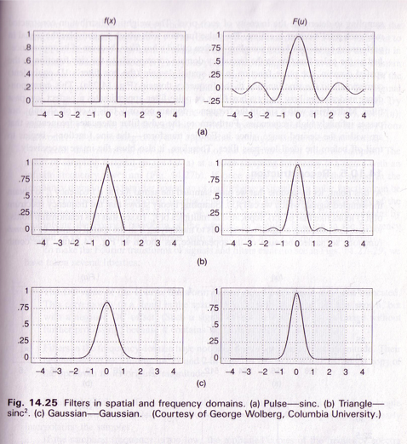

Slide 18
The Gaussian special case
Fourier transform of a Gaussian is a gaussian

Slide 19
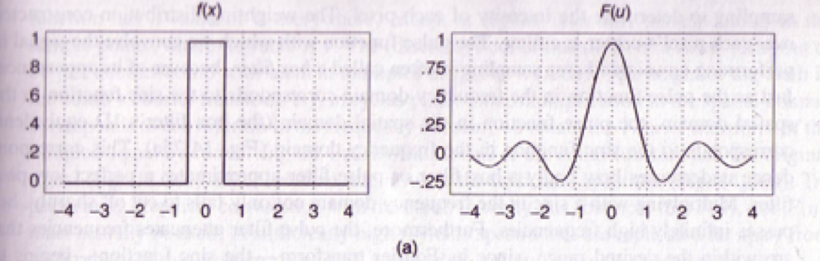
Sharp discontinuities require very high frequencies

Slide 20
Duality
Since Fourier and inverse Fourier look so much alike:
  Fourier transform of sinc is box
  Fourier transform of impulse is sine

Slide 21
Why talk about Fourier transforms?
Convolution is point-wise multiplication in frequency space
  Analyze which frequency components a particular filter lets through, e.g., low-pass, high-pass or band-pass filters
  Leads to fast algorithms for convolution with large filters: Fast FFT

Slide 22
Why talk about Fourier transforms
Frequency space reveals structure at various scales
  Noise is high-frequency
  ”Average brightness” is low-frequency
Useful to understand how we resize/resample images
  Sampling causes information loss
  What is lost exactly?
  What can we recover?

Slide 23
Fourier transforms from far away
Fourier transforms are basically a “change of basis”
Instead of representing image as “the value of each pixel”,
Represent image as “how much of each frequency component”
“Frequency components” are intuitive: slowly-changing or fast-changing images

Slide 24
”The cat has some serious periodic components.”
https://xkcd.com/26/

Slide 25
Resizing and resampling

Slide 26
Let’s enhance!
Louis Daguerre, 1838

Slide 27
Let’s enhance!
When is enhancement possible?
How can we model what happens when we upsample or downsample an image?
Resizing up or down very common operation
  Searching across scales
  applications have different memory/quality tradeoffs

Slide 28
What is a (digital) image?
True image is a function from R² to R
Digital image is a sample from it
1D example:
To enhance, we need to recover the original signal and sample again

Slide 29
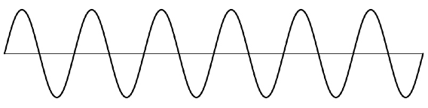
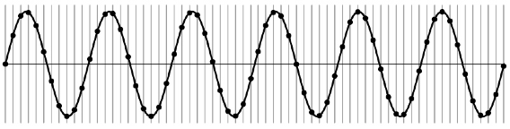
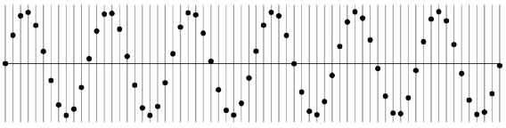
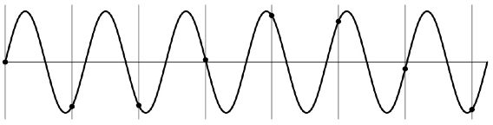
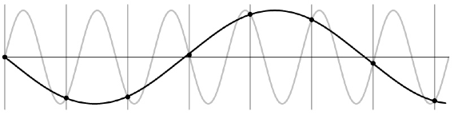
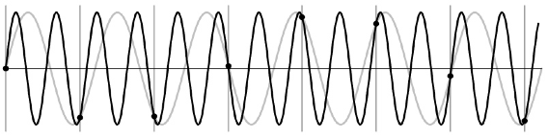
Undersampling
© Kavita Bala, Computer Science, Cornell University

Slide 30
Undersampling
What if we “missed” things between the samples?
Simple example: undersampling a sine wave
  unsurprising result: information is lost
  surprising result: indistinguishable from lower frequency
  also was always indistinguishable from higher frequencies
  aliasing: signals “traveling in disguise” as other frequencies

Slide 31
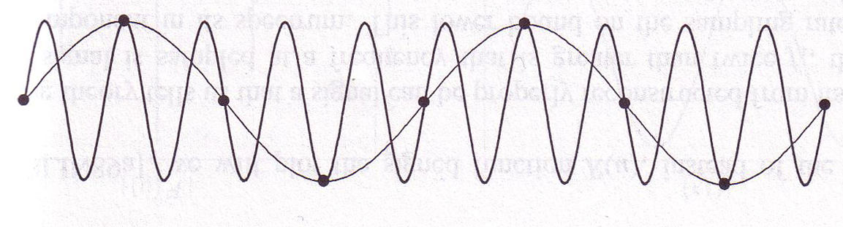
Aliasing
When sampling is not adequate, impossible to distinguish between low and high frequency signal
© Kavita Bala, Computer Science, Cornell University

Slide 32
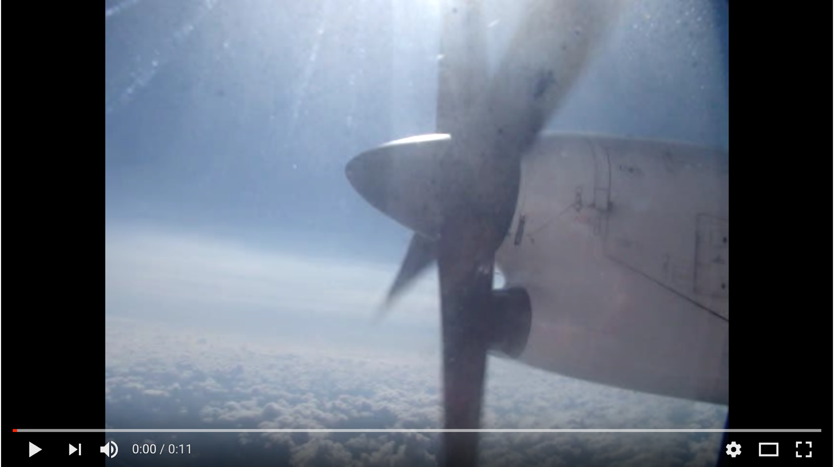
Aliasing in time

Slide 33
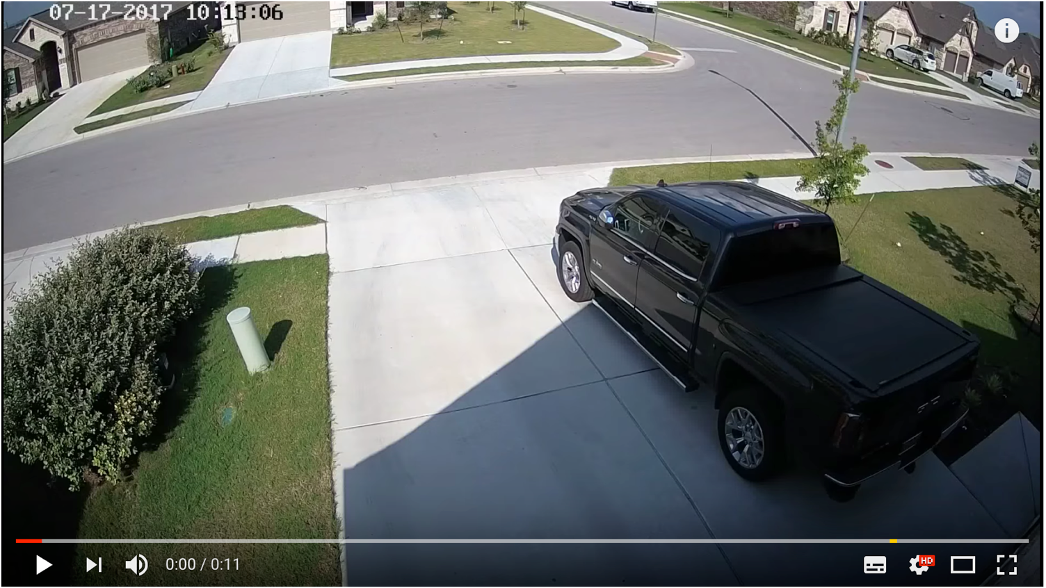
Aliasing in time

Slide 34
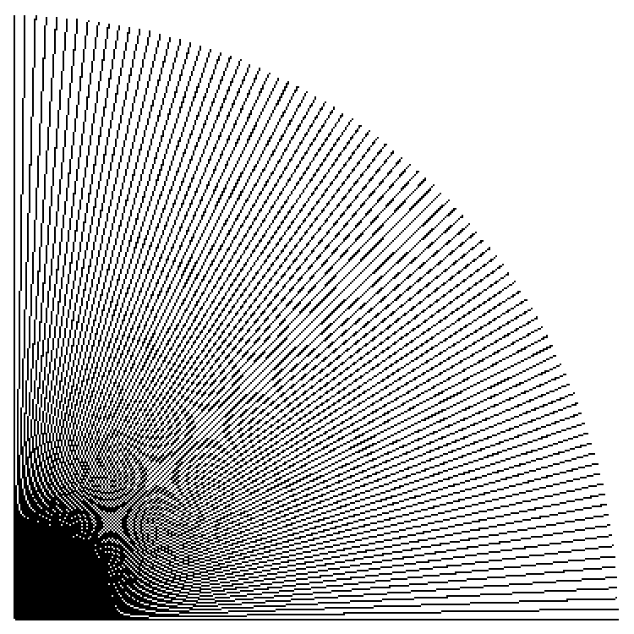
Point sampling
in action
Cornell CS4620 Fall 2015 • Lecture 23

Slide 35
How many samples do we need?
1 sample per time period is too less:

Slide 36
How many samples do we need?
2 samples per time-period is enough
Nyquist sampling theorem: Need to sample at least 2 times the frequency
General signals? Need to sample at least 2 times the maximum frequency

Slide 37
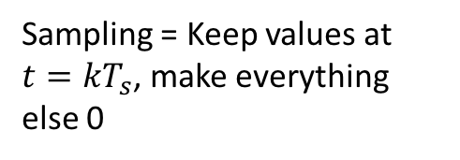
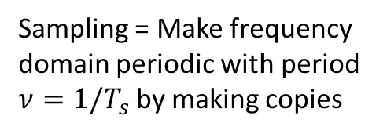
Nyquist sampling: why?
Spatial domain
Frequency domain
Sampling = Keep values at $t=kT_{s}$, make everything else 0
Sampling = Make frequency domain periodic with period $ν=1/T_{s}$ by making copies

Slide 38
Nyquist sampling: why?

Slide 39
Nyquist sampling: why?

Slide 40
How to subsample correctly
Nyquist says must sample at at least twice maximum frequency
What if signal has high frequencies?
Eliminate them before sampling!
  Convert to frequency space
  Multiply with band-pass filter

Slide 41
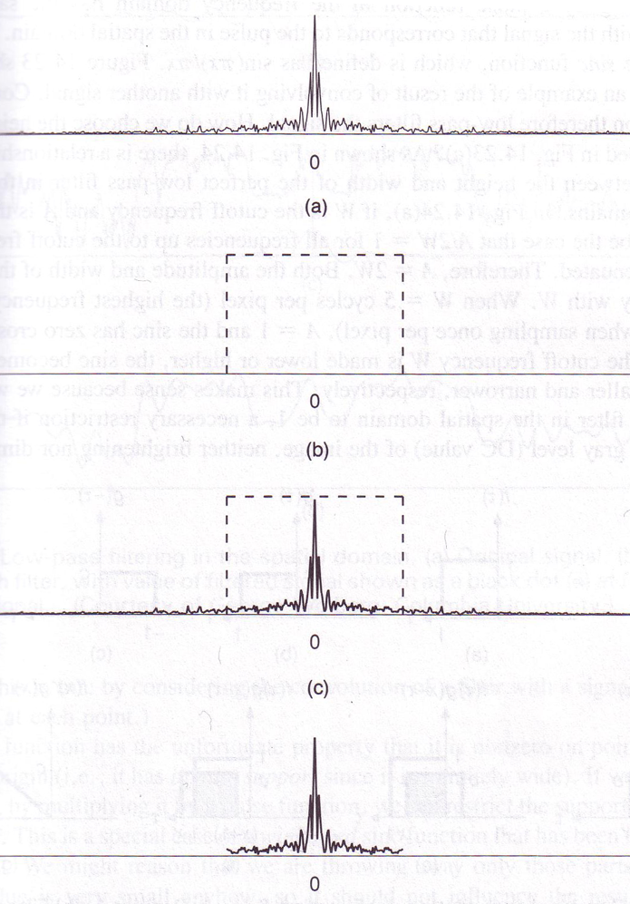
Eliminating
High
Frequencies
© Kavita Bala, Computer Science, Cornell University

Slide 42
Process
Can we do this in spatial domain?
  Yes!
Multiplication in frequency domain = convolution in spatial domain
Box filter in frequency domain = sinc in spatial domain
Multiplication with box filter in frequency domain = convolution with sinc filter in spatial domain

Slide 43
Reconstruction from samples
Spatial domain
Frequency domain
Sampling = Keep values at $t=kT_{s}$, make everything else 0
Sampling = Make frequency domain periodic with period $ν=1/T_{s}$ by making copies

Slide 44
Reconstruction from samples
Box filter in frequency space

Slide 45
Reconstruction from samples
Multiplication in frequency domain = convolution in spatial domain
Box filter in frequency domain = sinc filter in spatial domain
Convolve sampled signal with sinc filter to reconstruct

Slide 46
Reconstruction from samples
”Sampled signal” is non-zero at sample points and 0 everywhere else
  i.e., has holes
*

Slide 47
Recap: subsampling and reconstruction
Subsampling
Convolve with sinc filter to eliminate high frequencies
Sample by picking only values at sample points
Reconstruction
Start with sampled signal (0 at non-sample points)
Convolve with sinc to reconstruct

Slide 48
Sinc is annoying

Slide 49
Sinc and Gaussian
Sinc is annoying: infinite spatial extent
Use Gaussian instead!
Sinc/box
Gaussian
Spatial domain
Frequency domain

Slide 50


Subsampling images
Step 1: Convolve with Gaussian to eliminate high frequencies
Step 2: Drop unneeded pixels
Subsampling without removing high frequencies
Subsampling after removing high frequencies

Slide 51

Upsampling images
Step 1: blow up to original size with 0’s in between

Slide 52
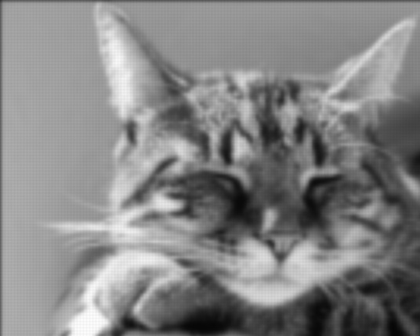
Upsampling images
Step 2: Convolve with Gaussian

Slide 53
Take-away
Subsampling causes aliasing
  High frequencies masquerading as low frequencies
Remove low frequencies by blurring!
  Ideal: sinc
  Common: Gaussian
When upsampling, reconstruct missing values by convolution
  Ideal: sinc
  Common: Gaussian

Slide 54
So… can we enhance?
Nyquist theorem limits frequencies we can reconstruct from subsampled image
Can only reconstruct max sampling frequency/2
Sorry CSI!

