Slide 1
All about convolution

Slide 2
Last time: Convolution and cross-correlation
Cross correlation
Convolution

Slide 3
Last time: Convolution and cross-correlation
Properties
  Shift-invariant: a sensible thing to require
  Linearity: convenient
Can be used for smoothing, sharpening
Also main component of CNNs

Slide 4
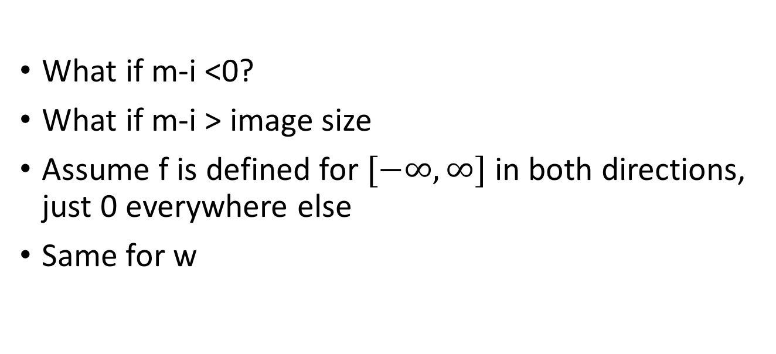
Boundary conditions
What if m-i <0?
What if m-i > image size
Assume f is defined for $[−∞,∞]$ in both directions, just 0 everywhere else
Same for w

Slide 5
Boundary conditions
90 | 0 | 0 | 0 | 0 | 0 | 0 | 0 | 0 | 0
0 | 0 | 0 | 10 | 10 | 10 | 0 | 0 | 0 | 0
0 | 0 | 10 | 20 | 20 | 20 | 10 | 40 | 0 | 0
0 | 10 | 20 | 30 | 0 | 20 | 10 | 0 | 0 | 0
0 | 10 | 0 | 30 | 40 | 30 | 20 | 10 | 0 | 0
0 | 10 | 20 | 30 | 40 | 30 | 20 | 10 | 0 | 0
0 | 10 | 20 | 10 | 40 | 30 | 20 | 10 | 0 | 0
0 | 10 | 20 | 30 | 30 | 20 | 10 | 0 | 0 | 0
0 | 0 | 10 | 20 | 20 | 0 | 10 | 0 | 20 | 0
0 | 0 | 0 | 10 | 10 | 10 | 0 | 0 | 0 | 0

Slide 6
Boundary conditions
90 | 0 | 0 | 0 | 0 | 0 | 0 | 0 | 0 | 0
0 | 0 | 0 | 10 | 10 | 10 | 0 | 0 | 0 | 0
0 | 0 | 10 | 20 | 20 | 20 | 10 | 40 | 0 | 0
0 | 10 | 20 | 30 | 0 | 20 | 10 | 0 | 0 | 0
0 | 10 | 0 | 30 | 40 | 30 | 20 | 10 | 0 | 0
0 | 10 | 20 | 30 | 40 | 30 | 20 | 10 | 0 | 0
0 | 10 | 20 | 10 | 40 | 30 | 20 | 10 | 0 | 0
0 | 10 | 20 | 30 | 30 | 20 | 10 | 0 | 0 | 0
0 | 0 | 10 | 20 | 20 | 0 | 10 | 0 | 20 | 0
0 | 0 | 0 | 10 | 10 | 10 | 0 | 0 | 0 | 0

Slide 7
Boundary conditions
90 | 0 | 0 | 0 | 0 | 0 | 0 | 0 | 0 | 0
0 | 0 | 0 | 10 | 10 | 10 | 0 | 0 | 0 | 0
0 | 0 | 10 | 20 | 20 | 20 | 10 | 40 | 0 | 0
0 | 10 | 20 | 30 | 0 | 20 | 10 | 0 | 0 | 0
0 | 10 | 0 | 30 | 40 | 30 | 20 | 10 | 0 | 0
0 | 10 | 20 | 30 | 40 | 30 | 20 | 10 | 0 | 0
0 | 10 | 20 | 10 | 40 | 30 | 20 | 10 | 0 | 0
0 | 10 | 20 | 30 | 30 | 20 | 10 | 0 | 0 | 0
0 | 0 | 10 | 20 | 20 | 0 | 10 | 0 | 20 | 0
0 | 0 | 0 | 10 | 10 | 10 | 0 | 0 | 0 | 0

Slide 8
Boundary conditions
90 | 0 | 0 | 0 | 0 | 0 | 0 | 0 | 0 | 0
0 | 0 | 0 | 10 | 10 | 10 | 0 | 0 | 0 | 0
0 | 0 | 10 | 20 | 20 | 20 | 10 | 40 | 0 | 0
0 | 10 | 20 | 30 | 0 | 20 | 10 | 0 | 0 | 0
0 | 10 | 0 | 30 | 40 | 30 | 20 | 10 | 0 | 0
0 | 10 | 20 | 30 | 40 | 30 | 20 | 10 | 0 | 0
0 | 10 | 20 | 10 | 40 | 30 | 20 | 10 | 0 | 0
0 | 10 | 20 | 30 | 30 | 20 | 10 | 0 | 0 | 0
0 | 0 | 10 | 20 | 20 | 0 | 10 | 0 | 20 | 0
0 | 0 | 0 | 10 | 10 | 10 | 0 | 0 | 0 | 0

Slide 9
Boundary conditions
90 | 0 | 0 | 0 | 0 | 0 | 0 | 0 | 0 | 0
0 | 0 | 0 | 10 | 10 | 10 | 0 | 0 | 0 | 0
0 | 0 | 10 | 20 | 20 | 20 | 10 | 40 | 0 | 0
0 | 10 | 20 | 30 | 0 | 20 | 10 | 0 | 0 | 0
0 | 10 | 0 | 30 | 40 | 30 | 20 | 10 | 0 | 0
0 | 10 | 20 | 30 | 40 | 30 | 20 | 10 | 0 | 0
0 | 10 | 20 | 10 | 40 | 30 | 20 | 10 | 0 | 0
0 | 10 | 20 | 30 | 30 | 20 | 10 | 0 | 0 | 0
0 | 0 | 10 | 20 | 20 | 0 | 10 | 0 | 20 | 0
0 | 0 | 0 | 10 | 10 | 10 | 0 | 0 | 0 | 0

Slide 10
Boundary conditions in practice
“Full convolution”: compute if any part of kernel intersects with image
  requires padding
  Output size = m+k-1
“Same convolution”: compute if center of kernel is in image
  requires padding
  output size = m
“Valid convolution”: compute only if all of kernel is in image
  no padding
  output size = m-k+1

Slide 11
More properties of convolution

Slide 12
More properties of convolution
Convolution is linear
Convolution is shift-invariant
Convolution is commutative (w*f = f*w)
Convolution is associative ( v*(w*f) = (v*w)*f )
Every linear shift-invariant operation is a convolution

Slide 13

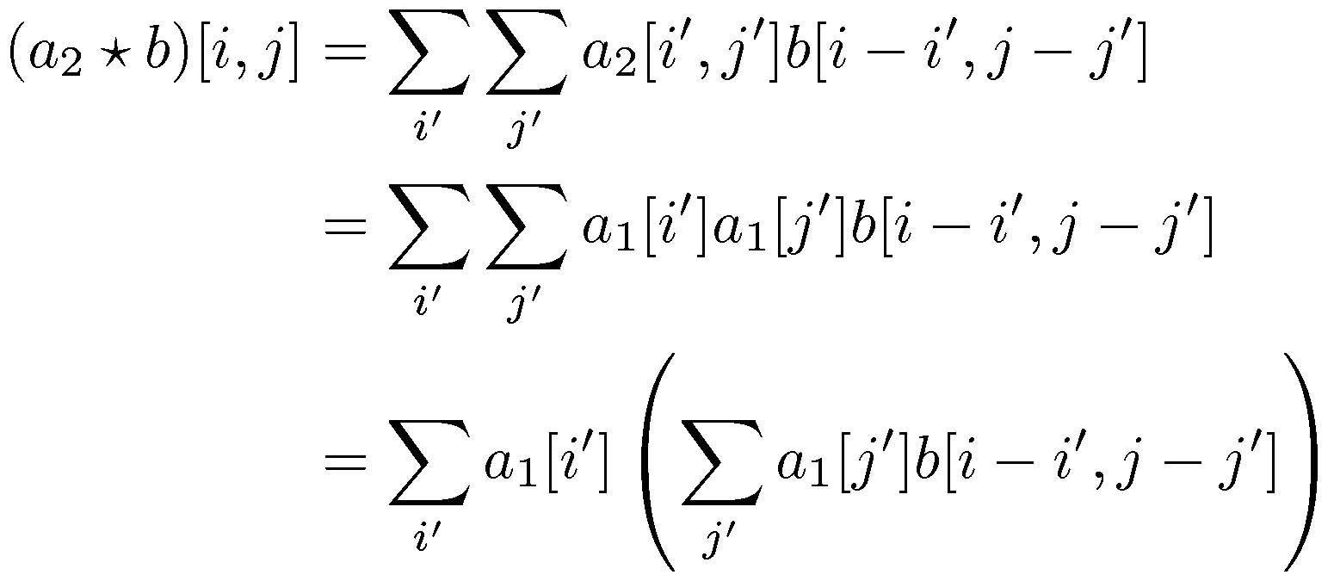
Optimization: separable filters
basic alg. is O(r²): large filters get expensive fast!
definition: a₂(x,y) is separable if it can be written as:
  this is a useful property for filters because it allows factoring:

Slide 14
More convolution filters
1 | 1 | 1 | 1 | 1
1 | 1 | 1 | 1 | 1
1 | 1 | 1 | 1 | 1
1 | 1 | 1 | 1 | 1
1 | 1 | 1 | 1 | 1
Mean filter
But nearby pixels are more correlated than far-away pixels
Weigh nearby pixels more
1/25

Slide 15
Gaussian filter

Slide 16

Gaussian filter
0.003 | 0.013 | 0.022 | 0.013 | 0.003
0.013 | 0.060 | 0.098 | 0.060 | 0.013
0.022 | 0.098 | 0.162 | 0.098 | 0.022
0.013 | 0.060 | 0.098 | 0.060 | 0.013
0.003 | 0.013 | 0.022 | 0.013 | 0.003
Ignore factor in front, instead, normalize filter to sum to 1
5x5, $σ$=1

Slide 17







Gaussian filter
21x21, $σ$=0.5
21x21, $σ$=1
21x21, $σ$=3

Slide 18


Difference of Gaussians
21x21, $σ$=3
21x21, $σ$=1

Slide 19

Difference of Gaussians

Slide 20
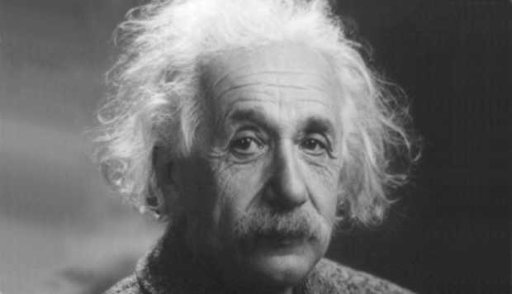
Images have structure at various scales

Slide 21
Fourier transform and the frequency domain

Slide 22
Signal processing
Images are 2D
For convenience, consider 1D signals
  Instead of space, time
f[i] : value of signal at point i (1D analog of f(i,j))

Slide 23
Signal processing
Instead of discrete signals, we will consider continuous signals
Discrete signals can be considered as samples from continuous signals
f : R → R, w : R → R
What is convolution for continuous signals?

Slide 24
Frequency
Frequency of a signal is how fast it changes
  Reflects scale of structure

Slide 25

Frequency
$x(t)=\cos{2πνt}$
What is the period?
What is the frequency?

Slide 26
A combination of frequencies
0.1 X
+
0.3 X
+
0.5 X
=

Slide 27
Fourier transform
Can we figure out the canonical single-frequency signals that make up a complex signal?
  Yes!
Can any signal be decomposed in this way?
  Yes!

Slide 28
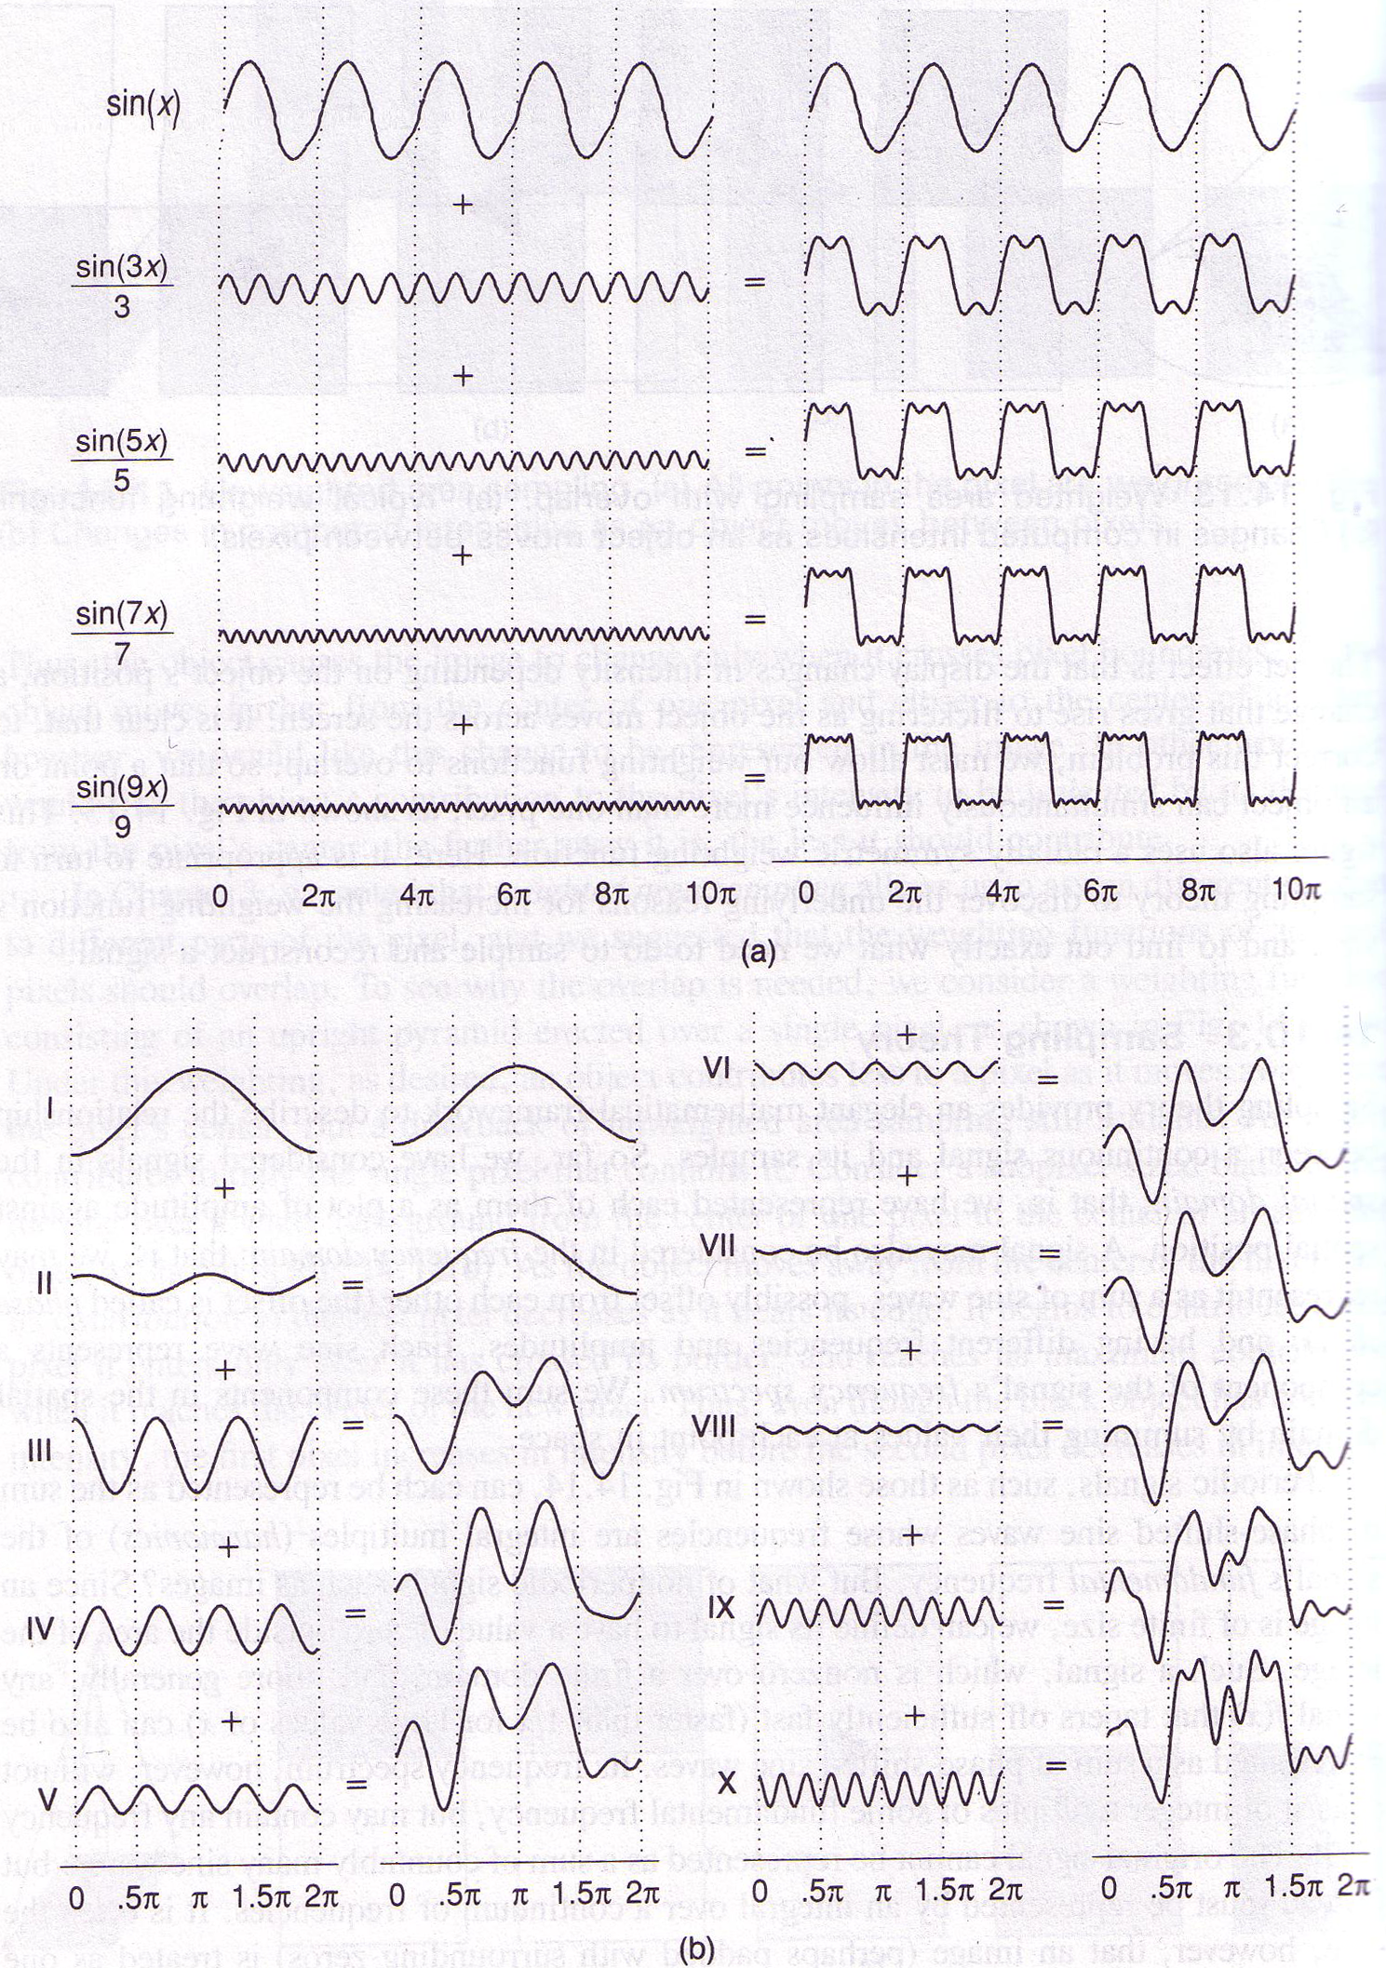
Idea of Fourier Analysis
Every signal (doesn’t matter what it is)
  Sum of sine/cosine waves

Slide 29
Idea of Fourier Analysis
Every signal (doesn’t matter what it is)
  Sum of sine/cosine waves

Slide 30
A box-like example

Slide 31
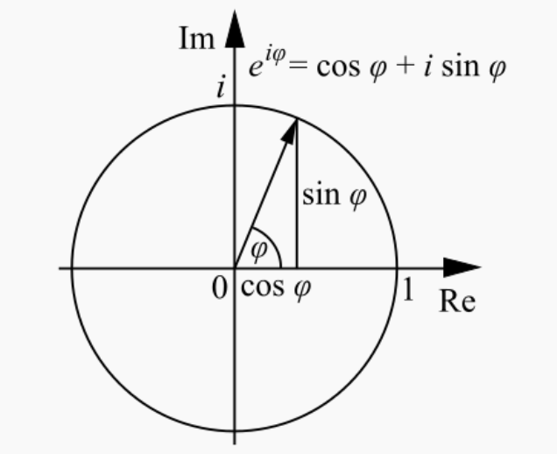
The Fourier bases
Not exactly sines and cosines, but complex variants
Euler’s formula

Slide 32
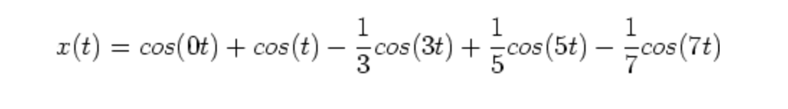
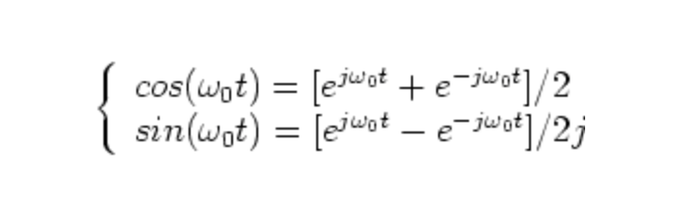
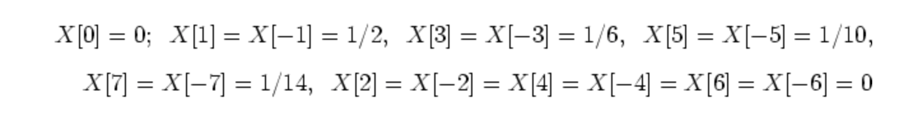
i is same as j

Slide 33
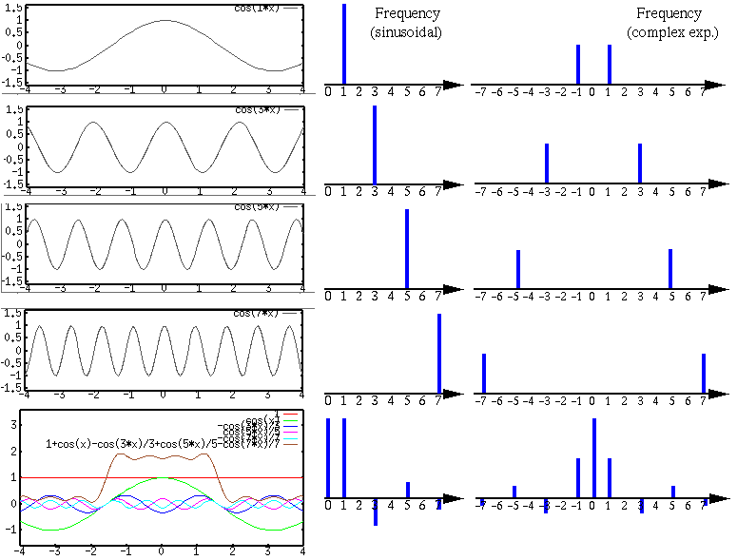

Slide 35
Fourier transform for periodic signals
Suppose x is periodic with period T
All components must be periodic with period T/k for some integer k
  Only frequencies are of the form k/T
Thus:
Given a signal x(t), Fourier transform gives us the coefficients a_{k} (we will denote these as X[k])
”Pure” signal

Slide 36
Fourier transform for aperiodic signals
What if signal is not periodic?
Can still decompose into sines and cosines!
But no restriction on frequency
Now need a continuous space of frequencies
Fourier transform gives us the function X(v)
”Pure” signal

Slide 37
Fourier transform
Note: X can in principle be complex: we often look at the magnitude |X(v)|

Slide 38
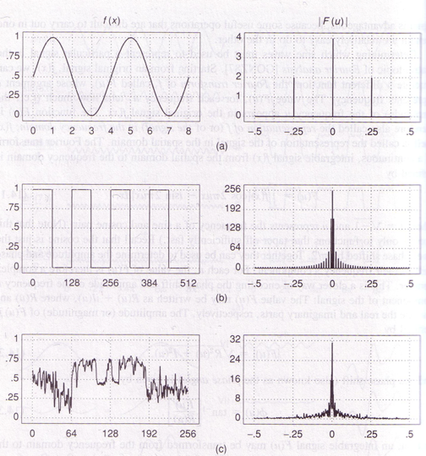
Time
Frequency
Why is there a peak at 0?

Slide 39
Fourier transform

Slide 40
Dual domains
Signal: time domain (or spatial domain)
Fourier Transform: Frequency domain
  Amplitudes are called spectrum
For any transformations we do in time domain, there are corresponding transformations we can do in the frequency domain
And vice-versa
Spatial Domain

Slide 41
Dual domains
Convolution in time domain = Point-wise multiplication in frequency domain
Convolution in frequency domain = Point-wise multiplication in time domain

Slide 42
Proof (if curious)

Slide 43
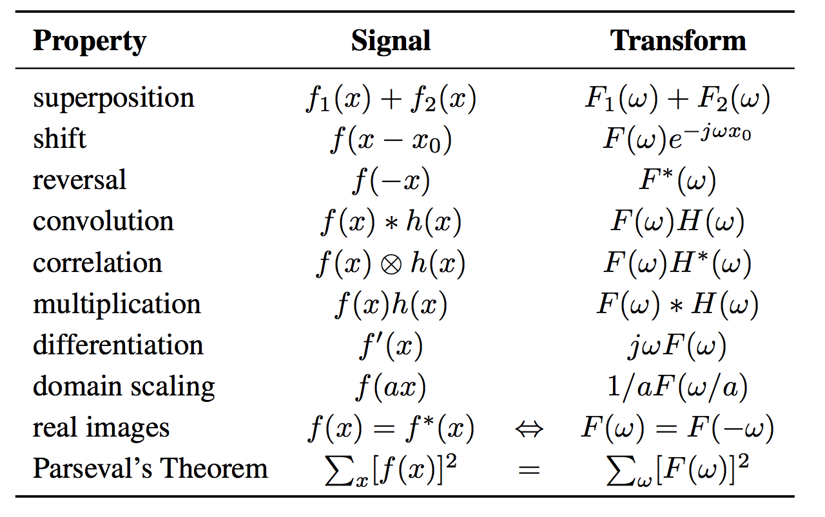
Properties of Fourier transforms

Slide 44
Back to 2D images
Images are 2D signals
Discrete, but consider as samples from continuous function
Signal: f(x,y)
Fourier transform F(v_{x}, v_{y}): contribution of a “pure” signal with frequency v_{x} in x and v_{y} in y

Slide 45
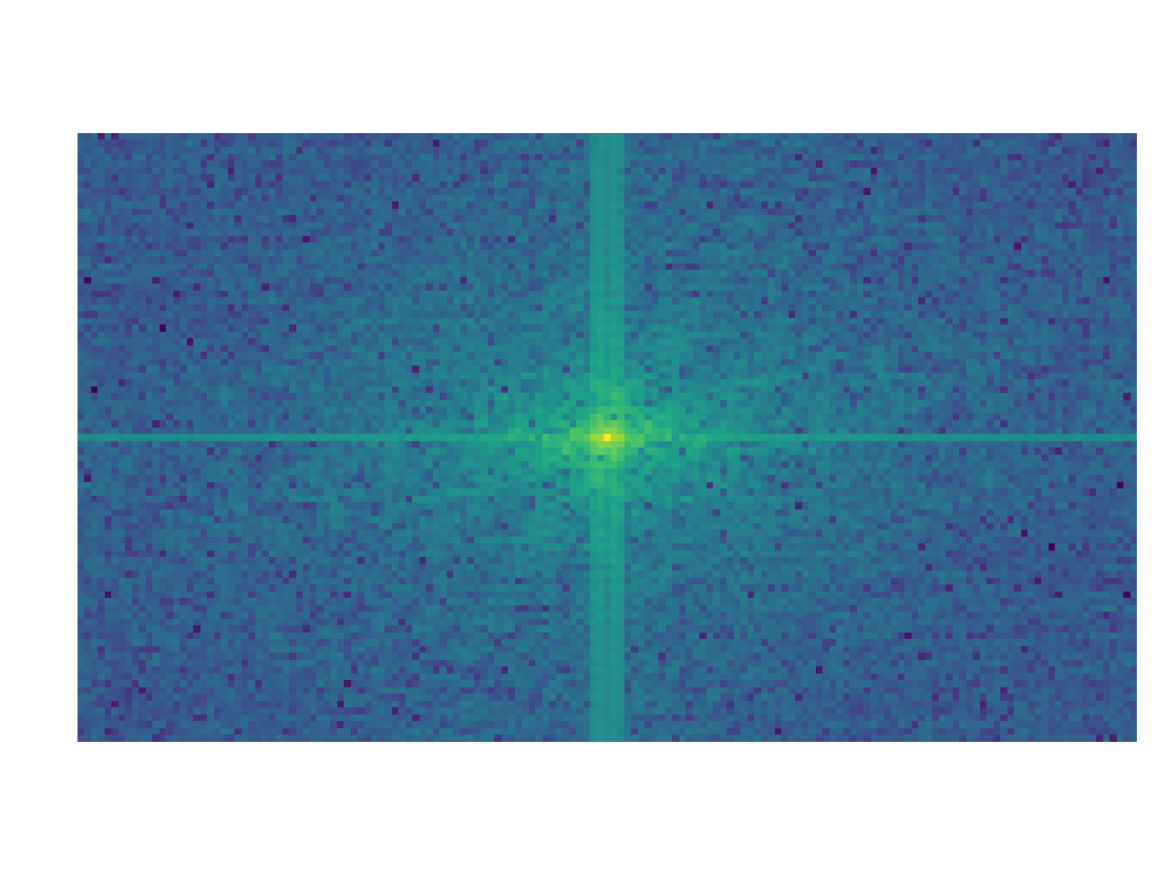
Back to 2D images

Slide 46
Signals and their Fourier transform
Spatial
Sine
Gaussian
Box
Frequency
Impulse
Gaussian
Sinc

Slide 47
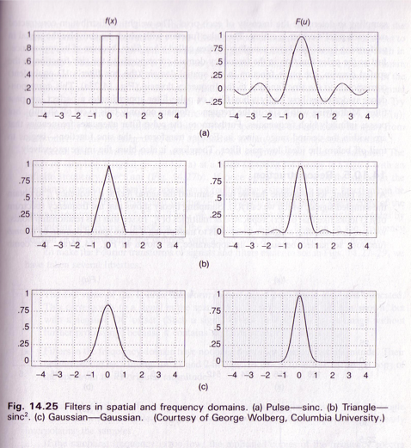

Slide 48
The Gaussian special case
Fourier transform of a Gaussian is a gaussian

Slide 49
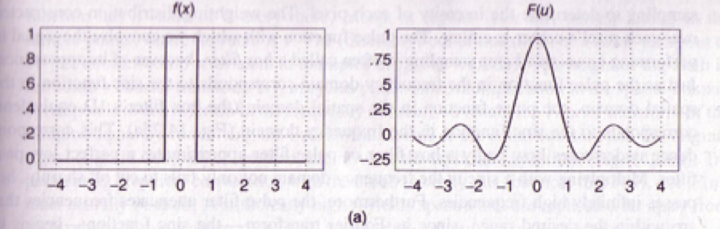
Sharp discontinuities require very high frequencies

Slide 50
Duality
Since Fourier and inverse Fourier look so much alike:
  Fourier transform of sinc is box
  Fourier transform of impulse is sine

Slide 51
Why talk about Fourier transforms?
Convolution is point-wise multiplication in frequency space
  Analyze which frequency components a particular filter lets through, e.g., low-pass, high-pass or band-pass filters
  Leads to fast algorithms for convolution with large filters: Fast FFT

Slide 52
Why talk about Fourier transforms
Frequency space reveals structure at various scales
  Noise is high-frequency
  ”Average brightness” is low-frequency
Useful to understand how we resize/resample images
  Sampling causes information loss
  What is lost exactly?
  What can we recover?

Slide 53
Fourier transforms from far away
Fourier transforms are basically a “change of basis”
Instead of representing image as “the value of each pixel”,
Represent image as “how much of each frequency component”
“Frequency components” are intuitive: slowly-changing or fast-changing images

Slide 54
”The cat has some serious periodic components.”
https://xkcd.com/26/

