Slide 1
The visual world

Slide 2

What do images look like?

Slide 3
The physical world
Not pixels!
Shape
Color
Material

Slide 4
The physical world
Not pixels!
Shape
Color
Articulation / deformation
Material

Slide 5
The physical world
Not pixels!

Slide 6
The physical world
Locations, orientations

Slide 7
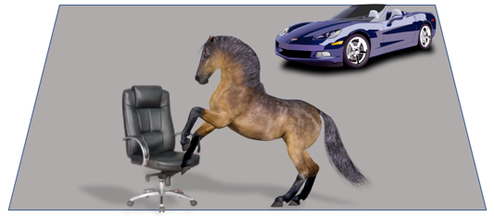
World → Images

Slide 8
The goal of computer vision
Computer vision

Slide 9
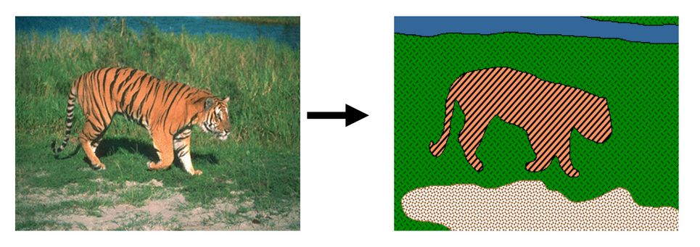
The goal(s) of computer vision
Grouping (“Reorganization”)
  Convert from “pixels” to “objects”: which groups of pixels correspond to objects?
[Blobworld]

Slide 10
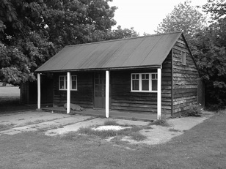
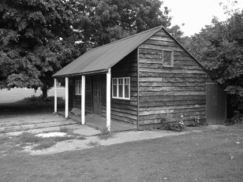
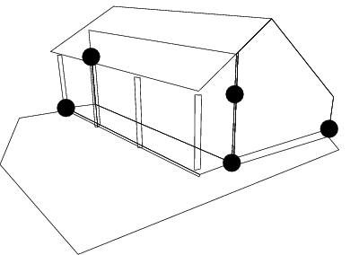
The goal(s) of computer vision
Reconstruction
  Go from 2D arrays to 3D: what does every pixel correspond to in 3D
Left View
Right View
[Hartley & Zisserman]

Slide 11
The goal(s) of computer vision
Recognition
  “Name” the object: what class does it belong to?
Picture credit: Magritte , Jon Barron

Slide 12
How do we do this?
Computer vision

Slide 13
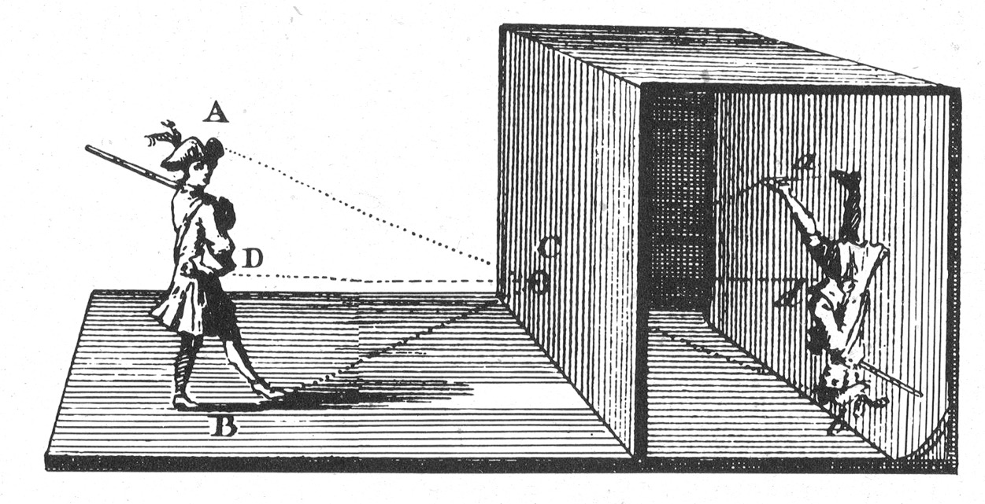
The pinhole camera - Camera Obscura

Slide 14
The pinhole camera
We will get into the math later

Slide 15
The pinhole camera

Slide 16

Not all 2D arrays are images

Slide 17
Consequence 1: nearby pixels are similar

Slide 18
Consequence 1: nearby pixels are similar
Log histogram of differences between adjacent pixels
Natural images
Random arrays

Slide 19
Consequence 1: nearby pixels are similar
Why?
Nearby pixels in pinhole camera lead to nearby rays
Nearby rays mostly fall on the same object

Slide 20
Consequence 1: nearby pixels are similar
Nearby pixels that are not similar tend to lie on different objects
Idea: To find where one object ends and another begins, look for abrupt changes in color

Slide 21
Consequence 1: nearby pixels are similar
Places of color change might correspond to object boundaries
Object boundaries are a clue to object shape
Idea: Use rough boundaries to recognize object(s)

Slide 22
Counterexample: camouflage

Slide 23
Consequence 2: Farther away objects appear smaller

Slide 24
Consequence 2: Farther away objects appear smaller

Slide 25
Consequence 2: Farther away objects appear smaller
Key modules: search over scales, zoom-out/zoom-in

Slide 26
Consequence 3: Image formation is lossy
We lose depth information

Slide 27

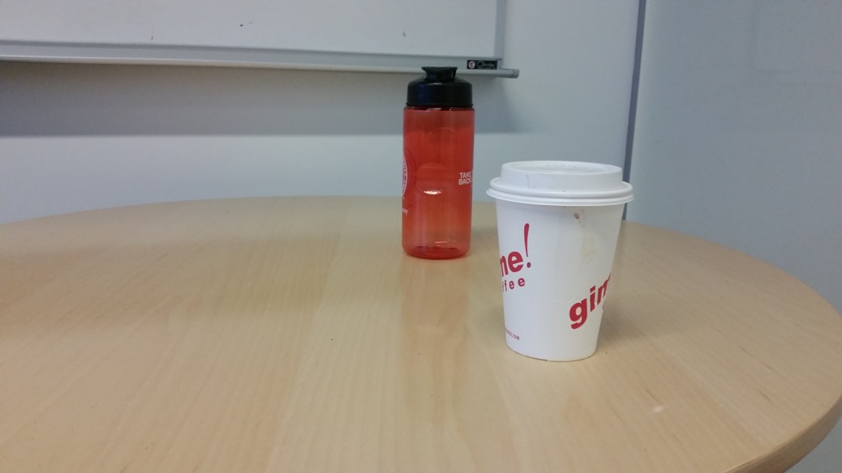
Consequence 3: Image formation is lossy
Idea: use multiple images

Slide 28


Consequence 3: Image formation is lossy
Idea: use multiple images

Slide 29
Consequence 3: Image formation is lossy
Idea: use multiple images

Slide 30

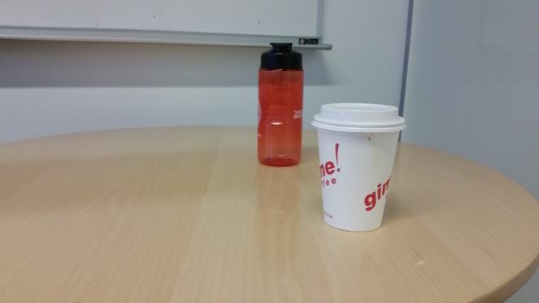
Consequence 4: Image formation is lossy
Idea: use multiple images
Need to find which pixel in image 2 matches which in image 1 - the correspondence problem

Slide 31

Color
Each pixel records “color” of a ray
But what is color?

Slide 32
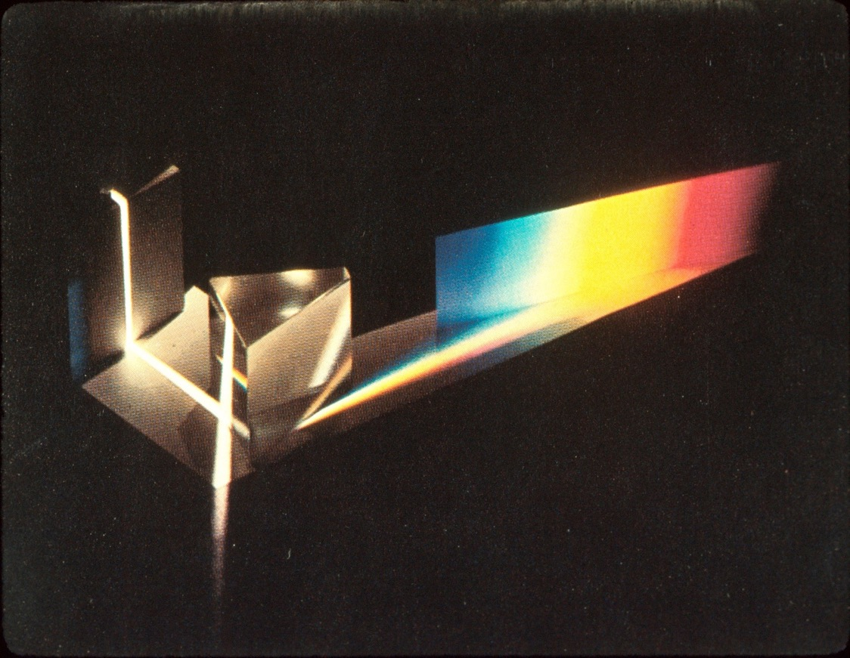
[source unknown]

Slide 33
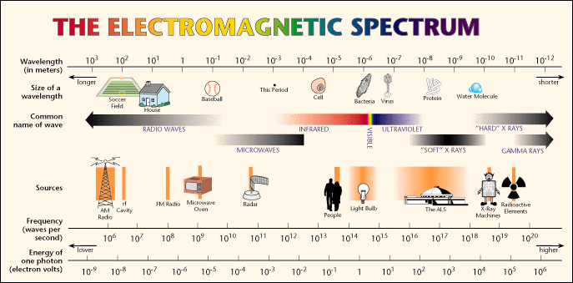
What is light?
Light is electromagnetic radiation
[Lawrence Berkeley Lab / MicroWorlds]

Slide 34
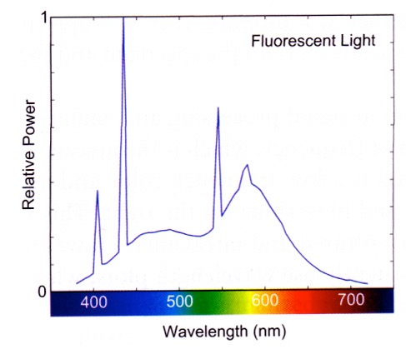
Physics to Brain
?
[Stone 2003]
Physical
Perceptual

Slide 35
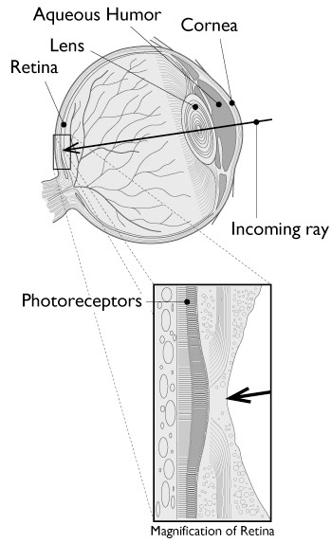
The eye as a measurement device
Light is measured by the photoreceptors in the retina
Photoreceptor cells absorb photons and convert to electrical signals
Different photoreceptor types respond to different wavelengths
[Greger et al. 1995]

Slide 36
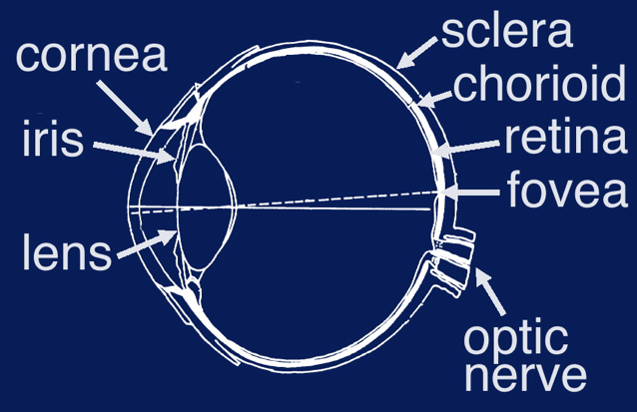
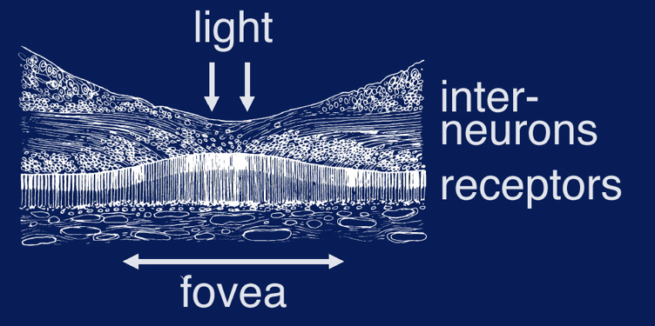
The eye
Left figure from Atkinson, Steven's Handbook of Experimental Psychology © Wiley, 1986.
Right figure from Sekuler, Perception © Alfed A. Knopf, 1985.
Notes:
any talk about the visual system wouldn’t be worth it’s salt if it didn’t start with a diagram of the eye, so here it is
the cross section on the left shows the eye’s major optical and neural stuctures
front part of the eye contains the eye’s optical system (cornea, iris, lens)
cornea - optically clear, tough, provides 2/3 of eye’s refractive power
iris - central aperture forms pupil, opens/closes to moderate amt. of light
lens - attached to ciliary muscles, change lens shape to alter focal dist.
lens divides eye into two chambers, filled with jelly-like substances known as the aqueous and vitreous humors
rear portion of the eye contains its neural structures, made up of 3 layers
sclera - tough outer covering, protects, maintains shape
chorioid - middle layer, provides blood supply
retina - innermost layer contains photoreceptors
retina inverted, light must travel through cell bodies to reach photosensitive pigments
receptors not distributed equally over the retinal surface
near center of retina, area called fovea (illustrated on right), here receptors most densely packed provides highest resolution vision
nasal side of the retina, area known as blind spot, has no receptors, location where optic nerve fibers exit the globe

Slide 37
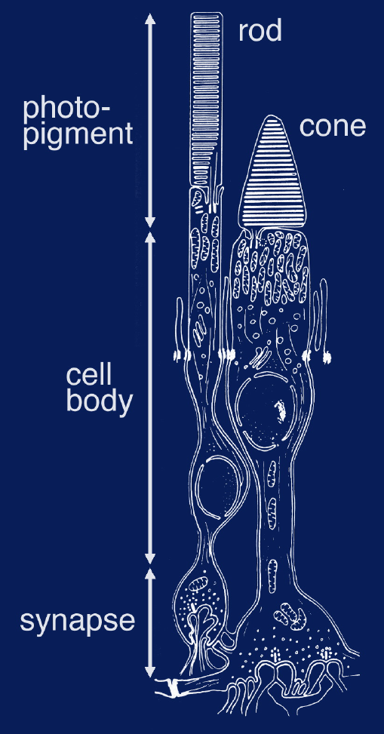
Photoreceptors
120 million rods
7-8 million cones
in each eye
Adapted from Levine, Vision in Man and Machine © McGraw-Hill, 1985.
Notes:
the retina is composed of two major classes of photoreceptors known as the rods and cones due to the shapes of their outer segments
outer segments contain layers of photosensitive material that convert light energy into chemical energy in the cell
inner segment contains the cell body which regulates the cell’s metabolism and is involved in the regeneration of photopigment
finally, there’s the synapse where the cell communicates to neighboring cells and is in turn affected by them
there are about 120 million rods and 7-8 million cones in each retina
rods - extremely sensitive, provide achromatic vision at low (scotopic) levels of illumination
three types of cones, provide trichromatic color vision at higher (photopic) levels

Slide 38
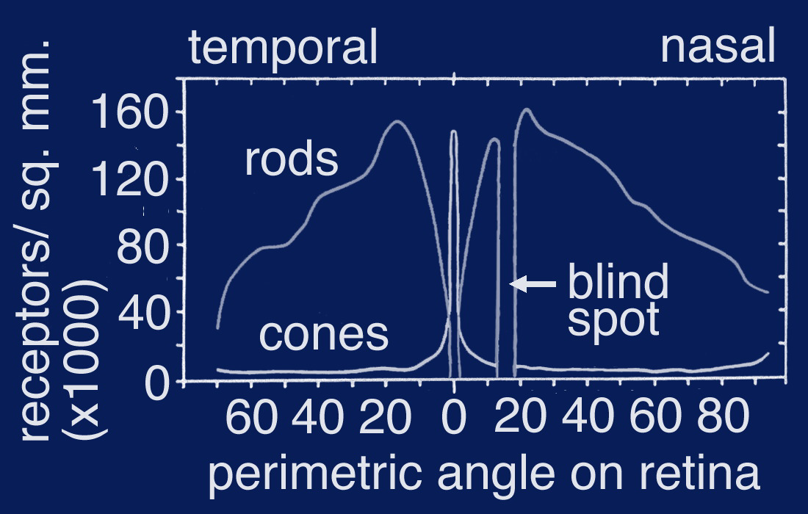
Receptor distribution
fovea
Adapted from Levine, Vision in Man and Machine © McGraw-Hill, 1985.
Notes:
the rods and cones are not distributed equally across the retina
the graph plots receptor density as a function of angle on the retinal surface
cone density is highest in the fovea but drops off rapidly as you move into the periphery
conversely, there aren’t any rods in the very center of the fovea, but as you move outward, rod density rises to a peak at about 20 deg. and then falls off again

Slide 39
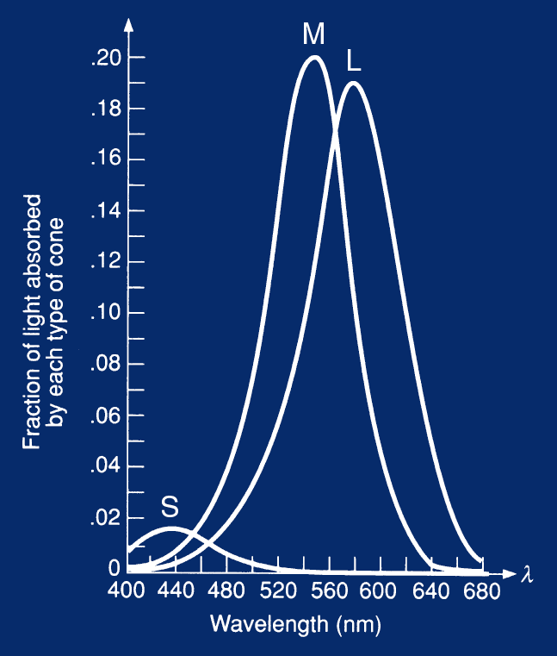
Cone Responses
S,M,L cones have broadband spectral sensitivity
Converts a distribution over wavelength into 3 values
Hence 3 colors: blue (S), green (M), red (L)
[source unknown]
Cornell CS4620 Fall 2008 • Lecture 15
© 2008 Steve Marschner •

Slide 40
Color

Slide 41
Color photography
The Emir of Bukhara, Alim Khan, in a 1911 color photograph by Sergey Prokudin-Gorsky. At right is the triple color-filtered black-and-white glass plate negative, shown here as a positive. [wikipedia article on color photography]

Slide 42
Color and light
How bees see the world
https://beecare.bayer.com/media-center/beenow/detail/vision-science-how-bees-perceive-the-world

Slide 43
Color and light
Each pixel records amount of energy in red light, blue light green light
But where does light energy come from?

Slide 44
Color and light
Reflected
Absorbed
Absorbed

Slide 45
Color and light

Slide 46
Color and light

Slide 47
Color and light

Slide 48
Color and light

Slide 49
Color and light
Color of a pixel depends on:
  Color of light
  “Paint” on surface
  Direction of light w.r.t surface
  Viewing direction
  Presence/absence of cast shadows
We will get into the math and physics later

Slide 50
Consequence 4: Pixel color is complicated
Idea: rely less on absolute color. Look at changes in color (may be object boundaries or change in paint) instead

Slide 51
Consequence 4: Pixel color is complicated
Understanding light can give us clues to shape

Slide 52
Take-away
Natural images are not arbitrary 2D arrays
They have properties resulting from physics / math of image formation
Solving computer vision requires using these properties

Slide 53
Some primitives
Edge detection: identifying where pixels change color
  Cue to object boundary
  Cue to shape
  More resilient to lighting than pixel color
Zooming into or out of images
  Searching for both nearby and far-off objects
Matching patches from two different images
  First step in identifying 3D location

Slide 54
Other related problems
Image Restoration
  denoising
  deblurring
Image Compression
  JPEG, JPEG2000, MPEG..
Again, use the same ``priors”

Slide 55
Next up: Image processing

Slide 56
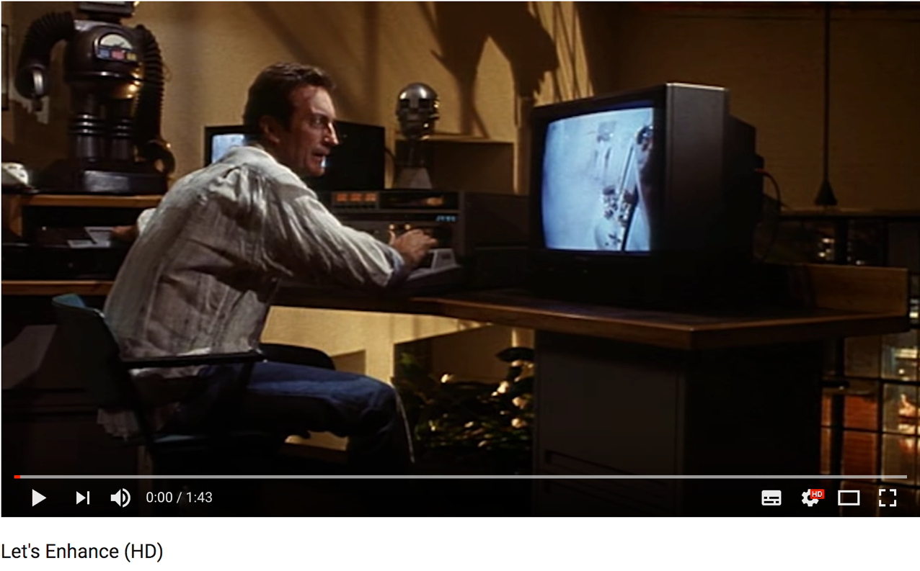
Let’s enhance

