Slide 1
CS4670/5670: Intro to Computer Vision
Instructor: Bharath Hariharan
Image credit Ross Girshick
Image credit Ira Kemelmacher-Shlizerman

Slide 2
Instructor
Bharath Hariharan (bharathh@cs.cornell.edu)
Office hours:
M/W/Thur: 10:00-11:00 am, or by appointment
Research interests:
Computer vision
Machine learning

Slide 3
Today
What is computer vision?
Course overview

Slide 4
Today
Readings
Szeliski, Chapter 1 (Introduction)

Slide 5
Every image tells a story
Goal of computer vision: perceive the “story” behind the picture
But what does “story” mean?
Depends on what we want to do with it!

Slide 6
Why Computer Vision? Example 1: Robotics
Notes:
Need computer vision to perceive the world
Why do we need perception?
Example 1: robots in environments humans can’t go, like Mars Rover.
Navigating requires understanding environment so as to not bump into nasty things, fall into crevasses etc.
Vision useful tool because can ”see” a very large part of the environment, and potentially very far away.

Slide 7
Why Computer Vision? Example 1: Robotics
http://theoatmeal.com/blog/google_self_driving_car
Notes:
For robots in human environments, need to perceive not just obstacles or navigational stuff but also where humans are, what they are doing, and even what they intend to do. For example, self driving cars need to not only find out if there are pedestrians, but also figure out the intent of the pedestrian: is she going to cross? Should we wait? Etc.

Slide 8
Why Computer Vision? Example 2: Internet Vision
Notes:
Example 2: The internet is full of visual data. Need to understand this visual data to: prune out or flag objectionable content, understand what people like or hate or are looking for, and use that for nefarious purposes like selling things, or help visually impaired people consume this visual content. Example: is this livestream video the video of a crime? Should this be reported and the people apprehended? Is this just news coverage?

Slide 9
Why Computer Vision? Example 3: AR
Notes:
Example 3: A big promise nowadays is AR (Augmented Reality), where we can see virtual things interacting with the real world. This can be used for education, for visualizing in engineering and STEM fields, for playing games and so on. But for virtual things to interact correctly with the real world, need to perceive the real world properly. Is this a table? Should things bounce off of it, or sink into it? Where’s the surface of the table?

Slide 10
The goal(s) or computer vision
What is the image about?
What objects are in the image?
Where are they?
How are they oriented?
What is the layout of the scene in 3D?
What is the shape of each object?
Notes:
If we want to check for objectionable content, then we may just want to know what the image is about.
In a self driving car, we may want to know if there are any pedestrians, or other cars, in the visual field, and if so, where are they so that we don’t run into them.
We may also want to know how they are oriented in space and where they are moving.
To navigate the scene successfully, both robots and self driving cars will need to know what the layout of the scene is in 3D.
If we are building a robot that has to pick things up, it probably needs to know the location and orientation fairly precisely, but it will also need to know the shape of the object and where it can be grasped.
And so on.
As humans, we do this fairly easily, and so many of you may not understand why this is so hard. Give example.

Slide 11
Vision is easy for humans

Slide 12
Vision is easy for humans

Slide 13
Vision is easy for humans
Attneave’s cat

Slide 14
Vision is easy for humans
Mooney faces

Slide 15
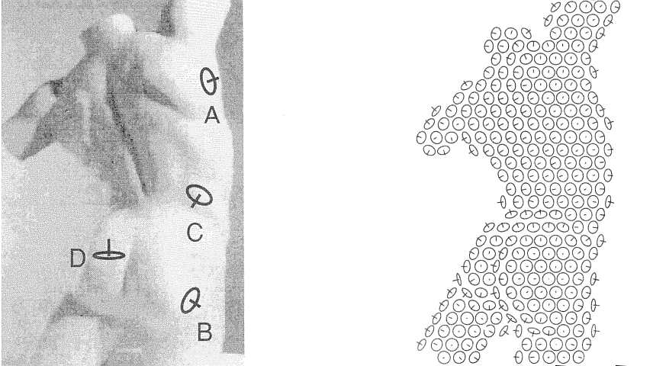
Vision is easy for humans
Surface perception in pictures. Koenderink, van Doorn and Kappers, 1992
Slide credit: Jitendra Malik

Slide 16
Vision is easy for humans
Source: “80 million tiny images” by Torralba, et al.

Slide 17
Vision is easy for humans
Source: “80 million tiny images” by Torralba, et al.

Slide 19
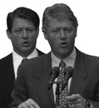
…but not always
Sinha and Poggio, Nature, 1996

Slide 20
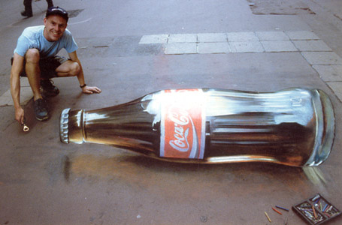
Vision is hard: Images are ambiguous

Slide 21
Vision is hard: Objects blend together
Notes:
For example, do you see something weird in this photograph of a Hollywood actor?
Do you think the actor’s body is this?

Slide 22
Vision is hard: Objects blend together
Notes:
And the thing is, a lot of the animal life on this planet has evolved to take advantage of this ambiguity, through camouflage.
Do you see the spider in here?
If we want a system that can detect spiders and lions and tigers and leopards in their natural environments, well we have to find a way around this ambiguity.

Slide 23
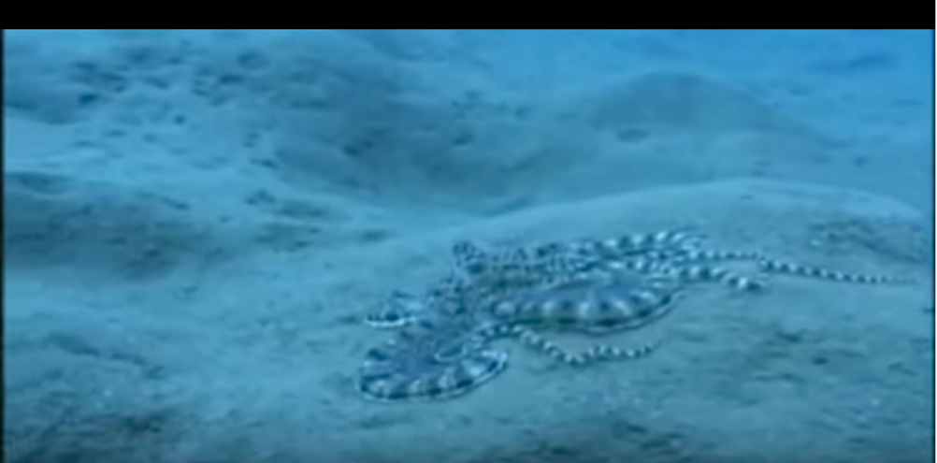
Vision is hard: Concepts have variance
Notes:
As if this ambiguity is not enough, a lot of things in the world can change shape and can look very different when you look at them from different directions. This mimic octopus here is a particularly egregious example, as it intentionally pretends to be something else.

Slide 24
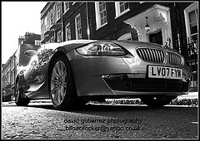
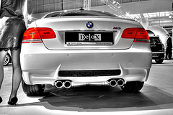
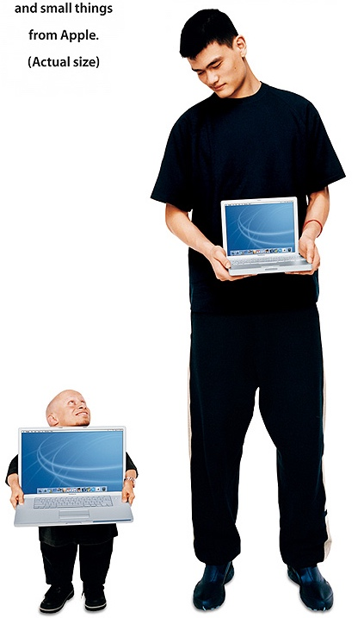
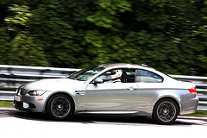
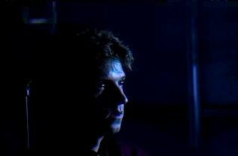
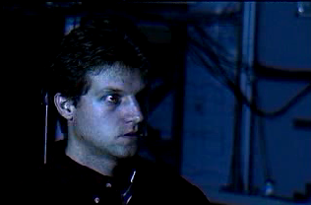
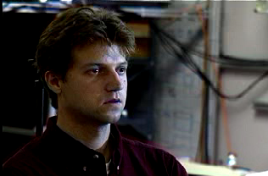
The many faces of intra-class variance
Viewpoint variation
Scale
Illumination

Slide 25
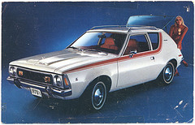
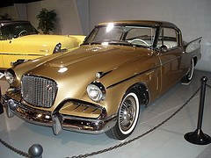
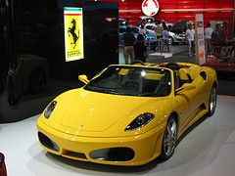
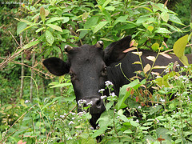
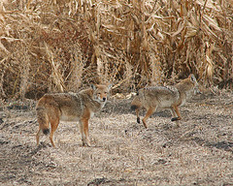
The many faces of intra-class variance
Shape variation
Occlusion
Background clutter

Slide 26
The many faces of intra-class variation
Notes:
In addition, there is also a lot of variation among instances of the same kind of object.
This here, for example, is a very weird kind of chair.
It looks nothing like a chair, but it offers exactly the same functionality as a chair.
Our vision systems need to ignore, or be invariant to, such vast variations, and recognize things for what they really are.

Slide 27
Vision is hard: Concepts are subtle
Tenessee Warbler
Orange Crowned Warbler
https://www.allaboutbirds.org
Notes:
At the same time, two things might look very similar, but be completely different. For example, these are two different species of birds even though they look very similar.

Slide 28
Vision is hard: local ambiguity
slide credit: Fei-Fei, Fergus & Torralba

Slide 29
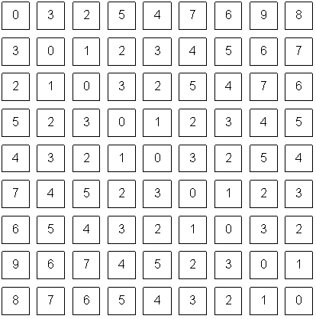
What the input looks like

Slide 30
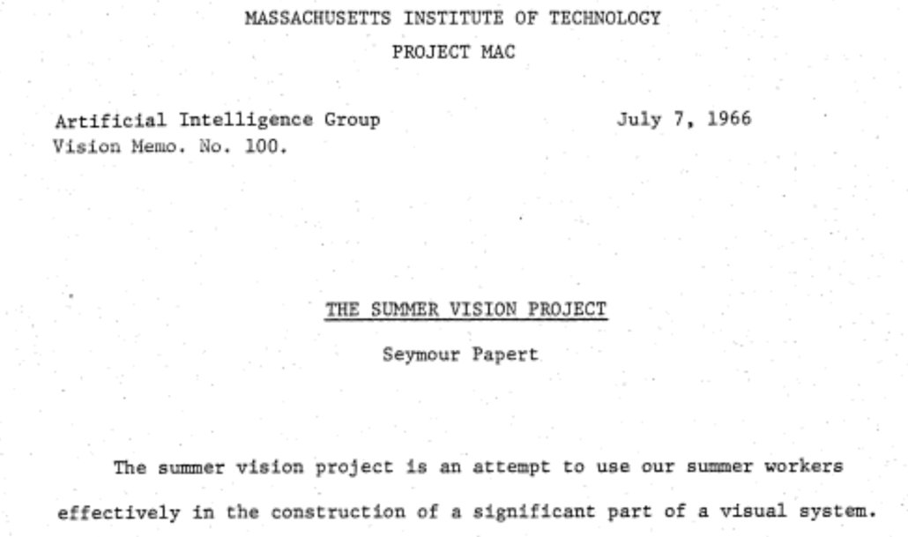
The “summer vision project”

Slide 31
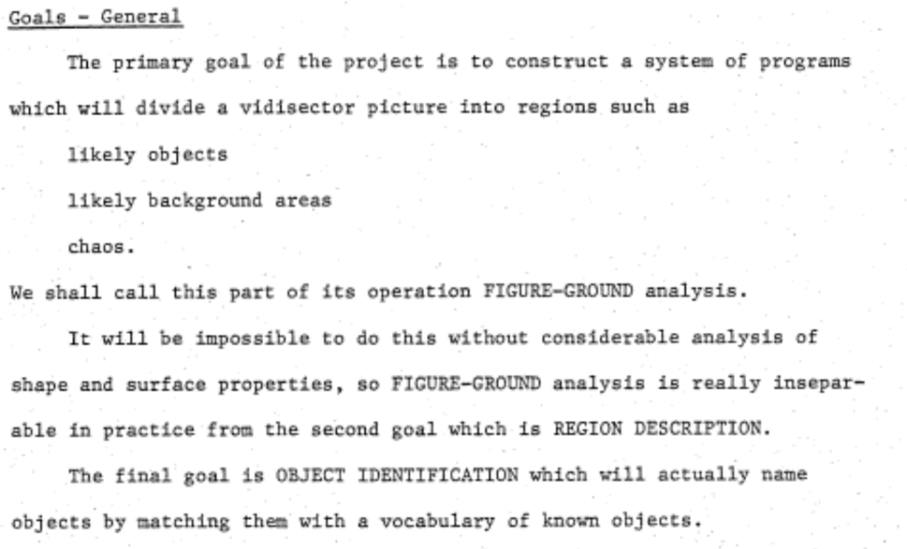
The “summer vision project”

Slide 32
The big reveal
“… in the 1960s almost no one realized that machine vision was difficult… The common and almost despairing feeling of the early investigators like B.K.P. Horn and T.O. Binford was that practically anything could happen in an image and furthermore that practically everything did."
--- Marr, 1982

Slide 33
Perception is the big problem
Our first foray into Artificial Intelligence was a program that did a credible job of solving problems in college calculus. Armed with that success, we tackled high school algebra; we found, to our surprise, that it was much harder. Attempts at grade school arithmetic provide problems of current research interest. An exploration of the child’s world of blocks proved insurmountable, except under the most rigidly constrained circumstances.
It finally dawned on us that the overwhelming majority of what we call intelligence is developed by the end of the first year of life.”
– Marvin Minsky, 1977

Slide 34
Cues to help us
The physics of image formation
Statistics and machine learning

Slide 35
where are we now?

Slide 36
Deployed: depth cameras
https://realsense.intel.com/stereo/
Microsoft Kinect

Slide 37
Deployed: depth cameras
Iphone TrueDepth

Slide 38
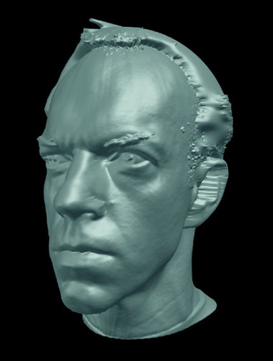
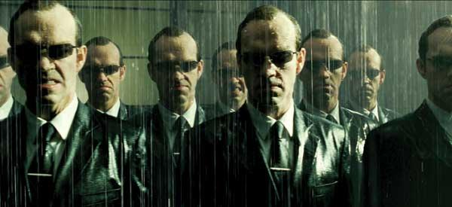
Deployed: shape capture
The Matrix movies, ESC Entertainment, XYZRGB, NRC
Source: S. Seitz

Slide 39
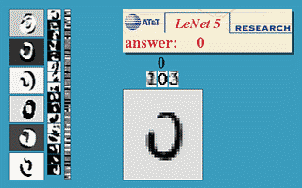
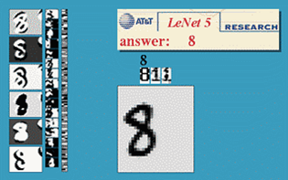
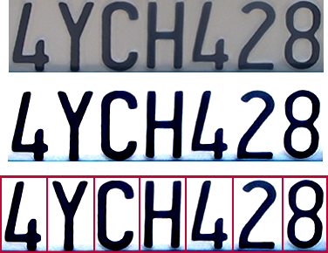
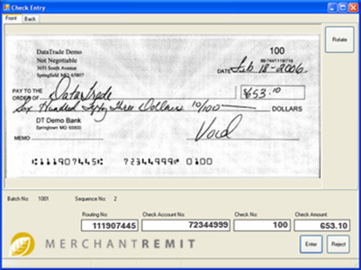
Deployed: Optical character recognition (OCR)
If you have a scanner, it probably came with OCR software
Digit recognition, AT&T labs
http://www.research.att.com/~yann/
License plate readers
http://en.wikipedia.org/wiki/Automatic_number_plate_recognition
Automatic check processing
Source: S. Seitz

Slide 40
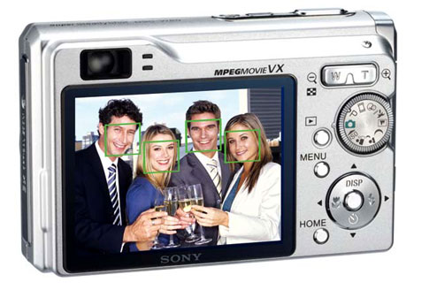
Deployed: Face detection
Cameras now detect faces
Canon, Sony, Fuji, …
Source: S. Seitz
Notes:
Why would this be useful? Main reason is focus. Also enables “smart” cropping.

Slide 41
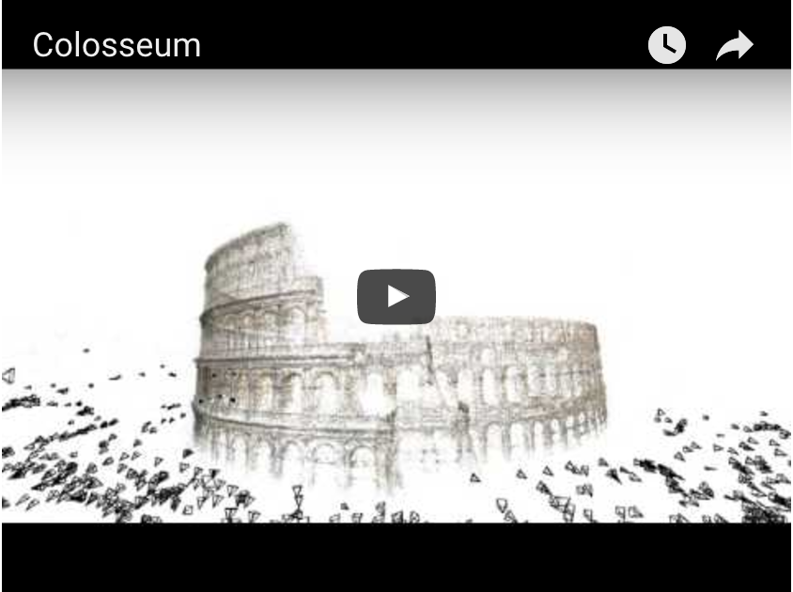
Established technology: 3D Models of the world
Building Rome in a Day. Sameer Agarwal, Noah Snavely, Ian Simon, Steven M. Seitz and Richard Szeliski. ICCV, 2009, Kyoto, Japan.

Slide 42
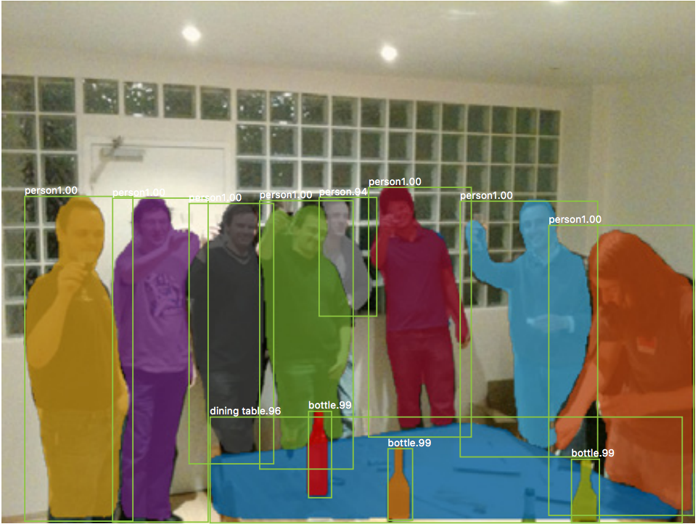
Significant progress: Recognizing objects
Mask R-CNN. Kaiming He, Georgia Gkioxari, Piotr Dollar, Ross Girshick. ICCV 2017

Slide 43
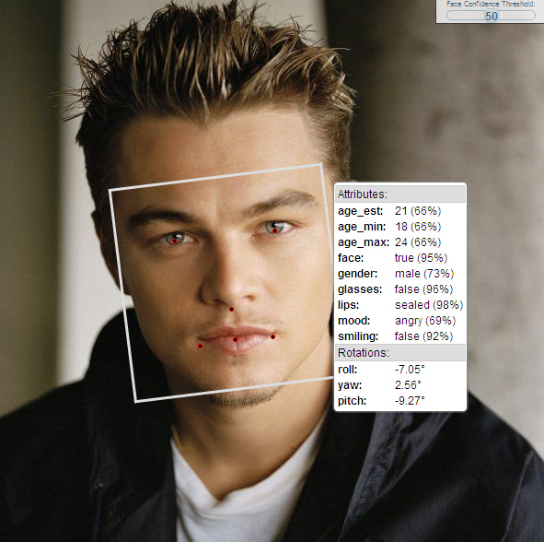
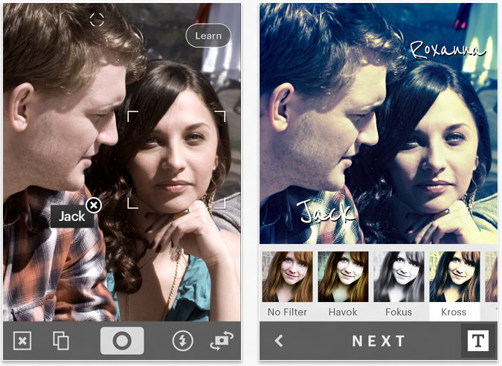
Significant progress: Face Recognition

Slide 44
Recognition-based product search

Slide 45
Significant progress: Species recognition
[iNaturalist]

Slide 46
Challenges: recognizing rare concepts
Aye-Aye

Slide 47
Challenges: recognizing rare concepts

Slide 48
Challenges: recognizing rare concepts

Slide 49
Challenges: Recovering 3D structure from limited views

Slide 50
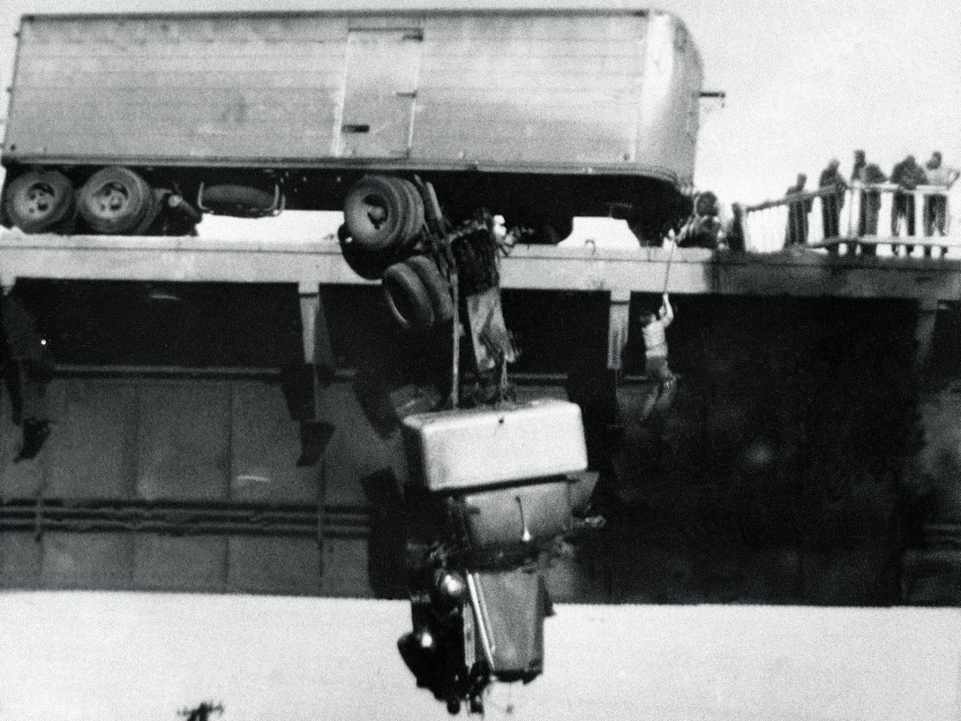
Challenges: Reasoning
What is going to happen next?
Virginia M. Schau
slide adapted from Larry Zitnick

Slide 51
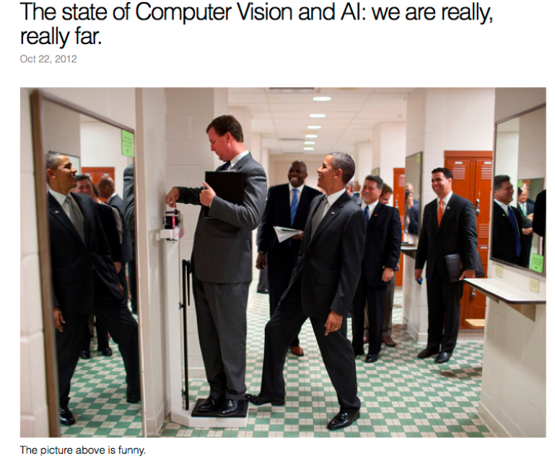
Why is this funny?
Andrej Karpathy

Slide 52
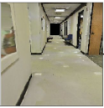
Challenges: Integrating Vision and Action
Plan
Turn left
Map
Cognitive Mapping and Planning for Visual Navigation
Saurabh Gupta, James Davidson, Sergey Levine, Rahul Sukthankar, Jitendra Malik
CVPR 2017
Notes:
Finally, recall that I mentioned that a goal of computer vision is to extract enough information from the visual world so that it is useful to some downstream action you want to perform. For example, if you are building a robot that needs to move about in corridors, then you might be using the visual input to build a map, and then planning in that map. Instead of building vision systems to extract the right information, can we instead directly use machine learning to train the system to do the task we are interested in?
This has the advantage that we do not need to figure out exactly what it is that the vision system should extract, and also, by doing so maybe the mapping and planning modules can learn to be resistant to the errors in the vision.

Slide 53
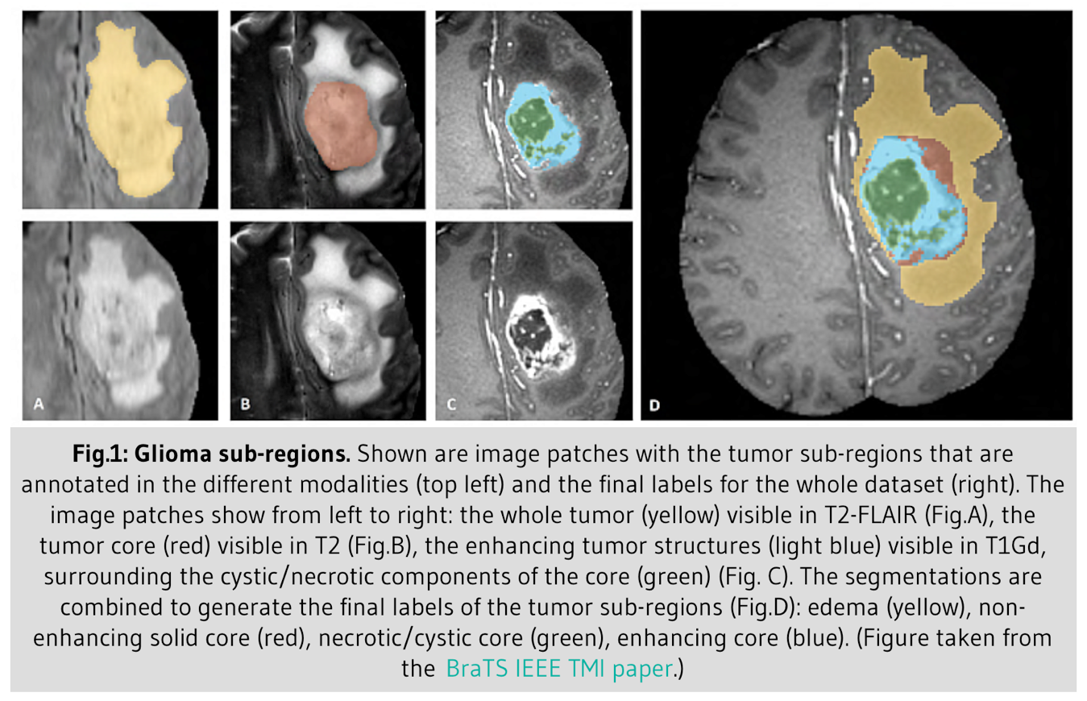
Challenges: Other imaging domains

Slide 54
Our Course

Slide 55
Instructor
Bharath Hariharan (bharathh@cs.cornell.edu)
Office hours:
M/W/Thu: 10:00-11:00, or by appointment
Research interests:
Computer vision: Object recognition
Machine learning: Deep learning

Slide 56
Important personnel
TAs:
Jimmy Briggs
Danlu (Athena) Huang
Alvin Zhu
Yiwei Ni
Karun Singh
Zhiqiu (Douglas) Lin

Slide 57
Other administrative details
Textbook:
Rick Szeliski, Computer Vision: Algorithms and Applications
online at: http://szeliski.org/Book/
Course webpage (lectures, assignments, OH): http://www.cs.cornell.edu/courses/cs4670/2018sp/
Announcements/grades via Piazza/CMS
Sign up on piazza
https://cmsx.cornell.edu/

Slide 58
Course requirements
Prerequisites—these are essential!
Data structures
A good working knowledge of python programming
Linear algebra
Calculus (plus basic multivariate calculus)
Course does not assume prior imaging experience
computer vision, image processing, graphics, etc.

Slide 59
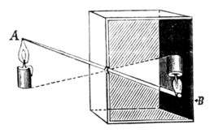
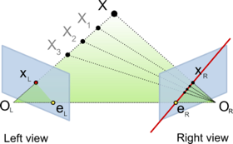
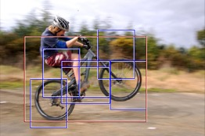
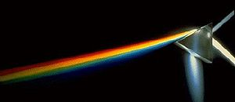
Course overview (tentative)
Low and mid-level vision
basic image formation
image processing, segmentation
Reconstruction
cameras, geometry and physics of image formation
stereo, structure from motion
Recognition
primer on machine learning, convolutional networks
classification, detection, segmentation

Slide 60
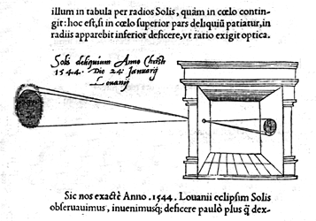
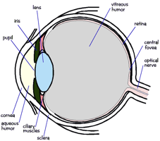
1. Low-level vision
Basic image processing and image formation
*
=
Filtering, edge detection
Image formation

Slide 61
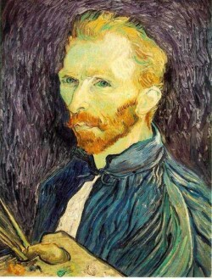
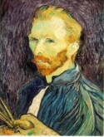
Project: Multiscale pyramids
G 1/8
G 1/4
Gaussian 1/2

Slide 62
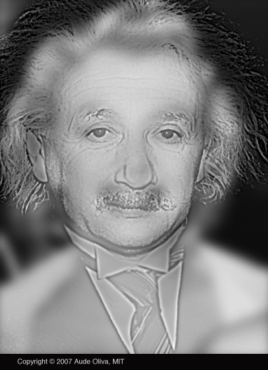

Slide 63
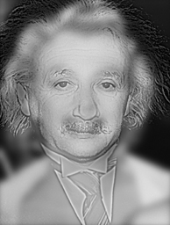

Slide 64
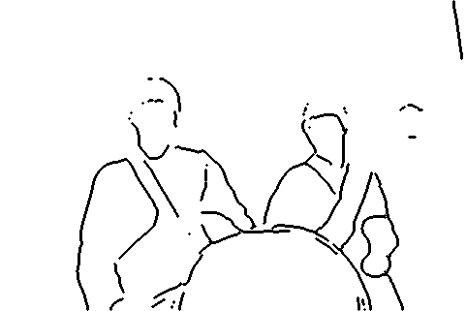
Project: Grouping and segmentation

Slide 65
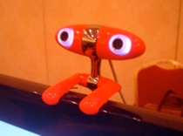
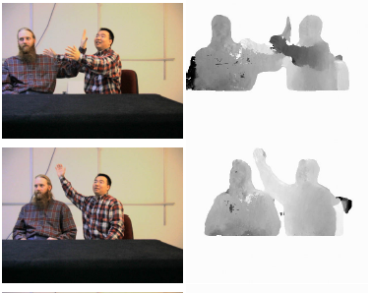
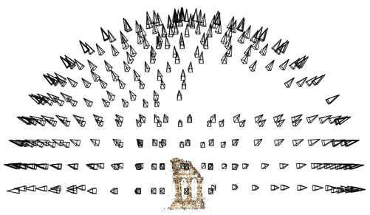
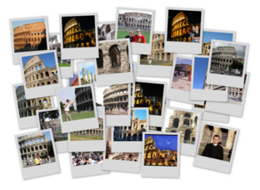
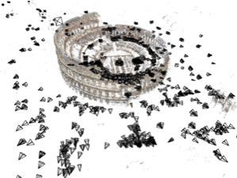
2. Reconstruction
Projective geometry
Stereo
Multi-view stereo
Structure from motion

Slide 66
Project: Feature detection and matching

Slide 67
Project: Stereo and photometric stereo

Slide 68
3. Recognition
“Cat”
Image classification
Object detection
cat
grass
Semantic segmentation
Sources: D. Lowe, L. Fei-Fei

Slide 69
Project: Deep learning for classification
Horse

Slide 70
Grading
One prelim, one final exam
Rough grade breakdown:
Midterm: 15-20%
Homeworks: 10-20%
Programming projects: 40-50%
Final exam: 15-20%

Slide 71
Late policy
Five free “slip days” will be available for the semester

Slide 72
Academic Integrity
Homeworks have to be done alone
No discussing
Assignments in pairs

Slide 73
Questions?

