Slide 1
Lecture 3: Filtering and Edge detection
CS4670/5670: Computer Vision
Kavita Bala

Slide 2
Announcements
PA 1 will be out later this week (or early next week)
due in 2 weeks
to be done in groups of two – please form your groups ASAP
Piazza: make sure you sign up
CMS: mail to Megan Gatch (mlg34@cornell.edu)

Slide 3

Mean filtering/Moving Average
Replace each pixel with an average of its neighborhood
Achieves smoothing effect
Removes sharp features
1
1
1
1
1
1
1
1
1

Slide 4
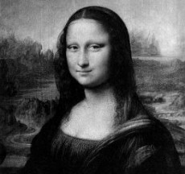
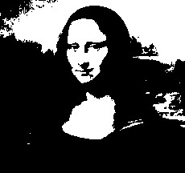

Filters: Thresholding

Slide 5
Linear filtering
One simple version: linear filtering
Replace each pixel by a linear combination (a weighted sum) of its neighbors
Simple, but powerful
Cross-correlation, convolution
The prescription for the linear combination is called the “kernel” (or “mask”, “filter”)
10
5
3
0
0
0
4
6
1
0
0.5
0
8
1
1
8
0
1
0.5
Local image data
kernel
Modified image data
Source: L. Zhang

Slide 6
Filter Properties
Linearity
Weighted sum of original pixel values
Use same set of weights at each point
S[f + g] = S[f] + S[g]
S[k f + m g] = k S[f] + m S[g]

Slide 7
Linear Systems
Is mean filtering/moving average linear?
Is thresholding linear?
Notes:
Draw 2 boxes with 1’s and 2’s. The sum of them is 3s. The average is 1, 2 and 3 respectively and can be achieved separately or together.
Thresholding is not linear
F1 = 1 > T (where T = 2)
F2 = 2 > T (where T = 2). Output is 0
F1 + F2 > T. Output is 1
Let threshold be 2

Slide 8
Filter Properties
Linearity
Weighted sum of original pixel values
Use same set of weights at each point
S[f + g] = S[f] + S[g]
S[p f + q g] = p S[f] + q S[g]
Shift-invariance
If f[m,n] ➔g[m,n], then f[m-p,n-q] ➔ g[m-p, n-q]
The operator behaves the same everywhere
S
S

Slide 9
Overview
Two important filtering operations
Cross correlation
Convolution
Sampling theory
Multiscale representations

Slide 10



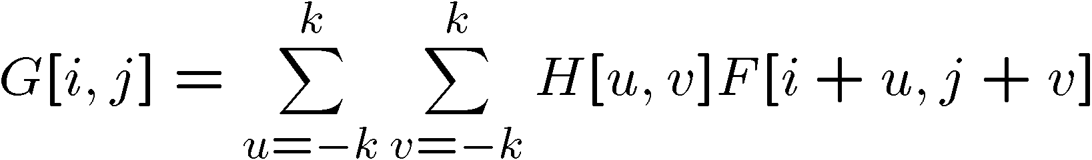

Cross-correlation
Let be the image, be the kernel (of size 2k+1 x 2k+1), and be the output image
Can think of as a “dot product” between local neighborhood and kernel for each pixel
This is called a cross-correlation operation:
Notes:
Draw out the grid. And show what you are multiplying with.

Slide 11
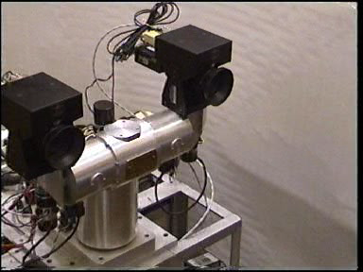
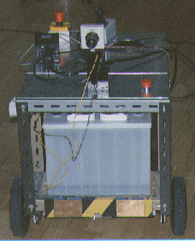
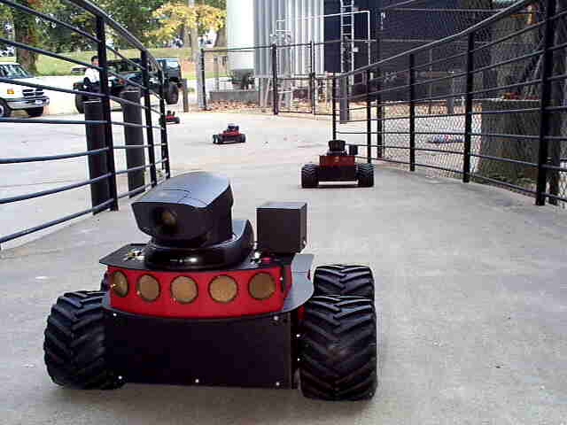
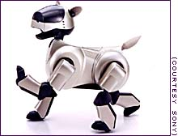
Stereo head
Camera on a mobile vehicle

Slide 12
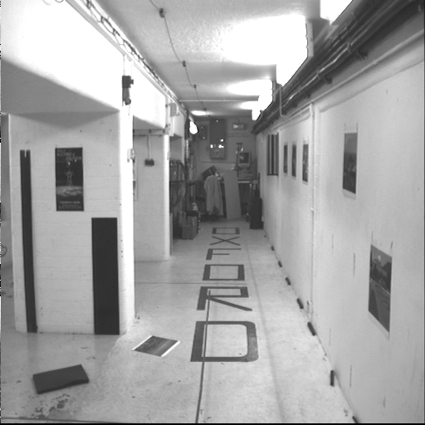
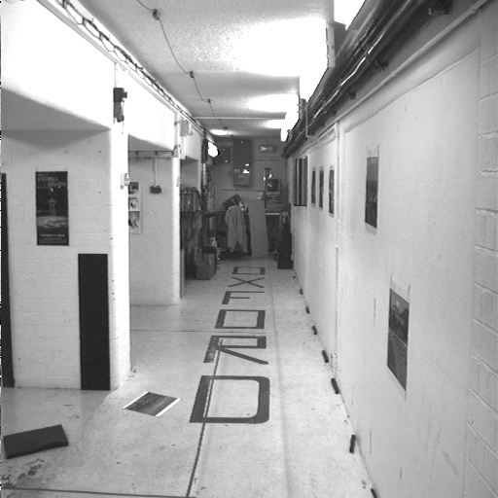
Example image pair – parallel cameras

Slide 13
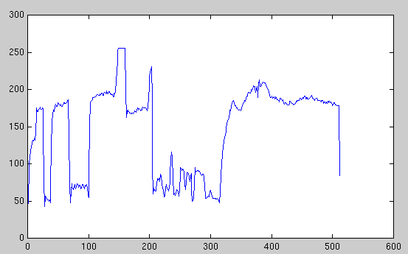
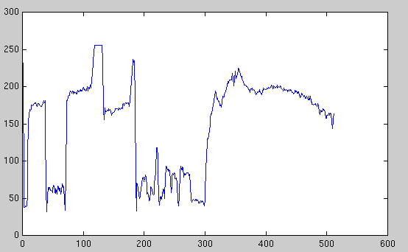
Intensity profiles
Clear correspondence between intensities, but also noise and ambiguity

Slide 14
left image band
right image band

Slide 15
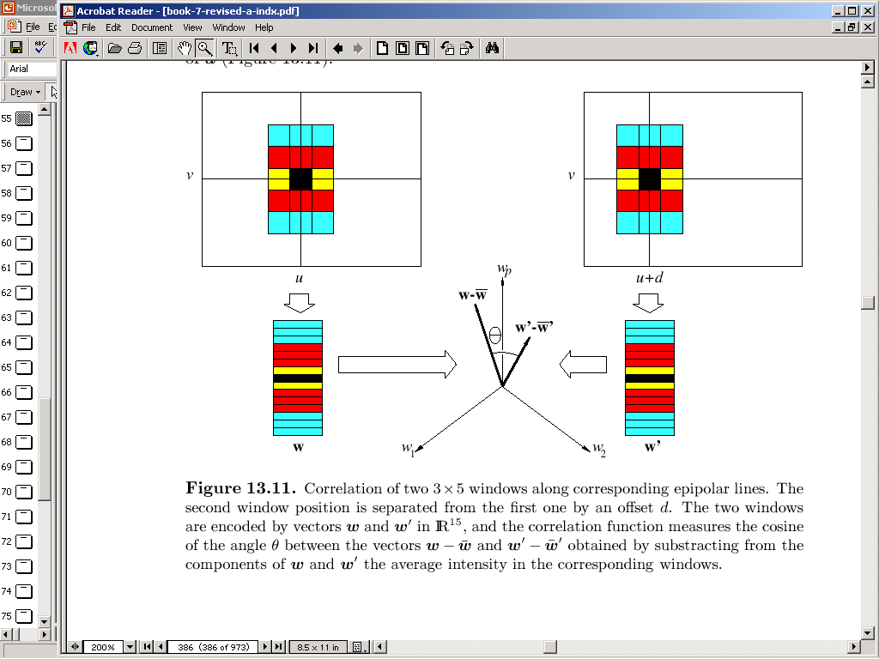

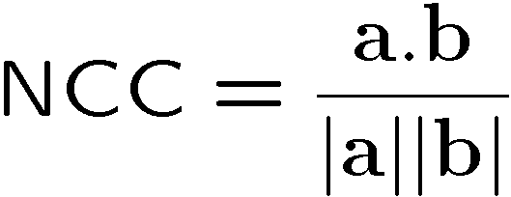
Normalized Cross Correlation
region A
region B
write regions as vectors
a
b
vector a
vector b
Notes:
Geometric interpretation

Slide 16
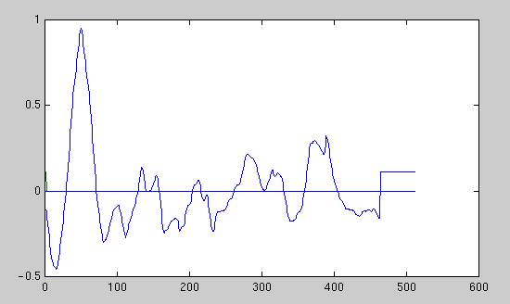
left image band
right image band
1
0.5
cross correlation
0
x

Slide 17
Cross-correlation
Let be the image, be the kernel (of size 2k+1 x 2k+1), and be the output image
Can think of as a “dot product” between local neighborhood and kernel for each pixel
This is called a cross-correlation operation:
Notes:
Draw out the grid. And show what you are multiplying with.

Slide 18
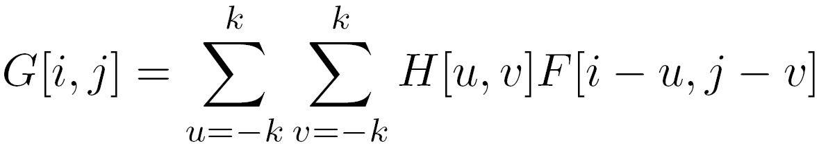

Convolution
Same as cross-correlation, except that the kernel is “flipped” (horizontally and vertically)
Convolution is commutative and associative
This is called a convolution operation:

Slide 19



Convolution
Adapted from F. Durand

Slide 20
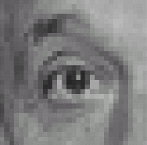
Linear filters: examples
*
0
0
0
=
1
0
0
0
0
0
Original
Shifted left
By 1 pixel
Source: D. Lowe

Slide 21
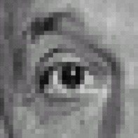



Linear filters: examples
*
0
0
0
-
1
1
1
=
0
2
0
1
1
1
0
0
0
1
1
1
Sharpening filter (accentuates edges)
Original
Source: D. Lowe

Slide 22
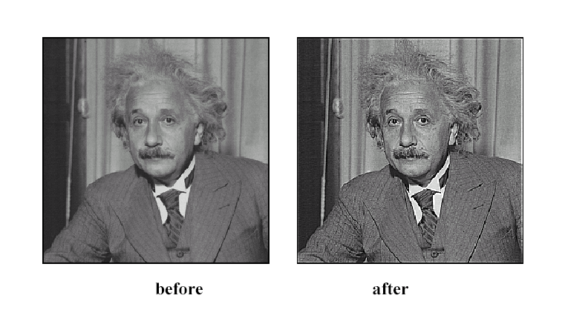
Sharpening
Source: D. Lowe

Slide 23
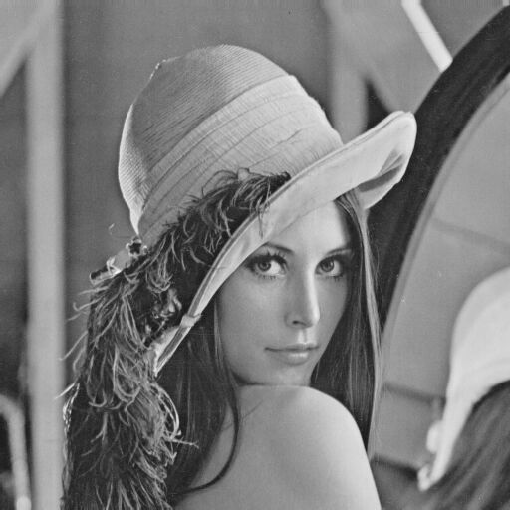
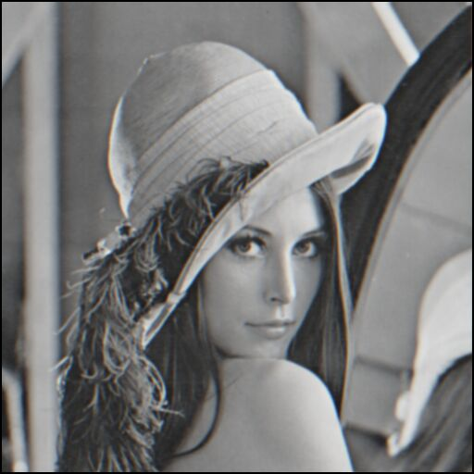
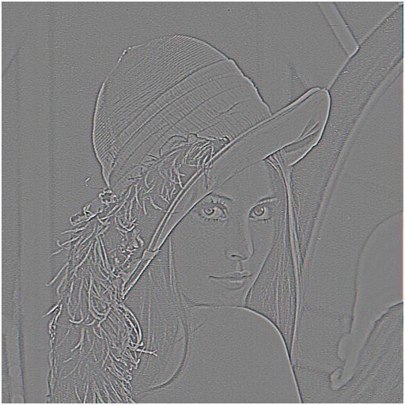

Sharpening revisited
What does blurring take away?
–
=
original
smoothed (5x5)
detail
Let’s add it back:
+ α
=
original
detail
sharpened
Source: S. Lazebnik

Slide 24
Sampling Theory

Slide 25
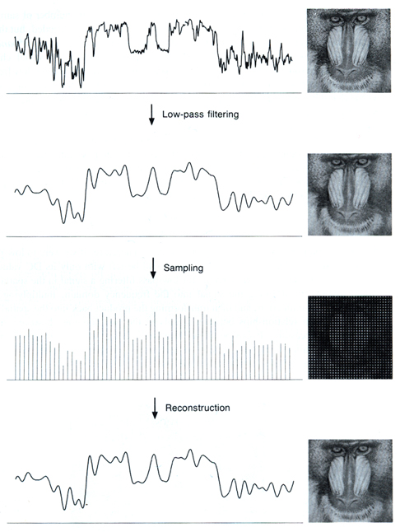
Sampled representations
[FvDFH fig.14.14b / Wolberg]

Slide 26
Reconstruction
Making samples back into a continuous function
for output (need realizable method)
for analysis or processing (need mathematical method)
[FvDFH fig.14.14b / Wolberg]

Slide 27
Roots of sampling
Nyquist 1928; Shannon 1949
famous results in information theory
1940s: first practical uses in telecommunications
1960s: first digital audio systems
1970s: commercialization of digital audio
1982: introduction of the Compact Disc
the first high-profile consumer application
This is why all the terminology has a communications or audio “flavor”
early applications are 1D; for us 2D (images) is important

Slide 28
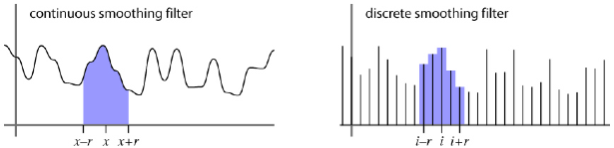
Filtering
Processing done on a function
in continuous form
also using sampled representation
Simple example: smoothing by averaging

Slide 29
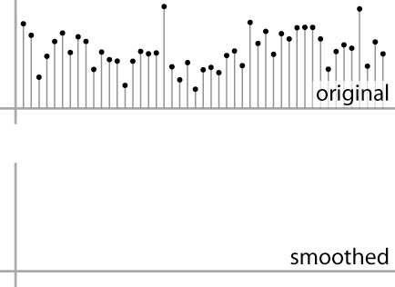
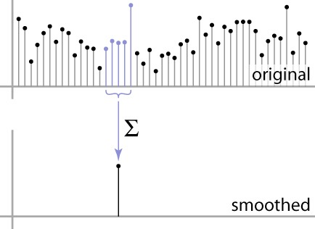
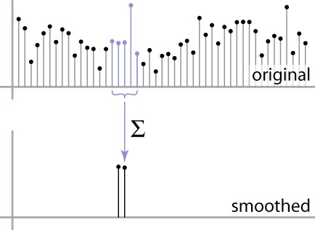
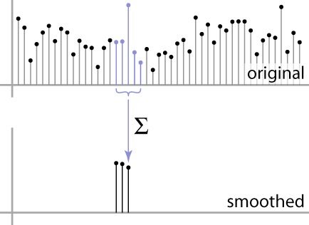
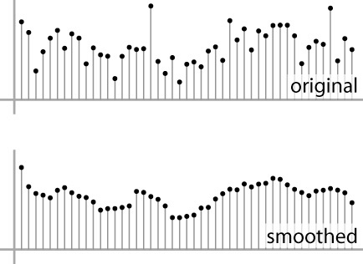
Convolution warm-up
basic idea: define a new function by averaging over a sliding window
a simple example to start off: smoothing

Slide 30
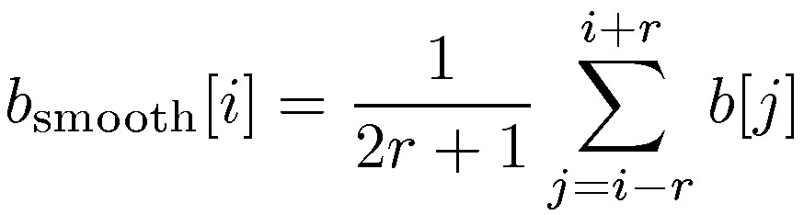
Convolution warm-up
Same moving average operation, expressed mathematically:

Slide 31
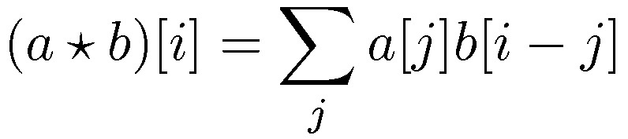
Discrete convolution
Simple averaging:
every sample gets the same weight
Convolution: same idea but with weighted average
each sample gets its own weight (normally zero far away)
This is all convolution is: a moving weighted average
Notes:
-2, 2
a(-2) b (10+2) + a (-1) b (10+1) + a (0) b (10) + a (1) b (10-1) + a (2) b (10-2)

Slide 32
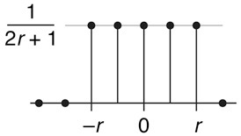
Filters
Sequence of weights a[j] is called a filter
Filter is nonzero over its region of support
usually centered on zero: support radius r
Filter is normalized so that it sums to 1.0
this makes for a weighted average
not just any old weighted sum
Most filters are symmetric about 0
since for images we usually want to treat left and right the same
a box filter

Slide 33
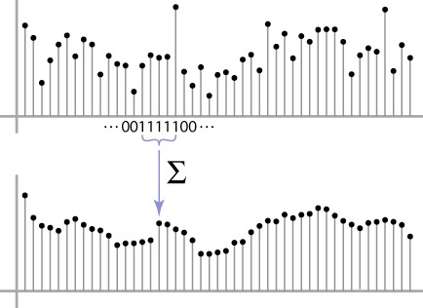
Convolution and filtering
Can express sliding average as convolution with a box filter
a_{box} = […, 0, 1, 1, 1, 1, 1, 0, …]

Slide 34
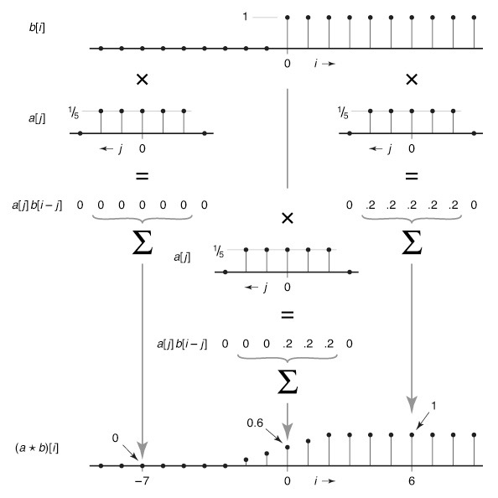
Example: box and step

Slide 35
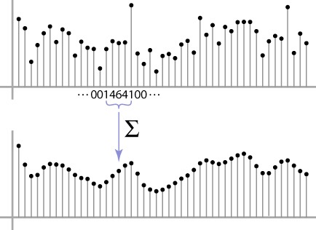
Convolution and filtering
Convolution applies with any sequence of weights
Example: Bell curve (Gaussian-like)
[…, 1, 4, 6, 4, 1, …]/16

Slide 36
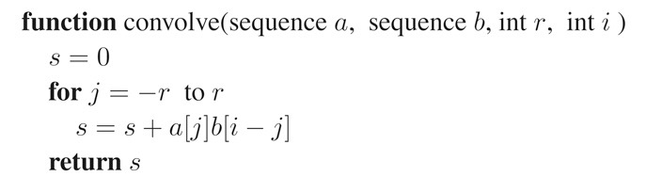
And in pseudocode…

Slide 37






Discrete convolution
Notation:
Convolution is a multiplication-like operation
commutative
associative
distributes over addition
scalars factor out
identity: unit impulse e = […, 0, 0, 1, 0, 0, …]
Conceptually no distinction between filter and signal

Slide 38
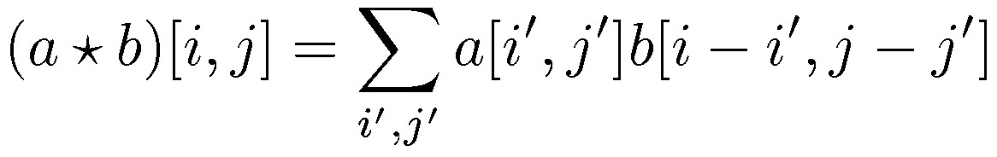
Discrete filtering in 2D
Same equation, one more index
now the filter is a rectangle you slide around over a grid of numbers
Commonly applied to images
blurring (using box, gaussian, …)
sharpening
Usefulness of associativity
often apply several filters one after another:
(((a * b₁) * b₂) * b₃)
this is equivalent to applying one filter:
a * (b₁ * b₂ * b₃)

Slide 39
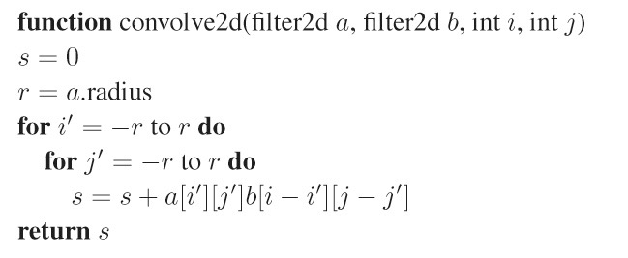
And in pseudocode…

Slide 40

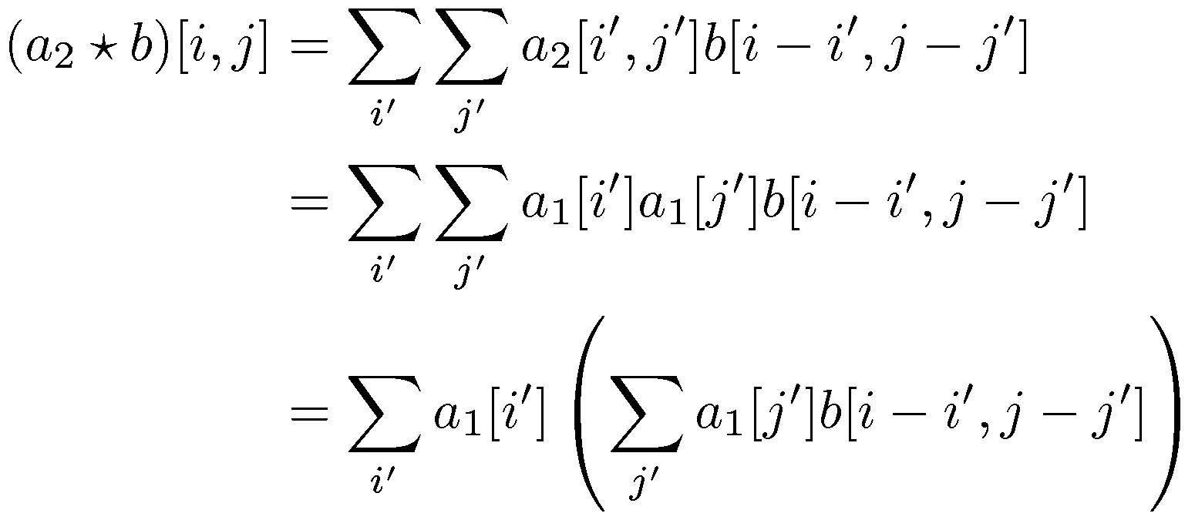
Optimization: separable filters
basic alg. is O(r²): large filters get expensive fast!
definition: a₂(x,y) is separable if it can be written as:
this is a useful property for filters because it allows factoring:

Slide 41



[Philip Greenspun]
two-stage resampling using a separable filter

Slide 42
A gallery of filters
Box filter
Simple and cheap
Tent filter
Linear interpolation
Gaussian filter
Very smooth antialiasing filter
B-spline cubic
Very smooth
...

Slide 43
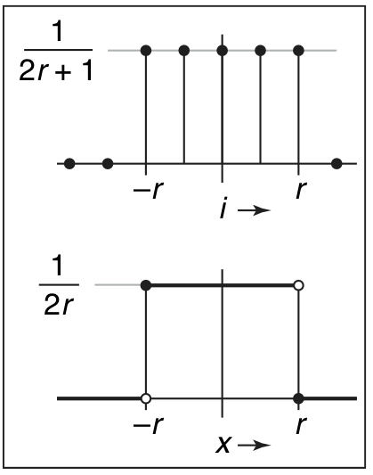
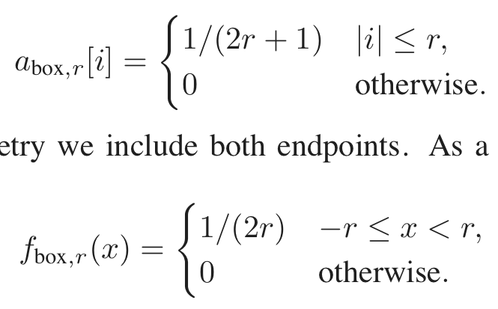
Box filter

Slide 44
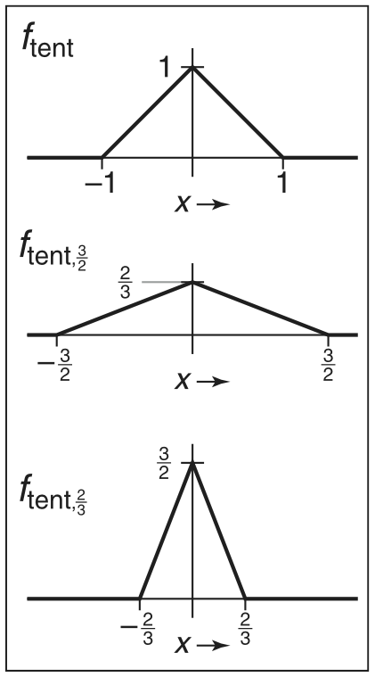
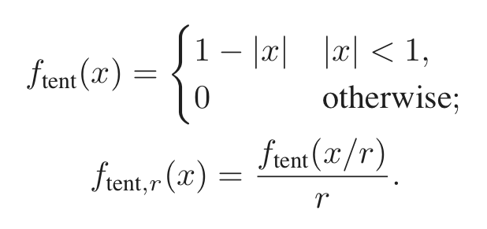
Tent filter

Slide 45
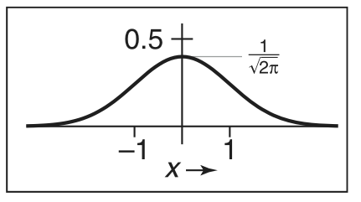
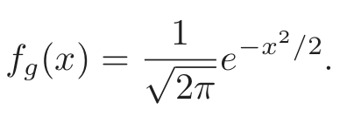
Gaussian filter

Slide 46
Reducing and enlarging
Very common operation
devices have differing resolutions
applications have different memory/quality tradeoffs
Also very commonly done poorly
Simple approach: drop/replicate pixels
Correct approach: use resampling

Slide 47

1000 pixel width
[Philip Greenspun]

Slide 48




[Philip Greenspun]
by dropping pixels
gaussian filter
250 pixel width

Slide 49


[Philip Greenspun]
box reconstruction filter
bicubic reconstruction filter
4000 pixel width

Slide 50








[Philip Greenspun]
original | box blur
sharpened | gaussian blur

Slide 51
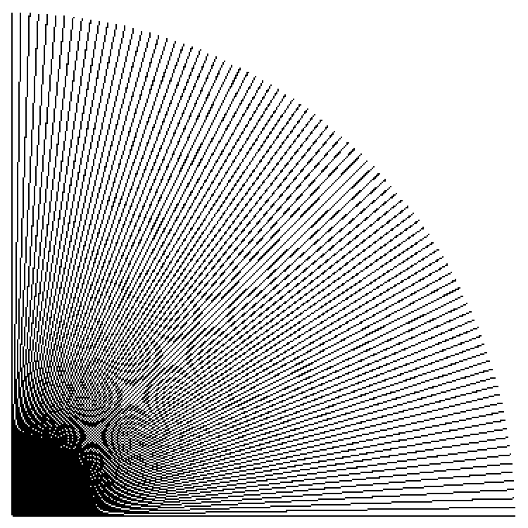
Point sampling
in action
Cornell CS4620 Fall 2015 • Lecture 23

Slide 52
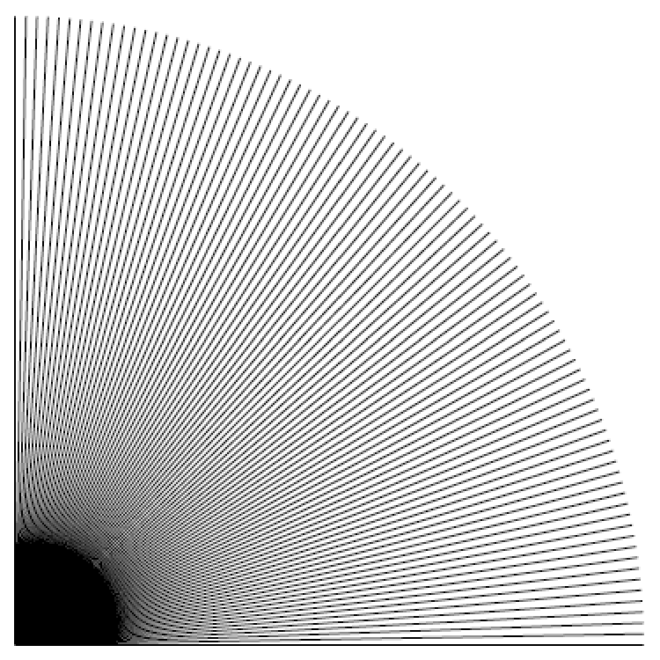
Box filtering
in action
Cornell CS4620 Fall 2015 • Lecture 23

Slide 53

Gaussian filtering
in action
Cornell CS4620/5620 Fall 2012 • Lecture 26
© 2012 Kavita Bala •
(with previous instructors James/Marschner)

Slide 54
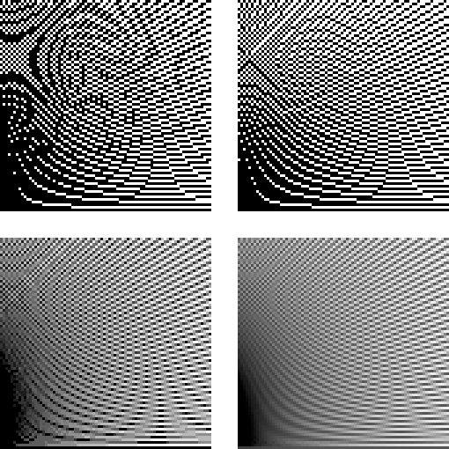
Filter comparison
Point sampling
Box filtering
Gaussian filtering
Cornell CS4620/5620 Fall 2012 • Lecture 26
© 2012 Kavita Bala •
(with previous instructors James/Marschner)

