Slide 1
Rust: A Cousin of C++ with better memory protection
Professor Ken Birman
CS4414 Lecture 27

Slide 2
Idea Map For Today
Many attacks exploit weak memory protection
C++ is built on C… and C is fundamentally unsafe
Rust idea
How well does it work?
What are the criticisms of Rust?
Today’s entire lecture borrows heavily from a lecture open-sourced by Prof. Wu-chang Feng at Portland State University, where they use Rust as their systems programming language

Slide 3
C++ is deeply connected to C
After templates are expanded and constexpr is resolved, C++ “transforms” to a C program for compilation. The template language is a true programming language with compile-time loops, conditional statements, function calls. Yet it reduces to “plain old C.”
Thus, many weaknesses of C translate to vulnerabilities in C++
To compensate we use logical reasoning to ensure safety and Valgrind as a debugging tool (but Valgrind is very slow)

Slide 4
C (the good parts)
Efficient code especially in resource-constrained environments
Direct control over hardware such as network interfaces and GPUs
Performance over safety
Memory managed manually (“wrap” C++ pointers to improve safety)
No periodic garbage collection (instead, each call to free incrementally updates the heap)
Favored by advanced programmers: total control

Slide 5
But…
Even with this help, both C and C++ make it very easy to make mistakes involving misuse of pointers.
C also has issues with type coercion (C++ fixes them!):
Integer promotion/coercion errors (where the code specifies the size of an integer, but then uses it in a way inconsistent with the size)
Unsigned vs. signed errors (in C, conversions back and forth are legal and won’t even trigger a warning… C++ will warn)
Integer casting errors (easy to misunderstand the rules)

Slide 6
and… in both C and C++…
Memory pointer errors are very easy to make
Dereferencing a null pointer
Buffer overflows, out-of-bound access (no array-bounds checking)
Format string errors in printf or std::cout
Dynamic memory errors (Memory leaks, use-after-free (dangling pointer), double free of a pointer)
All of these can cause software crashes and security vulnerabilities.

Slide 7
Example: C-style pointers in C or C++
Lightweight, low-level control of memory
typedef struct { int a; int b; } Dummy;
void foo() {
Dummy *ptr = (Dummy *) malloc(sizeof(struct Dummy));
ptr->a = 2048;
free(ptr);
}
Precise memory layout
Lightweight reference
Destruction
.a = 2048
.a
ptr
.b
Stack
Heap

Slide 8
… issue: errors go undetected
typedef struct { int a; int b; } Dummy;
void foo() {
Dummy *ptr = (Dummy *) malloc(sizeof(struct Dummy));
Dummy *alias = ptr;
free(ptr);
int a = alias.a;
free(alias);
}
Use after free
Aliasing
Mutation
Double free
Dangling Pointer
.a
ptr
.b
alias
Stack
Heap

Slide 9
These issues are all Solved by managed languages, but they are often slow
Java, Python, Ruby, C#, Scala, Go...
All of them restrict direct access to memory with run-time management of memory via garbage collection. But…
They pay a high overhead for tracking pointer use and array-index safety
Performance can be unpredictable due to GC (bad for real-time systems)
Limited concurrency (global interpreter lock typical)
In some cases a VM is required (like for Python)
Need more memory and CPU power (i.e. not bare-metal)

Slide 10
Requirements for system programMing
The language must be fast and have minimal runtime overhead
Developer should be able to visualize every action the entire system is performing and gain control over everything.
We often need direct memory access, but wish it was memory-safe

Slide 11
Rust
Rust is named after a fungus that is robust, distributed, and parallel.
It is also a subsequence of "robust".

Slide 12
Rust
From the official website (http://rust-lang.org):
Rust is a true system programming language.
No runtime requirement (runs fast)
Control over memory allocation/destruction.
Guarantees memory safety
Created by Monzilla to address severe memory leakage and corruption bugs in Firefox. First stable release in 5/2015

Slide 13
Rust overview
Performance, as with C or C++, similar look and feel as C++
Rust compiles to object code for bare-metal performance
Supports memory safety
Programs cannot dereference pointers that have been freed
Out-of-bound array accesses not allowed
Relatively low overhead
Compiler checks to make sure rules for memory safety are followed
Zero-cost abstraction in managing memory (i.e. no garbage collection)

Slide 14
Rust overview
How is this done? Like C++, much occurs at compile time!
Advanced type system
Novel language features to prevent memory and pointer issues
But there is a cost
Cognitive cost to programmers who must think more about rules for using memory and references as they program
Less control of the kind needed for ML and HPC programming

Slide 15
More on this last point (1)?
Recall fast word-count. Sagar first turned every file into std::strings, but then discarded most of the strings. A wasteful design.
Ken had a layer that operated directly on data in character buffers. This uses pointers to ascii chars in arrays.
In Rust, pointer logic like what Ken did is much harder to implement because the compiler perceives it as unsafe. Inserting safety checks for every pointer dereference is similarly wasteful.

Slide 16
More on this last point (2)?
Think about our lectures on SIMD, where we needed to control layout of data structures in memory to ensure that the alignment rules for data would be “visible” to the C++ compiler, and used templates + inlining + constexpr to preserve code elegance.
In Rust it can be hard or impossible to get the same kinds of guarantees. Rust lacks C++’s template “language”.

Slide 17
Rust is also at odds with direct-mapped GPU memory, DMA and RDMA
Device-mapped memory and mapped files can be exposed, but Rust protects accessing that memory with costly overheads.
All forms of direct memory transfers from network, disk or GPU are inherently unsafe, as are shared segments and VM page remapping: features advanced C++ developers often use.

Slide 18
Rust’s type system

Slide 19
Rust types look much like C/C++ types
Numeric types specified with width. The Unicode char default might surprise some C or C++ developers.
Primitive types
bool
char (4-byte unicode)
i8/i16/i32/i64/isize
u8/u16/u32/u64/usize
F32/f64

Slide 20
C types have some idiosyncrasies.
C “overloads” integers to get Booleans. Can create ambiguity: an integer isn’t limited to just 0 or 1.
True, False, or Fail? 1, 0, -1? Misinterpretations lead to security issues
Example: In the PHP is a widely used C library for web programming. In it, strcmp returns 0 for both equality *and* failure!
C++ offers a true Boolean type. If you use it, this can’t occur

Slide 21
C, C++ array type
In Rust, arrays stored with their length [T; N]
Allows for both compile-time and run-time checks on array access via[]
C
Rust
void main() {
int nums[8] = {1,2,3,4,5,6,7,8};
for ( x = 0; x < 10; i++ )
printf(“%d\n”,nums[i]);
}

Slide 22
Rust and bounds checking
But…
Checking bounds on every access adds overhead
Arrays typically accessed via more efficient iterators to allow compile time checking, avoid runtime overheads
Can use x86 loop instruction

Slide 23
Rust is very cautious about coersions
In C code, you can cast any integer to an unsigned integer of the same size, or back. C++ doesn’t allow this… except when compiling C
-1 casts to 2147483648 (largest uint32). Is this what a developer intended? The C specification just says this is an “undefined” cast!
A European rocket once veered wildly off course, then exploded because one module used unsigned int, but another used signed int.

Slide 24
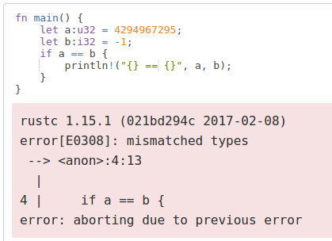
Rust vs C typing errors
C has confusing implicit integer casts and promotion
-1 > 0U
2147483647U < -2147483648
Rust’s type system prevents such comparisons
void main() {
unsigned int a = 4294967295;
int b = -1;
if (a == b)
printf("%u == %d\n",a,b);
}
mashimaro <~> 9:44AM % ./a.out
4294967295 == -1

Slide 25
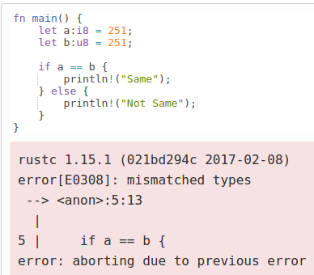
Rust vs C typing errors
Same or different?
void main() {
char a=251;
unsigned char b = 251;
printf("a = %x\n", a);
printf("b = %x\n", b);
if (a == b)
printf("Same\n");
else
printf("Not Same\n");
}
mashimaro<> % ./a.out
a = fffffffb
b = fb
Not Same

Slide 26
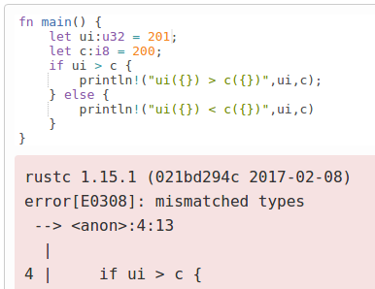
Rust vs C typing errors
201 > 200?
#include <stdio.h>
void main() {
unsigned int ui = 201;
char c=200;
if (ui > c)
printf("ui(%d) > c(%d)\n",ui,c);
else
printf("ui(%d) < c(%d)\n",ui,c);
}
mashimaro <~> 12:50PM % ./a.out
ui(201) < c(-56)

Slide 27
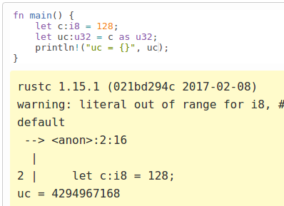
Rust vs C typing errors
In Rust, casting is allowed via the “as” keyword
Follows similar rules as C
But, warns problem before performing the promotion with sign extension. C++ does this too, but because C code can be pulled in so easily…
#include <stdio.h> void main() { char c=128; unsigned int uc; uc = (unsigned int) c; printf("%x %u\n",uc, uc);
}
mashimaro <~> 1:24PM % ./a.out
ffffff80 4294967168

Slide 28
Rust vs C typing errors
C has issues with unchecked underflow and overflow
Silent wraparound in C caught by runtime check in Rust
void main() {
unsigned int a = 4;
a = a - 3;
printf("%u\n",a-2);
}
mashimaro <~> 9:35AM % ./a.out
4294967295

Slide 29
Example: A famous C vulnerability
DNS parser vulnerability discussed in B&O, Chapter 2
count read as byte, then count bytes concatenated to nameStr
char *indx;
int count;
char nameStr[MAX_LEN]; //256
...
memset(nameStr, '\0', sizeof(nameStr));
...
indx = (char *)(pkt + rr_offset);
count = (char)*indx;
while (count){
(char *)indx++;
strncat(nameStr, (char *)indx, count);
indx += count;
count = (char)*indx;
strncat(nameStr, ".“, sizeof(nameStr) – strlen(nameStr));
}
nameStr[strlen(nameStr)-1] = '\0';
What if count = 128?
Sign extended then used in strncat
Type mismatch in Rust
char *strncat(char *dest, const char *src, size_t n);
http://www.informit.com/articles/article.aspx?p=686170&seqNum=6

Slide 30
Another C vulnerability
2002 FreeBSD getpeername() bug (B&O Ch. 2)
Kernel code to copy hostname into user buffer
copy_from_kernel() call takes signed int for size from user
memcpy call uses unsigned size_t
What if adversary gives a length of “-1” for his buffer size?
#define KSIZE 1024
char kbuf[KSIZE]
void *memcpy(void *dest, void *src, size_t n);
int copy_from_kernel(void *user_dest, int maxlen){
/* Attempt to set len=min(KSIZE, maxlen) */
int len = KSIZE < maxlen ? KSIZE : maxlen;
memcpy(user_dest, kbuf, len);
return len;
}
Type mismatch in Rust
(KSIZE < -1) is false, so len = -1
memcpy casts -1 to 2³²-1
Unauthorized kernel memory copied out

Slide 31
Rust’s Ownership & Borrowing
Compiler enforced:
Every resource has a unique owner.
Others can borrow the resource from its owner (e.g. create an alias) with restrictions
Owner cannot free or mutate its resource while it is borrowed.
Aliasing
Mutation
No need for runtime
Memory safety
Data-race freedom

Slide 32
Ownership and lifetimes
There can be only one “owner” of an object at a time.
When the “owner” of the object goes out of scope, its data is automatically freed
Can not access object beyond its lifetime (checked at compile-time)
struct Dummy { a: i32, b: i32 }
fn foo() {
let mut res = Box::new(Dummy {
a: 0,
b: 0
});
res.a = 2048;
}
Memory allocation
Resource owned by res is freed automatically
owns
.a = 2048
.a = 0
res
.b = 0
Heap
Stack

Slide 33
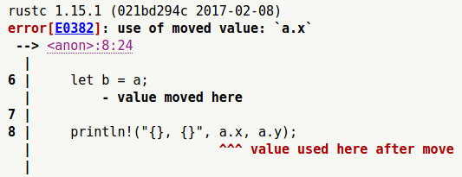
Assignment changes ownership
http://is.gd/pZKiBw

Slide 34
Ownership transfers in function calls
struct Dummy { a: i32, b: i32 }
fn foo() {
let mut res = Box::new(Dummy {
a: 0,
b: 0
});
take(res);
println!(“res.a = {}”, res.a);
}
fn take(arg: Box<Dummy>) {
}
Compiler Error. If you plan to use res again, must employ “borrow” semantics, not “move” semantics!
Ownership is moved from res to arg
arg is out of scope and the resource is freed automatically

Slide 35
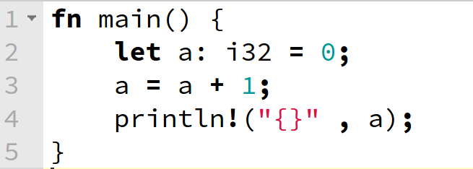
Mutability: a static form of locking
By default, Rust variables are immutable (read only)
Usage checked at compile time
mut is used to declare a resource as mutable.
fn main() {
let mut a: i32 = 0;
a = a + 1;
println!("{}" , a);
}
http://is.gd/OQDszP
rustc 1.14.0 (e8a012324 2016-12-16)
error[E0384]: re-assignment of immutable variable `a`
--> <anon>:3:5
|
2 | let a: i32 = 0;
| - first assignment to `a`
3 | a = a + 1;
| ^^^^^^^^^ re-assignment of immutable variable
error: aborting due to previous error
rustc 1.14.0 (e8a012324 2016-12-16)
1
Program ended.

Slide 36
Borrowing
You cannot borrow mutable reference from immutable object
Or mutate an object immutably borrowed
You cannot borrow more than one mutable reference (to support atomicity)
You can borrow an immutable reference many times
There cannot exist a mutable reference and an immutable one simultaneously (removes race conditions)
The lifetime of a borrowed reference should end before the lifetime of the owner object does (removes use after free)

Slide 37
Borrowing example (&)
You cannot borrow mutable reference from immutable object
struct Dummy { a: i32, b: i32 }
fn foo() {
let res = Box::new(Dummy{a: 0, b: 0});
res.a = 2048;
let borrower = &mut res;
}
Error: Resource is immutable
Error: Cannot get a mutable borrowing
of an immutable resource

Slide 38
Borrowing example (&)
You cannot mutate an object immutably borrowed
struct Dummy { a: i32, b: i32 }
fn foo() {
let mut res = Box::new(Dummy{
a: 0,
b: 0
});
take(&res);
res.a = 2048;
}
fn take(arg: &Box<Dummy>) {
arg.a = 2048;
}
Resource is returned from arg to res
Resource is immutably borrowed by arg from res
Compiler Error: Cannot mutate via
an immutable reference
Resource is still owned by res. No free here.

Slide 39
Borrowing example (&mut)
You cannot borrow more than one mutable reference
Aliasing
Mutation
struct Dummy { a: i32, b: i32 }
fn foo() {
let mut res = Box::new(Dummy{a: 0, b: 0});
take(&mut res);
res.a = 4096;
let borrower = &mut res;
}
fn take(arg: &mut Box<Dummy>) {
arg.a = 2048;
}
Mutably borrowed by arg from res but returned when take completes.
Multiple mutable borrowings
are disallowed
let alias = &mut res;
Returned from arg to res

Slide 40
Immutable, shared borrowing (&)
You can borrow more than one immutable reference
But, there cannot exist a mutable reference and an immutable one simultaneously
Aliasing
Mutation
struct Dummy { a: i32, b: i32 }
fn foo() {
let mut res = Box::new(Dummy{a: 0, b: 0});
{
let alias1 = &res;
let alias2 = &res;
let alias3 = alias2;
res.a = 2048;
}
res.a = 2048;
}

Slide 41
Use-after free in C or C++
Memory allocated to int
Then freed
Then used after free
If these calls are far away from each other,
this bug can be very hard to find.

Slide 42
Rust prevents this!
The lifetime of a borrowed reference should end before the lifetime of the owner object does

Slide 43
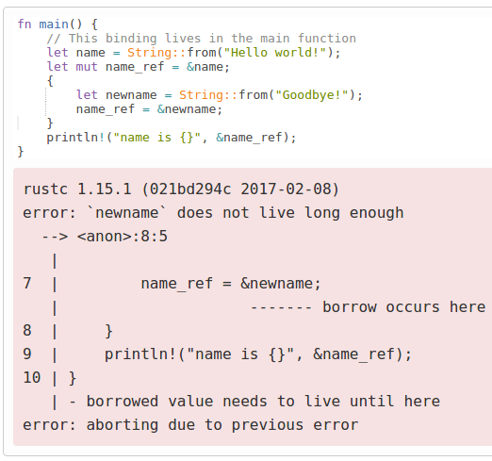
Use after free Caught by Rust at compile-time
Unique ownership, borrowing, and lifetime rules easily enforced

Slide 44
Dangling pointer in C
Famous scoping issues example (B&O Ch 3, Procedures)
int* func(int x) { int n; int *np; n = x; np = &n; return np;
}
What does np point to after function returns?
What happens if np is dereferenced after being returned?
Local variable is allocated in stack,
a temporal storage of function.
Reference returned, but variable now out
of scope (dangling pointer)
http://thefengs.com/wuchang/courses/cs201/class/08/invalid_ref.c

Slide 45
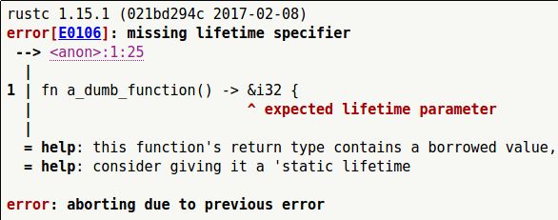
Caught by Rust at compile-time
Ownership/Borrowing rules ensure objects are not accessed beyond lifetime
borrowed pointer
cannot outlive
the owner!!
http://is.gd/3MTsSC

Slide 46
Seems like Rust wins every time! But it isn’t so simple!
C/C++
Haskell/Python
more control,
less safety
less control,
more safety
Rust
more control,
more safety

Slide 47
Rust ownership and borrowing can be annoying!
v is an owner of the vector
By taking a reference to v[0], x borrows the vector from v
now v cannot modify the vector
because it lent the ownership to x
http://is.gd/dEamuS

Slide 48
Concurrency & Data-race Freedom
struct Dummy { a: i32, b: i32 }
fn foo() {
let mut res = Box::new(Dummy {a: 0, b: 0});
std::thread::spawn(move || {
let borrower = &mut res;
borrower.a += 1;
});
res.a += 1;
}
Spawn a new thread
res is mutably borrowed
Error: res is being mutably borrowed

Slide 49
Mutably Sharing
Mutably sharing is inevitable in the real world.
Example: mutable doubly linked list
We require two mutable pointers to the middle mode. This is the essential feature of a list!
prev
prev
prev
next
next
next
struct Node {
prev: option<Box<Node>>,
next: option<Box<Node>>
}

Slide 50
Rust Solution: Raw Pointers
prev
prev
prev
next
next
next
struct Node {
prev: option<Box<Node>>,
next: *mut Node
}
Raw pointer
Rust allies C-style pointers too…. But now the compiler does NOT check the memory safety of most operations involving that pointer.
If possible, operations wrt. raw pointers should be encapsulated in a unsafe {} syntactic structure.

Slide 51
Rust Raw Pointers break rust’s normal mutability restrictions
let a = 3;
unsafe {
let b = &a as *const u32 as *mut u32;
*b = 4;
}
println!(“a = {}”, a);
I know what I’m doing
Print “a = 4”

Slide 52
Talking to libraries: the foreign Function Interface (FFI)
You can call code in libraries written in other languages, but the foreign functions are unsafe (e.g. libc calls)
extern {
fn write(fd: i32, data: *const u8, len: u32) -> i32;
}
fn main() {
let msg = b”Hello, world!\n”;
unsafe {
write(1, &msg[0], msg.len());
}
}

Slide 53
Big deal?
It is, because libraries are really important.
In ML we rely on tools like LINPACK, MPI, etc. And most GEMM kernels for ML tasks mix C or C++ with GPU or host parallelism.
Even if recoded in Rust they would still be unsafe!

Slide 54
So this tells us that Rust…
… often yields programs that actually are still unsafe!
Rust isn’t some sort of magic wand. It is more like a tool that we can use to protect ourselves against certain kinds of errors
Monzilla found it super effective! But some hard-core C++ developers who play with Rust find it annoying. And people focused on host parallelism may find the compiled code slow.

Slide 55
What about speed? Is RUST fast like C++, or Slow like Python?
Used correctly, Rust code performs well – potentially, better than Java and certainly better than Python. Sometimes as well as C++
Rust can do most of what we do in C++, and often at the same speed.
But it lacks templates + constexpr + inlining: C++ magic speedup

Slide 56
rust (currently) is weak on compile time optimizations
With skilled use of templates and constexpr, a C++ program can be extensively precomputed, leaving only things that must occur at runtime.
Rust has generics but nothing analogous to the C++ template language, so SIMD coding isn’t feasible. There are situations where Rust might be dramatically slower than C++ (despite using the same LLVM back end as Clang).

Slide 57
An unwinable debate!
People who love Rust aren’t going to switch back to C++
People who love C++ agree that Rust addresses many security issues (but at a cost). And they find ownership and mutability annoying, yet inadequate for even trivial data structures.
… the market adoption of Rust is good, but not overwhelming

Slide 58
Bottom line?
Rust genuinely is a powerful tool, but not trivial to use correctly, and limiting in important ways.
To get similar security in C++ requires systematic attention to risks, careful coding style, verification of logic, testing.
But because systems programming involves external libraries, GPUs and DMA, we sometimes have no other choice .

Slide 59
Further reading
Haozhong Zhang “An Introduction to The Rust Programming Language”
Aaron Turon, The Rust Programming Language, Colloquium on Computer Systems Seminar Series (EE380) , Stanford University, 2015.
Alex Crichton, Intro to the Rust programming language, http://people.mozilla.org/~acrichton/rust-talk-2014-12-10/
The Rust Programming Language, https://doc.rust-lang.org/stable/book/
Tim Chevalier, “Rust: A Friendly Introduction”, 6/19/2013

Slide 60
Resources
Rust website: http://rust-lang.org/
Rust by example: http://rustbyexample.com/
Guide: https://doc.rust-lang.org/stable/book/
User forum: https://users.rust-lang.org/
Book: https://doc.rust-lang.org/stable/book/academic-research.html
Speed of Rust versus C++*: https://www.bairesdev.com/blog/when-speed-matters-comparing-rust-and-c/
* Note: This guy never took CS4414! He means “if you code without giving it much thought”

