Slide 1
Networking
Professor Ken Birman
CS4414 Lecture 20

Slide 2
Idea Map For Today
The Internet, IP addresses and port numbers. Packets, routing, firewalls, tunnels, network address translation
TCP basics, SSL security
Socket API, Google GRPC
http versus https, VPNs, VPC

Slide 3
Internet basics
The internet is like a computerized postal system.
Any process can set up a “mailbox” (a socket), and post an address on it (bind an IP address and port number).
The address can then be registered for use by programs anywhere on the net… with limitations

Slide 4
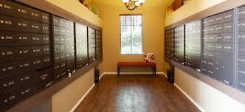
IP Addresses
Mailroom at 11 Riverside Drive, NYC
IPv4 is 32-bits (but only 28 are useable). IPv6 doubles this.
There are actually several types of addresses (classes)
In CS4414 we won’t dive into why, or what the others are for
Each address has an associated “port number” because one machine could have many processes using the network. Like a mailbox in an apartment building.
The IP address is used to route to the computer. Like a street address.
The port number is used to figure out which process gets the packet.

Slide 5
Address directory: DNS
The domain name service (DNS) map server names (www.cornell.edu) to IP addresses (128.253.173.247).
The DNS is operated by for-profit companies. They sell domain addresses, and server owners pay for listings.
Fancy web sites, like Netflix.com, have ways to route you to a data center somewhere near you, for speed.

Slide 6
A single machine can host many network services
To distinguish them, we use a “port number”
This is like an apartment number in a big building.
Some port numbers are standard, like 80 (for web services). Others are allocated on demand and look like random integers

Slide 7
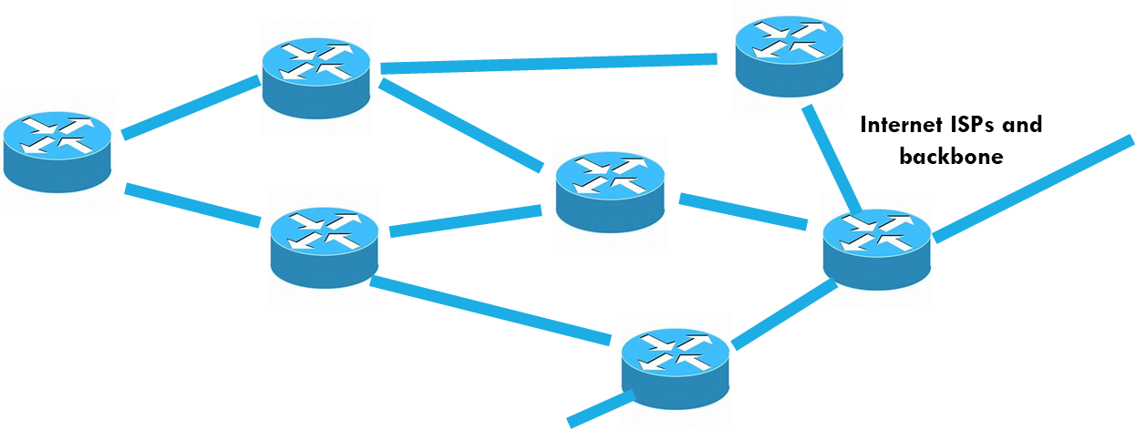
Routers and Links
The Internet is composed of high-speed network links between routers and switches.
A router takes an incoming packet and looks up the routing rule for sending it to the specified destination.
Then it forwards the message out on the corresponding link.
Switches are seen in clusters or racks of computers. Unlike a router, which can adapt the route over time, a switch uses fixed routing.
Packets have some maximum size, like 8KB. A “message” from process to process would often be far larger and will be sent as a series of packets.

Slide 8
Maximum packet size varies
In the wide-area Internet, 1400 bytes for historical reasons. By now this feels too small, but it isn’t easy to change...
In a local area network, 8KB is more typical.
In a datacenter you can switch to “fat packets” like 64KB or sometimes, even larger.

Slide 9
Network address translation
The “space” of addresses is much too small to cover the entire globe, so it evolved into a world of overlapping regions that use their own addresses. Like when a wifi router uses 192.168.0.xxx
Network address translators dynamically modify the (ip-address, port-no) information in packet headers to implement this (they might also block some packets: “firewall”)

Slide 10
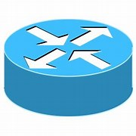
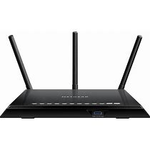
Network Address Translation, Firewalls, Routers, WifI…
Internet ISPs and backbone
192.168.0.3 port 7653
3752.412.88.16 port 211
WiFi + NAT box + firewall
154.771.21.71 port 73151
NAT box + firewall
Fortnight Server
192.168.364.778 port 921
Amazon AWS Cloud (Data Center)

Slide 11
Network Address Translation, Firewalls, Routers, WifI…
Internet ISPs and backbone
192.168.0.3 port 7653
3752.412.88.16 port 211
WiFi + NAT box + firewall
Routes picked to be economical, not necessarily fast or short!
154.771.21.71 port 73151
NAT box + firewall
Fortnight Server
192.168.364.778 port 921
Amazon AWS Cloud (Data Center)

Slide 12
Network Address Translation, Firewalls, Routers, WifI…
Internet ISPs and backbone
192.168.0.3 port 7653
3752.412.88.16 port 211
WiFi + NAT box + firewall
Could use a different route for traffic in return direction
154.771.21.71 port 73151
NAT box + firewall
Fortnight Server
192.168.364.778 port 921
Amazon AWS Cloud (Data Center)

Slide 13
Roles played by firewalls
They block unexpected “incoming” traffic. Configurable policy.
Permit “outgoing” traffic, such as http (TCP) connections to remote web services and other permitted services. Those use a known port no.
Apply network address translation, if desired.
* Map any outgoing messages to show that the sender is using the IP address of the router itself. Assign a new port number if this is a TCP connection request.
* Fix the packet checksum, to match these modified field. Later, incoming traffic to this IP address/port will be mapped back

Slide 14
Roles played by firewalls
By default, the policy often blocks everything! You need to configure the firewall policy to enable connectivity
They block unexpected “incoming” traffic. Configurable policy.
Permit “outgoing” traffic, such as http (TCP) connections to remote web services and other permitted services. Those use a known port no.
Apply network address translation, if desired.
Map any outgoing messages to show that the sender is using the IP address of the router itself. Assign a new port number if this is a TCP connection request.
Fix the packet checksum, to match these modified field. Later, incoming traffic to this IP address/port will be mapped back

Slide 15
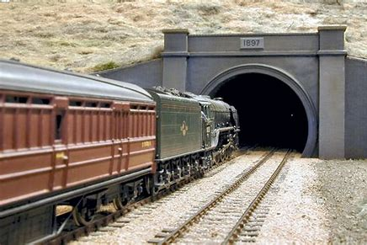
Tunnels
Trainload of IP packets enters a tunnel….
Sometimes it is convenient to send data through some domain without that domain “seeing” the packet headers.
A tunnel is used in such cases. A connection is is still needed, but then packets are sent through it as “pure data”.
On the far side, they exit the tunnel and get routed “normally”

Slide 16
A crazy patchwork! But it works…
Internet routers are fast and speed of light is quite fast too.
… Should you care that your data went via Delaware? … For the ISP, this route could be cheaper to operate, or use faster links and routers. The physically shortest path may be slower!
At each stage, a packet is routed to whatever router is next in the route for the particular IP address is happens to carry at that stage.

Slide 17
Mistakes do happen, but rarely
Internet routers use “routing tables” that tell them where to send packets. They adapt to route around outages.
Sometimes, mistakes can happen, but this is rare.
Goal of routing: Pick the most cost-effective, reliable, highest performing path available.

Slide 18
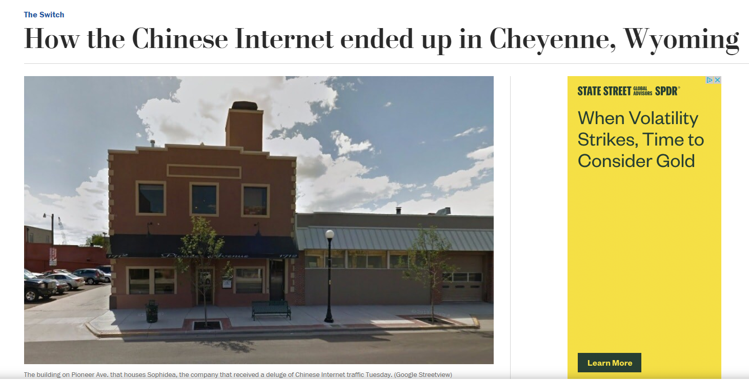
Mistakes do happen, but rarely
An ISP operator (somewhere very remote from China) accidentally miscoded one digit of a “fixed” route.
This disrupted global routing. Traffic intended for a centralized router in Shenzhen was “redirected” to a small cafe in Wyoming, near Yellowstone Park…
… all the traffic, for much of China

Slide 19
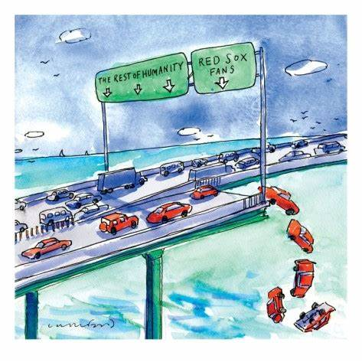
What did the cafE do with china’s Internet traffic?
Overload traffic
Regular traffic
They were “dropped” (discarded, silently)
In fact, this is a feature of the Internet!
The Internet works like a network of highways and bridges, but this kind of bridge can just toss cars off if a traffic jam forms!

Slide 20
Why drop packets? End-to-End principle
In the early days of the Internet a debate arose: should the Internet be reliable, or is it ok to drop packets?
The “end to end” principle was this: The Internet doesn’t need to be reliable, as long as it is blindingly fast and mostly reliable. The endpoints (sender, receiver) can provide reliability and flow-control.
Packet drop is common even though router/link failures are rare.

Slide 21
TCP Streams Embody the end-to-End rule
Like a pipe, TCP sends a stream of bytes from A to B, with no losses or corruption or out-of-order data.
TCP has two “end points”. The “end to end” principle makes these endpoints responsible for reliability and security.
TCP uses a protocol to achieve them: A scripted exchange of messages with a format that TCP imposes.

Slide 22
Data lives inside these TCP packets
TCP has a header of its own, with information used by the end-to-end protocol operated by the TCP module in the Linux kernel.
The message you send is chopped into segments and carried as data within these TCP packets.
On arrival, TCP will deliver the data, but you won’t see the TCP headers: it removes them in the kernel protocol stack.

Slide 23
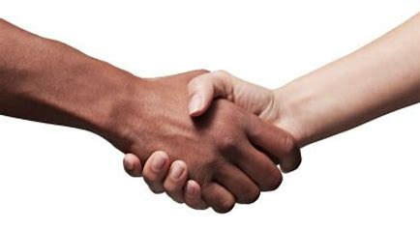
TCP starts with a special three-way handshake
TCP has some very basic security built in: the initial connection involves a “three way handshake”
Hello B. I am A, trying to connect to you. [SEQ=1234]
A, I would love to connect. [SEQ=9876]
B, this is A again. Success! [SEQ=1234,9876]
SSL is a standard for creating stronger security on TCP connections. It additionally establishes a session “key” used to encrypt all data.

Slide 24
TCP sliding window: Used after handshake
Mile high summary:
When TCP sends data, the sender numbers the packets. The receiver acknowledges receipt (“ack”) or if it notices a gap, asks for a retranmission (“nack”).
This is done using a form of bounded buffer: the sliding window.
The TCP sliding window. Animation available here

Slide 25
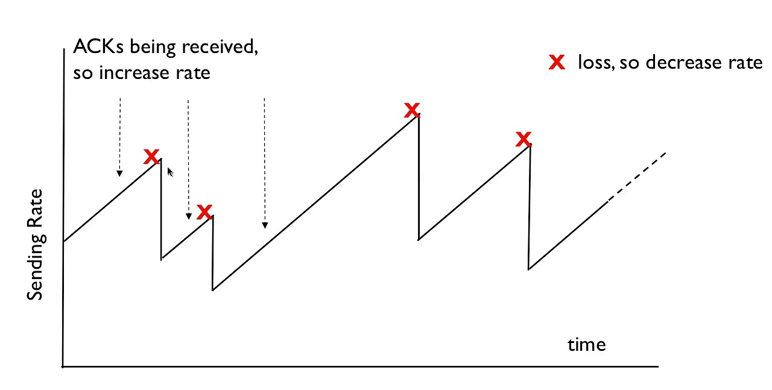
TCP also does rate control
TCP varies the transmission rate to match the speed of the connection. In effect, the bounded buffer size changes dynamically.
TCP steadily speeds up until packet drops occur: some router got overloaded. Then it slows down drastically… then speeds up.
Called an additive increase, multiplicative decrease scheme.

Slide 26
Limitations
NAT box + firewall
Recall that firewalls often allow outgoing TCP connection requests but block every form of unexpected incoming packet.
… they also will frequently create a whole networking enclave of their own, with IP addresses like
So, without help from the firewall you may be unable to connect from applications to external services!

Slide 27
Asymmetric connectivity!
A process on my computer, in my home, can connect to Netflix.com or Amazon.com or Azure.com.
Once the session is established, messages can flow both ways: the wifi router opens a “tunnel” that allows them through.
Yet that same Azure.com server wouldn’t be able to initiate a connection to my computer: traffic would be blocked!

Slide 28
How do we make these connections?
Consider a client on my machine, perhaps a web browser.
The server is on some other machine, perhaps at Netflix.com
In fact, Netflix.com is hosted by Amazon (rents machines on their cloud)
So if you talk to a Netflix.com server, your TCP connection will actually be to a machine in an Amazon AWS data center.
This is an aspect of modern cloud computing: “rent don’t own”.

Slide 29
Socket operations: Server
int sockfd = socket(AF_INET, SOCK_STREAM, 0);
// logic to initialize serv_addr struct not shown!
bind(sockfd, (struct sockaddr *) &serv_addr, sizeof(serv_addr));
listen(sockfd, 5);
int connfd = accept(sockfd);
int bytesread = receive(connfd, buffer, nbytes);
send(connfd, buffer, nbytes);

Slide 30
Socket operations: Server
Create a connection endpoint. This will be used for a TCP connection, but more initialization is required.
int sockfd = socket(AF_INET, SOCK_STREAM, 0);
// logic to initialize serv_addr struct not shown!
bind(sockfd, (struct sockaddr *) &serv_addr, sizeof(serv_addr));
listen(sockfd, 5);
int connfd = accept(sockfd);
int bytesread = receive(connfd, buffer, nbytes);
send(connfd, buffer, nbytes);

Slide 31
Socket operations: Server
Associate an IP address and port number with it. These come from “gethostbyname”
int sockfd = socket(AF_INET, SOCK_STREAM, 0);
// logic to initialize serv_addr struct not shown!
bind(sockfd, (struct sockaddr *) &serv_addr, sizeof(serv_addr));
listen(sockfd, 5);
int connfd = accept(sockfd);
int bytesread = receive(connfd, buffer, nbytes);
send(connfd, buffer, nbytes);

Slide 32
Socket operations: Server
int sockfd = socket(AF_INET, SOCK_STREAM, 0);
// logic to initialize serv_addr struct not shown!
bind(sockfd, (struct sockaddr *) &serv_addr, sizeof(serv_addr));
listen(sockfd, 5);
connfd = accept(sockfd);
int bytesread = receive(connfd, buffer, nbytes);
send(connfd, buffer, nbytes);
Tell Linux this server will accept up to five simultaneous client connections via the TCP protocol.

Slide 33
Socket operations: server
int sockfd = socket(AF_INET, SOCK_STREAM, 0);
// logic to initialize serv_addr struct not shown!
bind(sockfd, (struct sockaddr *) &serv_addr, sizeof(serv_addr));
listen(sockfd, 5);
int connfd = accept(sockfd);
int bytesread = receive(connfd, buffer, nbytes);
send(connfd, buffer, nbytes);
Accept returns the file descriptor of an established connection, and now the server can read bytes from it

Slide 34
Socket operations: server
int sockfd = socket(AF_INET, SOCK_STREAM, 0);
// logic to initialize serv_addr struct not shown!
bind(sockfd, (struct sockaddr *) &serv_addr, sizeof(serv_addr));
listen(sockfd, 5);
int connfd = accept(sockfd);
int bytesread = receive(connfd, buffer, nbytes);
send(connfd, buffer, nbytes);
Read a message

Slide 35
Socket operations: server
int sockfd = socket(AF_INET, SOCK_STREAM, 0);
// logic to initialize serv_addr struct not shown!
bind(sockfd, (struct sockaddr *) &serv_addr, sizeof(serv_addr));
listen(sockfd, 5);
int connfd = accept(sockfd);
int bytesread = receive(connfd, buffer, nbytes);
send(connfd, buffer, nbytes);
Send a response message

Slide 36
Socket operations: client
int sockfd = socket(AF_INET, SOCK_STREAM, 0);
… client does not need “bind” or “listen” or “accept”!
int connfd = connect(sockfd, (struct sockaddr *) &serv_addr, sizeof(serv_addr));
send(connfd, buffer, nbytes);
int bytesread = receive(connfd, buffer, nbytes);

Slide 37
How did the client get the server’s IP address?
It uses gethostbyname, then has to fill in the address struct.
It gets its own IP address by calling gethostbyname on localhost.
The server’s port number is from a table of standard port numbers.
Linux can also assign a port number. Your server can use this, then check the address and port number it received, then publish it in a file or on a web page for the client to find.

Slide 38
gethostbyname
The Internet includes a massively distributed service called the domain name service (DNS). The ISP hosts a version, and many companies do too.
The job is to map from a string like “cs.cornell.edu” to 132.236.207.53
The DNS is tree structured, and has a way to route lookups to the “owner” of the IP address. Cloud companies use it very dynamically: different people can be routed to different cloud datacenters.

Slide 39
OK… A is now connected to B!
A TCP stream is just a stream of bytes.
To make a request with arguments:
A builds a header identifying the requested operation and serializes the arguments into a byte array.
B reads the header first, allowing it to learn how much data to read.
The request-id will be used later to pair the result with a waiting thread.

Slide 40
Google GRPC: A popular packaging of these mechanisms
A library that can be used from C++, Java, Python, etc. Runs over TCP, like REST or CORBA but more modern, faster.
Fairly easy to use, but we won’t get into the details in CS4414.
GRPC allows a server to associate an object with a connection. The client can call methods in a type-checked way.

Slide 41
GRPC Overheads?
GRPC has a fast serialization method, much better than CORBA (from Lecture 19). When using a secure TCP session (with SSL), there is a small extra encryption/decryption delay.
Network delays are the main cost:
From Ken’s lake cottage in Trumansburg to Cornell: 1.5ms (routed via Syracuse).
Between two machines in a data center, they are as low as 50-100us.
On the public Internet, bandwidth of 10MB is excellent.
But inside a data center, rates can reach 10 GB: 1000x faster!.

Slide 42
GRPC Example: Hello World
Service instance, also running in the data center
Data Center Network
Client Program in
the same datacenter

Slide 43
GRPC Example: Hello World
// The greeting service definition is used by both the // Client and the server. It contains virtual methods
service Greeter {
// Sends a greeting
rpc SayHello (HelloRequest) returns (HelloReply) {}
}
// The request message containing the user's name.
message HelloRequest {
string name = 1;
}
// The response message containing the greetings
message HelloReply {
string message = 1;
}
class GreeterServiceImpl final : public Greeter::Service {
Status SayHello(ServerContext* context, const HelloRequest* request, HelloReply* reply) override { std::string prefix("Hello to my favorite client!");
reply->set_message(prefix + request->name());
return Status::OK;
}
};
Code running in the server
Code running in the client

Slide 44
Note about this example
What I showed you is incomplete! Normally the client and server would have a lot more application-specific code, too
GRPC requires a specific installation (it isn’t hard).
Compiling a client or server also requires various include files, and a special “initialization” must be called from main.

Slide 45
would a web browser use GRPC?
The web has its own encoding for messages: XML. GRPC is not used in this setting and would be blocked by firewalls.
This HTML encoding is less efficient than the one GRPC uses. It works well and is universal but is slow to compute and “bulky”.
Every message is encoded as a web page, and every reply
Data is printed in ascii text format.
Uses layers of standards: SOAP on HTML on XML… SSL would add a layer of encryption to this.

Slide 46
… so, what would a web browser do?
You launch your web browser and type in Netflix.com
The first step is to look up the IP address for Netflix.com. This is done by calling gethostbyname, which uses the DNS service.
You get an IP address for Netflix.com (in fact, the IP address of a nearby AWS data center: Netflix is hosted by Amazon).

Slide 47
Next steps
Your browser initiates an http connection (insecure: https uses SSL, but http isn’t encrypted in any way).
AWS selects some machine within the Amazon cloud with the Netflix web server process already running on it.
A three-way handshake is performed.

Slide 48
Next steps
Your Netflix Cookie!
Your web browser first sends Netflix a “cookie” with your user information. It uses the old web services model, so the cookie is actually encoded as a small web page.
Next Netflix sends back an initial welcome web page. The browser reads this back as a byte stream, deserializes it, and renders the page on your screen.

Slide 49
You select a movie…
“For the record, I don’t believe that I’m better than everyone else. Just that I’m better than you.”
Netflix recommends Wednesday.
You click the tile… it is associated with a URL link to the movie.
The browser sends an HTTP request to Netflix to “open” the URL. Netflix streams the movie back.

Slide 50
Would the browser be faster on GRPC?
HTML is not a suitable encoding for a photo or video!
But it has built-in special features for sending photos and videos. The browser makes an extra TCP connection, and the server streams the data in the format the client’s browser requests.
The server even resizes the images for the client’s browser size.

Slide 51
Other options
Client and server sound like A and B are very different kinds of programs, but in fact any GRPC process can play both roles.
So we can build applications in which there are multiple processes that cooperate in various ways, using message passing to share information.
As an example, A and B could “replicate” some kind of data captured from the real world by A: A would relay it to B.

Slide 52
Why replicate?
Fault tolerance: in a cloud-scale system, we may see crashes.
Performance: A and B could share the work for some task. Netflix serves popular movies from many servers.
Coordination: A might have some role, such as “be an air traffic controller for flight Delta 121” and B could track the actions in order to be smarter about ATC for other flights.

Slide 53
Other communication options
Some systems use a “message bus” or “message queue”. We saw one in the ATC example in Lecture 18.
These use a publish-subscribe model.
We define a set of topics, and programs can subscribe to them.
If a publisher publishes to some topic, upcalls occur in subscribers.

Slide 54
these work even in a single machine!
You don’t need two computers to create a GRPC or message bus application.
The tools work in an identical way on one computer (if the firewall is configured to allow it)
This is popular because it makes it so much easier to develop applications, and to port them from place to place.

Slide 55
Network security
We touched upon TCP security via SSL: a special version of a handshake that assigns a cryptographic key to each session.
HTTPS uses SSL automatically.
But what other forms of security are available?

Slide 56
VPN and VPC
Many of us have access to special computers at Cornell.
These aren’t available for public use, so they live inside cs.cornell.edu and aren’t even visible from outside Cornell.
With a “virtual private network” you can step inside the Cornell firewall from home, as if you were in Gates Hall!

Slide 57
How a VPN works.
Cornell operates a special VPN router. You need your netid to log into it. They use a product called Cisco AnyConnect.
Once you log in, a TTP SSL connection will exist from your machine to the VPN router.
IP addresses in the Cornell domain, or DNS requests, are automatically sent over this encrypted link.

Slide 58
Virtually private cloud
VPC is similar in concept, for people who use cloud computing.
Suppose your organization uses 10 machines on Azure or AWS.
Those 10 can be isolated from other cloud users: a VPC creates the illusion of a network composed purely of your machines, plus services the cloud operator provides (like the global file system)

Slide 59
With VPC, all traffic is encrypted
This way even if some intruder is watching the network, and even if your own applications use GRPC without SSL enabled, your messages are still encrypted.
It happens automatically. AWS and Azure both have special hardware accelerators to do the encryption and decryption.
In fact, with VPC they even encrypt files, using the same technique!

Slide 60
Summary of Lecture 20
When applications will run on multiple machines, we use networking to link the processes.
This occurs over TCP, often with SSL encryption. Encryption is not the default but is very common.
Google GRPC is one common library for building networked applications with a C++ object-oriented style of code.

