Slide 1
Deadlocks, Livelocks, and how to avoid them
Professor Ken Birman
CS4414 Lecture 17

Slide 2
Idea Map For today’s lecture
The monitor pattern in C++
Problems monitors solve (and problems they don’t solve)
Reminder: Thread Concept
Lightweight vs. Heavyweight
Thread “context”
Deadlocks and Livelocks
C++ mutex objects. Atomic data types.
Today we focus on deadlocks and livelocks.

Slide 3
Deadlock: Understanding
Deadlock arises in situations where we have multiple threads that share some form of protected object or objects.
For simplicity, A and B share X and Y.
Now suppose that A is holding a lock on X, and B has a lock on Y. A tries to lock Y, and B tries to lock X. Both wait, forever!

Slide 4
More examples
We only have one object, X.
A locks X, but due to a caught exception, exits the lock scope. Because A didn’t use scoped_lock, the lock isn’t released.
Now B tries to lock X and waits. Because A no longer realizes it holds the lock, this will persist forever.

Slide 5
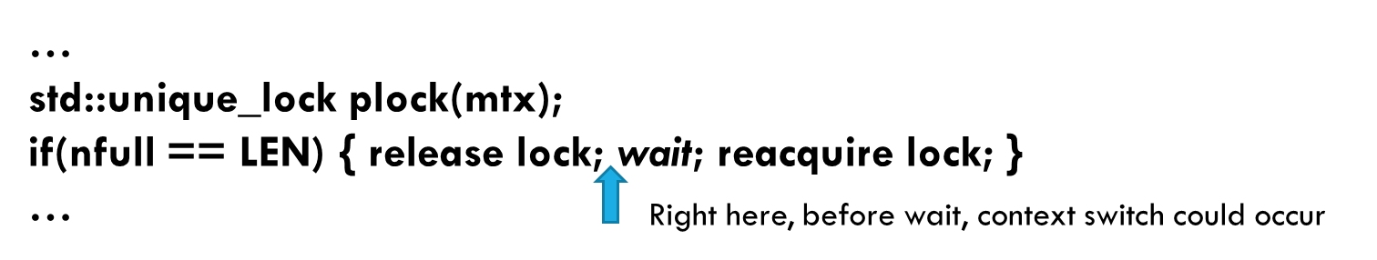
More examples
We only have some critical section
A locks it, but now needs to wait for some condition. The developer didn’t use the monitor pattern, and instead drops the lock and then waits on some other form of mutex
But B ran as soon as the lock was released, and by the time A waits, the condition A was waiting for is already true.

Slide 6
Acquiring a Mutex “twice”
Suppose that A is in a recursive algorithm, and the same thread attempts to lock mutex X more than once. The recursion would also unlock it the same number of times.
This is possible with a C++ “recursive_mutex” object.
But the standard C++ mutex is not recursive.

Slide 7
What if you try to recursively lock a non-recursive mutex?
The resulting behavior is not defined.
On some platforms, this will deadlock silently. A waits for A!
On others, you get an exception, “Deadlock would result.”

Slide 8
More Examples
A and B lock X and Y, but not in the same order.
Sometimes this can cause a deadlock… other times they manage to get away with it.
Examples on next slide.

Slide 9
As a timeline picture The good case
A: lock X A:lock Y A finished, releases locks B: lock Y B: lock X B finished, releases locks
In this run, A and B got lucky. It was a race, but A won and got both locks, finished what it was doing, then released them. B then runs, gets both locks, then releases them too.

Slide 10
As a timeline picture: The deadlock
A: lock X B: lock Y B: lock X A: lock Y
Trouble! Here, B grabbed the lock on Y while A was doing other stuff (but holding a lock on X). Now B wants a lock on X and A wants a lock on Y.
They get stuck: a deadlock!

Slide 11
Common hack – but a mistake!
The developer noticed the deadlock pattern but did not understand the issue.
C++ lock primitives have optional “timeout” arguments. So the developer decided to add a “random backoff” feature:
When locking an object, wait t milliseconds.
Initially, t=0 but after a timeout, change to a random value [0..999]
Then retry. The idea: sooner or later things should work…

Slide 12
What does this give us?
Now A locks X (and holds the lock), and B locks Y
A tries to lock Y, times out, retries… forever
B tries to lock X, times out, retries… forever
They aren’t “waiting” yet they actually are waiting!

Slide 13
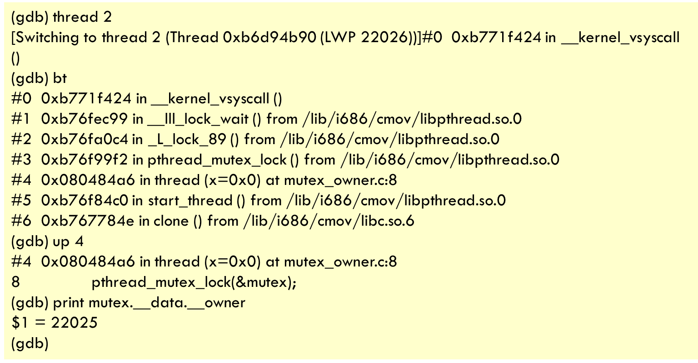
Better: Let the program get into a deadlock, then debug the issue
Without knowing about how mutex is implemented you can’t tell which thread is holding a lock.
But gdb can show you!
It can report the lightweight process “id” currently holding a lock
LWP is a form of unique pthread id. The same post explains how to find the corresponding thread
C++ - Is it possible to determine the thread holding a mutex? - Stack Overflow

Slide 14
Deadlock and Livelock Definitions
We say that a system is in a deadlocked state if one or more threads will wait indefinitely (for a lock that should have been released).
Non-example: A is waiting for input from the console. But Alice doesn’t type anything.
Non-example: A lock is used to signal “a cupcake is ready”, but we have run out of sugar and none can be baked.

Slide 15
Necessary and sufficient conditions for deadlock
Mutual exclusion: The system has resources protected by locks
Non-shareable resources: while A holds the lock, B waits.
No preemption: there is no way for B to “seize the lock” from A.
Cyclic waiting: A waits for B, B waits for A (a “circular” pattern)
With recursion using non-recursive locks, A could deadlock “by itself”

Slide 16
Conditions for Livelock
A livelock is really the same as a deadlock, except that the threads or processes have some way to “spin”.
As a result, instead of pausing, one or more may be spin-waiting.
We can define “inability to enter the critical section” as a wait, in which case the four necessary and sufficient conditions apply.

Slide 17
C++ and Linux are full of risks!
If you think about it, you can find hundreds of ways that Linux could potentially be at risk of deadlocks!
If you code with threads in C++ you run that risk too!
The developers of Linux designed the system to be free of deadlock. You can do so in your applications too. But it takes conscious though and a careful design.

Slide 18
How to avoid deadlocks?
Acquire locks in a fixed order that every thread respects. This rule implies that condition 4 (cyclic waiting) cannot arise.

Slide 19
How to avoid deadlocks?
Acquire locks in a fixed order that every thread respects. This rule implies that condition 4 (cyclic waiting) cannot arise.
Cool fact: std::scoped_lock will do this automatically if you list multiple mutexes in a single call.
But you do need to be able to list all the mutexes you might need.

Slide 20
How to avoid deadlocks?
Or, do it by hand but think about the pattern
Example: Recall A and B with X and Y. Use alphabetic ordering
We had A holding a lock on X and requesting a lock on Y: if our rule says lock X before Y, this is legal and A must wait.
Meanwhile B held a lock on Y. Given our rule, B is not allowed to request a lock on X at this point.
Nothing will check your logic! But if you code this correctly, it works

Slide 21
As a timeline picture
A: lock X B: lock Y A: lock Y B: lock X
B shouldn’t be trying to try to lock X while still holding a lock on Y,if you are using an ordered locking rule.
X is alphabetically smaller than Y, and B locked Y earlier. But C++ won’t will throw an exception here. Your code didn’t follow the rule… and nothing was checking

Slide 22

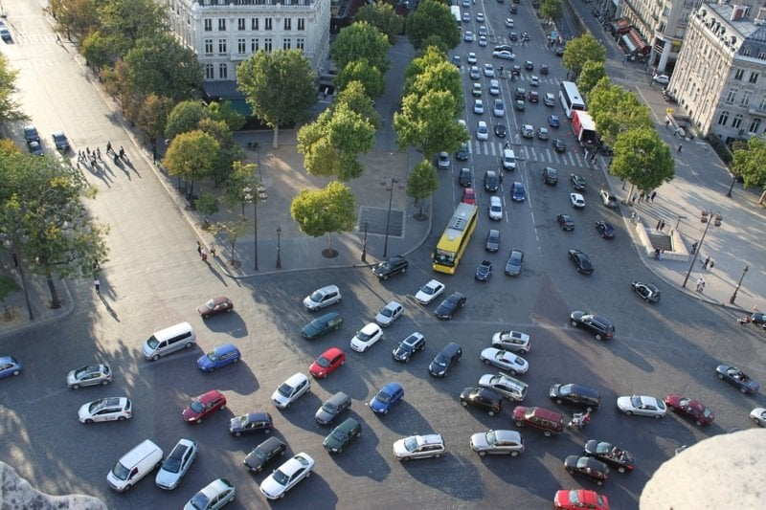
True thought problem
Ken was on sabbatical in Paris in 1995-1996
There are two traffic circles in France in which priority favors allowing cars to enter the circle over exit.
Deadlock occurs! Would “priority to the left” have the same risk?
We’ll use arrows to represent desired paths of individual vehicles

Slide 23
Visualizing the priorite-a-droite cycle
Many streets. Traffic flows in counter-clockwise direction
Streets are mostly two-way
Core problem: some cars just want to leave, while others continue around. But any entering car gets to go first

Slide 24
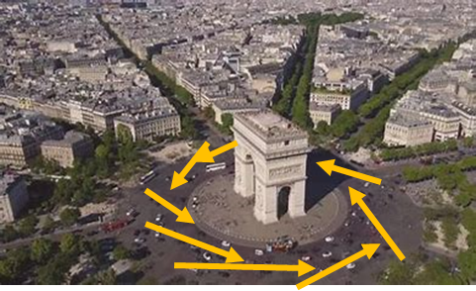
Understanding this in terms of lock cycles
A car in the circle holds a form of “lock” on the space it occupies. If car B allows car A to pass in front of it, this is like a lock-wait
When entering car C yields to car B which is behind car A, if A can always leave there is no cycle… and no deadlock.
If a car in the circle must wait for a car entering, but the entering car has no space to enter (and hence waits for a car already in the circle), we do get a cycle… and a deadlock!

Slide 25



Priority to the left is the modern rule
Most of the world uses the priority-to-the-left rule.
For a traffic circle, this means cars in the circle have priority over cars wanting to enter. “Drains” traffic out.
(BTW, in addition to great food, Belgium has priorite-a-droite… good to know!)

Slide 26
Priority to the left is the modern rule
Most of the world uses the priority-to-the-left rule.
For a traffic circle, this means cars in the circle have priority over cars wanting to enter. “Drains” traffic out.

Slide 27
In Belgium, au contraire…
Everyone knows that Belgium has great food and beers
But… Belgium also has priorite-a-droite…
Nobody really notices deadlock situations because Belgium has no big traffic circles similar to the Place Etoile or Place Victor Hugo in Paris.
On the other hand, there are road intersections with no stop signs or traffic lights, all over the whole country…

Slide 28

In Belgium, au contraire…
Everyone knows that Belgium has great food and beers
But… Belgium also has priorite-a-droite…
Nobody really notices deadlock situations because Belgium has no big traffic circles similar to the Place Etoile or Place Victor Hugo in Paris.
On the other hand, there are road intersections with no stop signs or traffic lights, all over the whole country.

Slide 29
Back on topic. So… use Ordered locking! But it can be impractical
There are many applications that learn what they must lock one item at a time, in some order they cannot predict.
So in such a situation, B didn’t know it would need a lock on X at the time it locked Z.
… now it is too late!

Slide 30
ExaMPLE: Unpredictable lock order
For example, this could arise in a for loop. Maybe B is scanning a std::list<Species*>, and needs a lock on each Species.
The std::list isn’t sorted by Species.name. The lock rule requires locks in Species-name sort order. B locks Fuzzy Tribble and Policle but now can’t lock Ballard’s Hooting Crane
Fuzzy Tribble
Policle
Darwin’s Tortle

Slide 31
What if it tries?
This is a rule you would impose on yourself
If you don’t respect your own design, that would be a bug in your code. C++ itself won’t enforce this rule.
It definitely is possible to “wrap” locks in a way that would track locking and detect cyclic wait, but this isn’t standard in C++

Slide 32
… Even so, Ordered Locking is useful
When you actually can impose an order and respect the rule, it is a very simple and convenient way to avoid deadlock.
Ordered locking is very common inside the Linux kernel. It has a cost (an application may need to sort a list of items, for example, before locking all of them), but when feasible, it works.

Slide 33
Timer based solutions
Sometimes it is too complicated to implement ordered locking.
Many programs just employ a timeout.
If B is running and tries to get a lock, but a timeout occurs, B aborts (releasing all its locks) and restarts.

Slide 34
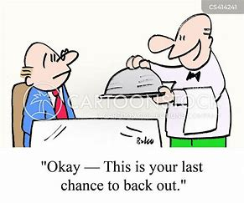
Backing out and retrying
For this purpose, B would employ “try_lock”.
This is a feature that acquires a lock if possible within some amount of time, but then gives up.
If B gets lucky, it is able to lock Y, then X, and no deadlock arises. But if the lock on Y fails, B must unlock X.
Backout can be costly

Slide 35

Concept: Abort and Retry
We say that a computation has “aborted” if it has a way to undo some of the work it has done.
For example, B could be executing, lock Y, then attempt to lock X. The try_lock fails, so B releases the lock on X and throws away the temporary data it created – it “rolls back”. Then it can retry, but get a lock on X first. Hopefully this will succeed.

Slide 36
Does this work?
Many database systems use abort/retry this way.
Assuming that the conditions giving rise to deadlocks are very rare, the odds are that on retry B will be successful.
But if deadlocks become common, we end up with a livelock. That was what we showed you on slides 8, 9

Slide 37
Preemptive solution (“Wound-wait”)
This method requires some way for the system to detect a deadlock if one arises, and a way for threads to abort.
When A and B start executing, each notes its start time.
Rule: in a deadlock, the older thread wins. So if A was first, A gets to lock Y and B aborts. If B was older, A aborts.

Slide 38
Detecting deadlocks
Clearly, we gain many options if a system has a way to detect deadlocks. Does C++ support this?
… you might think so, given the “deadlock would arise” exception for recursive locking. But in fact this is done just by tracking the thread-id for the thread holding a mutex.

Slide 39
How to build a deadlock detector
We wrap every locking operation with a method that builds a graph of which thread is waiting for which other thread.
For example, if A tries to lock Y, but B is holding that lock, we add a node for A, a node for B, and an A → edge.
If a thread is waiting for long enough, run “cycle detection”.

Slide 40
Cycle detection algorithms
A
B
Run the depth-first search algorithm.
Back-edges imply a cycle; success with no back-edges implies that the graph is cycle-free, hence there is no deadlock.
Complexity: V+E, where V is the number of threads (nodes) and E is the number of wait-edges.

Slide 41
Priority inversions
In some systems, threads are given different priorities to run.
Urgent: The thread should be scheduled as soon as possible.
Normal: The usual scheduling policy is fine.
Low: Schedule only when there is nothing else that needs to run.
A priority inversion occurs if a higher priority thread is waiting for a lower priority thread.
Deadlock can now arise if there is a steady workload of high priority tasks, so that the lower priority thread doesn’t get a chance to run.

Slide 42
How to detect this sort of problem
If we create a deadlock detector, we can extend it do handle priority-inversion detection!
For each mutex, track the priority of any thread that accesses it.
If we ever see a mutex that is accessed by a high and a low priority thread, a risk of priority inversion arises!

Slide 43
What to do about it?
One option is to temporarily change the priority of the lower priority thread.
Suppose that A holds a mutex on X.
B, higher priority than A, wants a lock on X. We can “bump” A to higher priority temporarily, then restore A to lower priority when it releases the lock on X.

Slide 44
None of these is cheap…
Recall our discussion of C++ versus Java and Python.
These methods of watching for cycles or priority inversions, possibly forcing threads to abort, rollback and retry, etc, are all examples of runtime mechanisms that can be very costly!
If you have no choice, then you use them. But don’t be naïve about how expensive they can become!

Slide 45


Jim Gray
Jim Gray, a Turing Award winner, was a big player in inventing databases and “transactions”. He worked at Microsoft
Jim’s focus for much of his career was on making it easier to create really big databases and to access them from programming languages like C++ (or C#, Java, Python, whatever)

Slide 46
Jim Gray’s study
In the 1990’s, databases were used for storing all forms of data
By the early 2000’s, they became extremely big and heavily loaded. People began to move them to NUMA machines and to use lots of threads.
Surprisingly, they slowed down!

Slide 47
Jim tracked down the cause
It turned out that with more and more load on the database server, hence lots of threads, the database locking algorithm was discovering a lot of deadlocks.
Running the cycle detector, aborting all of those waiting threads, rolling back and then retrying – it all added up to huge overheads!
Jim showed that once this occurred, his databases slowed down

Slide 48
The “full story”
He found that if you have a system with n servers (or using n cores), and the system is trying to process t “simultaneous” transactions (transactions), it could slow down as
O( n³ t⁵ )
You used cores or servers to have your system handle more concurrent threads or transactions
… but it slows down, dramatically!

Slide 49
… not what owners expected!
People who buy a NUMA machine and run a program with more threads want more performance, not less!
Also, the situation Jim identified didn’t arise instantly. It only showed up under heavy load. This made it hard to debug…
A Heisen-performance-bug!
Very bad news… Hard to find, impossible to fix!

Slide 50
What did Jim recommend?
He found ways to slice his big data sets into n distinct, independent chunks. He ran the n databases separately! The rate of abort/retry drops by a factor of n³
In fact, this is a good rule of thumb: try to design your program so that as few data structures as possible are accessed by multiple threads. For example, Ken’s word-count did this.
With one thread per data structure, no locking is needed!

Slide 51
Summary
Deadlock is a risk when we have concurrent tasks (threads or processes) that share resources and use locking.
There are simple ways to avoid deadlock, but they aren’t always practical. Ordered locking is a great choice, if feasible.
Complex options exist, but they can have high overheads.

Slide 52
Summary
Livelock is a form of deadlock in which threads or processes are active but no progress is occurring.
Often associated with some form of “busy wait” loop.
Deadlock avoidance mechanisms often can prevent livelocks, too

