Slide 1
Performance: Big Picture
Professor Ken Birman
CS4414 Lecture 11

Slide 2

Idea Map For Today
With so much to keep in mind, how can we possibly understand performance?
Today will be a “big picture” lecture talking about the challenge of visualizing all those different elements

Slide 3

Your job? Be a detective!
Nancy Drew
You suspect that your program isn’t the fastest it could be.
You need to be the sleuth and track down the bottleneck!
This centers on developing a mental image of your code
as it executes
You’ll need to have a theory of how fast it “could be”, than
search for evidence that something is slowing it down

Slide 4
A good detective has an open mind
You do need a mental image… but your theory could be wrong.
Sometimes the most obvious “issue” isn’t the root cause – it may be a symptom of the real cause, but “downstream” from it.
Example: your code isn’t scanning files quickly. Is it the algorithm?
Perhaps, the issue isn’t the scanning logic itself. Maybe something
else is causing this slowdown, and the scanner is just “waiting”

Slide 5
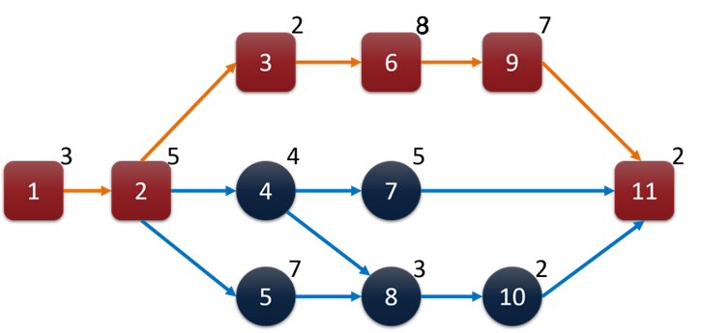
Definition: Critical Path
A critical path is the longest end-to-end sequence of sequentially dependent activities in an application.
This example shows 11 subtasks in some program (node numbers) each annotated by the expected delay.
The application has parallelism,
yet the steps shown in red
determine the critical path

Slide 6
Good performance versus busy work
One huge challenge for performance tuning is that a busy machine often isn’t an optimized machine!
We can be busy for a good reason, like training a machine-learning model
But often a busy computer is “thrashing” – doing work pointlessly

Slide 7
Ideal versus reality…
Ideally, we want all the “moving parts” seamlessly interacting to provide a smooth, efficient workflow
In practice we often find that most parts of the system are bottlenecked behind some very busy but ineffective component

Slide 8

Premature… optimization
It can be very tempting to rush to optimize some part of your program where you’ve just come up with an idea to speed it up
Recall the “drive to Niagara Falls” example from Lecture 3 – sure, a fast car can go faster, but if this means that you catch up to the next bottleneck sooner, you don’t really arrive any earlier!

Slide 9

Big Picture process
It is important to approach a systems programming challenge by really visualizing the whole task – all aspects of the solution
This includes the tasks that the operating system or network will be responsible for, and perhaps even things that other services are providing (in larger settings your programs often talk to services that run on other machines or in the cloud)

Slide 10

Domain crossings can be costly
A domain crossing occurs when we move data from the storage device to the Linux kernel or from kernel to user memory
They also occur when the user process issues a system call, requesting that Linux do something (like open a file, read data)
And they even occur if threads share a resource and must take turns accessing it (we’ll talk about this case a lot in future classes)

Slide 11
Modern systems hide these costs
Your code can access data without considering costs, and Linux will conceal the overheads
But this means that the same logic might be faster or slower depending on factors you aren’t controlling.
Gaining control involves intentionally designing code to ensure that data will be in the most efficient place at the right time

Slide 12
Tools of the trade
When you approach a performance question, pause and think about this big picture, and try to visualize all aspects
Is your program reading files? How many? How big?
Overall, are you working with a really large amount of
data, like gigabytes, or smaller things?
How fast is the hardware you’ll run on?
Complexity of the algorithms you’ll be using.

Slide 13
Isolation Testing
Used to study some component of your application. You create a dedicated specialized test to measure its speed or hunt for bugs.
You often can do this by “breaking” your application – with some special argument, main just calls the test logic, then exits.
This allows you to understand the speed of that element and to tune it, without worrying about the rest of your program.

Slide 14

How fast “should” your code be?
With a whiteboarding process you can often arrive at very crude estimates – rough but still very useful!
Time needed to do the file I/O
Computational time per “data item”, and “how many items”?
Will there be a great deal of copying needed?
What aspects look very sequential to you?

Slide 15
Hierarchy of delay
Think of each part of your application in terms of
Bandwidth: How fast data can be moved through it.
Latency: How long it takes.
Keep in mind that the disk and Linux and the network are all parts of your application even if you didn’t code those

Slide 16
A busy thing causes delay. But so does an idle thing!
We tend to think that delay is always caused by heavy loads
This is sometimes true. If you put a storage device under heavy load, it bogs down. But this might not consume CPU time.
But often, being “overloaded” shows up as “100% idle”. That component is spending all its time waiting, not computing.

Slide 17
CPU is not always the issue!
Sometimes we see components that are waiting for other things.
Each type of device has a minimal delay. This can grow if a backlog occurs due to overload.
Reading from a storage device? Normally < 1 ms
Reading over a network? Similar, but also depends on
  …. Where the service resides
  …. How you talk to it

Slide 18
Network types
The fastest networks are used in high speed clusters or data centers. Some use hardware accelerators called RDMA (remote DMA transfer over the network – ultra high bandwidth)
TCP/IP is fast in a cluster or inside a data center, but can be much slower with a wide-area link.
Terms: LAN means “local area network”. WAN: “wide area”.

Slide 19
Locking delays
A
B
Holds lock on X, does updates
X
Needs lock on X, must wait
Later in the course we will be focused on multithreaded code.
In that sort of program, we use “locking” to prevent threads from interfering with one-another and breaking the logic.
Waiting for a lock could be a cause of delay in such cases… and threads with locking are very common these days!

Slide 20
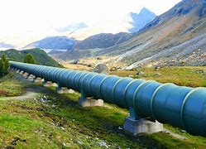
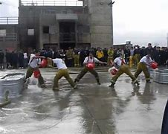
Pipelining
A huge tool is the idea of creating a steady flow via a pipeline
We say that we have a pipeline if there is some “sender” and some “receiver”, and they can both run simultaneously
Like a bucket brigade, a pipeline buffers some data
(a cost), freeing sender and receiver to run in parallel

Slide 21
Pipelines hide delay!
They let us request something “long before” we need it. A producer task can run faster than the consumer task.
If the data shows up when we aren’t yet ready to process it, that data just waits in the pipeline

Slide 22
You shouldn’t let pipelines get “too deep”
If a pipeline is holding huge amounts of data, or huge amounts of some other resources, costs accumulate
That memory could have been useful elsewhere
Linux limits how many files can be open all at once
Data might even become stale, if the underlying files change
Use your analysis to select a smart pipeline size – “depth”

Slide 23
Often we have adequate memory and processors to shift logic this way
A pipeline is just one way to use memory to speed things up. A machine has many resources… what is the best use for that space?
Linux Kernel
Buffer pool
User process with multiple threads
NUMA effects matter here!
Storage
device
File blocks

Slide 24
Our application design shapes performance
It does so explicitly when we launch multiple threads, or decide to have each thread use its own std::map to avoid locking and improve data locality.
It also does so implicitly, when our code includes hints that can lead the C++ compiler to discover the best compilation strategy, or behaves in a way that helps Linux prefetch file blocks.

Slide 25
Examples of compilation hints
C++ will optimize inner loops with integer loop variables and
simple termination conditions, putting loop variables in registers
The compiler will put pointers into registers in “tight loops”
Values reused close to one-another will be held in registers
Methods with modest numbers of “native type” arguments
will be called using registers to pass the parameters

Slide 26
Write your code as if you were describing the desired machine code
The cleaner the mapping to efficient machine code, the easier it will be for C++ to discover your intent and generate great code
In contrast, very complex logic may be harder for it to optimize
This matters for performance-critical code, but not for “general” logic. When tuning a critical path component, aim for simple, ultra-efficient C++ code that the compiler can easily optimize

Slide 27
Write your code as if you were describing the desired machine code
Compilers do best with loops that have “simple” termination conditions, not complicated expressions that call functions.
They are very good at sequentially scanning data structures or arrays in memory.
Any form of straightline code will compile well.

Slide 28
Avoid coding choices that can obstruct compiler analysis
Loop conditions that involve lots of function calls to functions that can’t be “pre-evaluated” at compile time.
Lots of inline if statements with unpredictable test conditions
Complicated array indexing with expressions that can only be evaluated “at runtime”

Slide 29
Remember that classes and templates are automatically eliminated!
C++ eliminates these at compile time, and once you understand how it does this, you can “visualize” the resulting code.
It does end up with very long, messy, variable names. But names are just compile time information and won’t change the machine code.
Once templates are eliminated, constant expression evaluation eliminates most remaining overheads due to classes and generics!
This is in contrast to Java or Python, and one reason C++ performs so well!

Slide 30
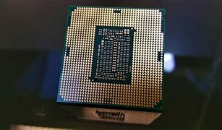
The CPU plays a big role, too!
After C++ maps your code to machine instructions we aren’t even finished!
The CPU itself will look ahead at many instructions and try to pre-load operands and might even reorder instructions! It also predicts which way branches (ifs, loops) will go.
The rule is to “preserve the semantics, not the rigid ordering.”

Slide 31
Everything is programmable. But not always directly using C++ code
We have many ways to “take control” of the operating system, or the devices, or choices the compiler will make.
They are not always the identical mechanism. Our C++ code is our way of talking to the compiler, and through it, ending up with machine code matched to the hardware.
But the pattern of system calls we issue is our way of talking to Linux

Slide 32
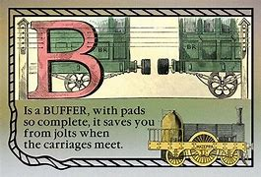
Buffered Printing
When a program is being debugged we often send output to the console.
This is very helpful for debugging. (Useful features: ^Z to pause the program, fg to restart it, ^S/^Q to pause/resume printing)
But for this to work, your program will do one I/O system call either per line, or per character. (Default: per line)

Slide 33
Improving critical path performance
Often a program generating an output file turns out to have a critical path in which the actual output operations are costly.
Core issue? Linux I/O system calls can be expensive and slow. Writing one character or one line at a time “maximizes” this cost.
Remedy? Write into a buffer… configure it to output each time 4096 bytes accumulate.

Slide 34
… why 4096 bytes?
Linux is optimized for 4K I/O operations
So if you write 15 characters, then 7, then 24… this is slow! You are doing multiple system calls when perhaps one would suffice
As a result, the streaming I/O library can buffer. It switches to 4K mode if the output target is another program (via a pipe) or a file (via I/O redirect). This improves efficiency dramatically!

Slide 35
Everything Has a price…
The downside of 4K writes is that if a program dies (or terminates) while buffering data that has not yet been written, the last lines won’t be written out.
It becomes important for you to “flush” those last buffered lines
So here we see a form of active control, yet it isn’t purely in the form of writing C++ code that takes control of something

Slide 36
What was the price?
You gained performance, but accepted that I/O will be buffered and hence that your program might run for a while before each new write occurs.
This creates a mental cost: if the program stops unexpectedly or crashes, some I/O might not have been done. You need to be sure to flush that I/O – and this is the cost of buffering.
“Simpler, but slower” versus “faster, but a little harder to understand”

Slide 37
Don’t sweat the small stuff
Start by trying to understand whether something is 10x slower than it should be.
Finding the major bottlenecks, or the very inefficient pieces of a solution, can pay off: fixing those first gives dramatic improvements… After that, you can focus on smaller things

Slide 38
Algorithms (sometimes) matter…
As a student you’ve learned a lot about algorithms
If the complexity genuinely reflects the costly resource, and we are in a situation where asymptotic costs are the bottleneck, picking the right algorithm is key.
But those two “ifs” are not minor points!

Slide 39
Efficient Algorithms don’t always focus on the costly resource
Many algorithms were created using standard metrics like compute time for one thread, or space consumed
In a parallel setting with a lot of memory, we might be fine with spending memory to save time – we saw examples earlier today.
And computing may actually be “cheap” too!

Slide 40
What would be a costly resource other than memory or CPU time?
Think about disk access
If an algorithm is designed to focus on, say, balancing a tree for constant depth, but the tree is on a disk, the tree nodes might not really match one-to-one with 4K disk blocks.
The algorithm might do a lot of disk block reads and writes that the complexity metric doesn’t count. Those I/Os are costly!

Slide 41
… algorithms are conceptual tools
When we work with algorithms we are working in a very conceptual way, highly abstracted from concrete resources. An algorithm is a design pattern
Our challenge as systems builders – engineers – is to map our understanding of the application into “relevant” algorithmic questions where the metrics we optimize are the costly aspects of the overall application pipeline.

Slide 42
Summary: Big Picture
The big picture is central to performance-oriented systems programming. Concurrency can hide pipeline delays.
We “gain control” over mechanisms in many ways – sometimes with our direct C++ code, but sometimes by arranging our program in clever ways, or by giving useful hints to the C++ compiler or Linux knowing they will make smart choices

Slide 43
Summary: Bottlenecks
Start by understanding bottlenecks and the critical path, and visualizing the desired flow of your computation.
You won’t be able to improve performance unless you understand goals, and understand where you started.
Random changes just make code messy, add bugs, and might not help – we want to only make the right changes.

Slide 44
Summary: Bottlenecks
They really come in two forms
Unavoidable work being done as efficiently as possible
Accidental work (or delays, perhaps even idle time) arising
from some form of mismatch between our code and the system
Once you identify a bottleneck, you can often intervene to improve exactly the slow step

Slide 45
Next lecture: Performance monitoring
Linux is full of tools we can use to measure performance and even understand overhead sources
These tools enable us to compare actual behavior of a program with our conceptual expectations
We’ll see how they can let us find bottlenecks

