Slide 1
Welcome to CS4414 Systems Programming
Professor Ken Birman
Lecture 1

Slide 2
The modern computing world is complex!
“Cloud” computing systems at an insane scale, truly huge
So many moving parts…
New concept: SYSML. This relates to the idea that we are creating systems to assist machine learning.

Slide 3
Reasons we care about performance
Roughly 1% of global electric use, doubling roughly every 2 years!
Modern forms of computing are very power-hungry! And this is causing growing impact on the global “electricity footprint” associated with popular ways of solving problems.
Future of civilization might depend on whether your code can minimize the amount of electricity it consumes!
https://energyinnovation.org/2020/03/20/how-much-energy-do-data-centers-really-use/
https://venturebeat.com July 15, 2020

Slide 4
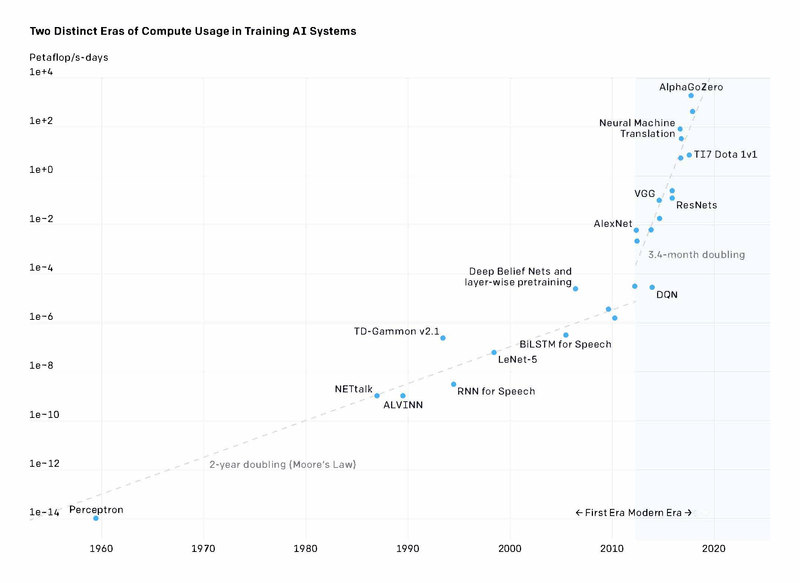
Compute time to train ML models
How much of this is really due to inefficient use of the language and hardware? Probably a lot!
3.4-month doubling
2-year doubling (Moore’s Law)

Slide 5
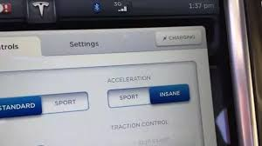
Some cars have insane speed buttons…
Guess what? So do computers!
In CS4414 we’ll push the button.
(in ways that are correct, secure, natural, elegant)

Slide 6
Smart use of the “platform” is how!
In CS4414 we will be learning about the Linux operating system. Linux is universal these days.
We will use C++ 20 as our programming language. You can go with C++ 23 if you prefer, and we will switch to it in 2025.
And we’ll learn to write code in smart ways that use the hardware and software “ideally” to get the best possible speed.

Slide 7
How we think of this in CS at Cornell
Modern PL and compilation tools
Networking
Distributed Systems
Databases
Great skills on a single NUMA server
Great skills on a cloud
Cloud Computing

Slide 8
How we think of this in CS at Cornell
Modern PL and compilation tools
Writing code that can perform extremely well and keep the CPU busy in a productive way
Learning to leverage concurrency in a correct, secure, effective way
Understanding ways of “taking control” over the hardware and the OS so they will be ideally effective
Networking
Distributed Systems
Databases
Great skills on a single NUMA server
Great skills on a cloud
Cloud Computing

Slide 9
Agenda for this first lecture?
A glimpse of this entire complicated, huge, crazy puzzle!
What does it even mean to “be in control” of the computer and the OS and the disk?
Why start with C++ and Linux?

Slide 10
“Idea map” for The whole semester
We favor C++ 20 here. It isn’t the only option (Rust is cool, for example), but we’ll use C++ 20 because industry seems to like it. C++ 20 is very stable, but C++ 23 will eventually replace it
The application must express your ideas in an elegant, efficient way using a language that promotes correctness and security while mapping cleanly to the hardware Linux abstractions expose that hardware in easily used forms.
Hardware: Capable of parallel computing, offers a NUMA runtime environment with multiple CPU cores.
Linux: The operating system “manages” the computer for us and translates hardware features into elegant abstractions.

Slide 11
When you write a program, does It matter how it gets executed?
Most people are familiar with Java and Python
Java has lots of data types (and lots of fancy syntax!), generics, other elaborate language features and compiles to a mix of machine code and programming language runtime logic.
Python is easier: No need to fuss with data types, easy to create arrays and transform all the objects with just one step.

Slide 12
When you write a program, does It matter how it gets executed?
Which is better?
Java
Python
… why?
Most people are familiar with Java and Python
Java has lots of data types (and lots of fancy syntax!), generics, other elaborate language features and compiles to a mix of machine code and programming language runtime logic.
Python is easier: No need to fuss with data types, easy to create arrays and transform all the objects with just one step.

Slide 13
Considerations people often cite
Expressivity and Efficiency: Can I code my solution elegantly and easily? Will my solution perform well?
Correctness: If I end up with buggy code, I’ll waste time (and my boss won’t be happy). A language should facilitate correctness.
Productivity: A language is just a tool. The easier it is to do the job (which is to solve some concrete problem), the better!

Slide 14
A subtle consideration: Modularity and compositionality
Don’t fix things that already work. Ideally, we want the system to provide lots of pre-packaged solutions for common tasks.
As a systems person, I’m very focused on this idea of pre-packaged modular solutions.
Modern machine learning forces us to think in these terms!

Slide 15
Microsoft FarmBeats Example
How many programs are in use here?
… hundreds! A modern computing applications is a software ecosystem

Slide 16
… this is the complication
As we deal with larger and larger scale, the “modules” won’t be simple things like a library that deals with managing a sorted list
We may need to “compose” entire programs or even systems, which will need to share files or perhaps “objects”.
… the programming language is just a part of this ecology

Slide 17
Drill-down considerations
We want our solutions to perform well and “scale well”.
For many tasks this involves working on the “cloud” (big remote data centers, like AWS or Microsoft Azure or Google).
In the cloud you rent the machines you need, as needed, but pay for what you use. So performance ≅ $$$.

Slide 18
Drill-down considerations
Which performs better?
Java
Python
… something else?
… why?
We want our solutions to perform well and “scale well”.
For many tasks this involves working on the “cloud” (big remote data centers, like AWS or Microsoft Azure or Google).
In the cloud you rent the machines you need, as needed, but pay for what you use. So performance ≅ $$$.

Slide 19
Why Linux? Does the O/S even matter?
When building “interesting” applications we often put a few building blocks together, Lego style.
Linux is full of small, easily used building blocks for common tasks, and has easy ways to connect things to make a bigger application from little pieces.
Productivity rises because you often don’t need to build new code – you can just use these existing standard programs in flexible ways.

Slide 20
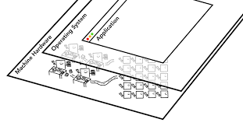
Linux and the Hardware: two Sides of the system architecture
We will be learning about the modern computer hardware, not so much from an internals perspective, but as users.
Linux lets you design applications that correspond closely to the hardware. But then we need a programming language that lets us talk directly to the operating system and the hardware.

Slide 21
Why are Python and Java expensive?
Python: Interpreted
Java: Runtime overheads
Compiles to a high-level representation that enables an “interpretive” execution model.
In fact, Python is like a “general machine” controlled by your code: Python itself runs on the hardware. Then your code runs on Python!
Gradual typing: Python is very laissez-faire and can’t optimize for specific data types.
Compiles (twice: to byte code, then via JIT) but rarely exploits full power of hardware. Limited optimizations, parallelism
Dynamic types and polymorphism are costly.
Everything is an object, causing huge need for copying and garbage collection.
It feels as if your programs run inside layers and layers of “black boxes”

Slide 22
How does C++ avoid these pitfalls?
C++ objects are a compile-time feature. At runtime, all the type-related work is finished: no runtime dynamics. The compiler “inline expands” and infers types, which makes coding easier. Then it optimizes heavily. You help it.
Computers execute billions of instructions per second, yet we can write code that will minimize the instructions and shape the choices. Parallelism is easy, and the compiler automatically leverages modern hardware features to ensure that you will have highly efficient code.

Slide 23
Let’s Drill down on speed
For some situations, C++ can be thousands of times faster than Python or Java, on a single machine!
Typically, these are cases where the application has a lot of parallelism that the program needs to exploit.
For example, identifying animals in a photo entails a lot of steps that involve pixel-by-pixel analysis of the image
But in fact, we can get substantial speedups just scanning large numbers of big files… hence our word-count demo

Slide 24
Parallelism
… in fact, it is very hard to exploit parallelism in a single Python program.
This is because the Python model is “single threaded”. Even so, PyTorch is highly parallel, because it leverages GPUs.
Java does allow parallelism, via “parallel threads”

Slide 25
Let’s Drill down on speed
We said that Python is slowest, Java is pretty good, but C++ can beat both. C++ knocks the socks off Java for parallel tasks.
What would be a good way to “see that in action”?
A small example: “word count” in Python, Java and C++

Slide 26
Word count task
Basically, we take our input files and “parse” them into words. All three languages have prebuilt library methods for this. Discard non-words (things like punctuation marks).
Keep a sorted list of words. As we see a word, we look it up and increment a count for that word (adding it if needed).
At the end, print out a nicely formatted table of the words/counts in descending order by count, alphabetic order for ties

Slide 27
The participants
Ken, back when he was kind of new to C++
Sagar, our head PhD TA in the early days, who was a hard-code C++ coder, spent two summers as a Microsoft employee.
Lucy, undergraduate coding superstar

Slide 28
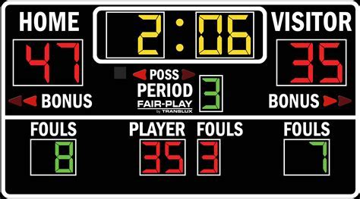
The Scoreboard
#1-A: Ken’s C++ Faster, but more complex… real 4.645s user 14.779s sys 1.983s #1-B (Sagar’s code, shorter & better use of C++…) real 8.200s user 49.295s sys 2.145s | #3 Lucy’s Java version (no threads) real 1m49.373s user 3m16.950s sys 8.742s
#2 Lucy’s Python version real 1m30.857s user 1m30.276s sys 0.572s This was only 19 lines of code! | #4: Pure Linux (buggy sort order) real 2m38.965s user 2m43.999s sys 27.084s

Slide 29
The Scoreboard
C++ version was 34x faster than Linux, 20x faster than Java or Python
#1-A: Ken’s C++ Faster, but more complex… real 4.645s user 14.779s sys 1.983s #1-B (Sagar’s code, shorter & better use of C++…) real 8.200s user 49.295s sys 2.145s | #3 Lucy’s Java version (no “true” threads) real 1m49.373s user 3m16.950s sys 8.742s
#2 Lucy’s Python version real 1m30.857s user 1m30.276s sys 0.572s This was only 19 lines of code! | #4: Pure Linux (buggy sort order) real 2m38.965s user 2m43.999s sys 27.084s

Slide 30
The Scoreboard
Notice that the user time is 3x larger than the real time. Puzzle: how can this be true?
#1-A: Ken’s C++ Faster, but more complex… real 4.645s user 14.779s sys 1.983s #1-B (Sagar’s code, shorter & better use of C++…) real 8.200s user 49.295s sys 2.145s | #3 Lucy’s Java version (no “true” threads) real 1m49.373s user 3m16.950s sys 8.742s
#2 Lucy’s Python version real 1m30.857s user 1m30.276s sys 0.572s This was only 19 lines of code! | #4: Pure Linux (buggy sort order) real 2m38.965s user 2m43.999s sys 27.084s

Slide 31
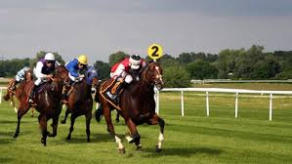
How can a program do 14.7779s of computing in 4.645s?
Could this just be a measurement mistake in Linux?
… in fact, if a process is using more than one thread it can harness more than one CPU at the same time.
With 3 CPUs running continuously at full speed, it can do 3x more work than the elapsed wall-clock time!
A 3-horsepower system

Slide 32
Quick dive into word count in C++
We’ll learn all of this over a few weeks
But today, we already might have a glimpse.

Slide 33
Example: Hello World in C++
First you’ll create a file, hello.cpp
Next, it must be compiled, for example:
g++ -std=c++20 hello.cpp –o hello
… and finally, launched:
./hello
Hello World
// My first C++ program
#include<iostream>
int main() {
std::cout << "Hello World“ << std::endl;
return 0;
}
We will be doing these steps from within Visual Studio Code
This “IDE” includes support for editing, compiling, debugging and executing your programs.

Slide 34
Example: Word Count in C++
This is the “core” of the counting logic:
using WC = std::map<std::string, int>;
WC sub_count[MAXTHREADS];
inline void found(int& tn, char*& word)
{
sub_count[tn][std::string(word)]++;
}

Slide 35
Example: Word Count in C++
… and here is the core of the sorting logic:
struct SortOrder: public std::binary_function<std::pair<int, std::string>, std::pair<int, std::string>, bool>
{
bool operator()(const std::pair<int, std::string>& lhs, const std::pair<int, std::string>& rhs) const
{
return lhs.first > rhs.first || (lhs.first == rhs.first && lhs.second < rhs.second);
}
};
using SO = std::map<std::pair<int, std::string>, int, SortOrder>;
SO sorted_totals;
for(auto wc: totals)
{
std::pair<int,std::string> new_pair(wc.second, wc.first);
sorted_totals[new_pair] = wc.second;
}

Slide 36
Example: Word Count in C++
Same logic but expressed using the c++2a decltype feature
using SO = std::map<std::pair<int, std::string>, int, decltype([](const std::pair<int, std::string>& lhs, const std::pair<int, std::string>& rhs) {return lhs.first > rhs.first || (lhs.first == rhs.first && lhs.second < rhs.second); })>;
SO sorted_totals;
for(auto wc: totals)
{
std::pair<int,std::string> new_pair(wc.second, wc.first);
sorted_totals[new_pair] = wc.second;
}

Slide 37
My code versus Sagar’s
My code understood that in files, data is just a long “vector” of characters – bytes – with some ‘\n’ characters (end of line).
My word-count kept the data in that form and only created std::string objects at the last moment, to increment the count:
“wptr” is a pointer directly to the bytes in the input buffer
inline void found(int& tn, char*& wptr)
{
sub_count[tn][std::string(wptr)]++;
}
Used in the hacking competition for lecture 1. All source code is on our web site!

Slide 38
A chunk of Linux source code
Notice: this has text (words) but also lots of other stuff, like spaces and tabs, special chars like (){};/_&* etc.
End of line is a special ascii char, ‘\n’ (code == 0x12).

Slide 39
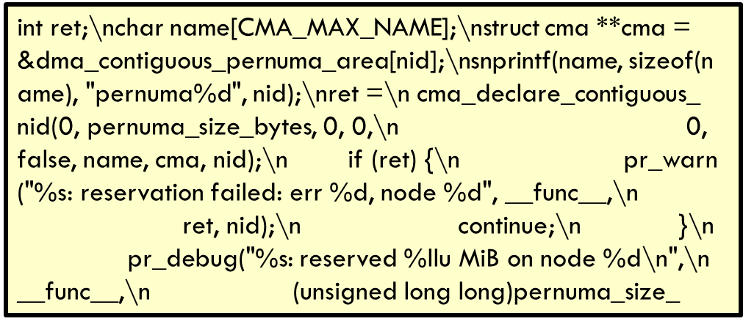
Visualization of my word count running
Read data into memory from disk file
Some file with Linux source code, like …/kernel/dma/contiguous.c
Memory buffer
Ken’s word-count process, when running

Slide 40
What do we mean by “read data into memory?”
In my program, some space gets allocated – set aside – in the address space as a place for file data to be held.
The program opened a source file and told Linux to copy 4096 bytes (one block) into that buffer area.
The text that you saw in that screenshot was stored there as a series of ascii bytes, a code that uses values 0..128

Slide 41
How my code actually worked
Change all “white space” to \0 (byte containing 0). Now each word is a null-terminated char* vector (a “c-string”)
Converted from a c-string to std::string in found:
int ret;\nchar name[CMA_MAX_NAME];\nstruct cma **cma =
int\0ret\0\0\0char\0name\0CMA_MAX_NAME\0\0\0struct\0 cma\0\0cma\0
wptr
found(current_thread_id, wptr);
sub_count[tn][std::string(word)]++;

Slide 42
When I first coded my solution, my program was very short, but rather slow.
I added parallel threads – which complicated the solution but helped a lot. Then because file opening was slow, I added a thread to “preopen” files before they were needed.
The C++ library for file opening and reading files was a bottleneck, so I switched to calling Linux file open and Linux file read, directly. This gave an additional speedup

Slide 43
What made Sagar’s version slower?
If you look at his code, you’ll find that it converts the whole file into std::string objects, line by line
Then it splits lines into substrings using a “splitter” method. Each chunk will be a std::string. But many won’t be “words”
If the substring matching the rule for a word, Sagar’s code uses a map like Ken’s code and increments the count.

Slide 44
What made Sagar’s Code Slower?
This means Sagar was creating perhaps 5-10x more std::string objects. At scale, with 50,000 files and millions of lines to scan, he does a lot of object creation, splitting and deletion, copying, garbage collection. Ken’s code “skipped” 95% of that work!
… So Ken’s code was way faster! Yet Sagar’s was closer to being pure C++. Ken’s mixed C++ with C

Slide 45
The Scoreboard
Total compute “load” was actually a lot lower for Ken’s C++ program. Hence… less energy consumed
#1-A: Ken’s C++ Faster, but more complex… real 4.645s user 14.779s sys 1.983s #1-B (Sagar’s code, shorter & better use of C++…) real 8.200s user 49.295s sys 2.145s | #3 Lucy’s Java version (no “true” threads) real 1m49.373s user 3m16.950s sys 8.742s
#2 Lucy’s Python version real 1m30.857s user 1m30.276s sys 0.572s This was only 19 lines of code! | #4: Pure Linux (buggy sort order) real 2m38.965s user 2m43.999s sys 27.084s

Slide 46
Central message here?
Understanding how the machine is representing your data can really matter if you want that last factor of 2x (or sometimes even 10x or 100x). Even C++ itself might miss that opportunity
So we need to learn about how NUMA computers represent data, and how our C++ code compiles to instructions that execute to perform the tasks we are coding!

Slide 47
How can we “anticipate” the costs of too many uses of Std::string?
We know that a file is basically a long vector of bytes.
A text file holds ascii chars with ‘\n’ for newline. A c-string is a region holding chars, ending with ‘\0’. Ken worked from this.
In contrast, a std::string is an object. At a minimum it has a string length and its own copy of the c-string holding the string data. It must be constructed and freed. That has to be costly.

Slide 48
How costly?
It wasn’t a huge effect
Yet because Sagar created a std::string for every “non-word” operator, plus braces, etc, he created a LOT of unneeded strings
And this added up to a surprising overhead!

Slide 49
Final version
With threads, my code was “part way” to the goal.
Thinking about bottlenecks, I decided to add one more parallel computing idea (we’ll see it soon). Then I changed some of my very heavily-used methods to be “inlined”
This gave that 20x-30x compared to Python and Java.

Slide 50
Didn’t I promise “thousands x” How did that drop to 30x?
We counted words in text files: Limited parallelism.
The C++ program is able to process them in parallel side-by-side streams, which was how we got the speedup.
With image processing or machine learning (tensor arithmetic), the value of parallel processing is dramatically larger.

Slide 51
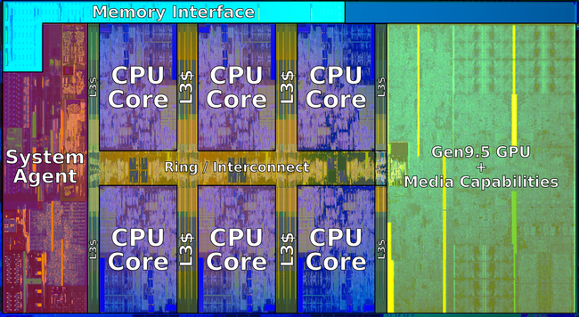
Parallelism in your computer
6-core Intel chip with GPU
A modern computer has multiple smaller computers (cores) that all run on the same computer memory (RAM). It may also have a special form of “accelerator” called a GPU.
To leverage this power, the computer offers special hardware instructions. The compiler can use those for big speedups. You can also use “threads”: a method of having more than one computational activity running within a single program.

Slide 52
Parallelism in your computer
A modern computer has multiple smaller computers (cores) that all run on the same computer memory (RAM). It may also have a special form of “accelerator” called a GPU.
To leverage this power, the computer offers special hardware instructions. The compiler can use those for big speedups. You can also use “threads”: a method of having more than one computational activity running within a single program.

Slide 53
Topic from Beyond CS4414: Cloud computing takes this further
For compute-intensive tasks, companies set up an account on a big commercial data center called a cloud. “Rent, don’t own”.
You can easily run a program on hundreds of thousands of computers, each instance processing different input files.
So a single job might have millions of threads working in parallel, and each using parallel computing instructions!
… the hard part is when they need to combine their results.

Slide 54
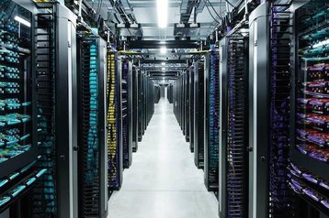
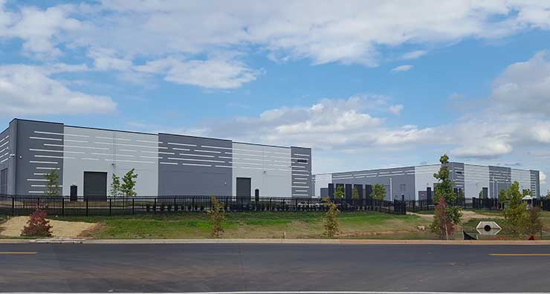
Modern Cloud Computing Data Center

Slide 55
Issues introduced by large scale
Program design: When we use networking to let processes talk to one-another, they need ways to share data, cooperate, coordinate, recover from failures.
Algorithmic: Just like in a single machine, there are more efficient and less efficient data structures and “protocols”
Security: At scale it is common to run into new kinds of attacks, and we need different styles of defense. Sensitive data is an especially important concern (like private information).

Slide 56
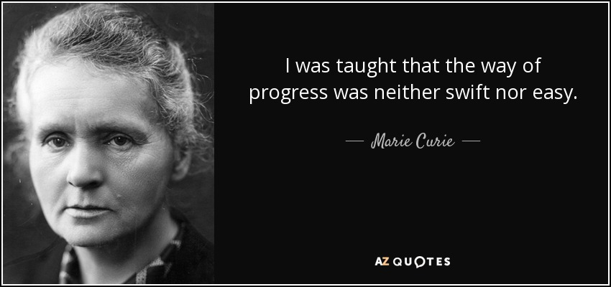
And yet…
First woman to win the Nobel Prize
Many jobs today involve larger scale computing platforms, even if you don’t work “for” a cloud company.
A factor of 10x can be dramatic if the code is used by Google to respond to a search or is part of the Facebook image feed.
C++ is the “way of progress” for demanding tasks.

Slide 57
Learning Linux and C++
You came into this class comfortable in an object oriented language, and learned data structures, so C++ should be easy to learn.
The operators and syntax and features will remind you of Java
There are extra operators, and those we will teach you, and things like dynamic memory management, but we won’t teach basics: those you need to learn in a hands-on way!
Similarly, we will provide pointers to lists of Linux commands and bash syntax, but these are topics for experiential learning

Slide 58
Roll your own? Or learn some weird library interface?
Once Sagar saw my version, he sped up his version, using more std::xxx methods – he basically ended up with something more standard.
Library solutions have the benefit of being standard, widely used, and heavily tested.
C++ libraries are also exceptionally performant, and for our course this is an important consideration!

Slide 59
Why would people care about word counting in a modern system, like for nlp?
Natural language programs are based on word counts, but :
White space, punctuation, hyphenation is removed
Conjunctions such as “a”, “and”, “or” are discarded
Upper case is mapped to lower-case
Stems are removed: “flying” might map to “fly”.

Slide 60
Why do NLP systems care about stems?
When people do a web search such as “learn to fly small plane” or “birds that cannot fly” small style differences arise.
Stems have been shown to be much more stable and consistent
Web pages for flying schools would probably use “fly” very extensively. In contrast “that” and “to” are less relevant…

Slide 61
What shapes the performance of “stemmed, lower-case word count”?
Speed of reading the data, especially if the file is large. At Google, some AI systems that learn from web pages scan hundreds of billions of them.
Splitting, stemming, mapping to lower case, discarding conjunctions
If we use new variables to hold stemmed words, we’ll need to “allocate” memory and initialize the object.
We’ll need to keep a sorted list of words, and look for each word as we discover it, and increase the associated counter.

Slide 62
Glimpse of Linux and Bash
This bash command runs c++, telling it to optimize the code, warn in a “fussy” way.
% g++ -std=c++11 -O3 -Wall -Wpedantic -pthread -o fast-wc fast-wc.cpp
This does a timed run of the program (fast-wc):
% time taskset 0xFF ./fast-wc -n4 -p
fast-wc with 4 cores, 50095 files, 16 blocks per read, parallel merge ON
define | 2008083
struct | 1694853
0 | 1268529
if | 1202461

Slide 63
More fun with bash
In fact we can use bash to…
Automatically open a file and have it look like “console input” in our C++ program.
Put the program output into a file
Run a program in the background
Put the program output into a bash variable, and then pass that variable as a command-line argument to some other program
… the list goes on for quite a while!

Slide 64
Remainder of Word Count in C++
I didn’t show you:
The standard includes required to import the std:: libraries
The main program that calls the “getWordCount” method
A bunch of little helper methods I wrote.

Slide 65
Confused? No worries…
New ideas are always confusing, especially if seen rapidly.
We will revisit all of these concepts much more carefully soon
Today was a big-picture perspective, and we don’t expect you to be able to do the same kind of thing… yet

Slide 66
Practical Considerations
Organizational stuff

Slide 67
Recitations matter!
In CS4414, we use the recitations to teach you C++ and Linux. We require them and we test on the material they cover.
We also are asking the ugrad TAs to organize a few longer “workshops” where they would problem solve while you watch (those will be on Zoom and recorded).
C++ is easy but it takes time and help. And even a person who knows C++ can learn new things from Alicia, Jonathan and Pengyue.

Slide 68
Setup
We will have everyone using the same version of GCC and the same version of Linux (Ubuntu)
This makes autograding possible, and also makes TA advising easier.

Slide 69
You can learn in groups… but must work alone
We encourage study groups. Learning as a group is great!
But… every single thing you do on a graded homework must be done by you, and not with any help from friends or CourseHero or other cheats. Graded work must be your individual work.
ChatGPT and similar bots are not particularly good at C++ so you can use them safely, without it being cheating.

Slide 70
Exams (some), Homework
We use the exact same grading formula as CS4410: 50% exams, 50% homework. There will be two prelims but no final. Cornell exam schedules will show the exact dates, times and rooms.
You are required to attend lectures. If people stop attending we might give a snap quiz from time to time. Videos from prior years are for catching up, not skipping lecture.

Slide 71
Curve
We curve the course
Our feeling is that most students should easily be able to earn a grade in the range from B- to A+. But A+ is “special” and not strictly from a formula. The instructor decides how many to give. Taking the final can never raise a grade from A to A+.
Grades below B- would only be used if a student really isn’t doing well, especially if that person is also skipping lectures.

