Slide 1
In search of an abstract way to think about Parallelism
Professor Ken Birman
CS4414 Lecture 8

Slide 2
Idea Map For Today
Understanding the parallelism inherent in
an application can help us achieve high
performance with less effort.
There is a disadvantage to this, too. If we
write code knowing how that some version of the C++ compiler or the O/S will “discover” some opportunity
for parallelism, that guarantee could erode over time.
Ideally, by “aligning” the way we express our code or solution with the way Linux and the C++ compiler discover parallelism, we obtain a great solution
This tension between what we explicitly express and
what we “implicitly” require is universal in computing,
although people are not always aware of it

Slide 3
Modern systems are full of opportunities for parallism
Hardware or software prefetching into a cache
File I/O overlapped with computing in the application
Threads (for example, in word count, 1 to open files and many to process those files).
Linux processes in a pipeline
Daemon processes on a computer
VMs sharing some host machine
Parallel instructions in the Intel instruction set (and many others)

Slide 4
A few Ways to obtain parallelism
Some of these are automatic. E.g.: if Linux notices that the file is being scanned sequentially, it will prefetch blocks.
Some require special logic: To process many blocks in parallel, you launch many threads, one per block. As long as these threads don’t interfere with one-another, we get an n-fold speedup.
Some depend on the compiler mapping your code to “parallel instructions” supported by the CPU.

Slide 5
Embarassing parallelism
There are entire textbooks and courses on parallel algorithms
But most parallel computing opportunities are totally obvious – things that can easily be done simultaneously if we understand how to “launch” and “control” that pattern of execution.
We call this “embarrassing parallelism” when the opportunity is just sitting there but we neglected to leverage it.

Slide 6

Opportunities for parallelism
Consider this photo rotation:
Does it have embarrassing parallism in the task?
Rotate 3-D

Slide 7
Opportunities for Parallelism
The application has multiple threads and
they are processing different blocks.
The blocks themselves are arrays of pixels. We need to multiply each pixel against a small 4x4 tensor describing the rotation
Application
File system could be doing prefetching
O/S kernel
Storage device
On disk, photo spans many blocks

Slide 8
What are the “requirements” for the maximum degree of parallelism?
A task must be able to run independently from any other tasks
There should be an opportunity to have many of these running
The individual tasks shouldn’t “stall” (like by waiting for I/O, or paging, or a lock)

Slide 9
Issues raised by launching Threads: “unnoticed” sharing
Recall that we want Linux to prefetch each block.
With n threads, we have n separate tasks requesting blocks.
It will be important that Linux still sees these requests in order, as sequential reads. If reads “jump around” in the file, Linux won’t notice the sequence and won’t prefetch. The threads stall…

Slide 10
Issues raised by launching Threads: “unnoticed” sharing
Suppose that your application uses a standard C++ library
If that library has any form of internal data sharing or dependencies, your threads might happen to call those methods simultaneously, causing interference effects.
This can lead to concurrency bugs, which will be a big topic for us soon (but not in today’s lecture). Preventing bugs requires locks

Slide 11
… locking can involve waiting. This is one example of a thread “stalling”
We will need to learn to use locking or other forms of concurrency control (mutual exclusion). For example, in C++:
std::mutex my_mutex; // Defines a form of lock
…
{
std::lock_guard my_lock(my_mutex); // Obtains the lock, may wait here
… this code will be safe …
}

Slide 12
… locking can involve waiting. This is one example of a thread “stalling”
std::lock_guard works, but modern C++ has other options too.
In an upcoming lecture we will see the “best standard practice”, but it involves a C++ language feature we haven’t talked about yet
We will need to learn to use locking or other forms of concurrency control (mutual exclusion). For example, in C++:
std::mutex my_mutex; // Defines a form of lock
…
{
std::lock_guard my_lock(my_mutex); // Obtains the lock, may wait here
… this code will be safe …
}

Slide 13
Locking reduces parallelism
Now thread A would wait for B, or vice versa, and the protected object, such as a counter, is incremented in two separate actions
But if A or B paused, we saw some delay
This is like with Amdahl’s law: the lock has become a bottleneck!

Slide 14
Parallel solutions may also be harder to create due to extra steps required
Think back to our word counting programs. It avoided locks!
We used 24 threads, but ended up with 24 separate sub-counts
  The issue was that we wanted the heap for each thread to be a
  RAM memory unit close to that thread
  So, we end up wanting each to have its own std::map to count words
  But rather than 24 one-by-one map-merge steps, we ended up going
  for a parallel merge approach

Slide 15
More costs of parallelism
These std::map merge operations are only needed because our decision to use parallel threads resulted in us having many maps.
… code complexity increased

Slide 16
Image and tensor processing
Images and the data objects that arise in ML are tensors: matrices with 1, 2 or perhaps many dimensions.
Operations like adjusting the colors on an image, adding or transposing a matrix, are embarrassingly parallel. Even matrix multiply has a mix of parallel and sequential steps.
This is why hardware vendors created GPUs.

Slide 17
Concept: SISD versus SIMD
X = Y*3;
A normal CPU is single instruction, single data
An instruction like movq moves a single quad-sized integer
to a register, or from a register to memory.
  An instruction like addq does an add operation on a single register
  So: one instruction, one data item

Slide 18
Concept SISD versus SIMD
Rotate 3-D
A SIMD instruction is a single instruction, but it operates on a vector or matrix all as a single operation. For example: apply a 3-D rotation to my entire photo in “one operation”
In effect, Intel used some space on the NUMA chip to create a kind of processor that can operate on multiple data items in a single clock step. One instruction, multiple data objects: SIMD

Slide 19
Side remark
Rotate 3-D
In fact, rotating a photo takes more than one machine instruction.
It actually involves a matrix multiplication: the photo is a kind of matrix (of pixels), and there is a matrix-multiplication we can perform that will do the entire rotation.
So… a single matrix multiplication, but it takes a few instructions in machine code, per pixel. SIMD could do each instruction on many pixels at the same time.

Slide 20
SIMD limitations
A SIMD system always has some limited number of CPUs for these parallel operations.
Moreover, the computer memory has a limited number of parallel data paths for these CPUs to load and store data
As a result, there will be some limit to how many data items the operation can act on in that single step!

Slide 21
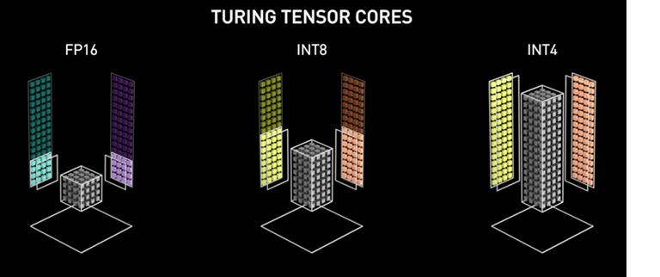
Intel vectorization compared with GPU
A vectorized computation on an Intel machine is limited to a total object size of 64 bytes.
  Intel allows you some flexibility about the data in this vector.
  It could be 8 longs, 16 int-32’s, 64 bytes, etc.
  In contrast, the NVIDIA Tesla T4 GPU we talked about in lecture 4 has thousands of CPUs that can talk, simultaneously, to the special built-in GPU memory. A Tesla SIMD can access a far larger vector or matrix in a single machine operation.

Slide 22
… CS4414 is about programming a NUMA machine, not a GPU
So, we won’t discuss the GPU programming case.
But it is interesting to realize that normal C++ can benefit from Intel’s vectorized instructions, if your machine has that capability!
To do this we need a C++ compiler with vectorization support and must write our code in a careful way, to “expose” parallelism

Slide 23
Special C++ compiler?
There are two major C++ compilers: gcc from GNU and clang, created by LLVM (an industry consortium)
But many companies have experimental extended compilers. The Intel one is based on Clang but has extra features.
All are “moving targets”. For example, C++ has been evolving (C++ 11, 17, 20….) each compiler tracks those (with delays).

Slide 24
The Intel Vectorization Instructions
When the MMX extensions to the Intel x86 instructions were released in 1996, Intel also released compiler optimization software to discover vectorizable code patterns and leverage these SIMD instructions where feasible.
The optimizations are only available if the target computer is an Intel chip that supports these SIMD instructions.

Slide 25
Initially, C++ did not support MMX
It took several years before other C++ compilers adopted the MMX extensions and incorporated the associated logic.
Today, C++ will search for vectorization opportunities if you ask for it, via -ftree-vectorize or –O3 flags to the C++ command line.
… so, many programs have vectorizable code that doesn’t exploit vector-parallel opportunities even on a computer than has MMX

Slide 26
Also, Intel is not the only CPU designer
AMD is another major player in the CPU design space. They have their own vector-parallel design, and the instructions are different from the Intel ones (but similar in overall approach).
ARM is an open-source CPU design. It aims at mobile phones and similar systems, and has all sorts of specializations for tasks such as video replay and image or video compression.

Slide 27
Modern C++ support for SIMD
Requires -ftree-vectorize or –O3
You must write your code in a vectorizable manner: simple for loops that access the whole vector (the loop condition can only have a simple condition based on vector length), body of the loop must map to the SIMD instructions.

Slide 28
GNU C++ examples that would parallelize automatically
This simple addition
can be done in parallel.
The compiler will eliminate the
loop if a single operation suffices.
Otherwise it will generate one
instruction per “chunk”
Example 1:
int a[256], b[256], c[256];
foo () {
int i;
for (i=0; i<256; i++){
a[i] = b[i] + c[i];
}
}
https://gcc.gnu.org/projects/tree-ssa/vectorization.html

Slide 29
GNU C++ examples that would parallelize automatically
Example 2:
int a[256], b[256], c[256];
foo (int n, int x) {
int i;
/* feature: support for unknown loop bound */
/* feature: support for loop invariants */
for (i=0; i<n; i++)
b[i] = x;
}
/* feature: general loop exit condition */
/* feature: support for bitwise operations */
while (n- -){
a[i] = b[i]&c[i]; i++;
}
}
Here we see more difficult
cases
The compiler can’t predict
the possible values n could
have, making this code hard
to “chunk”
https://gcc.gnu.org/projects/tree-ssa/vectorization.html

Slide 30
GNU C++ examples that would parallelize automatically
Example 8:
int a[M][N];
foo (int x) {
int i,j;
/* feature: support for multidimensional arrays */
for (i=0; i<M; i++) {
for (j=0; j<N; j++) {
a[i][j] = x;
}
}
}
Parallelizing a 2-d matrix
seems “easy” but in fact
data layout matters.
To successfully handle such
cases, the dimensions must
be constants known at
compile time!
https://gcc.gnu.org/projects/tree-ssa/vectorization.html

Slide 31
GNU C++ examples that would parallelize automatically
Example 9:
unsigned int ub[N], uc[N];
foo () {
int i;
/* feature: support summation reduction.
note: in case of floats use -funsafe-math-optimizations */
unsigned int diff = 0;
for (i = 0; i < N; i++) {
udiff += (ub[i] - uc[i]);
}
This sum over differences
is quite a tricky operation
to parallelize!
C++ uses a temporary
object, generates the diff,
then sums over the temporary
array
https://gcc.gnu.org/projects/tree-ssa/vectorization.html

Slide 32
Summary: Things you can do
Apply a basic mathematical operation to each element of a vector.
Perform element-by-element operations on two vectors of the same size and layout
Apply a very limited set of conditional operations on an item by item basis

Slide 33
Advice from Intel
Think hard about the layout of data in memory
  Vector hardware only reaches its peak performance for carefully
  “aligned” data (for example, on 16-byte boundaries).
  Data must also be densely packed: instead of an array of structures
  or objects, they suggest that you build objects that contain arrays of
  data, even if this forces changes to your software design.
  Write vectorization code in simple “basic blocks” that the compiler
  can easily identify. Straight-line code is best.
  “inline” any functions called on the right-hand of an = sign

Slide 34
Within that code…
On the right hand slide of expressions, limit yourself to accessing arrays and simple “invariant” expressions that can be computed once, at the top of the code block, then reused.
Avoid global variables: the compiler may be unable to prove to itself that the values don’t change, and this can prevent it from exploring many kinds of vectorization opportunities.

Slide 35
Left hand side…
When doing indexed data access, try to have the left hand side and right hand side “match up”: vectors of equal size, etc.
Build for loops with a single index variable, and use that variable as the array index – don’t have other counters that are also used.
  SIMD code can access a register holding the for-loop index, but
  might not be able to load other kinds of variables like counters

Slide 36
Things to avoid
No non-inlined function calls in these vectorizable loops, other than to basic mathematical functions provided in the Intel library
No non-vectorizable inner code blocks (these disable vectorizing the outer code block)
No “data dependent” end-of-loop conditions: These often make the whole loop non-vectorizable

Slide 37
Potential speedup?
With Intel MMX SIMD instructions, you get a maximum speedup of about 128x for operations on bit vectors.
More typical are speedups of 16x to 64x for small integers.
Future processors are likely to double this every few years

Slide 38
Floating Point
Given this form of vectorized integer support, there has been a lot of attention to whether floating point can somehow be mapped to integer vectors.
In certain situations this is possible: it works best if the entire vector can be represented using a single exponent, so that we can have a vector of values that share this same exponent, and then can interpret the vector as limited-precision floating point.

Slide 39
C++ vectorization for floats
There is a whole ten-page discussion of this in the compiler reference materials!
With care, you can obtain automatically vectorizable code for floats, but the rules are quite complicated.
… However, GPU programming would be even harder!

Slide 40
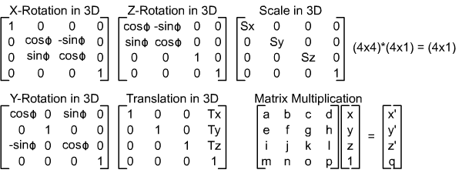
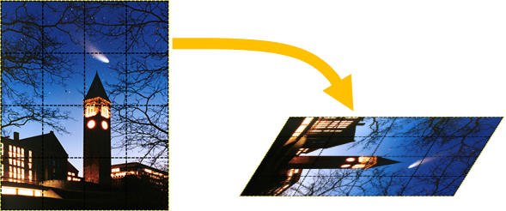
Could this solve our photo rotation?
We can think of a photo as a flat 3-D object. Each pixel is a square. A 3-D rotation is a form of matrix multiplication.

Slide 41
Two floating point options
We could “construe” our pixels as floating point numbers.
But we could also replace a floating point number by a rational number.
For example: π ≅ 22/7. So, x* π ≅ (x*22)/7.

Slide 42
Rational arithmetic lets us leverage the Intel vector hardware
The Intel vector instructions only work for integers.
But they are fast, and parallel, and by converting rational numbers to integers, we can get fairly good results.
Often this is adequate!

Slide 43
This is widely used in machine learning!
We noted that many ML algorithms are very power-hungry
Researchers have shown that often they are computing with far more precision than required and that reduced-precision versions work just as well, yet can leverage these vector-parallel SIMD instructions.
These are available in reduced-precision ML libraries and graphics libraries today.

Slide 44
GPU versus SIMD
Why not just ship the parallel job to the GPU?
  GPUs are costly, and consume a lot of power. A standard processor
  with SIMD support that can do an adequate job on the same task
  will be cheaper and less power-hungry.
  Even if you do have a GPU, using it has overheads:
  The system must move the data into the GPU. Like a calculator
  where you type in the data.
  Then it asks the GPU to perform some operation. “Press the button”
  Then must read the results out.

Slide 45

New-age options
An earlier “new age”
These include TPU accelerators: “tensor processing units”
FPGA: A programmable circuit, which can be connected to other circuits to build huge ultra-fast vision and speech interpreting hardware, or blazingly fast logic for ML.
RDMA: Turns a rack of computers or a data center into a big NUMA machine. Every machine can see the memory of every other machine

Slide 46
Stepping back we find… conceptual abstraction patterns.
When you look at a computer, like a desktop or a laptop, what do you see?
Some people just see a box with a display that has the usual applications: Word, Zoom, PowerPoint…
Advanced systems programmers see a complex machine, but they think of it in terms of conceptual building blocks.

Slide 47
Speed versus portability
One risk with this form of abstract reasoning is that code might not easily be portable.
We are learning about SIMD opportunities because most modern computers have SIMD instruction sets (Intel, AMD, etc).
A feature available on just one type of computer can result in a style of code that has poor performance on other machines.

Slide 48
Applications can have built-in Checks
If you do create an application that deliberately leverages hardware such as a particular kind of vectorization, it makes sense to have unit tests that benchmark the program on each distinct computer.
The program can then warn if used on an incompatible platform: “This program has not been optimized for your device, and may perform poorly”.

Slide 49
Summary
Understanding the computer architecture, behavior of the operating system, data object formats and C++ compiler enables us to squeeze surprising speedups from our system!
Because SIMD instructions have become common, it is worth knowing about them. When you are able to leverage them, you gain speed and reduce power consumption.

