Slide 1
Abstraction ↔ Performance:
An Enduring battle
Professor Ken Birman
CS4414 Lecture 6

Slide 2
Today’s lecture
Linux memory segments are a form of “abstraction”. The same can be said of C++ by-reference variables.
Before continuing to explore features of C++, we’ll do a small detour and look at the growing importance of abstractions in systems programming.
Along the way we’ll talk about the Linux file system “abstraction”

Slide 3
Idea Map For Today
Complex tensions: Simplicity/expressiveness.
Performance/elegance
Correctness and Security/ convenience
A thing should be as simple as possible.
This argues for elegant abstractions
Virtualization arises in many forms in Linux:
virtual memory, the process abstraction, full
virtual machines, container virtualization.
These offer good examples of those tensions
Yet some things are just not simple, like
NUMA hardware! This argues for powerful APIs
that expose performance-critical controls
To illustrate this idea we will look at the file system abstraction

Slide 4
Early computer systems didn’t have an operating system!
You wrote your program out on paper
Then “toggled it into memory”
Put the start execution address into the PC register by hand. Pressed “run”

Slide 5
code reuse emerged as an important goal
Once you have a working solution such as code to print to the lineprinter, why reimplement it?
At first you had to attach a punch-card deck to your punch-card deck, with a copy of the code you wanted to reuse.
This led to the idea that a computer should have built-in functionality to manage the hardware and make programming easier. The idea of an operating system was born!

Slide 6
The O/S and the Kernel
Some parts of the operating system run the computer hardware, but other parts do other tasks, such as copying files.
Over time, we began to refer to the resident portion of the O/S as the kernel, and the rest as “additional O/S components”
… it quickly turned out that protecting the kernel is important!

Slide 7

The Dawn of Hacking
(IBM 360, 1978)
The IBM 360 kernel managed a list of user
names and passwords.
Of course, passwords shouldn’t be in plain text. So the passwords were encrypted by a messy function that did a lot of shift and rotate and multiplication operations and ended up with a 16-bit number.
On the IBM 360, the kernel memory was “visible” to any process
The dawn of whacking. 1.8M BC

Slide 8

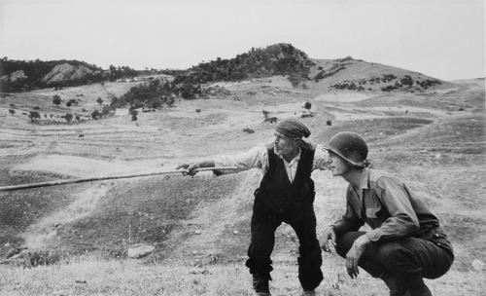
Guess what?
With the help of a friendly math student, it
was possible to invert this function.
… for each user account, we ended up with a whole list of passwords!
Late one night, the “IT police” rushed to the
computer center… my list of passwords was
right there, but they didn’t recognize them. So,
it didn’t occur to them that I was the criminal!
Helpful math wizard
The bad guy went that-a-way

Slide 9
In fact there were many issues
Theft of passwords was a big issue, but even without passwords, any user could literally see the memory in use by other users.
Personal information was completely visible, such as healthcare records, payroll records, etc.
Even the code of the kernel itself was visible. Other companies could dissemble it as a shortcut to competing with IBM!

Slide 10
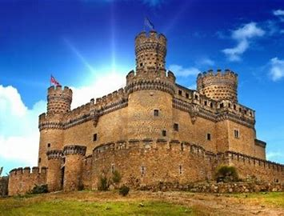
IBM 370 Kernel protections
… So, it was not a surprise when the IBM 370 introduced a wide range of additional kernel protections!
User mode / kernel mode: The kernel had a long list of special
instructions that it could execute, that were illegal for users.
Each user process was given its own page table, and limited
to seeing its own memory (the kernel, in contrast, “sees all”).
Traps and exceptions switched from user mode to kernel mode
Take a security course to learn more, including how some traps returned to the user… in kernel mode!

Slide 11
Protection of the File System
The file system is just a data structure built and managed by the kernel, on the storage unit (disk or USB drive or whatever).
In Linux, you could literally “see” that disk in two ways:
  You can chdir into the folders and open files and access them.
  If you knew the name of the device, such as /dev/usb2, you could
  access that device in “raw” mode and see the actual blocks holding
  the directories and files.

Slide 12

Why would this matter?
Imagine that you and your friends are sharing a
top-secret plan for the big surprise party for Rachel.
Rachel has access to your computer, so once you print the plan
you delete all the copies – including any backup copies.
But Rachel has a friend who is a “disk forensics specialist”…

Slide 13
How do file systems really work?
Think about malloc from our previous lecture.
Linux is managing a form of tree, on the disk, by reading blocks (fixed size, default is currently 4192 bytes), modifying data within them, then writing them back.
It has a free list of blocks: new space needs are satisfied from it, and any freed blocks (deleted files) are added to this list.

Slide 14
Linux File System Data Structure
Could span multiple storage devices, but we will focus on one
Can reach over the network to a file system server (but we won’t worry about that case)
Supports various “kinds” of files: small, medium, large, immense. File names can also be short or long or very, very long.

Slide 15
Links
In Linux, we distinguish the inode (the “file data structure”) from the name. A name is said to be a “link” to the inode.
A single file (or even directory) can have multiple names.
  Original form: “link”. A and B can be two names referencing the same
  inode number. Only works in a single file system, not across mount points.
  New form: “symbolic link”. File B contains the actual name for file A.
  Works in a similar way… yet not identical.

Slide 16
Links
Thought puzzle 1:
Suppose file “B” is a link to file “A”.
You delete A. What will happen to B?
In Linux, we distinguish the inode (the “file data structure”) from the name. A name is said to be a “link” to the inode.
A single file (or even directory) can have multiple names.
  Original form: “link”. A and B can be two names referencing the same
  inode number. Only works in a single file system, not across mount points.
  New form: “symbolic link”. File B contains the actual name for file A.
  Works in a similar way… yet not identical.

Slide 17
Links
Thought puzzle 2:
Suppose file “B” is a link to file “A”.
You edit A. What will happen to B?
In Linux, we distinguish the inode (the “file data structure”) from the name. A name is said to be a “link” to the inode.
A single file (or even directory) can have multiple names.
  Original form: “link”. A and B can be two names referencing the same
  inode number. Only works in a single file system, not across mount points.
  New form: “symbolic link”. File B contains the actual name for file A.
  Works in a similar way… yet not identical.

Slide 18
Symbolic links
These were added later because with mounted file systems, it
was a problem that links didn’t work across mount points.
With a symbolic link, a file can contain a pathname.
If you access it (or search through it), Linux “switches” to the symbolic link pathname.

Slide 19
Symbolic links
Thought puzzle 3:
Suppose file “B” is a symbolic link to file “A”.
You delete A. What will happen to B?
These were added later because with mounted file systems, it
was a problem that links didn’t work across mount points.
With a symbolic link, a file can contain a pathname.
If you access it (or search through it), Linux “switches” to the symbolic link pathname.

Slide 20
Symbolic links
Thought puzzle 4:
Suppose file “B” is a symbolic link to file “A”.
You edit A. What will happen to B?
These were added later because with mounted file systems, it
was a problem that links didn’t work across mount points.
With a symbolic link, a file can contain a pathname.
If you access it (or search through it), Linux “switches” to the symbolic link pathname.

Slide 21
Symbolic links
Thought puzzle 5:
Suppose file “B” is a symbolic link to file “A”.
You delete B. What will happen to A?
These were added later because with mounted file systems, it
was a problem that links didn’t work across mount points.
With a symbolic link, a file can contain a pathname.
If you access it (or search through it), Linux “switches” to the symbolic link pathname.

Slide 22
Symbolic links
Thought puzzle 6:
A is a symbolic link to B. B is a symbolic link to A.
What happens if you try to open A?
These were added later because with mounted file systems, it
was a problem that links didn’t work across mount points.
With a symbolic link, a file can contain a pathname.
If you access it (or search through it), Linux “switches” to the symbolic link pathname.

Slide 23
POSIX File System API
You access files via the “POSIX” API.
A process first must open the file:
int fd = open(“filename”, O_RDWR);
Now the file descriptor, fd, can be used to access the bytes. Linux considers all data files to just be buckets of bytes.

Slide 24
POSIX File System API
Many Linux system calls take extra arguments, often as bit masks, where each set bit requests some feature.
O_RDWR is a mask that means “open for reading and writing…
You access files via the “POSIX” API.
A process first must open the file:
int fd = open(“filename”, O_RDWR);
Now the file descriptor, fd, can be used to access the bytes. Linux considers all data files to just be buckets of bytes.

Slide 25
POSIX File System API
You can also create a file with “open”:
fd = open(“file”, O_CREAT, S_IRWXU|S_IRGRP|S_IROTH);
For O_CREAT you specify “permissions” on the new file, for
yourself (as owner), your “group” (team members) and “others

Slide 26
More POSIX operations
lseek(fd, location, SEEK_SET); // Move file “pointer”
nb = read(fd, buffer, nbytes); // nb will be “bytes actually read”
write(fd, buffer, nbytes); // Write nbytes at the current pointer
close(fd); // Releases resources
… many of these have also have options.

Slide 27
C++ FILE wrappers, mmap
In C++, wrappers are sometimes used to treat files like objects.
  Use std::iostream if you plan to just scan a text file.
  Use std::FILE if your file is a series of fixed-sized records.
There is also a way to “map” a file into memory: mmap.
  A mapped file looks like a vector of bytes (in C++, of type “char*”)
  You read or write the data by simply indexing into this vector.
  Must call fsync() or close() to force the writes back out to disk.

Slide 28
Stored data resides in blocks
Linux stores data in fixed-sized blocks. Each file has a length, in bytes. The last block might be partially filled.
A process can’t read beyond the end of the file (EOF): read indicates this by returning nb < nbytes. nb can be zero
You can create a gap by seeking beyond the end of a file and then writing. Linux returns 0’s if an application reads the gap.

Slide 29
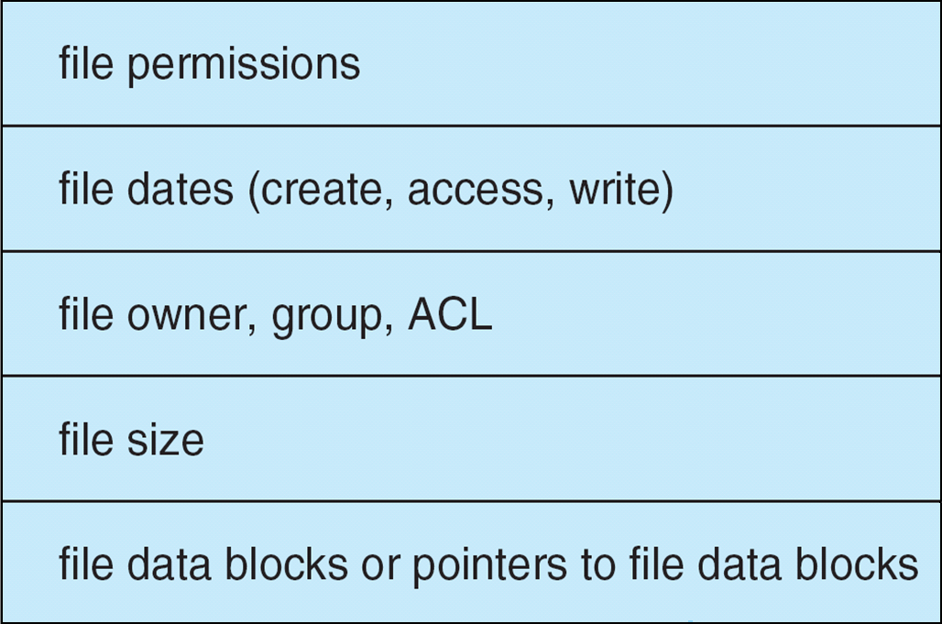
On the disk and Inside the kernel, a file has a File Control Block (inode)
}
For historical reasons, Linux calls this an inode structure
Each inode has a unique id number.

Slide 30
On the disk and Inside the kernel, a file has a File Control Block (inode)
Short for “index node”, meaning a data structure used to rapidly find information. In the Linux file system the role of the inode index is to rapidly find the data blocks in the file
}
For historical reasons, Linux calls this an inode structure
Each inode has a unique id number.

Slide 31
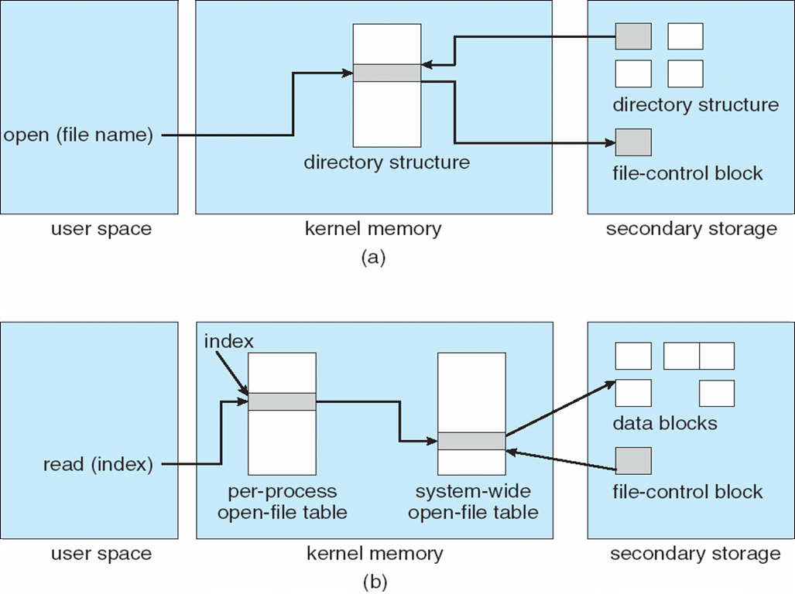
In-Memory File System Structures
One file or directory can have multiple “alias” names (links)
A name in a directory lets us determine the inode number. This gets us to the data structure with file content information
Once a file is open, the inode is also listed in the kernel’s “open files” table. Again, we can use this to get to the inode data structure containing information about the file permissions and contents.

Slide 32
File data is stored in blocks
Party-Plan.docx, 1234
To keep the inode structure size small, the inode itself only can list a small number of blocks. If the file is small, these hold data.
For a large file, each of these blocks themselves hold lists of blocks: a hierarchy of index blocks, with the actual data blocks as the “leaves” of the structure.
Huge files have additional layers of index blocks
Inode 1234:
File Control Block for
Party-Plan.docx

outer-index
index table
file

Slide 33
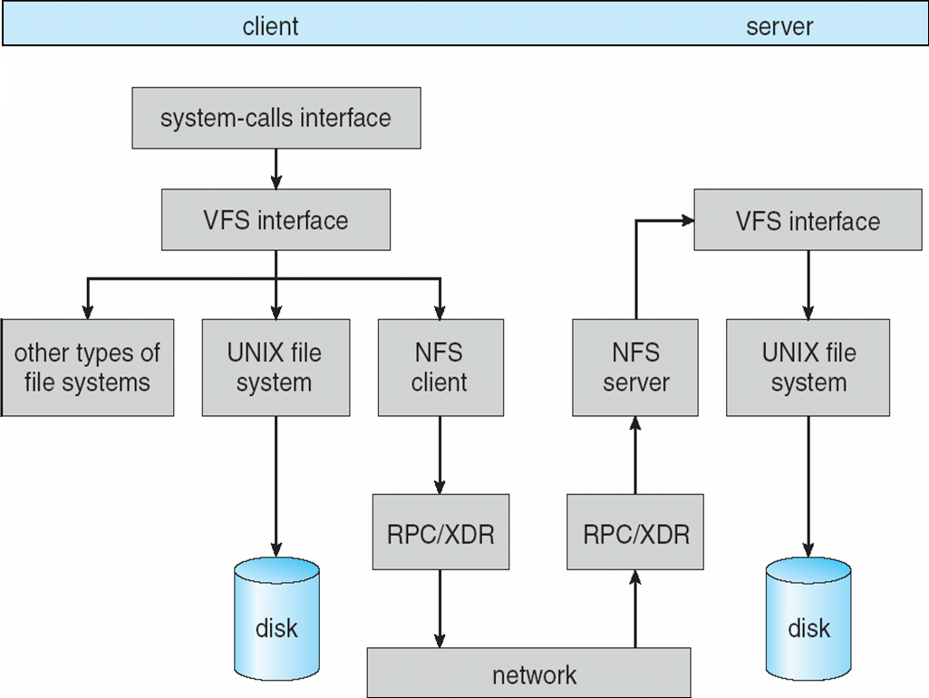
With a network file system, same idea…

Slide 34
…. So, when you deleted “party-plan.docx”
In fact the actual disk I/O that occurred was this:
  Linux accessed the block containing the directory, zeroed the inode
  number next to the file name, rewrote the block.
  Linux accessed the tree node for the file (called an “inode”) and
  changed its state from allocated to free. It put the inode on a freelist
  Linux walked down the list of blocks in the file, and put them on the
  freelist for disk blocks, and wrote that back to the disk.
  What did Linux not do?

Slide 35
…. So, when you deleted “party-plan.docx”
Linux never zeroed the actual contents of the inode, it only was put on the inode freelist. It never overwrote the file name – it just changed the inode number in the directory to 0.
And it never zeroed the contents of the file, either. It simply put the blocks on the freelist for blocks.
Thus, if you can “find” the inode, you can still reconstruct the whole file, until those blocks are actually reused for some other purpose!
In fact the actual disk I/O that occurred was this:
  Linux accessed the block containing the directory, zeroed the file
  name in the list of active files, rewrote the block.
  Linux accessed the tree node for the file (called an “inode”) and
  changed its state from allocated to free. It put the inode on a freelist
  Linux walked down the list of blocks in the file, and put them on the
  freelist for disk blocks, and wrote that back to the disk.
  What did Linux not do?

Slide 36
Why was the kernel so “Lazy”?
Linux is optimized for speed.
The designers thought about it this way: if you really wanted to ensure that Party-Plan.docx was destroyed, you could have used a tool to rewrite the actual bytes with gibberish, before deleting it.
You didn’t do this, hence you must care mostly about speed, and so you want Linux to be as fast as possible for file deletes.

Slide 37
Is it possible to “really” delete a file?
In some situations, yes. There are Linux tools to help you do this. Spies use them… most users don’t even know about them.
They overwrite the file bits with random garbage dozens of times.
But for most mortals, the real answer is: Maybe not. Any file you create, or download – including a web page – may linger on your machine! (And web pages can even have hidden content)

Slide 38

Rachel’s forensic toolkit
Her friend gave her copies of programs, easily downloaded from the network (in fact Linux even has standard ones you can install using apt-get) that
  Open the disk as a raw block device
  Scan the inode freelist looking for inodes that were freed yet where
  haven’t actually be reused for some other purpose yet
  Access the corresponding blocks, copying their data
  This allows them to generate “recovered files” without the proper name, but with some or even all of the data that they had when deleted!

Slide 39
These tools bypass file system security
In the file control block is a record of the file owner, permissions and last access time.
But when accessed as a raw disk block, the kernel ignores the existence of that file system data structure and treats the whole disk as a huge block device. The blocks are just byte arrays!
So normal file system permissions aren’t checked.

Slide 40
… which is why Linux normally allows their use only by the superuser
You can’t just open /dev/usb2 as a raw device without permission to access /dev/usb2 in the first place!
However… those permissions are fairly soft. If I found a backup of your disk, and plugged that into a Linux computer without telling it that the USB contains a file system, I could connect to it in this raw mode, and then could access the contents.

Slide 41
… how would Rachel even figure out the file names?
Some versions of the Linux kernel wipe clean the names of deleted files.
But the file system supports very long file names, and it can be costly to zero all of those bytes.
So many versions of Linux delete files by just zeroing the inode number in the directory, leaving the file name itself untouched.

Slide 42

… Of course it may not be trivial to match the name to the file
But many forensic tools make a good guess of which names match which inodes, with a good chance of finding
  Its old name (“Possibly PartyPlan.docx”)
  The correct list of blocks
  Most or all of the data it used to contain
  Rachel realizes her mom is not coming. ☹
So my mom is not coming to my baby shower?

Slide 43
A file system may look immaculate…
… yet to a forensic specialist, the disk is like a genome, full of junk (non-coding) DNA that still reveals a lot about the past!
And this doesn’t even consider forensic tools that try to use fancy hardware features to “recover” bytes that may have been written once, but then overwritten recently with zeros, or with random garbage.

Slide 44
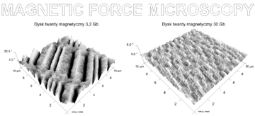
The first-write issue
With most forms of storage, the first bits written in a block leave a ghostly impression.
With cutting edge forensic tools (magnetic force microscopy), those ghostly images can be pulled off the disk. Then you can use tools (like gdb) to examine the data.

Slide 45
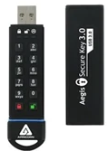
Even USB storage devices can be dangerous!
Hackers have attacked via “poisoned” file systems.
How this worked: they damaged the file system data structures, and when mounted, this allowed them to take full control!
The damage could be found and repaired by checking integrity of the file system structure before mounting it. But with a large file system this is quite slow.

Slide 46
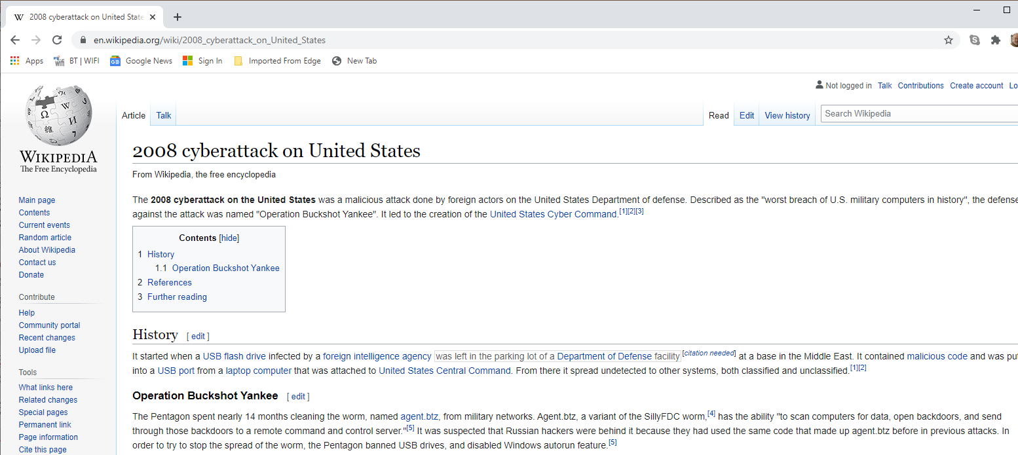

Slide 47
This is a story about file system security but also about abstractions
We want to think about a storage system in terms of elegant, high-level concepts like files and directories and links.
Yet there is an underlying reality here: data lives on a device. And there are situations where we need direct access to devices, such as when importing files from a different operating system.
The tension is fundamental: abstraction ↔ reality, performance, …

Slide 48
Definition: Abstraction
Abstraction is the process of filtering out – ignoring - the characteristics of patterns that we don't need in order to concentrate on those that we do.
Abstractions arise we filter out details to focus on key ideas.

Slide 49
We (want to) trust the kernel!
The O/S kernel is creating an illusion of private files, that we can safely delete or copy or modify.
But this illusion is only as good as the protection features that surround the O/S and those raw hardware devices. As historical operating systems got more complex, more and more issues surfaced!
When Unix was introduced, and then “reimplemented” as Linux, it was in part a response to a demand for simplicity

Slide 50
Yet no kernel is all-powerful
If someone can get physical access to a storage device, for example, those forensic tools still work. (Modern Linux does include the option of encrypting the contents of every file)
The idea, though, it to create a secure, performant, efficient environment for running programs and managing data.

Slide 51
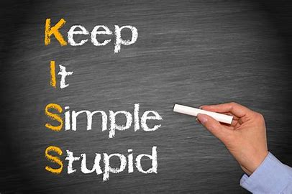
Linux themes
Minimalism: If something doesn’t have to be in the kernel, leave it out! Instead of rarely used complex features, limit the kernel to simple, general features that can be combined to solve all needs!
Performance: The kernel should be blazingly fast and reliable.
Correctness and security: The kernel should behave as advertised, always, and defend itself against attacks.

Slide 52
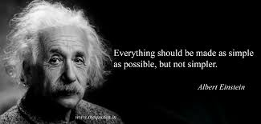
Modern hardware is not at all simple…
… so this creates a dilemma. In fact,
modern Linux is not remotely as simple
as the earliest Unix.
Yet this tension between features and
simplicity is still evident!
The modern concern is mostly centered on trust: If the kernel is small we have a better chance to verify its security!

Slide 53
Linux is modular and compositional
We saw how Linux encourages combining a few programs to accomplish a general task.
The kernel itself has some basic modules, that combine to offer all sorts of broader functionality. These have simple interfaces.
In the CS4410 course, O/S, you’ll learn all about how these work.

Slide 54
Roles of the modern Linux kernel
Manage the hardware and devices and file system. Be minimal, performant, correct, secure. Use energy efficiently.
Offer a process abstraction, segmented memory, threads.
Many computers are shared. Guarantee protection so that user A can’t be attacked by user B (includes theft of data, disruption, viruses, crashes…). Create a “virtual private computer” for each.

Slide 55
Roles of the modern Linux kernel
Be easy to manage (“administer”), and make it easy to diagnose problems when they occur.
Be portable: the same kernel should run on many kinds of computers, and it should be easy to move a user and her processes from machine to machine.

Slide 56
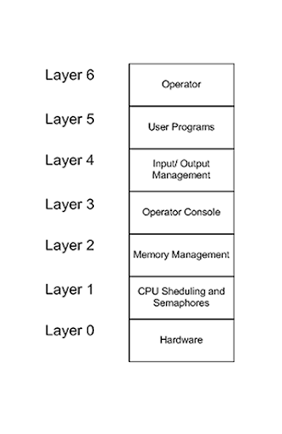
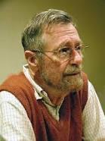
Theme: Abstractions
Idea dates to Edsger Dijkstra and
others.
… think of a complex system as a layered structure, in which each layer transforms layers below it into a higher-level abstraction
  At every layer we have data types, and abstract operations
  Each hides its implementation and introduces properties and guarantees

Slide 57
Wikipedia
Consider some concrete computing task.
Now remove “details” until only the pattern remains.
This process allows you to identify the underlying abstraction. A mathematician would say we are “modelling” the task.
https://en.m.wikipedia.org/wiki/Abstraction_(computer_science);

Slide 58
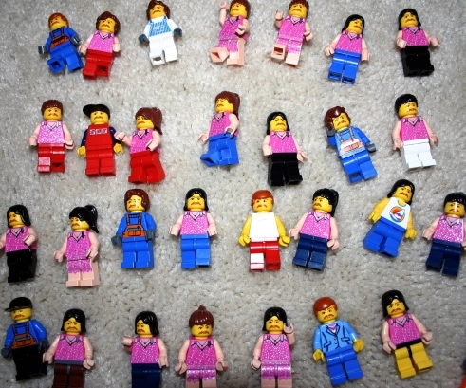

Example: Gatekeeper at Book sale
Friend of the Library is limited to 50 customers at a time.
But as people come in and out, it was hard to count.
They adopted a “people counting” scheme
Someone enters
Current occupancy
Someone leaves
Spaces remaining

Slide 59
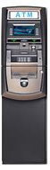

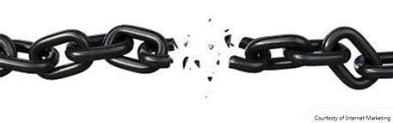
… this idea is adaptable!
Two or more doors? Just partition the 50 tokens!
Load balance by shifting tokens (but you must keep them in the same status, of course)
Even works for ATMs with
connectivity issues!
I have $150 of Ken’s money available
$150 of Ken’s money is blocked

Slide 60
The “token abstraction”
Here we are using some form of token as an abstraction
The invariant differs: Maximum of 50 people inside. But they
can enter or exit via any door
Account cannot be overdrawn
Yet the token abstraction covers all of these cases

Slide 61
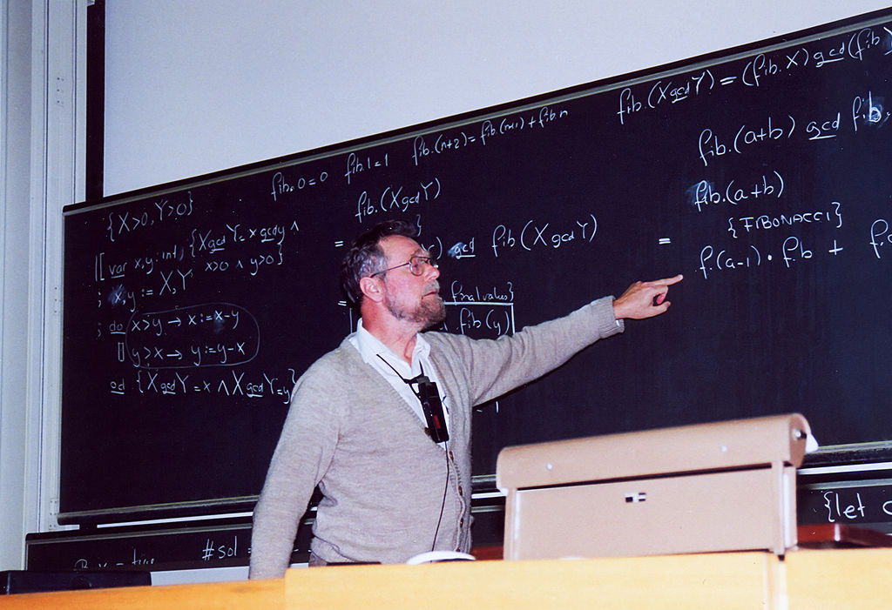
Pros and cons of abstractions
Dijkstra: The real power of layered
abstractions centers on specifications
and proofs. But proofs are just one aspect.
If we can fully describe the interfaces to our systems (APIs), and their behaviors, we can rigorously verify implementations.
This type of verification has been done for some versions of Linux and even for some C compilers (not C++ 11, however)

Slide 62
Concrete abstractions versus conceptual ones
In low-level computing courses most abstractions map directly to some sort of object class, like a binary tree or a list. These are concrete abstractions.
But when we create systems, abstractions can be “ideas”. We refer to these as conceptual abstractions.
We will give one example today and more in future lectures.

Slide 63
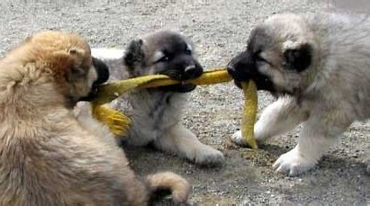
… a three-way tug of war!
We want simple, elegant abstractions. But abstractions can hide costs, as we saw with Python & Java!
We want to leverage high-performance hardware. But most hardware is very complex to use directly. Abstractions help!
We want security and protection… without sacrificing speed.

Slide 64
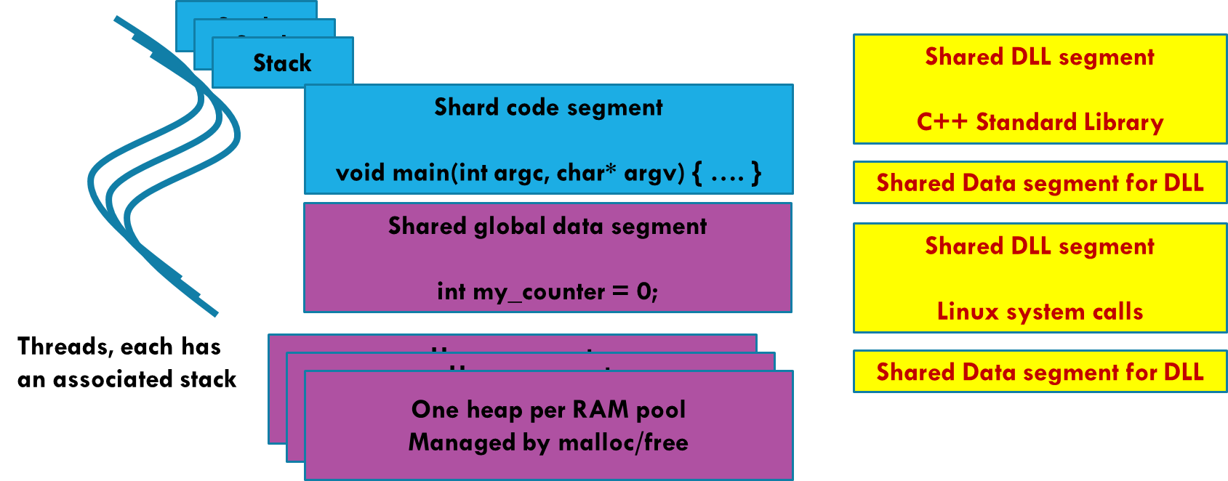
Example:
Virtual Memory
In lecture 5, we learned about process address spaces (segments and paging), and used the term virtual memory.
The hardware doesn’t “have” process address spaces. The abstraction is an idea that the kernel implements using hardware features.
If you see the term “virtual” it almost always means “an abstraction layered over a more general underlying feature.”

Slide 65
Virtual Machines and containers
Covered if time permits

Slide 66
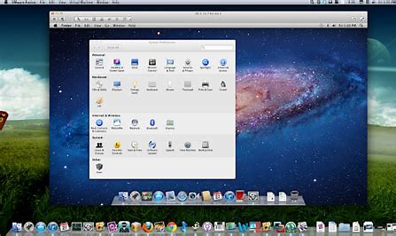
Virtualization can apply to the entire machine
Dijkstra is suggesting that the entire computing experience is virtual. He sees layers and layers of abstractions. At the time this was a revolutionary concept.
Today, the entire computer actually can be “virtualized”:
  We create a form of snapshot of the machine + your processes
  This virtual machine image can be moved easily, then restarted!

Slide 67
virtualization is a valuable tool!
It is extremely useful to be able to “move” programs or entire servers from place to place.
A virtual machine image is like a “program” that simulates your entire computer (even the file system, background jobs, etc).
You can even virtualize a legacy system and run it on a modern computer, if the modern system is compatible with the virtual image.

Slide 68
Pros and cons of virtualization
But…
  Some programs depend on things they access over the network, such
  as default printers, remote file systems, databases
  These might not work if you move the VM to a setting where those
  other systems aren’t available, or even if they have different host names
  Virtualization also imposes some overheads, and many programs slow down (especially if several VMs actually share one file system: even if the VM is unaware, all the file open requests would need to be translated)

Slide 69
Container virtualization
There are actually two major kinds of virtualization
  With “true” virtualization, we literally virtualize the entire computer
  and run the original operating system as a process in some other
  computer.
  But as noted, this can be costly.
  Container virtualization is a response (the “Docker” approach)
  In this approach a process or a set of processes are given the illusion
  that they run on a private computer, but in fact others can use it too.

Slide 70
Container Virtualization
Each distinct user ends up with a seemingly private file system (in reality these are folders in a master file system, but they can’t see the higher levels of it)
Each thinks they have private control over configurations, chron jobs and daemons, etc.
Sudo seems to work, but really works only within the scope of the user’s own jobs. For example, a “su” user can’t kill processes someone else actually owns (and can’t see them, either).

Slide 71
Containers offer a path to the cloud
The approach centers on changes to Linux and to the libraries, and the famous packaging of this is Kubenetes+Docker.
Linux and the libraries work jointly to hide the processes one user is running from the processes other users created.
For example, the “ps” command, which lists active processes, will only show the ones I am running.

Slide 72
Containers offer a path to the cloud
A major trend is to develop code on your own computers but eventually run the production versions “in the cloud”.
Here the idea is that a big company (such as Amazon, Microsoft or Google… but there are many more) operates a huge data center, maintaining the machines and managing them carefully.
They offer a virtualized “private cloud” to each customer.

Slide 73
Abstractions and security
Abstractions simply and allow us to work with a layered computing model.
Yet mundane tasks (like needing access to raw disks in order to import data from other operating systems, or to fix damage after a nasty crash) often involve tools that can “break” the abstraction boundary. Doing so exposes security risks!

Slide 74
Conclusion
We started by looking at the evolution of the kernel, leading to Dijkstra’s idea of “layered abstractions” and the KISS approach
Some layers we touched upon:
  The file system, the network, remote file servers.
  A USB drive is not “a file system” yet Linux lets us treat it that way.
  The process abstraction, the runtime environment…

Slide 75
Conclusion
  Abstraction is a powerful tool for improving specifications, verifying systems and introducing protective boundaries.
    A file system abstracts storage: The device just hold bytes
    We can abstract a system as a VM/container, use this to move applications
    to a new environment like a cloud.
  Yet excessive simplicity through an abstraction that hides performance-critical aspects can harm performance and even create security issues!

