Slide 1
Linux and C++ Under Attack!
Professor Ken Birman
CS4414 Lecture 26

Slide 2
Idea Map For Today
SYN ACK attacks
Stack Overflow Exploits
Kernel Level Exploits
Key Theft.
Covert Channels

Slide 3
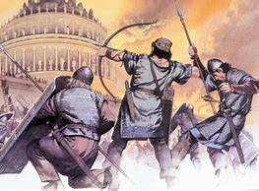
How to attack Linux systems
Limited only by creativity!
  System programs that have “backdoor” control features.
  May be much more common than we realize.
  Code that does a poor job of checking argument lengths
  Programs that get confused by certain mixes of parameters
  System calls that can be tricked into returning in privileged mode

Slide 4
How to attack Linux systems
… and that’s not all!
  Ways to replace a standard program with a non-standard
  version, and then perhaps tricking some tool into running it
  Ways of crashing the machine, or making it run extremely slowly
  Tricking a person into revealing a password, or resetting it
  Tricking someone into executing a compromised piece of code

Slide 5
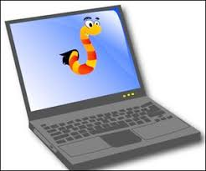
Cornell’s History in Hacking
The very first Internet “worm” was born at Cornell!
Robert Morris, a new PhD student who arrived a bit early was bored and was fooling around.
His decided to create a new lifeform: a little Internet program that might still be wandering around in hundreds of years.

Slide 6
Goals
His “worm” would just be a single process, or maybe a few
It would live on some machine for a while, then jump to its next host.
So it would wander the Internet… forever…

Slide 7
How it worked
His “worm” would be installed on some computer and would use the “at” command to schedule itself after a random sleep.
It would scan /etc/hosts to look for machines reachable from this one. It would then try to “jump” to the new host.

Slide 8
How it worked
How to move from place to place
  ssh or rsh or rcp: Copy itself (or perhaps login first, then copy itself)
  Exploit email issue: Sendmail had a remote-access feature for use in
  debugging: it could copy files in, or out, via a special command.
  Login in as admin or root (try some common passwords like admin,
  guest, secret, nullpass, etc)
  Bug in the “finger” program allowed it to copy a file in.

Slide 9
But of course, the worm might “fail”
Robert worried that various things could kill his worm.
An administrator might notice and remove it.
It could jump to a machine just as that machine crashed and was removed from the system permanently.

Slide 10
So…
He decided that with some small probability, the worm should “duplicate” itself by spreading to two machines, or reinfecting a machine where it already was installed.
He did this by picking a random number.
His intended value for R₀ was around 1.001

Slide 11
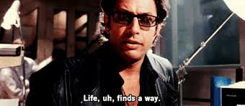
Then what?
He tested his program… it immediately escaped into the wild!
“R₀” was much larger than anticipated. Closer to 2.5. But even 1.001 would have been much too big.
Within hours, the worn spread to every Unix machine in the world. And continued to spread: it reinfected them again and again.

Slide 12
Then what?
He tested his program… it immediately escaped into the wild!
“R₀” was much larger than anticipated. Closer to 2.5. But even 1.001 would have been much too big.
Within hours, the worn spread to every Unix machine in the world. And continued to spread: it reinfected them again and again.
These were “pre-Linux” days, but Linux was born as an open-source clone of Unix, so it isn’t immune to such issues

Slide 13
Could this cause harm?
Infected machines quickly became overloaded and crashed. If rebooted, they crashed again.
Some Linux machines run respirators and dialysis units and X-ray units in hospitals. Some run floodgates for dams.
Linux computers control traffic lights in many cities. Some control power grid components or weapons systems.

Slide 14
The Worm was accidental…
It was a dumb idea, illegal, and it could have caused deaths.
But since then, many viruses have been deliberately designed using similar ideas!
Some have infected and damaged huge numbers of machines. And they can sweep the vulnerable machines within minutes.

Slide 15
Why some countries create worms
Many people have heard about Stuxnet. It was used to disrupt a nuclear weapons facility in Iran.
Some virus attacks are malicious. These often originate as part of geopolitical disputes between countries and are a form of warfare.

Slide 16

How Ken got to “chat” with ash Carter
Sec. Def. Ash Carter
Secretary of Defense Ash Carter was on NPR.
Ken called in and we talked for a few minutes.
Question: Why are the US and Russia hacking each other’s power grids, and why is it so “open”

Slide 17
Carter Doctrine
If you hack us, we’ll do even worse to you.
And we might not limit ourselves to exact symmetry.
And we’ll talk to the NY Times about it to make sure you don’t miss that we are doing it, since our techniques are very subtle.

Slide 18
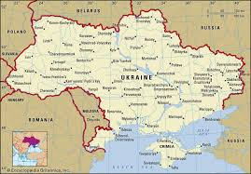
Russia in Ukraine
Russia decided to flex its muscles....
They devastated the power grid control systems in Ukraine.
Ukraine’s power control systems had to be rebuilt from scratch!

Slide 19
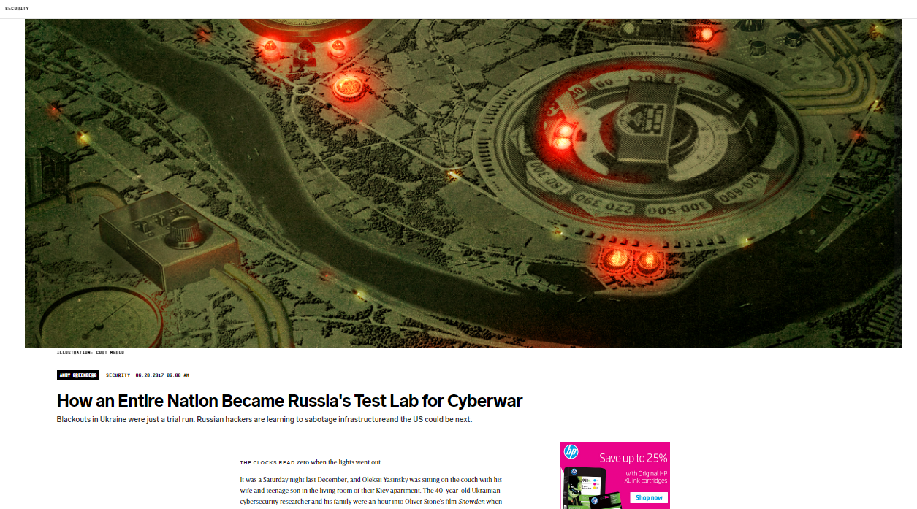
https://www.wired.com/story/russian-hackers-attack-ukraine/

Slide 20
How do they do it?
Sadly, computer systems are very easy to attack.
Understanding this will help you build software that won’t be quite so “porous”!

Slide 21
Example: Stack overrun exploit
Suppose a C or C++ program reads data from a command line or file, and needs to turn something into a string.
The data is in a char* buffer, so in a normal situation, the program allocates memory (strlen(s)+1 bytes) and calls strcpy.
But sometimes people do other things

Slide 22
Example: Stack overrun Exploit
Suppose that “Device names” are limited to 15 characters (plus 1 for a null), and the application is constructing a struct.
The struct might have a space for a 16 character name in it.
But in this case it would be easy to skip the strlen(s), so the program might get tricked into copying a much longer string.

Slide 23
What happens with a string overflow?
Strcpy won’t notice: it just copies beyond the end of the array.
… where is the array in memory, and what is beyond it? In a stack overrun exploit, the struct would be on the stack, and because stacks grow in the “downward” direction, the saved registers and return PC are in the “upward” direction

Slide 24
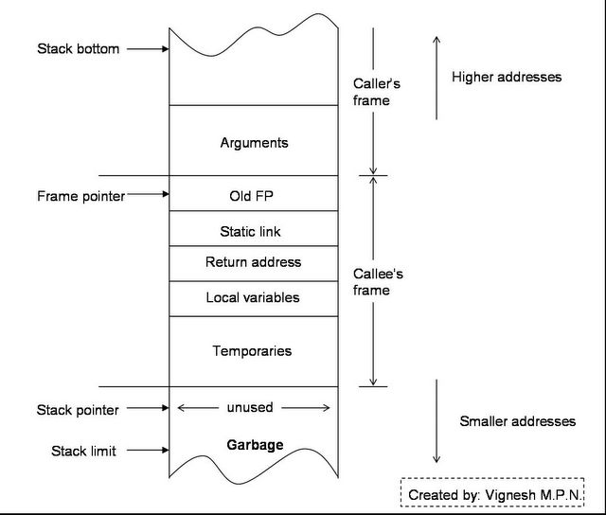
Stack Overrun picture
Our array is allocated in
“callee’s frame.”. Smaller
addresses: top of the stack.
Array would be in “local variables”
Overflow would occur “upward”

Slide 25
Stack Overrun picture
Our array is allocated in
“callee’s frame.”. Smaller
addresses: top of the stack.
Array would be in “local variables”
Overflow would occur “upward”
array

Slide 26
Stack Overrun picture
Our array is allocated in
“callee’s frame.”. Smaller
addresses: top of the stack.
Array would be in “local variables”
Overflow would occur “upward”
If the array overflows, we write data from smaller to higher addresses, overwriting all of this…

Slide 27
Stack Overrun picture
Exploit code goes here, at some known offset
Our array is allocated in
“callee’s frame.”. Smaller
addresses: top of the stack.
Array would be in “local variables”
Overflow would occur “upward”
Pointer to exploit code goes here

Slide 28
How would we guess the addresses?
No need! Many applications start up in a predictable way.
This determinism means that every single time, they call the “read a command” method in the same state.
So… the hacker just takes gdb and finds the address!

Slide 29
Now we have our whole attack…
If the attacker has a way to know where this stack generally lives in memory, they can copy their own “bootstrap” program in, and put a jump to the start of it into that return pc.
When the “read the input” method tries to return, the exploit takes control of the process.

Slide 30
Unix, Linux, C and C++ are full of risks like this!
It is easy to say “always make sure the char* object won’t overrun the string” but this rule depends on a human being!
C++ is strongly type checked… mostly. But strcpy is an unsafe operation and type checking won’t catch such issues.
And because C++ is very fast and light weight, it certainly won’t check for array indexing errors!

Slide 31
There are some “remedies”, but they aren’t widely used
Stack and address space randomization: by allocating some random sized chunks of memory, we can easily make addresses much less deterministic and repeatable.
We can mark code segments as execute-only, and data segments as non-executable.
There are tools to check for buffer overflows (valgrind is great!)

Slide 32
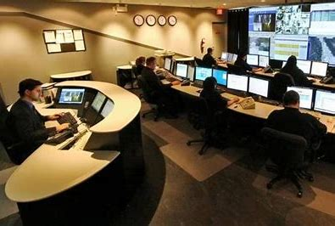
NSA ultra-hacker remark
“Sure… it would help if people would learn to lock the front doors. But keep in mind that we also know how to climb in the windows, or up to the balcony.
… And in the worst case we can break a window or cut an actual hole in the wall.
It isn’t so easy to keep us out!”

Slide 33
From a Security company:
Security Innovation, Inc
Relative Paths in Command Execute in Unix
Suppose that some program with superuser privilages includes this sequence of lines:
system(“cat /etc/shadow > /tmp/shadow.tmp”);
system(“chmod 600 /tmp/shadow.tmp”);
This seemingly trivial logic is full of risks!.

Slide 34
From a Security company
Security Innovation, Inc
What if the attacker put a symbolic link from /tmp/shadow.tmp to some file that normally can’t be overwritten?
Relative Paths in Command Execute in Unix
Suppose that some program with superuser privilages includes this sequence of lines:
system(“cat /etc/shadow > /tmp/shadow.tmp”);
system(“chmod 600 /tmp/shadow.tmp”);
This seemingly trivial logic is full of risks!.

Slide 35
From a Security company
Security Innovation, Inc
The official Linux “cat” lives in /bin. But suppose the attacker put a fake version of cat in the current directory? It will be discovered first!
Relative Paths in Command Execute in Unix
Suppose that some program with superuser privilages includes this sequence of lines:
system(“cat /etc/shadow > /tmp/shadow.tmp”);
system(“chmod 600 /tmp/shadow.tmp”);
This seemingly trivial logic is full of risks!.

Slide 36
From a Security company
Security Innovation, Inc
Chmod is also using a “relative” path notation.
Relative Paths in Command Execute in Unix
Suppose that some program with superuser privilages includes this sequence of lines:
system(“cat /etc/shadow > /tmp/shadow.tmp”);
system(“chmod 600 /tmp/shadow.tmp”);
This seemingly trivial logic is full of risks!.

Slide 37
From a Security company
Security Innovation, Inc
Race condition. The file permissions will initially be 666 after the cat and before the chmod executes.
Relative Paths in Command Execute in Unix
Suppose that some program with superuser privilages includes this sequence of lines:
system(“cat /etc/shadow > /tmp/shadow.tmp”);
system(“chmod 600 /tmp/shadow.tmp”);
This seemingly trivial logic is full of risks!.

Slide 38
What might the attacker put into this fake version of cat or chmod?
The commands will run with the same privelage as the parent program, so the hacker will take advantage, perhaps by having “./cat” contain this (and with permissions 777)
… leaves a “hook” for obtaining an “su” shell in /tmp
#/bin/sh
/bin/cp /bin/sh /tmp/rootshell
/bin/chmod 4777 /tmp/rootshell

Slide 39
Not every “race” is as easy to notice
Suppose that our superuser program does this:
system(“/usr/bin/cat /etc/passwd | awk ‘{print $1}’
| xargs `email –s “fractus will be down for service tonight”’);
This will send email to each user permitted to use this system with subject “fractus will be down for service tonight.”

Slide 40
Not every “race” is as easy to notice
Cat has a full pathname, but awk, xargs and email don’t. Same issue but harder to notice
Suppose that our superuser program does this:
system(“/usr/bin/cat /etc/passwd | awk ‘{print $1}’
| xargs `email –s “fractus will be down for service tonight”’);
This will send email to each user permitted to use this system with subject “fractus will be down for service tonight.”

Slide 41
Other common issues
Many examples of sloppy memory management and sloppy checking on pointers and copying.
Frequently found code that ignored error returns from system calls.
They found that obscure Linux features (like symbolic file links, international text strings with characters from many fonts) were often sources of developer confusion, causing errors that could be attacked.

Slide 42
Ancient bugs
By just reading Linux source code, it is easy to find bugs.
The Linux sendmail bug originated in 1980, more or less. The Morris worm exploited it in 1988. By then Eric Allman was focused on a startup and sendmail was mostly replaced by a follow-on system.
Yet the sendmail daemon was still launched on Linux at startup!

Slide 43
Why try to crash a system?
Attacks sometimes seek to take a computer over, but crashing a computer that has an important role can be just as effective.
For example, if that computer has an important server, crashing it means the server will also be down.
Now the attacker has crippled the company and could demand ransom. If the server was doing building security… then the security system just shut off.

Slide 44
Worms and viruses
These are a kind of attack that tries to spread itself from machine to machine.
A worm is usually passive, although it may leave the machine open for the attacker to take control later.
A virus deliberately does damage to each machine, or tries to steal information like bank accounts, passwords, etc.

Slide 45
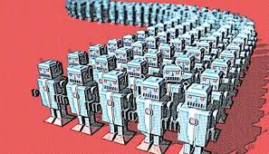
Bots
After taking control an attacker might not damage the machine
Many attacks are done to leave a form of “remote control” endpoint called a “bot”.
It allows the attacker to tell the machine to do things later… by some estimate, millions of machines are bots.

Slide 46
Ukraine bots
In Ukraine, once Russian bots were installed, they left them waiting for instructions.
When told to attack, the bots damaged the hardware (by changing the “firmware” into garbage). The infected machines crashed and couldn’t be restarted.

Slide 47
Other purposes?
Some bots are normal personal computers.
Instead of telling the bot army to do things, perhaps the attacker uses the bots to search for interesting files.
…. Like files with bank-related stuff. Or military intelligence.

Slide 48
DDoS attacks
A distributed denial of service attack is another way to leverage a bot army.
Attacker demands a ransom from Amazon or similar company.
If they don’t pay… the bots go shopping

Slide 49
File encryption attacks
In an attack of this kind, a virus or bot encrypts all the data files, and the attacker demands a payment for the decryption key.
Without payment… the files never get decrypted (and sometimes, even with payment, they never do!)

Slide 50
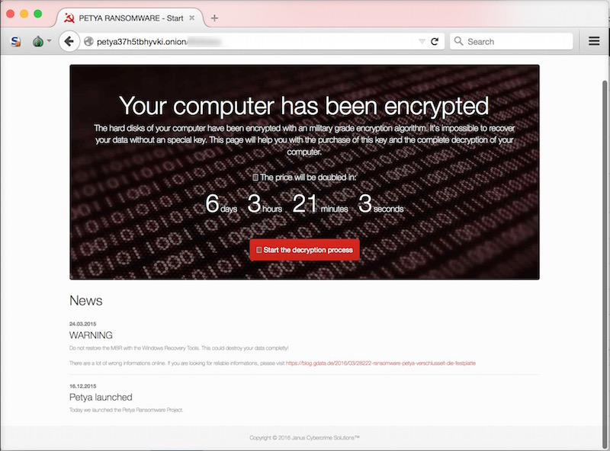
File encryption attacks
In an attack of this kind, a virus or bot encrypts all the data files, and the attacker demands a payment for the decryption key.
Without payment… the files never get decrypted (and sometimes, even with payment, they never do!)

Slide 51
Stealth Web Surfing attacks
It is illegal to possess many kinds of information.
Depends on the country, but this could include child porn or violent videos, how-to manuals for creating bombs, subversive political materials, terrorism plans, etc.
What if the attacker downloads that sort of stuff, then calls the policy and denounces you? They find it on your machine…

Slide 52
Stealth Web Surfing attacks
In fact a bot could even visit those sites every day, and download stuff for months or years
That leaves a trail of how active you are in their “group”. A bot could even upload child porn or other illegal things.
Then, bot erases itself. And the attacker calls the police.

Slide 53
Hacking summary
Sadly, it is very easy to do! There are even classes on this and whole conferences (like Defcon)!
“Rootkits” readily available on the dark web.
Learning about Linux protection features, and using them, plus writing better code, is the most effective option. But because we use standard libraries and other tools… is not enough.

