Slide 1
Storage at “big data” scale
Professor Ken Birman
CS4414 Lecture 23

Slide 2
Idea Map For Today
Modern applications often work with big data
By definition, big data means “you can’t fit it on your machine”
MemCacheD concept (a distributed version of std::map)
Hot and cold spots
Analogy to a distributed file system (and differences)

Slide 3
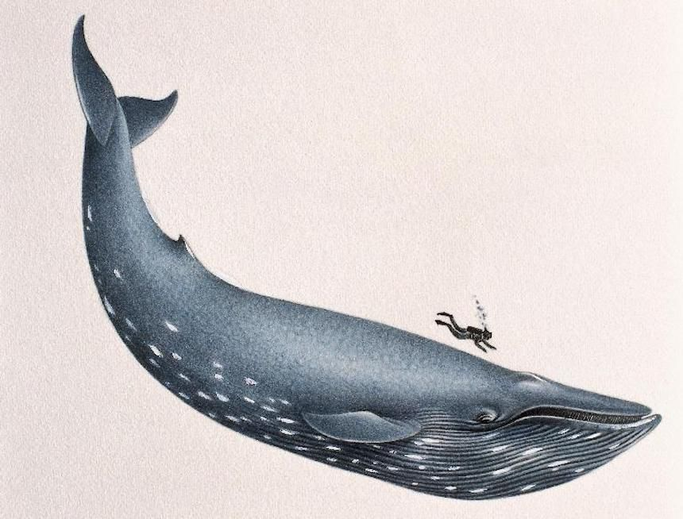
Big Data… can be huge!
A single computer can hold gigabytes of data in memory, and many gigabytes on a local storage device.
But in modern AI/ML systems, like computer vision systems, we may need to train a model on huge data sets (like multiple photos of each student at Cornell).
It is easy to end up with data sets that won’t fit on one computer.

Slide 4
Special issues with really big data
Where does it live, physically?
If big data is really big, it might not fit even with hundreds or thousands of machines – the “full” data set may be on much larger (but slower) archival storage systems.
So delay for access becomes a big concern!

Slide 5
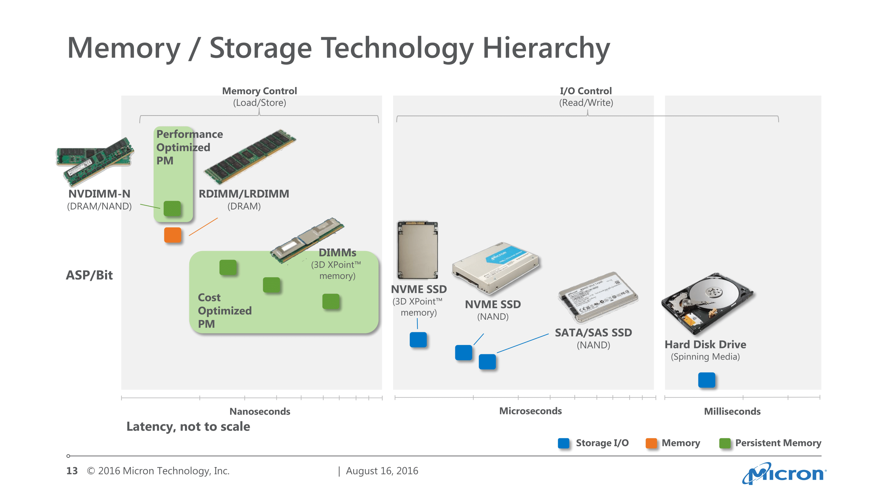
Memory/Storage Technology Hierarchy
(Average selling price)

Slide 6
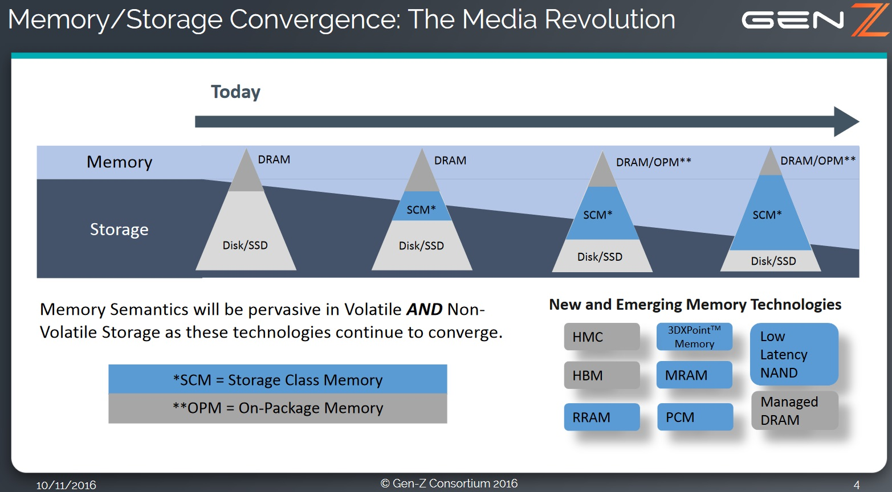

Slide 7
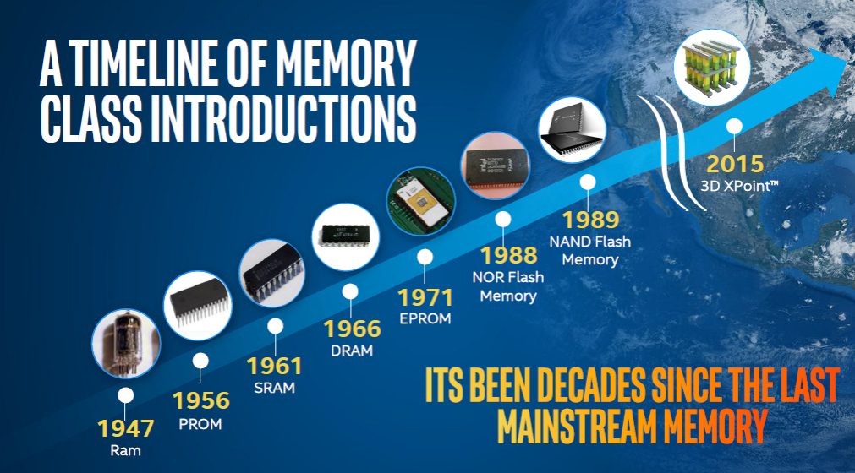

Slide 8

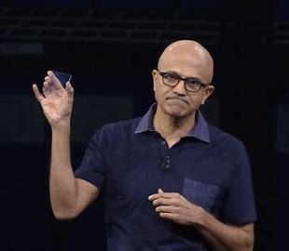
Coming soon…
Laser “zaps” a tiny volume. It melts, then refreezes in a
controlled way that can encode up to 6 bits per voxel
Glass (normal, inert silica) storage
Microsoft says that one cube could
hold 360 terrabytes and survive for
billions of years without degradation
This is Satya Nadella holding a sample

Slide 9

(or maybe not so soon…)
DNA storage?
DNA has even more capacity! The data is encoded in powdered DNA, which is quite stable under ideal conditions. Nobody even knows what the capacity limits would be.
Reading data would require DNA sequencing hardware

Slide 10
General rule…
The largest archival technologies are sometimes slow to access
Think of a “tape drive”. Incredible capacity, but you write it once and read rarely. When you do read, it can be slow.
Used for rarely accessed data, but at times highly valuable

Slide 11
General Rule
Memory is fastest, but as we saw, memory comes in a hierarchy
  In my address space, local NUMA memory
  In my address space, but remote NUMA memory
  On some other server, but in memory
  On my durable storage (flash memory or Optane). “The new disk”
  On the durable storage of some other server
  Archival storage… “Rotating disks are the new tape”.

Slide 12
Does it matter?
There is roughly a 10x to 100x increase in delay and loss of bandwidth at each layer.
… this even includes the network delays of GRPC over a datacenter network. (For general applications, 100us, but for MemCacheD when heavily optimized, can drop to 25-30us)
So the value of having data in memory (somewhere) is huge!

Slide 13
Connection to Systems Programming?
Up to now we focused on the single Linux box with NUMA cores, programmed with C++ processes and bash scripts and other tricks.
But the application really is a part of an ecosystem that could include many machines and the purpose may be to host and compute on huge amounts of data.
If our goal is efficiency and performance, we need to learn a new big-picture kind of perspective!

Slide 14
Special issues with really big data
Parallel computing is important, especially for AI/ML
But parallel algorithms really need data in memory, or “nearby”. Training a modern ML model can be infeasible if data is on a slower technology.
In our last lecture we talked about caching. In-memory remote caching offers an opportunity to use those ideas!

Slide 15
What are some really big data examples?
Companies like Apple, Microsoft, Facebook, etc. learn a lot about their users over time.
This pool of data is enormous. It includes photos, videos, cross-linked information about purchases and “click interests”, friends and fans and where you live and what stores are nearby…
So this is one of the main big data use cases today.

Slide 16
More examples
The entire web (and the “deep web”, too)
  The web would include all the web pages we can reach
  The “deep web” is the world of next-level and further pages you can
  reach by clicking things, or that are specialized for individuals. It
  also includes product prices, which are a big deal for companies!
  The web evolves, and for many organizations we also keep old copies
  of everything (the “Internet Archive” time machine does this too)
  Beyond all of this, the deep web also includes books and their contents,
  newspapers and other forms of information, etc…

Slide 17
More examples
Think about astronomy, or particle physics, or gravity waves
The detectors often are worldwide structures, and some capture
insane amounts of data, too much to process even with massive
parallelism!

Slide 18
What about the future world of IOT?
The term is short for “Internet of Things”, often written IoT
For example, smart traffic intersections linked to create a smart city. Or smart homes that form a smart community.
  The houses could have lots of solar grids on their roofs
  If they join forces, they might produce a lot of electricity. And if they
  have batteries, we could store some, too.
  All of this data (images, video, “lidar”, tracking data, “physical data”)…

Slide 19
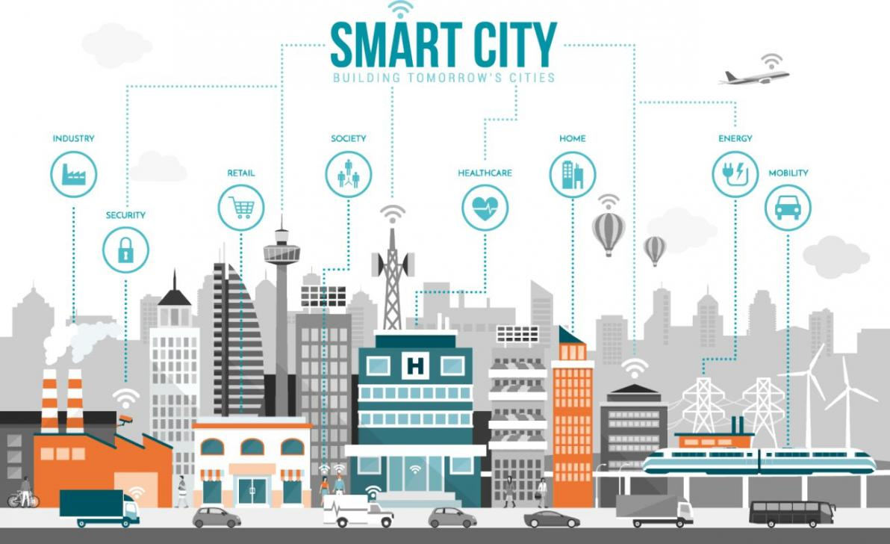

Slide 20
For this lecture we’ll focus on Memcached
Memcached was born to “respond” to this big data need, and gave rise to a whole way of thinking about data storage and access at scale.
Companies like Facebook and Google were first to embrace it.
The idea seems trivial but gave rise to a whole world of parallel algorithms for computing on data spread over millions of computers.

Slide 21
Cloud computing solutions
The basic idea of the cloud is that someone like Amazon or Microsoft (Azure) runs a giant computing center, and you rent some of the machines in a “virtual private cluster”.
Your application basically owns this infrastructure, but you don’t have to build everything from scratch.
They offer services that are tuned to work really well at scale.

Slide 22
Memcached concept
Originated in the 2003-2005 period.
Every programming language has some form of quick lookup class, based on the idea of hashing or a tree structure.
This suggests that we could take a very minimal API and standardize it for big data.

Slide 23
Memcached concept (Memory Cache Daemon)
The (entire!) API of MemCacheD:
MemCacheD::put(string key, object value)
object = MemCacheD::get(key)
Put saves a copy of the pair (key,value), replacing prior value. Get will fetch the object, if it can be found.

Slide 24
Isn’t this just a std::unordered_map?
C++ has a data structure that definitely can support the MemCacheD API.
The main difference is that the std::unordered_map is on a single computer, and is a C++ solution. Memcached might be on many computers in a data center, and is useful from many languages. Everyone “agrees” on the API.

Slide 25
Key aspect?
MemCacheD must give “in memory” (perhaps over a fast network) performance. The data could be on durable storage as a fall-back, but everything should have a flat cost for reads.
But… a cache doesn’t need to “remember” everything. Objects can be evicted to make room.
When MemCacheD does get a cache hit, the performance should be blazingly fast. O(1) lookups: GRPC overhead + data transfer cost.

Slide 26
Memcached can be local (useful when developing new code)
As noted, C++ std::unordered_map has a similar API and would be a great match to the MemCacheD standard. (std::map has an O(log) lookup cost, but std::unordered_map is O(1)).
But no single-computer solution can hold a really big data set. Your single computer only has a few 10’s of GB of memory

Slide 27
Remote Memcached runs as a “daemon”
The idea is that your computer will have a way to use RPC to talk to a pool of Memcached servers, all automatic so that you won’t need to do anything special to set this up.
The actual servers would run on cloud computing machines. The API is exactly the same. But now you get the total memory of the complete pool of machines!

Slide 28
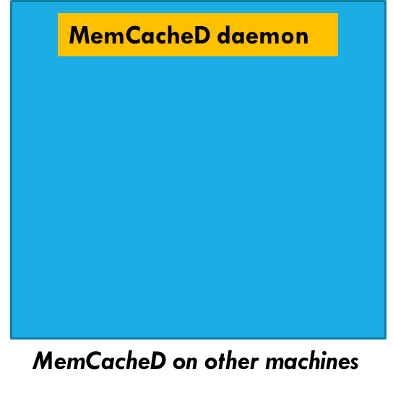
A pool of daemons…
You issue requests
via your local
daemon.
… but it might
forward to some
other daemon in
the pool
MemCacheD daemon
put(“some key”, obj)
My process
MemCacheD on my machine

Slide 29
Won’t the network be too slow?
In fact a modern datacenter network runs at speeds similar to the internal “bus” between your NUMA core and one of the on-board but non-local DRAM modules.
The only issue is that although data transfer speeds are high,
delay can be a barrier.
A modern datacenter network might have minimal delays of
1us. In contrast, accessing a DRAM module that isn’t close to
your core might be 125 clock cycles: about 25x faster.

Slide 30
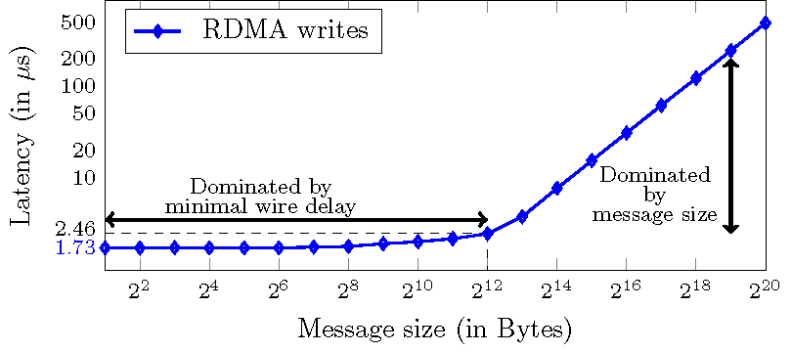
Speed of remote access in a data center
This tells us that MemCacheD will be awesome for large objects, like images or web pages: the overheads of getting to the server will be small compared to the data transfer times.
In contrast, if you are storing tiny objects, you might notice the delays much more, because they will be more dominating than the data transfer time.

Slide 31
So?
This tells us that MemCacheD will be awesome for large objects, like images or web pages: the overheads of getting to the server will be small compared to the data transfer times.
In contrast, if you are storing tiny objects, you might notice the delays much more, because they will be more dominating than the data transfer time.

Slide 32
How do they track the machines in the pool of Memcached servers?
You don’t really see this, but the daemon would use Zookeeper or something similar.
When you link to the MemCacheD DLL and initialize it, the library will look up the current membership of the service.
Now it has a list of all the machines running MemCacheD (IP address and port numbers for each).

Slide 33
Which machine to talk to?
In contrast with the case where we have an in-memory data structure, like a std::unordered_map in your own process, MemCacheD has an extra step of finding the server with the map that has your data.
Each MemCacheD server will have many data objects. We try to spread the data evenly.
So we use the concept of “hashing a key”, but we do it twice.

Slide 34
The usual approach
Hashing functions are standard and built into C++.
Hash the key of the (key,value) pair, mod the number of servers
server_id = std::hash(key) % NSERVERS;
Now just do an RPC (like GRPC) to the server that owns this key!

Slide 35
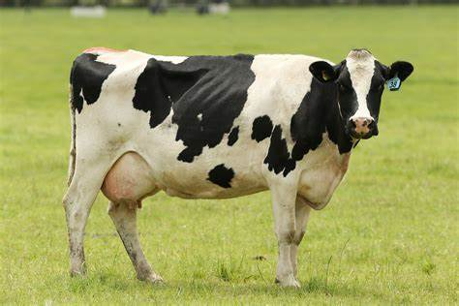
Example
Perhaps your application uses keys that are strings with pathnames deliberately similar to file system paths.
  /users/Alicia/SmartFarm/Animals/CowImages/Cow76512
  Hash will convert this string to a number, like 0x6AF615B80DDA71C
  Normally we use a uint64_t for these hash values. Also called size_t.

Slide 36
Std::hash
std::hash defines a set of templated methods:
auto string_hasher= std::hash<string>;
size_t hashcode = string_hasher(my_string);
Other notations are also possible, but some look a bit odd.

Slide 37
Many keys map to any single server
With this approach, two very different keys might map to exactly the same server-id.
This is why the server will still need to treat the data as a pool of (key,value) pairs: it will probably use std::unordered_map!
  One O(1) hashing operation to decide which server to talk to
  One more, inside that server, to find the object
  Overhead of an RPC to send the request, and get the reply

Slide 38




Accessing (key,value) Storage
Client
Zookeeper tracks
the membership
Key=Birman
Value=
Hash(“Birman”)%100000
Each machine has a set of (key,value) tuples stored in a local “Map” or perhaps on NVMe
In effect, two levels of hashing!
Notes:
This is how a distributed cache might be implemented. This example caches data items in a single process (each blue circle is one process on some server), so it won’t tolerate failures: if a single cache element were to get shut down for some reason, we would lose the associated shard – a portion of the cache would go cold.
At FB, even a brief glitch can put back-end services under load spikes, so actually they compute the likely frequency of such events. Only a few would happen per day. Yet this is occurring at massive scale, and even a few per day may be enough that you wouldn’t want that frequency of cache failures.

Slide 39
What if a server joins, or crashes?
This should be rare, but it could happen (like once in 8 hours)
When it does happen, we may need to shuffle (key,value) pairs from where they were previously to their new location.
Ideally, we have some spare servers and one can just take over from the failed machine. It will start with a cold cache, but we minimize the shuffle delays.

Slide 40
This is not always beneficial
In total, MemCacheD can hold a huge amount of data in memory
Durable storage I/O delays are larger than GRPC delays, and if we are lucky and find our data, we avoid reading or recreating the object from a file.
Payoff is best for large objects that were retrieved from some sort of expensive database service or slow media.

Slide 41
What would be an “expensive” object ideal for memcached?
Think about a photo or video that someone wants to view
Each device might have its own preferred screen size.
  Resizing on the device runs the battery down
  Resizing on the cloud is a good option, but once you have the object
  caching it will let you avoid recreating it again and again.

Slide 42
What makes this so effective?
Many clients share the MemCacheD service: parallelism!
The service itself can hold all of those resized objects in fast
memory units (or perhaps even on local storage)
Resizing is slow and energy-intensive. Transmitting on a network is quite cheap.

Slide 43
What would be a “bad use” of memcached?
It may not pay off to cache small things, like a few blocks of a file. Using memcached just wastes resources in such cases
The file system itself has effective caching mechanisms
Moreover, if the file system prefetcher anticipates the access, data might be in local cache before you request it.

Slide 44
MemCacheD is really for temporary data
The intent was to create a big data cache, not a new file system.
A Memcached server is allowed to evict data if it needs room.
… even if a process used put to store some (key,value) pair, don’t assume that get will find that object later!

Slide 45
Can we do better?
This is a bit beyond CS4414, but we can use data replication to build a MemCacheD that probably won’t lose data if a server fails or a network link is transiently flaky.
For example, AWS (Amazon) has a MemCacheD service called DynamoDB. It replicates every (key,value) tuple so that even in a crash, data generally won’t be lost. You can access it as a kind of database, which is why they added the “DB” part.

Slide 46
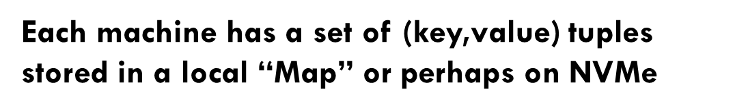
With some solutions, we can request replication for improved availability
Key=“Ken”
Value=
Zookeeper tracks
the membership
Hash(“Ken”)%100000
In effect, two levels of hashing!
Notes:
So one possible answer is to replicate the server handling each shard. Here we have two replicas per shard. In fact this model is common. Sharding with two replicas is very common, and sometimes for especially critical data we might have three copies. Even more would be used if we had a hot spot and wanted to spread the load, but not all key-value sharding solutions have that degree of sophistication.
If the management layer understands the fault-tolerance model and replication pattern, it can avoid shutting down both replicas simultaneously. So the owners of the FB cache would need to understand the management subsystem and configure it appropriately. Then their cache implementation would need to include a replication mechanism.
These aren’t such easy steps, which is one reason people tend to use existing μ-services rather than casually building their own: they could certainly implement a key-value cache, but would have way more trouble adding all these features needed in really serious deployments.

Slide 47
How did they build it?
… not a CS4414 topic!
The puzzle is that doing data replication correctly is harder than you might expect, because failures can leave confusing states.
The problem can be solved, and in fact Cornell is famous for working on this. But the details are covered in CS5412, cloud computing.

Slide 48
What makes it hard?
So far it probably sounds trivial: hash twice, use GRPC!
Data replication isn’t particularly hard either: you just take the key, hash it to find the “primary” server, then “add 1” and hash this new key. That can be the “backup”.
Each server ends up playing two roles.

Slide 49
But membership changes complicate things!
When servers start up, or terminate (or crash), we need to repair the Memcached server.
So these is a whole issue here of adding a new server to replace one that failed or terminated.
We might also need to re-replicate data (this new server “should” have some data it will be missing)

Slide 50
The weak semantics of Memcached are a strength and a weakness
Memcached seems very simple… partly because it makes no real promise except that get returns “something” from a prior put
Yet if we have no guarantee that get will find the most recent put results, we could actually see very old data… an “error”?
In fact staleness errors are rare (evictions are more common).

Slide 51
Are there “coherent” memcached’s?
A coherent cache would guarantee that the last data put into is the value you read out, and that data won’t get lost or corrupted.
Coherent caches exist (Cornell created one!), but most products have very weak guarantees. And even so, they are complex.
There is a tension between wanting to treat remote storage solutions as local memory, and wanting them to be super fast, lightweight…

Slide 52
Summary
We are increasingly faced with really big data scenarios
A popular option is to use a platform (like a cloud) that offers big data storage services.
Sometimes the real data would be on a slow device. But we can cache large “slices” of it in a key-value store, like MemCacheD.

