Slide 1
Coordination Patterns
Professor Ken Birman
CS4414 Lecture 18

Slide 2
Idea Map For Today
The monitor pattern in C++
Problems monitors solve (and problems they don’t solve)
Reminder: Thread Concept
Lightweight vs. Heavyweight
Thread “context”
Deadlocks and Livelocks
C++ mutex objects. Atomic data types.
Additional Coordination Patterns
Today we focus on other patterns for coordinating threads or entire processes.

Slide 3
Without coordination, many systems malfunction
Performance can drop unexpectedly
Overheads may soar
A coordination pattern is a visual or intellectual tool that we use when designing concurrent code, whether using threads or processes. It “inspires” a design that works well.

Slide 4


What is a coordination pattern?
Producers
Think about producer-consumer (cupcakes and kids).
  The producer pauses if the display case is full
  The consumers wait if we run out while a batch is baking
This is an example of a coordination pattern.
Bounded buffer
Consumers

Slide 5

Producer – consumer Pattern
Producer thread(s)
Consumer thread(s)
Bounded Buffer

Slide 6
Analogy: Software design patterns
Motivation: Early object-oriented programming approaches had a very flat perspective on programs:
We had objects, including data structures.
Threads operated on those objects.
Developers felt that it was hard to capture higher-level system structures and behaviors by just designing some class.

Slide 7
Modularity for complex, threaded programs
With larger programs, we invariably need to break the overall system up and think of it in terms of subsystems.
Each of these may have its own classes, its own threads, and its own internal patterns of coordination and behavior.
When a single system has many such “modules” side by side, the patterns used shape the quality of the resulting application

Slide 8
Some examples.
Main thread
File opener
Word-count workers
Fast-wc had a main thread, a thread for opening files (a form of module), a set of concurrent word counters, logic to merge the resulting std::map trees, and finally logic for sorting and printing the output.
We can think of this structure in a modular way. In fact, we need to think of it in a modular way to understand it!

Slide 9
What exactly does “Modular” mean?
A modular way of describing a system breaks it down into large chunks that may have complex implementations, but that offer simple abstraction barriers to one-another.
The operating system has many modules: the file system, the device drivers, the process management system, the clock system
Each involves a substantial but “separate” chunk of code.

Slide 10
More examples
Databases are integrated into modern systems (think of LINQ!)
Each database is a complex services and internally, deals with concurrent users, scaling, prefetching, locking to ensure correctness (a topic we will revisit in future lectures), fault-tolerance
Yet the user doesn’t see any of this complexity and is even unaware of the other concurrent users.

Slide 11
More examples
Web servers at companies like Amazon, Facebook, Netflix
The Linux kernel
The C++ compiler

Slide 12
Software design patterns
There is some similarity between “synchronization” patterns and “software design patterns”.
Basic idea: Problems that often arise in object oriented programs, and effective, standard ways of solving them.

Slide 13
Example: The Object visitor pattern
The visitor pattern associates virtual functions with existing classes.
The class offers a static method that permits the caller to provide an object (a “functor”) that implements this function interface. The base class keeps a list of visitors, and will call those functions when objects of the base-class type are created or modified.
With this you can build new logic that takes some action that was not already part of the design when the base class was created!

Slide 14
Reminder: Interfaces
In a C++ .hpp file, one normally puts the declarations of classes and templates, but the bodies are often in a .cpp file.
A “virtual” class is one that has a .hpp file defining it, but no implementations. An interface is a standardized virtual class.
A C++ class can “implement” an interface, and then you can pass class objects to any method that accepts the interface type.

Slide 15
Example of how you might use visitor
Suppose that you wanted to “monitor” a collection of files.
With this visitor pattern, you attach a notifier to the directory those files live in. The file system supports this form of visitation but doesn’t know who will use it in the future.
Each time a file changes, your program receives a notification.

Slide 16

How to think about the visitor idea
Consider a restaurant pager.
You place a take-out order but then can
go outside or wander around.
When your food is ready the pager wakes up and this notifies you. No need for the food preparer to do anything more.

Slide 17
Visitor pattern use cases
The visitor pattern is common with file systems: it allows an application with files open to “refresh” if a change occurs.
It is also useful with GUI displays. If something changes, the application can refresh or even recompute its layout.

Slide 18
Key elements of this pattern
The visitor is an object in some application
written after the service was created.
The application object derives from (implements)
the notification interface.
The visitor “interface” is a fully virtual class with an event notification method. The service will treat application objects as instances of visitor objects
The service doesn’t know what objects will be using it, but can use the interface class to notify
“future customers”.

Slide 19
Key elements of this pattern
The application class derives from (implements) the base class, but extends it with other application functionality
Visitor Interface is a base class

Slide 20
Why give this pattern a special name and think of it as a standard?
Visitor is a well known pattern and even taught in courses on software engineering. We sometimes teach it in CS2110
So anyone who sees a comment about it, and then sees the Watch method, knows immediately what this is and how to use it.
In effect, it is a standard way to do “refresh notifications”

Slide 21
Why is this such a big deal?
By allowing modules to standardize the way that they coordinate and interact, patterns bring a uniform way to create bigger systems from modular components.
The monitored module doesn’t know who will monitor it, but does know how to notify those future watchers.
The watchers simply need to implement the required interface

Slide 22

Factory pattern
Another example from software engineering.
A “factory” is a method that will create some class of objects on behalf of a caller that doesn’t know anything about the class.
Basically, it does an allocation and calls a constructor, and then returns a pointer to the new object.

Slide 23
Why a factory is useful
If module A has code that explicitly creates an object of type Foo, C++ can type check the code at compile time.
But if module B wants to “register” class Foo so that A can create Foo objects, A might be compiled separately from B.
The factory pattern enables B to do this. A requires a factory interface (for any kind of object), and B registers a Foo factory

Slide 24
Why a factory is useful
… without the factory, this same coordination is quite hard!
By allowing B to offer a factory that creates “widget objects” A has a way to ask B to create new B objects (derived from widget) and yet A doesn’t even know the definition of class B.
B simply needs to implement the factory interface

Slide 25
Templates are often used to implement modern C++ design patterns
A template can instantiate standard logic using some new type that the user supplies. So this is a second and powerful option that doesn’t require virtual functions and upcalls.
For example, we could do this for our bounded buffer. It would allow you to create a bounded buffer for any kind of object.
The bounded buffer pattern is valid no matter what objects it holds.

Slide 26
Summary: Why standard software engineering patterns help
They address the needs of larger, more modular systems
They are familiar and have standard structures. Developers who have never met still can quickly understand them.
They express functionality we often find valuable. If many systems use similar techniques to solve similar problems, we can create best-practice standards.

Slide 27
Synchronization patterns
These are patterns that stretch across threads or even between processes. They can even be used in computer networks, where the processes are on different machines!
Producer consumer is a synchronization pattern.

Slide 28
Synchronization patterns
Leader / workers is a second widely valuable synchronization pattern.
In this pattern, some thread is created to play the leader role. A set of workers will perform tasks on its behalf.

Slide 29

Leader / Workers pattern
Leader thread
Worker threads
Tasks to be performed (“peel these potatoes”)

Slide 30

Leader / Workers pattern
Leader thread
Worker threads
Tasks to be performed (“peel these potatoes”)

Slide 31

Leader / Workers pattern
Leader thread
Worker threads
Bag is empty? Workers terminate (threads exit)

Slide 32
Leader / workers pattern
Word-to-do queue
We need a way to implement the bag of work.
One can pass arguments to the threads, but this is very rigid. If we have lots of tasks, it may be better to be flexible.
So the bag of work will be some form of queue. You’ll need to protect it with locking! (Why?)

Slide 33
Pool of tasks
A std::list!
One option is to just fill a std::list with tasks to be performed, using a “task description object”. Then launch threads.
The list has a front and a back, which can be useful if the task order matters. Some versions support priorities (a “priority queue”).
It is easy to test to see if the list is empty.

Slide 34
Dynamic Task pools
Permits the leader to add tasks while the workers are running.
  The workers each remove a task from the pool, execute it, and then
  when finished, loop back and remove the next task.
  They may even use a second std::list to send results back to the leader!
  C++ calls this a promise pattern, supported by a std::promise library!
  But we can’t use “empty” to signal that we are finished (why?). So,
  the leader explicitly pushes some form of special objects that say “job
  done” at the end of the task pool. As workers see these, they exit.

Slide 35
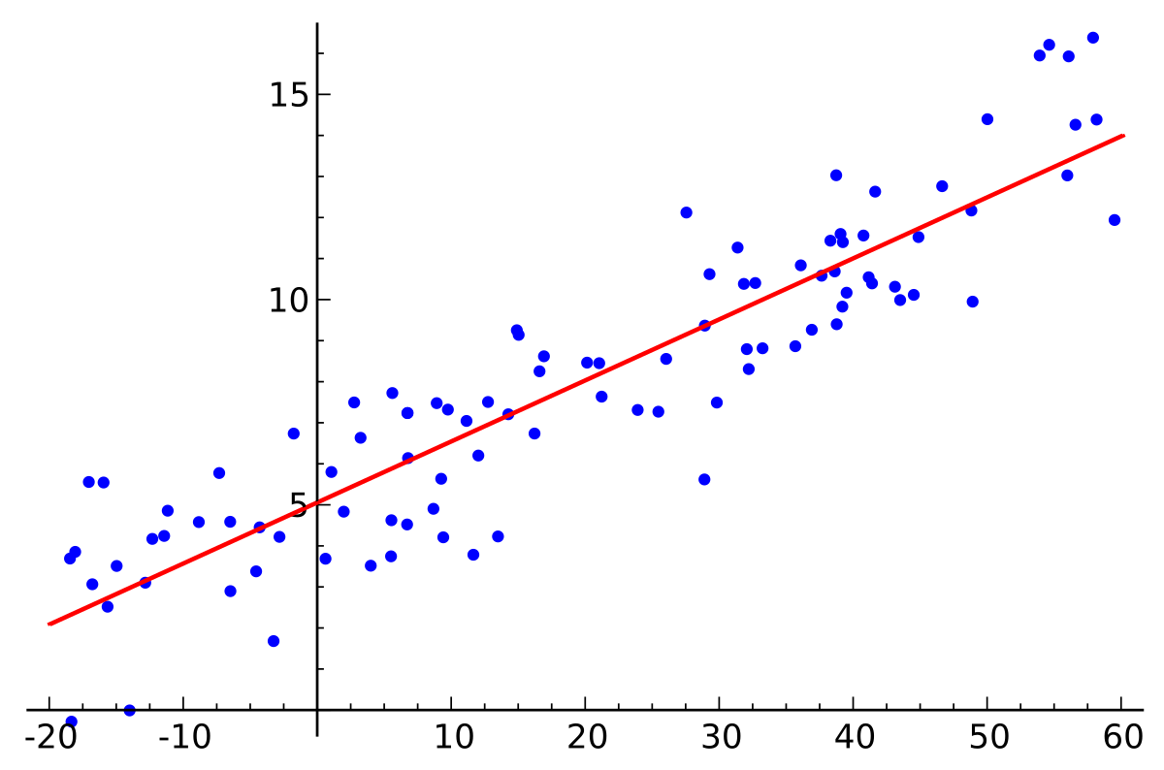
Example: Logistic Regression
In AI, it is common to have a parameter server that creates a model, and a set of workers that work to train the model from examples. Later we will use the model as a classifer.
  Worker takes the current model plus some data files, computes a
  gradient, and passes this to the parameter server (the leader)
  Parameter server consumes the gradients, improves the model, then
  assigns a new task to the worker.
  Terminates when the model has converged.

Slide 36
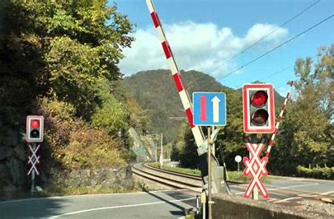
Barrier synchronization
In this pattern, we have a set of threads (perhaps, the workers from our logistic regression example).
We use this pattern if we want all our threads to finish task A before any starts on task B.
For this, we use a barrier.

Slide 37
Building a barrier
We normally use the monitor pattern.
The threads all call “barrier_wait”. This method uses a bool array to track which threads are ready, initialized to all false.
When all are ready, the thread that notices this issues notify_all to wake the others up. They wake up nearly simultaneously.

Slide 38
Building a barrier
Worker threads
Time
Phase one
Example: A computation with
distinct phases or epochs.
After phase one, all workers
must wait until phase two starts.

Slide 39
Building a barrier
Worker threads
Phase one
Time
Example: A computation with
distinct phases or epochs.
After phase one, all workers
must wait until phase two starts.
2 Done
1 Done
3 Done
Barrier
All are done! Phase two can start

Slide 40
Building a barrier
Worker threads
Phase one
Time
Example: A computation with
distinct phases or epochs.
After phase one, all workers
must wait until phase two starts.
Barrier
Phase two

Slide 41
Ordered Multicast pattern
This is a one-to-many pattern. Suppose some event occurs.
A sender thread needs every worker to see an object describing the event, so it puts that object on every worker’s work queue.
The pattern permits multiple senders: A sender locks all of the work queues, then emplaces the request, then unlocks. Thus all workers see the same ordering of requests.

Slide 42
Ordered Multicast pattern
Sender thread(s)
Worker threads
Event A

Slide 43
Ordered Multicast pattern
Sender thread(s)
Worker threads
Event A
Event B
Race condition: Danger is that one thread could see B before A, but others see A before B.

Slide 44
Ordered Multicast pattern
Sender thread(s)
Worker threads
Event A
Event B
Race condition: Danger is that one thread could see B before A, but others see A before B.

Slide 45
Ordered Multicast pattern
Sender thread(s)
Worker threads
Event A
Event B
An ordered multicast pattern implements a barrier that protects us against ordering inconsistencies. There are many ways to build the barrier. The pattern focuses on the behavior, not the implementation.

Slide 46
Ordered Multicast with Replies
In this model, we start with an ordered multicast, but then the leader for a given request awaits replies by supplying a reply queue.
Often, this uses a std::future in C++: a kind of object that will have its value filled in “later”.
The leader makes n requests, then collects n corresponding replies.

Slide 47
Ordered Multicast pattern
Sender thread(s)
Worker threads
Event A
Event B
With replies, workers can send results back to the sender threads.

Slide 48
All-reduce pattern: important in ML.
This pattern focuses on (key,value) pairs.
It assumes that there is a large (key,value) data set divided so that worker k has the k’th shard of the data set.
  For example, with integer keys, perhaps (key % n) == k
  With arbitrary objects, you can use the built-in C++ “hash” method.

Slide 49
All-Reduce pattern: Sharded data set
Leader
Worker threads
Shard A
Shard B
Shard C

Slide 50
All-Reduce: Map step
The leader maps some task over the n workers. This can be done in any way that makes sense for the application.
Each worker performs its share of the work by applying the requested function to the data in its shard.
When finished, each worker will have a list of new (key,value) pairs as its share of the result.

Slide 51
All-Reduce pattern: Map (first step)
Leader
Worker threads
Shard A
Shard B
Shard C

Slide 52
All-Reduce pattern: Map (first step)
Leader
Worker threads
Shard A
Shard B
Shard C
Result A
Result B
Result C

Slide 53
All-Reduce: Shuffle exchange
Each worker breaks its key-value result set into n parts by applying the sharding rule to the keys.
  Now it has one subset (perhaps empty) for each other worker.
  It hands that subset to corresponding worker.
  Every worker waits until it has n subset, one from each worker.

Slide 54
All-Reduce pattern: Map (first step)
Leader
Worker threads
Shard A
Shard B
Shard C

Slide 55
All-Reduce pattern: Map (first step)
Leader
Worker threads
Shard A
Shard B
Shard C
Result A
Result B
Result C

Slide 56
All-Reduce pattern: Map (first step)
Leader
Worker threads
Shard A
Shard B
Shard C
Result A
Result B
Result C
Subset 3
Subset 2
Subset 1

Slide 57
All-Reduce pattern: Shuffle
Leader
Worker threads
Shard A
Shard B
Shard C
Result A
Result B
Result C
Subset 3
Subset 3
Subset 3
Subset 2
Subset 2
Subset 2
Subset 1
Subset 1
Subset 1

Slide 58
All-Reduce pattern: Sort
Leader
Worker threads
Shard A
Shard B
Shard C
Result A
Result B
Result C
Subset 1
Subset 2
Subset 3
Subset 1
Subset 2
Subset 3
Subset 1
Subset 2
Subset 3
Not shown: There are messages being sent from A to B and C, from B to A and C, and from C to A and B. These “shuffle” the data

Slide 59
After the shuffle step, Workers apply a Reduce function
Each worker combines the incoming data, then sorts by key.
If it has multiple items with the same key, a reducing function is used to combine them. For example, sum might sum the values.
The new (key,value) pairs are the result of the all-reduce computation.

Slide 60
All-Reduce pattern: Map (first step)
Leader
Worker threads
Shard A
Shard B
Shard C
Result A
Result B
Result C
Subset 3
Subset 2
Subset 1

Slide 61
All-Reduce pattern: Shuffle
Leader
Worker threads
Shard A
Shard B
Shard C
Result A
Result B
Result C
Subset 3
Subset 3
Subset 3
Subset 2
Subset 2
Subset 2
Subset 1
Subset 1
Subset 1

Slide 62
All-Reduce pattern: Sort
Leader
Worker threads
Shard A
Shard B
Shard C
Result A
Result B
Result C
Subset 1
Subset 2
Subset 3
Subset 1
Subset 2
Subset 3
Subset 1
Subset 2
Subset 3

Slide 63
All-Reduce pattern: reduce
Leader
Worker threads
Shard A
Shard B
Shard C
Result A
Result B
Result C
Reduced results A
Reduced results B
Reduced results C

Slide 64
Map-reduce is A complex pattern!
All-Reduce is hard to get “used to” but very powerful once you understand it and work with it.
Over the past ten years it has become the most widely used “tool” to create parallel systems for machine learning
Many algorithms can be expressed in terms of it

Slide 65
Example: count word frequencies
In the first step, each thread computes word frequencies in a subset (shard) of the input files.
In the shuffle step, each worker ends up responsible for part of the alphabet, based on the hash function.
In the reduce step, if a worker was sent multiple counts for the same word, it sums them to end up with one total per word.

Slide 66
Example: multicore sorting
Map: Each worker scans its portion of the data, forming n “bins” (perhaps, using the hashing rule).
Shuffle: Each worker sends the k’th bin to the k’th worker.
Reduce: Each worker merges bins and sorts these intermediary results. We obtain sorted data spread over n workers.

Slide 67
Goals of these patterns?
Use all the NUMA cores.
Keep workers busy on independent shares of some data set, or doing independent tasks. Ideally, there is no need for locking because they use distinct data, or only read shared data.
Tasks communicate through std::list or bounded buffers

Slide 68
Summary
We are trying to work in stylized, familiar ways. Other developers who see your code will recognize the patterns.
These patterns aim for concurrent computing and sharing with as few locks as possible, to minimize overheads yet ensure correctness.

Slide 69


We use software design patterns to promote standard ways of building complex software systems.
We can also create standard coordination patterns, such as: producer-consumer, leader-worker, ordered multicast, all-reduce.
Each has a simple, elegant pattern. Implementations are complex… but we think about the pattern, not the way it was implemented!

