Slide 1
Synchronization Primitives
Professor Ken Birman
CS4414 Lecture 15

Slide 2
Idea Map For Multiple lectures!
Reminder: Thread Concept
C++ mutex objects. Atomic data types.
Lightweight vs. Heavyweight
Race Conditions, Deadlocks,
Livelocks
Thread “context” and scheduling
Today: Focus on the danger of sharing without synchronization and the hardware primitives we use to solve this.

Slide 3
… with concurrent threads, some sharing is usually necessary
Suppose that threads A and B are sharing an integer counter. What could go wrong?
We saw this example briefly in an early lecture. A and B both simultaneously try to increment counter. But increment occurs in steps: load the counter, add one, save it back.
… they conflict, and we “lose” one of the counting events.

Slide 4
Threads A and B share a counter
Thread A:
counter++;
Thread B:
counter++;
movq counter,%rax
addq $1,%rax
movq %rax,counter
movq counter,%rax
addq $1,%rax
movq %rax,counter
Either context switching or NUMA concurrency could cause these instruction sequences to interleave!

Slide 5
Example: Counter is initially 16, and both A and B try to increment it.
What A does
The problem is that A and B
have their own private copies
of the counter in %rax
With pthreads, each has a private
set of registers: a private %rax
With lightweight threads, context switching saved A’s copy while B ran, but then reloaded A’s context, which included %rax
%rax
16
(push)
16
17
17
(pop)
17
17
movq counter,%rax
addq $1,%rax
movq %rax,counter
What B does
movq counter,%rax
addq $1,%rax
movq %rax,counter

Slide 6
This interleaving causes a bug!
If we increment 16 twice, the answer should be 18.
If the answer is shown as 17, all sorts of problems can result.
Worse, the schedule is unpredictable. This kind of bug could come and go…

Slide 7
STL Requirement
Suppose you are using the C++ std library (the STL):
Every library method can simultaneously be called by multiple
read-only threads. If only readers are active, no locks are needed.
Every library method can be called by a single writer. No locking
is needed in this case either (this assumes no readers are active).
… However, you must protect against having multiple writers or a
mix of readers and writers that concurrently access the library.

Slide 8
BOOST requirement
Varies depending on the Boost library, which is one reason many companies are hesitant to use Boost
Some libraries are “thread safe” meaning they implement their own locking.
Some are like the STL. And some just specify their own rules!

Slide 9
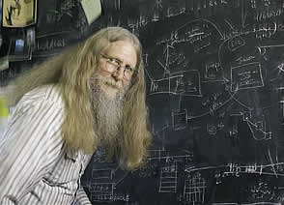


Bruce LindsAy
A famous database researcher
Bruce coined the terms “Bohrbugs” and “Heisenbugs”

Slide 10
Bruce Lindsay
In a concurrent system, we have two
kinds of bugs to worry about
A Bohrbug is a well-defined, reproducible thing. We test and test, find it, and crush it.
Concurrency can cause Heisenbugs… they are very hard to reproduce. People often misunderstand them, and just make things worse and worse by patching their code without fixing the root cause!

Slide 11
Concept: critical section
A critical section is a block of code that accesses variables that are read and updated. You must have two or more threads, at least one of them doing an update (writing to a variable).
The block where A and B access the counter is a critical section. In this example, both update the counter.
Reading constants or other forms of unchanging data is not an issue. And you can safely have many simultaneous readers.

Slide 12
we to ensure that A and B can’t both be in the critical section at the same time!
Basically, when A wants to increment counter, it goes into the critical section… and locks the door.
Then it can change the counter safely.
If B wants to access counter, it has to wait until A unlocks the door.

Slide 13
C++ allows us to do this.
std::mutex mtx;
void safe_inc(int& counter)
{
std::scoped_lock lock(mtx);
counter++;
}

Slide 14
C++ allows us to do this.
std::mutex mtx;
void safe_inc(int& counter)
{
std::scoped_lock lock(mtx);
counter++; // A critical section!
}

Slide 15
C++ allows us to do this.
std::mutex mtx;
void safe_inc(int& counter)
{
std::scoped_lock lock(mtx);
counter++; // A critical section!
}
This is a C++ type!

Slide 16
C++ allows us to do this.
std::mutex mtx;
void safe_inc(int& counter)
{
std::scoped_lock lock(mtx);
counter++; // A critical section!
}
This is a variable name!

Slide 17
C++ allows us to do this.
std::mutex mtx;
void safe_inc(int& counter)
{
std::scoped_lock lock(mtx);
counter++; // A critical section!
}
The mutex is passed to the scoped_lock constructor

Slide 18
Rule: scoped_lock
std::scoped_lock lock(mtx);
Your thread might pause when this line is reached.
Question: How long can the variable “lock” be accessed?
Answer: Until it goes out of scope when the thread exits the block in which it was declared.

Slide 19
Common mistake
std::scoped_lock(mtx);
std::scoped_lock lock(mtx);
Very easy to forget the variable name!
If you do this…
C++ does run the constructor
But then the “object immediately goes out of scope”
Effect is to acquire but then instantly release the lock

Slide 20
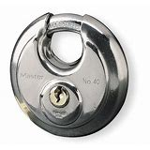
Rule: scoped_lock
std::scoped_lock lock(mtx);
Your thread might pause when this line is reached.
Suppose counter is accessed in two places?
… use std::scoped_lock something(mtx) in both, with the same mutex. “The mutex, not the variable name, determines which threads will be blocked”.

Slide 21
Rule: scoped_lock
std::scoped_lock lock(mtx);
When a thread “acquires” a lock on a mutex, it has sole control!
You have “locked the door”. Until the current code block exits, you hold the lock and no other thread can acquire it!
Upon exiting the block, the lock is released (this works even if you exit in a strange way, like throwing an exception)

Slide 22
People used to think locks were the solution to all our challenges!
They would just put a std::scoped_lock whenever accessing a critical section.
They would be very careful to use the same mutex whenever they were trying to protect the same resource.
It felt like magic! At least, it did for a little while…

Slide 23
But the question is not so simple!
Locking is costly. We wouldn’t want to use it when not needed.
And C++ actually offers many tools, which map to some very sophisticated hardware options.
Let’s learn about those first.

Slide 24
Issues to consider
Data structures: The thing we are accessing might not be just a single counter.
Threads could share a std::list or a std::map or some other structure with pointers in it. These complex objects may have a complex representation with several associated fields.
Moreover, with the alias features in C++, two variables can have different names, but refer to the same memory location.

Slide 25
Hardware atomics
Hardware designers realized that programmers would need help, so the hardware itself offers some guarantees.
First, memory accesses are cache line atomic.
What does this mean?

Slide 26
Cache line: A term we have seen before!
All of NUMA memory, including the L2 and L3 caches, are organized in blocks of (usually 64) bytes.
Such a block is called a cache line for historical reasons. Basically, the “line” is the width of a memory bus in the hardware.
CPUs load and store data in such a way that any object that fits in one cache line will be sequentially consistent.

Slide 27
Sequential consistency
Imagine a stream of reads and writes by different CPUs
Any given cache line sees a sequence of reads and writes. A read is guaranteed to see the value determined by the prior writes.
For example, a CPU never sees data “halfway” through being written, if the object lives entirely in one cache line.

Slide 28
Sequential consistency is already enough to build locks!
This was a famous puzzle in the early days of computing.
There were many proposed algorithms… and some were incorrect!
Eventually, two examples emerged, with nice correctness proofs

Slide 29
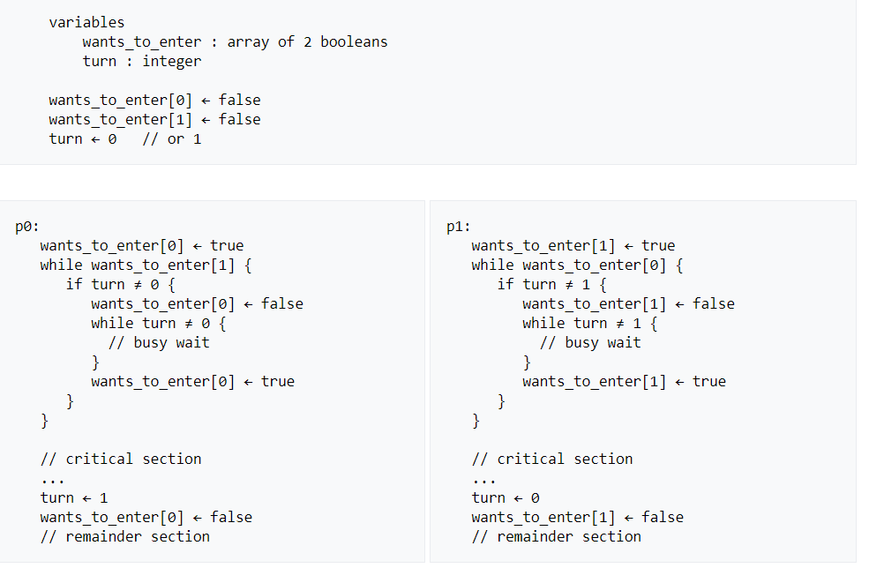
Dekker’s Algorithm for two processes
P0 and P1 can enter
freely, but if both try
at the same time, the
“turn” variable allows
first one to get in, then
the other.
Note: You are not responsible for Dekker’s algorithm, we show it just for completeness.

Slide 30
Decker’s algorithm was…
Fairly complicated, and not small (wouldn’t fit on one slide in a font any normal person could read)
Elegant, but not trivial to reason about.
In CS4410 we develop proofs that algorithms like this are correct, and those proofs are not simple!
Note: You are not responsible for Dekker’s algorithm, we show it just for completeness.

Slide 31



Leslie Lamport
Lamport extended Decker’s for many threads.
He uses a visual story to explain his algorithm: a Bakery
with a ticket dispenser
Tickets
Note: You are not responsible for the Bakery algorithm, we show it just for completeness.

Slide 32
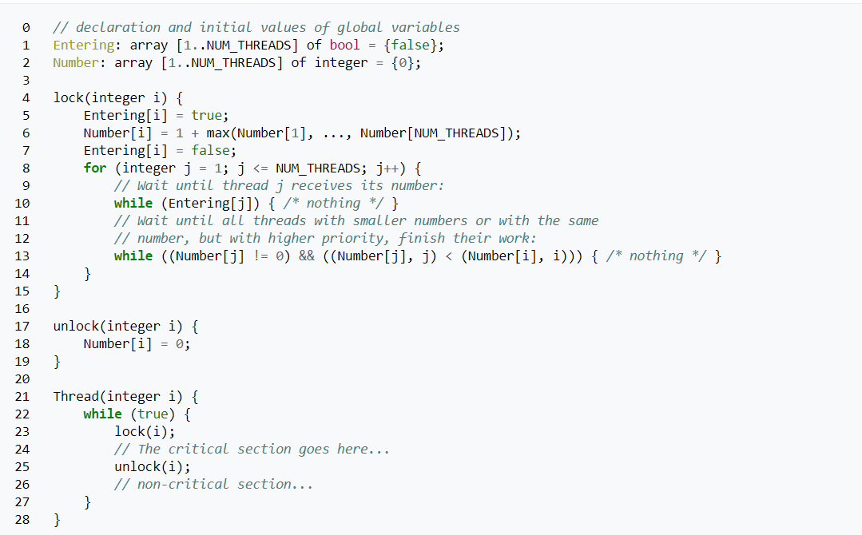
Lamport’s Bakery Algorithm for N threads
If no other thread
is entering, any
thread can enter
If two or more try
at the same time,
the ticket number
is used.
Tie? The thread
with the smaller id
goes first
Note: You are not responsible for the Bakery algorithm, we show it just for completeness.

Slide 33
Lamport’s correctness goals
An algorithm is safe if “nothing bad can happen.” For these mutual exclusion algorithms, safety means “at most one thread can be in a critical section at a time.”
An algorithm is live if “something good eventually happens”. So, eventually, some thread is able to enter the critical section.
An algorithm is fair if “every thread has equal probability of entry”
Note: You are not responsible for the Bakery algorithm, we show it just for completeness.

Slide 34
The bakery Algorithm is totally correct
It can be proved safe, live and even fair.
For many years, this algorithm was actually used to implement locks, like the scoped_lock we saw on slide 11
These days, the C++ libraries for synchronization use atomics, and we use the library methods (as we will see in Lecture 15).
Note: You are not responsible for the Bakery algorithm, we show it just for completeness.

Slide 35
Term: “Atomicity”
This means “all or nothing”
It refers to a complex operation that involves multiple steps, but in which no observer ever sees those steps in action.
We only see the system before or after the atomic action runs.

Slide 36
Atomic memory objects
Modern hardware supports atomicity for memory operations.
If a variable is declared to be atomic, using the C++ atomics templates, then basic operations occur to completion in an indivisible manner, even with NUMA concurrency.
For example, we could just declare
std::atomic<int> counter; // Now ++ is thread-safe

Slide 37
C / C++ atomics
They actually come in many kinds, with slightly different properties built in
  So-called weak atomics // FIFO updates, might “see” stale values
  Acquire-release atomics // Like using a spin-lock
  Stong atomics // Like using a mutex lock

Slide 38
Some issues with atomics
The strongest atomics (mutex locks) are slow to access: we wouldn’t want to use this annotation frequently!
The weaker forms are cheap but very tricky to use correctly
Often, a critical section would guard multiple operations. With atomics, the individual operations are safe, but perhaps not the block of operations.

Slide 39
Volatile
Volatile tells the compiler that a non-atomic variable might be updated by multiple threads… the value could change at any time.
This prevents C++ from caching the variable in a register as part of an optimization. But the hardware itself could still do caching.
Volatile is only needed if you do completely unprotected sharing. With C++ library synchronization, you never need this keyword.

Slide 40
When would you use Volatile?
Suppose that thread A will do some task, then set a flag “A_Done” to true. Thread B will “busy wait”:
while(A_Done == false) ; // Wait until A is done
Here, we need to add volatile (or atomic) to the declaration of A_Done. Volatile is faster than atomic, which is faster than a lock.

Slide 41
Higher level synchronization: Binary and counting semaphores (~1970’s)
We’ll discuss the counting form
  A form of object that holds a lock and a counter. The developer
  initializes the counter to some non-negative value.
  Acquire pauses until counter > 0, then decrements counter and returns
  Release increments semaphore (if a process is waiting, it wakes up).
  C++ has semaphores. The pattern is easy to implement.

Slide 42
Problems with semaphores
It turned out that semaphores were a cause of many bugs. Consider this code that protects a critical section:
mySem.acquire();
do something; // This is the critical section
mySem.release();
… unusual control flow could prevent the release(), such as a return or continue statement, or a caught exception.

Slide 43
Problems with Semaphores
It is also tempting to use semaphores as a form of “go to”
Process A Process B
runB.release(); runB.acquire();
This is kind of ugly and can easily cause confusion

Slide 44
Better high-level synchronization
The complexity of these mechanisms led people to realize that we need higher-level approaches to synchronization that are safe, live, fair and make it easy to create correct solutions.
Let’s look at an example of a higher level construct: a bounded buffer

Slide 45
bounded buffer (like a Linux Pipe!)
We have a set of threads.
Some produce objects (perhaps, cupcakes!)
Others consume objects (perhaps, children!)
Goal is to synchronize the two groups.

Slide 46
A ring buffer
We take an array of some fixed size, LEN, and think of it as a ring. The k’th item is at location (k % LEN). Here, LEN = 8
Producers write to the next free entry
nfree =3
free_ptr = 15
7
free
free
0
6
Consumers read from the head of the full section
15 % 8 = 7
Item
14
free
1
5
Item
13
Item
10
2
nfull =5
next_item = 10
4
Item
12
Item
11
3
10 % 8 = 2

Slide 47
A producer or consumer waits if needed
Producer:
void produce(Foo obj)
{
if(nfull == LEN) wait;
buffer[free_ptr++ % LEN] = obj;
++nfull;
- - nempty;
}
Consumer:
Foo consume()
{
if(nfull == 0) wait;
++nempty;
- - nfull;
return buffer[next_item++ % LEN];
}
As written, this code is unsafe… we can’t fix it just by adding atomics or locks!

Slide 48
We will solve this problem in lecture 16
Doing so yields a very useful primitive!
Putting a safe bounded buffer between a set of threads is a very effective synchronization pattern!
Example: In fast-wc we wanted to open files in one thread and scan them in other threads. A bounded buffer of file objects ready to be scanned was a perfect match to the need!

Slide 49
Why are bounded buffers so helpful?
… in part, because they are safe with concurrency.
But they also are a way to absorb transient rate mismatches.
  A baker prepares batches of 24 cupcakes at a time.
  The school children buy them one by one.
  If LEN ≥ 24, a bounded buffer of LEN cupcakes lets our baker make new batches continuously. The children can snack wheneverm they like.

Slide 50


TCP
TCP
The famous TCP networking protocol builds a bounded buffer that has two replicas separated by an Internet ink.
On one side, we have a server (perhaps, streaming a movie).
On the other, a consumer (perhaps, showing the movie)!

Slide 51
But one size doesn’t “fit all cases”
Only some use cases match this bounded buffer example (which, in any case, we still need to solve!)
Locks, similarly, are just a partial story.
So we need to learn to do synchronization in complex situations.

Slide 52
Critical sections can be subtle!
By now we have seen several forms of aliasing in C++, where a variable in one scope can also be accessed in some other scope, perhaps under a different name.
In C++ it is common to overload operators like +, -, even [ ]. So almost any code could actually be calling methods in classes, or functions elsewhere in the program.

Slide 53
We also use std::xxx libraries
Without looking at the code in the library, the user won’t know how it was implemented (and even if you look, an implementation can evolve!)
Some libraries are documented as thread safe (for example, the iostreams library that implements cout, cin).
But most C++ libraries do not do any locking.

Slide 54
Your job as developer
You must always have a visual image in your mind of the data objects your program is working with.
Among those, always ask yourself: could these objects or data structures be concurrently read and updated by multiple threads?
If so, you need to identify the “borders” around the code blocks that perform these accesses!

Slide 55
Many critical sections… one object?
A single object or data structure will often be accessed in many places.
So this can mean that the single object “causes” you to identify multiple critical sections, namely multiple blocks of code where those access events occur.
Thread A and thread B could be accessing counter in very different parts of a multithreaded program. Yet these can still clash.

Slide 56
You also should think about Deadlocks
We also need to worry about situations in which the locking we introduce causes bugs.
A process is deadlocked if there are any threads within it that will never make progress because they are stuck waiting for a lock.
A process is livelocked if two or more threads loop endlessly attempting to enter a critical section, but neither ever succeeds.

Slide 57
Summary
Unprotected critical sections cause serious bugs!
Locks are an example of a way to protect a critical section, but the bounded buffer clearly needs “more”
What we really are looking for is a methodology for writing thread-safe code that uses C++ libraries safely.

