Slide 1
Constant expressions in C++
Professor Ken Birman
CS4414 Lecture 9

Slide 2
Idea Map For Today
In Lecture 8 we learned that C++ can
automatically compile to vector-parallel
instructions.
Even without those long lists of advice, this same issue arises when C++ compiles normal code for normal machine instructions! Some styles promote faster code
Today we will look at another example, unrelated
to parallelism: the C++ concepts of “const” and “by
reference”. Const is notationally hard to get used to
but valuable. “By reference” is risky to use carelessly,
but important to understand!
… But we also saw longs lists of “suggested” coding styles intended to make it feasible for C++ to do this!

Slide 3
Connection to conceptual abstraction
Lectures 7 and 8 looked at cases in which the C++ compiler can carry out some sort of conceptual transformation or optimization if we understand the design pattern.
We saw this with control flow, and with SIMD parallelization.
Today we continue this theme by looking at compile-time expression evaluation: another powerful conceptual abstraction!

Slide 4
how do programs in C or C++ become executables?
Languages like Python and Java are highly portable. They compile to byte code… Java does “just in time” compilation to machine code.
This is not the case for C and C++. Each distinct computer may have a different CPU and its own memory layout rules.
Thus, “find” or “cat” or “tr” or “sort” or “uniq” needs to be turned into machine-language specific for the particular machine

Slide 5
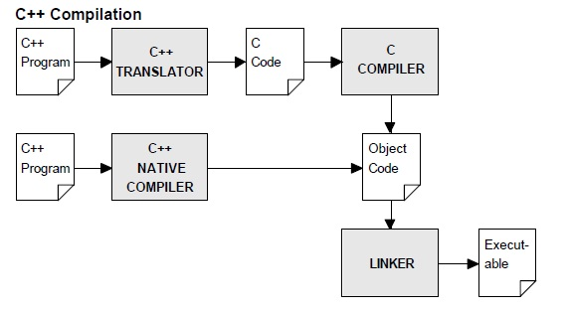
compilation
name.c/.cpp, name.h/.hpp: source code
name.s: assembler language
name.o: “object” code: machine code plus symbol table
name.dll: “dynamically linked library”
a.out: The default name for a compiled executable
core: If enabled, a file created in the current directory (or in /var/core) if your program crashes. Use gdb to find out where and why it happened. Compiler option –g is useful in this context.

Slide 6
Consider the humble procedure call…
In fact, let’s look at an example:
fibonacci(n) computes the n’th
fibonacci integer
1 2 3 5 8 13 21 ….
In fact, let’s look at an example:
fibonacci(n) computes the n’th
fibonacci integer
1 2 3 5 8 13
int fibonacci(int n)
{
if(n <= 1)
return n;
return fibonacci(n-1)+fibonacci(n-2);
}
21 = 8 + 13

Slide 7
Where is Fibonacci processed?
As we will see, in C++ there are several possible answers.
The most obvious case is when actual code will be created. Here the compiler itself generates that code.
Later we will see other cases where no code is generated!

Slide 8
… Fibonacci is the most famous example of recursion
When first introduced to recursion, many students are confused because
The method is invoking itself,
The variable n is being used multiple times in different ways,
We even call fibonacci twice in the same block!
Over time, you learn to think in terms of “scope” and to view each instance as a separate scope of execution.

Slide 9
… but n does need a memory location?
Where does the memory for n reside? … on the stack. Each time fibonacci is called, C++:
Pushes any registers to the stack, including the return PC
Pushes arguments (in our case, the current value of n)
Jumps to fibonacci, which allocates space on the stack for local
variables (in our case there aren’t any), and executes
When finished, fibonacci pops the PC and returns to the caller
The caller pops the things it pushed

Slide 10
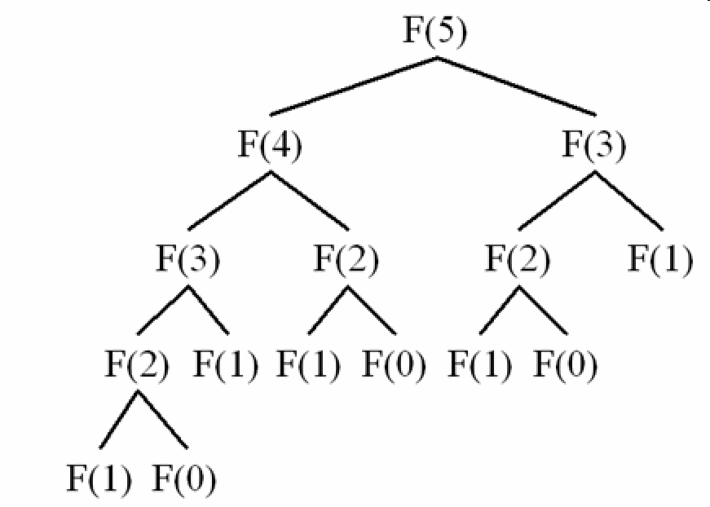
Fibonacci(5)
int fibonacci(n)
{
if(n <= 1)
return n;
return fibonacci(n-1)+fibonacci(n-2);
}
… 15 calls to fibonacci occur, in total

Slide 11
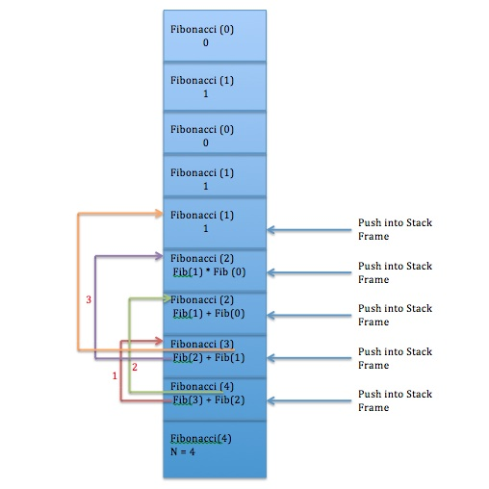
Fibonacci(5)
int fibonacci(3)
{
if(n <= 1)
return n;
return fibonacci(2)+fibonacci(1);
}
… 15 calls to fibonacci occur, in total

Slide 12
Where is time being spent?
2
How many instructions really relate to computing fibonacci?
We have an if statement: a comparison (call it
compare “a and b”) then branch “if a >= b”.
Two recursive calls, one addition, then return.
1
2 * ? + 1 + 1

Slide 13
The cost of the recursive calls
1
They each
  Push registers. Probably 1 is in use.
  Push arguments. In our case, n.
  Push the return PC, jump to fibonacci
  After the call, we need to pop the arguments
  and also pop the saved registers.
1
2
2

Slide 14
… now we can fill in the “?” with 6
2
How many instructions really relate to computing fibonacci?
We have an if statement: a comparison (call it
compare “a and b”) then branch “if a >= b”.
Two recursive calls, one addition, then return.
1
2 * ? + 1 + 1
2 * 6 + 1 + 1

Slide 15
How many instructions to push and pop arguments?
About 17 instructions per call to fibonacci. Of these, 1 is the actual addition operation, and the others are “housekeeping”
For example: fibonacci(5)=0…1…1…2…3…5
Our code needs to do the required 5 additions. However, to compute it we will do 15 recursive calls at a cost of about 17 instructions each: 255 instructions… 51x slower than ideal!

Slide 16
Some questions we can ask
When C++ creates space for us to hold n on the stack, why is it doing this?
We should have a copy of n if we will make changes, but then would want them discarded, or perhaps if the caller might be running a concurrent thread that could make changes to n “under our feet” (if the caller is spawning concurrent work).
But Fibonacci does not change n!

Slide 17
C++ “CONST” ANNOTATION
In C++ we have a way to express that something will not be changed.
The compiler can then use that knowledge to produce better code, in situations where an opportunity arises.

Slide 18
C++ const annotation
The easiest case:
const int MAXD = 1000; // Limit on number of Bignum digits
char digits[MAXD]; // digits is an array of 1000 8-bit ints
Here, we are declaring a “compile time constant”. C++ knows that MAXD is constant and can use this in various ways.

Slide 19
An example
… for example, consider
digits[MAXD-k-1] = c;
  This sets the item “k” from the end to 8. C++ can compute MAXN-1 as a constant, and index directly to this item as an offset relative to myvec.
  By having c and k in registers, only a single instruction is needed!
movq %rbx,_digits(999-%rax)

Slide 20
Why is this so great?
If C++ had not been able to anticipate that these are constants, it would have needed to compute the offset into digits.
That would require more instructions.
Here, we are leveraging knowledge of (1) which items are constants, and also (2) that C++ puts “frequently accessed” variables in registers.

Slide 21
More examples using “const”
We can mark an argument to a method with “const”.
This means “this argument will not be modified”.
  C++ won’t allow that argument to be used in any situation where it
  might be modified.
  C++ will also leverage this knowledge to generate better code.

Slide 22
More examples using “const”
We can mark an argument to a method with “const”.
This means “this argument will not be modified”.
  C++ won’t allow that argument to be used in any situation where it
  might be modified.
  C++ will also leverage this knowledge to generate better code.
// constant_values1.cpp
int main(const int argc, const char**argv) {
const int i = 5;
i = 10; // C3892
i++; // C2105
}

Slide 23
More examples using “const”
We can mark an argument to a method with “const”.
This means “this argument will not be modified”.
  C++ won’t allow that argument to be used in any situation where it
  might be modified.
  C++ will also leverage this knowledge to generate better code.
// constant_values3.cpp
int main(const int argc, const char**argv) ) {
char *mybuf = 0, *yourbuf;
char *const aptr = mybuf; // Initializes aptr…
*aptr = 'a'; // OK
aptr = yourbuf; // C3892
}

Slide 24
More examples using “const”
// constant_member_function.cpp
class Date
{
public:
Date( int, int, int );
Date(const& Date); // A “copy constructor”
int getMonth() const; // A read-only function
void setMonth( int ); // Updates month; can't be const
private:
int month, day, year;
};
We can mark an argument to a method with “const”.
This means “this argument will not be modified”.
  C++ won’t allow that argument to be used in any situation where it
  might be modified.
  C++ will also leverage this knowledge to generate better code.

Slide 25
aside
The “const” suffix for a read-only method like getMonth can only appear inside a method declared as a member of a class. It means “read only property” of the object the class defines.
If you used this same notation on a global method, it will be rejected with an error message.

Slide 26
Another aside
A constant lives in the compiler… not in program memory, unless the compiler “needs” to save a copy for some reason.
As a result, you cannot access a constant by reference: when you take the address of an object, or pass it using the “&” notation for a parameter to a method (like sum(int& x, int& y)), you are treating the constant as if it has a location in memory.

Slide 27
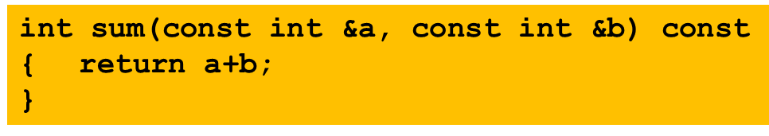
… but const can also mean “I don’t change this argument”
In this sum function, we are saying “sum will treat a and b as constants (it won’t change them). It accesses them by reference, so you cannot pass a constant to it

Slide 28
… but const can also mean “I don’t change this argument”
In this sum function, we are saying “sum will treat a and b as constants (it won’t change them). It accesses them by reference, so you cannot pass a constant to it
The const at the end says that this method will not change member variables in the class that defined it.

Slide 29
constexpr
This keyword says that “this expression should be entirely constant”. The expression can even include function calls.
C++ will complain if for some reason it can’t compute the result at compile time: a constant expression turns into a “result” during the compilation stage.
If successful, it treats the result as a const.

Slide 30
constexpr
This annotation says that “this expression should be entirely constant”. The expression can even include function calls.
C++ will complain if for some reason it can’t compute the result at compile time: a constant expression turns into a “result” during the compilation stage.
If successful, it treats the result as a const.
constexpr float x = 42.0;
constexpr float y{108};
constexpr float z = exp(5, 3);
constexpr int i; // Error! Not initialized
int j = 0;
constexpr int k = j + 1; //Error! j not a constant expression

Slide 31
Functions used in constant expressions
To use a function in as an initializer for a const, or in a constexpr, the function itself must be marked as a constexpr.
The compiler will complain if any aspect of the function cannot be fully computed at compile time.

Slide 32
We can combine these annotations
Here we declare that exp is a constant expression using a recursive method to compute x^n
constexpr float exp(const float &x, const int &n)
{
if(n == 0)
return 1;
if(n % 2 == 0)
return exp(x * x, n / 2);
return exp(x * x, (n - 1) / 2) * x;
}

Slide 33
What about Fibonacci(n)?
If n is a constant, fibonacci(n) can actually be computed as a constant expression too.
The C++ constexpr concept focuses on this sort of optimization. If something is marked as a constexpr, C++ computes it at compile time.
In principle, it could compute fibonacci(7)…. In practice, however, it might not realize it can pull this off and could give an error.

Slide 34
By-Reference arguments
A method can also ask for a “reference” to its argument, instead of the actual value being pushed on the stack.
This feature only works if C++ can be sure that the caller has an actual object (or reference to one, or a constant) to pass in.
But assuming you do, the method ends up with a second name for the argument passed in: a form of “alias”

Slide 35
By-Reference arguments
Notation:
fibonacci(int &n)
{
….
}
n doesn’t have a memory address of its own.
In fact it is a second name (an alias) for the argument passed to fibonacci

Slide 36
N is “used” just as it was earlier
We can still write things like
  if(n <= 1)
  return n;
  return fibonacci(n-1)+fibonacci(n-2);
  But now the compiled code is accessing the memory location the caller was using for n. Our method no longer has any local storage for n.

Slide 37
We can combine these annotations
C++ can compute fibonacci(5) as a constexpr entirely at compile time. It will just turn this into the constant 5.
… but it can only be used with a constant argument.
constexpr int fibonacci(const int &n)
{
return n <= 1? n: fibonacci(n-1)+fibonacci(n-2);
};

Slide 38
Inline annotation
This tells C++ that you want it to expand any calls to the method, producing a single “straight line” block of code. In C++ 17 is it considered redundant because the compiler does it automatically.
Thus:
c = sum(a, b);
would expand into
c = a + b;

Slide 39
Inline “versus” constexpr
Inline is saying “replace calls to this function with the code for this function”, but then optimize as much as you can.
Constexpr is saying “try to just compute this entirely at compile time, and replace this function call with the result.”
… similar outcome if the optimizer works well enough.

Slide 40
What if we inline fibonacci?
Suppose we had done it this way:
Now the expression “expands” if C++ is able to do so.
inline int fibonacci(const int &n)
{
return n <= 1? n: fibonacci(n-1)+fibonacci(n-2);
};

Slide 41
Inlining is automatic… yet the keyword is still commonly used
In effect, when we write “inline” we often are giving a hint both to the compiler (which probably ignores the hint and makes its own decision!) and also to other readers of the code.
We are saying “I wrote this code as a method, but in fact I am anticipating that this is really a “code pattern” that will be expanded for me, then optimized in place”.

Slide 42
Constexpr or inlining will save 255 instructions!
C++ sometimes works very hard at compile time, but by doing so, it can eliminate unneeded work at runtime.
In our example, we completely eliminated any actual runtime code for fibonacci… but only for calls with a constant argument.
If a constexpr function is called with a non-constant argument, it will simply be evaluated as much as possible at compile time but the computation will still need to be be finalized by calling it at runtime.

Slide 43
A concrete puzzle
#include <iostream>
using namespace std;
inline int fibonacci(const int &n)
{
return (n<=1)? n: fibonacci(n-1)+fibonacci(n-2);
};
int main(int argc, char**argv)
{
for(int n = 1; n < 10; n++)
{
cout << "fibonacci(" << n << ") is " << fibonacci(n) << endl;
}
return 0;
}
Consider this
program:
Why doesn’t
inline cause an
infinite recursion
in the compiler?

Slide 44
Recursive inlining?
In principle, if we call this version of fibonacci with a constant, it “should” expand it fully, then collapse the expression by realizing that constant arithmetic suffices.
But this centers on the compiler realizing that if it starts with n=1..10, then n-1-1…-1 eventually reaches 0, hence the right hand side of the return statement becomes dead code!
The compiler limits how much recursion it is willing to do at compile time. If it “gives up” it simply produces a call to normal code.

Slide 45
What about the for loop?
In fact, C++ can “tell” that the for loop iterates over 10 constant values: 1, 2, … 10
In principle, it should be able to do a constexpr evaluation for each of the values, but it is hard to know whether it will get this right. It may depend on the “optimization level” you pick.
For something that fancy C++ can be a bit unpredictable.

Slide 46
How do these features “interplay” with vectorization?
To write code that will vectorize nicely, it is very important that the compiler can determine:
Sizes of your vectors and matrices
  Loop “stride” values: The increment in a for loop
  Expressions used to access matrix or vector elements
  Values used to “map” from some input x to mapped[x]
  For such purposes, constexpr arithmetic can be incredibly useful!

Slide 47
Some “oddities” to know about
Suppose that MAXN is a const int. What does
const int MAXN = 10000;
const int* maxnptr = &MAXN;
mean? … Is maxnptr…
(1) a normal pointer to a const int, or
(2) is the pointer maxnptr itself a constant?

Slide 48
Some “oddities” to know about
Suppose that MAXN is a const int. What does
const int MAXN = 10000;
const int* maxnptr = &MAXN;
mean? … Is maxnptr…
(1) a normal pointer to a const int, or
(2) is the pointer maxnptr itself a constant?
const int is like a type
so., const int* is like a “pointer to a const int”
Compiler will reject this as illegal (a const int has a value, but no associated memory)

Slide 49
“const” statements are promises you must keep
Suppose I do this:
const int MAXN = 10000; // MAXN is a constant (10000)
int *mptr = (int*)&MAXN; // MAXN is really a const int
*mptr = 5000; // What would this do?
In C++ this code sequence is illegal: it modifies a constant.

Slide 50
“const” statements are promises you must keep
Suppose I do this:
const int MAXN = 10000; // MAXN is a constant (10000)
int *mptr = (int*)&MAXN; // MAXN is really a const int
*mptr = 5000; // What would this do?
In C++ this code sequence is illegal: it modifies a constant.
The compiler should complain that you are not permitted to take the address of a constant.
The error message will probably say that &MAXN is not a legal “rval”

Slide 51
Concept: Static Analysis
Modern computing environments often include tools that do some form of analysis of programs or other objects before the execution actually occurs.
For the C++ compiler, constexpr and inline illustrate forms of static analysis that benefit the compilation stage.

Slide 52
How static analysis is done
Focusing on the C++ compiler, it first scans your program and forms a parsed code representation based on applying the syntax rules.
Next, it can study this graph structure to learn things.
What sorts of things can static analysis discover?

Slide 53
Static Analysis opportunities
We saw constants, arguments by reference and inlining
Static analysis might also discover loop bounds, “dead” code (an if statement that is never true, or always true), variables that do or do not need space allocated, etc.
Static analysis is also at the core of type checking.

Slide 54
Consider the “auto” declaration
In C++ we often ask the compiler to figure out types:
Here we created a map from string “names” to Bignum objects, then iterate through the map (item will be a sequence of std::pair objects)
std::map<std::string, Bignum> the_map;
…
for(auto item: the_map) {
cout << “The next item is “ << item.to_string() << endl;
do_something(item);
}

Slide 55
Consider the “auto” declaration
In C++ we often ask the compiler to figure out types:
Here we created a map from string “names” to Bignum objects, then iterate through the map (item will be a sequence of std::pair objects)
auto requires a form of constexpr computation
std::map<std::string, Bignum> the_map;
…
for(auto item: the_map) {
cout << “The next item is “ << item.to_string() << endl;
do_something(item);
}
auto

Slide 56
Example of an auto-discovered type
When creating my “Bignum” solution, I once ran into this:
☹
std::pair<typename std::_Rb_tree<_Key, std::pair<const _Key, _Tp>, std::_Select1st<std::pair<const _Key, _Tp> >, _Compare, typename __gnu_cxx::__alloc_traits<_Allocator>::rebind<std::pair<const _Key, _Tp> >::other>::iterator, bool> std::map<_Key, _Tp, _Compare, _Alloc>::insert(const value_type&) [with _Key = std::__cxx11::basic_string<char>; _Tp = Bignum; _Compare = std::less<std::__cxx11::basic_string<char> >; _Alloc = std::allocator<std::pair<const std::__cxx11::basic_string<char>, Bignum> >; typename std::_Rb_tree<_Key, std::pair<const _Key, _Tp>, std::_Select1st<std::pair<const _Key, _Tp> >, _Compare, typename __gnu_cxx::__alloc_traits<_Allocator>::rebind<std::pair<const _Key, _Tp> >::other>::iterator = std::_Rb_tree_iterator<std::pair<const std::__cxx11::basic_string<char>, Bignum> >; std::map<_Key, _Tp, _Compare, _Alloc>::value_type = std::pair<const std::__cxx11::basic_string<char>, Bignum>]

Slide 57
What in the world was that???
The first thing to know is that C++ often generates its own variables. To avoid name conflicts, it puts underscore characters (_) at the front.
The second thing to know is that a std::map has a “comparison” function and an iterator, which (in my case) were defaults.
And so… this was the complete type for std::map<std::string,Bignum>.

Slide 58
In fact, C++ wouldn’t be useful without type inference!
Const and constexpr are “natural fits” for C++ because the compiler is already doing so much automatic inference.
These annotations simply advise the compiler to do what it wanted to do in any case!
… just a glimpse of the true complexity of modern languages

Slide 59
We saw constant expression math in Lecture 8, too!
C++ depends upon it to recognize parallelizable logic.
In fact, even code rearrangement can be understood as a form of constant expression evaluation: the code is like an expression, and all the variant forms of it are “equivalent” representations
This conceptual insight is key to modern compilation…

Slide 60
But beware: Not every static analysis problem can be solved!
We already saw this with constexpr and inlining: recursion can exceed the limitations of the compiler.
In fact, static analysis can even run into “unsolvable” problems!
  Type inference (auto) is potentially undecidable. Even the decidable
  versions have high complexity. Auto normally is successful.
  But experts can construct cases in which C++ may not be sure
  what the type of a variable is… and will give an error

Slide 61
Summary from today
C++ has advanced features that permit compile-time code analysis, compile-time type inference, and compile-time expression evaluation. This even includes recursive functions!
When we use const / constexpr, we “control” the compiler, which lets us ensure that the optimized code will use specialized instructions or achieve other kinds of efficiencies.
We code in an elegant, high-level way yet can control the compilation process down to ensuring that C++ will make the choices we want.

