Slide 1
Abnormal control flow abstractions
Professor Ken Birman
CS4414 Lecture 7

Slide 2
Idea Map for today
In many situations, we have a normal control flow but must also deal with abnormal events.
Linux offers programmable signal handling mechanisms that mimic interrupts.
The hardware has this issue: an I/O event might finish more or less at any instant. Interrupts are like procedure calls that occur “when needed”.
C++ offers a similar concept via its throw statement, and the try/catch control structure.
Can Dijkstra’s concept of creating abstractions offer a unified way to deal with abnormal control flow?
All forms of exceptions can disrupt computation, making it very hard to write a “safe” handler!

Slide 3
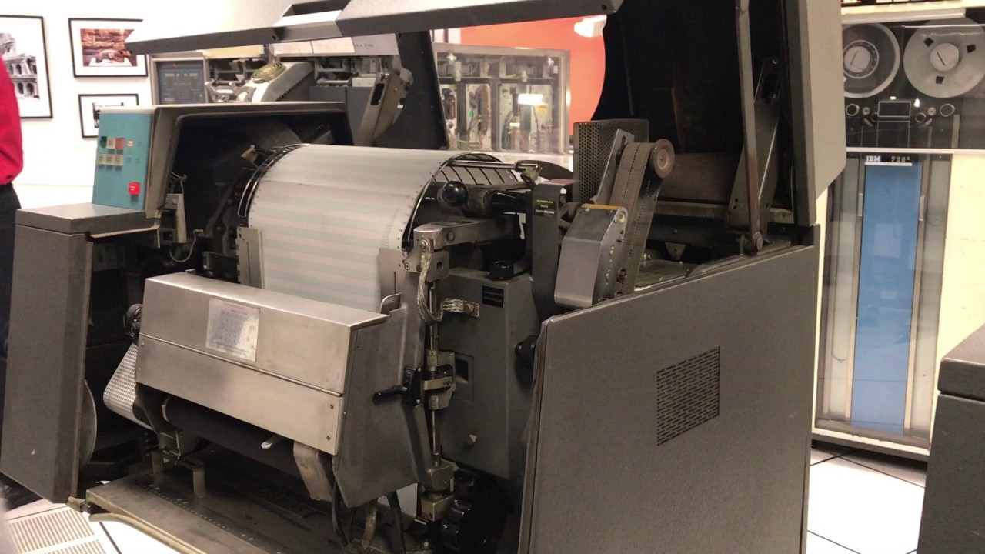
Printers apparently Used to Catch Fire fairly often!

Slide 4
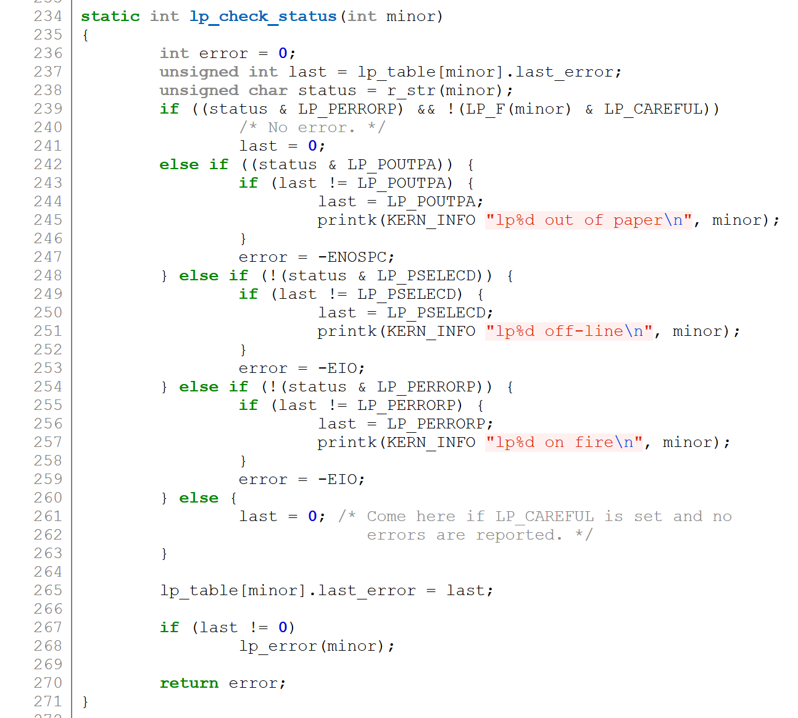
Highly Exceptional Control Flow
https://git.kernel.org/pub/scm/linux/kernel/git/torvalds/linux.git/tree/drivers/char/lp.c?h=v5.0-rc3

Slide 5
Today
Exceptional Control Flow
Linux signals
Programming language-level exceptions
C++ features for handling exceptions

Slide 6
Control Flow
Processors do only one thing:
  From startup to shutdown, a CPU simply reads and executes
  (interprets) a sequence of instructions, one at a time
  This sequence is the CPU’s control flow (or flow of control)
Physical control flow
<startup>
inst₁
inst₂
inst₃
…
inst_{n}
<shutdown>
Time

Slide 7
Altering the Control Flow
Up to now: two mechanisms for changing control flow:
  Jumps and branches… Call and return
  In effect, we change control flow to react to changes in program state
Insufficient: We also need to react to changes in system state
  Data arrives from a disk or a network adapter
  Instruction divides by zero
  User hits Ctrl-C at the keyboard… Timer expires…

Slide 8
Exceptions: several “flavors” but many commonalities
All exceptions “seize control,” generally by forcing the immediate execution of a handler procedure, no matter what your process was doing.
When a hardware device wants to signal that something needs attention, or has gone wrong, we say that the device triggers an interrupt. Linux generalizes this and views all forms of exceptions as being like interrupts.
Once this occurs, we can “handle” the exception in ways that might hide it, or we may need to stop some task entirely (like with ^C).

Slide 9
Biggest concern
An exception can occur in the middle of some sort of expression evaluation, or data structure update.
For example, if your code manages a linked list, the exception could occur in the middle of adding a node!
So… the handler cannot assume that data structures are intact!

Slide 10
How we handle this
We think in terms of “recoverable” exceptions and “non-recoverable” ones.
A recoverable exception occurs if the kernel or the program can handle the exception, then resume normal execution.
A non-recoverable exception terminates the task (or perhaps just part of some task).

Slide 11
Let’s look first at mechanisms, but then we will see an abstraction emerge
A mechanistic perspective looks at how each class of event arises. Each form of abnormal control flow has a concrete cause
Because the hardware features are diverse, we could end up with a diverse set of language features to deal with them.
In practice, there is a surprisingly degree of uniformity representing one abstraction that is applies in various ways

Slide 12
This illustrates conceptual abstraction
Rather than abstracting storage, the way a file system abstracts the storage blocks on a device, control flow abstractions have a conceptual flavor.
They illustrate a reused design pattern and a way of thinking about abnormal control flow. This concept is universal, yet the embodiment varies.

Slide 13
This design pattern is a Linux feature
An exception often causes a transfer of control to the OS kernel in response to some event (i.e., change in processor state)
  Examples: Divide by 0, arithmetic overflow, page fault, I/O request
  completes, typing Ctrl-C
User code
Kernel code
Event
I_current
Exception
I_next
Exception processing
by exception handler
Return to I_current
Return to I_next
Abort

Slide 14
Exception Tables
Exception
numbers
Each type of event has a
unique exception number k
k = index into exception table
(a.k.a. interrupt vector)
Handler k is called each time
exception k occurs
Code for
exception handler 0
Exception
Table
Code for
exception handler 1
0
1
Code for
exception handler 2
2
...
n-1
...
Code for
exception handler n-1

Slide 15
Exception tables
The kernel has one for interrupts.
Each process has one for signals.
The entries are simply the addresses of the handler methods. A special exception handler turns the exception into a kind of procedure call, at which the handler runs like normal code.

Slide 16
(Partial) Taxonomy
ECF
Asynchronous
Synchronous
Interrupts
Traps
Faults
Aborts

Slide 17
Asynchronous Exceptions (Interrupts)
Caused by events external to the processor
  Indicated by setting the processor’s interrupt pin
  Handler returns to the instruction that was about to execute
Examples:
  Timer interrupt
    Every few ms, an external timer chip triggers an interrupt.
    Used by the kernel to take back control from user programs
  I/O interrupt from external device
    Typing a character or hitting Ctrl-C at the keyboard
    Arrival of a packet from a network, or data from a disk

Slide 18
Synchronous Exceptions
Caused by events that occur as a result of executing an instruction:
  Traps
    Intentional, set program up to “trip the trap” and do something
    Examples: system calls, gdb breakpoints. Control resumes at “next” instruction
  Faults
    Unintentional but possibly recoverable
    Examples: page faults (recoverable), protection faults (unrecoverable), floating point exceptions
    Either re-executes faulting (“current”) instruction or aborts
  Aborts
    Unintentional and unrecoverable… Aborts current program
    Examples: illegal instruction, parity error, machine check

Slide 19
System Calls
Each Linux system call has a unique ID number
Examples:
Number | Name | Description
0 | read | Read file
1 | write | Write file
2 | open | Open file
3 | close | Close file
4 | stat | Get info about file
57 | fork | Create process
59 | execve | Execute a program
60 | _exit | Terminate process
62 | kill | Send signal to process

Slide 20
System Call Example: Opening File
User calls: open(filename, options)
Calls __open function, which invokes system call instruction syscall
00000000000e5d70 <__open>:
...
e5d79: b8 02 00 00 00 mov $0x2,%eax # open is syscall #2
e5d7e: 0f 05 syscall # Return value in %rax
e5d80: 48 3d 01 f0 ff ff cmp $0xfffffffffffff001,%rax
...
e5dfa: c3 retq
User code
Kernel code
%rax contains syscall number
Other arguments in %rdi, %rsi, %rdx, %r10, %r8, %r9
Return value in %rax
Negative value is an error corresponding to negative errno
syscall
Exception
cmp
Open file
Returns

Slide 21
System Call Example: Opening File
Almost like a function call
Transfer of control
On return, executes next instruction
Passes arguments using calling convention
Gets result in %rax
One Important exception!
Executed by Kernel
Different set of privileges
And other differences:
  e.g., “address” of “function” is in %rax
  Uses errno
  Etc.
User calls: open(filename, options)
Calls __open function, which invokes system call instruction syscall
00000000000e5d70 <__open>:
...
e5d79: b8 02 00 00 00 mov $0x2,%eax # open is syscall #2
e5d7e: 0f 05 syscall # Return value in %rax
e5d80: 48 3d 01 f0 ff ff cmp $0xfffffffffffff001,%rax
...
e5dfa: c3 retq
User code
Kernel code
%rax contains syscall number
Other arguments in %rdi, %rsi, %rdx, %r10, %r8, %r9
Return value in %rax
Negative value is an error corresponding to negative errno
syscall
Exception
cmp
Open file
Returns

Slide 22
Fault Example: Page Fault
int a[1000];
main ()
{
a[500] = 13;
}
User writes to memory location
That portion (page) of user’s memory is
currently paged out (on disk)
80483b7: c7 05 10 9d 04 08 0d movl $0xd,0x8049d10
User code
Kernel code
Exception: page fault
movl
Copy page from disk to memory
Return and reexecute movl

Slide 23
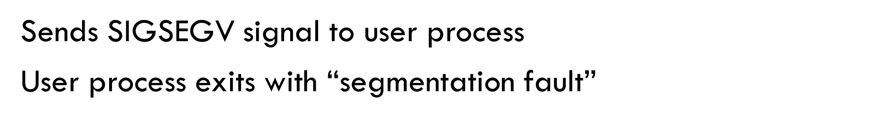
Fault Example: Invalid Memory Reference
int a[1000];
main ()
{
a[5000] = 13;
}
80483b7: c7 05 10 9d 04 08 0d movl $0xd,0x8049d10
User code
Kernel code
Exception: page fault
movl
Detect invalid address
Signal process

Slide 24
Some flavors of segment faults
Trying to read or write into memory that isn’t part of your address space.
Trying to modify a write-protected data or code segment.
Trying to jump into (execute) a data segment (this is actually possible, but you have to do something special).

Slide 25
Yet Exceptions also allow us to emulate “infinite number of cores”
Basic idea: if we have more threads than cores, we can use timer exceptions to switch from thread to thread (or process to process)
This is called a “context switch” and involves saving the state of the interrupted thread: the contents of the registers.
Then we can load the state of the thread we wish to switch to.

Slide 26
context switches between processes
For the hardware, a process is simply a set of threads plus a memory map that tells which memory pages belong to the process, and what protection rules to apply.
As part of the context switch, the kernel simply tells the hardware which “page table” to use for this process.

Slide 27
Today
Exceptional Control Flow
Linux signals
Programming language-level exceptions
C++ features for handling exceptions

Slide 28
Linux signals
Linux uses a variety of signals to “tell” an active process about exceptions relevant to it. The approach mimics what the hardware does for interrupts.
The signal must be caught or ignored. Some signals are ignored by default. Others must be caught and will terminate the process if not.
To catch a signal, a process (or some library it uses) must register a “signal handler” procedure. Linux will pause normal execution and call the handler. When the handler returns, the interrupted logic resumes.

Slide 29
List of Linux signals
SIGABRT Abort signal from abort(3)
SIGALRM Timer signal from alarm(2)
SIGBUS Bus error (bad memory access)
SIGCHLD Child stopped or terminated
SIGCONT Continue if stopped
SIGEMT Emulator trap
SIGFPE Floating-point exception
SIGHUP User logged out or controlling process terminated
SIGILL Illegal Instruction
SIGINFO A synonym for SIGPWR
SIGINT Interrupt from keyboard
SIGIO I/O now possible (4.2BSD)
SIGIOT IOT trap. A synonym for SIGABRT
SIGKILL Kill signal (cannot be caught or ignored)
SIGLOST File lock lost (unused)
SIGPIPE Broken pipe: write to pipe with no readers
SIGPOLL Pollable event (Sys V); synonym for SIGIO
SIGPROF Profiling timer expired
SIGPWR Power failure (System V)
SIGQUIT Quit from keyboard
SIGSEGV Invalid memory reference
SIGSTOP Stop process
SIGTSTP Stop typed at terminal
SIGSYS Bad system call (SVr4)
SIGTERM Termination signal
SIGTRAP Trace/breakpoint trap
SIGTTIN Terminal input for background process
SIGTTOU Terminal output for background process
SIGURG Urgent condition on socket (4.2BSD)
SIGUSR1 User-defined signal 1
SIGUSR2 User-defined signal 2
SIGVTALRM Virtual alarm clock (4.2BSD)
SIGXCPU CPU time limit exceeded (4.2BSD)
SIGXFSZ File size limit exceeded (4.2BSD)
SIGWINCH Window resize signal (4.3BSD, Sun)

Slide 30
GDB – Linux Debugger
Allows you to understand where an exception occurred.
You can set breakpoints, examine variables, see the call stack
You can even watch individual variables
Uses exception handlers for all of this!

Slide 31
Pause For a Demo: Lets see what happens if A program tries to access memory inappropriately, and how gdb helps us track such an issue down.

Slide 32
GDB cheatsheet - page 1
Running
<where>
next
# gdb <program> [core dump]
Start GDB (with optional core dump).
# gdb --args <program> <args…>
Start GDB and pass arguments
# gdb --pid <pid>
Start GDB and attach to process.
set args <args...>
Set arguments to pass to program to be debugged.
run
Run the program to be debugged.
kill
Kill the running program.
function_name
Break/watch the named function.
line_number
Break/watch the line number in the cur- rent source file.
file:line_number
Break/watch the line number in the named source file.
Go to next instruction (source line) but donʻt dive into functions.
finish
Continue until the current function re- turns.
continue
Continue normal execution.
Variables and memory
Conditions
print/format <what>
Print content of variable/memory locati- on/register.
display/format <what>
Like „print“, but print the information after each stepping instruction.
undisplay <display#>
Remove the „display“ with the given number.
enable display <display#>
disable display <display#>
En- or disable the „display“ with the gi- ven number.
x/nfu <address>
Print memory.
n: How many units to print (default 1). f: Format character (like „print“).
u: Unit.
Unit is one of:
b: Byte,
h: Half-word (two bytes)
w: Word (four bytes)
g: Giant word (eight bytes)).
break/watch <where> if <condition> Break/watch at the given location if the condition is met.
Conditions may be almost any C ex- pression that evaluate to true or false.
condition <breakpoint#> <condition> Set/change the condition of an existing break- or watchpoint.
Breakpoints
break <where>
Set a new breakpoint.
delete <breakpoint#>
Remove a breakpoint.
clear
Delete all breakpoints.
enable <breakpoint#>
Enable a disabled breakpoint.
disable <breakpoint#>
Disable a breakpoint.
Examining the stack
backtrace where
Show call stack.
backtrace full where full
Show call stack, also print the local va- riables in each frame.
frame <frame#>
Select the stack frame to operate on.
Watchpoints
watch <where>
Set a new watchpoint.
delete/enable/disable <watchpoint#>
Like breakpoints.
Stepping
step
Go to next instruction (source line), di- ving into function.
© 2007 Marc Haisenko <marc@darkdust.net>

Slide 33
GDB cheatsheet - page 2
Format
Manipulating the program
Informations
a c d f
Pointer.
Read as integer, print as character. Integer, signed decimal.
Floating point number. Integer, print as octal. Try to treat as C string.
Integer, print as binary (t = „two“). Integer, unsigned decimal.
Integer, print as hexadecimal.
set var <variable_name>=<value> Change the content of a variable to the given value.
return <expression>
Force the current function to return im- mediately, passing the given value.
disassemble disassemble <where>
Disassemble the current function or given location.
info args
Print the arguments to the function of the current stack frame.
info breakpoints
Print informations about the break- and watchpoints.
info display
Print informations about the „displays“.
info locals
Print the local variables in the currently selected stack frame.
info sharedlibrary
List loaded shared libraries.
info signals
List all signals and how they are cur- rently handled.
info threads
List all threads.
show directories
Print all directories in which GDB sear- ches for source files.
show listsize
Print how many are shown in the „list“ command.
whatis variable_name
Print type of named variable.
o
s t u x
Sources
directory <directory>
Add directory to the list of directories that is searched for sources.
list
list <filename>:<function> list <filename>:<line_number> list <first>,<last>
Shows the current or given source con- text. The filename may be omitted. If last is omitted the context starting at start is printed instead of centered a- round it.
set listsize <count>
Set how many lines to show in „list“.
<what>
expression
Almost any C expression, including function calls (must be prefixed with a cast to tell GDB the return value type).
file_name::variable_name
Content of the variable defined in the named file (static variables).
function::variable_name
Content of the variable defined in the named function (if on the stack).
{type}address
Content at address, interpreted as being of the C type type.
$register
Content of named register. Interesting registers are $esp (stack pointer), $ebp (frame pointer) and $eip (instruction pointer).
Signals
handle <signal> <options>
Set how to handle signles. Options are:
(no)print: (Donʻt) print a message when signals occurs.
(no)stop: (Donʻt) stop the program when signals occurs.
(no)pass: (Donʻt) pass the signal to the program.
Threads
thread <thread#>
Chose thread to operate on.
© 2007 Marc Haisenko <marc@darkdust.net>

Slide 34
Today
Exceptional Control Flow
Linux signals
Programming language-level exceptions
C++ features for handling exceptions

Slide 35
Unhandled Segmentation faults
Our program dereferenced a null pointer, causing a segmentation fault. gdb showed us the line and variable responsible for the crash.
Notice the contrast with the cases where Linux was able to handle the fault: page faults and stack faults… in those, the program hadn’t done anything wrong... The instruction that caused the fault can be retried (and will succeed) once the new page is mapped in.
With a segmentation fault, there is no way to “repair” the issue.

Slide 36
What can we do?
Segmentation faults terminate the process.
But you could also “imagine” catching them and just terminating some thread that triggered the fault.
Other kinds of exceptions might be user-designed ones intended to reflect program logic, like “divide by 0” in Bignum

Slide 37
… leading to
The C++ concept of a “thrown” exception, and try/catch
We use this feature to manage many kinds of exceptions that we anticipated and want to handle in code
But it can be a bit tricky to get this right without leaking memory or other kinds of resources, as we will see next

Slide 38
Today
Exceptional Control Flow
Linux signals
Programming language-level exceptions
C++ features for handling exceptions

Slide 39
Exceptions at the language level
Many programming languages have features to help you manage exceptions.
For Linux signals, this is done purely through library procedures that register that register the desired handler method.
But for program exceptions, a program might halt, or there may be a way to manage the exception and resume execution.
One big difference: Linux can restart a program at the exact instruction and in the exact state it was in prior to an interrupt or signal. But a programming language generally can’t resume the same instruction after an event like a zero divide, so we need a way to transfer control to “alternative logic”

Slide 40
What can we do if a fault might occur, but can be handled?
Most languages, including C++, offer a way to attempt some action, but then “catch” exceptions that might occur.
As part of these mechanisms the application is given a way to “throw” an exception if the logic detects a problem.

Slide 41
C++ construct
try
{
do_something…
}
catch (exception-type) // Something went wrong!
{
handler for exception // “Fix” the issue (or report it)
}

Slide 42
C++ construct
try
{
salaries[employee] *= 1.05;// Give a raise…
}
catch (EmployeeUnknown) // “Employee unknown”
{
handler for exception // Print an error msg
}

Slide 43
“do_something” won’t be retried
When Linux handled a page fault, it restarted the program on the same instruction and in the same state as it had at the fault.
When C++ catches this “not found” error and prints the error message, we just continue with the next line of code.

Slide 44
A common issue this can raise
Suppose that your program was working with a resource such as an open file, or was holding a lock (we’ll discuss locks soon…)
The try/catch can jump to a caller, exiting from one or more code blocks and method calls that were active.
Thus the resource could be left “dangling”, causing memory leaks or open files or other potential problems.

Slide 45
Visualizing this issue
void annual_sip(float standard_raise)
{
for(auto emp: emp_list)
  {
  try
  {
  give_raise(emp.name, .05);
  }
  catch(EmployeeNotFound)
  {
  cout << “Salary DB is missing an employee!” << endl;
  }
  }
void give_raise(char* name, float raise)
{
FILE *fp = fopen(“Paychecks.dat”);
salaries[name] *= 1.0 + raise;
…. write a record in the paychecks file…
fclose(fp);
}

Slide 46
Visualizing this issue
void annual_sip(float standard_raise)
{
for(auto emp: emp_list)
  {
  try
  {
  give_raise(emp.name, .05);
  }
  catch(EmployeeNotFound)
  {
  cout << “Salary DB is missing an employee!” << endl;
  }
  }
If this employee is not in the salaries database, exception is thrown here.
void give_raise(char* name, float raise)
{
FILE *fp = fopen(“Paychecks.dat”);
salaries[name] *= 1.0 + raise;
…. write a record in the paychecks file…
fclose(fp);
}

Slide 47
Visualizing this issue
void annual_sip(float standard_raise)
{
for(auto emp: emp_list)
  {
  try
  {
  give_raise(emp.name, .05);
  }
  catch(EmployeeNotFound)
  {
  cout << “Salary DB is missing an employee!” << endl;
  }
  }
void give_raise(char* name, float raise)
{
FILE *fp = fopen(“Paychecks.dat”);
salaries[name] *= 1.0 + raise;
…. write a record in the paychecks file…
fclose(fp);
}
The exception transfers control to the catch block in annual_sip. The stack frame of give_raise is released. But this means that the line that calls fclose will never execute, so we “leak” open files!

Slide 48
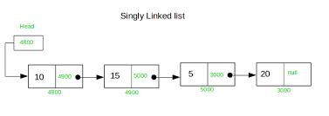
Linked List example
Suppose that your code is adding a node in a linked list. Now the exception handler tries to access that list data structure.
The list might sometimes “seem to be broken” because not all the pointers will have their correct values!
Any data that your program updates could be seen during the update, rather than just before or after!

Slide 49
Exceptions run a risk of bugs!
If an exception handler were to look at this list while it was changing, it could crash! Similarly, an exception handler can’t allocate new memory objects, or print a message – all of those could be unsafe at some random moment when the handler runs!
Solution? Sometimes you can temporarily disable exception handling. Additionally, it is always best for exceptional handlers to be short, self-contained, and to not invoke library methods!

Slide 50
That issue won’t arise with C++ catch
A throw/catch sequence won’t resume the code that threw the exception.
Moreover, in C++ we will have run the destructors for all stack allocated objects that went out of scope before running catch.
This gives a very predicable, controlled behavior

Slide 51
Could C++ throw/catch replace signals?
It may seem natural to think about using throw/catch as a signal replacement, but this won’t work.
The problem is that a signal is asynchronous and unpredictable. With throw/catch the exception is synchronous and usually involves a software “choice” to throw the exception.
This is a shame, in fact, because it is so hard to write safe signal handlers.

Slide 52
Summary
The exception pattern is very widely seen in Linux and C++. Broadly, exception handling mimics hardware interrupts. But hardware interrupts and signals can be “inhibited”.
C++ try/catch control flow can’t be inhibited and can easily disrupt updates and resource management: a potential source of serious bugs.
Per-resource wrappers offer an elegant solution.

