Slide 1
Why it is important (but hard) to leverage modern hardware
Professor Ken Birman
CS4414 Lecture 3

Slide 2
Idea map for today
Revisit the example from lecture 1. C++ was faster because it allowed Ken to leverage parallelism using threads.
Parallelism is a powerful tool, but only gives a speedup if the program itself is parallelizable. Sequential bottlenecks limit achievable speed
There are many “hidden” opportunities for parallelism that can benefit even a sequential program. A good example is prefetching in a cache

Slide 3
Reminder from Lecture 1
We had a “word-count shootout” and C++ was much faster!
But what was the C++ program doing that yielded such a speedup, and why didn’t the standard Linux approach using existing commands do as well?
And why were Python and Java so much slower?

Slide 4
Core idea
Our task was to compute word frequencies, then output them in a specific sorted order (descending by count, but alphabetic for ties).
The Linux kernel source code has about 26M lines of code in 74,000 files. It contains 4M distinct words, as defined above.
One option is to treat this as a big file and only use Linux commands.

Slide 5
Finding the words
Scan the files, breaking out each word and discarding garbage. This is called “splitting”.
Build a lookup tree… you’ll insert each “new” word into it with a count of 1. If the word is found in the tree, just increment counter
At the end you’ll need to output the data sorted in descending order by frequency of each word: a second sorting task.

Slide 6
How did the programs work?
The pure Linux version was easy to write but looks horrible:
find . -type f \( -name '*.c' -o –name ‘*.h’\) -exec cat {} \; |
tr -c '[A-Za-z0-9_ \012]' ' ' | tr -s '[ ]' '\012' | sort | uniq –c | sort –r –n

Slide 7
How did the programs work?
The pure Linux version was easy to write but looks horrible:
It uses what Linux calls a “pipe”. A process prints output to stdout (normally, the console) but we “redirect” it to become stdin (input) to another process. This uses 5 pipe operations: |
find . -type f \( -name '*.c' -o –name ‘*.h’\) -exec cat {} \; |
tr -c '[A-Za-z0-9_ \012]' ' ' | tr -s '[ ]' '\012' | sort | uniq –c | sort –r –n

Slide 8
Visualizing this application
find . -type f \( -name '*.c' -o –name ‘*.h’\) -exec cat {} \; | tr -c '[A-Za-z0-9_ \012]' ' ‘ | tr -s '[ ]' '\012’ | sort | uniq –c
…
mm_segment_t fs = get_fs();
set_fs(KERNEL_DS);
fd = (*syscall_open)(file, flags, mode);
if(fd != -1) {
(*syscall_read)(fd, buf, size);
(*syscall_close)(fd);
}
set_fs(fs);
…
…
fd
syscall_open
file
flags
mode
Fd
1
syscall_read
fd
buf
size
…
…
1
buf
fd
fd
fd
file
flags
mode
size
syscall_open
syscall_read
…
…
1 1
1 buf
3 fd
1 file
1 flags
1 mode
1 size
1 syscall_open
1 syscall_read
…

Slide 9
Where did word counting occur?
We did it in two steps. First, we sorted the file.
Uniq reads the sorted file and (–c flag) counts identical lines.
The final sort was not shown on that slide: “sort –r –n”. This outputs in descending order by number… which isn’t quite right!
sort –r –n will be in reversed alphabetical order for ties!

Slide 10
Linux summary
It involved running a chain of 6 processes linked by pipes.
It was quite slow.
A “hack” to fix the output order: Negate the counts, sort with –n but not –r, then strip the “-” signs. Ugly, but it would work.
#4: Pure Linux (buggy sort order)
  real 2m38.965s
  user 2m43.999s
  sys 27.084s

Slide 11
Writing a program to do this
Same idea, but now we need to “take control”
We will need programming tools to do the sorting and counting.
This lets us fix the issue of wanting our output to be sorted by (count,word) with descending count, but alphabetic word

Slide 12
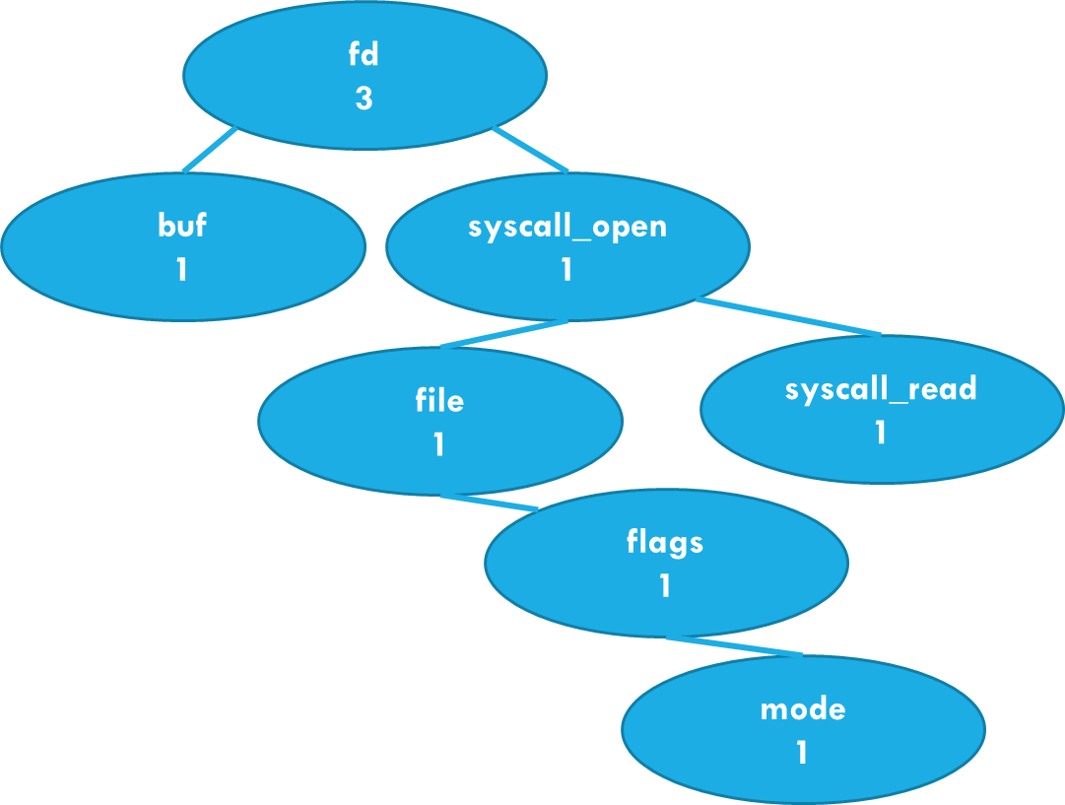
Visualizing this application
…
fd
syscall_open
file
flags
mode
fd
1
syscall_read
fd
buf
size
…
…
mm_segment_t fs = get_fs();
set_fs(KERNEL_DS);
fd = (*syscall_open)(file, flags, mode);
if(fd != -1) {
(*syscall_read)(fd, buf, size);
(*syscall_close)(fd);
}
set_fs(fs);
…
Sorted by name
Phase one: Count words in the file using a tree

Slide 13
Why a tree and not a hash table?
For a hash table to work well, you need to estimate the size
when you create it. We don’t know the expected size
We need our data sorted: a saves an extra sort step at the end.
How much time is being spent in the sorted list class?
Question to always ask : Will this choice shape performance?
Not every step of every program matters!

Slide 14
Visualizing this application
(3, fd)
(1, buf)
Sorted by name
Re-sorted by (count, name)
Word | Count
fd | 3
buf | 1
Output
Phase two: Sort by (count,word), then print output

Slide 15
Python, Java and C++ all have prebuilt tools for each step
Every one of these steps can just use a standard library.
We end up with very elegant, concise code.
It looks pretty similar for all three languages

Slide 16
Let’s start with Python
Python has a built-in splitter, built in vectors, and a vector sort.
It doesn’t leverage hardware parallelism.
One of our course staff
members (Lucy) coded this up…
#3 Lucy’s Python version
  real 1m30.857s
  user 1m30.276s
  sys 0.572s

Slide 17
What about Java versus C++?
Lucy also created a Java version. It compiles in two stages:
First to Java byte code
Then to machine code (JIT)
Both compilation steps are highly efficient, but there are some situations in which Java can only know the type of an object at runtime. This “runtime polymorphism” slows some libraries down.
#2 Lucy’s Java version (no threads)
  real 1m49.373s
  user 3m16.950s
  sys 8.742s

Slide 18
C++ Version?
#1: C++ using 24 parallel threads on 24 cores
  real 4.645s
  user 14.779s
  sys 1.983s
We created two C++ versions.
Sagar’s was pure and quite fast; we posted the code on the “extra materials” on our schedule web page.
Ken’s dropped into C for file I/O steps and went further than Sagar in leveraging parallelism. This was fastest of all.

Slide 19
C++ Disadvantage
C++ is syntactically different from Java or Python, which can take a little time to adjust to.
Not all C++ really is true to the spirit of the language. A purist, like Sagar or Alicia, wouldn’t like Ken’s code: it “hacks” the file data in an unsafe way!

Slide 20
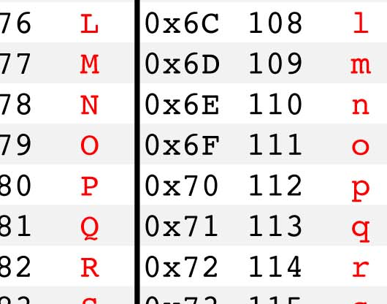
Files to… byte[] or char* or std::string
char[1024] buffer;
int fd = fopen(“file.c”, F_RDONLY);
char* sptr = buffer; ….
C an POSIX
…
mm_segment_t fs = get_fs();\nset_fs(KERNEL_DS);\n
fd = (*syscall_open)(file, flags, node);\nif(fd != -1) {\n (*syscall_read)(fd, buf, size);\n (*syscall_close)(fd);\n}\nset_fs(fs);
…
Linux kernel file-system buffer pool
C
str = getline(fd);
C++
std::string nextline;
nextline << inputstream; …

Slide 21

Some costs
Every language must open the file (checking permissions, etc)
We always have to read a block of bytes at a time, turn them into words (and deal with words split over a block boundary)
In a file, the lines just end with ‘\n’. A “c string” needs to end in ‘\0’ and a C++ string is an object with its own constructor.

Slide 22

Costs of copying
In languages that use objects, we generally need to convert the character string into a string object by allocating an object, computing the length of our string, allocating enough space for it, and then copying the bytes (plus a null).
All of this takes time and might even have other overheads, such as those associated with “locking” (lectures 11-14).

Slide 23
Std::string benefits and costs
std::string and std::iostream automate many of the tasks!
We can read a line at a time, and it is easy to split the string into words (in fact there are libraries you can use for this)
These map cleanly to x86 instructions so the code is fast.

Slide 24
C on POSIX advantages and limitations
Ken’s code mixed C++ with “just a little” code in C that talked directly to Linux file system operation (POSIX) and worked directly on data in buffers.
This avoided much of that copying and saved time. But Sagar’s code was shorter and more elegant, and not “much” slower

Slide 25
quality of machine code
Whether we use Python or Java or C++, at the end of the day the computer executes machine code. We saw some last week.
Python itself is implemented in Java or C++ and compiled.
But then Python interprets your code. This causes slowdown.

Slide 26
Runtime types versus static types
With Java “interesting” things (like tree nodes, or strings) are objects.
Java object types are learned at runtime… this is called “reflection”. Reflection has a cost, paid at runtime – programs run slower. There are ways to speed reflection up, but overheads remain an issue.
C++ types are always fully known at compile time (statically). This lets the compiler use type information to do code optimization.

Slide 27
data structures and compilation quality are just the start.
Our server had 28 cores, and each core had a way to pretend to be two CPUs (hyperthreading), making 56 CPUs.
At first it seemed as if we should use two threads per core. But Linux needed some cores, and hyperthreading turned out to slow things down. We got the best numbers with 24 application threads.
After they finish, we could then merge the trees into one big count tree, combining the sub-results.

Slide 28
In fact, we should think of the application as a series of tasks
I’m just using this term to mean “some part of a bigger job”. Stages would be another common term for this idea.
Overall, we want to scan all 74,000 files. But it might make sense to subdivide this into a set of tasks.
A single task might do the work of scanning files 1 to 1600

Slide 29
We want to keep all 26 cores busy
This form of parallelism forces us to make a choice.
We do this by creating “threads” that each perform a task

Slide 30
Thread: A big topic for CS4414
Think about a method that has no return value:
do_something(args….);
A thread runs some method in parallel with its parent.
  “You clear the table… I’ll get some chips and salsa”
  “You scan files 1…1000” … “I‘ll scan 1001…2000”

Slide 31
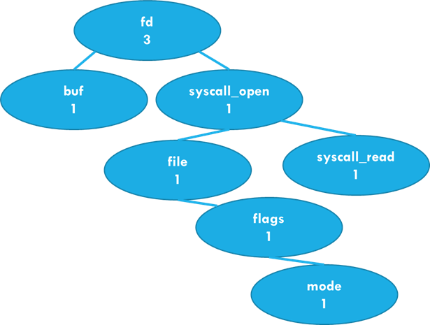
Visualizing task-level Parallelism
. . .
Computational thread 1 processes about 2000 files
Computational thread 2 processes about 2000 files
Computational thread 3 processes about 2000 files
Computational thread 24 processes about 2000 files
File System has 74,000 files in it

Slide 32
Understanding the timer output
In this example, my program will run silently on 8 cores using 16 threads
The “real” (wall clock) time
was 18.469 seconds.
This is how long we waited for it to finish
% time taskset 0xFF ./fast-wc -n16 -s
real 0m18.469s
user 0m43.406s
sys 0m18.203s

Slide 33
Understanding the timer output
The “user” time measures compute
in my 16 threads. It can be as
much as 16*real time!
% time taskset 0xFF ./fast-wc -n16 -s
real 0m18.469s
user 0m43.406s
sys 0m18.203s

Slide 34
Why did I show each thread with its own word-count tree?
A tree node needs to live somewhere in physical memory.
If each core builds its own word-count tree for files it scans, that tree will be entirely in its local memory, and not shared.
Later we will see that sharing objects involves adding locking and that this brings costs.

Slide 35
Down side of having 56 trees…
… we end up with 56x more memory in use!
Linux had 4M “unique” words, but with 56 threads, only 27,000 words are seen by half or more! 3.2M are seen by just 1 or 2 threads.
Suppose an average word-count node requires 64 bytes, and that we end up with 250,000 nodes per thread. With 56 times will require 16MB x 56 = 896MB. We have enough memory!

Slide 36
Downside of Having 56 Trees…
At the end, we have 56 trees containing sub-counts.
Before sorting, we’ll need to merge them.

Slide 37
With sorted trees, Tree merge is “easy”
For each node in tree B, look up that word in tree A, sum the counts.
C++ is like Java or Python: it has “iterators” for data structures
Just a tiny for loop. But who should run it?

Slide 38
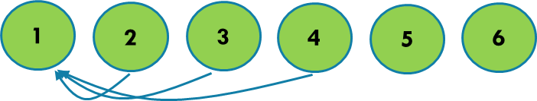
Each thread computes a partial word count on a portion of our data
Visualization: Thread 1 runs the merge step.
… this is linear: 55 merge operations. Can we do better?

Slide 39
Parallel Binary merge
1
Ends at the very top
In this picture, we merge from
the bottom to the top
For 56 threads:
Merge [1,2] and [3,4] and … [55,56]
Then [1,3] ……………. [53, 55]
…
Finally: [1, 29]
1
3
Thread 3 terminates
1
2
3
4
Starts at the bottom
Threads 2 and 4 have no more work and terminate

Slide 40
Parallel Binary merge
1
Ends at the very top
Rule: Each thread t has a variable k and initializes k = t (its own thread-id in [1…n]). Initialize s to 1.
do {
If (k is even) { thread t terminates. }
else { merge tree t + s into tree t; }
k >>= 1; s <<= 1;
} until (all trees merged into tree 1);
In this picture, we merge from
the bottom to the top
For 56 threads:
Merge [1,2] and [3,4] and … [55,56]
Then [1,3] ……………. [53, 55]
…
Finally: [1, 29]
1
3
Thread 3 terminates
1
2
3
4
Starts at the bottom
Threads 2 and 4 have no more work and terminate

Slide 41
Worth implementing?
% time taskset 0xFF ./fast-wc -n16 -s
real 0m18.469s
user 0m43.406s
sys 0m18.203s
Time spent in Linux:
File I/O
My program offers parallel merge (-p). It helps… a tiny bit.
Issue: my C++ version was really bottlenecked by file I/O. No matter how fast the threads run, the “sys 18.203s” remains!
C++ tricks can’t reduce runtime below 18.203s without some way of improving the efficiency of parallel file I/O!

Slide 42
Reminder: Tree or hash list?
Now we can answer the question from slides 12/13/14
In fact replacing our tree with a hash list probably wouldn’t help: the file I/O bottleneck wouldn’t be impacted.
The real-time speed limit is ultimately the need to read all the files (unless Linux already had them in the file system cache)

Slide 43
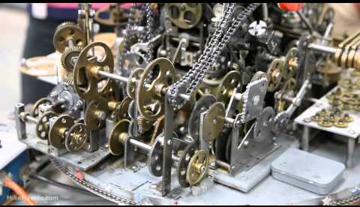
new challenge: keep everything running simultaneously!
Finding the bottleneck can be difficult
Even our little merge program has many moving parts
  All those threads, building trees
  But also the work Linux is doing when the threads open files and
  read them.
  Which is the limiting stage of our complete “system” (fast-wc + Linux)?
Finding the bottleneck can be difficult

Slide 44
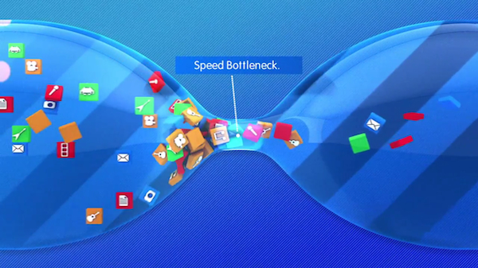
Terminology
bottleneck
A bottleneck: “the limiting factor” for some task… we don’t really use the term for a “balanced” task that has no limiting spot.
Compute-bound: The task is bottlenecked (limited) by the speed of calculations on some kind of in-memory data.
I/O bound: The task is bottlenecked on fetching data from some kind of storage device, or over the network.

Slide 45
Our challenge: Not just data structures and parallelism, but bottlenecks
How can we identify the bottlenecks that limit performance?
Can we even measure the degree of parallelism we are achieving?
In fact Linux has tools we can use for that.
We’ll be learning about them!

Slide 46
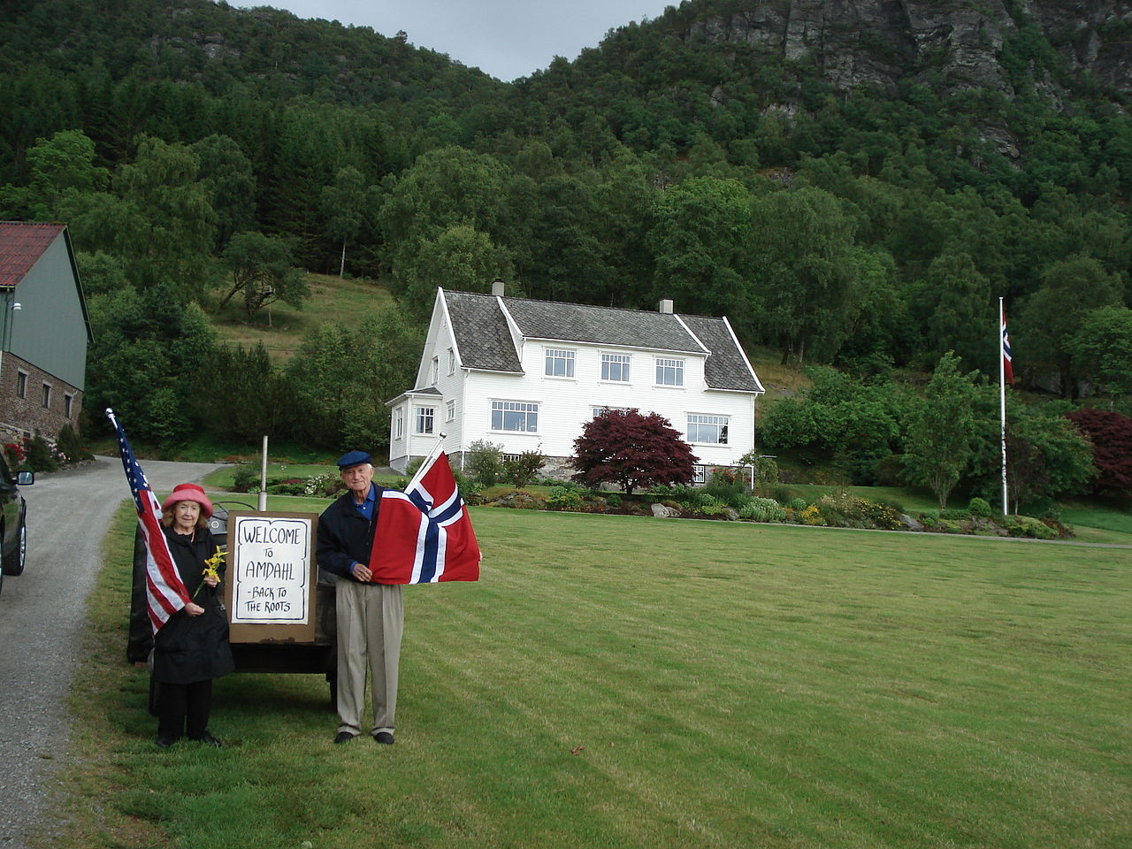
Amdahl’s Law
Gene on the family farm in Norway
Gene Amdahl was a leading research on parallelism and supercomputing in IBM’s HPC division.
He became interested in a basic question. How fast can computations be performed, with infinite parallelism?

Slide 47


A Day Trip to Niagara Falls
You and your friends want to do a safe, socially distanced trip to Niagara falls.
There are six of you. One option
is to rent a mini-bus and sit far
apart, but the mini-bus is slow

Slide 48


A Day Trip to Niagara Falls
Better plan: You rent three convertible sports cars.
With roofs open, each can safely hold two people
Best of all, the cars are “insanely fast”.
But as you head north, the narrow road has a
bottleneck! Until you all pass this slow tractor, the
group will have to wait.
Gene Amdahl’s Tractor in Norway

Slide 49
How Amdahl thought about parallelism
In any computation, we have some parts that are highly parallel, such as scanning our 74,000 different files. Parallelism can speed those up.
But the computation will also have sequential tasks, which could include sequential logic buried in the operating system or the hardware.
The sequential work will limit the speedup due to parallelism!

Slide 50
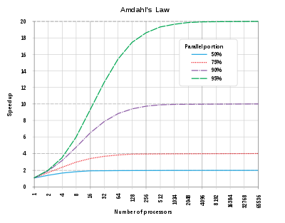
How AmDahl Expressed his law
Suppose that p represents the percentage of the task that can be parallelized.
Then 1/(1-p) is the maximum
possible speedup

Slide 51
What would be sequential in our word-frequency application?
Each distinct word-count tree is managed by code that does “find or insert” and “increase the count” operations.
Those individual operations will be sequential.

Slide 52
What else would be sequential in our word count application?
Once we have our single tree, we have to re-sort it, because we wanted our printed output to have common words at the top.
Ken and Sagar both needed a second sorted tree for this.
In fact, counting and the final sort both have identical cost!

Slide 53
The file system ends up very busy!
These threads are opening and reading a lot of files
Can it keep up?
If not, our threads won’t be active…

Slide 54

The file system ends up very busy!
This is a famous issue with Linux. For example, Google and Facebook have Linux servers holding huge collections of web pages or photos.
They ended up putting images into “strips” to reduce the load
on the file system.

Slide 55
Enrichment materials
Covered to the extent that we have time

Slide 56
File access costs: Two aspects
Each file has to be opened, which is a moment when Linux checks that the user has permission to access the file.
Once the file is open, it takes time to read and process data.
When reading, the fast-wc application does many “system calls”

Slide 57
File access costs: Two aspects
With 56 threads doing concurrent reads, the file system is doing a lot of data fetches from the disk (in “blocks” of 4096 bytes)
If those reads become a bottleneck, our threads will pause and we lose parallelism.

Slide 58
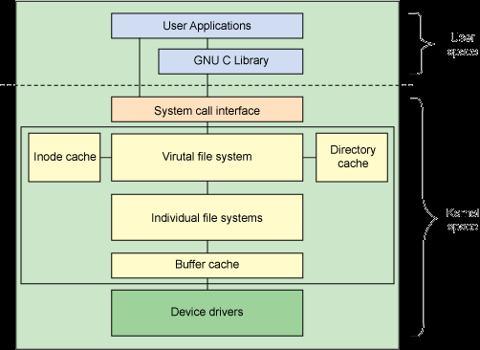
How the Linux file System is structured
User space
Kernel
space
User level programs can’t access
files “directly”. They use Linux.
The implementation is modular
with multiple layers, but notice
the various caches: inodes,
buffers and directories.
Virtual File System

Slide 59
Cache: A concept used throughout computing
A pool of memory holding copies of data that “lives” elsewhere.
The Linux buffer pool is a cache of data read from files. Each
time data is read, Linux keeps a copy (for a while). If it fills up,
Linux will “evict” something else to make room.
If the application re-reads that same data Linux can
avoid the need to fetch it from the storage device again.

Slide 60
Prefetching into a cache
Linux also watches for sequential read patterns: you read the first 4096 bytes from a file, then the next 4096, then the next…
Linux will bet that you plan to continue doing this and issues one or two reads ahead of time, saving the data in cache.
Question: In what way is this a form of “parallelism”?

Slide 61
Prefetching into a cache
Linux also watches for sequential read patterns: you read the first 4096 bytes from a file, then the next 4096, then the next…
Linux will bet that you plan to continue doing this and issues one or two reads ahead of time, saving the data in cache.
Question: In what way is this a form of “parallelism”?
Why is prefetching a form of parallelism?
Answer: It lets us overlap the work of finding and reading
the next block of the file (the next 4096 bytes) with the
word-counting logic for the current block.

Slide 62
Why Prefetching and caching help
Modern disks (SSD and rotating disks!) have large delays compared to memory access. 0.1ms or more delay.
Without a high rate of cache hits, we would spend 1 second (or longer) waiting for disk read requests to complete
With prefetching into the Linux buffer pool, we don’t experience those 0.1ms delays. Our threads keep running

Slide 63
In fact the CPU itself uses caches and prefetching, too!
A modern CPU has multiple caches:
L1: the registers. C++ might “cache” data in them
L2 instruction and data cache: much larger, slightly slower
pair of caches used by the the CPU.
L3 data cache: shared by the entire NUMA computer (all the
CPU cores).
Main memory: In modules; largest, but slowest to access

Slide 64
Performance differs enormously!
Accessing L1 cache on the Dell server I used as an example last time: 2 or 3 clock cycles. The clock runs at 3GHz.
Accessing the L2 cache takes 12 or 13 clock cycles
L3 access jumps to perhaps 40-75 clock cycles. The actual delay depends on how heavily loaded the memory bus is.
If we need to go to the memory module, there are two cases: the closest memory module will require125 clock cycles to access. A remote memory module takes 250 clock cycles.

Slide 65
Ideal case
All of our 28 cores are busy (two threads each). But maybe some are busy in the kernel, not in my user code.
Each word-count thread is hard at work counting on the current block
At every level of the memory hierarchy, prefetching is anticipating the next instruction needed, next data needed, next block of file data needed, and already loading it.

Slide 66
Wrap-up

Slide 67
Our agenda in the next 24 lectures
In the recitation, learn C++-17 and Linux.
Meanwhile, in class, learn to think in terms of performance-aware program design that considers memory hierarchies, parallelism, prefetching and caching.
By the end of the semester, learn to identify the performance-limiting bottleneck and to focus on speeding it up!

Slide 68
Summary
Many decisions go into programming
Not every decision has performance impact. Often you should favor elegance, standard libraries, speed of development.
But there is usually a critical path that shapes speed. Find it. Optimizing that part of your code pays off.

