Slide 1
Welcome to CS4414
Systems Programming
Professor Ken Birman
Lecture 1

Slide 2
“Idea map” for The whole semester
We favor C++ 17 here. It isn’t the only option (Rust is cool, for example), but we’ll use C++ 17 because industry seems to like it. C++ 17 is very stable, but C++ 20 will eventually replace it
The application must express your ideas in an elegant, efficient way that promotes correctness and security while mapping cleanly to the hardware
Linux abstractions expose that hardware in easily used forms.
Hardware: Capable of parallel computing, offers a NUMA runtime environment with multiple CPU cores.
Linux: The operating system “manages” the computer for us and translates hardware features into elegant abstractions.

Slide 3
When you write a program, should you care how it gets executed?
Most people are familiar with Java and Python
Java has lots of data types (and lots of fancy syntax!), generics, other elaborate language features and compiles to a mix of machine code and programming language runtime logic.
Python is easier: No need to fuss with data types, easy to create arrays and transform all the objects with just one step.

Slide 4
When you write a program, should you care how it gets executed?
Which is better?
Java
Python
… why?
Most people are familiar with Java and Python
Java has lots of data types (and lots of fancy syntax!), generics, other elaborate language features and compiles to a mix of machine code and programming language runtime logic.
Python is easier: No need to fuss with data types, easy to create arrays and transform all the objects with just one step.

Slide 5
Considerations people often cite
Expressivity and Efficiency: Can I code my solution elegantly and easily? Will my solution perform well?
Correctness: If I end up with buggy code, I’ll waste time (and my boss won’t be happy). A language should facilitate correctness.
Productivity: A language is just a tool. The easier it is to do the job (which is to solve some concrete problem), the better!

Slide 6
A subtle consideration: Modularity and compositionality
Don’t fix things that already work. Ideally, we want the system to provide lots of pre-packaged solutions for common tasks.
As a systems person, I’m very focused on this idea of pre-packaged modular solutions.
Modern machine learning forces us to think in these terms!

Slide 7

Microsoft FarmBeats Example
How many
programs are
in use here?
… hundreds!
A modern computing applications is a software ecosystem

Slide 8
… this is the complication
As we deal with larger and larger scale, the “modules” won’t be simple things like a library that deals with managing a sorted list
We may need to “compose” entire programs or even systems, which will need to share files or perhaps “objects”.
… the programming language is just a part of this ecology

Slide 9
Drill-down considerations
We want our solutions to perform well and “scale well”.
For many tasks this involves working on the “cloud” (big remote data centers, like AWS or Microsoft Azure or Google).
In the cloud you rent the machines you need, as needed, but pay for what you use. So performance ≅ $$$.

Slide 10
Drill-down considerations
Which performs better?
Java
Python
… something else?
… why?
We want our solutions to perform well and “scale well”.
For many tasks this involves working on the “cloud” (big remote data centers, like AWS or Microsoft Azure or Google).
In the cloud you rent the machines you need, as needed, but pay for what you use. So performance ≅ $$$.

Slide 11
Reasons we care about performance
Modern forms of computing are very power-hungry! And this is causing growing impact on the global “electricity footprint” associated with popular ways of solving problems.
Future of civilization might depend on whether your code can minimize the amount of electricity it consumes!

Slide 12
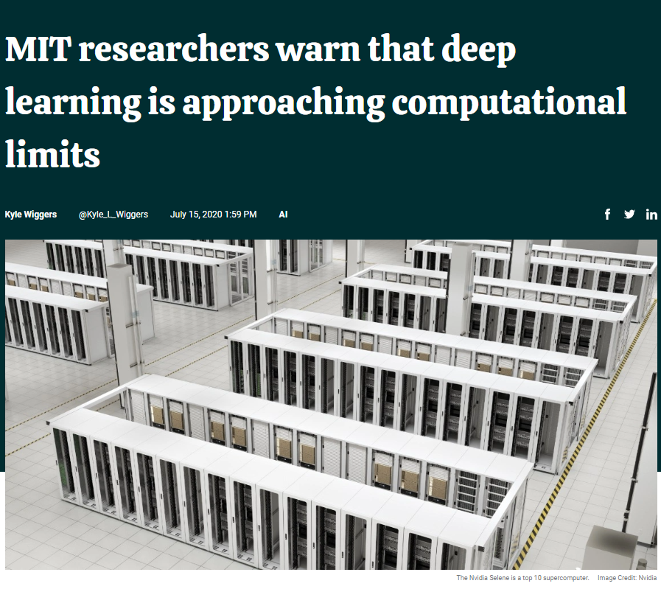

Reasons we care about performance
Roughly 1% of global electric use, doubling roughly every 2 years!
Modern forms of computing are very power-hungry! And this is causing growing impact on the global “electricity footprint” associated with popular ways of solving problems.
Future of civilization might depend on whether your code can minimize the amount of electricity it consumes!
https://energyinnovation.org/2020/03/17/how-much-energy-do-data-centers-really-use/
https://venturebeat.com July 15, 2020

Slide 13
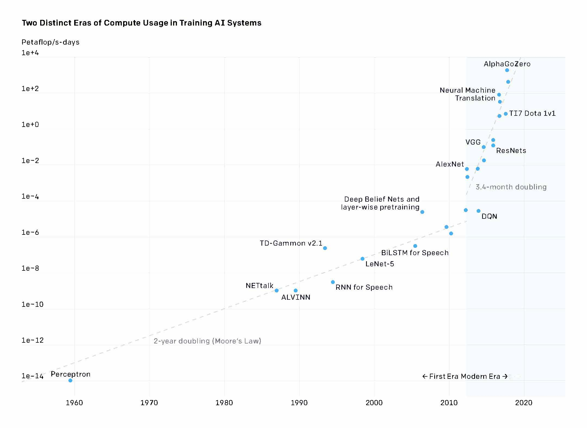
Compute time to train ML models
How much of this is really due to inefficient use of the language and hardware? Probably a lot!
3.4-month doubling
2-year doubling (Moore’s Law)

Slide 14
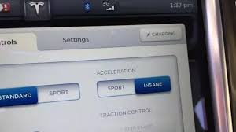
Some cars have insane speed buttons…
Guess what? So do
computers!
In CS4414 we’ll push the button.
(in ways that are correct, secure, natural, elegant)

Slide 15
Smart use of the “platform” is how!
In CS4414 we will be learning about the Linux operating system. Linux is universal these days.
We will use C++ 17 as our programming language.
And we’ll learn to write code in smart ways that use the hardware and software “ideally” to get the best possible speed.

Slide 16

Why Linux? Does the O/S even matter?
When building “interesting” applications we often
put a few building blocks together, Lego style.
Linux is full of small, easily used building blocks for common tasks, and has easy ways to connect things to make a bigger application from little pieces.
Productivity rises because you often don’t need to build new code – you can just use these existing standard programs in flexible ways.

Slide 17
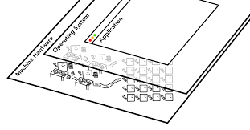
Linux and the Hardware: two
Sides of the system architecture
We will be learning about the modern computer hardware, not so much from an internals perspective, but as users.
Linux lets you design applications that correspond closely to the hardware. But then we need a programming language that lets us talk directly to the operating system and the hardware.

Slide 18
Why are Python and Java expensive?
Python: Interpreted
Java: Runtime overheads
Compiles to a high-level representation that enables an “interpretive” execution model.
In fact, Python is like a “general machine” controlled by your code: Python itself runs on the hardware. Then your code runs on Python!
Gradual typing: Python is very laissez-faire and can’t optimize for specific data types.
Compiles (twice: to byte code, then via JIT) but rarely exploits full power of hardware. Limited optimizations, parallelism
Dynamic types and polymorphism are costly.
Everything is an object, causing huge need for copying and garbage collection.
It feels as if your programs run inside layers and layers of “black boxes”

Slide 19
How does C++ avoid these pitfalls?
C++ objects are a compile-time feature. At runtime, all the type-related work is finished: no runtime dynamics.
The compiler “inline expands” and optimizes heavily. You help it.
Computers execute billions of instructions per second, yet we can write code that will minimize the instructions and shape the choices.
Parallelism is easy, and the compiler automatically leverages modern hardware features to ensure that you will have highly efficient code.

Slide 20

Let’s Drill down on speed
For some situations, C++ can be thousands of times faster than Python or Java, on a single machine!
Typically, these are cases where the application has a lot of
parallelism that the program needs to exploit.
For example, identifying animals in a photo entails a lot of
steps that involve pixel-by-pixel analysis of the image
But in fact, we can get substantial speedups just scanning
large numbers of big files… hence our word-count demo

Slide 21
Let’s Drill down on speed
We said that Python is slowest, Java is pretty good, but C++ can beat both. C++ knocks the socks off Java for parallel tasks.
What would be a good way to “see that in action”?
A small example: “word count” in Python, Java and C++

Slide 22
Word count task
Basically, we take our input files and “parse” them into words. All three languages have prebuilt library methods for this. Discard non-words (things like punctuation marks).
Keep a sorted list of words. As we see a word, we look it up and increment a count for that word (adding it if needed).
At the end, print out a nicely formatted table of the words/counts in descending order by count, alphabetic order for ties

Slide 23
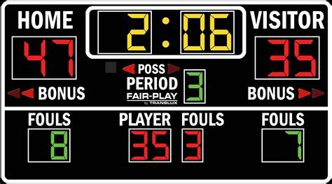
The Scoreboard
#1-A: Ken’s C++ Faster, but more complex… real 4.645s user 14.779s sys 1.983s #1-B (Sagar’s code, shorter & better use of C++…) real 8.200s user 49.295s sys 2.145s | #3 Lucy’s Java version (no threads) real 1m49.373s user 3m16.950s sys 8.742s
#2 Lucy’s Python version real 1m30.857s user 1m30.276s sys 0.572s This was only 19 lines of code! | #4: Pure Linux (buggy sort order) real 2m38.965s user 2m43.999s sys 27.084s

Slide 24
The Scoreboard
C++ version was 34x faster than Linux, 20x faster than Java or Python
#1-A: Ken’s C++ Faster, but more complex… real 4.645s user 14.779s sys 1.983s #1-B (Sagar’s code, shorter & better use of C++…) real 0m8.200s user 0m49.295s sys 0m2.145s | #3 Lucy’s Java version (no threads) real 1m49.373s user 3m16.950s sys 8.742s
#2 Lucy’s Python version real 1m30.857s user 1m30.276s sys 0.572s This was only 19 lines of code! | #4: Pure Linux (buggy sort order) real 2m38.965s user 2m43.999s sys 27.084s

Slide 25
The Scoreboard
Notice that the user time is 3x larger than the real time. Puzzle: how can this be true?
#1-A: Ken’s C++ Faster, but more complex… real 4.645s user 14.779s sys 1.983s #1-B (Sagar’s code, shorter & better use of C++…) real 8.200s user 49.295s sys 2.145s | #3 Lucy’s Java version (no threads) real 1m49.373s user 3m16.950s sys 8.742s
#2 Lucy’s Python version real 1m30.857s user 1m30.276s sys 0.572s This was only 19 lines of code! | #4: Pure Linux (buggy sort order) real 2m38.965s user 2m43.999s sys 27.084s

Slide 26
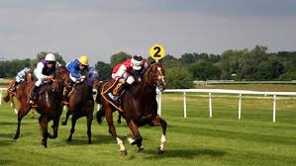
How can a program do 14.7779s of computing in 4.645s?
Could this just be a measurement mistake in Linux?
… in fact, if a process is using more than one thread it can harness more than one CPU at the same time.
With 3 CPUs running continuously at full speed, it can do 3x more work than the elapsed wall-clock time!
A 3-horsepower system

Slide 27
Didn’t I promise “thousands x”
How did that drop to 30x?
We counted words in text files: Limited parallelism.
The C++ program is able to process them in parallel side-by-side streams, which was how we got the speedup.
With image processing or machine learning (tensor arithmetic), the value of parallel processing is dramatically larger.

Slide 28
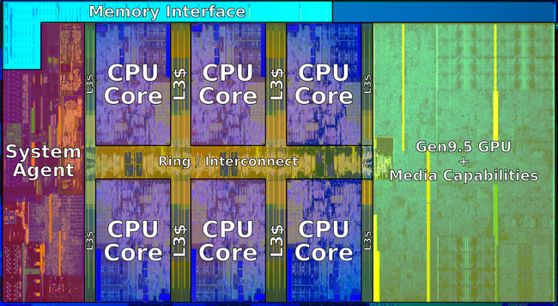
Parallelism in your computer
6-core Intel chip with GPU
A modern computer has multiple smaller computers (cores) that all run on the same computer memory (RAM). It may also have a special form of “accelerator” called a GPU.
To leverage this power, the computer offers special hardware instructions. The compiler can use those for big speedups. You can also use “threads”: a method of having more than one computational activity running within a single program.

Slide 29

Parallelism in your computer
A modern computer has multiple smaller computers (cores) that all run on the same computer memory (RAM). It may also have a special form of “accelerator” called a GPU.
To leverage this power, the computer offers special hardware instructions. The compiler can use those for big speedups. You can also use “threads”: a method of having more than one computational activity running within a single program.

Slide 30
Topic from Beyond CS4414:
Cloud computing takes this further
For compute-intensive tasks, companies set up an account on a big commercial data center called a cloud. “Rent, don’t own”.
You can easily run a program on hundreds of thousands of computers, each instance processing different input files.
So a single job might have millions of threads working in
parallel, and each using parallel computing instructions!
… the hard part is when they need to combine their results.

Slide 31
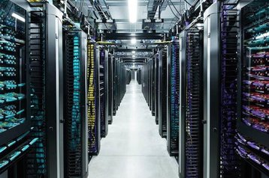
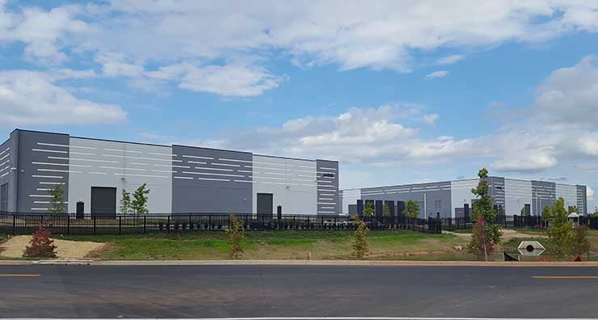

Modern Cloud Computing Data Center

Slide 32
Issues introduced by large scale
Program design: When we use networking to let processes talk to one-another, they need ways to share data, cooperate, coordinate, recover from failures.
Algorithmic: Just like in a single machine, there are more efficient and less efficient data structures and “protocols”
Security: At scale it is common to run into new kinds of attacks, and we need different styles of defense. Sensitive data is an especially important concern (like private information).

Slide 33
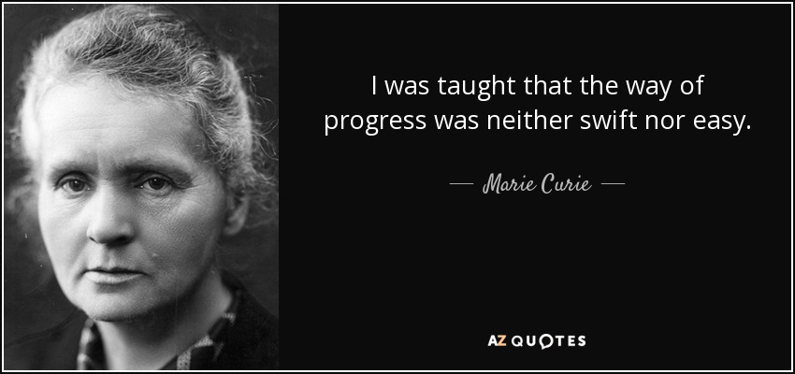
And yet…
First woman to win the Nobel Prize
Many jobs today involve larger scale computing platforms, even if you don’t work “for” a cloud company.
A factor of 10x can be dramatic if the code is used by Google to respond to a search or is part of the Facebook image feed.
C++ is the “way of progress” for demanding tasks.

Slide 34
Learning Linux and C++
You came into this class comfortable in an object oriented language, and learned data structures, so C++ should be easy to learn.
The operators and syntax and features will remind you of Java
There are extra operators, and those we will teach you, and things
like dynamic memory management, but we won’t teach basics:
those you need to learn in a hands-on way!
Similarly, we will provide pointers to lists of Linux commands
and bash syntax, but these are topics for experiential learning

Slide 35
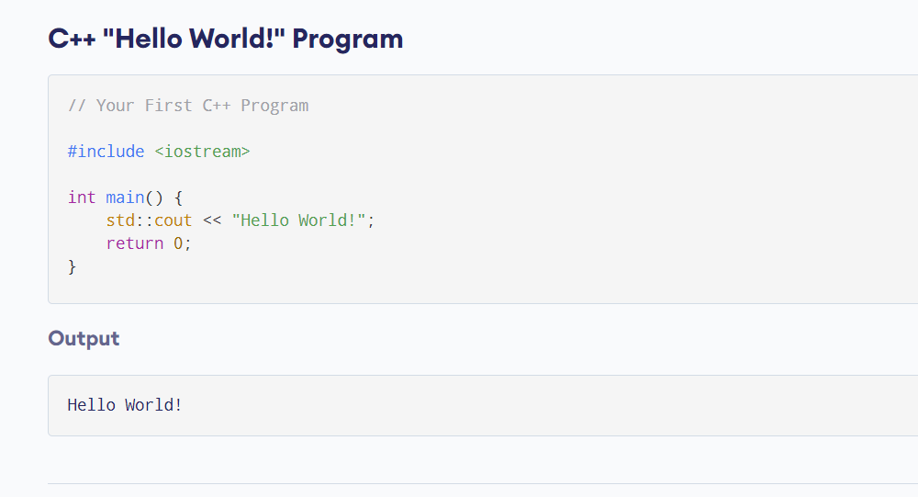
Example: Hello World in C++

Slide 36
Example: Word Count in C++
This is the “core” of the counting logic:
using WC = std::map<std::string, int>;
WC sub_count[MAXTHREADS];
inline void found(int& tn, char*& word)
{
sub_count[tn][std::string(word)]++;
}

Slide 37
Example: Word Count in C++
… and here is the core of the sorting logic:
struct SortOrder: public std::binary_function<std::pair<int, std::string>, std::pair<int, std::string>, bool>
{
bool operator()(const std::pair<int, std::string>& lhs, const std::pair<int, std::string>& rhs) const
{
return lhs.first > rhs.first || (lhs.first == rhs.first && lhs.second < rhs.second);
}
};
using SO = std::map<std::pair<int, std::string>, int, SortOrder>;
SO sorted_totals;
for(auto wc: totals)
{
std::pair<int,std::string> new_pair(wc.second, wc.first);
sorted_totals[new_pair] = wc.second;
}

Slide 38
Frightening Syntax!
But the course staff is used to C++ and we can help.
Once you really learn it, you’ll start to find it much more natural.
The one big thing to know is that even a single misplaced character can trigger pages of compiler complaints, so you do need to understand exactly what you are “asking it to do!”

Slide 39
The way of progress being “neither easy nor fast” aspect?
C++ will eventually start to feel much easier, after a few weeks.
But you don’t automatically get high speed. That takes more work – rewarding work, because you can measure the improvements as you make them, but it does take effort!
The key is to be able match your coding goals to the hardware.

Slide 40
When I first coded my solution, my program was very short, but rather slow.
I added parallel threads – which complicated the solution but helped a lot. Then because file opening was slow, I added a thread to “preopen” files before they were needed.
The C++ library for file opening and reading files was a bottleneck, so I switched to calling Linux file open and Linux file read, directly. This gave an additional speedup

Slide 41
Final version
With threads, my code was “part way” to the goal.
Thinking about bottlenecks, I decided to add one more parallel computing idea (we’ll see it soon). Then I changed some of my very heavily-used methods to be “inlined”
This gave that 20x-30x compared to Python and Java.

Slide 42
Roll your own? Or learn some weird library interface?
In C++ we could certainly code everything from scratch.
But library solutions have the benefit of being standard, widely used, and heavily tested.
C++ libraries are also exceptionally performant, and for our course this is an important consideration!

Slide 43
Remainder of Word Count in C++
I didn’t show you:
The standard includes required to import the std:: libraries
The main program that calls the “getWordCount” method
A bunch of little helper methods I wrote.

Slide 44
Why would people care about word counting in a modern system, like for nlp?
Natural language programs are based on word counts, but :
White space, punctuation, hyphenation is removed
Conjunctions such as “a”, “and”, “or” are discarded
Upper case is mapped to lower-case
Stems are removed: “flying” might map to “fly”.

Slide 45
Why do NLP systems care about stems?
When people do a web search such as “learn to fly small plane” or “birds that cannot fly” small style differences arise.
Stems have been shown to be much more stable and consistent
Web pages for flying schools would probably use “fly” very extensively. In contrast “that” and “to” are less relevant…

Slide 46
What shapes the performance of “stemmed, lower-case word count”?
Speed of reading the data, especially if the file is large.
At Google, some AI systems that learn from web pages scan
hundreds of billions of them.
Splitting, stemming, mapping to lower case, discarding conjunctions
If we use new variables to hold stemmed words, we’ll need
to “allocate” memory and initialize the object.
We’ll need to keep a sorted list of words, and look for each
word as we discover it, and increase the associated counter.

Slide 47
Glimpse of Linux and Bash
This bash command runs c++, telling it to optimize the code, warn in a “fussy” way.
% g++ -std=c++11 -O3 -Wall -Wpedantic -pthread -o fast-wc fast-wc.cpp
This does a timed run of the program (fast-wc):
  % time taskset 0xFF ./fast-wc -n4 -p
fast-wc with 4 cores, 50095 files, 16 blocks per read, parallel merge ON
define | 2008083
struct | 1694853
0 | 1268529
if | 1172461

Slide 48
More fun with bash
In fact we can use bash to…
Automatically open a file and have it look like “console input”
in our C++ program.
Put the program output into a file
Run a program in the background
Put the program output into a bash variable, and then pass
that variable as a command-line argument to some other program
… the list goes on for quite a while!

Slide 49
Practical Considerations
Organizational stuff

Slide 50
Recitations matter!
In CS4414, we use the recitations to teach you C++ and Linux
We also are asking the ugrad TAs to organize a few longer “workshops” where they would problem solve while you watch (those will be on Zoom and recorded).
C++ is easy but it takes time and help to learn. And even a person who knows C++ can learn new things from Sagar and Alicia.

Slide 51
Is C++ hard to learn?
C++ is easy to learn at a basic level (in CS4414 we won’t dive into the really fancy, obscure, C++ features).
C++ was designed to make the mapping to the hardware and to the machine instructions “evident”. An interview with the inventor of C++.
Unlike that sense of black-boxes everywhere, with C++ you can know everything your code is doing, even to very low levels.

Slide 52
Developer tools (IDE)
Ken and Sagar do many things at the “command line” layer of Linux. Neither uses any kind of IDE for C++ on Linux.
But there are good IDE options, like Eclipse and Visual Studio Code
Linux comes in many flavors. We prefer Ubuntu, the bash shell, and the “cmake” application builder. Sagar loves the emacs editor.

Slide 53
Resources
The whole course closely tracks the main textbook by Bryant and O’Halloran at CMU.
Main difference is that CMU CS213 views the class as an
introduction to programming languages and compilers
CS4414 has a systems-centric focus. But in fact the textbook
includes this material, even if CMU’s course brushes over it
To fill in gaps, we also recommend getting a C++ textbook and learning to access the online Linux materials

Slide 54
Setup
No matter what you use, Linux requires some (annoying) setup, and you’ll need to use online resources to get these right.
Otherwise things like console colors or the editor colors might be difficult to read. Linux still works, but could be hard to use. c++ might get confused and not find things like the std library.
Ample online instructions about every single step…

Slide 55
Equipment
CS4414 will be a very hands-on course, with a stream of homework assignments that you’ll work on for one or two weeks at a time.
Recitation will introduce the things you need to know and drill down on “surprises” relative to Java and Python, but you really learn these things by doing.
You can use your own laptop, or a Cornell machine (CSUG lab), but not a tablet that lacks a keyboard and mouse.

Slide 56
You can learn in groups… but must work alone
We encourage study groups. Learning as a group is great!
But… every single thing you do on a graded homework must be done by you, and not with any help from friends or CourseHero or other cheats. Graded work must be your individual work.
We have outstanding TAs (ugrad and PhD) to help if you get stuck, and you can also post questions on Piazza (or answer them)

Slide 57
Exams (some), Homework
We use the exact same grading formula as CS4410: 50% exams, 50% homework. There will be one prelim and one final. Cornell exam schedules will show the exact dates, times and rooms.
You are required to attend every lecture. Cornell asked us not to create videos for offline viewing, and we won’t.
If you get sick and miss a lecture, the ugrad TAs could help you review the slides we covered that day.

Slide 58
Curve
CS4414 is new, so there is no history to base a curve on.
Our feeling is that most students should easily be able to earn a grade in the range from B- to A+.
Grades below B- would only be used if a student really isn’t doing well, especially if that person is also skipping lectures.

Slide 59
Academic Integrity
We use automated tools to look for suspicious code.
Ask us for help if you fall behind or have trouble with a homework. We’ll help, and you’ll do well in the course.
If you cheat in CS4414 you trade a B- or better for an F. You can’t drop a class once this happens or expunge that F, it goes on your record, and you could be expelled from the CS program.

Slide 60
Downstream courses
CS4414 is a great preparation for other courses!
In AI and ML courses, you’ll need to write really high quality, fast code. The experience you gain here will pay off there.
CS4414 feeds naturally into systems courses like O/S, programming languages and compilers, security, networking, databases, embedded systems and IoT, cloud computing…

