Slide 1
Before we start… a quick Synchronization review!
Setting: We have some variables shared by several threads. All of them do updates that read and then modify data.
Question: Describe our synchronization “goal” very succinctly.
Question: Which synchronization tool would you use?

Slide 2
Before we start… a quick Synchronization review!
Setting: We have some variables shared by several threads. All of them do updates that read and then modify data.
Question: Describe our synchronization “goal” very succinctly.
Question: Which synchronization tool would you use?
Goal: Mutual exclusion for the critical section in which the threads access the variables.
This means only one thread can be accessing them at a time.

Slide 3
Before we start… a quick Synchronization review!
Setting: We have some variables shared by several threads. All of them do updates that read and then modify data.
Question: Describe our synchronization “goal” very succinctly.
Question: Which synchronization tool would you use?
Tool: A mutual exclusion lock. We allocate a std::mutex object.
Code blocks that touches the shared variables will use the scoped_lock pattern, which automatically acquires/releases the mutex.

Slide 4
Before we start… a quick Synchronization review!
Setting: There is a data structure that some threads only read. But other threads update this data.
Observation: We actually can allow multiple reads to run concurrently. The concern would be with updates: writers. At must one can run at a time, and no readers can run while the writer is active.

Slide 5
Before we start… a quick Synchronization review!
Setting: There is a data structure that some threads only read. But other threads update this data.
Observation: We actually can allow multiple reads to run concurrently. The concern would be with updates: writers. At must one can run at a time, and no readers can run while the writer is active.
Goal: This is the readers and writers pattern.
Allow multiple readers, but only a single writer.
If a writer is waiting, no new readers can access the data structure until the writer is finished.

Slide 6
Before we start… a quick Synchronization review!
Setting: There is a data structure that some threads only read. But other threads update this data.
Observation: We actually can allow multiple reads to run concurrently. The concern would be with updates: writers. At must one can run at a time, and no readers can run while the writer is active.
Tool: We can use the readers and writers code from Lecture 16
Each reader calls startread, then accesses the structure, then endread.
Writers call startwrite, then update the data structure, then endwrite.

Slide 7


Before we start… a quick Synchronization review!
Bottom layer
Top layer
Setting: There are a bunch of display icons, and threads call draw to render them on a background.
Draw updates an internal data structure that tracks the contents of each pixel, in layers, but doesn’t actually output to the console.
To do that, we call redisplay. Pixel by pixel, it figures out what is on top, then outputs the resulting display image.

Slide 8
Networking
Professor Ken Birman
CS4414 Lecture 19

Slide 9
Idea Map For Today
The Internet, IP addresses and port numbers.
Packets, routing, firewalls, tunnels, network address translation
TCP basics, SSL security
Socket API, Google GRPC
http versus https, VPNs, VPC

Slide 10
Internet basics
The internet is like a computerized postal system.
Any process can set up a “mailbox” (a socket), and post an address on it (bind an IP address and port number).
The address can then be registered for use by programs anywhere on the net… with limitations

Slide 11
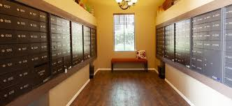
IP Addresses
Mailroom at 11 Riverside Drive, NYC
IPv4 is 32-bits (but only 28 are useable). IPv6 doubles this.
  There are actually several types of addresses (classes)
  In CS4414 we won’t dive into why, or what the others are for
  Each address has an associated “port number” because one machine could have many processes using the network. Like a mailbox in an apartment building.
  The IP address is used to route to the computer. Like a street address.
  The port number is used to figure out which process gets the packet.

Slide 12
Address directory: DNS
A service call the domain name service (DNS) tracks server names and IP addresses.
The DNS is operated by for-profit companies. They sell domain addresses, and server owners pay for listings.
Fancy web sites, like Netflix.com, have ways to route you to a data center somewhere near you, for speed.

Slide 13
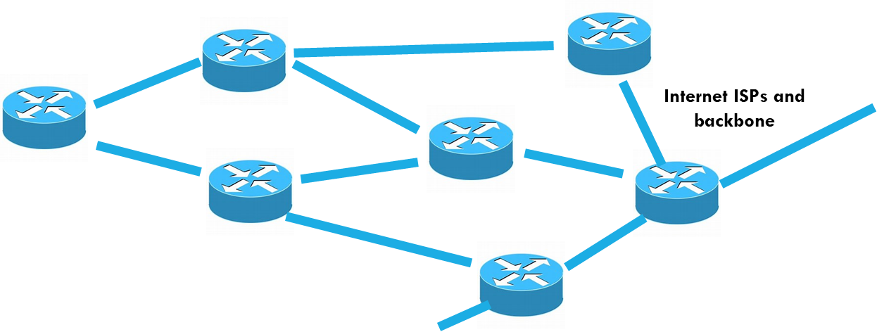
Routers and Links
The Internet is composed of high-speed network links between routers and switches.
  A router takes an incoming packet and looks up the routing rule
  for sending it to the specified destination.
  Then it forwards the message out on the corresponding link.
  Switches are seen in clusters or racks of computers. Unlike a router,
  which can adapt the route over time, a switch uses fixed routing.
  Packets have some maximum size, like 8KB. A “message” from process to process would often be far larger and will be sent as a series of packets.

Slide 14
Maximum packet size varies
In the wide-area Internet, 1400 bytes for historical reasons. By now this feels too small, but it isn’t easy to change...
In a local area network, 8KB is more typical.
In a datacenter you can switch to “fat packets” like 64KB or sometimes, even larger.

Slide 15
Network address translation
The “space” of addresses is much too small to cover the entire globe, so it evolved into a world of overlapping regions that use their own addresses. Like when a wifi router uses 192.168.0.xxx
Network address translators dynamically modify the (ip-address, port-no) information in packet headers to implement this (they might also block some packets: “firewall”)

Slide 16


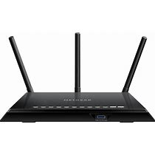

Network Address Translation, Firewalls, Routers, WifI…
Internet ISPs and backbone
192.168.0.3 port 7653
3752.412.88.16 port 211
WiFi + NAT box + firewall
154.771.21.71 port 73151
NAT box + firewall
Fortnight Server
192.168.364.778 port 921
Amazon AWS Cloud (Data Center)

Slide 17
Network Address Translation, Firewalls, Routers, WifI…
Internet ISPs and backbone
192.168.0.3 port 7653
3752.412.88.16 port 211
WiFi + NAT box + firewall
Routes picked to be
economical, not necessarily
fast or short!
154.771.21.71 port 73151
NAT box + firewall
Fortnight Server
192.168.364.778 port 921
Amazon AWS Cloud (Data Center)

Slide 18
Network Address Translation, Firewalls, Routers, WifI…
Internet ISPs and backbone
192.168.0.3 port 7653
3752.412.88.16 port 211
WiFi + NAT box + firewall
Could use a
different route
for traffic
in return direction
154.771.21.71 port 73151
NAT box + firewall
Fortnight Server
192.168.364.778 port 921
Amazon AWS Cloud (Data Center)

Slide 19
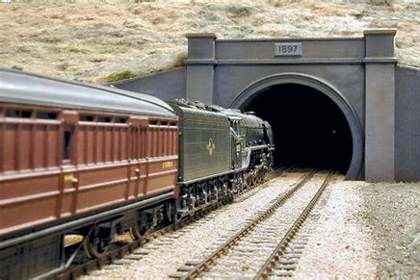
Tunnels
Trainload of IP packets enters a tunnel….
Sometimes it is convenient to send data through some domain without that domain “seeing” the packet headers.
A tunnel is used in such cases. A connection is made, but then packets are sent through it as “pure data”.
On the far side, they exit the tunnel and get routed “normally”

Slide 20
A crazy patchwork! But it works…
Internet routers are fast and speed of light is quite fast too.
… Should you care that your data went via Delaware?
… For the ISP, this route could be cheaper to operate, or use faster
links and routers. The physically shortest path may be slower!
At each stage, a packet is routed to whatever router is next in the route for the particular IP address is happens to carry at that stage.

Slide 21
Mistakes do happen, but rarely
Internet routers use “routing tables” that tell them where to send packets. They adapt to route around outages.
Sometimes, mistakes can happen, but this is rare.
Goal of routing: Pick the most cost-effective, reliable, highest performing path available.

Slide 22
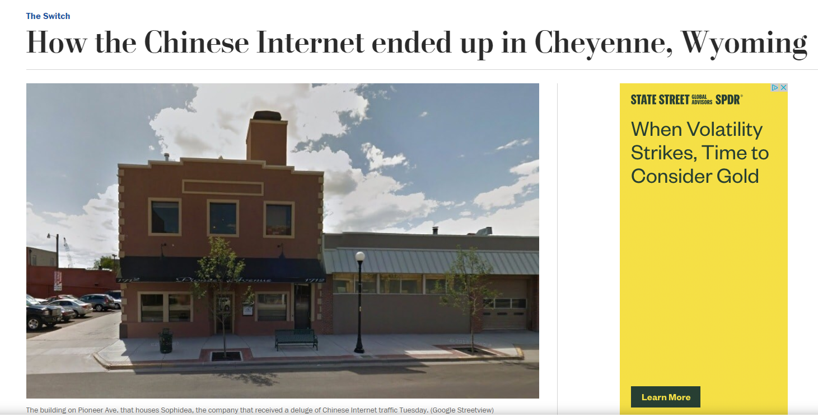
Mistakes do happen, but rarely
An ISP operator (somewhere very remote from China) accidentally miscoded one digit of a “fixed” route.
This disrupted global routing.
Traffic intended for a centralized router in Shenzhen was “redirected” to a small cafe in Wyoming, near Yellowstone Park…
… all the traffic, for much of China

Slide 23
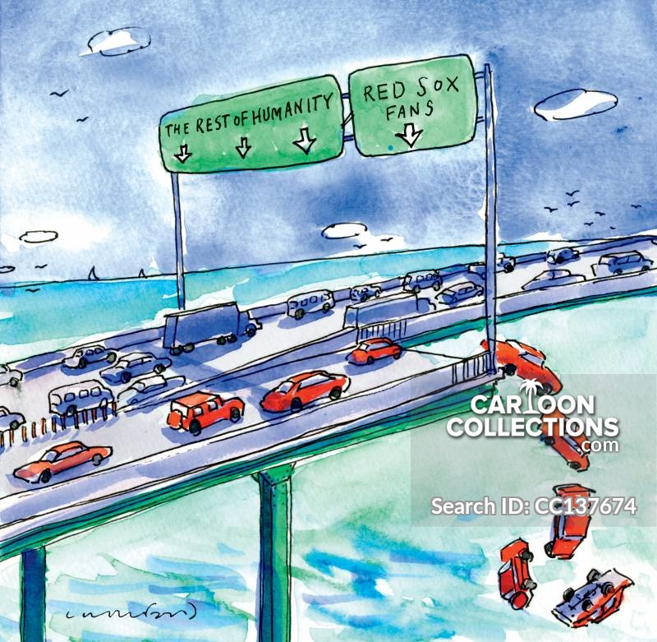
What did the cafE do with china’s Internet traffic?
Overload traffic
Regular traffic
They were “dropped” (discarded, silently)
In fact, this is a feature of the Internet!
The Internet works like a network of highways and bridges, but a bridge can just toss cars off if a traffic jam ever forms!

Slide 24
Why drop packets? End-to-End principle
In the early days of the Internet a debate arose: should the Internet be reliable, or is it ok to drop packets?
The “end to end” principle was this: The Internet itself doesn’t need to be reliable, as long as it is blindingly fast and mostly reliable. This ultimately “won” over other options.
In fact, failures are rare. But overload is common.

Slide 25
TCP Streams Embody the end-to-End rule
Like a pipe, TCP sends a stream of bytes from A to B, with no losses or corruption or out-of-order data.
TCP has two “end points”. The “end to end” principle makes these endpoints responsible for reliability and security.
TCP uses a protocol to achieve them: A scripted exchange of messages with a format that TCP imposes.

Slide 26
Data lives inside these TCP packets
TCP has a header of its own, with information used by the end-to-end protocol operated by the TCP module in the Linux kernel.
The message you send is chopped into segments and carried as data within these TCP packets.
On arrival, TCP will deliver the data, but you won’t see the TCP headers: it removes them in the kernel protocol stack.

Slide 27

TCP starts with a special three-way handshake
TCP has some very basic security built in: the initial connection involves a “three way handshake”
Hello B. I am A, trying to connect to you. [SEQ=1234]
A, I would love to connect. [SEQ=9876]
B, this is A again. Success! [SEQ=1234,9876]
SSL is a standard for creating stronger security on TCP connections. It additionally establishes a session “key” used to encrypt all data.

Slide 28
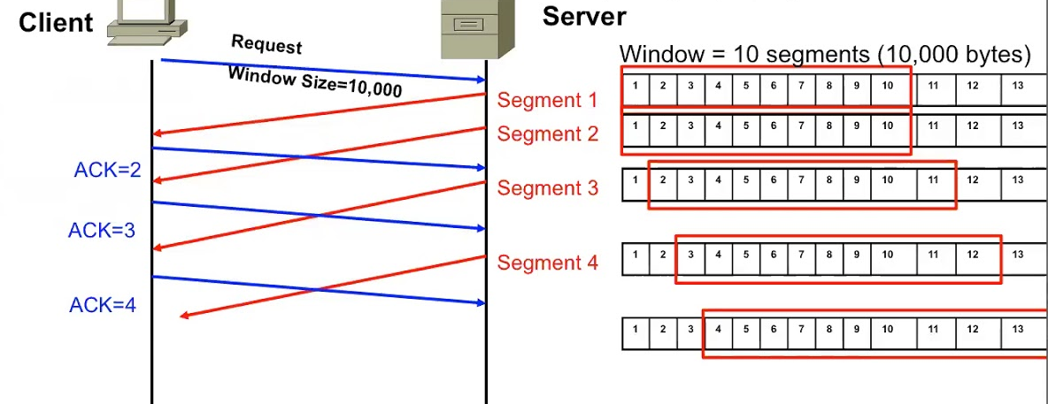
TCP sliding window:
Used after handshake
Mile high summary:
When TCP sends data, the sender numbers the packets. The receiver acknowledges receipt (“ack”) or if it notices a gap, asks for a retranmission (“nack”).
This is done using a form of bounded buffer: the sliding window.
The TCP sliding window. Animation available here

Slide 29
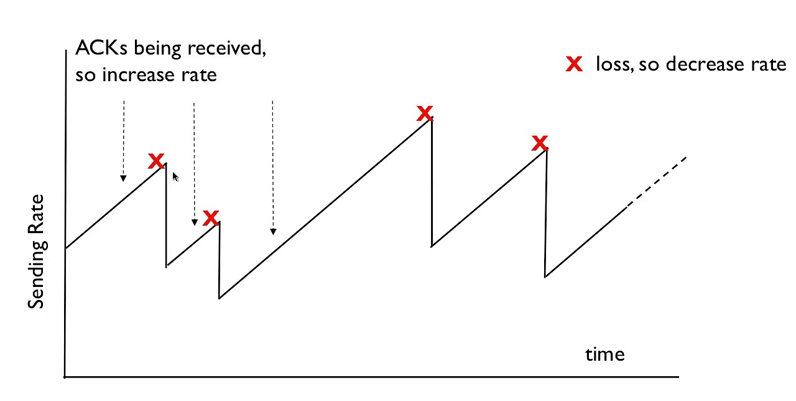
TCP also does rate control
TCP has a scheme for varying the transmission rate to match the speed of the connection.
TCP steadily speeds up until packet drops occur: some router got overloaded. Then it slows down drastically… then speeds up.
Called an additive increase, multiplicative decrease scheme.

Slide 30
Limitations
NAT box + firewall
All systems have firewalls of various kinds, and some also have additional features (such as “network address translation”, and “VPN tunneling”).
Those are programmed to block unwanted Internet traffic.
For example, my wifi router gives computers in my home IP addreses like 192.168.0.11. These are not visible outside my home.

Slide 31
Asymmetric connectivity!
A process on my computer, in my home, can connect to Netflix.com or Amazon.com or Azure.com.
Once the session is established, messages can flow both ways: the wifi router opens a “tunnel” that allows them through.
Yet that same Azure.com server wouldn’t be able to initiate a connection to my computer: traffic would be blocked!

Slide 32
How do we make these connections?
Consider a client on my machine, perhaps a web browser.
The server is on some other machine, perhaps at Netflix.com
  In fact, Netflix.com is hosted by Amazon (rents machines on their cloud)
  So if you talk to a Netflix.com server, your TCP connection will actually
  be to a machine in an Amazon AWS data center.
  This is an aspect of modern cloud computing: “rent don’t own”.

Slide 33
Socket operations: Server
int sockfd = socket(AF_INET, SOCK_STREAM, 0);
// logic to initialize serv_addr struct not shown!
bind(sockfd, (struct sockaddr *) &serv_addr, sizeof(serv_addr));
listen(sockfd, 5);
int connfd = accept(sockfd);
int bytesread = receive(connfd, buffer, nbytes);
send(connfd, buffer, nbytes);

Slide 34
Socket operations: Server
Create a connection endpoint. This will be used for a TCP connection, but more initialization is required.
int sockfd = socket(AF_INET, SOCK_STREAM, 0);
// logic to initialize serv_addr struct not shown!
bind(sockfd, (struct sockaddr *) &serv_addr, sizeof(serv_addr));
listen(sockfd, 5);
int connfd = accept(sockfd);
int bytesread = receive(connfd, buffer, nbytes);
send(connfd, buffer, nbytes);

Slide 35
Socket operations: Server
Associate an IP address and port number with it. These come from “gethostbyname”
int sockfd = socket(AF_INET, SOCK_STREAM, 0);
// logic to initialize serv_addr struct not shown!
bind(sockfd, (struct sockaddr *) &serv_addr, sizeof(serv_addr));
listen(sockfd, 5);
int connfd = accept(sockfd);
int bytesread = receive(connfd, buffer, nbytes);
send(connfd, buffer, nbytes);

Slide 36
Socket operations: Server
int sockfd = socket(AF_INET, SOCK_STREAM, 0);
// logic to initialize serv_addr struct not shown!
bind(sockfd, (struct sockaddr *) &serv_addr, sizeof(serv_addr));
listen(sockfd, 5);
connfd = accept(sockfd);
int bytesread = receive(connfd, buffer, nbytes);
send(connfd, buffer, nbytes);
Tell Linux this server will accept up to five simultaneous client connections via the TCP protocol.

Slide 37
Socket operations: server
int sockfd = socket(AF_INET, SOCK_STREAM, 0);
// logic to initialize serv_addr struct not shown!
bind(sockfd, (struct sockaddr *) &serv_addr, sizeof(serv_addr));
listen(sockfd, 5);
int connfd = accept(sockfd);
int bytesread = receive(connfd, buffer, nbytes);
send(connfd, buffer, nbytes);
Accept returns the file descriptor of an established connection, and now the server can read bytes from it

Slide 38
Socket operations: server
int sockfd = socket(AF_INET, SOCK_STREAM, 0);
// logic to initialize serv_addr struct not shown!
bind(sockfd, (struct sockaddr *) &serv_addr, sizeof(serv_addr));
listen(sockfd, 5);
int connfd = accept(sockfd);
int bytesread = receive(connfd, buffer, nbytes);
send(connfd, buffer, nbytes);
Read some bytes

Slide 39
Socket operations: server
int sockfd = socket(AF_INET, SOCK_STREAM, 0);
// logic to initialize serv_addr struct not shown!
bind(sockfd, (struct sockaddr *) &serv_addr, sizeof(serv_addr));
listen(sockfd, 5);
int connfd = accept(sockfd);
int bytesread = receive(connfd, buffer, nbytes);
send(connfd, buffer, nbytes);
Write some bytes

Slide 40
Socket operations: client
int sockfd = socket(AF_INET, SOCK_STREAM, 0);
… client does not need “bind” or “listen” or “accept”!
int connfd = connect(sockfd, (struct sockaddr *) &serv_addr,
sizeof(serv_addr));
send(connfd, buffer, nbytes);
int bytesread = receive(connfd, buffer, nbytes);

Slide 41
How did the client get the server’s IP address?
It uses gethostbyname, then has to fill in the address struct.
It gets its own IP address by calling gethostbyname on localhost.
  The server’s port number is from a table of standard port numbers.
  Linux can also assign a port number. Your server can use this, then
  check the address and port number it received, then publish it in a file
  or on a web page for the client to find.

Slide 42
OK… A is now connected to B!
A TCP stream is just a stream of bytes.
To make a request with arguments:
A builds a header identifying the requested operation and serializes
the arguments into a byte array.
B reads the header first, allowing it to learn how much data to read.
The request-id will be used later to pair the result with a waiting thread.

Slide 43
Google GRPC: A popular packaging of these mechanisms
A library that can be used from C++, Java, Python, etc. Runs over TCP.
Fairly easy to use, but we won’t get into the details in CS4414.
GRPC allows a server to associate an object with a connection.
The client can call methods in a type-checked way.

Slide 44
GRPC Overheads?
GRPC has a fast serialization method, much better than CORBA (from Lecture 18). When using a secure TCP session (with SSL), there is a small extra encryption/decryption delay.
Network delays are the main cost:
  From Ken’s lake cottage in Trumansburg to Cornell: 1.5ms (routed via Syracuse).
  Between two machines in a data center, they are as low as 50-100us.
  On the public Internet, bandwidth of 10MB is excellent.
  But inside a data center, rates can reach 10 GB: 1000x faster!.

Slide 45
GRPC Example: Hello World
// The greeting service definition is used by both the
// Client and the server. It contains virtual methods
service Greeter {
// Sends a greeting
rpc SayHello (HelloRequest) returns (HelloReply) {}
}
// The request message containing the user's name.
message HelloRequest {
string name = 1;
}
// The response message containing the greetings
message HelloReply {
string message = 1;
}
class GreeterServiceImpl final : public Greeter::Service {
Status SayHello(ServerContext* context, const HelloRequest*
request, HelloReply* reply) override {
std::string prefix("Hello to my favorite client!");
reply->set_message(prefix + request->name());
return Status::OK;
}
};

Slide 46
Note about this example
What I showed you is incomplete!
GRPC requires a specific installation (it isn’t hard).
Compiling a client or server also requires various include files, and a special “initialization” must be called from main.

Slide 47
would a web browser use GRPC?
The web has its own encoding for messages.
This HTML encoding is less efficient than the one GRPC uses. It works well and is universal but is slow to compute and “bulky”.
  Every message is encoded as a web page, and every reply
  Data is printed in ascii text format.
  Uses layers of standards: SOAP on HTML on XML… SSL would add
  a layer of encryption to this.

Slide 48
… so
You launch your web browser and type in Netflix.com
The first step is to look up the IP address for Netflix.com. This is done by calling gethostbyname, which uses the DNS service.
You get an IP address for Netflix.com (in fact, the IP address of a nearby AWS data center: Netflix is hosted by Amazon).

Slide 49
Next steps
Your browser initiates an http connection (insecure: https uses SSL, but http isn’t encrypted in any way).
AWS selects some machine within the Amazon cloud with the Netflix web server process already running on it.
A three-way handshake is performed.

Slide 50

Next steps
Your Netflix Cookie!
Your web browser first sends Netflix a “cookie” with your user information. It uses the old web services model, so the cookie is actually encoded as a small web page.
Next Netflix sends back an initial welcome web page. The browser reads this back as a byte stream, deserializes it, and renders the page on your screen.

Slide 51


You select a movie…
Babylon Berlin…
a good choice!
Netflix recommends Babylon Berlin.
You click the tile… it is associated with a URL link to the movie.
The browser sends an HTTP request to Netflix to “open” the URL. Netflix streams the movie back.

Slide 52
Would the browser be faster on GRPC?
HTML is not a suitable encoding for a photo or video!
But it has built-in special features for sending photos and videos. The browser makes an extra TCP connection, and the server streams the data in the format the client’s browser requests.
The server even resizes the images for the client’s browser size.

Slide 53
Other options
Client and server sound like A and B are very different kinds of programs, but in fact any GRPC process can play both roles.
So we can build applications in which there are multiple processes that cooperate in various ways, using message passing to share information.
As an example, A and B could “replicate” some kind of data captured from the real world by A: A would relay it to B.

Slide 54
Why replicate?
Fault tolerance: in a cloud-scale system, we may see crashes.
Performance: A and B could share the work for some task.
Netflix serves popular movies from many servers.
Coordination: A might have some role, such as “be an air traffic controller for flight Delta 121” and B could track the actions in order to be smarter about ATC for other flights.

Slide 55
Other communication options
Some systems use a “message bus” or “message queue”. We saw one in the ATC example in Lecture 18.
These use a publish-subscribe model.
  We define a set of topics, and programs can subscribe to them.
  If a publisher publishes to some topic, upcalls occur in subscribers.

Slide 56
these work even in a single machine!
You don’t need two computers to create a GRPC or message bus application.
The tools work in an identical way on one computer (if the firewall is configured to allow it)
This is popular because it makes it so much easier to develop applications, and to port them from place to place.

Slide 57
Network security
We touched upon TCP security via SSL: a special version of a handshake that assigns a cryptographic key to each session.
HTTPS uses SSL automatically.
But what other forms of security are available?

Slide 58
VPN and VPC
Many of us have access to special computers at Cornell.
These aren’t available for public use, so they live inside cs.cornell.edu and aren’t even visible from outside Cornell.
With a “virtual private network” you can step inside the Cornell firewall from home, as if you were in Gates Hall!

Slide 59
How a VPN works.
Cornell operates a special VPN router. You need your netid to log into it. They use a product called Cisco AnyConnect.
Once you log in, a TTP SSL connection will exist from your machine to the VPN router.
IP addresses in the Cornell domain, or DNS requests, are automatically sent over this encrypted link.

Slide 60
Virtually private cloud
VPC is similar in concept, for people who use cloud computing.
Suppose your organization uses 10 machines on Azure or AWS.
Those 10 can be isolated from other cloud users: a VPC creates the illusion of a network composed purely of your machines, plus services the cloud operator provides (like the global file system)

Slide 61
With VPC, all traffic is encrypted
This way even if some intruder is watching the network, and even if your own applications use GRPC without SSL enabled, your messages are still encrypted.
It happens automatically. AWS and Azure both have special hardware accelerators to do the encryption and decryption.
In fact, with VPC they even encrypt files, using the same technique!

Slide 62
Summary of Lecture 19
When applications will run on multiple machines, we use networking to link the processes.
This occurs over TCP, often with SSL encryption. Encryption is not the default but is very common.
Google GRPC is one common library for building networked applications with a C++ object-oriented style of code.

