Slide 1
TreeDisk and Testing
CS 4411
Spring 2020

Slide 2
Announcements
Last lecture
P5 due May 8th
Office hours continue until May 8th (including in this time slot)

Slide 3
Outline for Today
TreeDisk design
TraceDisk and Traces
Using TraceDisk to test and debug

Slide 4
Recall: EGOS Filesystem Design
Block File Server uses one Virtual Block Store per file
Disks like TreeDisk and FatDisk provide VBSes
BFS
Metadata
File 1
File 2
…
File n
TreeDisk
inode 0: 4 blocks
inode 1: 2500 blocks
inode 2: 125 blocks
…
inode n: 856 blocks
ClockDisk
inode 0: 39062500 blocks
ProtDisk
inode 0: 39062500 blocks

Slide 5
TreeDisk Overview
Every VBS (file) is a tree of blocks
Data only stored at leaves
Indirect blocks store pointers to children (block numbers)
Inode points to root
Inode
root
Indirect blocks
Children
Children
Children
Data 0
Data 1
Data 2
Data 3
Data blocks

Slide 6
More Details
Branching factor: number of block_nos that fit in a block
Empty blocks: use block number 0
If size = 1, no indirect blocks: root points to single block
Inode
size = 16
root
Indirect blocks
0
0
0
0
0
0
0
Data 0
Data 1
Data 6
Data 7
Data 12
Data 15
Data blocks
Notes:
Block 0 is the superblock, so it’s never part of a file

Slide 7
Tree Blocks on Disk
Indirect block layer 1
Indirect block layer 2
Inode 1, size = 1
Inode 32, size = 16
Data 0
Data 0
Data 1
Data 6
Data 7
Data 12
Data 15
Superblock
Inode Blocks
Indirect and Data Blocks

Slide 8
The Free List
head
Linked list of “indirect blocks”
Superblock stores head
Used as a stack: take & add free blocks from head
Initially all data blocks are on free list
26
21
0
27
22
17
28
23
18
29
24
19
30
25
20

Slide 9
TreeDisk Read
Get root indirect block by reading inode
Search down tree to find block with specified index
Since data blocks are always “sorted,” a simple n-ary search
0
1
2
3
4
7
8
9
10
12
13
14

Slide 10
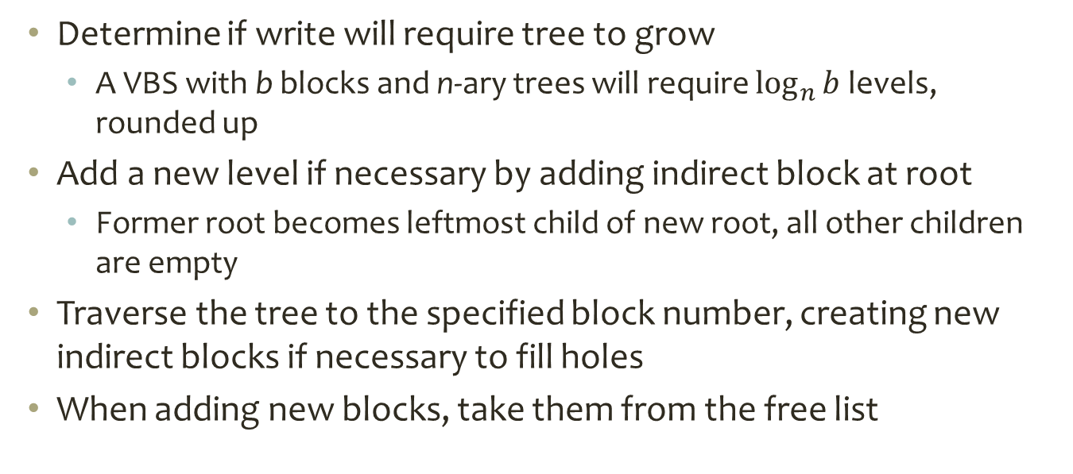
TreeDisk Write
Determine if write will require tree to grow
A VBS with b blocks and n-ary trees will require $\log_{n}{b}$ levels, rounded up
Add a new level if necessary by adding indirect block at root
Former root becomes leftmost child of new root, all other children are empty
Traverse the tree to the specified block number, creating new indirect blocks if necessary to fill holes
When adding new blocks, take them from the free list

Slide 11
TreeDisk Create
Compute number of inode blocks for # of inodes
Initialize superblock and inode blocks
Put all data blocks on free list
Freelist block 1
Freelist block 0
Blocks “owned” by freelist block 0
Blocks “owned” by freelist block 1
Superblock
Inode Blocks
Indirect and Data Blocks

Slide 12
Outline
TreeDisk design
TraceDisk and Traces
Using TraceDisk to test and debug

Slide 13
Testing a Block Store
How do you know if a block store works?
Throw the whole OS at it and see if it boots?
Block store API:
read(ino, offset)
write(ino, offset)
getsize(ino)
setsize(ino, size)
sync(ino)
What if we could test these operations individually?

Slide 14
TraceDisk: Scriptable Block Store
TraceDisk is top layer instead of BFS
Calls read, write, etc. operations on layer below based on script in an input file
Can run outside EGOS
Trace file
TraceDisk
read
write
read
read
write
inode 0
inode 1
inode 2
…
inode n
ClockDisk
ProtDisk

Slide 15
Trace File Format
command:inode:block:[data]
W – write integer value to the block
R – read the block, compare its data to the expected value
S – call setsize on the inode, setting it to the specified number of blocks
G – call getsize on the inode, compare the result to the expected number of blocks
F – call sync on the inode
W:1:0:666
W:2:0:999
W:2:1:3768
R:1:0:666
R:2:0:999
W:2:0:8765
W:2:1:1342
G:2:2
S:2:0
F:-1

Slide 16
The Trace Program
Basic idea: Set up layered block storage with TraceDisk as top layer and RamDisk as bottom layer, run test, exit
Can put any other block stores between these
Trace main
Trace file
TraceDisk
read
write
read
read
write
inode 0
inode 1
inode 2
…
inode n
Block store being tested
RamDisk
Memory in trace.c

Slide 17
Other Helpful Block Stores
CheckDisk: Saves a copy of every block written
On read, compares result of below->read to cached copy of block
struct block_list {
struct block_list *next;
unsigned int ino;
block_no offset;
block_t block;
};
//in checkdisk_read…
(*cs->below->read)(cs->below, ino, offset, block)
struct block_list *bl;
for (bl = cs->bl; bl != 0; bl = bl->next) {
if (bl->ino == ino && bl->offset == offset) {
if (memcmp(&bl->block, block, BLOCK_SIZE) != 0) {
fprintf(stderr, "!!CHKDISK %s: checkdisk_read: corrupted\n\r", cs->descr);
exit(1);
}
return 0;
}
}
struct checkdisk_state {
block_store_t *below;
const char *descr;
struct block_list *bl;
};

Slide 18
Other Helpful Block Stores
Raid1Disk: mirrors operations onto two lower disks – run same trace on two block stores in parallel
Compare filesystems, or with/without cache
write(6,1,block)
Raid1Disk
Raid1Disk
TreeDisk
write(6,1,block)
write(6,1,block)
TreeDisk
TreeDisk
FatDisk
ClockDisk
reads and writes
RamDisk 1
RamDisk 2
RamDisk 1
RamDisk 2

Slide 19
Other Helpful Block Stores
PartDisk: Adds partitions to a disk
Splits up a single-inode block store (e.g. RamDisk, ProtDisk) into several fixed-size inodes
Raid1Disk
TreeDisk
FatDisk
PartDisk inode 0
PartDisk inode 1
RamDisk

Slide 20
Trace Configurations
“raid1”: No filesystem, just 1 disk with cache and another disk without
MapDisk: remaps inode 0 (in incoming commands) to inode x (on blockstore below)
TraceDisk
Raid1Disk
CheckDisk
MapDisk
ClockDisk
PartDisk inode 0
PartDisk inode 1
RamDisk

Slide 21
Trace Configurations
“raid1+tree+cache”: 2 copies of TreeDisk, 1 with cache, 1 without
Now that TreeDisk can use an inode other than 0, could get rid of MapDisk here
TraceDisk
Raid1Disk
TreeDisk 0
TreeDisk 1
CheckDisk
MapDisk
ClockDisk
PartDisk inode 0
PartDisk inode 1
RamDisk

Slide 22
Trace Configurations
“raid1+cache+tree”: almost the same, except cache goes above TreeDisk
This is why cache can’t make assumptions about what’s above/below
TraceDisk
Raid1Disk
CheckDisk
TreeDisk 1
ClockDisk
MapDisk
TreeDisk 0
PartDisk inode 0
PartDisk inode 1
RamDisk

Slide 23
Outline
TreeDisk design
TraceDisk and Traces
Using TraceDisk to test and debug

Slide 24
Building and Running Trace
Make directory test/cache_test/ parallel to src/
Put trace.c and tracedisk.c in test/cache_test/
Call make cache_test
Program trace will now be in your root directory
Run it: ./trace [-wt] config-string path/to/trace.txt

Slide 25
Testing Your FatDisk
Add fatdisk.c to the sources in src/make/Makefile.cache_test:
SRC = test/cache_test/tracedisk.c src/block/checkdisk.c src/block/clockdisk.c … src/block/fatdisk.c
Create a new “configuration” in trace.c that uses FatDisk, or edit an existing one to use FatDisk instead of TreeDisk:
if (fatdisk_create(xcdisk, 0, MAX_INODES) < 0) {
panic("trace: can't create fatdisk file system");
}
block_store_t *fdisk = fatdisk_init(xcdisk, 0);

Slide 26
Debugging with Trace
Trace is a “normal” C program, so you can debug it with GDB
Remember to comment out this line in trace.c: alarm(5)
This sets an alarm to interrupt the program if it gets “stuck,” but debugging will intentionally freeze the program
Set a breakpoint on fatdisk functions to stop when control reaches your “layer”

Slide 27
TraceDisk Demo

