Slide 1
Git and GitHub
CS 4411
Spring 2020

Slide 2
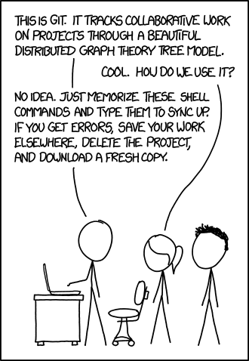
If that doesn’t fix it, git.txt contains the phone number of a friend of mine who understands git. Just wait through a few minutes of “It’s really pretty simple, just think of branches as...” and eventually you’ll learn the commands that will fix everything.

Slide 3
Outline for Today
Git overview
Git vs. GitHub
Basic Git commands
Conflicts and merges
Branches
Recovering from errors

Slide 4
Git Model
Remote repo
Commit C:
/src/grass/process.c
/src/grass/process.h
/src/apps/mt.c
Head
Commits
A
B
C
Origin
Repo contents
Local repo
Makefile
src
|---apps
|---earth
|---grass
| |---process.c
| |---process.h
|---lib
Head
“Working tree”
A
B
C

Slide 5
Making a Commit
Remote repo
Head
A
B
C
D
Origin
push
Local repo
Head
Commit D:
/src/apps/mt.c
/src/apps/myprogram.c
/src/make/Makefile.apps
A
B
C
D

Slide 6
Git with GitHub
GitHub repo: etremel/egos
GitHub repo: jsmith/egos
Head
Head
Fork
A
B
C
D
A
B
C
E
Origin
Origin
Local repo
Local repo
Head
Head
A
B
C
D
A
B
C
E
Notes:
GitHub is just one possible “remote” for your repository
GitHub introduces a new operation: Fork

Slide 7
Outline
Git overview
Git vs. GitHub
Basic Git commands
Conflicts and merges
Branches
Recovering from errors

Slide 8
Getting Started with Clone
git clone: Create a new local repository by copying a remote repo
Result: New folder named “ejt64-egos” in current directory, containing new git repo
Contents identical to repo on server
Origin set to https://github.coecis.cornell.edu/cs4411-2020sp/ejt64-egos.git
$ git clone https://github.coecis.cornell.edu/cs4411-2020sp/ejt64-egos.git
Protocol
Server
Path to repository on server

Slide 9
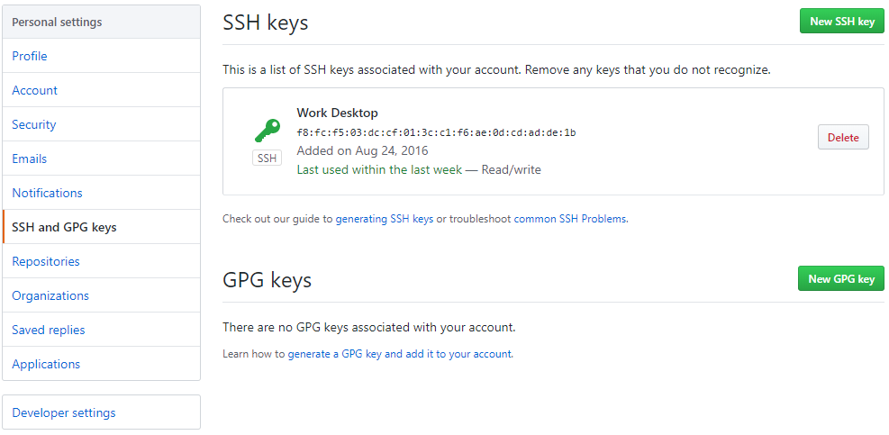
HTTPS or SSH?
Easy to start, no setup required
Must enter username and password every time you pull or push
Once set up, no username or password required
Need to create an SSH key on your computer and add it to your Cornell GitHub account
$ git clone https://github.coecis.cornell.edu/cs4411-2020sp/ejt64-egos.git
$ git clone git@github.coecis.cornell.edu:cs4411-2020sp/ejt64-egos.git

Slide 10
Add and Commit
Make changes to files
Choose some changed files that you’re ready to “publish”
git add the changed files
git commit and write a message
~/egos$ vim src/apps/mt.c
~/egos$ vim src/grass/process.c
~/egos$ git add src/apps/mt.c
~/egos$ git commit
Commit E:
/src/apps/mt.c

Slide 11
Pull and Push
At first, a commit is only on your local repo
git push copies commits to the “origin” remote repo
git pull downloads commits from origin and applies them
Origin repo
Head
A
B
C
D
Local repo
Partner’s repo
pull
Head
Head
push
A
B
C
D
A
B
C
D

Slide 12
Understanding Git Status
Current branch
~/egos$ git status
On branch master
Your branch is up to date with 'origin/master'
Changes to be committed:
(use "git reset HEAD <file>…" to unstage)
modified: src/grass/process.c
Changes not staged for commit:
(use "git add <file>…" to update what will be committed)
modified: src/grass/disksvr.c
Untracked files:
(use "git add <file>…" to include in what will be committed)
src/apps/myprogram.c
Whether you have unpushed commits
Changes you have added with git add
git knows a file has changed, but you haven’t added it yet
New files you have not yet added in any commit

Slide 13
Git Status After a Commit
~/egos$ git status
On branch master
Your branch is 1 commit behind 'origin/master'
Changes not staged for commit:
(use "git add <file>…" to update what will be committed)
modified: src/grass/process.c
Untracked files:
(use "git add <file>…" to include in what will be committed)
src/apps/tags
src/grass/tags
You made a commit, but haven’t pushed
After your last commit, you continued editing this file
These files still haven’t been added to any commit

Slide 14
Ignoring Files You’ll Never Add
Some files you never want to commit: ctags files, compiled output, LaTeX aux files…
Git will keep bothering you about them in git status
Add a file named .gitignore to the root of your repo, and then add it to a commit
~/egos$ cat .gitignore
# ctags files
tags
# LaTeX junk
*.aux
*.log
*.bbl
# The debug log directory
logs/
# Object files in the build dir
build/**/*.o
~/egos$
https://www.atlassian.com/git/tutorials/saving-changes/gitignore

Slide 15
Diff: What Am I Committing?
~/egos$ git diff
diff --git a/src/lib/queue.c b/src/lib/queue.c
index c638853..19106c3 100644
--- a/src/lib/queue.c
+++ b/src/lib/queue.c
@@ -19,7 +19,7 @@ struct element {
void queue_init(struct queue *q){
q->first = 0;
q->last = &q->first;
- q->nelts = 0;
+ q->num_elements = 0;
}
/* Put it on the wrong side of the queue. I.e., make it the next
@@ -34,7 +34,7 @@ void queue_insert(struct queue *q, void *item){
}
e->next = q->first;
q->first = e;
First file with changes
Line number skipped to
Deleted from original (last commit)
Added in current state of file
Skip ahead again to line 34

Slide 16
Diff Details
Shows differences only for that file
Why does it give no results? I know I made changes!
Answer: you have already git added your changes
~/egos$ git diff src/grass/process.c
~/egos$ git diff
~/egos$
~/egos$ git diff --staged
diff --git a/src/lib/queue.c b/src/lib/queue.c
index c638853..19106c3 100644
--- a/src/lib/queue.c
+++ b/src/lib/queue.c
@@ -19,7 +19,7 @@ struct element {

Slide 17
Un-Adding and Deleting
Oops, I didn’t mean to add that file!
Telling git you want to delete myprogram.c:
~/egos$ git add src/lib/queue.c
~/egos$ git reset HEAD src/lib/queue.c
~/egos$ git rm src/apps/myprogram.c
~/egos$ git status
On branch master
Your branch is up to date with 'origin/master'
Changes to be committed:
(use "git reset HEAD <file>…" to unstage)
deleted: src/apps/myprogram.c

Slide 18
Renaming
Telling git you want to rename myprogram.c:
Otherwise, git will think you deleted myprogram.c, and both myprogram.c and newname.c will end up in the repo
~/egos$ git mv src/apps/myprogram.c src/apps/newname.c
~/egos$ git status
On branch master
Your branch is up to date with 'origin/master'
Changes to be committed:
(use "git reset HEAD <file>…" to unstage)
renamed: src/apps/myprogram.c -> src/apps/newname.c

Slide 19
Outline
Git overview
Git vs. GitHub
Basic Git commands
Conflicts and merges
Branches
Recovering from errors

Slide 20
Concurrent Changes
GitHub repo
Head
A
B
C
D
push
My local repo
Partner’s local repo
Head
Head
A
B
C
D
A
B
C
E

Slide 21
Possible Outcomes
No conflicts, just merge
~/egos$ git pull
# Editor pops up
Merge made by the 'recursive' strategy
src/lib/queue.c | 14 +++++++-------
1 file changed, 7 insertions (+), 7 deletions (-)
Merge branch 'master' of https://github.coecis.cornell.edu/etremel/egos.git
# Please enter the commit message for your changes. Lines starting
# with '#' will be ignored, and an empty message aborts the commit
Partner’s local repo
D
Head
A
B
C
E
M

Slide 22
Possible Outcomes
Conflicting changes to the same file(s)
~/egos$ git pull
Auto-merging src/lib/queue.c
CONFLICT (content): Merge conflict in src/lib/queue.c
Automatic merge failed; fix conflicts and then commit the result
~/egos$ git status
On branch master
Your branch and 'origin/master' have diverged,
and have 1 and 1 different commits each, respectively.
…
Unmerged paths:
(use "git add <file>..." to mark resolution)
both modified: src/lib/queue.c

Slide 23
Conflict File Syntax
Inside queue.c:
void queue_add(struct queue *queue, void *item){
struct element *e = calloc(1, sizeof(*e));
e->item = item;
e->next = 0;
<<<<<<< HEAD
*queue->last = e;
queue->last = &e->next;
queue->nelts++;
=======
*q->last = e;
q->last = &e->next;
q->num_elements++;
>>>>>>> 354a72479204de581ffa83551843b92e585506b8
}
Merged lines with no conflicts
HEAD means these changes are in your local HEAD commit
Your local version of conflicting lines
Origin repo’s version of conflicting lines
Hash of commit from origin that contains these conflicting changes

Slide 24
Finishing the Merge
Edit the file to choose a single version of the conflicting lines
Make sure to delete the <<<<<<< and ======= lines!
When you have resolved the conflict:
~/egos$ git add src/lib/queue.c
~/egos$ git commit
# Write a message for the merge commit
~/egos$ git push

Slide 25
Outline
Git overview
Git vs. GitHub
Basic Git commands
Conflicts and merges
Branches
Recovering from errors

Slide 26
Git Branches
Track different sequences of commits diverging from common starting point
Make explicit what happened already when you & your partner made conflicting commits
Let you choose when to merge
new-
feature
D
E
A
B
C
J
K
master

Slide 27
Branch Basics
thread- develop
Creates a new branch, pointing to same commit as master
New commit goes on thread-develop, master still points to last commit
~/egos$ git checkout -b thread-develop
Switched to a new branch 'thread-develop'
A
B
C
master
~/egos$ git add src/apps/mt.c
~/egos$ git commit
thread- develop
D
A
B
C
master

Slide 28
Branch Basics
Changes your repo’s active branch to master – you’ll notice the changes you made to mt.c are gone
This commit goes on master, and the HEAD pointer for master moves up
~/egos$ git checkout master
Switched to branch 'master'
Your branch is up to date with 'origin/master'
thread- develop
D
~/egos$ git add src/grass/process.c
~/egos$ git commit
A
B
C
J
master

Slide 29
Pushing and Pulling
You want to push the commit on your new branch to GitHub:
OK, do what it says
After this point, git push will just work
~/egos$ git checkout thread-develop
Switched to branch 'thread-develop'
~/egos$ git push
fatal: The current branch thread-develop has no upstream branch.
To push the current branch and set the remote as upstream, use
git push --set-upstream origin thread-develop

Slide 30
Why Was That Necessary?
checkout -b only creates a branch on your local repo
GitHub repo won’t add a commit to a branch that doesn’t exist
GitHub repo
?
Push
“add this commit to thread-develop”
A
B
C
thread- develop
Local repo
master
D
Origin
A
B
C
J
master

Slide 31
Pushing and Pulling
You want to switch to a new branch your partner created
Why didn’t that work?
~/egos$ git checkout thread-develop
error: pathspec 'thread-develop' did not match any file(s) known to git
~/egos$ git pull
Remote: Enumerating objects
…
From github.coecis.cornell.edu:etremel/egos
* [new branch] thread-develop -> origin/thread-develop
Already up to date.
~/egos$ git checkout thread-develop
Branch 'thread-develop' set up to track remote branch 'thread-develop' from 'origin'
Switched to a new branch 'thread-develop'
Now the local repo knows about the branch

Slide 32
Merging Branches
Eventually, you’ll want to merge your branch back into master
First, switch your current branch to master
Then, merge the feature branch into master
new-
feature
D
E
A
B
C
J
K
M
~/egos$ git pull
~/egos$ git checkout master
master
Resolve any merge conflicts, same as when you pull and see conflicts
~/egos$ git merge new-feature
~/egos$ git push
Publish the merge commit, so everyone else can see the merge

Slide 33
Repository Design with Branches
In many software teams, master is the “stable” branch
Each new feature or bug fix is developed on its own branch
When tested and safe, branch is merged into master
While developing on a branch, merge from master into your branch to get updates and bugfixes
D
E
F
A
B
C
J
K
M
L

Slide 34
Outline
Git overview
Git vs. GitHub
Basic Git commands
Conflicts and merges
Branches
Recovering from errors

Slide 35
Some Useful Incantations
Oops! I made a commit but then made one small change
Oops! I want to edit the message on the commit I just made
Oops! I deleted a file and didn’t mean to
# Do this BEFORE you push
$ git add changed-file.c
$ git commit --amend --no-edit
$ git commit --amend
# Edit the message in your editor
$ git checkout path/to/file.c

Slide 36
Branch-Related Problems
I just made a commit to master, but I should have put it on a new branch instead
# Create a new branch with the same state as master
$ git branch new-branch-name
# Remove the latest commit from master
$ git reset HEAD~ --hard
# Switch to the new branch, which still has the commit
$ git checkout new-branch-name

Slide 37
Branch-Related Problems
I just committed to the wrong branch – I thought I was on the queue-develop branch but I’m on the experiments branch
# Undo the last commit, but leave files changed
$ git reset HEAD~ --soft
# Stash the changed files, then move to the right branch
$ git stash
$ git checkout queue-develop
$ git stash pop
# Commit the changes on the correct branch
$ git add queue.c queue.h
$ git commit

Slide 38
The Unnecessary Merge
Make changes, commit, push…then realize your repo is stale
Upon pull, you’re prompted to create a merge commit
$ git push
! [rejected] master -> master (fetch first)
error: failed to push some refs to 'https://github.com/etremel/egos.git'
hint: Updates were rejected because the remote contains work that you do
hint: not have locally. This is usually caused by another repository pushing
hint: to the same ref. You may want to first integrate the remote changes
hint: (e.g., 'git pull ...') before pushing again.
$ git pull
Merge branch 'master' of https://github.com/etremel/egos.git
# Please enter the commit message for your changes. Lines starting
# with '#' will be ignored, and an empty message aborts the commit

Slide 39
The Unnecessary Merge
If I had known to pull first, I wouldn’t have to merge!
First, ensure the merge aborts without making a merge commit
Either due to genuine conflict, or by deleting the merge commit message and saving (empty commit message aborts the commit)
Then:
$ git reset --hard
$ git reset HEAD^
$ git stash
$ git pull # no merge this time
$ git stash pop
$ git add foo.c bar.c # etc
$ git commit
Discard changes made by merge
Undo your last commit, leaving files changed
Stash your changes, then pull again
Re-do your commit on the new head

Slide 40
Further Reading
Atlassian Git Tutorials:
https://www.atlassian.com/git/tutorials
Detailed documentation on every command:
https://git-scm.com/docs
Happy Git with R’s “Useful Git Patterns:”
https://happygitwithr.com/workflows-intro.html
Oh Shit, Git!?! (source of my error-recovery examples):
https://ohshitgit.com/

