Slide 1
File System Implementation Issues
Ken Birman

Slide 2
File System Implementation
Change of topic…
How exactly are file systems implemented?
Comes down to: how do we represent
Volumes
Directories (link file names to file “structure”)
The list of blocks containing the data
Other information such as access control list or permissions, owner, time of access, etc?
And, can we be smart about layout?

Slide 3

Overall structure
User Process
User Process
User mode
File System Module (kernel)
Copy of superblock
File System Cache (“buffer”)
Inode cache
Disk Driver
Physical Storage Layer
I/O requests

Slide 4
Basic sequence
User application does a file operation
Perhaps, open, then seek, then read
O/S tries to satisfy requests using cached records
If needed data isn’t in the cache, posts an I/O request and makes the user process (actually: the kernel thread) wait
Upon completion, perform the request, copying data into or from the user’s space as needed
Then make user process runable again
With a cache hit, a file system operation might take 100us… if it misses, perhaps 10-50ms to a hard disk

Slide 5
Prefetch policy
Most kernels prefetch file blocks
Fetch first two blocks of data when file is opened
If user reads blocks i, i+1 then prefetch i+2
Goal?
Keep the disk a little ahead of the application
But don’t waste time doing unnecessary I/O

Slide 6
Write-behind policy
When user does a write, update the cache
Thus, cached version of file, inode and super block can be “more current” than the version actually on the disk
Periodically, like once every 60 seconds, “sync” the cache with the disk by writing out dirty entries
Also if file is closed or user explicitly calls fsync()
Crash?
O/S wants file system to make sense… but doesn’t care if some “unsynced” data was lost!
If an application does something sensitive, it calls fsync() before telling the human user the request is done

Slide 7
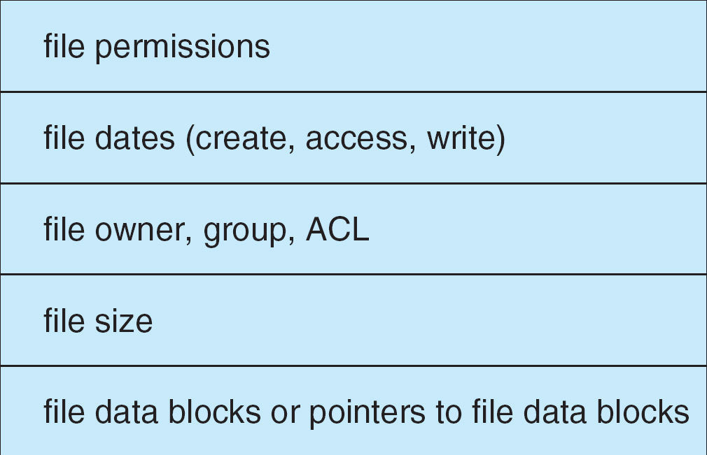
File Control Block
FCB has all the information about the file
Linux systems call these i-node structures

Slide 8
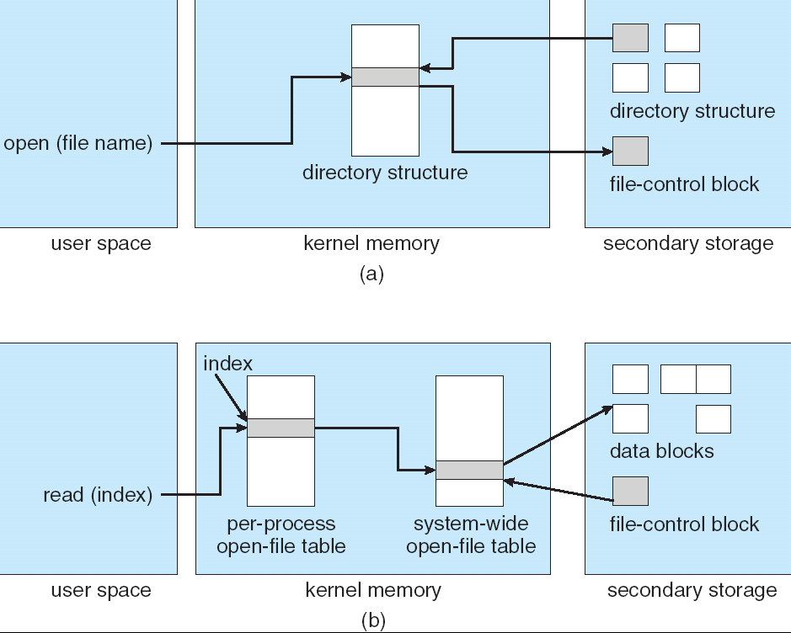
Files Open and Read

Slide 9
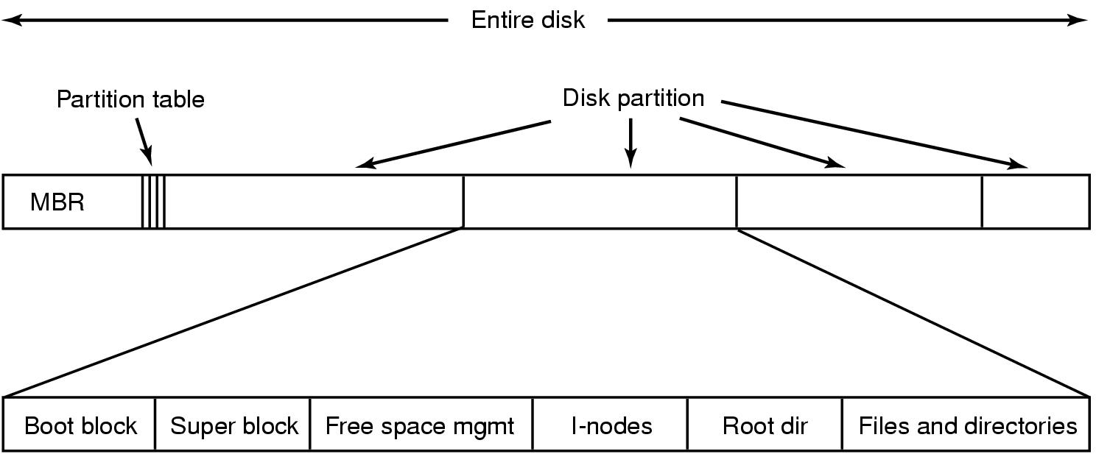
File System Layout
File System is stored on disks
Disk is divided into 1 or more partitions
Sector 0 of disk called Master Boot Record
End of MBR has partition table (start & end address of partitions)
First block of each partition has boot block
Loaded by MBR and executed on boot

Slide 10
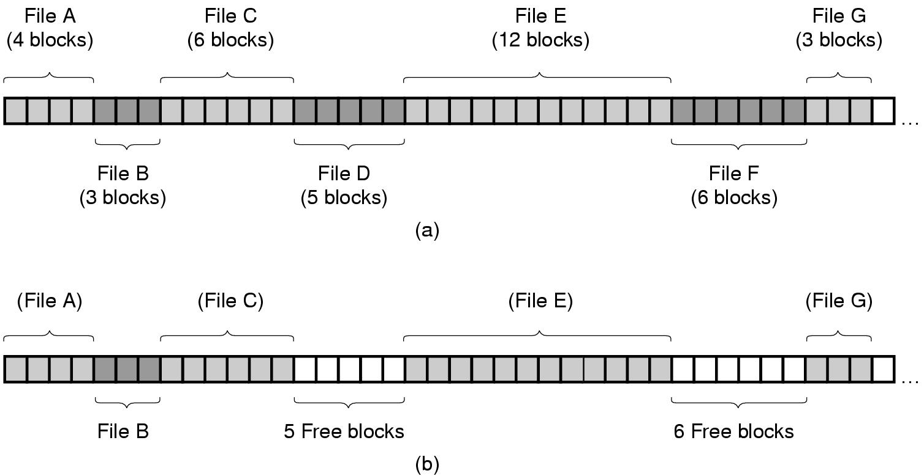
Implementing Files
Contiguous Allocation: allocate files contiguously on disk

Slide 11
Contiguous Allocation
Pros:
Simple: state required per file is start block and size
Performance: entire file can be read with one seek
Cons:
Fragmentation: external is bigger problem
Usability: user needs to know size of file
Used in CDROMs, DVDs

Slide 12
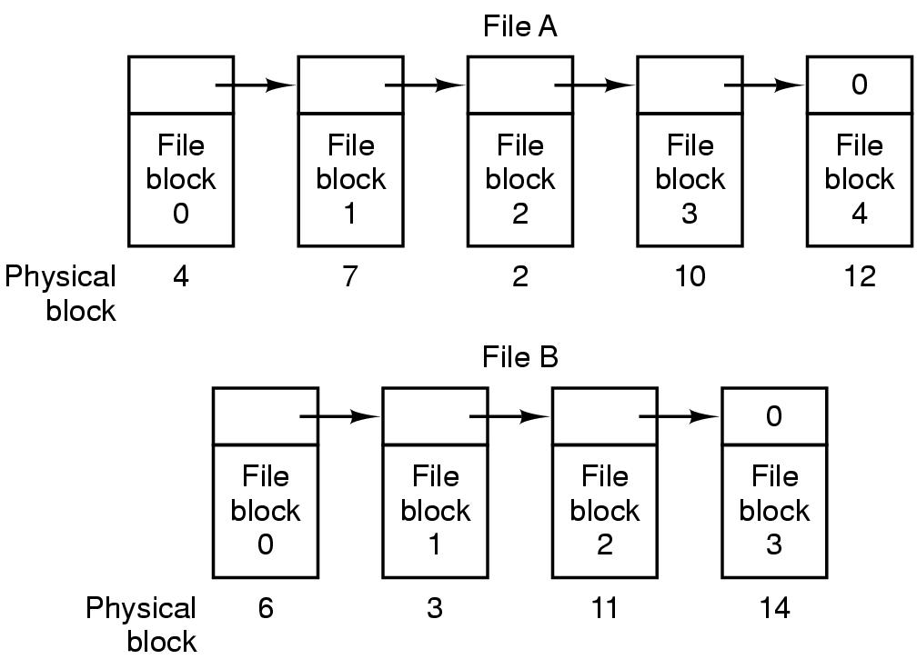
Linked List Allocation
Each file is stored as linked list of blocks
First word of each block points to next block
Rest of disk block is file data

Slide 13
Linked List Allocation
Pros:
No space lost to external fragmentation
Disk only needs to maintain first block of each file
Cons:
Random access is costly
Data stored in blocks is no longer a power of 2

Slide 14
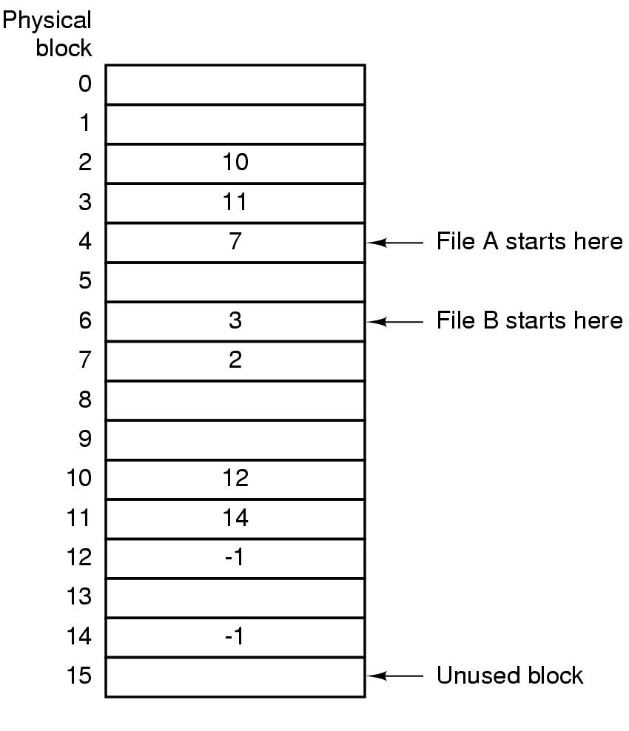
Using an in-memory table
Implement a linked list allocation using a table
Called File Allocation Table (FAT)
Take pointer away from blocks, store in this table

Slide 15
FAT Discussion
Pros:
Entire block is available for data
Random access is faster since entire FAT is in memory
Cons:
Entire FAT should be in memory
For 20 GB disk, 1 KB block size, FAT has 20 million entries
If 4 bytes used per entry ⇒ 80 MB of main memory required for FS

Slide 16
Linux: Three behaviors
Small files: All the blocks are listed in the inode, so once the O/S has the inode cached, it also can find the blocks
Medium sized files: the O/S can find the first few blocks. This gives it some breathing room to load the “indirection” block, which lists more file system blocks
Large files: Here, all the file system blocks are indirection blocks. So to find any block, the O/S needs to first read the inode, then an indirection block, then the real block

Slide 17
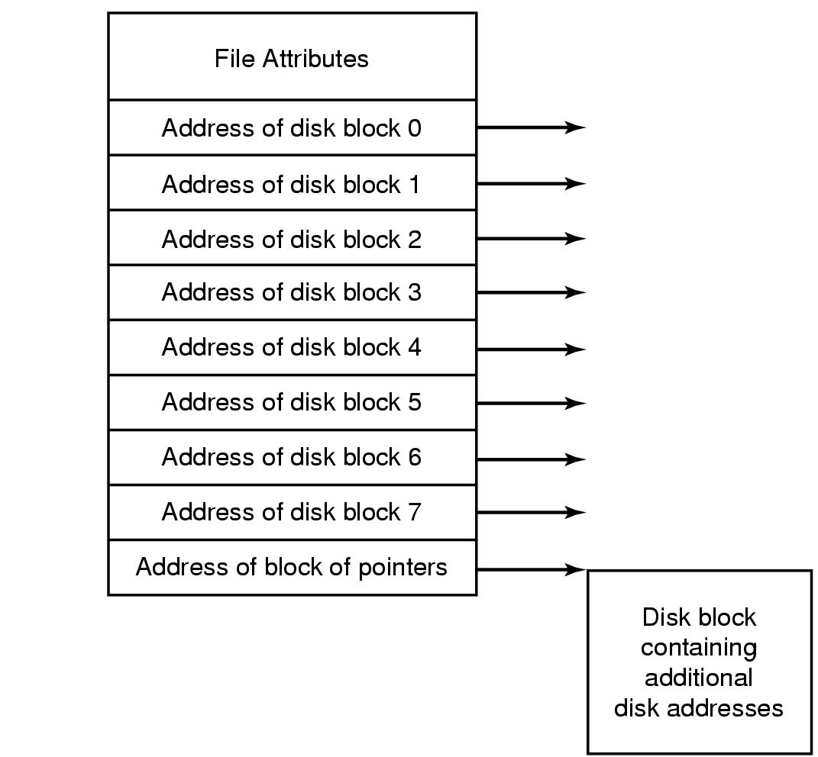
I-nodes (Linux)
Index-node (I-node) is a per-file data structure
Lists attributes and disk addresses of file’s blocks
Pros: Space (max open files * size per I-node)
Cons: what if file expands beyond I-node address space?

Slide 18
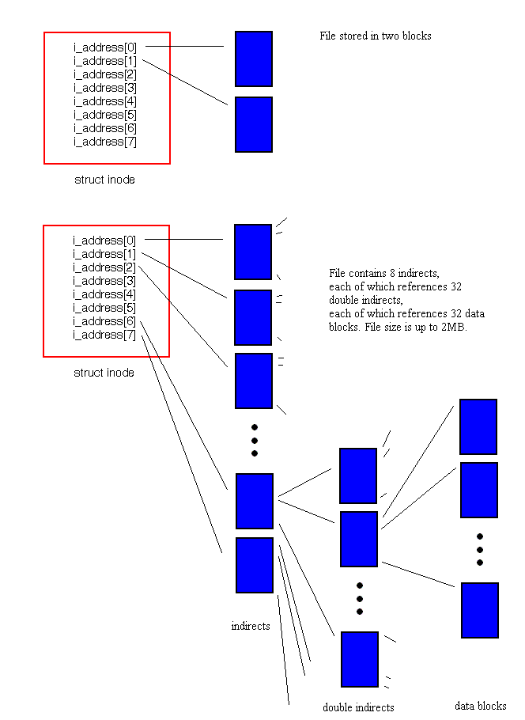
I-nodes (Linux)
Small file with two blocks
Large files: like a small file in which all the blocks are indirection blocks

Slide 19
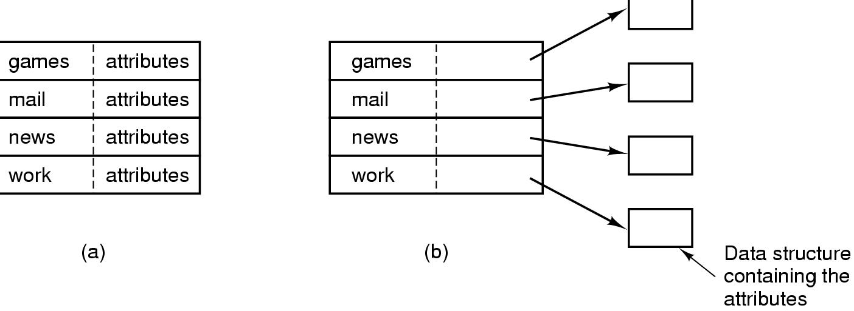
Implementing Directories
When a file is opened, OS uses path name to find dir
Directory has information about the file’s disk blocks
Whole file (contiguous), first block (linked-list) or I-node
Directory also has attributes of each file
Directory: map ASCII file name to file attributes & location
2 options: entries have all attributes, or point to file I-node

Slide 20
Implementing Directories
What if files have large, variable-length names?
Solution:
Limit file name length, say 255 chars, and use previous scheme
Pros: Simple Cons: wastes space
Directory entry comprises fixed and variable portion
Fixed part starts with entry size, followed by attributes
Variable part has the file name
Pros: saves space
Cons: holes on removal, page fault on file read, word boundaries
Directory entries are fixed in length, pointer to file name in heap
Pros: easy removal, no space wasted for word boundaries
Cons: manage heap, page faults on file names

Slide 21
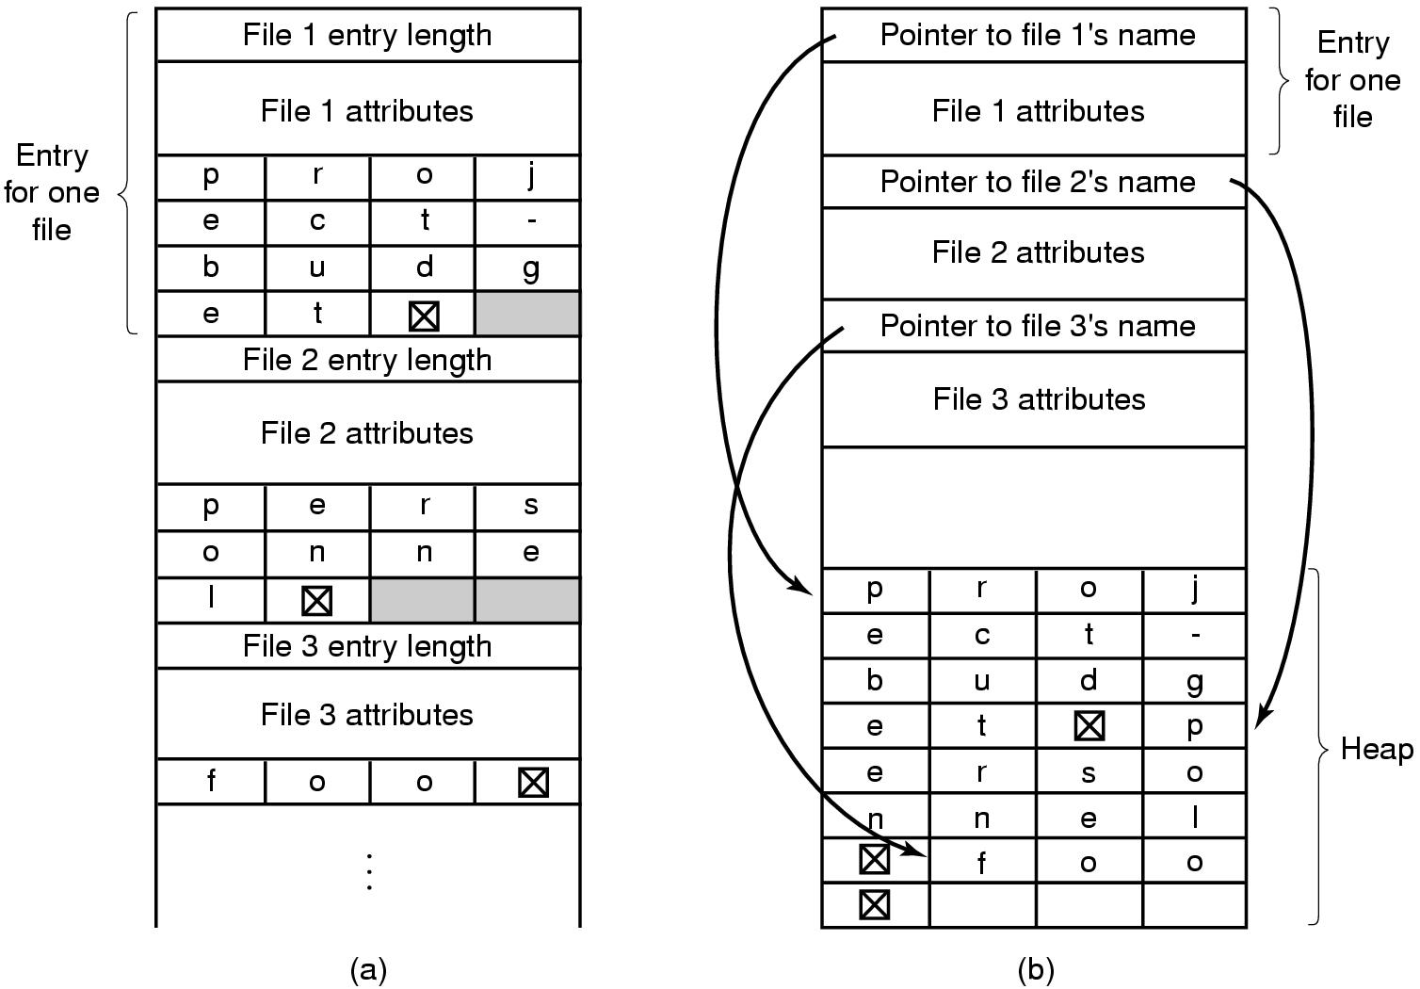
Managing file names: Example

Slide 22
Directory Search
Simple Linear search can be slow
Alternatives:
Use a per-directory hash table
Could use hash of file name to store entry for file
Pros: faster lookup
Cons: More complex management
Caching: cache the most recent searches
Look in cache before searching FS

Slide 23
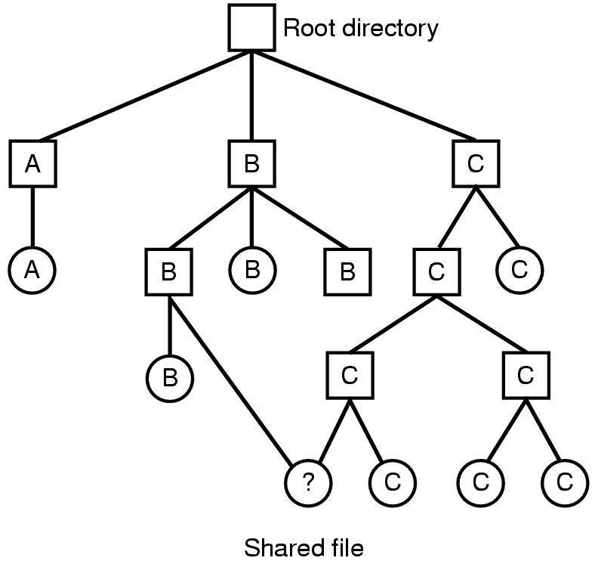
Shared Files
If B wants to share a file owned by C
One Solution: copy disk addresses in B’s directory entry
Problem: modification by one not reflected in other user’s view

Slide 24
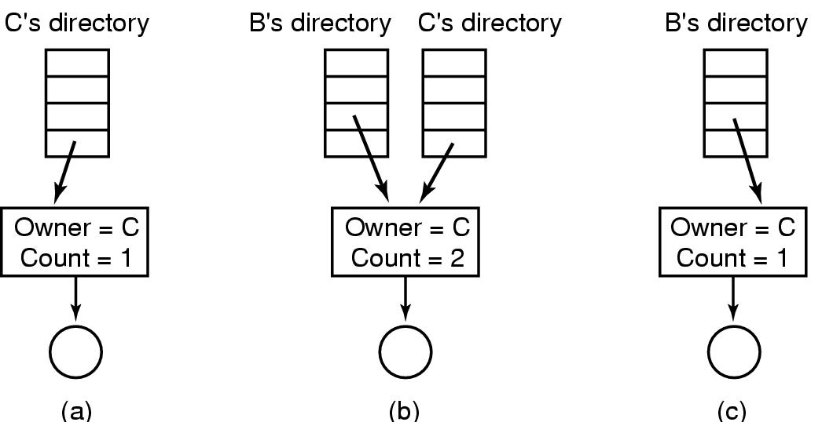
Sharing Files: Solutions
2 approaches:
Use i-nodes to store file information in directories
Cons: What happens if owner deletes file?
Symbolic links: B links to C’s file by creating a file in its directory
The new Link file contains path name of file being linked
Cons: read overhead

Slide 25
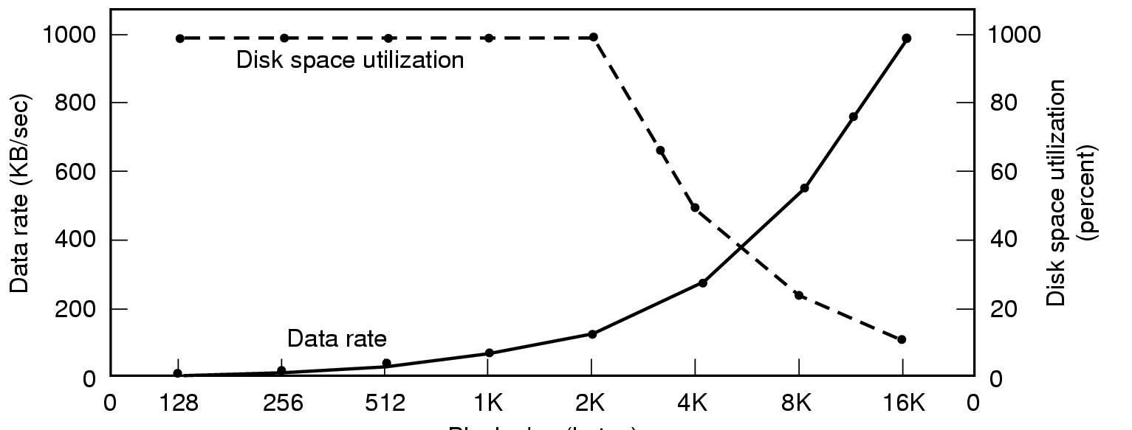
Disk Space Management
Files stored as fixed-size blocks
What is a good block size? (sector, track, cylinder?)
If 131,072 bytes/track, rotation time 8.33 ms, seek time 10 ms
To read k bytes block: 10+ 4.165 + (k/131072)*8.33 ms
Median file size: 2 KB
Block size

Slide 26
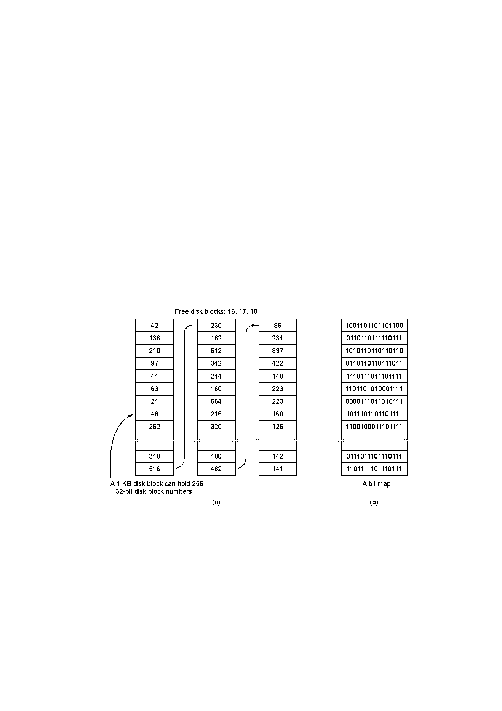
Managing Free Disk Space
2 approaches to keep track of free disk blocks
Linked list and bitmap approach

Slide 27
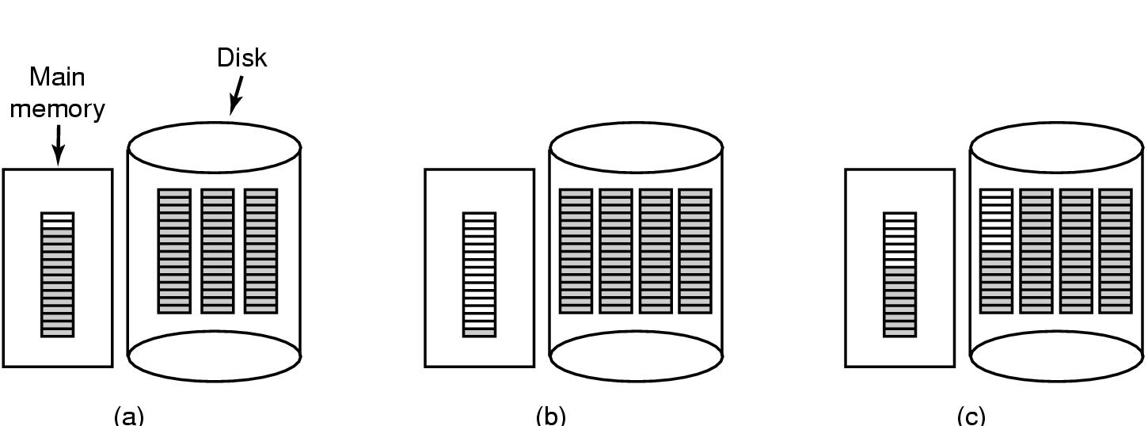
Tracking free space
Storing free blocks in a Linked List
Only one block need to be kept in memory
Bad scenario: Solution (c)
Storing bitmaps
Lesser storage in most cases
Allocated disk blocks are closer to each other

Slide 28
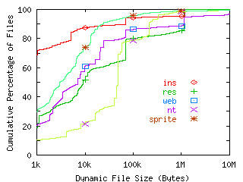
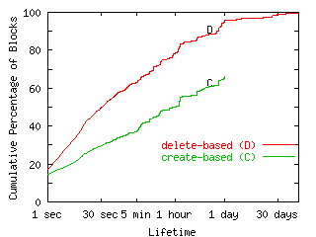
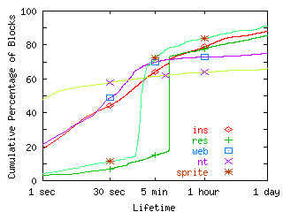
Measured file lifetimes, sizes
Source: “A Comparison of File System Workloads”, Drew Roselli, Jacob R. Lorch, and Thomas E. Anderson, 2000 USENIX Technical Conference
File Size Lifetime (byte) Lifetime (block)
(C): Block deleted-block created; (D): File deleted-File created

Slide 29
Observations?
Many files are quite small
So Linux idea was a good one…
Many files have fairly short lifetimes
So write-through cache policy can be a big win
With luck, file may be deleted before we ever write it to the disk at all!

Slide 30
Fancier issues
Optimizing disk head movement
It turns out that the cost of moving the disk arm (seek) is very high
Optimal way to read a list of blocks?
Put them in order
Seek to the outside rim of the disk
Then pick up blocks in “inward” order….
Many disk drivers reorder requests for this reason. Algorithm is called “C-Scan” because disk arm moves in a circular motion

Slide 31
Perils of C-Scan
Sorting the blocks before doing the I/O can cause some nasty surprises!
For example, suppose that John User
Creates a file “picture of Mom” (allocates inode, blocks..)
Crops the file: “Mom-cropped” ( “ “ “ )
Deletes “picture of Mom” (now some go back to free list)
Renames “Mom-cropped” as “picture of Mom” (updates dir.)
Sequence did MANY disk reads and writes!

Slide 32
Perils of C-Scan
Suppose the computer were to crash
If we did the I/O operations in order, then we simply chop off history in the past
But if we were in the midst of a re0rdered list of operations we may see a mixture
Some things from the future
Some from the past

Slide 33
Bad things if a crash occurs
Perhaps an inode we are using is still shown on the inode free list, or blocks allocated to one of the files are on the block free list
For example free list could be updated and yet “Picture of Mom” wasn’t actually deleted yet because that requires a write to the directory, too
Could even end up with two files named Picture of Mom, or files that share blocks!
Sounds like reordering disk I/O is very risky!

Slide 34
Perils of C-Scan
To avoid this risk, modern O/S actually gives the disk driver a partially ordered list of I/O requests
Rule is: if the O/S says “A happens before B”, the driver must respect that
But if O/S says “A and B can be done in any order” the driver is allowed to reorder them for C-Scan
This ensures that if a crash occurs, we won’t have reordered sensitive actions

