Slide 1
Dining Philosophers…. Then Deadlocks (part I)
Ken Birman

Slide 2
Dining Philosophers
A problem that was invented to illustrate some issues related to synchronization with objects
Our focus here is on the notion of sharing resources that only one user at a time can own
Such as a keyboard on a machine with many processes active at the same time
Or a special disk file that only one can write at a time (bounded buffer is an instance)

Slide 3
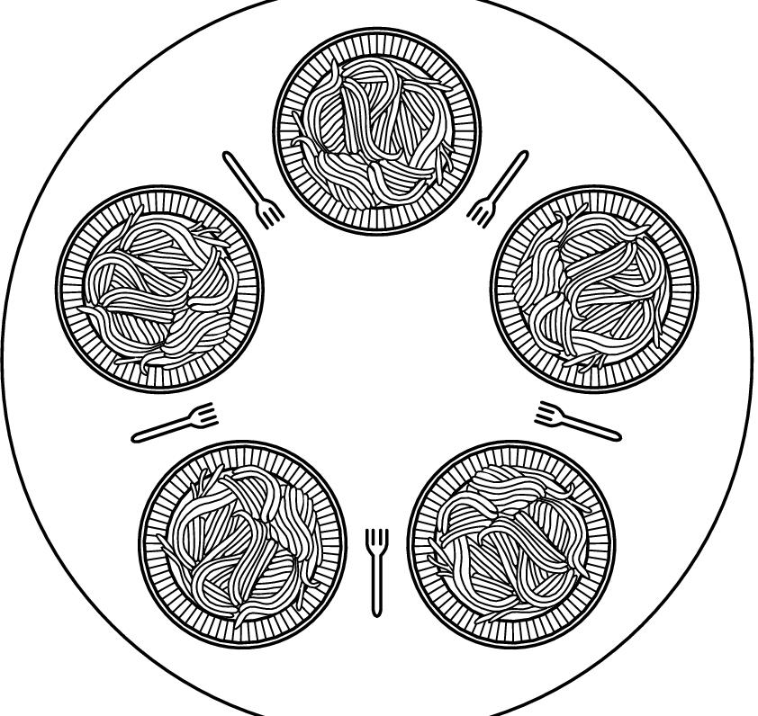
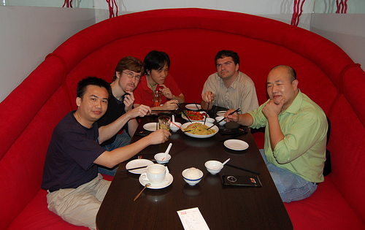
Dining Philosopher’s Problem
Dijkstra
Philosophers eat/think
Eating needs two forks
Pick one fork at a time
Idea is to capture the concept of multiple processes competing for limited resources

Slide 4
Rules of the Game
The philosophers are very logical
They want to settle on a shared policy that all can apply concurrently
They are hungry: the policy should let everyone eat (eventually)
They are utterly dedicated to the proposition of equality: the policy should be totally fair

Slide 5
What can go wrong?
Lots of things! We can give them names:
Starvation: A policy that can leave some philosopher hungry in some situation (even one where the others collaborate)
Fairness: even if nobody starves, should we worry about policies that let some eat more often than others?
Deadlock: A policy that leaves all the philosophers “stuck”, so that nobody can do anything at all
Livelock: A policy that makes them all do something endlessly without ever eating!

Slide 6
A flawed conceptual solution
Const int N = 5;
Philosopher i (0, 1, .. N-1)
do {
think();
take_fork(i);
take_fork((i+1)%N);
eat(); /* yummy */
put_fork(i);
put_fork((i+1)%N);
} while (true);

Slide 7
Coding our flawed solution?
Shared: semaphore fork[5];
Init: fork[i] = 1 for all i=0 .. 4
Philosopher i
do {
fork[i].acquire();
fork[i+1].acquire();
/* eat */
fork[i].release();
fork[i+1].release();
/* think */
} while(true);
Oops! Subject to deadlock if they all pick up their “right” fork simultaneously!

Slide 8
Dining Philosophers Solutions
Set table for five, but only allow four philosophers to sit simultaneously
Asymmetric solution
Odd philosopher picks left fork followed by right
Even philosopher does vice versa
Pass a token
Allow philosopher to pick fork only if both available

Slide 9
Why study this problem?
The problem is a cute way of getting people to think about deadlocks
Our goal: understand properties of solutions that work and of solutions that can fail!

Slide 10
Cyclic wait
How can we “model” a deadlocked philosophers state?
Every philosopher is holding one fork
… and each is waiting for a neighbor to release one fork
We can represent this as a graph in which
Nodes represent philosophers
Edges represent waiting-for

Slide 11
Cyclic wait

Slide 12
Cyclic wait
We can define a system to be in a deadlock state if
There exists ANY group of processes, such that
Each process in the group is waiting for some other process
And the wait-for graph has a cycle
Doesn’t require that every process be stuck… even two is enough to say that the system as a whole contains a deadlock (“is deadlocked”)

Slide 13
Four Conditions for Deadlock
Mutual Exclusion
At least one resource must be held is in non-sharable mode
Hold and wait
There exists a process holding a resource, and waiting for another
No preemption
Resources cannot be preempted
Circular wait
There exists a set of processes {P₁, P₂, … P_{N}}, such that
P₁ is waiting for P₂, P₂ for P₃, …. and P_{N} for P₁
All four conditions must hold for deadlock to occur

Slide 14
What about livelock?
This is harder to express
Need to talk about making “meaningful progress”
In CS414 we’ll limit ourselves to deadlock
Detection: For example, build a graph and check for cycles (not hard to do)
Avoidance – we’ll look at several ways to avoid getting into trouble in the first place!
As it happens, livelock is relatively rare (but you should worry about it anyhow!)

Slide 15
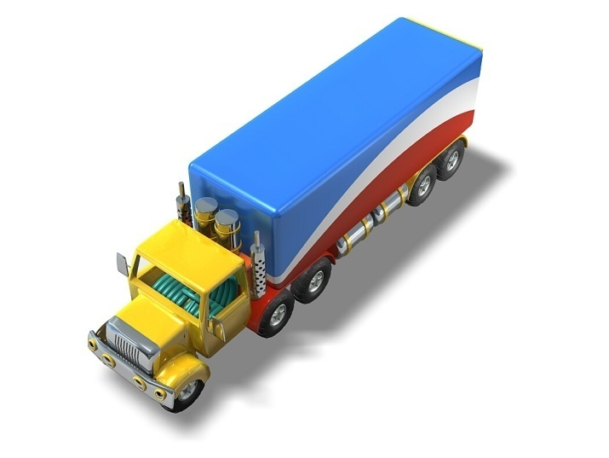
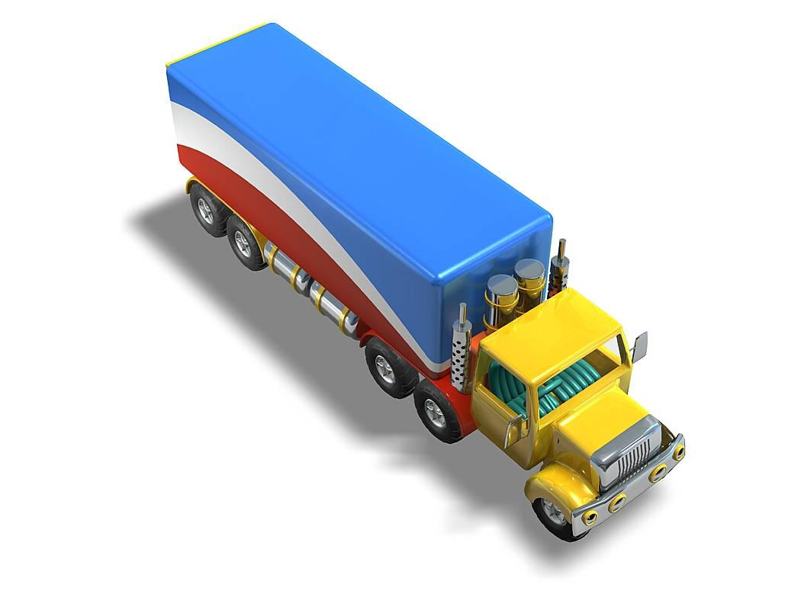
Real World Deadlocks?
Truck A has to wait for truck B to move
Not deadlocked

Slide 16
Real World Deadlocks?
Gridlock (assuming trucks can’t back up)

Slide 17
Real World Deadlocks?

Slide 18
The strange story of “priorité a droite”
France has many traffic circles…
… normally, the priority rule is that a vehicle trying to enter must yield to one trying to exit
Can deadlock occur in this case?
But there are two that operate differently
Place Etoile and Place Victor Hugo, in Paris
What happens in practice?

Slide 19
Belgium: “priorité a droite”
In Belgium, all incoming roads from the right have priority unless otherwise marked, even if the incoming road is small and you are on a main road.
This is important to remember if you drive in Europe!
Thought question:
Is the entire country deadlock-prone?

Slide 20
Testing for deadlock
Steps
Collect “process state” and use it to build a graph
Ask each process “are you waiting for anything”?
Put an edge in the graph if so
We need to do this in a single instant of time, not while things might be changing
Now need a way to test for cycles in our graph

Slide 21
Testing for deadlock
How do cars do it?
Never block an intersection
Must back up if you find yourself doing so
Why does this work?
“Breaks” a wait-for relationship
Illustrates a sense in which intransigent waiting (refusing to release a resource) is one key element of true deadlock!

Slide 22
Testing for deadlock
One way to find cycles
Look for a node with no outgoing edges
Erase this node, and also erase any edges coming into it
Idea: This was a process people might have been waiting for, but it wasn’t waiting for anything else
If (and only if) the graph has no cycles, we’ll eventually be able to erase the whole graph!
This is called a graph reduction algorithm

Slide 23
Graph reduction example
0
3
4
8
This graph can be “fully reduced”, hence there was no deadlock at the time the graph was drawn.
Obviously, things could change later!
7
2
11
1
5
9
10
12
6

Slide 24
Graph reduction example
This is an example of an “irreducible” graph
It contains a cycle and represents a deadlock, although only some processes are in the cycle

Slide 25
Graph Reduction
Given a “state” that our system is in, tells us how to determine whether the system is deadlocked
But as stated only works for processes that wait for each other, like trucks in our deadlock example
What about processes waiting to acquire locks?
Locks are “objects”
Our graphs don’t have a notation for this…

Slide 26
Resource-wait graphs
With two kinds of nodes we can extend our solution to deal with resources too
A process: P₃ will be represented as:
A big circle with the process id inside it
A resource: R₇ will be represented as:
A resource often has multiple identical units, such as “blocks of memory”
Represent these as circles in the box
Arrow from a process to a resource: “I want k units of this resource.” Arrow to a process: this process holds k units of the resource
P₃ wants 2 units of R₇
3
2
7

Slide 27
Resource-wait graphs
1
2
3
4
1
2
1
1
2
5
1
4

Slide 28
Reduction rules?
Find a process that can have all its current requests satisfied (e.g. the “available amount” of any resource it wants is at least enough to satisfy the request)
Erase that process (in effect: grant the request, let it run, and eventually it will release the resource)
Continue until we either erase the graph or have an irreducible component. In the latter case we’ve identified a deadlock

Slide 29
This graph is reducible: The system is not deadlocked
1
2
3
4
1
2
1
1
2
1
1
4

Slide 30
This graph is not reducible: The system is deadlocked
1
2
3
4
1
2
1
1
2
5
1
4

Slide 31
A tricky choice…
When should resources be treated as “different classes”?
Seems obvious
“memory pages” are different from “forks”
But suppose we split some resource into two sets?
The main group of memory and the extra memory
Keep this in mind next week when we talk about ways of avoiding deadlock.
It proves useful in doing “ordered resource allocation”

Slide 32
Take-Away: Conditions for Deadlock
Mutual Exclusion
At least one resource must be held is in non-sharable mode
Hold and wait
There exists a process holding a resource, and waiting for another
No preemption
Resources cannot be preempted
Circular wait
There exists a set of processes {P₁, P₂, … P_{N}}, such that
P₁ is waiting for P₂, P₂ for P₃, …. and P_{N} for P₁
All four conditions must hold for deadlock to occur

