Slide 1
I/O
Hakim Weatherspoon
CS 3410
Computer Science
Cornell University
[Weatherspoon, Bala, Bracy, McKee, and Sirer]

Slide 2
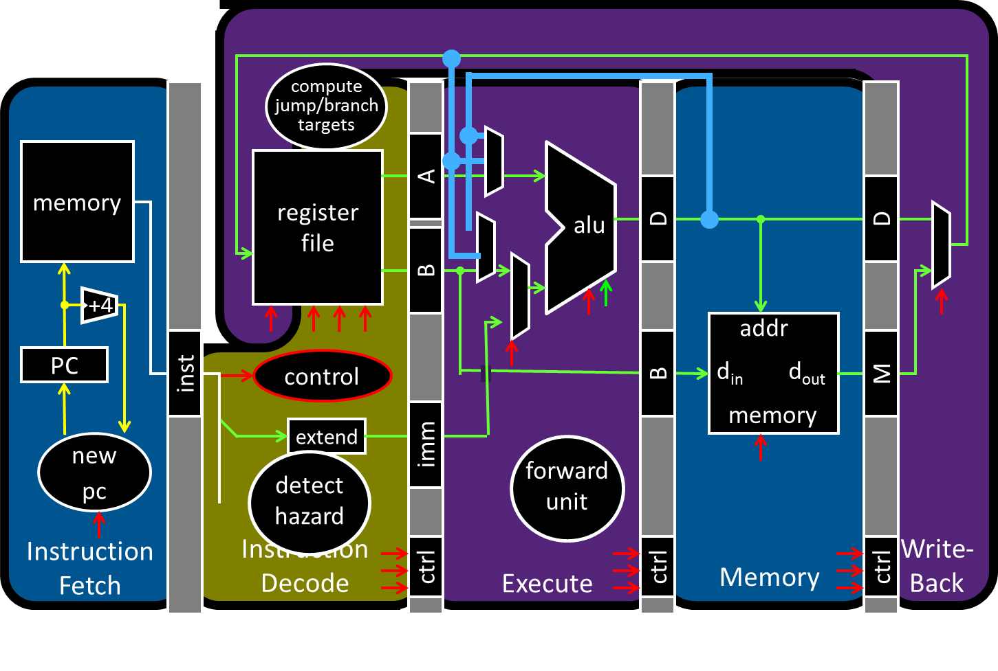
Big Picture: Input/Output (I/O)
How does a processor interact with its environment?

Slide 3
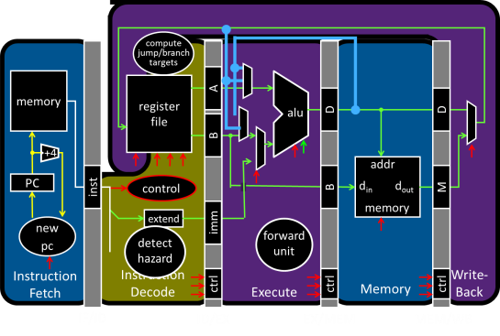
Big Picture: Input/Output (I/O)
How does a processor interact with its environment?
Computer System =
Memory + Datapath + Control
+ Input + Output
Keyboard
Network
Disk
Display

Slide 4
I/O Devices Enables Interacting with Environment
Device | Behavior | Partner | Data Rate (b/sec)
Keyboard | Input | Human | 100
Mouse | Input | Human | 3.8k
Sound Input | Input | Machine | 3M
Voice Output | Output | Human | 264k
Sound Output | Output | Human | 8M
Laser Printer | Output | Human | 3.2M
Graphics Display | Output | Human | 800M – 8G
Network/LAN | Input/Output | Machine | 100M – 10G
Network/Wireless LAN | Input/Output | Machine | 11 – 54M
Optical Disk | Storage | Machine | 5 – 120M
Flash memory | Storage | Machine | 32 – 200M
Magnetic Disk | Storage | Machine | 800M – 3G

Slide 5
Round 1: All devices on one interconnect
Replace all devices as the interconnect changes
e.g. keyboard speed == main memory speed ?!
Unified Memory and I/O Interconnect
Memory
Display
Disk
Keyboard
Network

Slide 6
Round 2: I/O Controllers
Decouple I/O devices from Interconnect
Enable smarter I/O interfaces
Core0
Core1
Core0
Core1
Cache
Cache
Cache
Cache
Unified Memory and I/O Interconnect
Memory
Controller
I/O
Controller
I/O
Controller
I/O
Controller
I/O
Controller
Memory
Display
Disk
Keyboard
Network

Slide 7
Round 3: I/O Controllers + Bridge
Separate high-performance processor, memory, display interconnect from lower-performance interconnect
Core0
Core1
Cache
Cache
High Performance
Interconnect
Bridge
Lower Performance
Legacy Interconnect
Memory
Controller
I/O
Controller
I/O
Controller
I/O
Controller
I/O
Controller
Memory
Display
Disk
Keyboard
Network

Slide 8
Bus Parameters
Width = number of wires
Transfer size = data words per bus transaction
Synchronous (with a bus clock) or asynchronous (no bus clock / “self clocking”)

Slide 9
Bus Types
Processor – Memory (“Front Side Bus”. Also QPI)
Short, fast, & wide
Mostly fixed topology, designed as a “chipset”
CPU + Caches + Interconnect + Memory Controller
I/O and Peripheral busses (PCI, SCSI, USB, LPC, …)
Longer, slower, & narrower
Flexible topology, multiple/varied connections
Interoperability standards for devices
Connect to processor-memory bus through a bridge

Slide 10
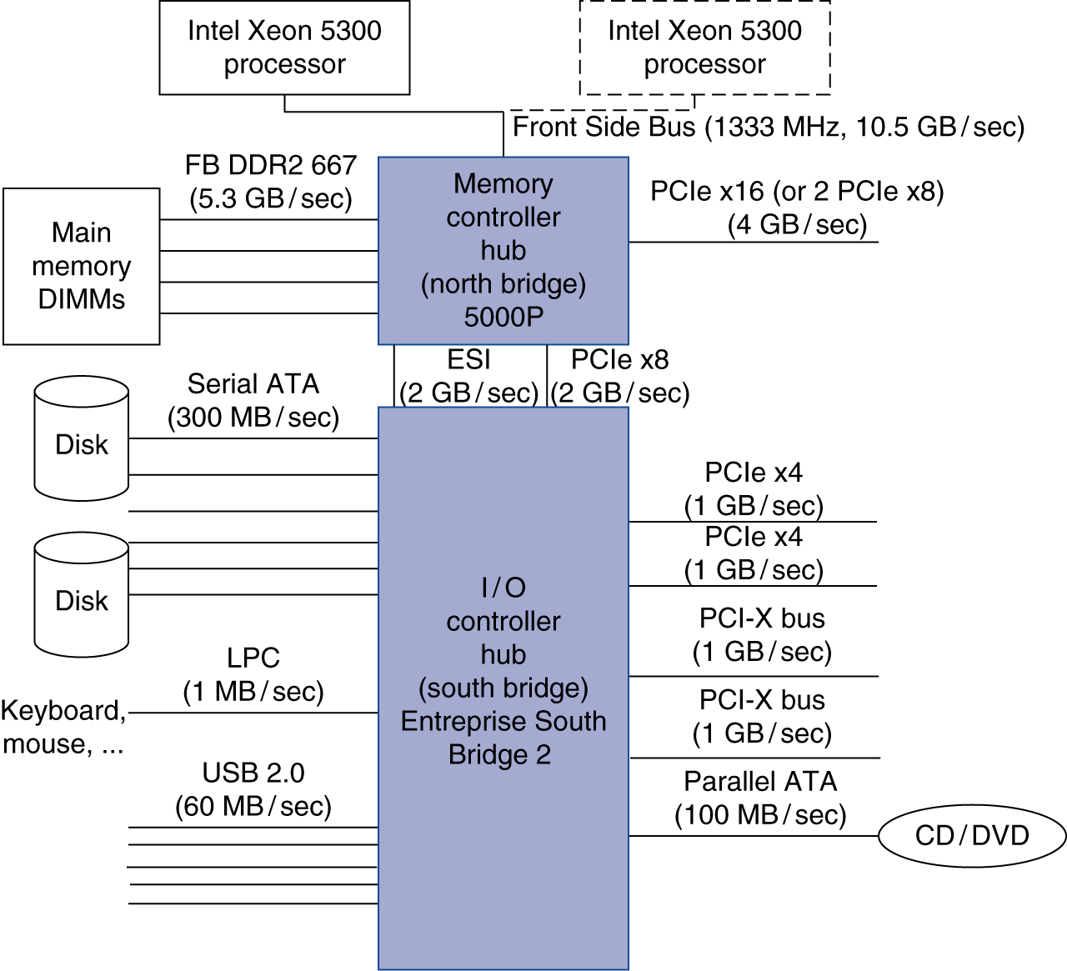
Round 3: I/O Controllers + Bridge
Separate high-performance processor, memory, display interconnect from lower-performance interconnect

Slide 11
Example Interconnects
Name | Use | Devices per channel | Channel Width | Data Rate (B/sec)
Firewire 800 | External | 63 | 4 | 100M
USB 2.0 | External | 127 | 2 | 60M
USB 3.0 | External | 127 | 2 | 625M
Parallel ATA | Internal | 1 | 16 | 133M
Serial ATA (SATA) | Internal | 1 | 4 | 300M
PCI 66MHz | Internal | 1 | 32-64 | 533M
PCI Express v2.x | Internal | 1 | 2-64 | 16G/dir
Hypertransport v2.x | Internal | 1 | 2-64 | 25G/dir
QuickPath (QPI) | Internal | 1 | 40 | 12G/dir

Slide 12
Interconnecting Components
Interconnects are (were?) busses
parallel set of wires for data and control
shared channel
multiple senders/receivers
everyone can see all bus transactions
bus protocol: rules for using the bus wires
Alternative (and increasingly common):
dedicated point-to-point channels
e.g. Intel
Xeon
e.g. Intel
Nehalem

Slide 13
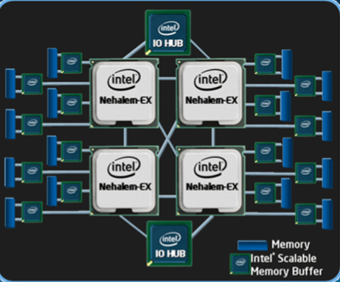
Round 4: I/O Controllers+Bridge+ NUMA
Remove bridge as bottleneck with Point-to-point interconnects
E.g. Non-Uniform Memory Access (NUMA)

Slide 14
Takeaways
Diverse I/O devices require hierarchical interconnect which is more recently transitioning to point-to-point topologies.

Slide 15
Next Goal
How does the processor interact with I/O devices?

Slide 16
I/O Device Driver Software Interface
Set of methods to write/read data to/from device and control device
Example: Linux Character Devices
// Open a toy " echo " character device
int fd = open("/dev/echo", O_RDWR);
// Write to the device
char write_buf[] = "Hello World!";
write(fd, write_buf, sizeof(write_buf));
// Read from the device
char read_buf [32];
read(fd, read_buf, sizeof(read_buf));
// Close the device
close(fd);
// Verify the result
assert(strcmp(write_buf, read_buf)==0);

Slide 17
I/O Device API
Typical I/O Device API
a set of read-only or read/write registers
Command registers
writing causes device to do something
Status registers
reading indicates what device is doing, error codes, …
Data registers
Write: transfer data to a device
Read: transfer data from a device
Every device uses this API

Slide 18
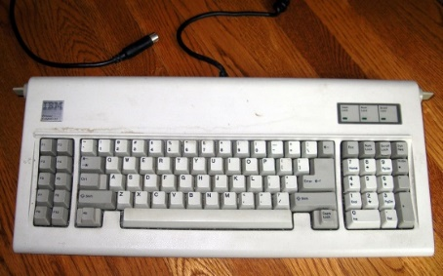
I/O Device API
Simple (old) example: AT Keyboard Device
8-bit Status:
8-bit Command: 0xAA = “self test” 0xAE = “enable kbd” 0xED = “set LEDs”
…
8-bit Data: scancode (when reading) LED state (when writing) or …
PE | TO | AUXB | LOCK | AL2 | SYSF | IBS | OBS
Input
Buffer
Status
Input
Buffer
Status

Slide 19
Communication Interface
Q: How does program OS code talk to device?
A: special instructions to talk over special busses
Programmed I/O
inb xa, 0x64
outb xa, 0x60
Specifies: device, data, direction
Protection: only allowed in kernel mode
Interact with cmd, status, and
data device registers directly
kbd status register
kbd data register
Kernel boundary crossing is expensive
*x86: $a implicit; also inw, outw, inh, outh, …

Slide 20
Communication Interface
Q: How does program OS code talk to device?
A: Map registers into virtual address space
Memory-mapped I/O
Accesses to certain addresses redirected to I/O devices
Data goes over the memory bus
Protection: via bits in pagetable entries
OS+MMU+devices configure mappings
Faster. Less boundary crossing

Slide 21
Memory-Mapped I/O
0xFFFF FFFF
Virtual
Address
Space
I/O
Controller
0x00FF FFFF
Physical
Address
Space
Display
I/O
Controller
Disk
agreed-upon locations for communication
I/O
Controller
Keyboard
I/O
Controller
0x0000 0000
0x0000 0000
Network
Less-favored alternative = Programmed I/O:
Syscall instructions that communicate with I/O
Communicate via special device registers

Slide 22
Device Drivers
Programmed I/O
char read_kbd()
{
do {
sleep();
status = inb(0x64);
} while(!(status & 1));
return inb(0x60);
}
Memory Mapped I/O
struct kbd {
char status, pad[3];
char data, pad[3];
};
kbd *k = mmap(...);
char read_kbd()
{
do {
sleep();
status = k->status;
} while(!(status & 1));
return k->data;
}
syscall
syscall

Slide 23
I/O Data Transfer
How to talk to device?
Programmed I/O or Memory-Mapped I/O
How to get events?
Polling or Interrupts
How to transfer lots of data?
disk->cmd = READ_4K_SECTOR;
disk->data = 12;
while (!(disk->status & 1) { }
for (i = 0..4k)
buf[i] = disk->data;
Very,
Very,
Expensive

Slide 24
Data Transfer
1. Programmed I/O: Device ←→ CPU ←→ RAM
for (i = 1 .. n)
CPU issues read request
Device puts data on bus & CPU reads into registers
CPU writes data to memory
2. Direct Memory Access (DMA): Device ←→ RAM
CPU sets up DMA request
for (i = 1 ... n) Device puts data on bus & RAM accepts it
Device interrupts CPU after done
CPU
RAM
DISK
CPU
RAM
DISK
Which one is the winner? Which one is the loser?

Slide 25
DMA Example
DMA example: reading from audio (mic) input
DMA engine on audio device… or I/O controller … or …
int dma_size = 4*PAGE_SIZE;
int *buf = alloc_dma(dma_size);
...
dev->mic_dma_baseaddr = (int)buf;
dev->mic_dma_count = dma_len;
dev->cmd = DEV_MIC_INPUT | DEV_INTERRUPT_ENABLE | DEV_DMA_ENABLE;

Slide 26
DMA Issues (1): Addressing
Issue #1: DMA meets Virtual Memory
RAM: physical addresses
Programs: virtual addresses
CPU
MMU
RAM
DISK

Slide 27
DMA Example
DMA example: reading from audio (mic) input
DMA engine on audio device… or I/O controller … or …
int dma_size = 4*PAGE_SIZE;
void *buf = alloc_dma(dma_size);
...
dev->mic_dma_baseaddr = virt_to_phys(buf);
dev->mic_dma_count = dma_len;
dev->cmd = DEV_MIC_INPUT | DEV_INTERRUPT_ENABLE | DEV_DMA_ENABLE;

Slide 28
DMA Issues (1): Addressing
Issue #1: DMA meets Virtual Memory
RAM: physical addresses
Programs: virtual addresses
CPU
MMU
RAM
DISK
uTLB

Slide 29
DMA Issues (2): Virtual Mem
Issue #2: DMA meets Paged Virtual Memory
DMA destination page may get swapped out
CPU
RAM
DISK

Slide 30
DMA Issues (4): Caches
Issue #4: DMA meets Caching
DMA-related data could be cached in L1/L2
DMA to Mem: cache is now stale
DMA from Mem: dev gets stale data
CPU
L2
RAM
DISK

Slide 31
DMA Issues (4): Caches
Issue #4: DMA meets Caching
DMA-related data could be cached in L1/L2
DMA to Mem: cache is now stale
DMA from Mem: dev gets stale data
CPU
L2
RAM
DISK

Slide 32
Programmed I/O vs Memory Mapped I/O
Programmed I/O
Requires special instructions
Can require dedicated hardware interface to devices
Protection enforced via kernel mode access to instructions
Virtualization can be difficult
Memory-Mapped I/O
Re-uses standard load/store instructions
Re-uses standard memory hardware interface
Protection enforced with normal memory protection scheme
Virtualization enabled with normal memory virtualization scheme

Slide 33
Polling vs. Interrupts
How does program learn device is ready/done?
1. Polling: Periodically check I/O status register
Common in small, cheap, or real-time embedded systems
Predictable timing, inexpensive
Wastes CPU cycles
2. Interrupts: Device sends interrupt to CPU
Cause register identifies the interrupting device
Interrupt handler examines device, decides what to do
Only interrupt when device ready/done
Forced to save CPU context (PC, SP, registers, etc.)
Unpredictable, event arrival depends on other devices’ activity
Clicker Question: Which is better?
Polling (B) Interrupts (C) Both equally good/bad

Slide 34
I/O Takeaways
Diverse I/O devices require hierarchical interconnect which is more recently transitioning to point-to-point topologies.
Memory-mapped I/O is an elegant technique to read/write device registers with standard load/stores.
Interrupt-based I/O avoids the wasted work in polling-based I/O and is usually more efficient.
Modern systems combine memory-mapped I/O,
interrupt-based I/O, and direct-memory access
to create sophisticated I/O device subsystems.

