Slide 1
Caches & Memory
Hakim Weatherspoon
CS 3410
Computer Science
Cornell University
[Weatherspoon, Bala, Bracy, McKee, and Sirer]

Slide 2
Programs 101
C Code
RISC-V Assembly
int main (int argc, char* argv[ ]) {
int i;
int m = n;
int sum = 0;
for (i = 1; i <= m; i++) {
sum += i;
}
printf (“...”, n, sum);
}
main: addi sp,sp,-48
sw x1,44(sp)
sw fp,40(sp)
move fp,sp
sw x10,-36(fp)
sw x11,-40(fp)
la x15,n
lw x15,0(x15)
sw x15,-28(fp)
sw x0,-24(fp)
li x15,1
sw x15,-20(fp)
L2: lw x14,-20(fp)
lw x15,-28(fp)
blt x15,x14,L3
. . .
Load/Store Architectures:
Read data from memory (put in registers)
Manipulate it
Store it back to memory
Instructions that read from
or write to memory…

Slide 3
Programs 101
C Code
RISC-V Assembly
int main (int argc, char* argv[ ]) {
int i;
int m = n;
int sum = 0;
for (i = 1; i <= m; i++) {
sum += i;
}
printf (“...”, n, sum);
}
main: addi sp,sp,-48
sw ra,44(sp)
sw fp,40(sp)
move fp,sp
sw a0,-36(fp)
sw a1,-40(fp)
la a5,n
lw a5,0(x15)
sw a5,-28(fp)
sw x0,-24(fp)
li a5,1
sw a5,-20(fp)
L2: lw a4,-20(fp)
lw a5,-28(fp)
blt a5,a4,L3
. . .
Load/Store Architectures:
Read data from memory (put in registers)
Manipulate it
Store it back to memory
Instructions that read from
or write to memory…

Slide 4
1 Cycle Per Stage: the Biggest Lie (So Far)
Code Stored in Memory
(also, data and stack)
compute
jump/branch
targets
memory
register
file
A
ALU
D
D
B
+4
addr
PC
inst
control
B
d_{in}
d_{out}
M
memory
new
pc
extend
imm
forward
unit
detect
hazard
Stack, Data, Code
Stored in Memory
Instruction
Fetch
Instruction
Decode
Write-
Back
ctrl
ctrl
ctrl
Execute
Memory
IF/ID
ID/EX
EX/MEM
MEM/WB

Slide 5
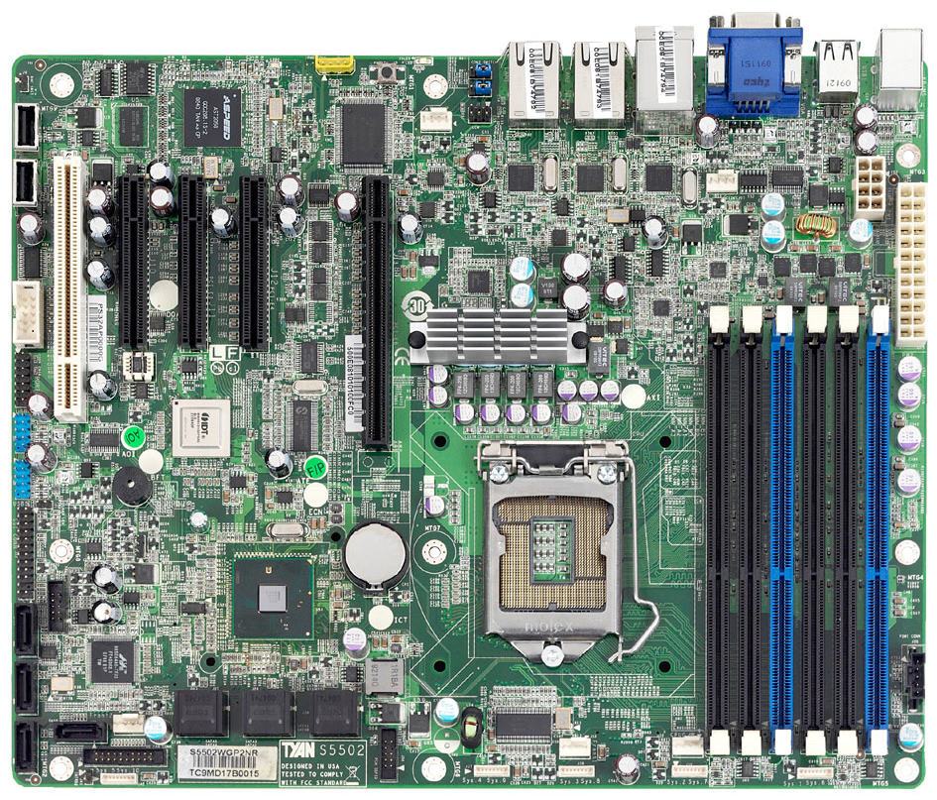
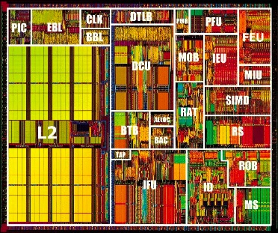
What’s the problem?
CPU
+ big
– slow
– far away
Main Memory
SandyBridge Motherboard, 2011
http://news.softpedia.com

Slide 6

The Need for Speed
CPU Pipeline

Slide 7
The Need for Speed
CPU Pipeline
Instruction speeds:
add,sub,shift: 1 cycle
mult: 3 cycles
load/store: 100 cycles
  off-chip 50(-70)ns
  2(-3) GHz processor → 0.5 ns clock

Slide 8
The Need for Speed
CPU Pipeline

Slide 9
What’s the solution?
Caches !
Level 1
Data $
Level 2 $
Level 1
Insn $
Intel Pentium 3, 1999

Slide 10
Aside
Go back to 04-state and 05-memory and look at how registers, SRAM and DRAM are built.

Slide 11
What’s the solution?
Caches !
Level 1
Data $
Level 2 $
Level 1
Insn $
What lucky data gets to go here?
Intel Pentium 3, 1999

Slide 12
Locality Locality Locality
If you ask for something, you’re likely to ask for:
the same thing again soon
→ Temporal Locality
something near that thing, soon
→ Spatial Locality
^{total = 0;}
^{for (i = 0; i < n; i++)}
^{total += a[i];}
^{return total;}

Slide 13

Your life is full of Locality
Last Called
Speed Dial
Favorites
Contacts
Google/Facebook/email

Slide 14



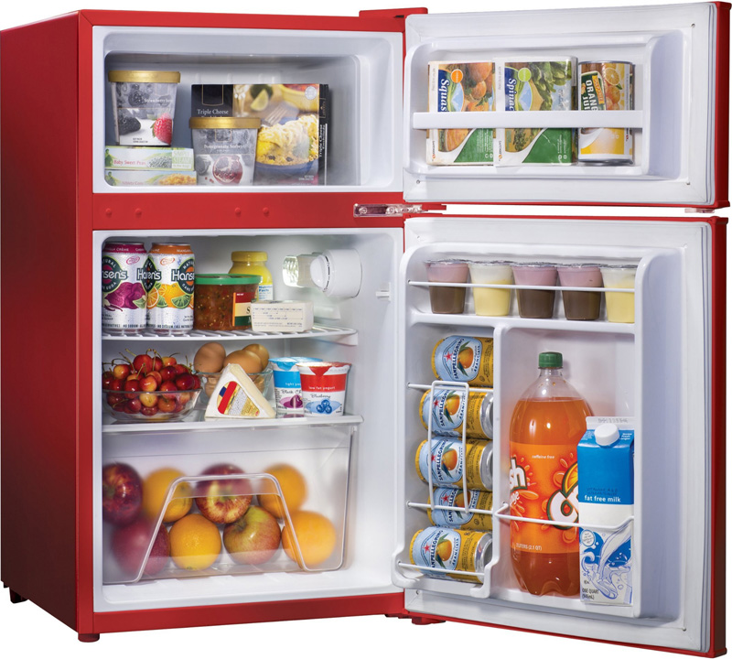


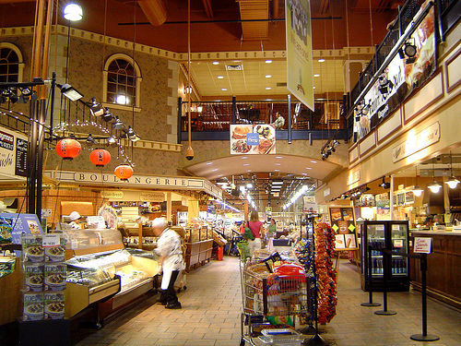
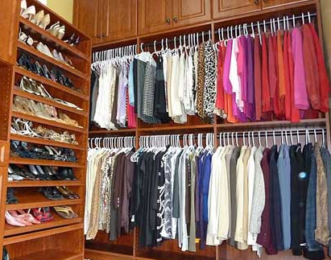
Your life is full of Locality

Slide 15
The Memory Hierarchy
Small, Fast
1 cycle,
128 bytes
Registers
4 cycles,
64 KB
L1 Caches
L2 Cache
12 cycles,
256 KB
L3 Cache
36 cycles,
2-20 MB
Main Memory
50-70 ns,
512 MB – 4 GB
Big, Slow
5-20 ms
16GB – 4 TB,
Disk
Intel Haswell Processor, 2013

Slide 16
Some Terminology
Cache hit
data is in the Cache
t_{hit} : time it takes to access the cache
Hit rate (%hit): # cache hits / # cache accesses
Cache miss
data is not in the Cache
t_{miss} : time it takes to get the data from below the $
Miss rate (%miss): # cache misses / # cache accesses
Cacheline or cacheblock or simply line or block
Minimum unit of info that is present/or not in the cache

Slide 17
The Memory Hierarchy
1 cycle,
128 bytes
  average access time
  t_{avg} = t_{hit} + %_{miss}* t_{miss}
  = 4 + 5% x 100
  = 9 cycles
Registers
4 cycles,
64 KB
L1 Caches
L2 Cache
12 cycles,
256 KB
L3 Cache
36 cycles,
2-20 MB
Main Memory
50-70 ns,
512 MB – 4 GB
5-20 ms
16GB – 4 TB,
Disk
Intel Haswell Processor, 2013

Slide 18
Single Core Memory Hierarchy
ON CHIP
Processor
Regs
Registers
L1 Caches
I$
D$
L2
L2 Cache
L3 Cache
Main Memory
Main Memory
Disk
Disk

Slide 19
Multi-Core Memory Hierarchy
ON CHIP
Processor
Processor
Processor
Processor
Regs
Regs
Regs
Regs
I$
D$
I$
D$
I$
D$
I$
D$
L2
L2
L2
L2
L3
Main Memory
Disk

Slide 20
Memory Hierarchy by the Numbers
CPU clock rates ~0.33ns – 2ns (3GHz-500MHz)
*Registers,D-Flip Flops: 10-100’s of registers
Memory technology | Transistor count* | Access time | Access time in cycles | $ per GIB in 2012 | Capacity
SRAM (on chip) | 6-8 transistors | 0.5-2.5 ns | 1-3 cycles | $4k | 256 KB
SRAM (off chip) |  | 1.5-30 ns | 5-15 cycles | $4k | 32 MB
DRAM | 1 transistor (needs refresh) | 50-70 ns | 150-200 cycles | $10-$20 | 8 GB
SSD (Flash) |  | 5k-50k ns | Tens of thousands | $0.75-$1 | 512 GB
Disk |  | 5M-20M ns | Millions | $0.05-$0.1 | 4 TB

Slide 21

Basic Cache Design
Direct Mapped Caches

Slide 22
16 Byte Memory
MEMORY
addr | data
0000 | A
0001 | B
0010 | C
0011 | D
0100 | E
0101 | F
0110 | G
0111 | H
1000 | J
1001 | K
1010 | L
1011 | M
1100 | N
1101 | O
1110 | P
1111 | Q
load 1100 → r1
Byte-addressable memory
4 address bits → 16 bytes total
b addr bits → 2^{b} bytes in memory

Slide 23
4-Byte, Direct Mapped Cache
MEMORY
addr | data
0000 | A
0001 | B
0010 | C
0011 | D
0100 | E
0101 | F
0110 | G
0111 | H
1000 | J
1001 | K
1010 | L
1011 | M
1100 | N
1101 | O
1110 | P
1111 | Q
CACHE
index
XXXX
data
A
B
C
D
index
00
01
10
11
Cache entry
= row
= (cache) line
= (cache) block
Block Size: 1 byte
Direct mapped:
Each address maps to 1 cache block
4 entries → 2 index bits (2^{n} → n bits)
Index with LSB:
Supports spatial locality

Slide 24
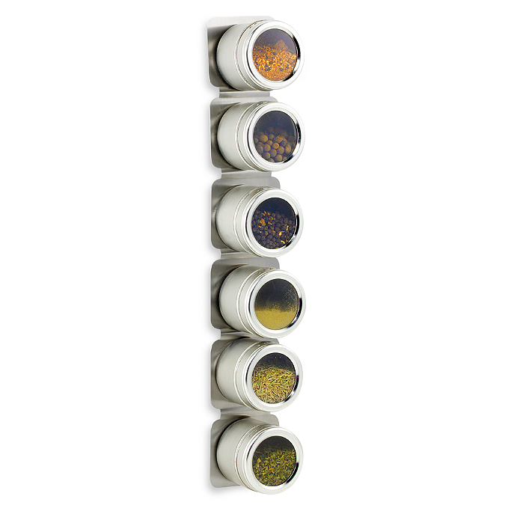
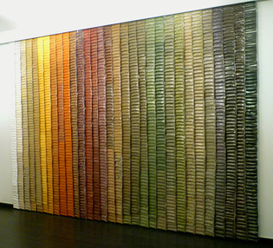
Analogy to a Spice Rack
Spice Rack
(Cache)
Spice Wall
(Memory)
index spice
A
B
C
D
E
F
…
Z
Compared to your spice wall
  Smaller
  Faster
  More costly (per oz.)
http://www.bedbathandbeyond.com

Slide 25
Analogy to a Spice Rack
Spice Rack
(Cache)
Spice Wall
(Memory)
index spice
tag
A
B
C
D
E
F
…
Z
innamon
Cinnamon
How do you know what’s in the jar?
Need labels
  Tag = Ultra-minimalist label

Slide 26
4-Byte, Direct Mapped Cache
MEMORY
addr | data
0000 | A
0001 | B
0010 | C
0011 | D
0100 | E
0101 | F
0110 | G
0111 | H
1000 | J
1001 | K
1010 | L
1011 | M
1100 | N
1101 | O
1110 | P
1111 | Q
tag|index
XXXX
CACHE
tag
00
00
00
00
index
00
01
10
11
 | data
 | A
 | B
 | C
 | D
Tag: minimalist label/address
address = tag + index

Slide 27
4-Byte, Direct Mapped Cache
MEMORY
addr | data
0000 | A
0001 | B
0010 | C
0011 | D
0100 | E
0101 | F
0110 | G
0111 | H
1000 | J
1001 | K
1010 | L
1011 | M
1100 | N
1101 | O
1110 | P
1111 | Q
CACHE
index
00
01
10
11
V | tag | data
0 | 00 | X
0 | 00 | X
0 | 00 | X
0 | 00 | X
One last tweak: valid bit

Slide 28
Simulation #1 of a 4-byte, DM Cache
MEMORY
addr | data
0000 | A
0001 | B
0010 | C
0011 | D
0100 | E
0101 | F
0110 | G
0111 | H
1000 | J
1001 | K
1010 | L
1011 | M
1100 | N
1101 | O
1110 | P
1111 | Q
tag|index
XXXX
CACHE
index
00
01
10
11
V | tag | data
0 | 11 | X
0 | 11 | X
0 | 11 | X
0 | 11 | X
load 1100
Lookup:
Index into $
Check tag
Check valid bit

Slide 29
Block Diagram
4-entry, direct mapped Cache
tag|index
1101
CACHE
V | tag | data
1 | 00 | 1111 0000
1 | 11 | 1010 0101
0 | 01 | 1010 1010
1 | 11 | 0000 0000
2
2
Great!
Are we done?
2
8
=
1010 0101
data
Hit!

Slide 30
Simulation #2:
4-byte, DM Cache
MEMORY
addr | data
0000 | A
0001 | B
0010 | C
0011 | D
0100 | E
0101 | F
0110 | G
0111 | H
1000 | J
1001 | K
1010 | L
1011 | M
1100 | N
1101 | O
1110 | P
1111 | Q
CACHE
index
00
01
10
11
V | tag | data
1 | 11 | N
0 | 11 | X
0 | 11 | X
0 | 11 | X
load 1100
load 1101
load 0100
load 1100
Miss
Lookup:
Index into $
Check tag
Check valid bit

Slide 31

Reducing Cold Misses
by Increasing Block Size
Leveraging Spatial Locality

Slide 32

Increasing Block Size
MEMORY
addr | data
0000 | A
0001 | B
0010 | C
0011 | D
0100 | E
0101 | F
0110 | G
0111 | H
1000 | J
1001 | K
1010 | L
1011 | M
1100 | N
1101 | O
1110 | P
1111 | Q
CACHE
offset
XXXX
index
00
01
10
11
V | tag | data
0 | x | A | B
0 | x | C | D
0 | x | E | F
0 | x | G | H
Block Size: 2 bytes
Block Offset: least significant bits indicate where you live in the block
Which bits are the index? tag?

Slide 33
Simulation #3:
8-byte, DM Cache
MEMORY
addr | data
0000 | A
0001 | B
0010 | C
0011 | D
0100 | E
0101 | F
0110 | G
0111 | H
1000 | J
1001 | K
1010 | L
1011 | M
1100 | N
1101 | O
1110 | P
1111 | Q
index
CACHE
tag| |offset
XXXX
index
00
01
10
11
V | tag | data
0 | x | X | X
0 | x | X | X
0 | x | X | X
0 | x | X | X
load 1100
load 1101
load 0100
load 1100
Lookup:
Index into $
Check tag
Check valid bit

Slide 34

Removing Conflict Misses
with Fully-Associative Caches

Slide 35
Simulation #4:
8-byte, FA Cache
MEMORY
addr | data
0000 | A
0001 | B
0010 | C
0011 | D
0100 | E
0101 | F
0110 | G
0111 | H
1000 | J
1001 | K
1010 | L
1011 | M
1100 | N
1101 | O
1110 | P
1111 | Q
XXXX
tag|offset
CACHE
V | tag | data
0 | xxx | X | X
V | tag | data
0 | xxx | X | X
V | tag | data
0 | xxx | X | X
V | tag | data
0 | xxx | X | X
load 1100
load 1101
load 0100
load 1100
Miss
Lookup:
Index into $
Check tags
Check valid bits
LRU Pointer

Slide 36
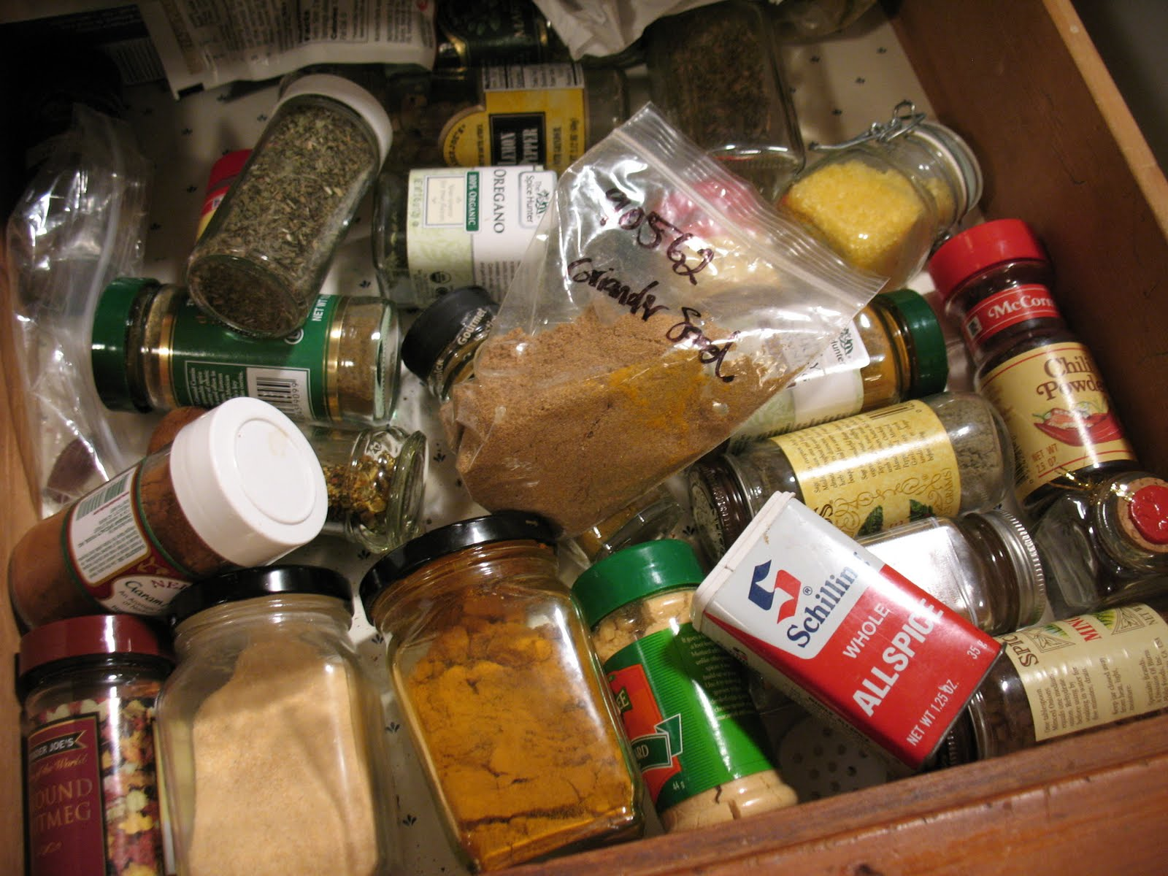

Pros and Cons of Full Associativity
+ No more conflicts!
+ Excellent utilization!
But either:
Parallel Reads
– lots of reading!
Serial Reads
– lots of waiting
  t_{avg} = t_{hit} + %_{miss}* t_{miss}
  = 4 + 5% x 100
  = 9 cycles
  = 6 + 3% x 100
  = 9 cycles

Slide 37
Pros & Cons
 | Direct Mapped | Fully Associative
Tag Size | Smaller | Larger
SRAM Overhead | Less | More
Controller Logic | Less | More
Speed | Faster | Slower
Price | Less | More
Scalability | Very | Not Very
# of conflict misses | Lots | Zero
Hit Rate | Low | High
Pathological Cases | Common | ?

Slide 38

Reducing Conflict Misses
with Set-Associative Caches
Not too conflict-y. Not too slow.
… Just Right!

Slide 39
8 byte, 2-way
set associative Cache
MEMORY
addr | data
0000 | A
0001 | B
0010 | C
0011 | D
0100 | E
0101 | F
0110 | G
0111 | H
1000 | J
1001 | K
1010 | L
1011 | M
1100 | N
1101 | O
1110 | P
1111 | Q
XXXX
tag||offset
XXXX
XXXX
offset
index
CACHE
index
0
1
V | tag | data
0 | xx | E | F
0 | xx | C | D
V | tag | data
0 | xx | N | O
0 | xx | P | Q
What should the offset be?
What should the index be?
What should the tag be?

Slide 40
8 byte, 2-way
set associative Cache
MEMORY
addr | data
0000 | A
0001 | B
0010 | C
0011 | D
0100 | E
0101 | F
0110 | G
0111 | H
1000 | J
1001 | K
1010 | L
1011 | M
1100 | N
1101 | O
1110 | P
1111 | Q
XXXX
tag||offset
index
CACHE
index
0
1
V | tag | data
0 | xx | X | X
0 | xx | X | X
V | tag | data
0 | xx | X | X
0 | xx | X | X
load 1100
load 1101
load 0100
load 1100
Miss
Lookup:
Index into $
Check tag
Check valid bit
LRU Pointer

Slide 41
Eviction Policies
Which cache line should be evicted from the cache to make room for a new line?
Direct-mapped: no choice, must evict line selected by index
Associative caches
  Random: select one of the lines at random
  Round-Robin: similar to random
  FIFO: replace oldest line
  LRU: replace line that has not been used in the longest time

Slide 42

Misses: the Three C’s
Cold (compulsory) Miss:
never seen this address before
Conflict Miss:
cache associativity is too low
Capacity Miss:
cache is too small

Slide 43
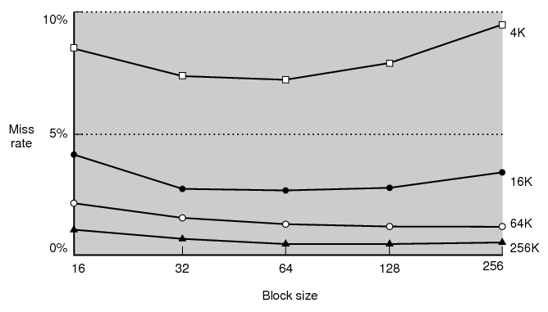
Miss Rate vs. Block Size

Slide 44
Block Size Tradeoffs
For a given total cache size,
Larger block sizes mean….
  fewer lines
  so fewer tags, less overhead
  and fewer cold misses (within-block “prefetching”)
But also…
  fewer blocks available (for scattered accesses!)
  so more conflicts
  can decrease performance if working set can’t fit in $
  and larger miss penalty (time to fetch block)

Slide 45
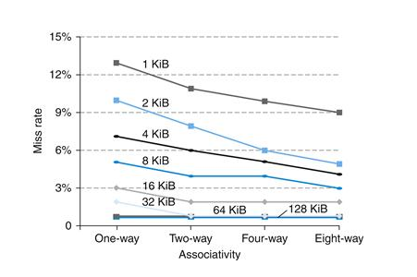
Miss Rate vs. Associativity

Slide 46
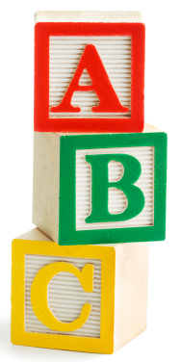
ABCs of Caches
  t_{avg} = t_{hit} + %_{miss}* t_{miss}
+ Associativity:
⬇conflict misses ☺
⬆hit time ☹
+ Block Size:
⬇cold misses ☺
⬆conflict misses ☹
+ Capacity:
⬇capacity misses ☺
⬆hit time ☹

Slide 47
Which caches get what properties?
  t_{avg} = t_{hit} + %_{miss}* t_{miss}
Design with speed in mind
Fast
L1 Caches
More Associative
Bigger Block Sizes
Larger Capacity
L2 Cache
L3 Cache
Design with miss rate in mind
Big

Slide 48
Roadmap
Things we have covered:
  The Need for Speed
  Locality to the Rescue!
  Calculating average memory access time
  $ Misses: Cold, Conflict, Capacity
  $ Characteristics: Associativity, Block Size, Capacity
Things we will now cover:
  Cache Figures
  Cache Performance Examples
  Writes

Slide 49
2-Way Set Associative Cache (Reading)
Tag Index Offset
V
Tag
Data
V
Tag
Data
=
=
line select
64bytes
word select
hit?
data
32bits

Slide 50
3-Way Set Associative Cache (Reading)
Tag Index Offset
=
=
=
line select
64bytes
word select
hit?
data
32bits

Slide 51

How Big is the Cache?
Tag Index Offset
n bit index, m bit offset, N-way Set Associative
Question: How big is cache?
Data only?
(what we usually mean when we ask “how big” is the cache)
Data + overhead?

Slide 52
Performance Calculation with $ Hierarchy
  t_{avg} = t_{hit} + %_{miss}* t_{miss}
Parameters
  Reference stream: all loads
  D$: t_{hit} = 1ns, %_{miss} = 5%
  L2: t_{hit} = 10ns, %_{miss} = 20% (local miss rate)
  Main memory: t_{hit} = 50ns
What is t_{avgD$} without an L2?
  t_{missD$} =
  t_{avgD$} =
What is t_{avgD$} with an L2?
  t_{missD$} =
  t_{avgL2} =
  t_{avgD$} =

Slide 53
Performance Summary
Average memory access time (AMAT) depends on:
cache architecture and size
Hit and miss rates
Access times and miss penalty
Cache design a very complex problem:
Cache size, block size (aka line size)
Number of ways of set-associativity (1, N, ∞)
Eviction policy
Number of levels of caching, parameters for each
Separate I-cache from D-cache, or Unified cache
Prefetching policies / instructions
Write policy

Slide 54
Takeaway
Direct Mapped → fast, but low hit rate
Fully Associative → higher hit cost, higher hit rate
Set Associative → middleground
Line size matters. Larger cache lines can increase performance due to prefetching. BUT, can also decrease performance is working set size cannot fit in cache.
Cache performance is measured by the average memory access time (AMAT), which depends cache architecture and size, but also the access time for hit, miss penalty, hit rate.

Slide 55
What about Stores?
We want to write to the cache.
If the data is not in the cache?
  Bring it in. (Write allocate policy)
Should we also update memory?
Yes: write-through policy
No: write-back policy

Slide 56
Write-Through Cache
16 byte, byte-addressed memory
4 btye, fully-associative cache:
2-byte blocks, write-allocate
4 bit addresses:
3 bit tag, 1 bit offset
Memory
Instructions:
LB x1 ← M[ 1 ]
LB x2 ← M[ 7 ]
SB x2 → M[ 0 ]
SB x1 → M[ 5 ]
LB x2 ← M[ 10 ]
SB x1 → M[ 5 ]
SB x1 → M[ 10 ]
0
1
2
3
4
5
6
7
8
9
10
11
12
13
14
15
78
29
120
lru V tag data
123
71
1
0
150
162
0
0
173
18
Register File
Cache
21
33
x0
x1
x2
x3
28
Misses: 0
Hits: 0
Reads: 0
Writes: 0
19
200
210
225

Slide 57
Write-Through (REF 1)
Memory
Instructions:
LB x1 ← M[ 1 ]
LB x2 ← M[ 7 ]
SB x2 → M[ 0 ]
SB x1 → M[ 5 ]
LB x2 ← M[ 10 ]
SB x1 → M[ 5 ]
SB x1 → M[ 10 ]
0
1
2
3
4
5
6
7
8
9
10
11
12
13
14
15
78
29
120
lru V tag data
123
71
1
0
150
162
0
0
173
18
Register File
Cache
21
33
x0
x1
x2
x3
28
Misses: 0
Hits: 0
Reads: 0
Writes: 0
19
200
210
225

Slide 58
Summary: Write Through
Write-through policy with write allocate
Cache miss: read entire block from memory
Write: write only updated item to memory
Eviction: no need to write to memory

Slide 59
Next Goal: Write-Through vs. Write-Back
What if we DON’T to write stores immediately to memory?
  Keep the current copy in cache, and update memory when data is evicted (write-back policy)
  Write-back all evicted lines?
    No, only written-to blocks

Slide 60
Write-Back Meta-Data (Valid, Dirty Bits)
V | D | Tag | Byte 1 | Byte 2 | … Byte N
V = 1 means the line has valid data
D = 1 means the bytes are newer than main memory
When allocating line:
  Set V = 1, D = 0, fill in Tag and Data
When writing line:
  Set D = 1
When evicting line:
  If D = 0: just set V = 0
  If D = 1: write-back Data, then set D = 0, V = 0

Slide 61
Write-back Example
Example: How does a write-back cache work?
Assume write-allocate

Slide 62
Handling Stores (Write-Back)
16 byte, byte-addressed memory
4 btye, fully-associative cache:
2-byte blocks, write-allocate
4 bit addresses:
3 bit tag, 1 bit offset
Memory
Instructions:
LB x1 ← M[ 1 ]
LB x2 ← M[ 7 ]
SB x2 → M[ 0 ]
SB x1 → M[ 5 ]
LB x2 ← M[ 10 ]
SB x1 → M[ 5 ]
SB x1 → M[ 10 ]
0
1
2
3
4
5
6
7
8
9
10
11
12
13
14
15
78
29
120
lru V d tag data
123
71
1
0
150
162
0
0
173
18
Register File
Cache
21
33
x0
x1
x2
x3
28
Misses: 0
Hits: 0
Reads: 0
Writes: 0
19
200
210
225

Slide 63
Write-Back (REF 1)
Memory
Instructions:
LB x1 ← M[ 1 ]
LB x2 ← M[ 7 ]
SB x2 → M[ 0 ]
SB x1 → M[ 5 ]
LB x2 ← M[ 10 ]
SB x1 → M[ 5 ]
SB x1 → M[ 10 ]
0
1
2
3
4
5
6
7
8
9
10
11
12
13
14
15
78
29
120
lru V d tag data
123
71
1
0
150
162
0
0
173
18
Register File
Cache
21
33
x0
x1
x2
x3
28
Misses: 0
Hits: 0
Reads: 0
Writes: 0
19
200
210
225

Slide 64
How Many Memory References?
Write-back performance
How many reads?
How many writes?

Slide 65
Write-back vs. Write-through Example
Assume: large associative cache, 16-byte lines
N 4-byte words
for (i=1; i<n; i++)
A[0] += A[i];
for (i=0; i<n; i++)
B[i] = A[i]

Slide 66
So is write back just better?
Short Answer: Yes (fewer writes is a good thing)
Long Answer: It’s complicated.
Evictions require entire line be written back to memory (vs. just the data that was written)
Write-back can lead to incoherent caches on multi-core processors (later lecture)

Slide 67
Optimization: Write Buffering

Slide 68
Write-through vs. Write-back
Write-through is slower
  But simpler (memory always consistent)
Write-back is almost always faster
  write-back buffer hides large eviction cost
  But what about multiple cores with separate caches but sharing memory?
Write-back requires a cache coherency protocol
  Inconsistent views of memory
  Need to “snoop” in each other’s caches
  Extremely complex protocols, very hard to get right

Slide 69
Cache-coherency
Q: Multiple readers and writers?
  A: Potentially inconsistent views of memory
A’
CPU
CPU
CPU
CPU
A
L1
L1
A
A
L1
L1
L1
L1
L1
L1
A
L2
L2
A
disk
net
Mem
Cache coherency protocol
  May need to snoop on other CPU’s cache activity
  Invalidate cache line when other CPU writes
  Flush write-back caches before other CPU reads
  Or the reverse: Before writing/reading…
  Extremely complex protocols, very hard to get right

Slide 70
Takeaway
Write-through policy with write allocate
  Cache miss: read entire block from memory
  Write: write only updated item to memory
  Eviction: no need to write to memory
  Slower, but cleaner
Write-back policy with write allocate
  Cache miss: read entire block from memory
    **But may need to write dirty cacheline first**
  Write: nothing to memory
  Eviction: have to write to memory entire cacheline because don’t know what is dirty (only 1 dirty bit)
  Faster, but more complicated, especially with multicore

Slide 71
Cache Conscious Programming
// H = 6, W = 10
int A[H][W];
for(x=0; x < W; x++)
for(y=0; y < H; y++)
sum += A[y][x];
1
2
3
4
5
6
W
1
2
3
4
5
6
YOUR MIND
CACHE
H
MEMORY

Slide 72
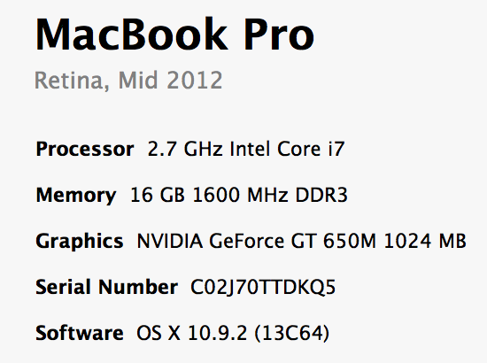
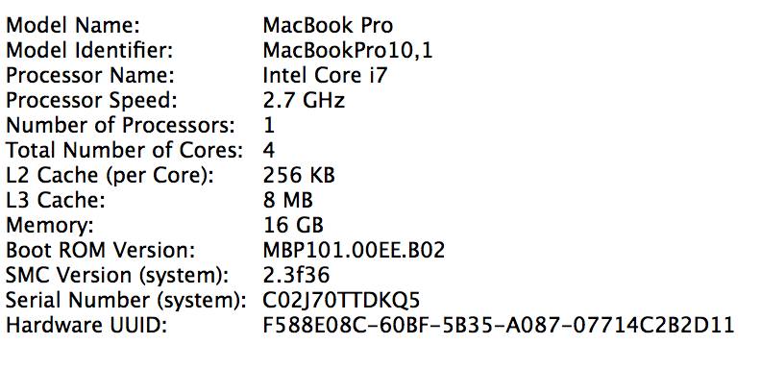
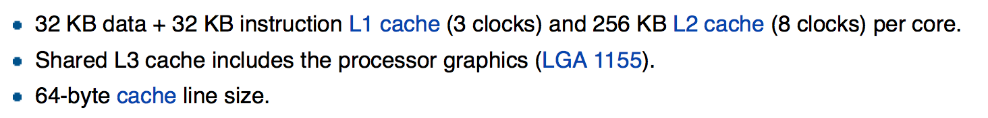
By the end of the cache lectures…

Slide 73
A Real Example
Microsoft Surfacebook
Dual core
Intel i7-6600 CPU @ 2.6 GHz
(purchased in 2016)
> dmidecode -t cache
Cache Information
Socket Designation: L1 Cache
Configuration: Enabled, Not Socketed, Level 1
Operational Mode: Write Back
Location: Internal
Installed Size: 128 kB
Maximum Size: 128 kB
Supported SRAM Types:
Synchronous
Installed SRAM Type: Synchronous
Speed: Unknown
Error Correction Type: Parity
System Type: Unified
Associativity: 8-way Set-associative
Cache Information
Socket Designation: L2 Cache
Configuration: Enabled, Not Socketed,
Level 2
Operational Mode: Write Back
Location: Internal
Installed Size: 512 kB
Maximum Size: 512 kB
Supported SRAM Types:
Synchronous
Installed SRAM Type: Synchronous
Speed: Unknown
Error Correction Type: Single-bit ECC
System Type: Unified
Associativity: 4-way Set-associative
Cache Information
Socket Designation: L3 Cache
Configuration: Enabled, Not Socketed,
Level 3
Operational Mode: Write Back
Location: Internal
Installed Size: 4096 kB
Maximum Size: 4096 kB
Supported SRAM Types:
Synchronous
Installed SRAM Type: Synchronous
Speed: Unknown
Error Correction Type: Multi-bit ECC
System Type: Unified
Associativity: 16-way Set-associative

Slide 74
A Real Example
Dual-core 3.16GHz Intel
(purchased in 2011)
> sudo dmidecode -t cache
Cache Information
Configuration: Enabled, Not Socketed, Level 1
Operational Mode: Write Back
Installed Size: 128 KB
Error Correction Type: None
Cache Information
Configuration: Enabled, Not Socketed, Level 2
Operational Mode: Varies With Memory Address
Installed Size: 6144 KB
Error Correction Type: Single-bit ECC
> cd /sys/devices/system/cpu/cpu0; grep cache/*/*
cache/index0/level:1
cache/index0/type:Data
cache/index0/ways_of_associativity:8
cache/index0/number_of_sets:64
cache/index0/coherency_line_size:64
cache/index0/size:32K
cache/index1/level:1
cache/index1/type:Instruction
cache/index1/ways_of_associativity:8
cache/index1/number_of_sets:64
cache/index1/coherency_line_size:64
cache/index1/size:32K
cache/index2/level:2
cache/index2/type:Unified
cache/index2/shared_cpu_list:0-1
cache/index2/ways_of_associativity:24
cache/index2/number_of_sets:4096
cache/index2/coherency_line_size:64
cache/index2/size:6144K

Slide 75
A Real Example
Dual 32K L1 Instruction caches
  8-way set associative
  64 sets
  64 byte line size
Dual 32K L1 Data caches
  Same as above
Single 6M L2 Unified cache
  24-way set associative (!!!)
  4096 sets
  64 byte line size
4GB Main memory
1TB Disk
Dual-core 3.16GHz Intel
(purchased in 2009)

Slide 76
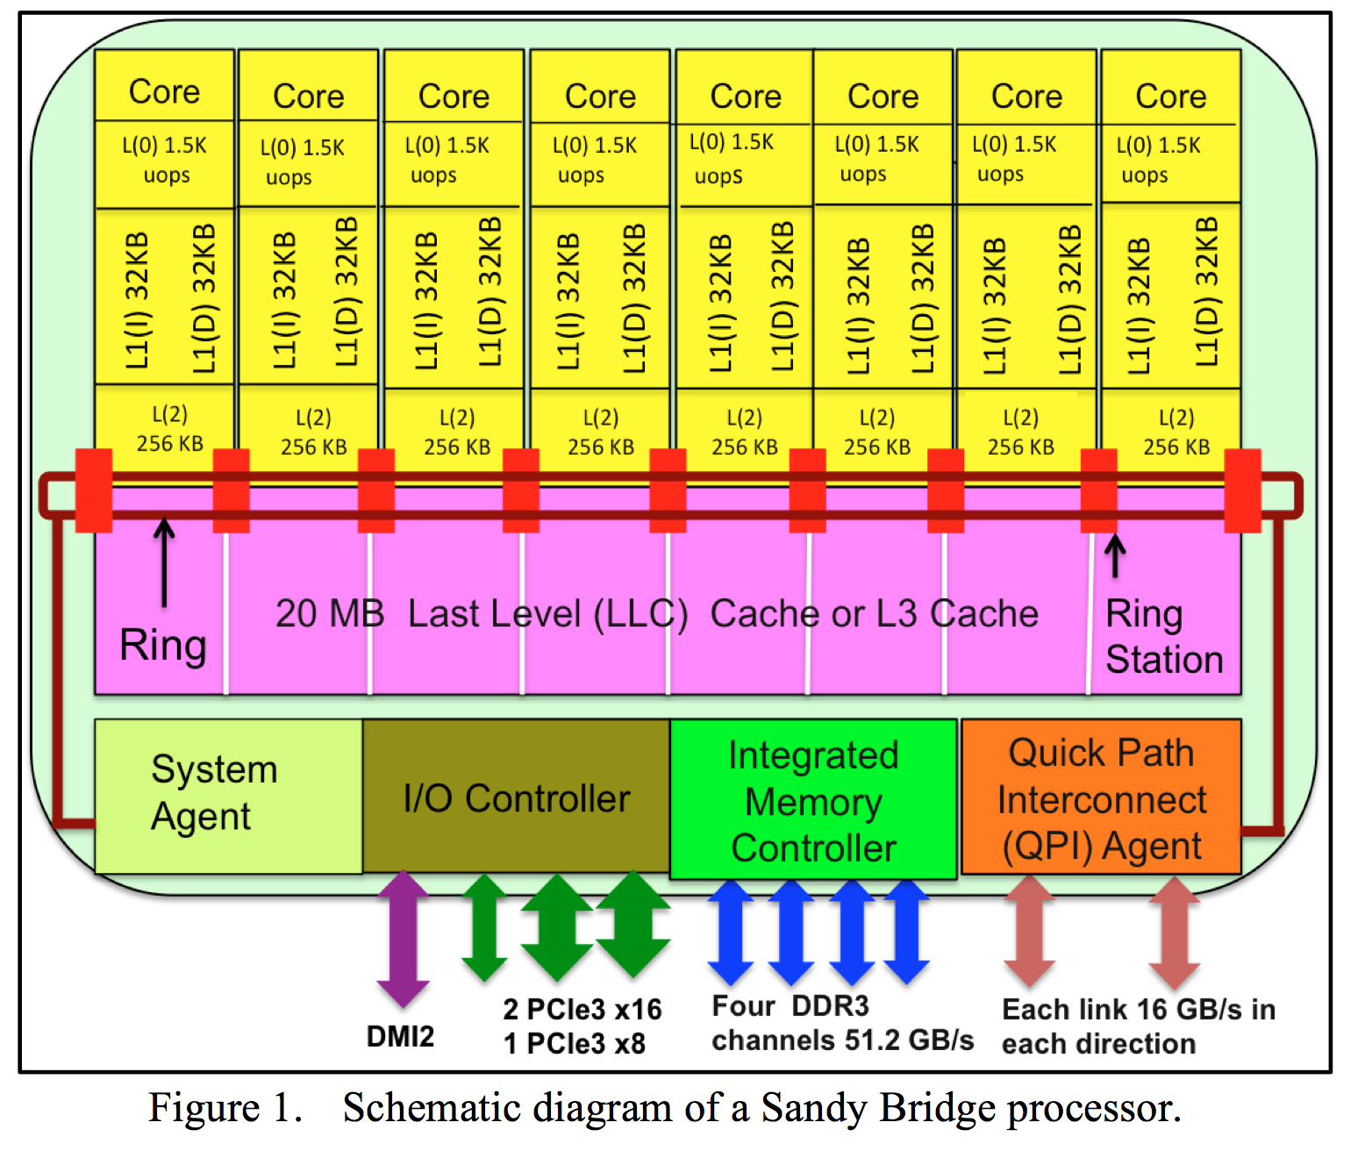

Slide 77
Summary
Memory performance matters!
  often more than CPU performance
  … because it is the bottleneck, and not improving much
  … because most programs move a LOT of data
Design space is huge
  Gambling against program behavior
  Cuts across all layers:
  users → programs → os → hardware
NEXT: Multi-core processors are complicated
  Inconsistent views of memory
  Extremely complex protocols, very hard to get right

