Slide 1
RISC, CISC, and ISA Variations
Hakim Weatherspoon
CS 3410
Computer Science
Cornell University
[Weatherspoon, Bala, Bracy, McKee, and Sirer]

Slide 2
Announcements
Prelim tonight
  Tuesday at 7:30pm
  Go to location based on NetID
  [a – g]* : HLS110 (Hollister 110)
  [h – mg]* : HLSB14 (Hollister B14)
  [mh – z]* : KMBB11 (Kimball B11)

Slide 3
Announcements
Prelim1:
  Time: We will start at 7:30pm sharp, so come early
  Location: on previous slide
  Closed Book
  Cannot use electronic device or outside material
  Practice prelims are online in CMS
Material covered everything up to end of this week
  Everything up to and including data hazards
  Appendix A (logic, gates, FSMs, memory, ALUs)
  Chapter 4 (pipelined [and non] MIPS processor with hazards)
  Chapters 2 (Numbers / Arithmetic, simple MIPS instructions)
  Chapter 1 (Performance)
  Projects 1 and 2, Lab0-4, C HW1

Slide 4
iClicker Question
Which is not considered part of the ISA?
There is a control delay slot.
The number of inputs each instruction can have.
Load-use stalls will not be detected by the processor.
The number of cycles it takes to execute a multiply.
Each instruction is encoded in 32 bits.

Slide 5
iClicker Question
Which is not considered part of the ISA?
There is a control delay slot.
The number of inputs each instruction can have.
Load-use stalls will not be detected by the processor.
The number of cycles it takes to execute a multiply.
Each instruction is encoded in 32 bits.

Slide 6
Big Picture: Where are we now?
compute
jump/branch
targets
memory
register
file
A
alu
D
D
B
+4
addr
PC
inst
control
B
d_{in}
d_{out}
M
memory
extend
Forward
unit
new
pc
Detect
hazard
imm
Instruction
Fetch
Instruction
Decode
Execute
Write-
Back
ctrl
ctrl
ctrl
Memory
IF/ID
ID/EX
EX/MEM
MEM/WB

Slide 7
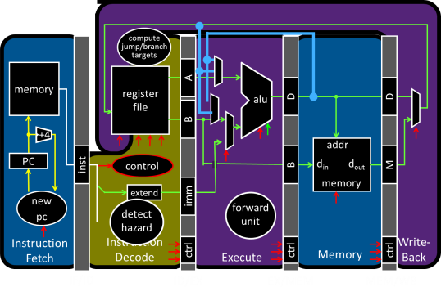
Big Picture: Where are we going?
C
int x = 10;
x = 2 * x + 15;
x0 = 0
x5 = x0 + 10
x5 = x5<<1 #x5 = x5 * 2
x5 = x15 + 15
compiler
RISC-V
assembly
addi x5, x0, 10
muli x5, x5, 2
addi x5, x5, 15
assembler
10 r0 r5 op = addi
00000000101000000000001010010011
00000000001000101000001010000000
00000000111100101000001010010011
machine
code
15 r5 r5 op = addi
CPU
Circuits
Gates
Transistors
Silicon
op = r-type x5 shamt=1 x5 func=sll
Notes:
32 bits, 4 bytes
Add a line to represent the instruction set architecture
Another line for assembly
Another line, high level language

Slide 8
Big Picture: Where are we going?
C
int x = 10;
x = 2 * x + 15;
compiler
High Level Languages
RISC-V
assembly
addi x5, x0, 10
muli x5, x5, 2
addi x5, x5, 15
assembler
00000000101000000000001010010011
00000000001000101000001010000000
00000000111100101000001010010011
machine
code
Instruction Set
Architecture (ISA)
CPU
Circuits
Gates
Transistors
Silicon

Slide 9
Goals for Today
Instruction Set Architectures
  ISA Variations, and CISC vs RISC
  Peek inside some other ISAs:
    X86
    ARM

Slide 10
Next Goal
Is RISC-V the only possible instruction set architecture (ISA)?
What are the alternatives?

Slide 11
Instruction Set Architecture Variations
ISA defines the permissible instructions
  RISC-V: load/store, arithmetic, control flow, …
  ARMv7: similar to RISC-V, but more shift, memory, & conditional ops
  ARMv8 (64-bit): even closer to RISC-V, no conditional ops
  VAX: arithmetic on memory or registers, strings, polynomial evaluation, stacks/queues, …
  Cray: vector operations, …
  x86: a little of everything

Slide 12
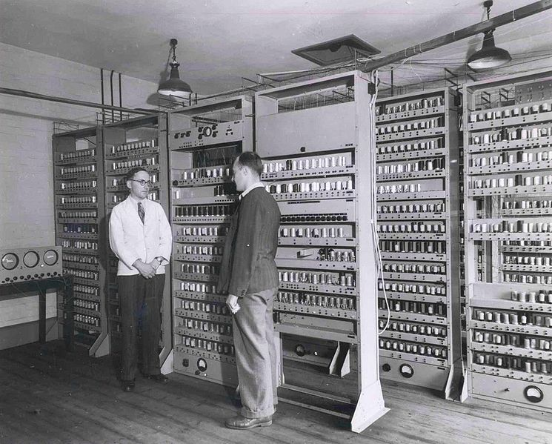
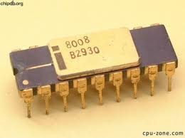
Brief Historical Perspective on ISAs
Accumulators
  Early stored-program computers had one register!
  One register is two registers short of a RISC-V instruction!
  Requires a memory-based operand-addressing mode
    Example Instructions: add 200 // ACC = ACC + Mem[200]
      Add the accumulator to the word in memory at address 200
      Place the sum back in the accumulator
Intel 8008 in 1972
was an accumulator
EDSAC (Electronic Delay Storage
Automatic Calculator) in 1949
Notes:
Accumulator: one register (http://en.wikipedia.org/wiki/Electronic_Delay_Storage_Automatic_Calculator )
The accumulator is both the source operand and the destination for the operation. The second operand comes from memory.
EDSAC (Electronic Delay Storage Automatic Calculator) in 1949. EDSAC was the second electronic digital stored-program computer to go into regular service. The first being the EDVAC (Electronic Discrete Variable Automatic Computer), which, unlike its predecessor the ENIAC, it was binary rather than decimal, and was a stored program computer. The EDVAC had a memory capacity of 1000 44-byte words (i.e. 5.5 kB today). EDVAC's addition time was 864 microseconds (about 1.16 kHz) and its multiplication time was 2900 microseconds (about 0.38 kHz). The computer had almost 6,000 vacuum tubes and 12,000 diodes, and consumed 56 kW of power. It covered 490 ft² (45.5 m²) of floor space and weighed 17,300 lb (7,850 kg). The full complement of operating personnel was thirty people per eight-hour shift.
EDSAC details: The instructions available were: add, subtract, multiply, collate,[10] shift left, shift right, load multiplier register, store (and optionally clear) accumulator, conditional skip, read input tape, print character, round accumulator, no-op and stop. There was no division instruction (though a number of division subroutines were available) and no way to directly load a number into the accumulator (a “store and zero accumulator” instruction followed by an “add” instruction were necessary for this).

Slide 13
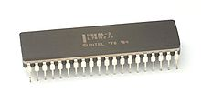
Brief Historical Perspective on ISAs
Next step, more registers…
  Dedicated registers
    E.g. indices for array references in data transfer instructions, separate accumulators for multiply or divide instructions, top-of-stack pointer.
  Extended Accumulator
    One operand may be in memory (like previous accumulators).
    Or, all the operands may be registers (like RISC-V).
Intel 8086
“extended accumulator”
Processor for IBM PCs
Notes:
The next step in the evolution of instruction sets was the addition of registers dedicated to specific operations. Hence, registers might be included to act as indices for array references in data transfer instructions, to act as separate accumulators for multiply or divide instructions, and to serve as the top-of-stack pointer. Perhaps the best-known example of this style of instruction set is found in the Intel 8086, the computer at the core of the IBM Personal Computer. This style of instruction set is labeled extended accumulator, dedicated register, or special-purpose register. Like the single-register accumulator architectures, one operand may be in memory for arithmetic instructions. Like the MIPS architecture, however, there are also instructions where all the operands are registers.

Slide 14
Brief Historical Perspective on ISAs
Next step, more registers…
  General-purpose registers
    Registers can be used for any purpose
    E.g. RISC-V, MIPS, ARM, x86
  Register-memory architectures
    One operand may be in memory (e.g. accumulators)
    E.g. x86 (i.e. 80386 processors)
  Register-register architectures (aka load-store)
    All operands must be in registers
    E.g. RISC-V, MIPS, ARM
Notes:
The generalization of the dedicated-register architecture allows all the registers to be used for any purpose, hence the name general-purpose register. MIPS is an example of a general-purpose register architecture. This style of instruction set may be further divided into those that allow one operand to be in memory (as found in accumulator architectures), called a register-memory architecture, and those that demand that operands always be in registers, called either a load-store or a register-register architecture.
The 80386 is Intel’s attempt to transform the 8086 into a general-purpose register-memory instruction set. Perhaps the best-known register-memory instruction set is the IBM 360 architecture, first announced in 1964. This instruction set is still at the core of IBM’s mainframe computers—responsible for a large part of the business of the largest computer company in the world. Register-memory architectures were the most popular in the 1960s and the first half of the 1970s.
Digital Equipment Corporation’s VAX architecture took memory operands one step further in 1977. It allowed an instruction to use any combination of registers and memory operands. A style of architecture in which all operands can be in memory is called memory-memory. (In truth the VAX instruction set, like almost all other instruction sets since the IBM 360, is a hybrid, since it also has general-purpose registers.)

Slide 15
Takeaway
The number of available registers greatly influenced the instruction set architecture (ISA)
Machine | Num General Purpose Registers | Architectural Style | Year
EDSAC | 1 | Accumulator | 1949
IBM 701 | 1 | Accumulator | 1953
CDC 6600 | 8 | Load-Store | 1963
IBM 360 | 18 | Register-Memory | 1964
DEC PDP-8 | 1 | Accumulator | 1965
DEC PDP-11 | 8 | Register-Memory | 1970
Intel 8008 | 1 | Accumulator | 1972
Motorola 6800 | 2 | Accumulator | 1974
DEC VAX | 16 | Register-Memory, Memory-Memory | 1977
Intel 8086 | 1 | Extended Accumulator | 1978
Motorola 6800 | 16 | Register-Memory | 1980
Intel 80386 | 8 | Register-Memory | 1985
ARM | 16 | Load-Store | 1985
MIPS | 32 | Load-Store | 1985
HP PA-RISC | 32 | Load-Store | 1986
SPARC | 32 | Load-Store | 1987
PowerPC | 32 | Load-Store | 1992
DEC Alpha | 32 | Load-Store | 1992
HP/Intel IA-64 | 128 | Load-Store | 2001
AMD64 (EMT64) | 16 | Register-Memory | 2003
Notes:
The generalization of the dedicated-register architectureallows all the registers to be used for any purpose, hence the name general-purpose register. MIPS is an example of a general-purpose register architecture. This style of instruction set may be further divided into those that allow one operand to be in memory (as found in accumulator architectures), called a register-memory architecture, and those that demand that operands always be in registers, called either a load-store or a register-register architecture.
The 80386 is Intel’s attempt to transform the 8086 into a general-purpose register-memory instruction set. Perhaps the best-known register-memory instruction set is the IBM 360 architecture, first announced in 1964. This instruction set is still at the core of IBM’s mainframe computers—responsible for a large part of the business of the largest computer company in the world. Register-memory architectures were the most popular in the 1960s and the first half of the 1970s.
Digital Equipment Corporation’s VAX architecture took memory operands one step further in 1977. It allowed an instruction to use any combination of registers and memory operands. A style of architecture in which all operands can be in memory is called memory-memory. (In truth the VAX instruction set, like almost all other instruction sets since the IBM 360, is a hybrid, since it also has general-purpose registers.)
Digital Equipment Corporation’s VAX architecture took memory operands one step further in 1977. It allowed an instruction to use any combination of registers and memory operands. A style of architecture in which all operands can be in memory is called memory-memory. (In truth the VAX instruction set, like almost all other instruction sets since the IBM 360, is a hybrid, since it also has general-purpose registers.)

Slide 16
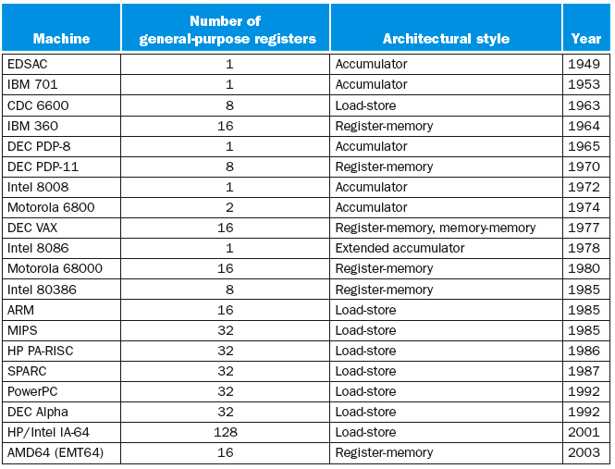
Takeaway
The number of available registers greatly influenced the instruction set architecture (ISA)
Notes:
The generalization of the dedicated-register architectureallows all the registers to be used for any purpose, hence the name general-purpose register. MIPS is an example of a general-purpose register architecture. This style of instruction set may be further divided into those that allow one operand to be in memory (as found in accumulator architectures), called a register-memory architecture, and those that demand that operands always be in registers, called either a load-store or a register-register architecture.
The 80386 is Intel’s attempt to transform the 8086 into a general-purpose register-memory instruction set. Perhaps the best-known register-memory instruction set is the IBM 360 architecture, first announced in 1964. This instruction set is still at the core of IBM’s mainframe computers—responsible for a large part of the business of the largest computer company in the world. Register-memory architectures were the most popular in the 1960s and the first half of the 1970s.
Digital Equipment Corporation’s VAX architecture took memory operands one step further in 1977. It allowed an instruction to use any combination of registers and memory operands. A style of architecture in which all operands can be in memory is called memory-memory. (In truth the VAX instruction set, like almost all other instruction sets since the IBM 360, is a hybrid, since it also has general-purpose registers.)
Digital Equipment Corporation’s VAX architecture took memory operands one step further in 1977. It allowed an instruction to use any combination of registers and memory operands. A style of architecture in which all operands can be in memory is called memory-memory. (In truth the VAX instruction set, like almost all other instruction sets since the IBM 360, is a hybrid, since it also has general-purpose registers.)

Slide 17
Next Goal
How to compute with limited resources?
i.e. how do you design your ISA if you have limited resources?

Slide 18
In the Beginning…
People programmed in assembly and machine code!
  Needed as many addressing modes as possible
  Memory was (and still is) slow
CPUs had relatively few registers
  Register’s were more “expensive” than external mem
  Large number of registers requires many bits to index
Memories were small
  Encouraged highly encoded microcodes as instructions
  Variable length instructions, load/store, conditions, etc

Slide 19
In the Beginning…
People programmed in assembly and machine code!
E.g. x86
  > 1000 instructions!
    1 to 15 bytes each
    E.g. dozens of add instructions
  operands in dedicated registers, general purpose registers, memory, on stack, …
    can be 1, 2, 4, 8 bytes, signed or unsigned
  10s of addressing modes
    e.g. Mem[segment + reg + reg*scale + offset]
E.g. VAX
  Like x86, arithmetic on memory or registers, but also on strings, polynomial evaluation, stacks/queues, …

Slide 20
Complex Instruction Set Computers (CISC)

Slide 21
Takeaway
The number of available registers greatly influenced the instruction set architecture (ISA)
Complex Instruction Set Computers were very complex
  Necessary to reduce the number of instructions required to fit a program into memory.
  However, also greatly increased the complexity of the ISA as well.

Slide 22
Next Goal
How do we reduce the complexity of the ISA while maintaining or increasing performance?

Slide 23
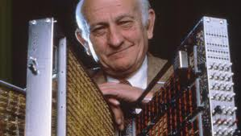
Reduced Instruction Set Computer (RISC)
John Cock
  IBM 801, 1980 (started in 1975)
  Name 801 came from the bldg that housed the project
  Idea: Possible to make a very small and very fast core
  Influences: Known as “the father of RISC Architecture”. Turing Award Recipient and National Medal of Science.

Slide 24


Reduced Instruction Set Computer (RISC)
Dave Patterson
  RISC Project, 1982
  UC Berkeley
  RISC-I: ½ transistors & 3x faster
  Influences: Sun SPARC, namesake of industry
John L. Hennessy
  MIPS, 1981
  Stanford
  Simple, full pipeline
  Influences: MIPS computer system, PlayStation, Nintendo

Slide 25
Reduced Instruction Set Computer (RISC)
RISC-V Design Principles
Simplicity favors regularity
  32 bit instructions
  Same instruction format works at 16- or 64-bit formats
Smaller is faster
  Small register file
Make the common case fast
  Include support for constants
Good design demands good compromises
  Support for different type of interpretations/classes

Slide 26
Reduced Instruction Set Computer
RISC-V = Reduced Instruction Set Computer (RlSC)
  ≈ 200 instructions, 32 bits each, 4 formats
  all operands in registers
    almost all are 32 bits each
  ≈ 1 addressing mode: Mem[reg + imm]
x86 = Complex Instruction Set Computer (ClSC)
  > 1000 instructions, 1 to 15 bytes each
  operands in dedicated registers, general purpose registers, memory, on stack, …
    can be 1, 2, 4, 8 bytes, signed or unsigned
  10s of addressing modes
    e.g. Mem[segment + reg + reg*scale + offset]

Slide 27
The RISC Tenets
RISC
Single-cycle execution
Hardwired control
Load/store architecture
Few memory addressing modes
Fixed-length insn format
Reliance on compiler optimizations
Many registers (compilers are better at using them)
CISC
many multicycle operations
microcoded multi-cycle operations
register-mem and mem-mem
many modes
many formats and lengths
hand assemble to get good performance
few registers

Slide 28
RISC vs CISC
RISC Philosophy
Regularity & simplicity
Leaner means faster
Optimize the
common case
Energy efficiency
Embedded Systems
Phones/Tablets
CISC Rebuttal
Compilers can be smart
Transistors are plentiful
Legacy is important
Code size counts
Micro-code!
Desktops/Servers

Slide 29


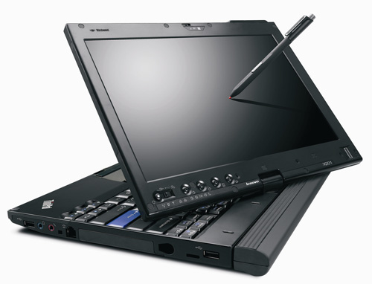
ARMDroid vs WinTel
  Android OS on ARM processor
  Windows OS on Intel (x86) processor

Slide 30
iClicker Question
What is one advantage of a CISC ISA?
It naturally supports a faster clock.
Instructions are easier to decode.
The static footprint of the code will be smaller.
The code is easier for a compiler to optimize.
You have a lot of registers to use.

Slide 31
iClicker Question
What is one advantage of a CISC ISA?
It naturally supports a faster clock.
Instructions are easier to decode.
The static footprint of the code will be smaller.
The code is easier for a compiler to optimize.
You have a lot of registers to use.

Slide 32
Takeaway
The number of available registers greatly influenced the instruction set architecture (ISA)
Complex Instruction Set Computers were very complex
- Necessary to reduce the number of instructions required to fit a program into memory.
- However, also greatly increased the complexity of the ISA as well.
Back in the day… CISC was necessary because everybody programmed in assembly and machine code! Today, CISC ISA’s are still dominant due to the prevalence of x86 ISA processors. However, RISC ISA’s today such as ARM have an ever increasing market share (of our everyday life!).
ARM borrows a bit from both RISC and CISC.

Slide 33
Next Goal
How does RISC-V and ARM compare to each other?

Slide 34
RISC-V instruction formats
All RISC-V instructions are 32 bits long, have 4 formats
R-type
I-type
S-type
U-type
funct7 | rs2 | rs1 | funct3 | rd | op
7 bits | 5 bits | 5 bits | 3 bits | 5 bits | 7 bits
imm |  | rs1 | funct3 | rd | op
12 bits |  | 5 bits | 3 bits | 5 bits | 7 bits
imm | rs2 | rs1 | funct3 | imm | op
7 bits | 5 bits | 5 bits | 3 bits | 5 bits | 7 bits
imm |  |  |  | rd | op
20 bits |  |  |  | 5 bits | 7 bits
34

Slide 35
ARMv7 instruction formats
All ARMv7 instructions are 32 bits long, has 3 formats
R-type
I-type
J-type
opx | op | rs | rd | opx | rt
4 bits | 8 bits | 4 bits | 4 bits | 8 bits | 4 bits
opx | op | rs | rd | immediate
4 bits | 8 bits | 4 bits | 4 bits | 12 bits
opx | op | immediate (target address)
4 bits | 4 bits | 24 bits

Slide 36
ARMv7 Conditional Instructions
  while(i != j) {
  if (i > j)
  i -= j;
  else
  j -= i;
  }
  Loop: BEQ Ri, Rj, End // if "NE" (not equal), then stay in loop
  SLT Rd, Rj, Ri // "GT" if (i > j),
  BNE Rd, R0, Else // …
  SUB Ri, Ri, Rj // if "GT" (greater than), i = i-j;
  J Loop
  Else: SUB Rj, Rj, Ri // or "LT" if (i < j)
  J Loop // if "LT" (less than), j = j-i;
End:
In RISC-V, performance will be
slow if code has a lot of branches

Slide 37
ARMv7 Conditional Instructions
  while(i != j) {
  if (i > j)
  i -= j;
  else
  j -= i;
  }
  LOOP: CMP Ri, Rj // set condition "NE" if (i != j)
  // "GT" if (i > j),
  // or "LT" if (i < j)
  SUBGT Ri, Ri, Rj // if "GT" (greater than), i = i-j;
  SUBLE Rj, Rj, Ri // if "LE" (less than or equal), j = j-i;
  BNE loop // if "NE" (not equal), then loop
In ARM, can avoid delay due to
Branches with conditional
instructions
0
1
0
0
=
≠
<
>
0
0
0
1
=
≠
<
>
1
0
1
0
=
≠
<
>
0
1
0
0
=
≠
<
>

Slide 38
ARMv7: Other Cool operations
Shift one register (e.g. Rc) any amount
Add to another register (e.g. Rb)
Store result in a different register (e.g. Ra)
ADD Ra, Rb, Rc LSL #4
Ra = Rb + Rc<<4
Ra = Rb + Rc x 16

Slide 39
ARMv7 Instruction Set Architecture
All ARMv7 instructions are 32 bits long, has 3 formats
Reduced Instruction Set Computer (RISC) properties
  Only Load/Store instructions access memory
  Instructions operate on operands in processor registers
  16 registers
Complex Instruction Set Computer (CISC) properties
  Autoincrement, autodecrement, PC-relative addressing
  Conditional execution
  Multiple words can be accessed from memory with a single instruction (SIMD: single instr multiple data)

Slide 40
ARMv8 (64-bit) Instruction Set Architecture
All ARMv8 instructions are 64 bits long, has 3 formats
Reduced Instruction Set Computer (RISC) properties
  Only Load/Store instructions access memory
  Instructions operate on operands in processor registers
  32 registers and r0 is always 0
NO MORE Complex Instruction Set Computer (CISC) properties
  NO Conditional execution
  NO Multiple words can be accessed from memory with a single instruction (SIMD: single instr multiple data)

Slide 41
Instruction Set Architecture Variations
ISA defines the permissible instructions
  RISC-V: load/store, arithmetic, control flow, …
  ARMv7: similar to RISC-V, but more shift, memory, & conditional ops
  ARMv8 (64-bit): even closer to RISC-V, no conditional ops
  VAX: arithmetic on memory or registers, strings, polynomial evaluation, stacks/queues, …
  Cray: vector operations, …
  x86: a little of everything

Slide 42
ISA Takeaways
The number of available registers greatly influenced the instruction set architecture (ISA)
Complex Instruction Set Computers were very complex
+ Small # of insns necessary to fit program into memory.
- greatly increased the complexity of the ISA as well.
Back in the day… CISC was necessary because everybody programmed in assembly and machine code! Today, CISC ISA’s are still dominant due to the prevalence of x86 ISA processors. However, RISC ISA’s today such as ARM have an ever increasing market share (of our everyday life!).
ARM borrows a bit from both RISC and CISC.

