Slide 1
The RISC-V Processor
Hakim Weatherspoon
CS 3410
Computer Science
Cornell University
[Weatherspoon, Bala, Bracy, and Sirer]

Slide 2
Announcements
Make sure to go to your Lab Section this week
Completed Proj1 due Friday, Feb 15th
Note, a Design Document is due when you submit Proj1 final circuit
Work alone
BUT use your resources
Lab Section, Piazza.com, Office Hours
Class notes, book, Sections, CSUGLab

Slide 3
Announcements
Check online syllabus/schedule
http://www.cs.cornell.edu/Courses/CS3410/2019sp/schedule
Slides and Reading for lectures
Office Hours
Pictures of all TAs
Project and Reading Assignments
Dates to keep in Mind
Prelims: Tue Mar 5th and Thur May 2nd
Proj 1: Due next Friday, Feb 15th
Proj3: Due before Spring break
Final Project: Due when final will be Feb 16th
Schedule is subject to change

Slide 4
Collaboration, Late, Re-grading Policies
“White Board” Collaboration Policy
Can discuss approach together on a “white board”
Leave, watch a movie such as Black Lightening, then write up solution independently
Do not copy solutions
Late Policy
Each person has a total of five “slip days”
Max of two slip days for any individual assignment
Slip days deducted first for any late assignment,
cannot selectively apply slip days
For projects, slip days are deducted from all partners
25% deducted per day late after slip days are exhausted
Regrade policy
Submit written request within a week of receiving score

Slide 5
Announcements
Level Up (optional enrichment)
Teaches CS students tools and skills needed in their coursework as well as their career, such as Git, Bash Programming, study strategies, ethics in CS, and even applying to graduate school.
Thursdays at 7-8pm in 310 Gates Hall, starting this week
http://www.cs.cornell.edu/courses/cs3110/2019sp/levelup/

Slide 6
Big Picture: Building a Processor
memory
register file
inst
alu
+4
+4
addr
=?
PC
d_{in}
d_{out}
control
cmp
offset
memory
new pc
target
imm
extend
A single cycle processor

Slide 7
Goal for the next few lectures
Understanding the basics of a processor
We now have the technology to build a CPU!
Putting it all together:
Arithmetic Logic Unit (ALU)
Register File
Memory
SRAM: cache
DRAM: main memory
RISC-V Instructions & how they are executed
7

Slide 8
RISC-V Register File
memory
register file
inst
alu
+4
+4
addr
=?
PC
d_{in}
d_{out}
control
cmp
offset
memory
new pc
target
imm
extend
A single cycle processor

Slide 9
RISC-V Register File
RISC-V register file
32 registers, 32-bits each
x0 wired to zero
Write port indexed via R_{W}
on falling edge when WE=1
Read ports indexed via R_{A}, R_{B}
Dual-Read-Port Single-Write-Port
32 x 32 Register File
D_{W}
Q_{A}
32
32
Q_{B}
32
WE
R_{W}
R_{A}
R_{B}
1
5
5
5

Slide 10
RISC-V Register File
RISC-V register file
32 registers, 32-bits each
x0 wired to zero
Write port indexed via R_{W}
on falling edge when WE=1
Read ports indexed via R_{A}, R_{B}
RISC-V register file
Numbered from 0 to 31
Can be referred by number: x0, x1, x2, … x31
Convention, each register also has a name:
x10 – x17 → a0 – a7, x28 – x31 → t3 – t6
W
x0
x1
…
x31
A
32
32
B
32
WE
R_{W}
R_{A}
R_{B}
1
5
5
5

Slide 11
RISC-V Memory
memory
register file
inst
alu
+4
+4
addr
=?
PC
d_{in}
d_{out}
control
cmp
offset
memory
new pc
target
imm
extend
A single cycle processor

Slide 12
RISC-V Memory
1 byte
address
D_{in}
D_{out}
memory
 | 0x000fffff
 | . . .
 | 0x0000000b
 | 0x0000000a
 | 0x00000009
 | 0x00000008
 | 0x00000007
 | 0x00000006
 | 0x00000005
 | 0x00000004
 | 0x00000003
 | 0x00000002
 | 0x00000001
 | 0x00000000
32
32
32
2
0x05
addr
mc
E
32-bit address
32-bit data (but byte addressed)
Enable + 2 bit memory control (mc)
00: read word (4 byte aligned)
01: write byte
10: write halfword (2 byte aligned)
11: write word (4 byte aligned)

Slide 13
Putting it all together: Basic Processor
memory
register file
inst
alu
+4
+4
addr
=?
PC
d_{in}
d_{out}
control
cmp
offset
memory
new pc
target
imm
extend
A single cycle processor

Slide 14
To make a computer
Need a program
Stored program computer
Architectures
von Neumann architecture
Harvard (modified) architecture

Slide 15
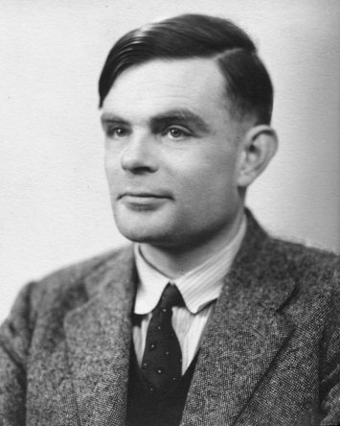
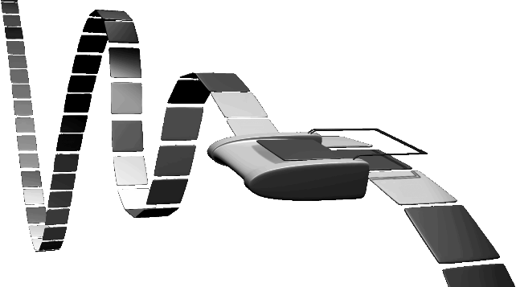
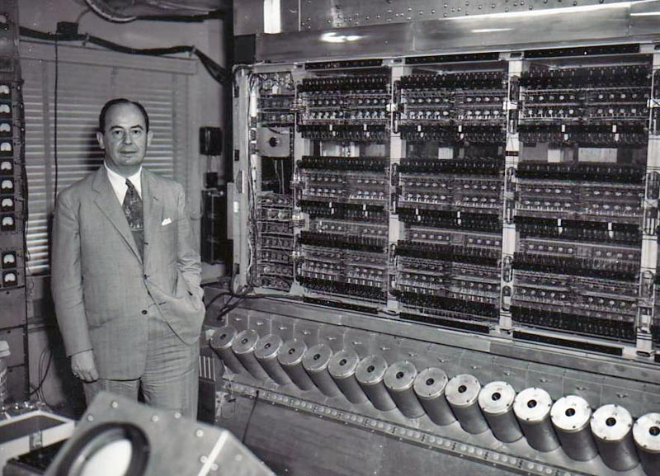
To make a computer
Need a program
Stored program computer
(a Universal Turing Machine)
Architectures
von Neumann architecture
Harvard (modified) architecture
Notes:
A stored-program computer is one which stores program instructions in electronic memory. Often the definition is extended with the requirement that the treatment of programs and data in
http://en.wikipedia.org/wiki/Universal_Turing_machine#Stored-program_computer
Davis makes a persuasive argument that Turing's conception of what is now known as "the stored-program computer", of placing the "action table"—the instructions for the machine—in the same "memory" as the input data, strongly influenced John von Neumann's conception of the first American discrete-symbol (as opposed to analog) computer—the EDVAC (Electronic Discrete Variable Automatic Computer) [previous machine, ENIAC (Electronic Numerical Integrator And Computer), was not a stored-program computer, and was not even in binary, it was in decimal].
See video on von Neumann describe the stored-program computer, 34 minutes into video, https://www.youtube.com/watch?v=VTS9O0CoVng
Also, see clip on Turing in the movie The Imitation Game where Turing states that the Bombe will work in breaking the Enigma machine: https://www.youtube.com/watch?v=MM47hsaYWZE

Slide 16
Putting it all together: Basic Processor
A RISC-V CPU with a (modified) Harvard architecture
Modified: instructions & data in common address space, separate instr/data caches can be accessed in parallel
CPU
Data Memory
Registers
00100000001
00100000010
00010000100
...
Control
data, address,
control
ALU
Program Memory
10100010000
10110000011
00100010101
...
Notes:
The Harvard architecture is a computer architecture with physically separate storage and signal pathways for instructions and data. --- http://en.wikipedia.org/wiki/Harvard_architecture
Under pure von Neumann architecture the CPU can be either reading an instruction or reading/writing data from/to the memory. Both cannot occur at the same time since the instructions and data use the same bus system. In a computer using the Harvard architecture, the CPU can both read an instruction and perform a data memory access at the same time, even without a cache. A Harvard architecture computer can thus be faster for a given circuit complexity because instruction fetches and data access do not contend for a single memory pathway .
Also, a Harvard architecture machine has distinct code and data address spaces: instruction address zero is not the same as data address zero. Instruction address zero might identify a twenty-four bit value, while data address zero might indicate an eight bit byte that isn't part of that twenty-four bit value.
A modified Harvard architecture machine is very much like a Harvard architecture machine, but it relaxes the strict separation between instruction and data while still letting the CPU concurrently access two (or more) memory buses. The most common modification includes separate instruction and data caches backed by a common address space. While the CPU executes from cache, it acts as a pure Harvard machine. When accessing backing memory, it acts like a von Neumann machine (where code can be moved around like data, a powerful technique). This modification is widespread in modern processors such as the ARM architecture and X86 processors. It is sometimes loosely called a Harvard architecture, overlooking the fact that it is actually "modified".

Slide 17
Takeaway
A processor executes instructions
Processor has some internal state in storage elements (registers)
A memory holds instructions and data
(modified) Harvard architecture: separate insts and data
von Neumann architecture: combined inst and data
A bus connects the two
We now have enough building blocks to build machines that can perform non-trivial computational tasks

Slide 18
Next Goal
How to program and execute instructions on a RISC-V processor?

Slide 19
Instruction Processing
Prog
Mem
Reg. File
Data
Mem
inst
ALU
+4
5
5
5
PC
control
A basic processor
fetches
decodes
executes
one instruction at a time
Instructions:
stored in memory, encoded in binary
00100000000000100000000000001010
00100000000000010000000000000000
00000000001000100001100000101010

Slide 20
Levels of Interpretation: Instructions
for (i = 0; i < 10; i++) printf(“go cucs”);
High Level Language
C, Java, Python, ADA, …
Loops, control flow, variables
main: addi x2, x0, 10
addi x1, x0, 0
loop: slt x3, x1, x2
...
Assembly Language
No symbols (except labels)
One operation per statement
“human readable machine language”
10 x2 x0 op=addi
Machine Language
Binary-encoded assembly
Labels become addresses
The language of the CPU
00000000101000010000000000010011
00100000000000010000000000010000
00000000001000100001100000101010
Instruction Set Architecture
ALU, Control, Register File, …
Machine Implementation
(Microarchitecture)

Slide 21
Instruction Set Architecture (ISA)
Different CPU architectures specify different instructions
Two classes of ISAs
Reduced Instruction Set Computers (RISC)
IBM Power PC, Sun Sparc, MIPS, Alpha
Complex Instruction Set Computers (CISC)
Intel x86, PDP-11, VAX
Another ISA classification: Load/Store Architecture
Data must be in registers to be operated on
For example: array[x] = array[y] + array[z]
1 add ? OR 2 loads, an add, and a store ?
Keeps HW simple → many RISC ISAs are load/store

Slide 22
Takeaway
A RISC-V processor and ISA (instruction set architecture) is an example a Reduced Instruction Set Computers (RISC) where simplicity is key, thus enabling us to build it!!

Slide 23
Next Goal
How are instructions executed?
What is the general datapath to execute an instruction?

Slide 24
Five Stages of RISC-V Datapath
Prog.
Mem
Reg. File
Data
Mem
inst
ALU
+4
5
5
5
PC
control
Fetch
Decode
Execute
Memory
WB
A single cycle processor – this diagram is not 100% spatial

Slide 25
Five Stages of RISC-V Datapath
Basic CPU execution loop
Instruction Fetch
Instruction Decode
Execution (ALU)
Memory Access
Register Writeback

Slide 26
Stage 1: Instruction Fetch
Prog.
Mem
Reg. File
Data
Mem
inst
ALU
+4
5
5
5
PC
control
Fetch
Decode
Execute
Memory
WB
Fetch 32-bit instruction from memory
Increment PC = PC + 4

Slide 27
Stage 2: Instruction Decode
Prog.
Mem
Reg. File
Data
Mem
inst
ALU
+4
5
5
5
PC
control
Fetch
Decode
Execute
Memory
WB
Gather data from the instruction
Read opcode; determine instruction type, field lengths
Read in data from register file
(0, 1, or 2 reads for jump, addi, or add, respectively)

Slide 28
Stage 3: Execution (ALU)
Prog.
Mem
Reg. File
Data
Mem
inst
ALU
+4
5
5
5
PC
control
Fetch
Decode
Execute
Memory
WB
Useful work done here (+, -, *, /), shift, logic operation, comparison (slt)
Load/Store? lw x2, x3, 32 → Compute address

Slide 29
Stage 4: Memory Access
Prog.
Mem
Reg. File
Data
Mem
inst
ALU
addr
Data
+4
Data
5
5
5
PC
R/W
control
Fetch
Decode
Execute
Memory
WB
Used by load and store instructions only
Other instructions will skip this stage

Slide 30
Stage 5: Writeback
Prog.
Mem
Reg. File
Data
Mem
inst
ALU
+4
5
5
5
PC
control
Fetch
Decode
Execute
Memory
WB
Write to register file
For arithmetic ops, logic, shift, etc, load. What about stores?
Update PC
For branches, jumps

Slide 31
Takeaway
The datapath for a RISC-V processor has five stages:
Instruction Fetch
Instruction Decode
Execution (ALU)
Memory Access
Register Writeback
This five stage datapath is used to execute all RISC-V instructions

Slide 32
Next Goal
Specific datapaths RISC-V Instructions

Slide 33
RISC-V Design Principles
Simplicity favors regularity
32 bit instructions
Smaller is faster
Small register file
Make the common case fast
Include support for constants
Good design demands good compromises
Support for different type of interpretations/classes

Slide 34
Instruction Types
Arithmetic
add, subtract, shift left, shift right, multiply, divide
Memory
load value from memory to a register
store value to memory from a register
Control flow
conditional jumps (branches)
jump and link (subroutine call)
Many other instructions are possible
vector add/sub/mul/div, string operations
manipulate coprocessor
I/O

Slide 35
RISC-V Instruction Types
Arithmetic/Logical
R-type: result and two source registers, shift amount
I-type: result and source register, shift amount in 16-bit immediate with sign/zero extension
U-type: result register, 16-bit immediate with sign/zero extension
Memory Access
I-type for loads and S-type for stores
load/store between registers and memory
word, half-word and byte operations
Control flow
U-type: jump-and-link
I-type: jump-and-link register
S-type: conditional branches: pc-relative addresses

Slide 36
RISC-V instruction formats
All RISC-V instructions are 32 bits long, have 4 formats
R-type
I-type
S-type
U-type
funct7 | rs2 | rs1 | funct3 | rd | op
7 bits | 5 bits | 5 bits | 3 bits | 5 bits | 7 bits
imm |  | rs1 | funct3 | rd | op
12 bits |  | 5 bits | 3 bits | 5 bits | 7 bits
imm | rs2 | rs1 | funct3 | imm | op
7 bits | 5 bits | 5 bits | 3 bits | 5 bits | 7 bits
imm |  |  |  | rd | op
20 bits |  |  |  | 5 bits | 7 bits

Slide 37
R-Type (1): Arithmetic and Logic
00000000011001000100001000110011
funct7 | rs2 | rs1 | funct3 | rd | op
7 bits | 5 bits | 5 bits | 3 bits | 5 bits | 7 bits
op | funct3 | mnemonic | description
0110011 | 000 | ADD rd, rs1, rs2 | R[rd] = R[rs1] + R[rs2]
0110011 | 000 | SUB rd, rs1, rs2 | R[rd] = R[rs1] – R[rs2]
0110011 | 110 | OR rd, rs1, rs2 | R[rd] = R[rs1] | R[rs2]
0110011 | 100 | XOR rd, rs1, rs2 | R[rd] = R[rs1] ⊕ R[rs2]

Slide 38
Arithmetic and Logic
Prog.
Mem
Reg. File
ALU
+4
5
5
5
PC
control
Fetch
Decode
Execute
Memory
WB
skip

Slide 39
R-Type (2): Shift Instructions
0000000001100010000101000011011
funct7 | rs2 | rs1 | funct3 | rd | op
7 bits | 5 bits | 5 bits | 3 bits | 5 bits | 7 bits
op | funct3 | mnemonic | description
0110011 | 001 | SLL rd, rs1, rs2 | R[rd] = R[rs1] << R[rs2]
0110011 | 101 | SRL rd, rs1, rs2 | R[rd] = R[rs1] >>> R[rs2] (zero ext.)
0110011 | 101 | SRA rd, rs1, rs2 | R[rd] = R[rt] >>> R[rs2] (sign ext.)

Slide 40
Shift
Prog.
Mem
Reg. File
ALU
+4
5
5
5
PC
control
Fetch
Decode
Execute
Memory
WB
skip

Slide 41
I-Type (1): Arithmetic w/ immediates
00000000010100101000001010010011
imm |  | rs1 | funct3 | rd | op
12 bits |  | 5 bits | 3 bits | 5 bits | 7 bits
op | funct3 | mnemonic | description
0010011 | 000 | ADDI rd, rs1, imm | R[rd] = R[rs1] + imm
0010011 | 111 | ANDI rd, rs1, imm | R[rd] = R[rs1] & zero_extend(imm)
0010011 | 110 | ORI rd, rs1, imm | R[rd] = R[rs1] | zero_extend(imm)

Slide 42
Arithmetic w/ immediates
Prog.
Mem
Reg. File
ALU
+4
5
5
5
PC
control
imm
extend
16
12
shamt
Fetch
Decode
Execute
Memory
WB
skip

Slide 43
U-Type (1): Load Upper Immediate
“
”
00000000000000000101001010110111
imm |  |  |  | rd | op
20 bits |  |  |  | 5 bits | 7 bits
op | mnemonic | description
0110111 | LUI rd, imm | R[rd] = imm << 16

Slide 44
Load Upper Immediate
Prog.
Mem
Reg. File
ALU
0x50000
+4
5
5
5
PC
control
16
imm
extend
16
12
shamt
Fetch
Decode
Execute
Memory
WB
skip

Slide 45
RISC-V Instruction Types
Arithmetic/Logical
R-type: result and two source registers, shift amount
I-type: result and source register, shift amount in 16-bit immediate with sign/zero extension
U-type: result register, 16-bit immediate with sign/zero extension
Memory Access
I-type for loads and S-type for stores
load/store between registers and memory
word, half-word and byte operations
Control flow
U-type: jump-and-link
I-type: jump-and-link register
S-type: conditional branches: pc-relative addresses
✔

Slide 46
RISC-V Instruction Types
Arithmetic/Logical
R-type: result and two source registers, shift amount
I-type: result and source register, shift amount in 16-bit immediate with sign/zero extension
U-type: result register, 16-bit immediate with sign/zero extension
Memory Access
I-type for loads and S-type for stores
load/store between registers and memory
word, half-word and byte operations
Control flow
U-type: jump-and-link
I-type: jump-and-link register
S-type: conditional branches: pc-relative addresses
✔

Slide 47
Summary
We have all that it takes to build a processor!
Arithmetic Logic Unit (ALU)
Register File
Memory
RISC-V processor and ISA is an example of a Reduced Instruction Set Computers (RISC)
Simplicity is key, thus enabling us to build it!
We now know the data path for the MIPS ISA:
register, memory and control instructions

