Slide 1
State
Prof. Hakim Weatherspoon
CS 3410
Computer Science
Cornell University
[Weatherspoon, Bala, Bracy, and Sirer]

Slide 2
Goals for Today
State
How do we store one bit?
Attempts at storing (and changing) one bit
Set-Reset Latch
D Latch
D Flip-Flops
Master-Slave Flip-Flops
Register: storing more than one bit, N-bits
Basic Building Blocks
Decoders and Encoders

Slide 3
Goal
How do we store store one bit?

Slide 4
First Attempt: Unstable Devices
B
C
A

Slide 5
Second Attempt: Bistable Devices
Stable and unstable equilibria?
A
B
A Simple Device
Notes:
How to create state? Feedback.
Show how the signal works

Slide 6

Third Attempt: Set-Reset Latch
A
S
$$\overline{Q}$$
Q
R
B
Notes:
Can you store a value (with this circuit)?
Can you change its value?
Q is comes from Latin language "quiscens" or "the present particle" or "what is present available" or "present output"
How to create state? Feedback.
Show how the signal works

Slide 7
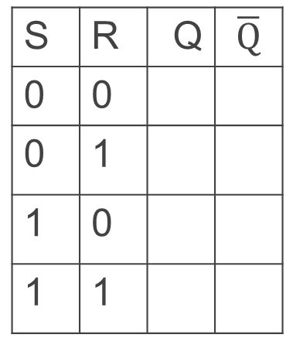


Third Attempt: Set-Reset Latch
S
A
$$\overline{Q}$$
Q
B
R
A | B | OR | NOR
0 | 0 | 0 | 1
0 | 1 | 1 | 0
1 | 0 | 1 | 0
1 | 1 | 1 | 0
S | R | Q | $$\overline{Q}$$
0 | 0
0 | 1
1 | 0
1 | 1
S | R | Q | $$\overline{Q}$$
0 | 0
0 | 1
1 | 0
1 | 1
Set-Reset (S-R) Latch
Stores a value Q and its complement

Slide 8


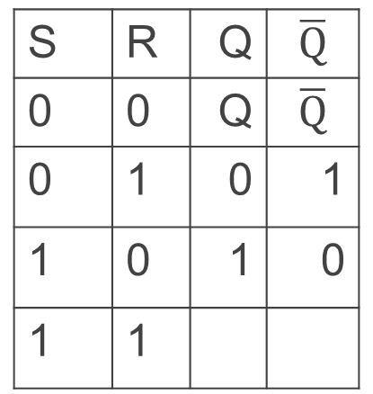
Third Attempt: Set-Reset Latch
S
Q
S
R
$$\overline{Q}$$
$$\overline{Q}$$
Q
R
S | R | Q | $$\overline{Q}$$
0 | 0 | Q | $$\overline{Q}$$
0 | 1 | 0 | 1
1 | 0 | 1 | 0
1 | 1
Set-Reset (S-R) Latch
Stores a value Q and its complement
Notes:
Start with 0, 1 => 0, 1
then 0, 0 => 0, 1
then 1, 0 => 1, 0
then 0, 0 => 1, 0, better yet “stay”
1, 1 is forbidden, b/c going to 0, 0 after goes haywire
i.e.
Start 1,1 => 0,0
Alright. Now change S,R to 0, 0, what happens.
1, 1=>0, 0 -> 0, 0=> 0, 0 -> 0, 0=>1, 1 -> 0, 0=> 0, 0 -> oscillations.
S R=>Q,!Q -> S,R=>Q,!Q -> S, R=>Q,!Q -> S,R => Q,!Q

Slide 9
Takeaway
Set-Reset (SR) Latch can store one bit and we can change the value of the stored bit. But, SR Latch has a forbidden state.

Slide 10
Next Goal
How do we avoid the forbidden state of S-R Latch?

Slide 11
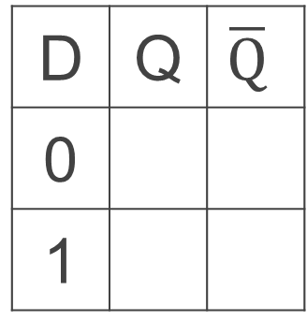
Fourth Attempt: (Unclocked) D Latch
D
S
Q
D
S
R
Q
$$\overline{Q}$$
R
Q
D | Q | $$\overline{Q}$$
0
1
Fill in the truth table?
A | B | OR | NOR
0 | 0 | 0 | 1
0 | 1 | 1 | 0
1 | 0 | 1 | 0
1 | 1 | 1 | 0
Notes:
Start in 0, 0, 1
Change to D = 1
After NOT gate, R = 0
After OR+NOT gates, /Q = 0 (R is already ready then), Q goes to 1
Problem: No way to hold state

Slide 12
Takeaway
Set-Reset (SR) Latch can store one bit and we can change the value of the stored bit. But, SR Latch has a forbidden state.
(Unclocked) D Latch can store and change a bit like an SR Latch while avoiding the forbidden state.

Slide 13
Next Goal
How do we coordinate state changes to a D Latch?

Slide 14
Aside: Clocks
Clock helps coordinate state changes
Usually generated by an oscillating crystal
Fixed period
Frequency = 1/period
clock
high
rising edge
falling edge
1
0
clock
period
clock
low

Slide 15
Clock Disciplines
Level sensitive
State changes when clock is high (or low)
Edge triggered
State changes at clock edge
positive edge-triggered
negative edge-triggered

Slide 16
Clock Methodology
Clock Methodology
Negative edge, synchronous
Edge-Triggered → signals must be stable near falling edge
“near” = before and after
t_{setup} t_{hold}
t_{setup}
t_{hold}
clk
t_{combinational}
compute
save
compute
save
compute

Slide 17

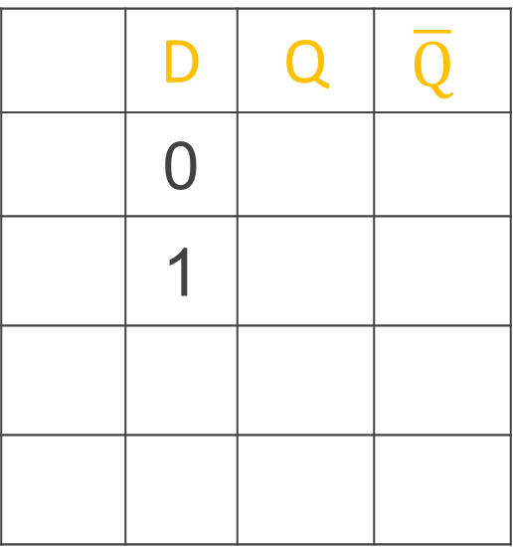

Round 2: D Latch (1)
D
Inverter prevents SR Latch from entering 1,1 state
S
Q
R
$$\overline{Q}$$
 | D | Q | $$\overline{Q}$$
 | 0
 | 1
Reset
Set
D
Q
C
$$\overline{Q}$$
Notes:
Any forbidden S=R=1 inputs? No
Need both truth tables
Answer:
Q
Q
0
1

Slide 18
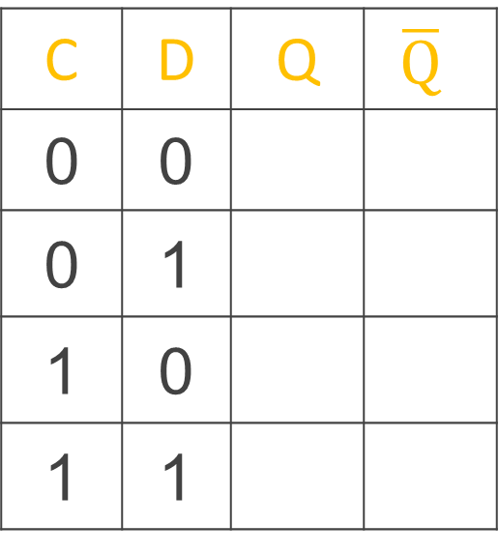
Round 2: D Latch (1)
D
Level sensitive
Inverter prevents SR Latch from entering 1,1 state
C enables changes
S
Q
C
R
$$\overline{Q}$$
C = 1, D Latch transparent: set/reset (according to D)
C = 0, D Latch opaque: keep state (ignore D)
C | D | Q | $$\overline{Q}$$
0 | 0
0 | 1
1 | 0
1 | 1
No
Change
D
Q
Reset
C
$$\overline{Q}$$
Set
Notes:
Any forbidden S=R=1 inputs? No
Need both truth tables
Answer:
Q
Q
0
1

Slide 19

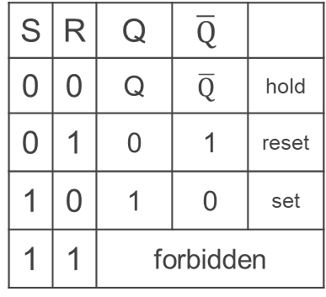
Round 2: D Latch (1)
D
Level sensitive
Inverter prevents SR Latch from entering 1,1 state
C enables changes
S
Q
C
R
$$\overline{Q}$$
C = 1, D Latch transparent: set/reset (according to D)
C = 0, D Latch opaque: keep state (ignore D)
C | D | Q | $$\overline{Q}$$
0 | 0
0 | 1
1 | 0
1 | 1
No
Change
S | R | Q | $$\overline{Q}$$
0 | 0 | Q | $$\overline{Q}$$ | hold
0 | 1 | 0 | 1 | reset
1 | 0 | 1 | 0 | set
1 | 1 | forbidden
D
Q
Reset
C
$$\overline{Q}$$
Set
Notes:
Any forbidden S=R=1 inputs? No
Need both truth tables
Answer:
Q
Q
0
1

Slide 20
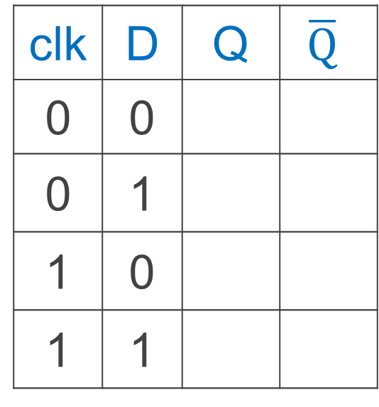

Round 2: D Latch(1)
Level Sensitive D Latch
Clock high: set/reset (according to D)
Clock low: keep state (ignore D)
D
Q
clk
$$\overline{Q}$$
clk | D | Q | $$\overline{Q}$$
0 | 0
0 | 1
1 | 0
1 | 1
clk
D
Q
Notes:
Any forbidden S=R=1 inputs? No
Need both truth tables

Slide 21



Round 3: D Flip-Flop
D
D
Q
D
Q
Q
Edge-Triggered
Data captured when clock high
Output changes only on falling edges
X
clk
C
$$\overline{Q}$$
C
$$\overline{Q}$$
$$\overline{Q}$$
L1
L2
Notes:
Master-Slave Flip Flop
- Outputs change only on falling edges
- Data is captured on rising edges
1 cycle delay
but works out perfectly – data for the next stage is ready 1 cycle ahead of time

Slide 22
Round 3: D Flip-Flop
D passes through L1 to X
D
D
Q
D
Q
Q
D
X
Clock = 1: L1 transparent L2 opaque
X
X
clk
1
C
0
C
When CLK rises (0→1),
now X can change,
Q does not change
L1
L2
X passes through L2 to Q
D
D
Q
D
Q
Q
X
Q
Clock = 0: L1 opaque L2 transparent
X
X
clk
0
C
1
C
L1
L2
When CLK falls (1→0),
Q gets X, X cannot change
Notes:
Master-Slave Flip Flop
- Outputs change only on falling edges
- Data is captured on rising edges
1 cycle delay
but works out perfectly – data for the next stage is ready 1 cycle ahead of time

Slide 23



Edge-Triggered D Flip-Flop
1
0
0
D Flip-Flop
Edge-Triggered
Data captured when clock is high
Output changes only on falling edges
D
D
Q
D
Q
Q
X
clk
0
C
$$\overline{Q}$$
1
C
$$\overline{Q}$$
$$\overline{Q}$$
L1
L2
clk
D
X
Q
A
B
Notes:
Master-Slave Flip Flop
- Outputs change only on falling edges
- Data is captured on rising edges
1 cycle delay
but works out perfectly – data for the next stage is ready 1 cycle ahead of time

Slide 24
Takeaway
Set-Reset (SR) Latch can store one bit and we can change the value of the stored bit. But, SR Latch has a forbidden state.
(Unclocked) D Latch can store and change a bit like an SR Latch while avoiding a forbidden state.
An Edge-Triggered D Flip-Flip (aka Master-Slave D Flip-Flip) stores one bit. The bit can be changed in a synchronized fashion on the edge of a clock signal.

Slide 25
Next Goal
How do we store more than one bit, N bits?

Slide 26
Registers
D0
Register
D flip-flops in parallel
shared clock
extra clocked inputs: write_enable, reset, …
D1
D2
D3
4-bit
reg
4
4
clk
clk

Slide 27
Takeaway
Set-Reset (SR) Latch can store one bit and we can change the value of the stored bit. But, SR Latch has a forbidden state.
(Unclocked) D Latch can store and change a bit like an SR Latch while avoiding a forbidden state.
An Edge-Triggered D Flip-Flip (aka Master-Slave D Flip-Flip) stores one bit. The bit can be changed in a synchronized fashion on the edge of a clock signal.
An N-bit register stores N-bits. It is created with N D-Flip-Flops in parallel along with a shared clock.

Slide 28
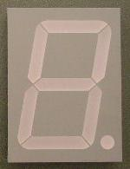
An Example: What will this circuit do?
4
16
Decoder
4
4
4-bit
reg
+1
Clk
4

Slide 29
Decoder Example: 7-Segment LED
d7
d6
d5
d4
7-Segment LED
photons emitted when electrons fall into holes
d3
d2
d1
d0
Notes:
Previous slide would need to display up to 16, so would need a 16-segment LED decoder

Slide 30
Decoder Example: 7-Segment LED Decoder
3 inputs
encode 0 – 7 in binary
7 outputs
one for each LED
7LED decode

Slide 31
7 Segment LED Decoder Implementation
b2 | b1 | b0 | d6 | d5 | d4 | d3 | d2 | d1 | d0
0 | 0 | 0
0 | 0 | 1
0 | 1 | 0
0 | 1 | 1
1 | 0 | 0
1 | 0 | 1
1 | 1 | 0
1 | 1 | 1
d1
d2
d0
d3
d4
d6
d5

Slide 32
Basic Building Blocks We have Seen
N
2^{N}
0
N
binary
encoder
1
N
N
2
N
N
Multiplexor
binary
decoder
. . .
2^{N}
N
2^{M}-1
M

Slide 33
Encoders
0
1
2
3
N Input wires
4
Log₂(N) outputs wires
encoder
5
. . .
6
7
e.g. Voting:
Can only vote for one out of N
candidates, so N inputs.
But can encode vote efficiently
with binary encoding.
. . .
N
Notes:
N possible inputs -> log2(N) wires to encode

Slide 34
Example Encoder Truth Table
a | b | c | d
0 | 0 | 0 | 0
1 | 0 | 0 | 0
0 | 1 | 0 | 0
0 | 0 | 1 | 0
0 | 0 | 0 | 1
a
1
o₀
b
2
o₁
c
3
o₂
d
4
A 3-bit
encoder
with 4 inputs for simplicity
Notes:
Implementation . . .
assume 8 choices, exactly one mark detected

Slide 35
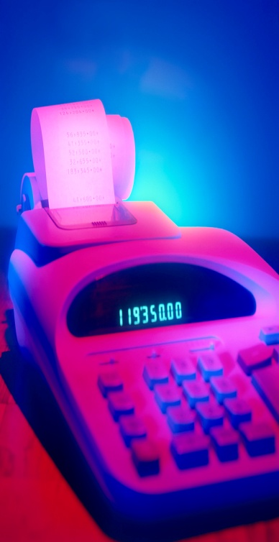
Basic Building Blocks Example: Voting
enc
7LED decode
detect
8
3
7
Ballots
The 3410 optical scan
vote reader
machine

Slide 36
Basic Building Blocks We have Seen
N
2^{N}
0
N
binary
encoder
1
N
N
2
N
N
Multiplexor
binary
decoder
. . .
2^{N}
N
2^{M}-1
M

Slide 37
Recap
We can now build interesting devices with sensors
Using combinational logic
We can also store data values (aka Sequential Logic)
In state-holding elements
Coupled with clocks

Slide 38
Summary
We can now build interesting devices with sensors
Using combinational logic
We can also store data values
Stateful circuit elements (D Flip Flops, Registers, …)
Clock to synchronize state changes

