Slide 1
State
Prof. Hakim Weatherspoon
CS 3410
Computer Science
Cornell University
[Weatherspoon, Bala, Bracy, and Sirer]

Slide 2
Big Picture: Building a Processor
memory
register
file
inst
alu
+4
+4
addr
=?
PC
d_{in}
d_{out}
control
cmp
offset
memory
new
pc
target
imm
extend
A single cycle processor
2

Slide 3
Review
We can generalize 1-bit Full Adders to 32 bits, 64 bits …
A₃ B₃
A₂ B₂
A₁ B₁
A₀ B₀
C₀
S₃
S₂
S₁
S₀

Slide 4
Review
We can generalize 1-bit Full Adders to 32 bits, 64 bits …
B₃
B₂
B₁
B₀
A₃
mux
A₂
mux
A₁
mux
A₀
mux
0=add
1=sub
over
flow
S₃
S₂
S₁
S₀

Slide 5
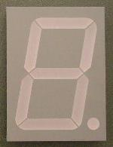
Example: A Calculator
8
A
8
decoder
8
B
S
0=add
1=sub

Slide 6
Example: A Calculator
8
A
8
8
adder
decoder
8
8
B
mux
8
S
0=add
1=sub

Slide 7
Example: A Calculator
8
128
A
0b1000 0000
8
8
adder
decoder
8
8
128
B
mux
0b1000 0000
8
S
0=add
1=sub

Slide 8
Example: A Calculator
8
128
A
0b1000 0000
8
8
adder
decoder
8
8
128
B
mux
0b1000 0000
8
S
0=add
1=sub

Slide 9
Review: Efficiency and Generality
We can generalize 1-bit Full Adders to 32 bits, 64 bits …
How long does it take to compute a result?
B₃
B₂
B₁
B₀
A₃
mux
A₂
mux
A₁
mux
A₀
mux
0=add
1=sub
over
flow
S₃
S₂
S₁
S₀

Slide 10
Review: Efficiency and Generality
We can generalize 1-bit Full Adders to 32 bits, 64 bits …
How long does it take to compute a result?
  A) 2 ns
  B) 2 gate delays
  C) 10 ns
  D) 10 gate delays
  E) 8 gate delays

Slide 11
Review: Efficiency and Generality
We can generalize 1-bit Full Adders to 32 bits, 64 bits …
How long does it take to compute a result?
B₃
B₂
B₁
B₀
A₃
mux
A₂
mux
A₁
mux
A₀
mux
0=add
1=sub
over
flow
t=10
t=8
S₃
t=6
S₂
t=4
S₁
t=2
S₀
t=0

Slide 12
Review: Efficiency and Generality
We can generalize 1-bit Full Adders to 32 bits, 64 bits …
How long does it take to compute a result?
Can we store the result?
B₃
B₂
B₁
B₀
A₃
mux
A₂
mux
A₁
mux
A₀
mux
0=add
1=sub
over
flow
t=10
t=8
S₃
t=6
S₂
t=4
S₁
t=2
S₀
t=0

Slide 13
Performance
Speed of a circuit is affected by the number of gates in series (on the critical path or the deepest level of logic)
inputs
arrive
Combinational
Logic
outputs
expected
t_{combinational}

Slide 14
4-bit Ripple Carry Adder
A₃ B₃
A₂ B₂
A₁ B₁
A₀ B₀
C₄
C₃
C₂
C₁
C₀
S₃
S₂
S₁
S₀
Carry ripples from lsb to msb
First full adder, 2 gate delay
Second full adder, 2 gate delay
…
Notes:
Carry-lookahead adders would be more efficient performance wise (i.e. lower gate delay), but more expense hardware wise (i.e. more logic gates)

Slide 15
Stateful Components
Until now is combinationial logic
  Output is computed when inputs are present
  System has no internal state
  Nothing computed in the present can depend on what happened in the past!
Need a way to record data
Need a way to build stateful circuits
Need a state-holding device
Inputs
Combinational
circuit
Outputs
N
M
Notes:
How are we going to stably store state

Slide 16
Goals for Today
State
  How do we store one bit?
  Attempts at storing (and changing) one bit
    Set-Reset Latch
    D Latch
    D Flip-Flops
    Master-Slave Flip-Flops
  Register: storing more than one bit, N-bits
Basic Building Blocks
  Decoders and Encoders

Slide 17
Goal
How do we store store one bit?

Slide 18
First Attempt: Unstable Devices
B
C
A

Slide 19
First Attempt: Unstable Devices
B
0
1
C
0
1
0
1
A
Does not work!
  Unstable
  Oscillates wildly!

Slide 20
Second Attempt: Bistable Devices
Stable and unstable equilibria?
A
B
A Simple Device
In stable state, A = B
How do we change the state?
0
1
1
0
A
B
A
B
Notes:
How to create state? Feedback.
Show how the signal works

Slide 21

Third Attempt: Set-Reset Latch
A
S
$$\overline{Q}$$
Q
R
B
Notes:
Can you store a value (with this circuit)?
Can you change its value?
Q is comes from Latin language "quiscens" or "the present particle" or "what is present available" or "present output"
How to create state? Feedback.
Show how the signal works

Slide 22
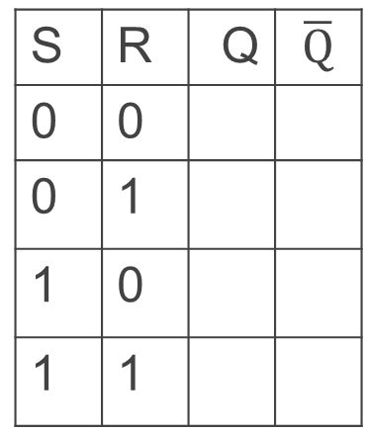


Third Attempt: Set-Reset Latch
S
A
$$\overline{Q}$$
Q
B
R
A | B | OR | NOR
0 | 0 | 0 | 1
0 | 1 | 1 | 0
1 | 0 | 1 | 0
1 | 1 | 1 | 0
S | R | Q | $$\overline{Q}$$
0 | 0
0 | 1
1 | 0
1 | 1
S | R | Q | $$\overline{Q}$$
0 | 0
0 | 1
1 | 0
1 | 1
Set-Reset (S-R) Latch
Stores a value Q and its complement

Slide 23

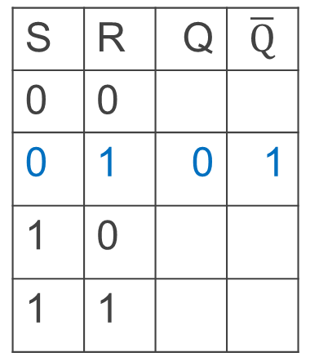
Third Attempt: Set-Reset Latch
S
0
A
$$\overline{Q}$$
0
1
Q
B
$\overline{Q}$will be 1
R
Q will be 0 if R is 1
A | B | OR | NOR
0 | 0 | 0 | 1
0 | 1 | 1 | 0
1 | 0 | 1 | 0
1 | 1 | 1 | 0
1
S | R | Q | $$\overline{Q}$$
0 | 0
0 | 1
1 | 0
1 | 1
S | R | Q | $$\overline{Q}$$
0 | 0
0 | 1 | 0 | 1
1 | 0
1 | 1
Set-Reset (S-R) Latch
Stores a value Q and its complement

Slide 24
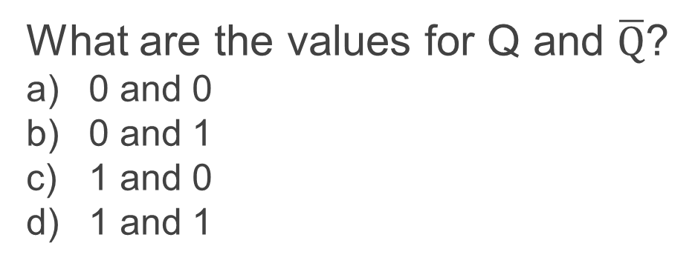

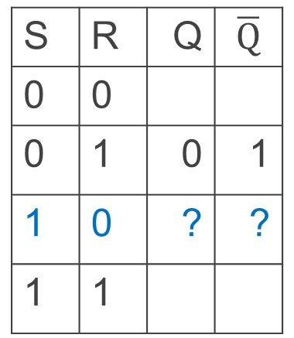
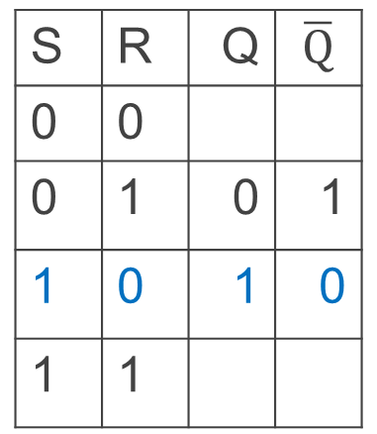
Third Attempt: Set-Reset Latch
S
1
A
$$\overline{Q}$$
1
0
Q
B
$\overline{Q}$will be 0 if S is 1
R
Q will be 1
A | B | OR | NOR
0 | 0 | 0 | 1
0 | 1 | 1 | 0
1 | 0 | 1 | 0
1 | 1 | 1 | 0
0
Set-Reset (S-R) Latch
Stores a value Q and its complement
S | R | Q | $$\overline{Q}$$
0 | 0
0 | 1 | 0 | 1
1 | 0 | 1 | 0
1 | 1
S | R | Q | $$\overline{Q}$$
0 | 0
0 | 1 | 0 | 1
1 | 0 | ? | ?
1 | 1
What are the values for Q and $\overline{Q}$?
0 and 0
0 and 1
1 and 0
1 and 1
iClicker Question
Notes:
Ask a clicker question about Q and !Q

Slide 25
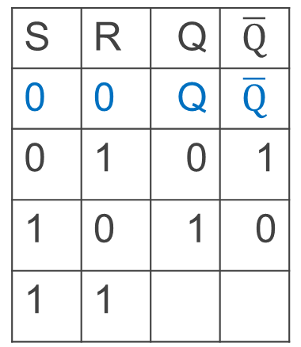
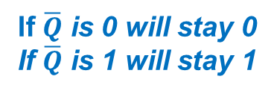
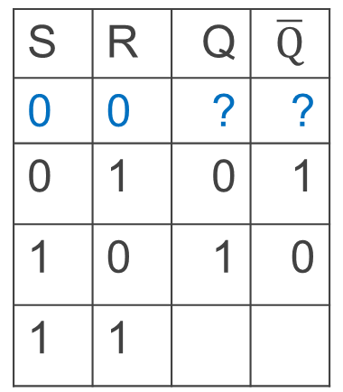
Third Attempt: Set-Reset Latch
1
S
1->0
A
$$\overline{Q}$$
1
0
Q
B
If $\overline{Q}$ is 0 will stay 0
If $\overline{Q}$ is 1 will stay 1
R
If Q is 1, will stay 1
if Q is 0, will stay 0
A | B | OR | NOR
0 | 0 | 0 | 1
0 | 1 | 1 | 0
1 | 0 | 1 | 0
1 | 1 | 1 | 0
0
S | R | Q | $$\overline{Q}$$
0 | 0 | Q | $$\overline{Q}$$
0 | 1 | 0 | 1
1 | 0 | 1 | 0
1 | 1
S | R | Q | $$\overline{Q}$$
0 | 0 | ? | ?
0 | 1 | 0 | 1
1 | 0 | 1 | 0
1 | 1
Set-Reset (S-R) Latch
Stores a value Q and its complement
Notes:
Since the set and reset input are both 0, the Q and !Q determine the output, which will hold.

Slide 26

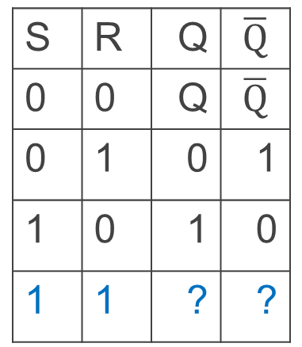
Third Attempt: Set-Reset Latch
S
1
A
$$\overline{Q}$$
0
0
Q
B
$\overline{Q}$ will be 0 since S is 1
R
Q will be 0 since R is 1
A | B | OR | NOR
0 | 0 | 0 | 1
0 | 1 | 1 | 0
1 | 0 | 1 | 0
1 | 1 | 1 | 0
1
S | R | Q | $$\overline{Q}$$
0 | 0 | Q | $$\overline{Q}$$
0 | 1 | 0 | 1
1 | 0 | 1 | 0
1 | 1 | ? | ?
Set-Reset (S-R) Latch
Stores a value Q and its complement
What happens when S,R changes from 1,1 to 0,0?

Slide 27
iClicker Question
What’s wrong with the SR Latch?
Q is undefined when S=1 and R=1
(That’s why this is called the forbidden state.)
Q oscillates between 0 and 1 when the inputs transition from 1,1 → 0,0
The SR Latch is problematic b/c it has two outputs to store a single bit.
There is nothing wrong with the SR Latch!

Slide 28
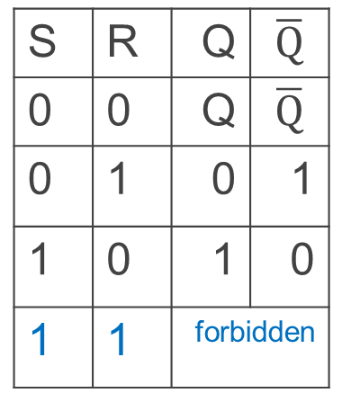
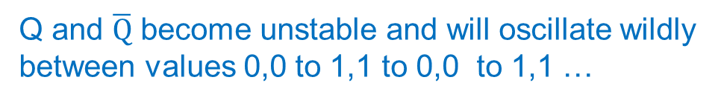
Third Attempt: Set-Reset Latch
1
S
->0
A
$$\overline{Q}$$
0
->1
->0
->1
0
->1
->0
->1
Q
B
R
A | B | OR | NOR
0 | 0 | 0 | 1
0 | 1 | 1 | 0
1 | 0 | 1 | 0
1 | 1 | 1 | 0
1
->0
S | R | Q | $$\overline{Q}$$
0 | 0 | Q | $$\overline{Q}$$
0 | 1 | 0 | 1
1 | 0 | 1 | 0
1 | 1 | forbidden
Set-Reset (S-R) Latch
Stores a value Q and its complement
What happens when S,R changes from 1,1 to 0,0?
Q and $\overline{Q}$ become unstable and will oscillate wildly
between values 0,0 to 1,1 to 0,0 to 1,1 …
Notes:
Start with 0, 1 => 0, 1
then 0, 0 => 0, 1
then 1, 0 => 1, 0
then 0, 0 => 1, 0, better yet “stay”
1, 1 is forbidden, b/c going to 0, 0 after goes haywire
i.e.
Start 1,1 => 0,0
Alright. Now change S,R to 0, 0, what happens.
1, 1=>0, 0 -> 0, 0=> 0, 0 -> 0, 0=>1, 1 -> 0, 0=> 0, 0 -> oscillations.
S R=>Q,!Q -> S,R=>Q,!Q -> S, R=>Q,!Q -> S,R => Q,!Q

Slide 29


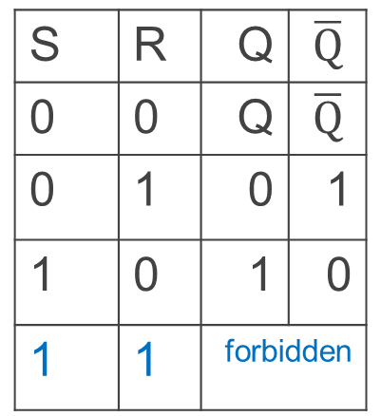
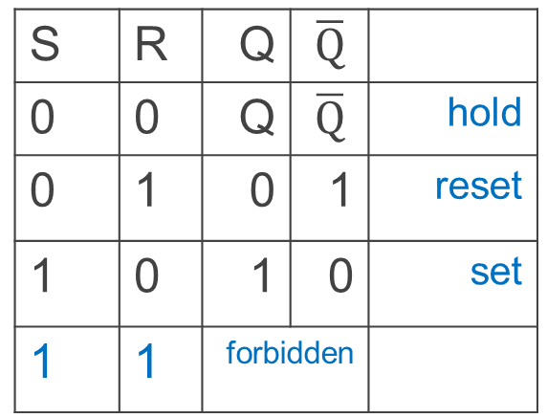
Third Attempt: Set-Reset Latch
S
Q
S
R
$$\overline{Q}$$
$$\overline{Q}$$
Q
R
S | R | Q | $$\overline{Q}$$
0 | 0 | Q | $$\overline{Q}$$ | hold
0 | 1 | 0 | 1 | reset
1 | 0 | 1 | 0 | set
1 | 1 | forbidden
Set-Reset (S-R) Latch
Stores a value Q and its complement
S | R | Q | $$\overline{Q}$$
0 | 0 | Q | $$\overline{Q}$$
0 | 1 | 0 | 1
1 | 0 | 1 | 0
1 | 1 | forbidden
Notes:
Start with 0, 1 => 0, 1
then 0, 0 => 0, 1
then 1, 0 => 1, 0
then 0, 0 => 1, 0, better yet “stay”
1, 1 is forbidden, b/c going to 0, 0 after goes haywire
i.e.
Start 1,1 => 0,0
Alright. Now change S,R to 0, 0, what happens.
1, 1=>0, 0 -> 0, 0=> 0, 0 -> 0, 0=>1, 1 -> 0, 0=> 0, 0 -> oscillations.
S R=>Q,!Q -> S,R=>Q,!Q -> S, R=>Q,!Q -> S,R => Q,!Q

Slide 30
Takeaway
Set-Reset (SR) Latch can store one bit and we can change the value of the stored bit. But, SR Latch has a forbidden state.

Slide 31
Next Goal
How do we avoid the forbidden state of S-R Latch?

Slide 32
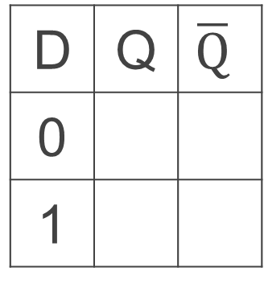
Fourth Attempt: (Unclocked) D Latch
D
S
Q
D
S
R
Q
$$\overline{Q}$$
R
Q
D | Q | $$\overline{Q}$$
0
1
Fill in the truth table?
A | B | OR | NOR
0 | 0 | 0 | 1
0 | 1 | 1 | 0
1 | 0 | 1 | 0
1 | 1 | 1 | 0
Notes:
Start in 0, 0, 1
Change to D = 1
After NOT gate, R = 0
After OR+NOT gates, /Q = 0 (R is already ready then), Q goes to 1
Problem: No way to hold state

Slide 33
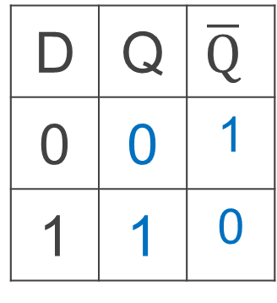
Fourth Attempt: (Unclocked) D Latch
D
S
Q
D
S
R
Q
$$\overline{Q}$$
R
Q
D | Q | $$\overline{Q}$$
0 | 0 | 1
1 | 1 | 0
Fill in the truth table?
Data (D) Latch
  Easier to use than an SR latch
  No possibility of entering an undefined state
When D changes, Q changes
    … immediately (…after a delay of 2 Ors and 2 NOTs)
Need to control when the output changes
A | B | OR | NOR
0 | 0 | 0 | 1
0 | 1 | 1 | 0
1 | 0 | 1 | 0
1 | 1 | 1 | 0
Notes:
Start in 0, 0, 1
Change to D = 1
After NOT gate, R = 0
After OR+NOT gates, /Q = 0 (R is already ready then), Q goes to 1
Problem: No way to hold state

Slide 34
Takeaway
Set-Reset (SR) Latch can store one bit and we can change the value of the stored bit. But, SR Latch has a forbidden state.
(Unclocked) D Latch can store and change a bit like an SR Latch while avoiding the forbidden state.

Slide 35
Next Goal
How do we coordinate state changes to a D Latch?

Slide 36
Aside: Clocks
Clock helps coordinate state changes
  Usually generated by an oscillating crystal
  Fixed period
  Frequency = 1/period
clock
high
rising
edge
falling
edge
1
0
clock
period
clock
low

Slide 37
Clock Disciplines
Level sensitive
  State changes when clock is high (or low)
Edge triggered
  State changes at clock edge
positive edge-triggered
negative edge-triggered

Slide 38
Clock Methodology
Clock Methodology
Negative edge, synchronous
Edge-Triggered → signals must be stable near falling edge
“near” = before and after
t_{setup} t_{hold}
t_{setup}
t_{hold}
clk
t_{combinational}
compute
save
compute
save
compute

Slide 39

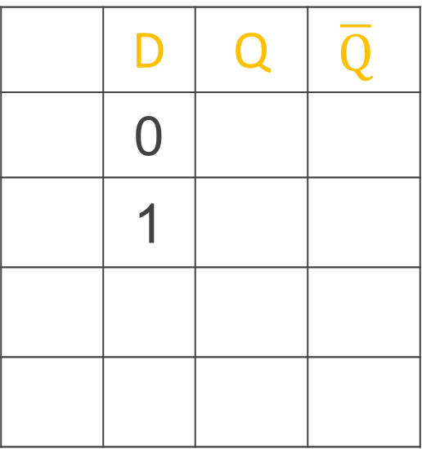

Round 2: D Latch (1)
D
Inverter prevents SR Latch from entering 1,1 state
S
Q
R
$$\overline{Q}$$
 | D | Q | $$\overline{Q}$$
 | 0
 | 1
Reset
Set
D
Q
C
$$\overline{Q}$$
Notes:
Any forbidden S=R=1 inputs? No
Need both truth tables
Answer:
Q
Q
0
1

Slide 40
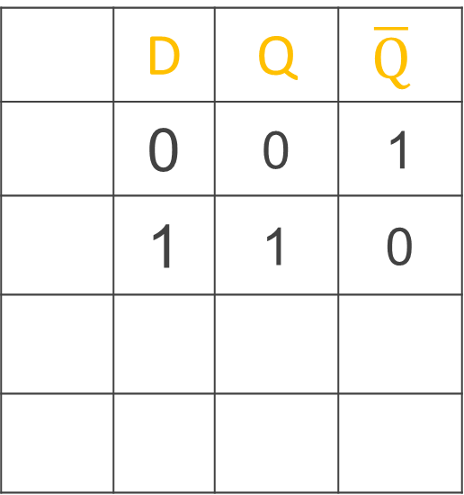
Round 2: D Latch (1)
D
Inverter prevents SR Latch from entering 1,1 state
S
Q
R
$$\overline{Q}$$
 | D | Q | $$\overline{Q}$$
 | 0 | 0 | 1
 | 1 | 1 | 0
Reset
Set
D
Q
C
$$\overline{Q}$$
Notes:
Any forbidden S=R=1 inputs? No
Need both truth tables
Answer:
Q
Q
0
1

Slide 41
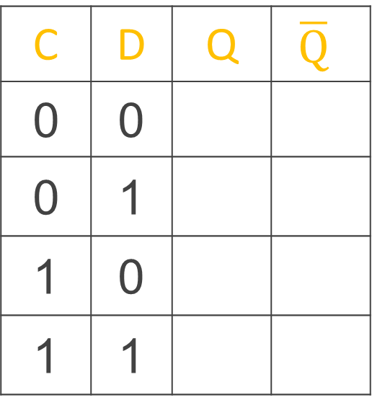
Round 2: D Latch (1)
D
Level sensitive
Inverter prevents SR Latch from entering 1,1 state
C enables changes
S
Q
C
R
$$\overline{Q}$$
C = 1, D Latch transparent:
set/reset (according to D)
C = 0, D Latch opaque:
keep state (ignore D)
C | D | Q | $$\overline{Q}$$
0 | 0
0 | 1
1 | 0
1 | 1
No
Change
D
Q
Reset
C
$$\overline{Q}$$
Set
Notes:
Any forbidden S=R=1 inputs? No
Need both truth tables
Answer:
Q
Q
0
1

Slide 42
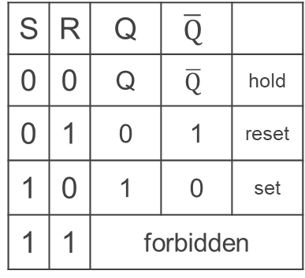
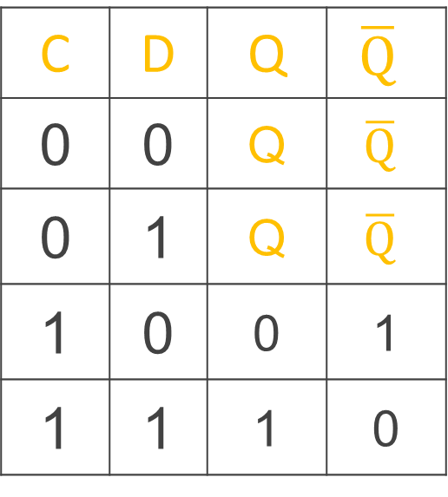
Round 2: D Latch (1)
D
Level sensitive
Inverter prevents SR Latch from entering 1,1 state
C enables changes
S
Q
C
R
$$\overline{Q}$$
C = 1, D Latch transparent:
set/reset (according to D)
C = 0, D Latch opaque:
keep state (ignore D)
C | D | Q | $$\overline{Q}$$
0 | 0 | Q | $$\overline{Q}$$
0 | 1 | Q | $$\overline{Q}$$
1 | 0 | 0 | 1
1 | 1 | 1 | 0
No
Change
S | R | Q | $$\overline{Q}$$
0 | 0 | Q | $$\overline{Q}$$ | hold
0 | 1 | 0 | 1 | reset
1 | 0 | 1 | 0 | set
1 | 1 | forbidden
D
Q
Reset
C
$$\overline{Q}$$
Set
Notes:
Any forbidden S=R=1 inputs? No
Need both truth tables
Answer:
Q
Q
0
1

Slide 43

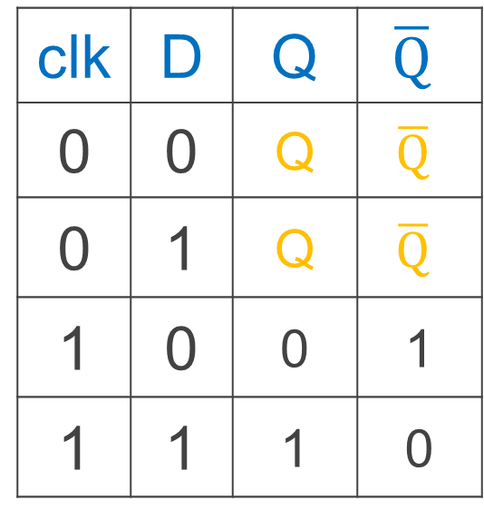
iClicker Question
What is the value of Q at A & B?
A = 0, B = 0
A = 0, B = 1
A = 1, B = 0
A = 1, B = 1
D
Q
clk
$$\overline{Q}$$
clk | D | Q | $$\overline{Q}$$
0 | 0 | Q | $$\overline{Q}$$
0 | 1 | Q | $$\overline{Q}$$
1 | 0 | 0 | 1
1 | 1 | 1 | 0
clk
D
Q
A
B
Notes:
Any forbidden S=R=1 inputs? No
Need both truth tables

Slide 44
iClicker Question
What is the value of Q at A & B?
A = 0, B = 0
A = 0, B = 1
A = 1, B = 0
A = 1, B = 1
D
Q
clk
$$\overline{Q}$$
clk | D | Q | $$\overline{Q}$$
0 | 0 | Q | $$\overline{Q}$$
0 | 1 | Q | $$\overline{Q}$$
1 | 0 | 0 | 1
1 | 1 | 1 | 0
clk
D
Q
A
B
Notes:
Any forbidden S=R=1 inputs? No
Need both truth tables

Slide 45
iClicker Question
Level Sensitive D Latch
Clock high:
set/reset (according to D)
Clock low:
keep state (ignore D)
D
Q
clk
$$\overline{Q}$$
clk | D | Q | $$\overline{Q}$$
0 | 0 | Q | $$\overline{Q}$$
0 | 1 | Q | $$\overline{Q}$$
1 | 0 | 0 | 1
1 | 1 | 1 | 0
clk
D
Q
A
B
Notes:
Any forbidden S=R=1 inputs? No
Need both truth tables

Slide 46



Round 3: D Flip-Flop
D
D
Q
D
Q
Q
Edge-Triggered
Data captured when clock high
Output changes only on falling edges
X
clk
C
$$\overline{Q}$$
C
$$\overline{Q}$$
$$\overline{Q}$$
L1
L2
Notes:
Master-Slave Flip Flop
- Outputs change only on falling edges
- Data is captured on rising edges
1 cycle delay
but works out perfectly – data for the next stage is ready 1 cycle ahead of time

Slide 47
Round 3: D Flip-Flop
D passes through L1 to X
D
D
Q
D
Q
Q
D
X
Clock = 1: L1 transparent
L2 opaque
X
X
clk
1
C
0
C
When CLK rises (0→1),
now X can change,
Q does not change
L1
L2
X passes through L2 to Q
D
D
Q
D
Q
Q
X
Q
Clock = 0: L1 opaque
L2 transparent
X
X
clk
0
C
1
C
L1
L2
When CLK falls (1→0),
Q gets X, X cannot change
Notes:
Master-Slave Flip Flop
- Outputs change only on falling edges
- Data is captured on rising edges
1 cycle delay
but works out perfectly – data for the next stage is ready 1 cycle ahead of time

Slide 48
iClicker Question – start here
What is the value of Q
at A & B?
A = 0, B = 0
A = 0, B = 1
A = 1, B = 0
A = 1, B = 1
D
D
Q
D
Q
Q
X
clk
C
C
L1
L2
clk
D
X
Q
A
B

Slide 49
iClicker Question – start here
What is the value of Q
at A & B?
A = 0, B = 0
A = 0, B = 1
A = 1, B = 0
A = 1, B = 1
D
D
Q
D
Q
Q
X
clk
C
C
L1
L2
clk
D
X
Q
A
B
Notes:
A=1, B=0

Slide 50



Edge-Triggered D Flip-Flop
1
0
0
D Flip-Flop
Edge-Triggered
Data captured when clock is high
Output changes only on falling edges
D
D
Q
D
Q
Q
X
clk
0
C
$$\overline{Q}$$
1
C
$$\overline{Q}$$
$$\overline{Q}$$
L1
L2
clk
D
X
Q
A
B
Notes:
Master-Slave Flip Flop
- Outputs change only on falling edges
- Data is captured on rising edges
1 cycle delay
but works out perfectly – data for the next stage is ready 1 cycle ahead of time

Slide 51
Edge-Triggered D Flip-Flop
1
0
0
D Flip-Flop
Edge-Triggered
Data captured when clock is high
Output changes only on falling edges
D
D
Q
D
Q
Q
X
clk
0
C
$$\overline{Q}$$
1
C
$$\overline{Q}$$
$$\overline{Q}$$
L1
L2
clk
D
X
Q
A
B
Notes:
Master-Slave Flip Flop
- Outputs change only on falling edges
- Data is captured on rising edges
1 cycle delay
but works out perfectly – data for the next stage is ready 1 cycle ahead of time

Slide 52
Takeaway
Set-Reset (SR) Latch can store one bit and we can change the value of the stored bit. But, SR Latch has a forbidden state.
(Unclocked) D Latch can store and change a bit like an SR Latch while avoiding a forbidden state.
An Edge-Triggered D Flip-Flip (aka Master-Slave D Flip-Flip) stores one bit. The bit can be changed in a synchronized fashion on the edge of a clock signal.

Slide 53
Next Goal
How do we store more than one bit, N bits?

Slide 54
Registers
D0
Register
D flip-flops in parallel
shared clock
extra clocked inputs:
write_enable, reset, …
D1
D2
D3
4-bit
reg
4
4
clk
clk

Slide 55
Takeaway
Set-Reset (SR) Latch can store one bit and we can change the value of the stored bit. But, SR Latch has a forbidden state.
(Unclocked) D Latch can store and change a bit like an SR Latch while avoiding a forbidden state.
An Edge-Triggered D Flip-Flip (aka Master-Slave D Flip-Flip) stores one bit. The bit can be changed in a synchronized fashion on the edge of a clock signal.
An N-bit register stores N-bits. It is created with N D-Flip-Flops in parallel along with a shared clock.

Slide 56
An Example: What will this circuit do?
4
16
Decoder
4
4
4-bit
reg
+1
Clk
4

Slide 57
An Example: What will this circuit do?
Reset
Run
WE
R
4
16
Decoder
4
4
A[4]
1 = 0001 =B[4]
4-bit
reg
C_{out}
+1
S[4]
Clk
4

Slide 58
Decoder Example: 7-Segment LED
d7
d6
d5
d4
7-Segment LED
  photons emitted when electrons fall into holes
d3
d2
d1
d0
Notes:
Previous slide would need to display up to 16, so would need a 16-segment LED decoder

Slide 59
Decoder Example: 7-Segment LED
d7
d6
d5
d4
7-Segment LED
  photons emitted when electrons fall into holes
d3
d2
d1
d0
Notes:
Previous slide would need to display up to 16, so would need a 16-segment LED decoder

Slide 60
Decoder Example: 7-Segment LED Decoder
3 inputs
encode 0 – 7 in binary
7 outputs
one for each LED
7LED decode

Slide 61
7 Segment LED Decoder Implementation
b2 | b1 | b0 | d6 | d5 | d4 | d3 | d2 | d1 | d0
0 | 0 | 0
0 | 0 | 1
0 | 1 | 0
0 | 1 | 1
1 | 0 | 0
1 | 0 | 1
1 | 1 | 0
1 | 1 | 1
b2 | b1 | b0 | d6 | d5 | d4 | d3 | d2 | d1 | d0
0 | 0 | 0
0 | 0 | 1
0 | 1 | 0
0 | 1 | 1
1 | 0 | 0
1 | 0 | 1
1 | 1 | 0
1 | 1 | 1 | 1 | 0 | 0 | 0 | 0 | 1 | 1
d1
d2
d0
d3
d4
d6
d5

Slide 62
7 Segment LED Decoder Implementation
b2 | b1 | b0 | d6 | d5 | d4 | d3 | d2 | d1 | d0
0 | 0 | 0
0 | 0 | 1
0 | 1 | 0
0 | 1 | 1
1 | 0 | 0
1 | 0 | 1
1 | 1 | 0
1 | 1 | 1
b2 | b1 | b0 | d6 | d5 | d4 | d3 | d2 | d1 | d0
0 | 0 | 0 | 1 | 1 | 1 | 0 | 1 | 1 | 1
0 | 0 | 1 | 1 | 0 | 0 | 0 | 0 | 0 | 1
0 | 1 | 0 | 0 | 1 | 1 | 1 | 0 | 1 | 1
0 | 1 | 1 | 1 | 1 | 0 | 1 | 0 | 1 | 1
1 | 0 | 0 | 1 | 0 | 0 | 1 | 1 | 0 | 1
1 | 0 | 1 | 1 | 1 | 0 | 1 | 1 | 1 | 0
1 | 1 | 0 | 1 | 1 | 1 | 1 | 1 | 1 | 0
1 | 1 | 1 | 1 | 0 | 0 | 0 | 0 | 1 | 1
d1
d2
d0
d3
d4
d6
d5

Slide 63
Basic Building Blocks We have Seen
N
2^{N}
0
N
binary
encoder
1
N
N
2
N
N
Multiplexor
binary
decoder
. . .
2^{N}
N
2^{M}-1
M

Slide 64
Encoders
0
1
2
3
N Input wires
4
Log₂(N) outputs wires
encoder
5
. . .
6
7
e.g. Voting:
Can only vote for one out of N
candidates, so N inputs.
But can encode vote efficiently
with binary encoding.
. . .
N
Notes:
N possible inputs -> log2(N) wires to encode

Slide 65
Example Encoder Truth Table
a | b | c | d
0 | 0 | 0 | 0
1 | 0 | 0 | 0
0 | 1 | 0 | 0
0 | 0 | 1 | 0
0 | 0 | 0 | 1
a
1
o₀
b
2
o₁
c
3
o₂
d
4
A 3-bit
encoder
with 4 inputs
for simplicity
Notes:
Implementation . . .
assume 8 choices, exactly one mark detected

Slide 66
Example Encoder Truth Table
a | b | c | d |  | o₂ | o₁ | o₀
0 | 0 | 0 | 0 |  | 0 | 0 | 0
1 | 0 | 0 | 0 |  | 0 | 0 | 1
0 | 1 | 0 | 0 |  | 0 | 1 | 0
0 | 0 | 1 | 0 |  | 0 | 1 | 1
0 | 0 | 0 | 1 |  | 1 | 0 | 0
a
1
o₀
b
2
o₁
c
3
o₂
d
4
o₂ = abcd
o₁ = abcd + abcd
o₀ = abcd + abcd
A 3-bit
encoder
with 4 inputs
for simplicity
Notes:
Implementation . . .
assume 8 choices, exactly one mark detected

Slide 67
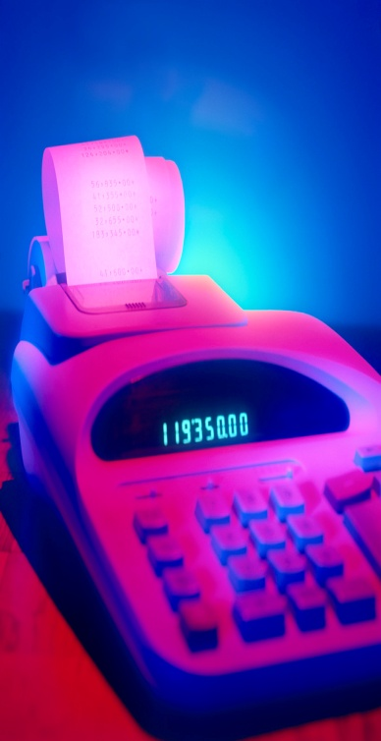
Basic Building Blocks Example: Voting
enc
7LED
decode
detect
8
3
7
Ballots
The 3410 optical scan
vote reader
machine

Slide 68
Basic Building Blocks We have Seen
N
2^{N}
0
N
binary
encoder
1
N
N
2
N
N
Multiplexor
binary
decoder
. . .
2^{N}
N
2^{M}-1
M

Slide 69
Recap
We can now build interesting devices with sensors
  Using combinational logic
We can also store data values (aka Sequential Logic)
  In state-holding elements
  Coupled with clocks

Slide 70
Summary
We can now build interesting devices with sensors
  Using combinational logic
We can also store data values
  Stateful circuit elements (D Flip Flops, Registers, …)
  Clock to synchronize state changes

