Slide 1
Numbers and Arithmetic
Prof. Hakim Weatherspoon
CS 3410
Computer Science
Cornell University
[Weatherspoon, Bala, Bracy, and Sirer]

Slide 2
Big Picture: Building Processor
Simplified Single-cycle processor

Slide 3
Goals for Today
  Binary Operations
  Number representations
  One-bit and four-bit adders
  Negative numbers and two’s compliment
  Addition (two’s compliment)
  Detecting and handling overflow
  Subtraction (two’s compliment)

Slide 4
Number Representations
Recall: Binary
  Two symbols (base 2): true and false; 1 and 0
  Basis of Logic Circuits and all digital computers
So, how do we represent numbers in Binary (base 2)?

Slide 5
Number Representations
Recall: Binary
  Two symbols (base 2): true and false; 1 and 0
  Basis of Logic Circuits and all digital computers
So, how do we represent numbers in Binary (base 2)?
  We can represent numbers in Decimal (base 10).
    E.g. 6 3 7
  Can just as easily use other bases
    Base 2 — Binary
    Base 8 — Octal
    Base 16 — Hexadecimal
10² 10¹ 10⁰
1 0 0 1 1 1 1 1 0 1
2⁹ 2⁸ 2⁷ 2⁶ 2⁵ 2⁴ 2³ 2² 2¹ 2⁰
0o 1 1 7 5
8³ 8² 8¹ 8⁰
0x 2 7 d
16² 16¹ 16⁰
Notes:
637 has a 1’s place , 10’s place and 100’s place
Show how to go from

Slide 6
Number Representations
Recall: Binary
  Two symbols (base 2): true and false; 1 and 0
  Basis of Logic Circuits and all digital computers
So, how do we represent numbers in Binary (base 2)?
  We can represent numbers in Decimal (base 10).
    E.g. 6 3 7
  Can just as easily use other bases
    Base 2 — Binary
    Base 8 — Octal
    Base 16 — Hexadecimal
6∙10² + 3∙10¹ + 7∙10⁰ = 637
10² 10¹ 10⁰
1∙2⁹+1∙2⁶+1∙2⁵+1∙2⁴+1∙2³+1∙2²+1∙2⁰ = 637
1∙8³ + 1∙8² + 7∙8¹ + 5∙8⁰ = 637
2∙16² + 7∙16¹ + d∙16⁰ = 637
2∙16² + 7∙16¹ + 13∙16⁰ = 637
Notes:
637 has a 1’s place , 10’s place and 100’s place
Show how to go from

Slide 7
Number Representations: Activity #1 Counting
How do we count in different bases?
  Dec (base 10) Bin (base 2) Oct (base 8) Hex (base 16)
0
1
2
3
4
5
6
7
8
9
10
11
12
13
14
15
16
17
18
.
.
99
100
0
1
10
11
100
101
110
111
1000
1001
1010
1011
1100
1101
1110
1111
1 0000
1 0001
1 0010
.
.
0
1
2
3
4
5
6
7
10
11
12
13
14
15
16
17
20
21
22
.
.
0
1
2
3
4
5
6
7
8
9
a
b
c
d
e
f
10
11
12
.
.
0b 1111 1111 = ?
0b 1 0000 0000 = ?
0o 77 = ?
0o 100 = ?
0x ff = ?
0x 100 = ?
Notes:
The base represents the number of unique symbols (decimal has 10, octal has 8, hexadecimal has 16, and binary has 2 unique symbols)
Every group of four bits is called a nibble, every group of 8 bits is a byte

Slide 8
Number Representations: Activity #1 Counting
How do we count in different bases?
  Dec (base 10) Bin (base 2) Oct (base 8) Hex (base 16)
0
1
2
3
4
5
6
7
8
9
10
11
12
13
14
15
16
17
18
.
.
99
100
0
1
10
11
100
101
110
111
1000
1001
1010
1011
1100
1101
1110
1111
1 0000
1 0001
1 0010
.
.
0
1
2
3
4
5
6
7
10
11
12
13
14
15
16
17
20
21
22
.
.
0
1
2
3
4
5
6
7
8
9
a
b
c
d
e
f
10
11
12
.
.
0b 1111 1111 = 255
0b 1 0000 0000 = 256
0o 77 = 63
0o 100 = 64
0x ff = 255
0x 100 = 256
Notes:
Every group of four bits is called a nibble, every group of 8 bits is a byte

Slide 9
Number Representations
  How to convert a number between different bases?
  Base conversion via repetitive division
  Divide by base, write remainder, move left with quotient
  637 ÷ 8 = 79 remainder 5
  79 ÷ 8 = 9 remainder 7
  9 ÷ 8 = 1 remainder 1
  1 ÷ 8 = 0 remainder 1
637 = 0o 1175
lsb (least significant bit)
msb (most significant bit)
msb
lsb
Notes:
**Convert to a different base instead of same base**
637 = 0o1175 = 0b1001111101 = 0x27D
oct: 637 : 79 : 9 : 1 : 0
bin: 637 : 318 : 159 : 79 : 39 : 19 : 9 : 4 : 2 : 1 : 0
hex: 637 : 39 : 2 : 0

Slide 10
Number Representations
Convert a base 10 number to a base 2 number
Base conversion via repetitive division
  Divide by base, write remainder, move left with quotient
  637 ÷ 2 = 318 remainder 1
  318 ÷ 2 = 159 remainder 0
  159 ÷ 2 = 79 remainder 1
  79 ÷ 2 = 39 remainder 1
  39 ÷ 2 = 19 remainder 1
  19 ÷ 2 = 9 remainder 1
  9 ÷ 2 = 4 remainder 1
  4 ÷ 2 = 2 remainder 0
  2 ÷ 2 = 1 remainder 0
  1 ÷ 2 = 0 remainder 1
637 = 10 0111 1101 (can also be written as 0b10 0111 1101)
lsb (least significant bit)
msb (most significant bit)
msb
lsb
Notes:
Ask students to write down binary number after we figure it out. The question is did they writ the MSB on the left?
637 = 0o1175 = 0b10 0111 1101 = 0x27D
oct: 637 : 79 : 9 : 1 : 0
bin: 637 : 318 : 159 : 79 : 39 : 19 : 9 : 4 : 2 : 1 : 0
hex: 637 : 39 : 2 : 0

Slide 11
Clicker Question!
Convert the number 657₁₀ to base 16
What is the least significant digit of this number?
a) D
b) F
c) 0
d) 1
e) 11
Notes:
657 = 0x291
hex: 637 : 39 : 2 : 0

Slide 12
Clicker Question!
Convert the number 657₁₀ to base 16
What is the least significant digit of this number?
a) D
b) F
c) 0
d) 1
e) 11
Notes:
657 = 0x291
hex: 637 : 39 : 2 : 0

Slide 13
Number Representations
Convert a base 10 number to a base 16 number
Base conversion via repetitive division
  Divide by base, write remainder, move left with quotient
  657 ÷ 16 = 41 remainder 1
  41 ÷ 16 = 2 remainder 9
  2 ÷ 16 = 0 remainder 2
Thus, 657 = 0x291
lsb
msb
Notes:
Is 657 same as 0x 657 ?
657 = 0o1175 = 0b10 0111 1101 = 0x27D
oct: 657 : 79 : 9 : 1 : 0
bin: 657 : 318 : 159 : 79 : 39 : 19 : 9 : 4 : 2 : 1 : 0
hex: 657 : 39 : 2 : 0

Slide 14
Number Representations
Convert a base 10 number to a base 16 number
Base conversion via repetitive division
  Divide by base, write remainder, move left with quotient
  637 ÷ 16 = 39 remainder 13
  39 ÷ 16 = 2 remainder 7
  2 ÷ 16 = 0 remainder 2
637 = 0x 2 7 13 = ?
Thus, 637 = 0x27d
lsb
dec = hex
10 = 0xa
11 = 0xb
12 = 0xc
13 = 0xd
14 = 0xe
15 = 0xf
= bin
= 1010
= 1011
= 1100
= 1101
= 1110
= 1111
msb
Notes:
Is 637 same as 0x 637 ?
637 = 0o1175 = 0b10 0111 1101 = 0x27D
oct: 637 : 79 : 9 : 1 : 0
bin: 637 : 318 : 159 : 79 : 39 : 19 : 9 : 4 : 2 : 1 : 0
hex: 637 : 39 : 2 : 0

Slide 15
Number Representations
Convert a base 2 number to base 8 (oct) or 16 (hex)
Binary to Hexadecimal
  Convert each nibble (group of four bits) from binary to hex
  A nibble (four bits) ranges in value from 0…15, which is one hex digit
    Range: 0000…1111 (binary) => 0x0 …0xF (hex) => 0…15 (decimal)
  E.g. 0b 10 0111 1101
  2 7 d → 0x27d
    Thus, 637 = 0x27d = 0b10 0111 1101
Binary to Octal
  Convert each group of three bits from binary to oct
  Three bits range in value from 0…7, which is one octal digit
    Range: 0000…1111 (binary) => 0x0 …0xF (hex) => 0…15 (decimal)
  E.g. 0b1 001 111 101
  1 1 7 5 → 0o 1175
    Thus, 637 = 0o1175 = 0b10 0111 1101
Notes:
Ask class to convert from binary to octal
637 = 0o1175 = 0b10 0111 1101 = 0x27D
oct: 637 : 79 : 9 : 1 : 0
bin: 637 : 318 : 159 : 79 : 39 : 19 : 9 : 4 : 2 : 1 : 0
hex: 637 : 39 : 2 : 0

Slide 16
Number Representations Summary
We can represent any number in any base
  Base 10 – Decimal
  Base 2 — Binary
  Base 8 — Octal
  Base 16 — Hexadecimal
6 3 7
6∙10² + 3∙10¹ + 7∙10⁰ = 637
10² 10¹ 10⁰
1∙2⁹+1∙2⁶+1∙2⁵+1∙2⁴+1∙2³+1∙2²+1∙2⁰ = 637
1 0 0 1 1 1 1 1 0 1
2⁹ 2⁸ 2⁷ 2⁶ 2⁵ 2⁴ 2³ 2² 2¹ 2⁰
0o 1 1 7 5
1∙8³ + 1∙8² + 7∙8¹ + 5∙8⁰ = 637
8³ 8² 8¹ 8⁰
0x 2 7 d
2∙16² + 7∙16¹ + d∙16⁰ = 637
2∙16² + 7∙16¹ + 13∙16⁰ = 637
16²16¹16⁰
Notes:
637 has a 1’s place , 10’s place and 100’s place

Slide 17
Achievement Unlocked!
There are 10 types of people in the world:
Those who understand binary
And those who do not
And those who know this joke was written
in base 2

Slide 18
Takeaway
Digital computers are implemented via logic circuits and thus represent all numbers in binary (base 2).
We (humans) often write numbers as decimal and hexadecimal for convenience, so need to be able to convert to binary and back (to understand what the computer is doing!).
Notes:
We can write any number in any base we like. The most natural base for computers is binary, which is hard to read, which is the reason we use hex and octal. Decimal..

Slide 19
Today’s Lecture
Binary Operations
  Number representations
  One-bit and four-bit adders
  Negative numbers and two’s compliment
  Addition (two’s compliment)
  Detecting and handling overflow
  Subtraction (two’s compliment)

Slide 20
Next Goal
Binary Arithmetic: Add and Subtract two binary numbers

Slide 21
Binary Addition
How do we do arithmetic in binary?
1
183
+ 254
Addition works the same way regardless of base
  Add the digits in each position
  Propagate the carry
  Unsigned binary addition is pretty easy
  Combine two bits at a time
  Along with a carry
4
3
7
Carry-in
Carry-out
1
1
1
001110
+ 011100
1
0
1
0
1
0
Notes:
Talk about Cin (carry in) and Cout (carry out)
Animate this better
Add another slide
So we need two numbers, the sum, carry in, and carry out

Slide 22
Binary Addition
How do we do arithmetic in binary?
1
183
+ 254
Addition works the same way regardless of base
  Add the digits in each position
  Propagate the carry
  Unsigned binary addition is pretty easy
  Combine two bits at a time
  Along with a carry
437
111
001110
+ 011100
101010
Notes:
Talk about Cin (carry in) and Cout (carry out)
Animate this better
Add another slide
So we need two numbers, the sum, carry in, and carry out

Slide 23
Binary Addition
Binary addition requires
  Add of two bits PLUS carry-in
  Also, carry-out if necessary

Slide 24
1-bit Adder
Half Adder
Adds two 1-bit numbers
Computes 1-bit result and 1-bit carry
No carry-in
A
B
C_{out}
S
Clicker Question
What is the equation for C_{out}?
A + B
AB
A ⊕ B
A + !B
!A!B
A | B | C_{out} | S
0 | 0
0 | 1
1 | 0
1 | 1
Notes:
Adds two 1-bit numbers,
computes 1-bit result and carry out
Useful for the rightmost binary digit, not much else

Slide 25
1-bit Adder
Half Adder
Adds two 1-bit numbers
Computes 1-bit result and 1-bit carry
No carry-in
A
B
C_{out}
S
Clicker Question
What is the equation for C_{out}?
A + B
AB
A ⊕ B
A + !B
!A!B
A | B | C_{out} | S
0 | 0
0 | 1
1 | 0
1 | 1
Notes:
Adds two 1-bit numbers,
computes 1-bit result and carry out
Useful for the rightmost binary digit, not much else

Slide 26
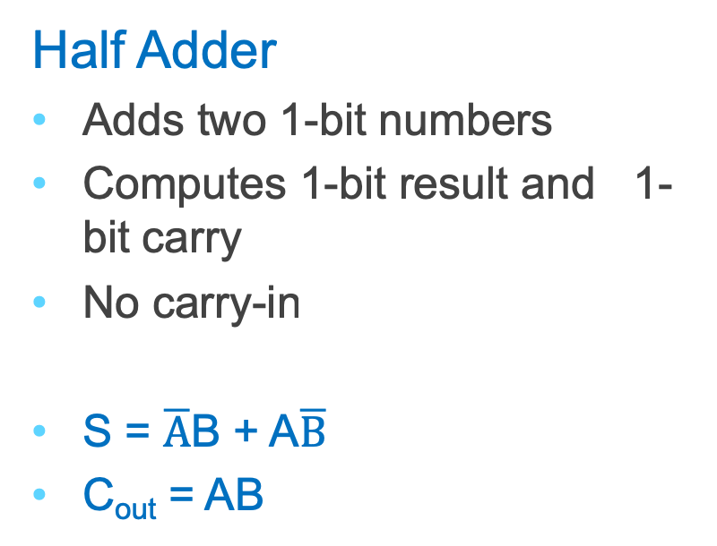
1-bit Adder
Half Adder
Adds two 1-bit numbers
Computes 1-bit result and 1-bit carry
No carry-in
S = $\overline{A}$B + A$\overline{B}$
C_{out} = AB
A
B
C_{out}
S
A | B | C_{out} | S
0 | 0 | 0 | 0
0 | 1 | 0 | 1
1 | 0 | 0 | 1
1 | 1 | 1 | 0
A
B
C_{out}
S
Notes:
Adds two 1-bit numbers,
computes 1-bit result and carry out
Useful for the rightmost binary digit, not much else

Slide 27
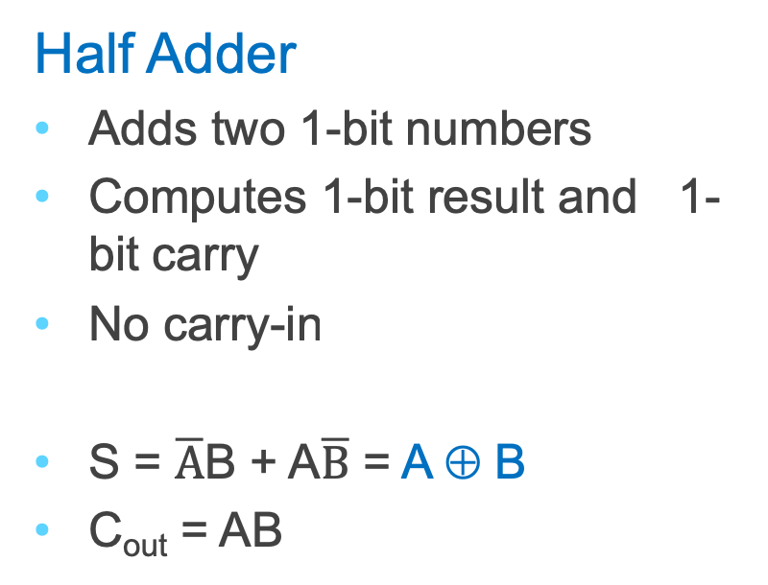
1-bit Adder
Half Adder
Adds two 1-bit numbers
Computes 1-bit result and 1-bit carry
No carry-in
S = $\overline{A}$B + A$\overline{B}$ = A ⊕ B
C_{out} = AB
A
B
C_{out}
S
A | B | C_{out} | S
0 | 0 | 0 | 0
0 | 1 | 0 | 1
1 | 0 | 0 | 1
1 | 1 | 1 | 0
A
B
C_{out}
S
Notes:
Adds two 1-bit numbers,
computes 1-bit result and carry out
Useful for the rightmost binary digit, not much else

Slide 28
1-bit Adder with Carry
Full Adder
Adds three 1-bit numbers
Computes 1-bit result and 1-bit carry
Can be cascaded
Now You Try:
Fill in Truth Table
Create Sum-of-Product Form
Minimization the equation
  Karnaugh Maps (coming soon!)
  Algebraic minimization
Draw the Logic Circuits
A
B
C_{out}
C_{in}
S
A | B | C_{in} | C_{out} | S
0 | 0 | 0
0 | 0 | 1
0 | 1 | 0
0 | 1 | 1
1 | 0 | 0
1 | 0 | 1
1 | 1 | 0
1 | 1 | 1

Slide 29
1-bit Adder with Carry
Full Adder
Adds three 1-bit numbers
Computes 1-bit result and 1-bit carry
Can be cascaded
A
B
C_{out}
C_{in}
S
A | B | C_{in} | C_{out} | S
0 | 0 | 0
0 | 0 | 1
0 | 1 | 0
0 | 1 | 1
1 | 0 | 0
1 | 0 | 1
1 | 1 | 0
1 | 1 | 1
Clicker Question
What is the equation for C_{out}?
A + B + C_{in}
!A + !B + ! C_{in}
A ⊕ B ⊕ C_{in}
AB + AC_{in} + BC_{in}
ABC_{in}

Slide 30
1-bit Adder with Carry
Full Adder
Adds three 1-bit numbers
Computes 1-bit result and 1-bit carry
Can be cascaded
A
B
C_{out}
C_{in}
S
A | B | C_{in} | C_{out} | S
0 | 0 | 0
0 | 0 | 1
0 | 1 | 0
0 | 1 | 1
1 | 0 | 0
1 | 0 | 1
1 | 1 | 0
1 | 1 | 1
Clicker Question
What is the equation for C_{out}?
A + B + C_{in}
!A + !B + ! C_{in}
A ⊕ B ⊕ C_{in}
AB + AC_{in} + BC_{in}
ABC_{in}

Slide 31
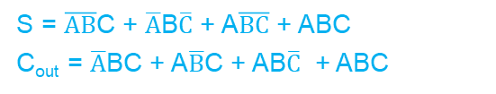
1-bit Adder with Carry
Full Adder
Adds three 1-bit numbers
Computes 1-bit result and 1-bit carry
A
B
C_{out}
C_{in}
A
B
Can be cascaded
C_{out}
S
C_{in}
S = $\overline{AB}$C + $\overline{A}$B$\overline{C}$ + A$\overline{BC}$ + ABC
C_{out} = $\overline{A}$BC + A$\overline{B}$C + AB$\overline{C}$ + ABC
A | B | C_{in} | C_{out} | S
0 | 0 | 0 | 0 | 0
0 | 0 | 1 | 0 | 1
0 | 1 | 0 | 0 | 1
0 | 1 | 1 | 1 | 0
1 | 0 | 0 | 0 | 1
1 | 0 | 1 | 1 | 0
1 | 1 | 0 | 1 | 0
1 | 1 | 1 | 1 | 1
S

Slide 32
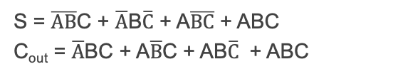
1-bit Adder with Carry
Full Adder
Adds three 1-bit numbers
Computes 1-bit result and 1-bit carry
A
B
C_{out}
C_{in}
A
B
Can be cascaded
C_{out}
S
C_{in}
S = $\overline{AB}$C + $\overline{A}$B$\overline{C}$ + A$\overline{BC}$ + ABC
C_{out} = $\overline{A}$BC + A$\overline{B}$C + AB$\overline{C}$ + ABC
A | B | C_{in} | C_{out} | S
0 | 0 | 0 | 0 | 0
0 | 0 | 1 | 0 | 1
0 | 1 | 0 | 0 | 1
0 | 1 | 1 | 1 | 0
1 | 0 | 0 | 0 | 1
1 | 0 | 1 | 1 | 0
1 | 1 | 0 | 1 | 0
1 | 1 | 1 | 1 | 1
AB
00 01 11 10
C_{in}
S
0
1
AB
00 01 11 10
C_{in}
S
C_{out}
0
1

Slide 33
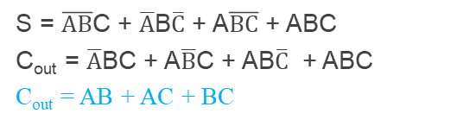
1-bit Adder with Carry
Full Adder
Adds three 1-bit numbers
Computes 1-bit result and 1-bit carry
A
B
C_{out}
C_{in}
A
B
Can be cascaded
C_{out}
S
C_{in}
S = $\overline{AB}$C + $\overline{A}$B$\overline{C}$ + A$\overline{BC}$ + ABC
C_{out} = $\overline{A}$BC + A$\overline{B}$C + AB$\overline{C}$ + ABC
C_{out} = AB + AC + BC
A | B | C_{in} | C_{out} | S
0 | 0 | 0 | 0 | 0
0 | 0 | 1 | 0 | 1
0 | 1 | 0 | 0 | 1
0 | 1 | 1 | 1 | 0
1 | 0 | 0 | 0 | 1
1 | 0 | 1 | 1 | 0
1 | 1 | 0 | 1 | 0
1 | 1 | 1 | 1 | 1
AB
00 01 11 10
C_{in}
S
0
1
0 | 1 | 0 | 1
1 | 0 | 1 | 0
AB
00 01 11 10
C_{in}
S
C_{out}
0
1
0 | 0 | 1 | 0
0 | 1 | 1 | 1

Slide 34
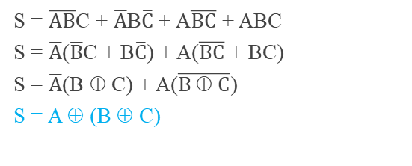
1-bit Adder with Carry
Full Adder
Adds three 1-bit numbers
Computes 1-bit result and 1-bit carry
A
B
C_{out}
C_{in}
A
B
Can be cascaded
C_{out}
S
C_{in}
S = $\overline{AB}$C + $\overline{A}$B$\overline{C}$ + A$\overline{BC}$ + ABC
S = $\overline{A}$($\overline{B}$C + B$\overline{C}$) + A($\overline{BC}$ + BC)
S = $\overline{A}$(B ⊕ C) + A($\overline{B ⊕ C}$)
S = A ⊕ (B ⊕ C)
A | B | C_{in} | C_{out} | S
0 | 0 | 0 | 0 | 0
0 | 0 | 1 | 0 | 1
0 | 1 | 0 | 0 | 1
0 | 1 | 1 | 1 | 0
1 | 0 | 0 | 0 | 1
1 | 0 | 1 | 1 | 0
1 | 1 | 0 | 1 | 0
1 | 1 | 1 | 1 | 1
AB
00 01 11 10
C_{in}
S
0
1
0 | 1 | 0 | 1
1 | 0 | 1 | 0
AB
00 01 11 10
C_{in}
S
C_{out}
0
1
0 | 0 | 1 | 0
0 | 1 | 1 | 1

Slide 35
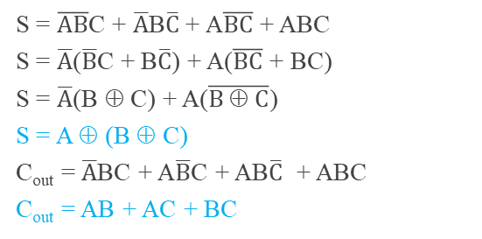
1-bit Adder with Carry
Full Adder
Adds three 1-bit numbers
Computes 1-bit result and 1-bit carry
A
B
C_{out}
C_{in}
A
B
Can be cascaded
C_{out}
S
C_{in}
S = $\overline{AB}$C + $\overline{A}$B$\overline{C}$ + A$\overline{BC}$ + ABC
S = $\overline{A}$($\overline{B}$C + B$\overline{C}$) + A($\overline{BC}$ + BC)
S = $\overline{A}$(B ⊕ C) + A($\overline{B ⊕ C}$)
S = A ⊕ (B ⊕ C)
C_{out} = $\overline{A}$BC + A$\overline{B}$C + AB$\overline{C}$ + ABC
C_{out} = AB + AC + BC
A | B | C_{in} | C_{out} | S
0 | 0 | 0 | 0 | 0
0 | 0 | 1 | 0 | 1
0 | 1 | 0 | 0 | 1
0 | 1 | 1 | 1 | 0
1 | 0 | 0 | 0 | 1
1 | 0 | 1 | 1 | 0
1 | 1 | 0 | 1 | 0
1 | 1 | 1 | 1 | 1
S

Slide 36
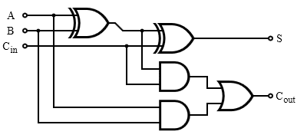
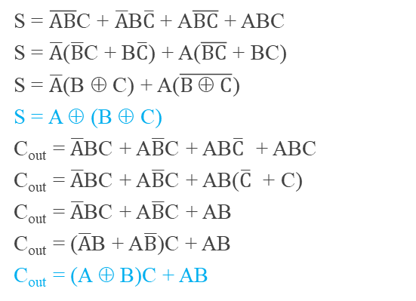
Lab1 1-bit Adder with Carry
Full Adder
Adds three 1-bit numbers
Computes 1-bit result and 1-bit carry
A
B
C_{out}
C_{in}
A
B
Can be cascaded
C_{out}
S
S = $\overline{AB}$C + $\overline{A}$B$\overline{C}$ + A$\overline{BC}$ + ABC
S = $\overline{A}$($\overline{B}$C + B$\overline{C}$) + A($\overline{BC}$ + BC)
S = $\overline{A}$(B ⊕ C) + A($\overline{B ⊕ C}$)
S = A ⊕ (B ⊕ C)
C_{out} = $\overline{A}$BC + A$\overline{B}$C + AB$\overline{C}$ + ABC
C_{out} = $\overline{A}$BC + A$\overline{B}$C + AB($\overline{C}$ + C)
C_{out} = $\overline{A}$BC + A$\overline{B}$C + AB
C_{out} = ($\overline{A}$B + A$\overline{B}$)C + AB
C_{out} = (A ⊕ B)C + AB
A | B | C_{in} | C_{out} | S
0 | 0 | 0 | 0 | 0
0 | 0 | 1 | 0 | 1
0 | 1 | 0 | 0 | 1
0 | 1 | 1 | 1 | 0
1 | 0 | 0 | 0 | 1
1 | 0 | 1 | 1 | 0
1 | 1 | 0 | 1 | 0
1 | 1 | 1 | 1 | 1

Slide 37
4-bit Adder
4-Bit Full Adder
Adds two 4-bit numbers and carry in
Computes 4-bit result and carry out
Can be cascaded
A[4]
B[4]
C_{out}
C_{in}
S[4]
Notes:
Adds two 1-bit numbers, along with carry-in, computes 1-bit result and carry out
Can be cascaded to add N-bit numbers

Slide 38
4-bit Adder
Adds two 4-bit numbers, along with carry-in
Computes 4-bit result and carry out
Carry-out = overflow indicates result does not fit in 4 bits
Notes:
Transition: to do subtraction, just add, but negate one number

Slide 39
4-bit Adder
Adds two 4-bit numbers, along with carry-in
Computes 4-bit result and carry out
Carry-out = overflow indicates result does not fit in 4 bits
Notes:
Transition: to do subtraction, just add, but negate one number

Slide 40
Takeaway
Digital computers are implemented via logic circuits and thus represent all numbers in binary (base 2).
We (humans) often write numbers as decimal and hexadecimal for convenience, so need to be able to convert to binary and back (to understand what computer is doing!).
Adding two 1-bit numbers generalizes to adding two numbers of any size since 1-bit full adders can be cascaded.

Slide 41
Today’s Lecture
Binary Operations
  Number representations
  One-bit and four-bit adders
  Negative numbers and two’s compliment
  Addition (two’s compliment)
  Detecting and handling overflow
  Subtraction (two’s compliment)

Slide 42
Next Goal
How do we subtract two binary numbers?
Equivalent to adding with a negative number
How do we represent negative numbers?

Slide 43
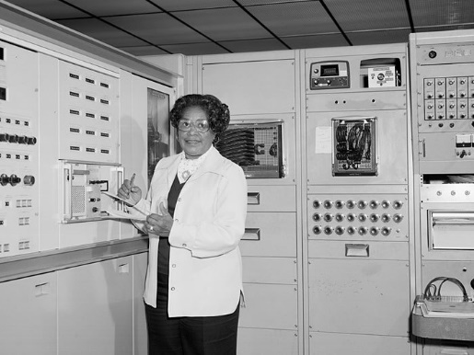
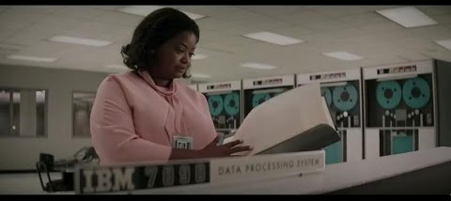
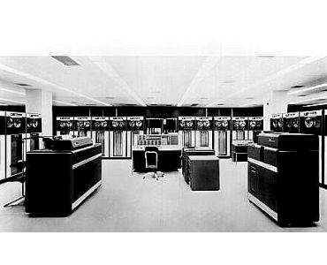
1st Attempt: Sign/Magnitude Representation
First Attempt: Sign/Magnitude Representation
IBM 7090, 1959:
“a second-generation transistorized version of the
earlier IBM 709 vacuum tube mainframe computers”
  1 bit for sign (0=positive, 1=negative)
  N-1 bits for magnitude
0111 = 7
1111 = -7
Problem?
Two zero’s: +0 different than -0
Complicated circuits
-2 + 1 = ???
0000 = +0
1000 = -0
Notes:
problems? two zeros, circuit still complicated
e.g. the existence of two forms of the same value (-0 and +0) necessitates two rather than a single comparison when checking for equality with zero.
The IBM 7090 was based in sign-magnitude representation.
The CDC 6000 series and UNIVAC 1100 series computers were based on ones' complement.
Also, in one’s complement, in addition to two zero’s, there is a crazy phenomenon called "end-around carry“: If the carry extends past the end of the word it is said to have "wrapped" around, a condition called an "end-around carry". When this occurs, the bit must be added back in at the right-most bit. This phenomenon does not occur in two's complement arithmetic.
Subtraction is similar, except that borrows are propagated to the left instead of carries. If the borrow extends past the end of the word it is said to have "wrapped" around, a condition called an "end-around borrow". When this occurs, the bit must be subtracted back in at the right-most bit. This phenomenon does not occur in two's complement arithmetic.
The CDC 6000 series and UNIVAC 1100 series computers were based on ones' complement.

Slide 44
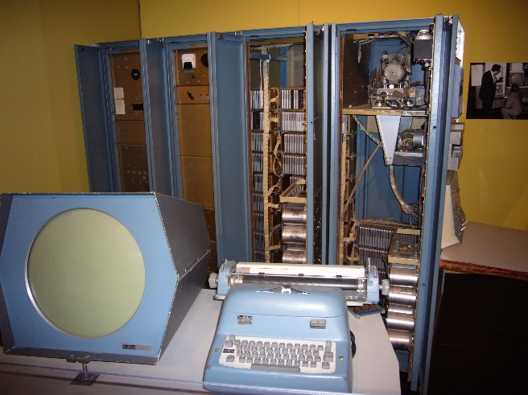
Second Attempt: One’s complement
Second Attempt: One’s complement
  Leading 0’s for positive and 1’s for negative
  Negative numbers: complement the positive number
Problem?
  Two zero’s still: +0 different than -0
  -1 if offset from two’s complement
  Complicated circuits
    Carry is difficult
0111 = 7
1000 = -7
0000 = +0
1111 = -0
PDP 1
Notes:
problems? two zeros, circuit still complicated
e.g. the existence of two forms of the same value (-0 and +0) necessitates two rather than a single comparison when checking for equality with zero.
The IBM 7090 was based in sign-magnitude representation.
The CDC 6000 series and UNIVAC 1100 series computers were based on ones' complement.
Also, in one’s complement, in addition to two zero’s, there is a crazy phenomenon called "end-around carry“: If the carry extends past the end of the word it is said to have "wrapped" around, a condition called an "end-around carry". When this occurs, the bit must be added back in at the right-most bit. This phenomenon does not occur in two's complement arithmetic.
Subtraction is similar, except that borrows are propagated to the left instead of carries. If the borrow extends past the end of the word it is said to have "wrapped" around, a condition called an "end-around borrow". When this occurs, the bit must be subtracted back in at the right-most bit. This phenomenon does not occur in two's complement arithmetic.
The CDC 6000 series and UNIVAC 1100 series computers were based on ones' complement.

Slide 45
Two’s Complement Representation
What is used: Two’s Complement Representation
Nonnegative numbers are represented as usual
  0 = 0000, 1 = 0001, 3 = 0011, 7 = 0111
Leading 1’s for negative numbers
To negate any number:
  complement all the bits (i.e. flip all the bits)
  then add 1
  -1: 1 ⇒ 0001 ⇒ 1110 ⇒ 1111
  -3: 3 ⇒ 0011 ⇒ 1100 ⇒ 1101
  -7: 7 ⇒ 0111 ⇒ 1000 ⇒ 1001
  -8: 8 ⇒ 1000 ⇒ 0111 ⇒ 1000
  -0: 0 ⇒ 0000 ⇒ 1111 ⇒ 0000 (this is good, -0 = +0)
Notes:
add 1 and *discard carry*
Add a “Did you know box”
The two's complement of an N-bit number is defined as the *complement* with respect to 2^N, in other words the result of subtracting the number from 2^N. This is also equivalent to taking the *ones' complement* and then adding one, since the sum of a number and its ones' complement is all 1 bits. The two's complement of a number behaves like the negative of the original number in most arithmetic, and positive and negative numbers can coexist in a natural way.
Two's complement is the easiest to implement in hardware, which may be the ultimate reason for its widespread popularity[citation needed]. Remember that processors on the early mainframes often consisted of thousands of transistors – eliminating a significant number of transistors was a significant cost savings. The architects of the early integrated circuit based CPUs (Intel 8080, etc.) chose to use two's complement math. As IC technology advanced, virtually all adopted two's complement technology. Intel, AMD, and IBM POWER chips are all two's complement.[

Slide 46

Two’s Complement
Non-negatives
(as usual):
+0 = 0000
+1 = 0001
+2 = 0010
+3 = 0011
+4 = 0100
+5 = 0101
+6 = 0110
+7 = 0111
+8 = 1000
Negatives (two’s complement)
flip then add 1
$\overline{0}$ = 1111 -0 = 0000
$\overline{1}$ = 1110 -1 = 1111
$\overline{2}$ = 1101 -2 = 1110
$\overline{3}$ = 1100 -3 = 1101
$\overline{4}$ = 1011 -4 = 1100
$\overline{5}$ = 1010 -5 = 1011
$\overline{6}$ = 1001 -6 = 1010
$\overline{7}$ = 1000 -7 = 1001
$\overline{8}$ = 0111 -8 = 1000
Notes:
choose -8 so we have a sign bit
+0 = -0
wraps from +7 to -8
asymmetric: no +8

Slide 47
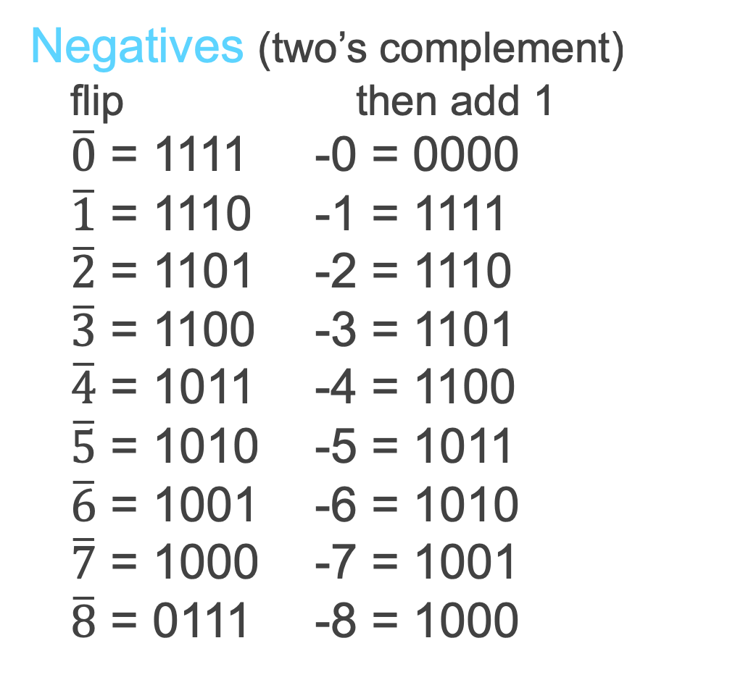
Two’s Complement
Non-negatives
(as usual):
+0 = 0000
+1 = 0001
+2 = 0010
+3 = 0011
+4 = 0100
+5 = 0101
+6 = 0110
+7 = 0111
+8 = 1000
Negatives (two’s complement)
flip then add 1
$\overline{0}$ = 1111 -0 = 0000
$\overline{1}$ = 1110 -1 = 1111
$\overline{2}$ = 1101 -2 = 1110
$\overline{3}$ = 1100 -3 = 1101
$\overline{4}$ = 1011 -4 = 1100
$\overline{5}$ = 1010 -5 = 1011
$\overline{6}$ = 1001 -6 = 1010
$\overline{7}$ = 1000 -7 = 1001
$\overline{8}$ = 0111 -8 = 1000
Notes:
choose -8 so we have a sign bit
+0 = -0
wraps from +7 to -8
asymmetric: no +8

Slide 48
Two’s Complement vs. Unsigned
-1 = 1111 = 15
-2 = 1110 = 14
-3 = 1101 = 13
-4 = 1100 = 12
-5 = 1011 = 11
-6 = 1010 = 10
-7 = 1001 = 9
-8 = 1000 = 8
+7 = 0111 = 7
+6 = 0110 = 6
+5 = 0101 = 5
+4 = 0100 = 4
+3 = 0011 = 3
+2 = 0010 = 2
+1 = 0001 = 1
0 = 0000 = 0
4 bit
Two’s Complement
-8 … 7
4 bit
Unsigned Binary
0 … 15

Slide 49
Clicker Question!
What is the value of the 2s complement number
11010
a) 26
b) 6
c) -6
d) -10
e) -26
Notes:
657 = 0x291
hex: 637 : 39 : 2 : 0

Slide 50
Clicker Question!
What is the value of the 2s complement number
11010
a) 26
b) 6
c) -6
d) -10
e) -26
11010
00101
______+1
-6 = 00110
(flip)
Notes:
657 = 0x291
hex: 637 : 39 : 2 : 0

Slide 51
Two’s Complement Facts
Signed two’s complement
  Negative numbers have leading 1’s
  zero is unique: +0 = - 0
  wraps from largest positive to largest negative
N bits can be used to represent
  unsigned: range 0…2^{N}-1
    eg: 8 bits ⇒ 0…255
  signed (two’s complement): -(2^{N-1})…(2^{N-1} - 1)
    E.g.: 8 bits ⇒ (1000 000) … (0111 1111)
    -128 … 127
Notes:
Why two’s complement works:
Given a set of all possible N-bit values, we can assign the lower (by binary value) half to be the integers from 0 to (2^[N−1]−1) inclusive and the upper half to be −2^[N−1] to −1 inclusive. The upper half can be used to represent negative integers from −2^[N−1] to −1 because, under addition modulo 2^N they behave the same way as those negative integers. That is to say that because i + j mod 2^N = i + (j + 2^N) mod 2^N any value in the set { j + k2^N | k is an integer } can be used in place of j.
For example, with eight bits, the unsigned bytes are 0 to 255. Subtracting 256 from the top half (128 to 255) yields the signed bytes −128 to −1.
The relationship to two's complement is realized by noting that 256 = 255 + 1, and (255 − x) is the ones' complement of x.
http://en.wikipedia.org/wiki/Two%27s_complement

Slide 52
Sign Extension & Truncation
Extending to larger size
  1111 = -1
  1111 1111 = -1
  0111 = 7
  0000 0111 = 7
Truncate to smaller size
  0000 1111 = 15
  BUT, 0000 1111 = 1111 = -1

Slide 53
Two’s Complement Addition
Addition with two’s complement signed numbers
Addition as usual. Ignore the sign. It just works!
Examples
  1 + -1 =
  -3 + -1 =
  -7 + 3 =
  7 + (-3) =
-1 = 1111 = 15
-2 = 1110 = 14
-3 = 1101 = 13
-4 = 1100 = 12
-5 = 1011 = 11
-6 = 1010 = 10
-7 = 1001 = 9
-8 = 1000 = 8
+7 = 0111 = 7
+6 = 0110 = 6
+5 = 0101 = 5
+4 = 0100 = 4
+3 = 0011 = 3
+2 = 0010 = 2
+1 = 0001 = 1
0 = 0000 = 0

Slide 54
Two’s Complement Addition
Addition with two’s complement signed numbers
Addition as usual. Ignore the sign. It just works!
Examples
  1 + -1 = 0001 + 1111 =
  -3 + -1 = 1101 + 1111 =
  -7 + 3 = 1001 + 0011 =
  7 + (-3) = 0111 + 1101 =
-1 = 1111 = 15
-2 = 1110 = 14
-3 = 1101 = 13
-4 = 1100 = 12
-5 = 1011 = 11
-6 = 1010 = 10
-7 = 1001 = 9
-8 = 1000 = 8
+7 = 0111 = 7
+6 = 0110 = 6
+5 = 0101 = 5
+4 = 0100 = 4
+3 = 0011 = 3
+2 = 0010 = 2
+1 = 0001 = 1
0 = 0000 = 0

Slide 55
Two’s Complement Addition
Addition with two’s complement signed numbers
Addition as usual. Ignore the sign. It just works!
Examples
  1 + -1 = 0001 + 1111 = 0000 (0)
  -3 + -1 = 1101 + 1111 = 1100 (-4)
  -7 + 3 = 1001 + 0011 = 1100 (-4)
  7 + (-3) = 0111 + 1101 = 0100 (4)
-1 = 1111 = 15
-2 = 1110 = 14
-3 = 1101 = 13
-4 = 1100 = 12
-5 = 1011 = 11
-6 = 1010 = 10
-7 = 1001 = 9
-8 = 1000 = 8
+7 = 0111 = 7
+6 = 0110 = 6
+5 = 0101 = 5
+4 = 0100 = 4
+3 = 0011 = 3
+2 = 0010 = 2
+1 = 0001 = 1
0 = 0000 = 0

Slide 56
Two’s Complement Addition
Addition with two’s complement signed numbers
Addition as usual. Ignore the sign. It just works!
Examples
  1 + -1 = 0001 + 1111 = 0000 (0)
  -3 + -1 = 1101 + 1111 = 1100 (-4)
  -7 + 3 = 1001 + 0011 = 1100 (-4)
  7 + (-3) = 0111 + 1101 = 0100 (4)
  Clicker Question
  Which of the following has problems?
    7 + 1
    -7 + -3
    -7 + -1
    Only (a) and (b) have problems
    They all have problems
-1 = 1111 = 15
-2 = 1110 = 14
-3 = 1101 = 13
-4 = 1100 = 12
-5 = 1011 = 11
-6 = 1010 = 10
-7 = 1001 = 9
-8 = 1000 = 8
+7 = 0111 = 7
+6 = 0110 = 6
+5 = 0101 = 5
+4 = 0100 = 4
+3 = 0011 = 3
+2 = 0010 = 2
+1 = 0001 = 1
0 = 0000 = 0
Notes:
1 + (-1)
(-3) + (-1)
(-7) + 3
7 + (-3)
7 + 1 : overflow
(-7) + (-3) : overflow
(-7) + (-1)
7 + 1 = 0111+0001 = 1000 = -8 (OVERFLOW)! (Had a carry in to the MSB!) Sign of out != sign of in
7 + (-3) 0111+ 1101 = 1100 = -4
-7+-3 = 1001 + 1101 = 0110 (cout = 1) (Did not have a carry in to the MSB)
-7+-1 = 1001 + 1111 = 1000 (cout = 1)

Slide 57
Two’s Complement Addition
Addition with two’s complement signed numbers
Addition as usual. Ignore the sign. It just works!
Examples
  1 + -1 = 0001 + 1111 = 0000 (0)
  -3 + -1 = 1101 + 1111 = 1100 (-4)
  -7 + 3 = 1001 + 0011 = 1100 (-4)
  7 + (-3) = 0111 + 1101 = 0100 (4)
  Clicker Question
  Which of the following has problems?
    7 + 1 = 1000
    -7 + -3 = 1 0110
    -7 + -1 = 1000
    Only (a) and (b) have problems
    They all have problems
-1 = 1111 = 15
-2 = 1110 = 14
-3 = 1101 = 13
-4 = 1100 = 12
-5 = 1011 = 11
-6 = 1010 = 10
-7 = 1001 = 9
-8 = 1000 = 8
+7 = 0111 = 7
+6 = 0110 = 6
+5 = 0101 = 5
+4 = 0100 = 4
+3 = 0011 = 3
+2 = 0010 = 2
+1 = 0001 = 1
0 = 0000 = 0
Notes:
1 + (-1)
(-3) + (-1)
(-7) + 3
7 + (-3)
7 + 1 : overflow
(-7) + (-3) : overflow
(-7) + (-1)
7 + 1 = 0111+0001 = 1000 = -8 (OVERFLOW)! (Had a carry in to the MSB!) Sign of out != sign of in
7 + (-3) 0111+ 1101 = 1100 = -4
-7+-3 = 1001 + 1101 = 0110 (cout = 1) (Did not have a carry in to the MSB)
-7+-1 = 1001 + 1111 = 1000 (cout = 1)

Slide 58
Two’s Complement Addition
Addition with two’s complement signed numbers
Addition as usual. Ignore the sign. It just works!
Examples
  1 + -1 = 0001 + 1111 = 0000 (0)
  -3 + -1 = 1101 + 1111 = 1100 (-4)
  -7 + 3 = 1001 + 0011 = 1100 (-4)
  7 + (-3) = 0111 + 1101 = 0100 (4)
  Clicker Question
  Which of the following has problems?
    7 + 1 = 1000 overflow
    -7 + -3 = 1 0110 overflow
    -7 + -1 = 1000 fine
    Only (a) and (b) have problems
    They all have problems
-1 = 1111 = 15
-2 = 1110 = 14
-3 = 1101 = 13
-4 = 1100 = 12
-5 = 1011 = 11
-6 = 1010 = 10
-7 = 1001 = 9
-8 = 1000 = 8
+7 = 0111 = 7
+6 = 0110 = 6
+5 = 0101 = 5
+4 = 0100 = 4
+3 = 0011 = 3
+2 = 0010 = 2
+1 = 0001 = 1
0 = 0000 = 0
Notes:
1 + (-1)
(-3) + (-1)
(-7) + 3
7 + (-3)
7 + 1 : overflow
(-7) + (-3) : overflow
(-7) + (-1)
7 + 1 = 0111+0001 = 1000 = -8 (OVERFLOW)! (Had a carry in to the MSB!) Sign of out != sign of in
7 + (-3) 0111+ 1101 = 1100 = -4
-7+-3 = 1001 + 1101 = 0110 (cout = 1) (Did not have a carry in to the MSB)
-7+-1 = 1001 + 1111 = 1000 (cout = 1)

Slide 59
Next Goal
In general, how do we detect and handle overflow?

Slide 60
Overflow
When can overflow occur?
  adding a negative and a positive?
    Overflow cannot occur (Why?)
    Always subtract larger magnitude from smaller
  adding two positives?
    Overflow can occur (Why?)
    Precision: Add two positives, and get a negative number!
  adding two negatives?
    Overflow can occur (Why?)
    Precision: add two negatives, get a positive number!
Rule of thumb:
  Overflow happens iff
  carry into msb != carry out of msb

Slide 61
Overflow
When can overflow occur?
  adding a negative and a positive?
    Overflow cannot occur (Why?)
    Always subtract larger magnitude from smaller
  adding two positives?
    Overflow can occur (Why?)
    Precision: Add two positives, and get a negative number!
  adding two negatives?
    Overflow can occur (Why?)
    Precision: add two negatives, get a positive number!
Rule of thumb:
  Overflow happens iff
  carry into msb != carry out of msb
Notes:
Overflow occurs because there are not enough bits to represent the precision/magnitude of the result of the add
MSB
0
Cout = 0 0 Cin = 0
0
a = 0
Cout = 0 b = 0 Cin = 1 (Overflow!)
s = 1
a = 1
Cout = 1 b = 1 Cin = 0 (Overflow!)
s = 0
a = 1
Cout = 1 b = 1 Cin = 1
s = 1

Slide 62
Overflow
When can overflow occur?
  adding a negative and a positive?
    Overflow cannot occur (Why?)
    Always subtract larger magnitude from smaller
  adding two positives?
    Overflow can occur (Why?)
    Precision: Add two positives, and get a negative number!
  adding two negatives?
    Overflow can occur (Why?)
    Precision: add two negatives, get a positive number!
Rule of thumb:
  Overflow happens iff
  carry into msb != carry out of msb
A | B | C_{in} | C_{out} | S
0 | 0 | 0 | 0 | 0
0 | 0 | 1 | 0 | 1
0 | 1 | 0 | 0 | 1
0 | 1 | 1 | 1 | 0
1 | 0 | 0 | 0 | 1
1 | 0 | 1 | 1 | 0
1 | 1 | 0 | 1 | 0
1 | 1 | 1 | 1 | 1
A_{MSB} B_{MSB}
Wrong
Sign
over
flow
C_{out_MSB}
C_{in_MSB}
S_{MSB}
Wrong
Sign

Slide 63
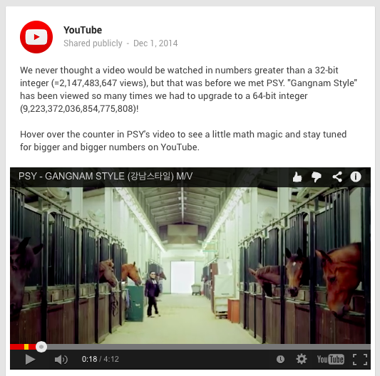

Slide 64
Today’s Lecture
Binary Operations
  Number representations
  One-bit and four-bit adders
  Negative numbers and two’s compliment
  Addition (two’s compliment)
  Detecting and handling overflow
  Subtraction (two’s compliment)

Slide 65
Binary Subtraction
Why create a new circuit?
Just use addition using two’s complement math
  How?

Slide 66

Binary Subtraction
Two’s Complement Subtraction
  Subtraction is simply addition,
  where one of the operands has been negated
    Negation is done by inverting all bits and adding one
    A – B = A + (-B) = A + ($\overline{B}$ + 1)
Notes:
a – b, where b is so large that –B overflows
B must be -8, so that –B = -8
last bit will change
if a >= 0, will correctly signal overflow
if a < 0, will correctly subtract and not signal overflow

Slide 67
Binary Subtraction
Two’s Complement Subtraction
  Subtraction is simply addition,
  where one of the operands has been negated
    Negation is done by inverting all bits and adding one
    A – B = A + (-B) = A + ($\overline{B}$ + 1)
Q: How do we detect and handle overflows?
Q: What if (-B) overflows?
Notes:
a – b, where b is so large that –B overflows
B must be -8, so that –B = -8
last bit will change
if a >= 0, will correctly signal overflow
if a < 0, will correctly subtract and not signal overflow

Slide 68
Two’s Complement Adder
Two’s Complement Adder with overflow detection

Slide 69
Two’s Complement Adder
Two’s Complement Adder with overflow detection

Slide 70
Two’s Complement Adder
Two’s Complement Adder with overflow detection
Note: 4-bit adder is drawn for illustrative purposes and may not represent the optimal design.

Slide 71
Two’s Complement Adder
Two’s Complement Adder with overflow detection
Note: 4-bit adder is drawn for illustrative purposes and may not represent the optimal design.

Slide 72
Two’s Complement Adder
Two’s Complement Adder with overflow detection

Slide 73
Two’s Complement Adder
Two’s Complement Adder with overflow detection
Before: 2 inverters, 2 AND gates, 1 OR gate After: 1 XOR gate

Slide 74
Takeaways
Digital computers are implemented via logic circuits and thus represent all numbers in binary (base 2).
We write numbers as decimal or hex for convenience and need to be able to convert to binary and back (to understand what the computer is doing!).
Adding two 1-bit numbers generalizes to adding two numbers of any size since 1-bit full adders can be cascaded.
Using Two’s complement number representation simplifies adder Logic circuit design (0 is unique, easy to negate). Subtraction is adding, where one operand is negated (two’s complement; to negate: flip the bits and add 1).
Overflow if sign of operands A and B != sign of result S.
Can detect overflow by testing C_{in} != C_{out} of the most significant bit (msb), which only occurs when previous statement is true.

Slide 75
Summary
We can now implement combinational logic circuits
  Design each block
    Binary encoded numbers for compactness
  Decompose large circuit into manageable blocks
    1-bit Half Adders, 1-bit Full Adders,
    n-bit Adders via cascaded 1-bit Full Adders, ...
  Can implement circuits using NAND or NOR gates
  Can implement gates using use PMOS and NMOS-transistors
  And can add and subtract numbers (in two’s compliment)!
  Next time, state and finite state machines…

