Slide 1
Introduction
Prof. Hakim Weatherspoon
CS 3410
Computer Science
Cornell University
[Weatherspoon, Bala, Bracy, and Sirer]

Slide 2

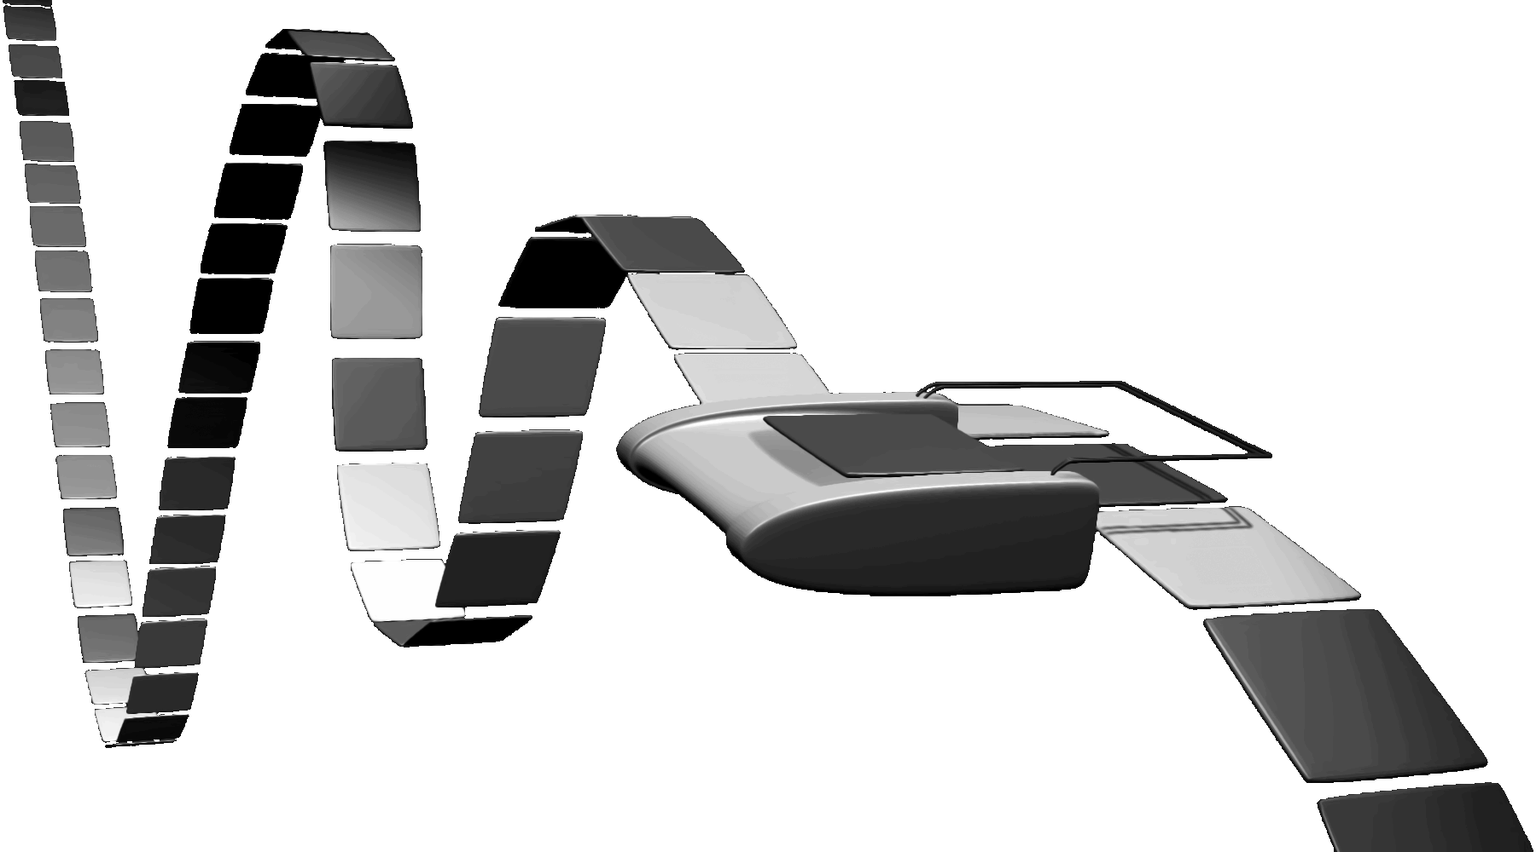
Turing Machine
1936
Alan Turing
= abstract model for CPU that can simulate any algorithm
Notes:
How does The Imitation Game, Engima/Bombe, Turing relate to you and this course?!
Alan Turing thesis in 1936 came up with an abstract model for a CPU that can simulate any algorithm, a Turing Machine. You will build a CPU and understand it and its organization
http://en.wikipedia.org/wiki/Turing_machine
A Turing machine is a hypothetical device that manipulates symbols on a strip of tape according to a table of rules. Despite its simplicity, a Turing machine can be adapted to simulate the logic of any computer algorithm, and is particularly useful in explaining the functions of a CPU inside a computer.
Note that every part of the machine (i.e. its state, symbol-collections, and used tape at any given time) and its actions (such as printing, erasing and tape motion) is finite, discrete and distinguishable; it is the unlimited amount of tape and runtime that gives it an unbounded amount of storage space.

Slide 3
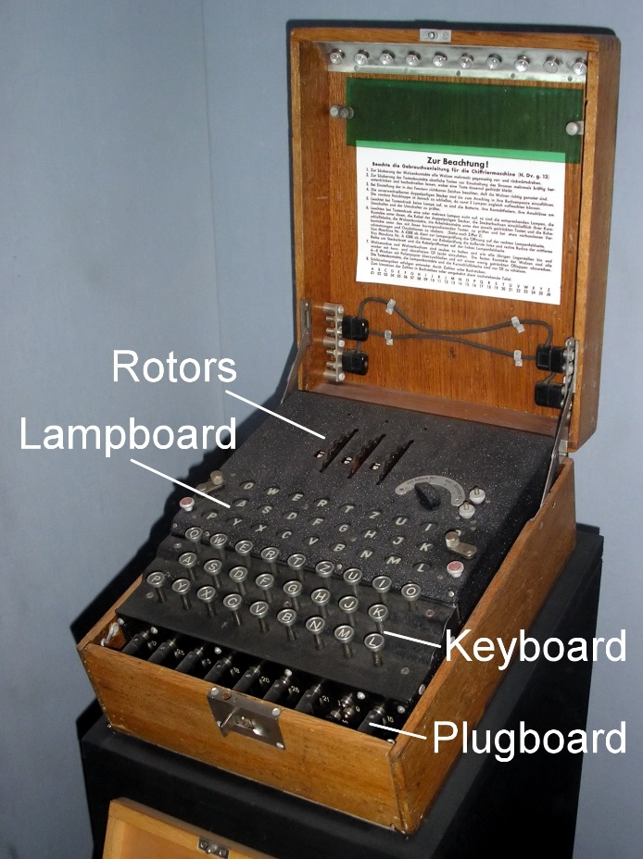
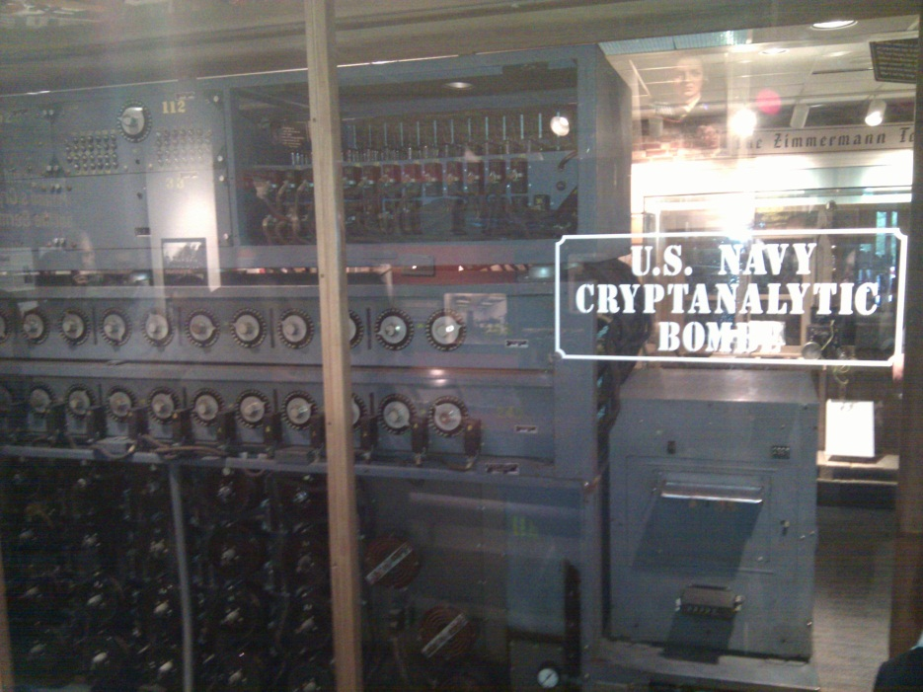
The Bombe
used by the Allies to
break the German
Enigma machine during
World War II
Enigma machine
Used by the Germans during
World War II to encrypt and
exchange secret messages
Notes:
http://en.wikipedia.org/wiki/Bombe
How many possible combinations to break an Enigma cipher text (msg encrypted by the Enigma machine)?
Rotors x Rotor posititions x plugboard combinations with 10 pairs = 159 quintillion = 1.59 x 10^20 158,962,555,217,826,360,000
Rotors (3 of 5 rotors): 5 x 4 x 3 = 60
Rotor positions: 26 x 26 x 26 = 17,526
plugboard: 26! / (6!10!2^10)
Numberphile on Enigma/Bombe
For those who want to learn more about the mechanism of the Bombe and how it exploited the flaw in the Enigma, Numberphile has recently done an excellent episode on it. Enjoy!
Flaw in the Enigma: http://www.youtube.com/watch?v=V4V2bpZlqx8
Previous episode on Enigma: http://www.youtube.com/watch?v=G2_Q9FoD-oQ

Slide 4
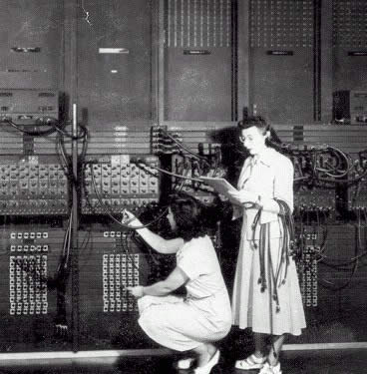
ENIAC
Electronic Numerical Integrator And Computer
1946
John Mauchly
J. Presper Eckert

Slide 5
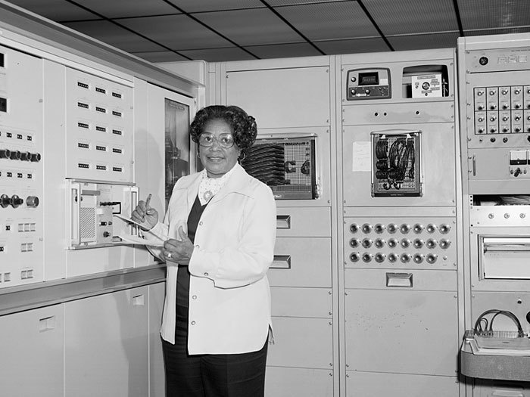
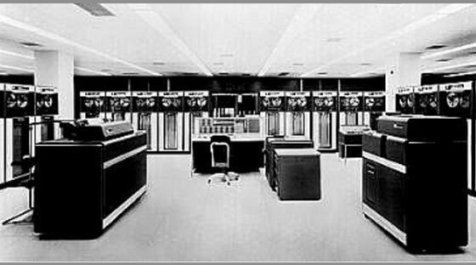
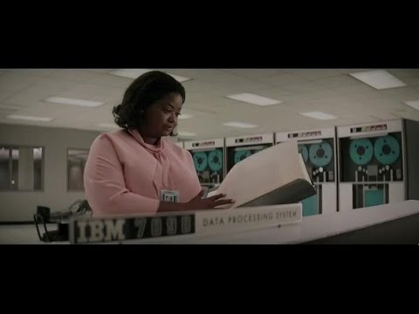
IBM 7090
Human Computers programming the IBM 7090
Mary Jackson
Hidden Figures

Slide 6
Who are you?
“Sometimes it is the people that no one imagines anything of who do the things that no one can imagine.” – Alan Turing
Turing Award Winners?
Eckert Mauchly Award Winners?

Slide 7
Course Objective
Understand the HW / SW interface software
  How a processor works
  How a computer is organized
Establish a foundation for building applications
  How to write a good program
    Good = correct, fast, and secure
  How to understand where the world is going
Understand technology (past, present, future)

Slide 8

What is this?
#include <stdio.h>
int main() {
printf("Hello world!\n");
return 0;
}
How does it work?
I’m glad you asked…
15 weeks later and you’ll know!
“I know Kung Fu.”

Slide 9
Compilers and Assemblers
C
int x = 10;
x = 2 * x + 15;
compiler
r0 = 0
r5 = r0 + 10
r5 = r5 * 2
r5 = r5 + 15
RISC-V
assembly
language
addi r5, r0, 10
muli r5, r5, 2
addi r5, r5, 15
Everything is a number!
assembler
10 r0 r5 op = addi
RISC-V
machine
language
00000000101000000000001010010011
00000000000100101001001010010011
00000000111100101000001010010011
15 r5 r5 op = addi

Slide 10
How to Design a Simple Process

Slide 11
Instruction Set Architecture (ISA)
Abstract interface between hardware and the lowest level software
User portion of the instruction set plus the operating system interfaces used by application programmers

Slide 12
Basic Computer System
A processor executes instructions
  Processor has some internal state in storage elements (registers)
A memory holds instructions and data
  von Neumann architecture: combined inst and data
A bus connects the two

Slide 13
Overview

Slide 14
Covered in this course

Slide 15

Where did it begin?
Electrical Switch
  On/Off
  Binary
Transistor
The first transistor on a workbench at AT&T Bell Labs in 1947
Notes:
John Bardeen
Walter Brattain
William Shockley

Slide 16
Moore’s Law
1965
  # of transistors integrated on a die doubles every 18-24 months (i.e., grows exponentially with time)
Amazingly visionary
  2300 transistors, 1 MHz clock (Intel 4004) - 1971
  16 Million transistors (Ultra Sparc III)
  42 Million transistors, 2 GHz clock (Intel Xeon) – 2001
  55 Million transistors, 3 GHz, 130nm technology, 250mm² die (Intel Pentium 4) – 2004
  290+ Million transistors, 3 GHz (Intel Core 2 Duo) – 2007
  721 Million transistors, 2 GHz (Nehalem) - 2009
  1.4 Billion transistors, 3.4 GHz Intel Haswell (Quad core) – 2013
  7.2 Billion transistors, 3-3.9 GHz Intel Broadwell (22-core) – 2016
Notes:
Tbyte = 2^40 bytes (or 10^12 bytes)
Note that Moore’s law is not about speed predictions but about chip complexity

Slide 17
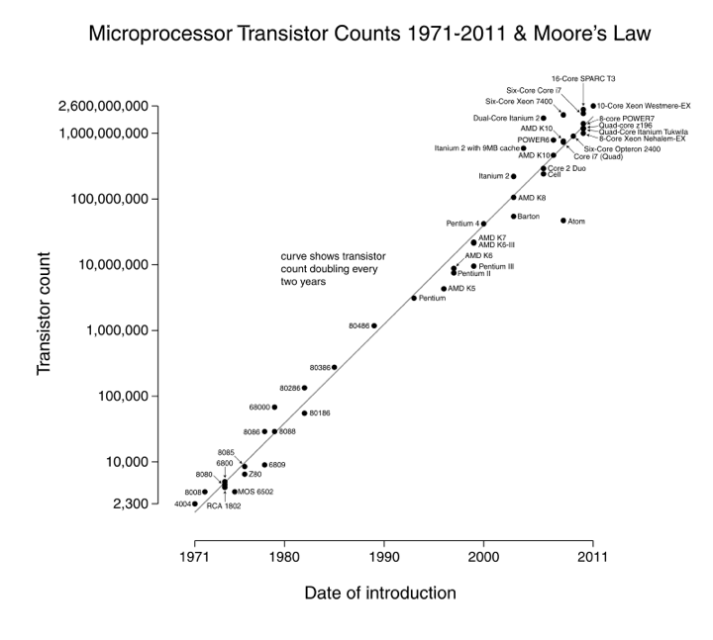

Slide 18
Processor Performance Increase
Notes:
Another powerpoint “comic” – note that the y axis is log !
x/y where x is the model number and y is the speed in MHz
Rate of performance improvement has been between 1.5 and 1.6 times per year – how much longer will Moore’s Law hold?

Slide 19
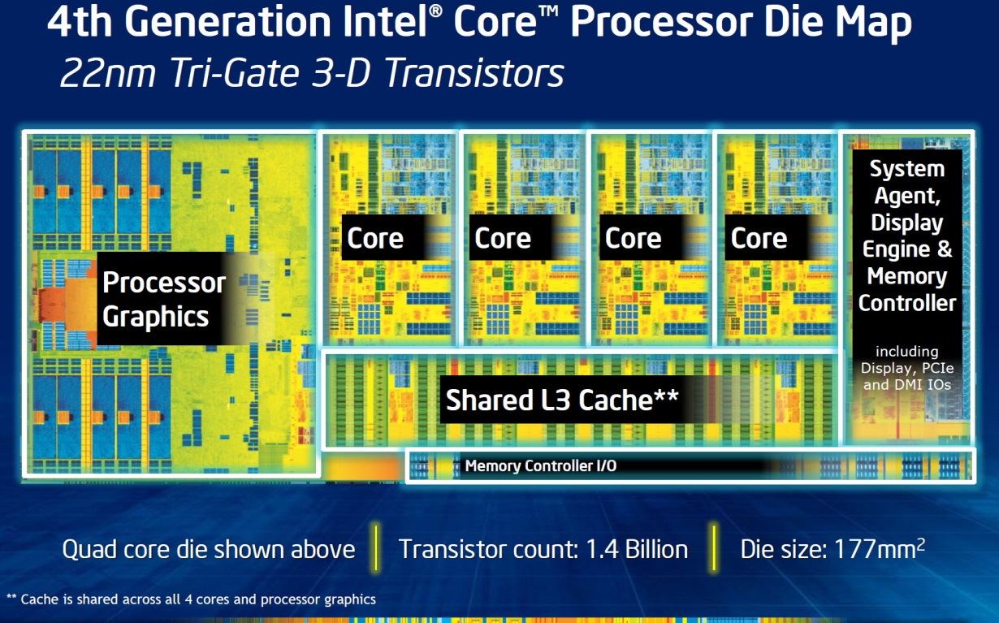
Then and Now
https://en.wikipedia.org/wiki/Transistor_count
http://techguru3d.com/4th-gen-intel-haswell-processors-architecture-and-lineup/
The first transistor
  One workbench at AT&T Bell Labs
  1947
  Bardeen, Brattain, and Shockley
Intel Haswell
  1.4 billion transistors, 22nm
  177 square millimeters
  Four processing cores
What are we doing with all these transistors?
https://en.wikipedia.org/wiki/Transistor_count
Notes:
John Bardeen
Walter Brattain
William Shockley

Slide 20
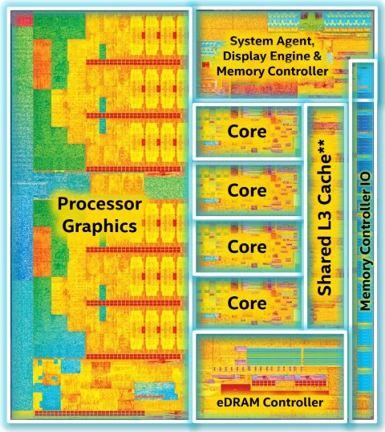
Then and Now
https://en.wikipedia.org/wiki/Transistor_count
https://www.computershopper.com/computex-2015/performance-preview-desktop-broadwell-at-computex-2015
The first transistor
  One workbench at AT&T Bell Labs
  1947
  Bardeen, Brattain, and Shockley
Intel Broadwell
  7.2 billion transistors, 14nm
  456 square millimeters
  Up to 22 processing cores
What are we doing with all these transistors?
https://en.wikipedia.org/wiki/Transistor_count

Slide 21
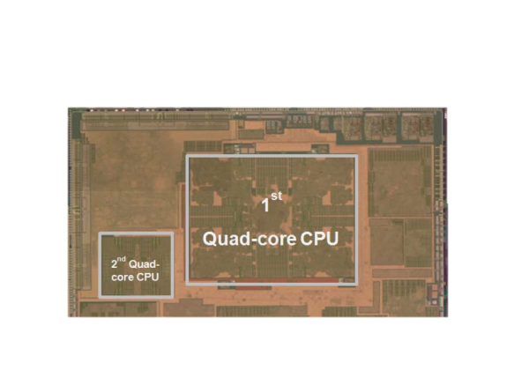
Then and Now
https://en.wikipedia.org/wiki/Transistor_count
The first transistor
  One workbench at AT&T Bell Labs
  1947
  Bardeen, Brattain, and Shockley
Galaxy Note 9
  8 processing cores
  Exynos 9 Octa 8895 processor
What are we doing with all these transistors?
https://en.wikipedia.org/wiki/Exynos

Slide 22
What are we doing with all these transistors?
Everything these days!
  Phones, cars, televisions, games, computers,…

Slide 23
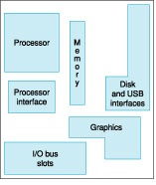
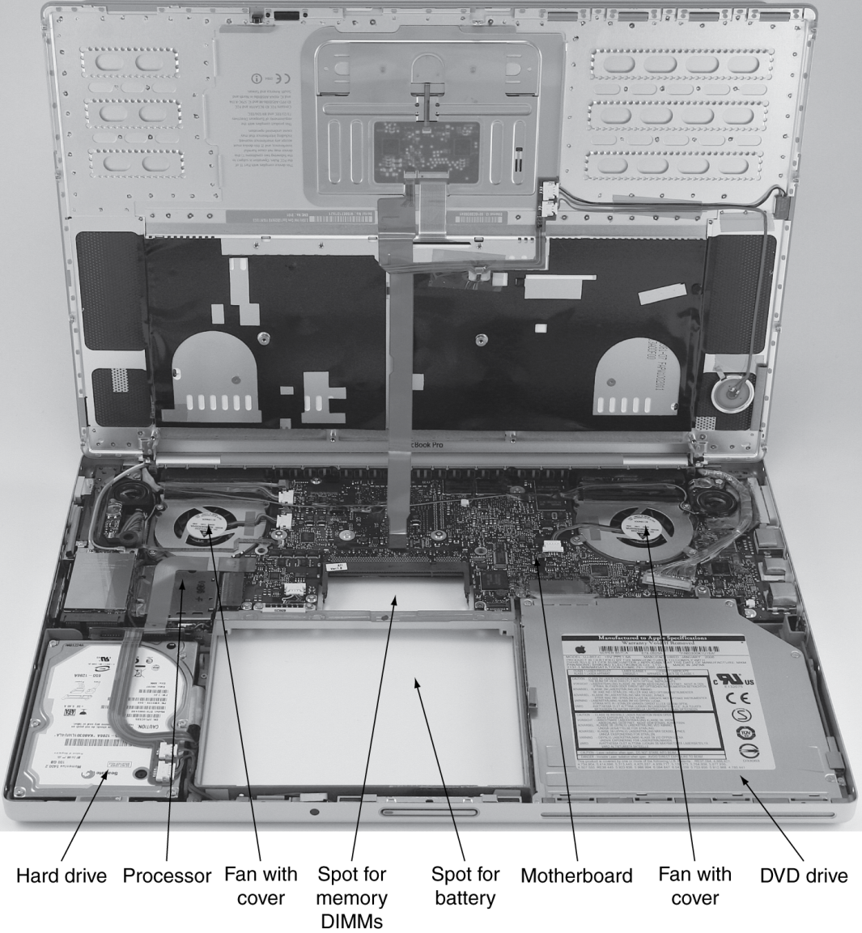
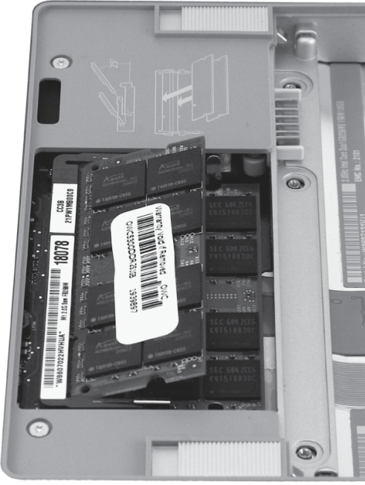
Computer System Organization

Slide 24
Reflect
Why take this course?
  Basic knowledge needed for all other areas of CS:
    operating systems, compilers, ...
  Levels are not independent
    hardware design ↔ software design ↔ performance
  Crossing boundaries is hard but important
    device drivers
  Good design techniques
    abstraction, layering, pipelining, parallel vs. serial, ...
  Understand where the world is going
  The Mysteries of Computing will be revealed!

