Slide 1
Introduction
Prof. Hakim Weatherspoon
CS 3410
Computer Science
Cornell University
[Weatherspoon, Bala, Bracy, and Sirer]

Slide 2
First Clicker Question!
How excited are you to take this class??
I’ve been waiting my whole life to take 3410. I couldn’t sleep last night I’m so excited.
I’m excited.
I’ve heard good things, but my excitement is on hold.
Excited, not sure. Anxious? Yes.
Help! I’m a CS minor trapped in this class. Please rescue me. (Seriously.)

Slide 3
Who am I?
Hakim Weatherspoon
Undergrad: Computer Engineering at University of Washington
PhD: Computer Science, Distributed Systems at University of California, Berkeley
Academia: Cornell
Taught 3410 and 4410 more than 10 times over 10 years!

Slide 4
Second Clicker Question!
Who are you?
Freshman
Sophomore
Junior
Senior
Other

Slide 5
“Sometimes it is the people that no one imagines anything of
who do the things that no one can imagine”
--quote from the movie The Imitation Game

Slide 6
“Can machines think?”
-- Alan Turing, 1950 Computing Machinery and Intelligence

Slide 7
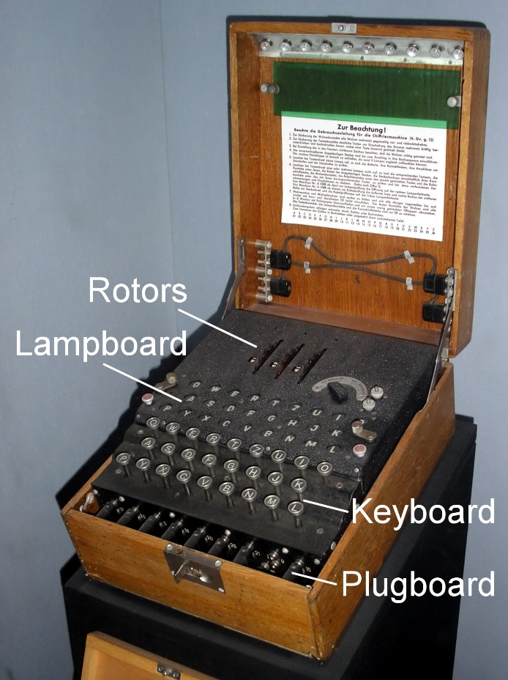
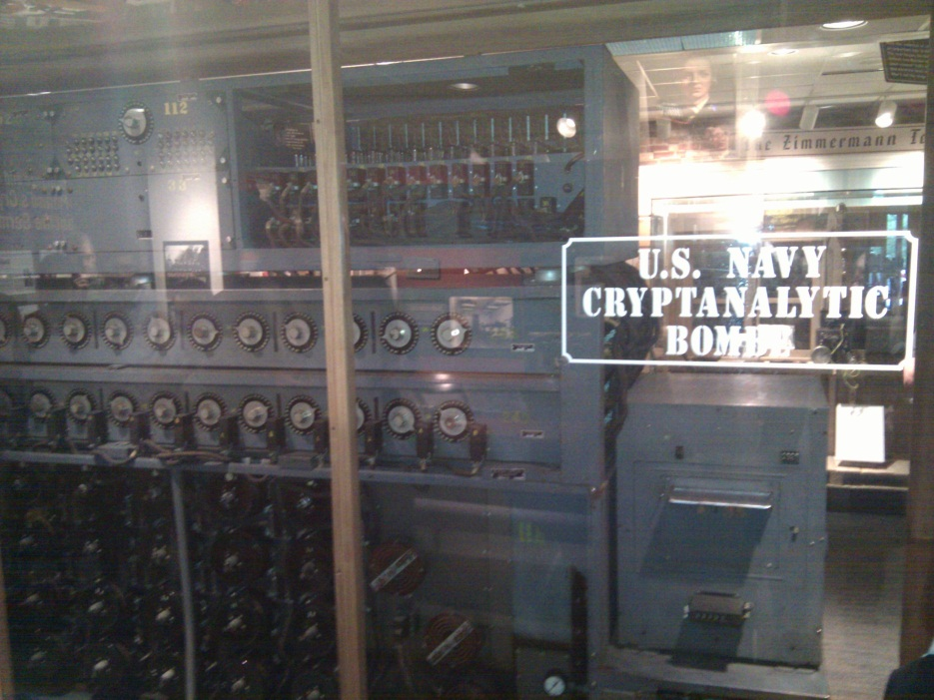
The Bombe
used by the Allies to
break the German
Enigma machine during
World War II
Enigma machine
Used by the Germans during
World War II to encrypt and
exchange secret messages

Slide 8
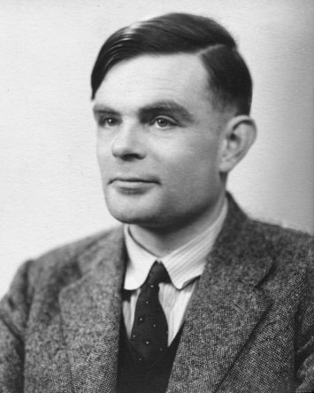
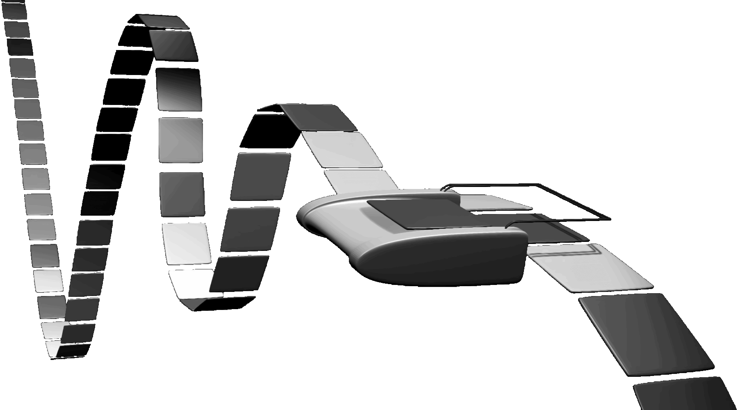
Turing Machine
1936
Alan Turing
= abstract model for CPU that can simulate any algorithm

Slide 9
Course Objective
Bridge the gap between hardware and software
How a processor works
How a computer is organized
Establish a foundation for building higher-level applications
How to understand program performance
How to understand where the world is going

Slide 10
How class is organized
Before you take this class…
Lecture
Lab Sections
Office Hours
Online Tools
Grading
Who’s Who

Slide 11
Pre-requisites and scheduling
CS 2110 required (OO Programming & Data Structures)
Must have satisfactorily completed CS 2110
Cannot take CS 2110 concurrently with CS 3410
CS 3420 (ECE 3140) (Embedded Systems)
Take either CS 3410 or CS 3420
both satisfy CS and ECE requirements
However, Need ENGRD 2300 to take CS 3420
CS 3110 (Data Structures and Functional Programming)
Not advised to take CS 3110 and 3410 together
Lectures scheduled at the same time so you can’t

Slide 12
Pre-requisites and scheduling
CS 2043 (UNIX Tools and Scripting)
2-credit course will greatly help with CS 3410.
Spring only
CS 2024 (C++)
1 to 2-credit course will greatly help with CS 3410
ECE 2400 (Computer Systems Programming)
New course started last semester
Lot of overlap with 2110, 2043, 2024, and 3410

Slide 13
Required Textbook
Computer Organization and Design RISC-V Edition
1st Edition

Slide 14
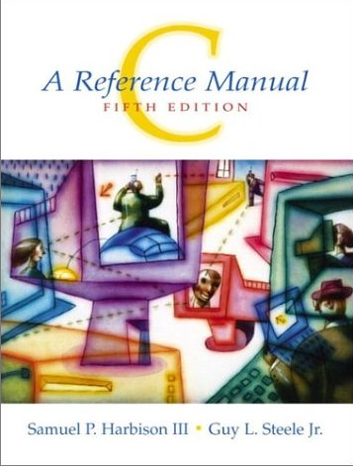
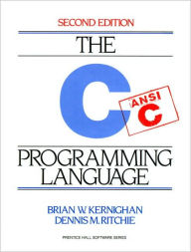
C Resources (Optional)

Slide 15
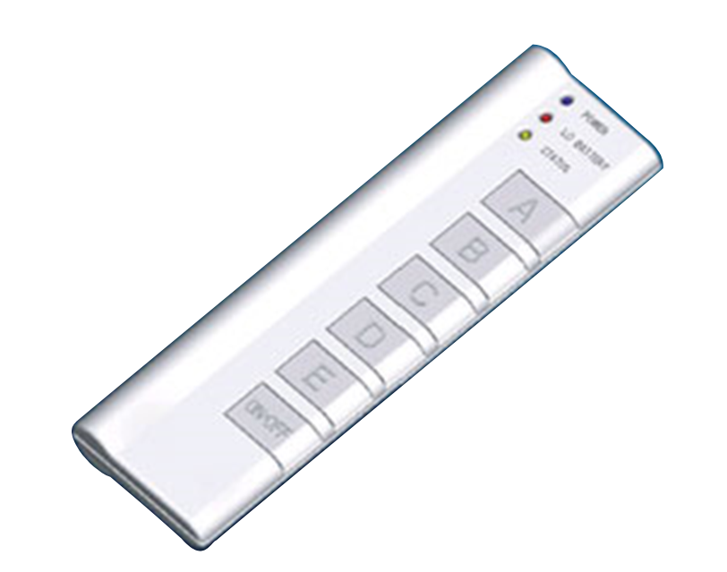
Lectures
Tuesday & Thursday 10:10-11:25
155 Olin Hall
iClicker: Bring to every Lecture
(starting today!)
missing a few times is okay
No cell phones (except for Reef Polling)
No Laptops

Slide 16
Active Learning
Interactive Textbook
Clickers
Activity Sheets
Classroom DJ, Breaks
Autograders
Lab Sections
You ask Questions
I ask Questions

Slide 17
How class is organized
Before you take this class…
Lecture
Lab Sections
Office Hours
Online Tools
Grading
Who’s Who

Slide 18
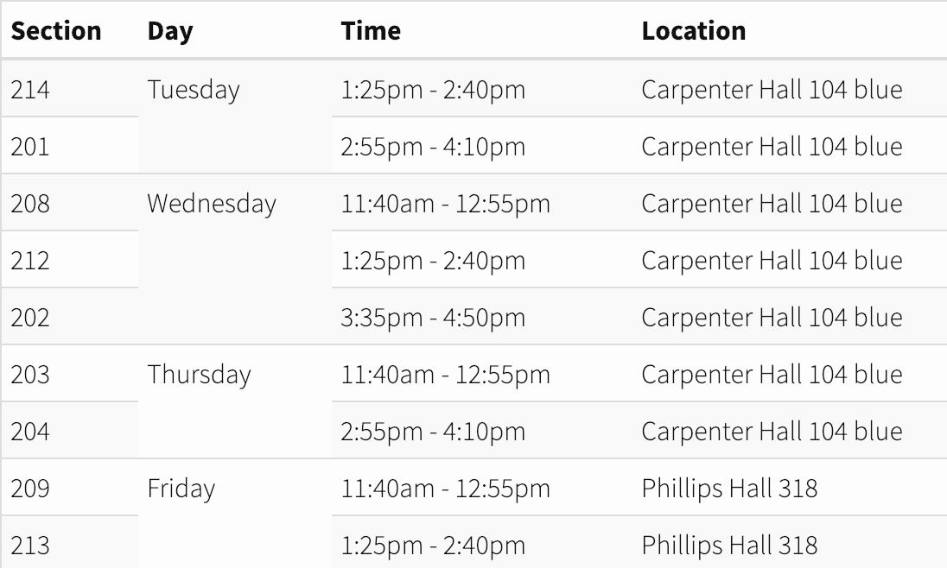
Lab Sections Start this Week!

Slide 19
Office Hours
My Office Hours:
Mondays 1:15-2:15pm, Tuesday 1:15-2:15pm
TA Office Hours:
Always in Rhodes Hall, Rooms 400 & 402
Every day of the week
See Google Calendar on course website
Start Sunday
Awesome Course Staff on the website

Slide 20
Communication
Website
http://www.cs.cornell.edu/courses/cs3410/2018sp
Email
cs3410-prof@cornell.edu
The email alias goes to me, or come to my office hours
Assignments
CMS: http://cmsx.csuglab.cornell.edu
Newsgroup
http://www.piazza.com/cornell/spring2019/cs3410
For students
iClicker
http://atcsupport.cit.cornell.edu/pollsrvc/

Slide 21
Personal Emergencies
Please email cs3410-prof@cornell.edu
Get Help
Get Documentation
The earlier the better

Slide 22
Online Tools
http://www.cs.cornell.edu/courses/cs3410/2019sp
Office Hours / Consulting Hours
Lecture slides, schedule, and Logisim
CSUG lab access (esp. second half of course)
Finalized Schedule will be up by next lecture (readings by Friday)
Submit to CMS.
This class is relentless.
Stay on top of it!

Slide 23
Course Management
Github for assignment dissemination
CMS for submissions & grades

Slide 24
Labs and Projects
Labs Assignments
Weekly
To be done in lab
Projects
2 Individual Projects: you work alone
4 Pair Projects: you work in pairs
Partners will be assigned

Slide 25
Exams
Two Prelims
March 5 and May 2
Administrative Assistant
Corey Torres <ct365@cornell.edu>, Gates 401
Please give accommodation letters to her within the first 2 weeks

Slide 26
Grading
Approximately:
Practicum ~50%
Labs 10%
Projects 40%
Lecture ~50%
Prelims 35%
Zybook 10%
Participation 5%

Slide 27
Grading
Regrade policy
Within 1 week of the assignment (or exam)’s return
Late Policy
Each person has a total of 5 “Slip days”
Max of 2 slip days for any project
Cannot ever submit later than 48 hours late
Handled by CMS, need to check implementation
For pair projects, slip days deducted from all partners
25% deducted per day late after slip days are exhausted
Cannot use on Labs. (Lowest 2 lab scores will be dropped.)

Slide 28
Who am I, Revisited
Nice and a vertebrate:
Piazza posts about course material very welcome
Visits to my office hours very welcome
Correspondence about use of slip days, your alarm clock, your all-nighters, your alcohol intake, your car battery, etc. etc. not welcome
No exceptions
Deadlines are firm

Slide 29
Academic Integrity
All submitted work must be your own
OK to study together, but do not share solultions
Cite your sources
Project groups submit joint work
Same rules apply to projects at the group level
Cannot use someone else’s solution
Stressed? Tempted? Lost?
Come see us before due date!
Plagiarism in any form will not be tolerated

Slide 30
Academic Integrity Rules of Thumb
Looking at code that we didn’t give you?
STOP
Protect yourself. Solutions are hard to un-see
White board rule of collaboration
Work on white board, take no notes
Erase, go home, watch an episode of Stranger Things
Code up by yourself

Slide 31
Questions so far?

