Slide 1
Storage
CS 3410
Computer System Organization & Programming
These slides are the product of many rounds of teaching CS 3410 by Deniz Altinbuke, Kevin Walsh, and Professors Weatherspoon, Bala, Bracy, and Sirer.

Slide 2
Challenge
How do we store lots of data for a long time
Disk (Hard disk, floppy disk, …)
Tape (cassettes, backup, VHS, …)
CDs/DVDs

Slide 3
Challenge
How do we store lots of data for a long time
Disk (Hard disk, floppy disk, …Solid State Disk (SSD)
Tape (cassettes, backup, VHS, …)
CDs/DVDs
Non-Volitile Persistent Memory (NVM; e.g. 3D Xpoint)

Slide 4
I/O System Characteristics
Dependability is important
Particularly for storage devices
Performance measures
Latency (response time)
Throughput (bandwidth)
Desktops & embedded systems
Mainly interested in response time & diversity of devices
Servers
Mainly interested in throughput & expandability of devices

Slide 5
Memory Hierarchy
16 KB
registers/L1
2 ns, random access
512 KB
L2
5 ns, random access
2 GB
20-80 ns, random access
DRAM
300 GB
2-8 ms, random access
Disk
2006
1 TB
100s, sequential access
Tape

Slide 6
Memory Hierarchy
128 KB
registers/L1
2 ns, random access
4 MB
L2
5 ns, random access
256 GB
20-80 ns, random access
DRAM
6 TB
2-8 ms, random access
Disk
30 TB
100ns-10us, random access
Millions of IOPS (I/O per sec)
SSD

Slide 7
Memory Hierarchy
128 KB
registers/L1
2 ns, random access
4 MB
L2
5 ns, random access
256 GB
20-80 ns, random access
DRAM
1 TB
20 -100 ns, random access
Non-volatile memory
6 TB
2-8 ms, random access
Disk
30 TB
100ns-10us, random access
Millions of IOPS (I/O per sec)
SSD
Notes:
30TB 2.5in Samsung Flash Drive https://arstechnica.com/gadgets/2018/02/samsung-crams-30tb-of-ssd-into-a-single-2-5-inch-drive/
60TB 3.5in Seagate Flash Drive https://arstechnica.com/gadgets/2016/08/seagate-unveils-60tb-ssd-the-worlds-largest-hard-drive/

Slide 8
Memory Hierarchy
30 TB
SSD
100ns-10us, random access
Millions of IOPS (I/O per sec)
2⁴⁵B
Server
10s of Disks
256 TB
2⁴⁸B
Rack of Servers
10s of Servers
10 PB
2⁵³B
Data Center
10-100s of Servers
1 EB
2⁶⁰B
Cloud
10-100s of
Data Centers
0.1 YB
2⁶⁷B

Slide 9
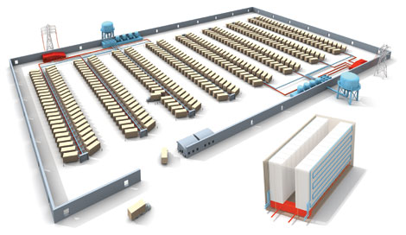
The Rise of Cloud Computing
How big is Big Data in the Cloud?
Exabytes: Delivery of petabytes of storage daily
Titan tech boom, randy katz, 2008
Notes:
Big Data: Volume (Exabytes), Velocity (Petabytes/day), variety (worlds data)
1KB: webpage (and amount of L1 [level-1] cache)
1MB: music file (and amount of L3 [level-3] cache)
1GB: movie file (and amount of memory in a computer)
1TB: genome file (and 1 hard disk drive)
1PB: 1000x genome file or million moves
1EB: million genome files, billion movies, trillion music files, quadrillion webpages

Slide 10
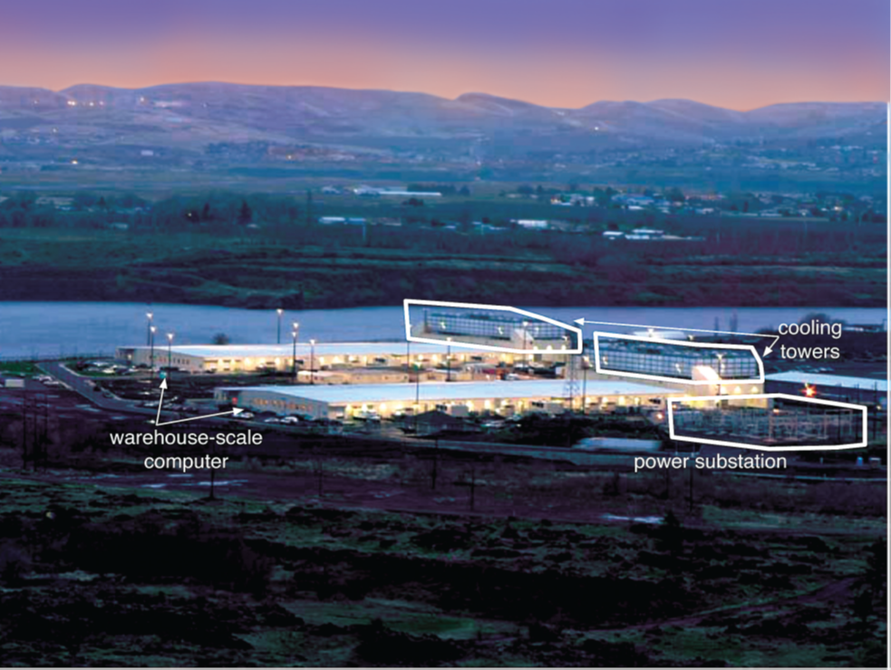
The Rise of Cloud Computing
How big is Big Data in the Cloud?
Most of the worlds data (and computation) hosted by few companies

Slide 11
The Rise of Cloud Computing
How big is Big Data in the Cloud?
Most of the worlds data (and computation) hosted by few companies

Slide 12
The Rise of Cloud Computing
The promise of the Cloud
ubiquitous, convenient, on-demand network access to a shared pool of configurable computing resources (e.g., networks, servers, storage, applications, and services) that can be rapidly provisioned and released with minimal management effort or service provider interaction.
NIST Cloud Definition
Notes:
The cloud completes the commoditization process and makes storage and computation a commodity.
Public vs private
IaaS, PaaS, SaaS
On demand (self service), network access, resource pooling, rapid elasticity, measured service

Slide 13
The Rise of Cloud Computing
The promise of the Cloud
ubiquitous, convenient, on-demand network access to a shared pool of configurable computing resources (e.g., networks, servers, storage, applications, and services) that can be rapidly provisioned and released with minimal management effort or service provider interaction.
NIST Cloud Definition
Notes:
The cloud completes the commoditization process and makes storage and computation a commodity.
Public vs private
IaaS, PaaS, SaaS
On demand (self service), network access, resource pooling, rapid elasticity, measured service

Slide 14
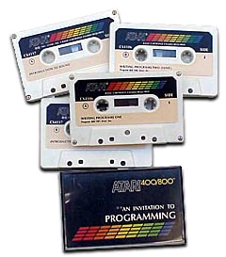
Tapes
Same basic principle for 8-tracks, cassettes, VHS, ...
Ferric Oxide Powder: ferromagnetic material
During recording, the audio signal is sent through the coil of wire to create a magnetic field in the core.
During playback, the motion of the tape creates a varying magnetic field in the core and therefore a signal in the coil.
0 0 1 0 1 0 1 0 1

Slide 15
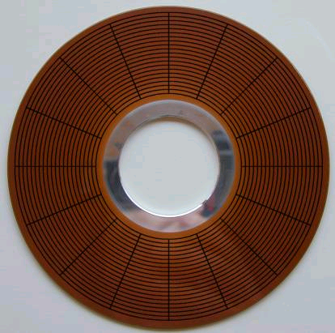
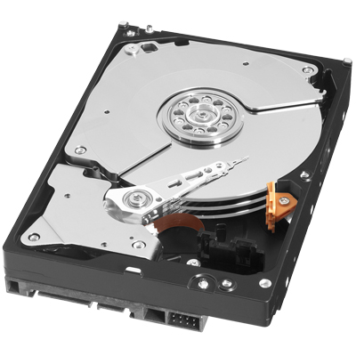
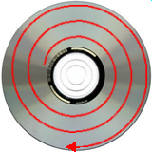
Disks & CDs
Disks use same magnetic medium as tapes
concentric rings (not a spiral)
CDs & DVDs use optics and a single spiral track

Slide 16
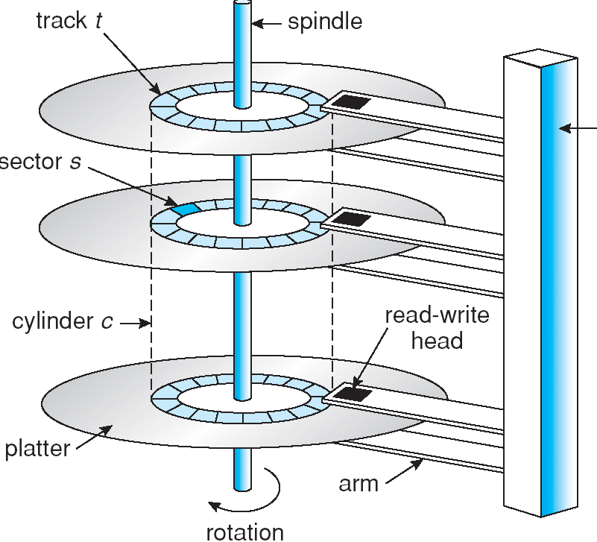
Disk Physics
Typical parameters :
1 spindle
1 arm assembly
1-4 platters
1-2 sides/platter
1 head per side
(but only 1 active head at a time)
700-20480 tracks/surface
16-1600 sectors/track

Slide 17
Disk Accesses
Accessing a disk requires:
specify sector: C (cylinder), H (head), and S (sector)
specify size: number of sectors to read or write
specify memory address
Performance:
seek time: move the arm assembly to track
Rotational delay: wait for sector to come around
transfer time: get the bits off the disk
Controller time: time for setup
Track
Sector
Seek Time
Rotation
Delay

Slide 18
Example
Average time to read/write 512-byte sector
Disk rotation at 10,000 RPM
Seek time: 6ms
Transfer rate: 50 MB/sec
Controller overhead: 0.2 ms
Average time:
Seek time + rotational delay + transfer time + controller overhead
6ms + 0.5 rotation/(10,000 RPM) + 0.5KB/(50 MB/sec) + 0.2ms
6.0 + 3.0 + 0.01 + 0.2 = 9.2ms

Slide 19
Disk Access Example
If actual average seek time is 2ms
Average read time = 5.2ms

Slide 20
Disk Scheduling
Goal: minimize seek time
secondary goal: minimize rotational latency
FCFS (First come first served)
Shortest seek time
SCAN/Elevator
First service all requests in one direction
Then reverse and serve in opposite direction
Circular SCAN
Go off the edge and come to the beginning and start all over again

Slide 21
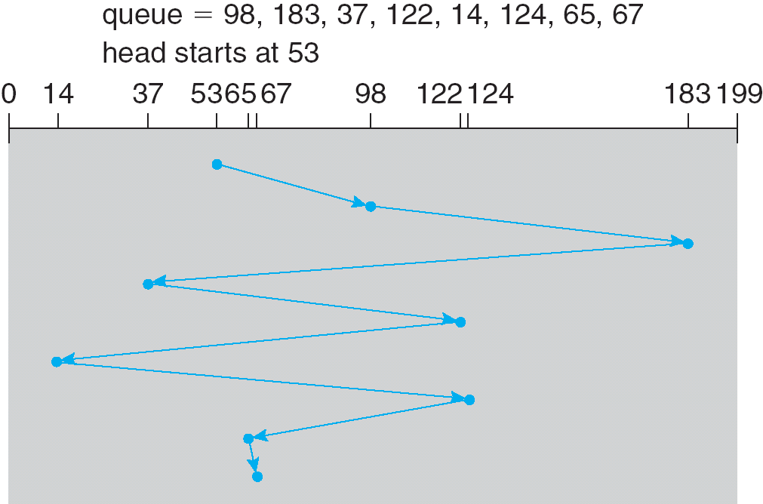
FCFS

Slide 22
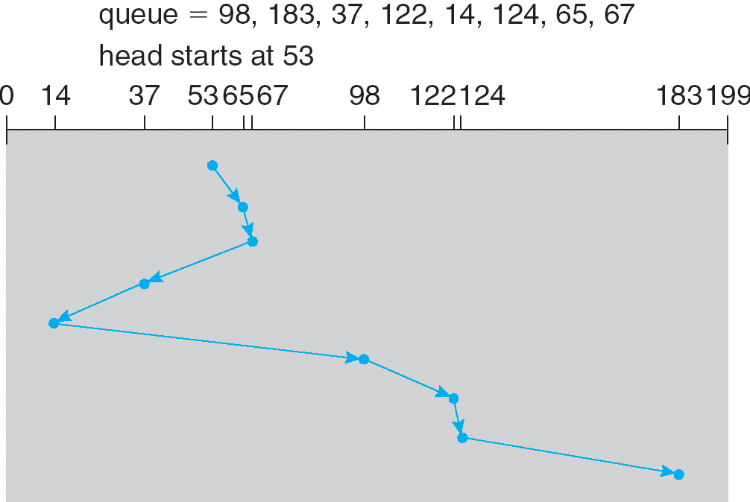
SSTF

Slide 23
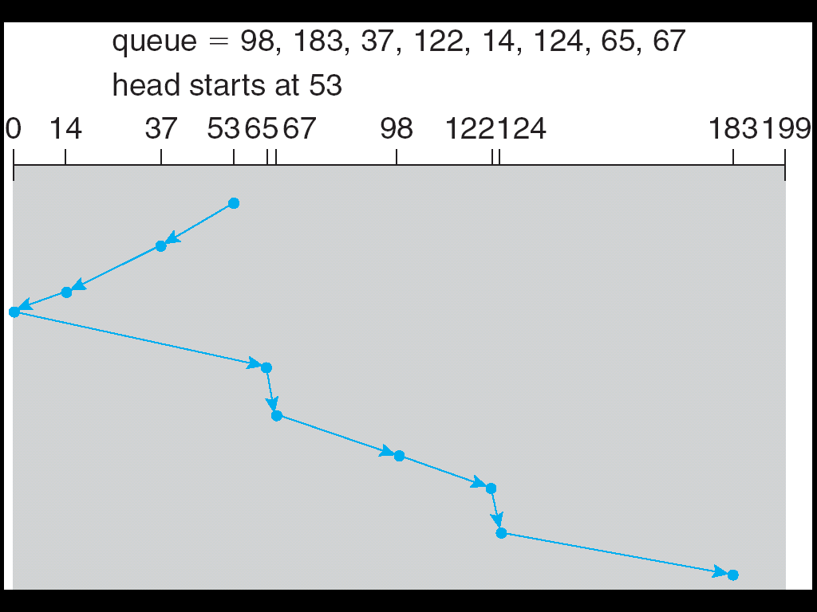
SCAN

Slide 24
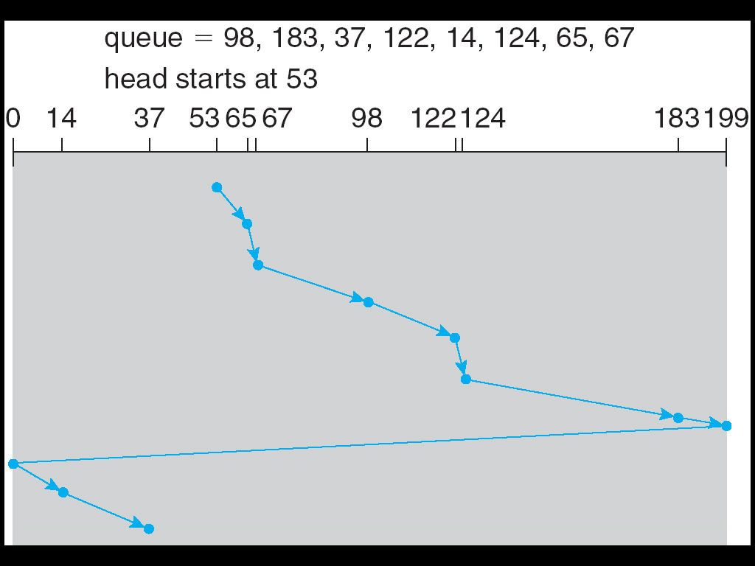
C-SCAN

Slide 25
Disk Geometry: LBA
New machines use logical block addressing instead of CHS
machine presents illusion of an array of blocks, numbered 0 to N
Modern disks…
have varying number of sectors per track
roughly constant data density over disk
varying throughput over disk
remap and reorder blocks (to avoid defects)
completely obscure their actual physical geometry
have built-in caches to hide latencies when possible (but being careful of persistence requirements)
have internal software running on an embedded CPU

Slide 26
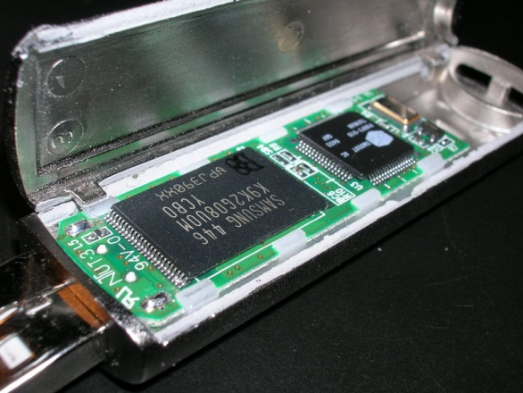
Flash Storage
Nonvolatile semiconductor storage
100× – 1000× faster than disk
Smaller, lower power
But more $/GB (between disk and DRAM)
But, price is dropping and performance is increasing faster than disk

Slide 27
Flash Types
NOR flash: bit cell like a NOR gate
Random read/write access
Used for instruction memory in embedded systems
NAND flash: bit cell like a NAND gate
Denser (bits/area), but block-at-a-time access
Cheaper per GB
Used for USB keys, media storage, …
Flash bits wears out after 1000’s of accesses
Not suitable for direct RAM or disk replacement
Flash has unusual interface
can only “reset” bits in large blocks

Slide 28
I/O vs. CPU Performance
Amdahl’s Law
Don’t neglect I/O performance as parallelism increases compute performance
Example
Benchmark takes 90s CPU time, 10s I/O time
Double the number of CPUs/2 years
I/O unchanged
Year | CPU time | I/O time | Elapsed time | % I/O time
now | 90s | 10s | 100s | 10%
+2 | 45s | 10s | 55s | 18%
+4 | 23s | 10s | 33s | 31%
+6 | 11s | 10s | 21s | 47%

Slide 29
RAID
Redundant Arrays of Inexpensive Disks
Big idea:
Parallelism to gain performance
Redundancy to gain reliability

Slide 30
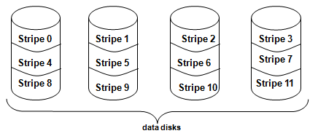
Raid 0
Striping
Non-redundant disk array!

Slide 31
Raid 1
Mirrored Disks!
More expensive
On failure use the extra copy

Slide 32
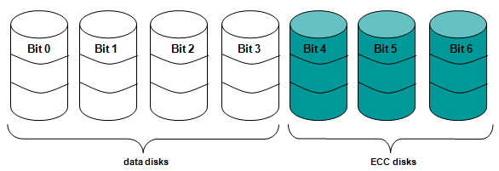
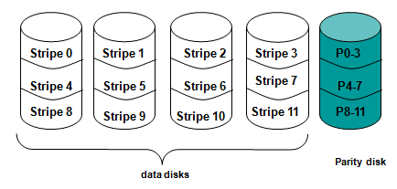
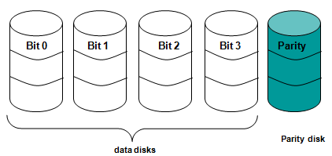
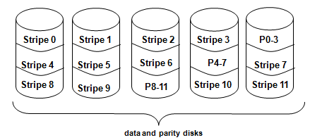
Raid 2-3-4-5-6
Bit Level Striping and Parity Checks!
As level increases:
More guarantee against failure, more reliability
Better read/write performance
Raid 2
Raid 4
Raid 3
Raid 5

Slide 33
Summary
Disks provide nonvolatile memory
I/O performance measures
Throughput, response time
Dependability and cost very important
RAID
Redundancy for fault tolerance and speed

