Slide 1
I/O
Hakim Weatherspoon
CS 3410
Computer Science
Cornell University
The slides are the product of many rounds of teaching CS 3410 by Professors Weatherspoon, Bala, Bracy, McKee, and Sirer.

Slide 2
Announcements
Project5 Cache Race Games night Monday, May 7th, 5pm
Come, eat, drink, have fun and be merry!
Location: B11 Kimball Hall
Prelim2: Thursday, May 3rd in evening
Time and Location: 7:30pm sharp in Statler Auditorium
Old prelims are online in CMS
Project6: Malloc
Design Doc due May 9th, bring design doc to mtg May 7-9
Project due Tuesday, May 15th at 4:30pm
Will not be able to use slip days
Lab Sections are Optional this week
Ask Prelim2 or Project6 questions

Slide 3
Goals for Today
Computer System Organization
How does a processor interact with its environment?
I/O Overview
How to talk to device?
Programmed I/O or Memory-Mapped I/O
How to get events?
Polling or Interrupts
How to transfer lots of data?
Direct Memory Access (DMA)

Slide 4
Next Goal
How does a processor interact with its environment?

Slide 5
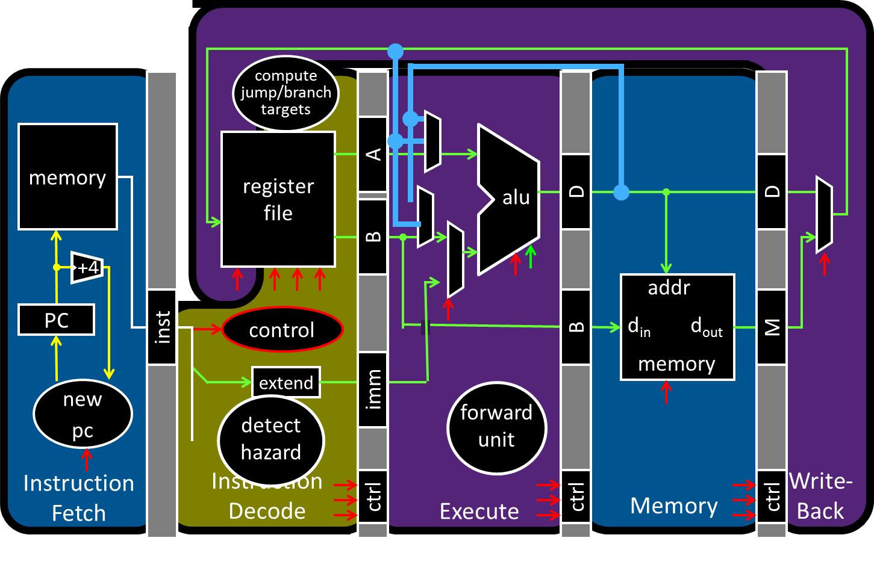
Big Picture: Input/Output (I/O)
How does a processor interact with its environment?

Slide 6
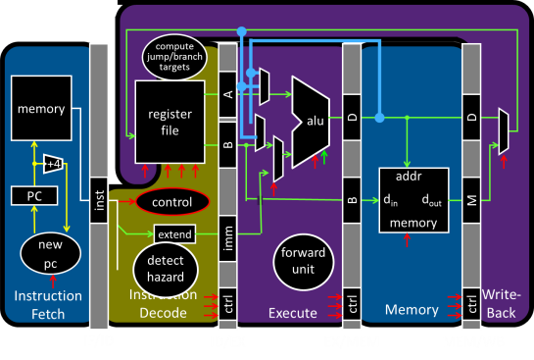
Big Picture: Input/Output (I/O)
How does a processor interact with its environment?
Computer System Organization =
Memory + Datapath + Control +
Input + Output

Slide 7
I/O Devices Enables Interacting with Environment
Device | Behavior | Partner | Data Rate (b/sec)
Keyboard | Input | Human | 100
Mouse | Input | Human | 3.8k
Sound Input | Input | Machine | 3M
Voice Output | Output | Human | 264k
Sound Output | Output | Human | 8M
Laser Printer | Output | Human | 3.2M
Graphics Display | Output | Human | 800M – 8G
Network/LAN | Input/Output | Machine | 100M – 10G
Network/Wireless LAN | Input/Output | Machine | 11 – 54M
Optical Disk | Storage | Machine | 5 – 120M
Flash memory | Storage | Machine | 32 – 200M
Magnetic Disk | Storage | Machine | 800M – 3G

Slide 8
Attempt#1: All devices on one interconnect
Replace all devices as the interconnect changes
e.g. keyboard speed == main memory speed ?!
Unified Memory and I/O Interconnect
Memory
Display
Disk
Keyboard
Network
Notes:
- All devices run at same speed, but performance requirements vary significantly across I/O devices
- Difficult to evolve interconnect due to legacy compatibility

Slide 9
Attempt#2: I/O Controllers
Decouple I/O devices from Interconnect
Enable smarter I/O interfaces
Core0
Core1
Cache
Cache
Unified Memory and I/O Interconnect
Memory
Controller
I/O
Controller
I/O
Controller
I/O
Controller
I/O
Controller
Memory
Display
Disk
Keyboard
Network
Notes:
- Decouple I/O devices from interconnect
- Enable smarter I/O interfaces

Slide 10
Attempt#3: I/O Controllers + Bridge
Separate high-performance processor, memory, display interconnect from lower-performance interconnect
Core0
Core1
Cache
Cache
High Performance
Interconnect
Bridge
Lower Performance
Legacy Interconnect
Memory
Controller
I/O
Controller
I/O
Controller
I/O
Controller
I/O
Controller
Memory
Display
Disk
Keyboard
Network
Notes:
- Use bridge to separate high-performance processor, memory, display interconnect from lower-performance interconnect
- High-performance interconnect can evolve more quickly
fast/expensive busses when needed; slow/cheap elsewhere
I/O controllers to connect end devices

Slide 11
Bus Parameters
Width = number of wires
Transfer size = data words per bus transaction
Synchronous (with a bus clock) or asynchronous (no bus clock / “self clocking”)

Slide 12
Bus Types
Processor – Memory (“Front Side Bus”. Also QPI)
Short, fast, & wide
Mostly fixed topology, designed as a “chipset”
CPU + Caches + Interconnect + Memory Controller
I/O and Peripheral busses (PCI, SCSI, USB, LPC, …)
Longer, slower, & narrower
Flexible topology, multiple/varied connections
Interoperability standards for devices
Connect to processor-memory bus through a bridge
Notes:
Note: USB is not really a bus, it is really a network.

Slide 13
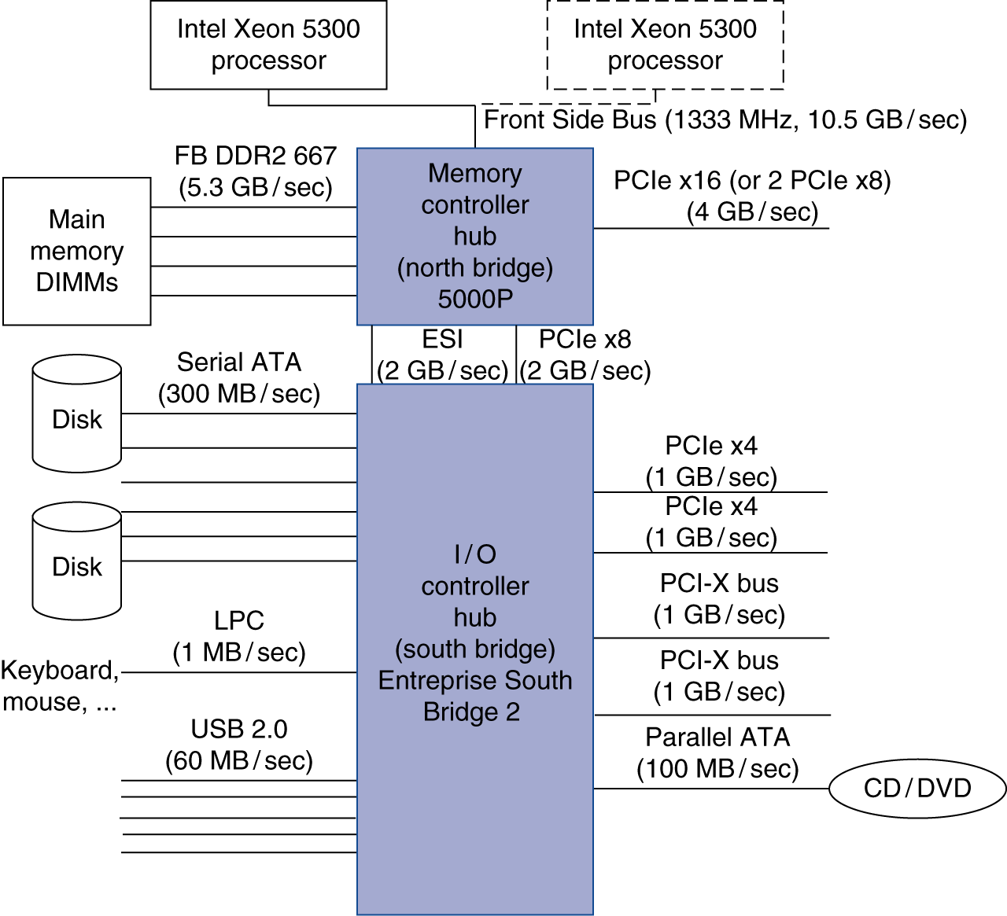
Attempt#3: I/O Controllers + Bridge
Separate high-performance processor, memory, display interconnect from lower-performance interconnect
Notes:
- Use bridge to separate high-performance processor, memory, display interconnect from lower-performance interconnect
- High-performance interconnect can evolve more quickly
fast/expensive busses when needed; slow/cheap elsewhere
I/O controllers to connect end devices

Slide 14
Example Interconnects
Name | Use | Devics per channel | Channel Width | Data Rate (B/sec)
Firewire 800 | External | 63 | 4 | 100M
USB 2.0 | External | 127 | 2 | 60M
USB 3.0 | External | 127 | 2 | 625M
Parallel ATA | Internal | 1 | 16 | 133M
Serial ATA (SATA) | Internal | 1 | 4 | 300M
PCI 66MHz | Internal | 1 | 32-64 | 533M
PCI Express v2.x | Internal | 1 | 2-64 | 16G/dir
Hypertransport v2.x | Internal | 1 | 2-64 | 25G/dir
QuickPath (QPI) | Internal | 1 | 40 | 12G/dir
Notes:
USB 3.0 has transmission speeds of up to 5 Gbit/s (625MB/s), which is 10 times as fast as USB 2.0 (480 Mbit/s; 60MB/s) before taking into account that USB 3.0 is full duplex whereas USB 2.0 is half duplex, giving USB 3.0 the potential total bandwidth if utilized both ways to 20 times that of USB 2.0.[3]

Slide 15
Interconnecting Components
Interconnects are (were?) busses
parallel set of wires for data and control
shared channel
multiple senders/receivers
everyone can see all bus transactions
bus protocol: rules for using the bus wires
Alternative (and increasingly common):
dedicated point-to-point channels
e.g. Intel
Xeon
e.g. Intel
Nehalem
Notes:
CPU – North Bridge / Memory Controller
North Bridge – South Bridge / SuperIO

Slide 16
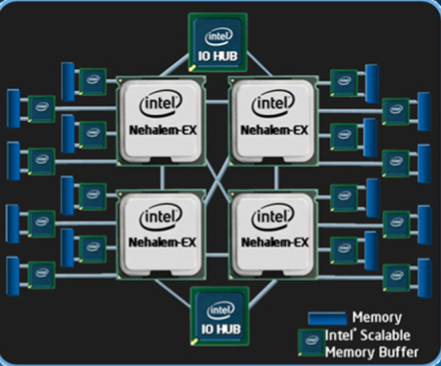
Attempt#4: I/O Controllers+Bridge+ NUMA
Remove bridge as bottleneck with Point-to-point interconnects
E.g. Non-Uniform Memory Access (NUMA)
Notes:
- Use bridge to separate high-performance processor, memory, display interconnect from lower-performance interconnect
- High-performance interconnect can evolve more quickly
fast/expensive busses when needed; slow/cheap elsewhere
I/O controllers to connect end devices

Slide 17
Takeaways
Diverse I/O devices require hierarchical interconnect which is more recently transitioning to point-to-point topologies.

Slide 18
Next Goal
How does the processor interact with I/O devices?

Slide 19
I/O Device Driver Software Interface
Set of methods to write/read data to/from device and control device
Example: Linux Character Devices
// Open a toy " echo " character device
int fd = open("/dev/echo", O_RDWR);
// Write to the device
char write_buf[] = "Hello World!";
write(fd, write_buf, sizeof(write_buf));
// Read from the device
char read_buf [32];
read(fd, read_buf, sizeof(read_buf));
// Close the device
close(fd);
// Verify the result
assert(strcmp(write_buf, read_buf)==0);
Notes:
Set of methods to write/read data to/from device and control device-
Example: Linux Character Devices

Slide 20
I/O Device API
Typical I/O Device API
a set of read-only or read/write registers
Command registers
writing causes device to do something
Status registers
reading indicates what device is doing, error codes, …
Data registers
Write: transfer data to a device
Read: transfer data from a device
Every device uses this API

Slide 21
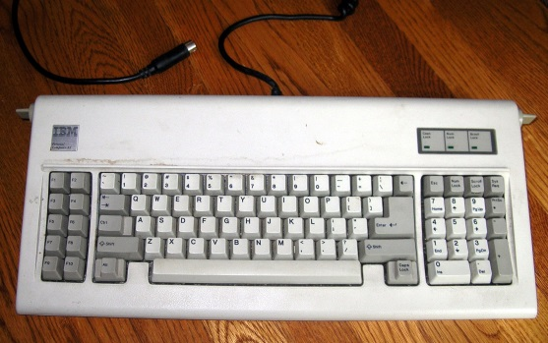
I/O Device API
Simple (old) example: AT Keyboard Device
8-bit Status:
8-bit Command: 0xAA = “self test” 0xAE = “enable kbd” 0xED = “set LEDs”
…
8-bit Data: scancode (when reading) LED state (when writing) or …
PE | TO | AUXB | LOCK | AL2 | SYSF | IBS | OBS
Input
Buffer
Stats
Input
Buffer
Stats
Notes:
IBS = input buffer status: 0 = waiting for commands, 1 = busy
OBS = output buffer status: 0 = waiting for data, 1 = data is available
http://en.wikipedia.org/wiki/IBM_PC/AT
The IBM Personal Computer AT, more commonly known as the IBM AT and also sometimes called the PC AT or PC/AT, was IBM's second-generation PC, designed around the 6 MHz Intel 80286 microprocessor and released in 1984 as machine type 5170. The name AT stood for "Advanced Technology", and was chosen because the AT offered various technologies that were then new in personal computers; one such advancement was that the 80286 processor supported protected mode. IBM later released an 8 MHz version of the AT.
http://en.wikipedia.org/wiki/AT_keyboard
The AT keyboard was a keyboard with 84 keys introduced with the IBM PC/AT computer. It succeeded the 83-key PC/XT keyboard and therefore did not have many of the features seen on modern keyboards such as inverted-T arrow keys and dual ctrl and alt keys. It was later replaced with the 101-key Enhanced keyboard. Nonetheless, "AT keyboard" remains a popular name for any keyboard that uses the five-pin DIN connector. This connector is often considered a Legacy port. Many Enhanced keyboards used this, though it was eventually superseded by the PS/2 connector, which is mechanically different but electrically and protocol-wise identical; thus, the AT keyboard protocol remained the most common standard on PC keyboards well into the 2000s. Many modern computers now use Universal Serial Bus (USB) connectors instead of, or in addition to, PS/2 connectors. The USB connector is electrically and protocol-wise quite different.
Compared to the 83-key XT keyboard, the AT keyboard uses a different communication protocol and a different set of scancodes. Despite having the same connector, the two are not interchangeable. Some PC-compatible mid-to-late 1980s keyboards not made by IBM were switchable between the two protocols and scancode sets, usually with a slider type switch on the underside.

Slide 22
Communication Interface
Q: How does program OS code talk to device?
A: special instructions to talk over special busses
Programmed I/O
inb $a, 0x64
outb $a, 0x60
Specifies: device, data, direction
Protection: only allowed in kernel mode
Interact with cmd, status, and
data device registers directly
kbd status register
kbd data register
Kernel boundary crossinging is expensive
*x86: $a implicit; also inw, outw, inh, outh, …

Slide 23
Communication Interface
Q: How does program OS code talk to device?
A: Map registers into virtual address space
Memory-mapped I/O
Accesses to certain addresses redirected to I/O devices
Data goes over the memory bus
Protection: via bits in pagetable entries
OS+MMU+devices configure mappings
Faster. Less boundary crossing

Slide 24
Memory-Mapped I/O
0xFFFF FFFF
Virtual
Address
Space
I/O
Controller
0x00FF FFFF
Display
Physical
Address
Space
I/O
Controller
Disk
I/O
Controller
Keyboard
I/O
Controller
Network
0x0000 0000
0x0000 0000

Slide 25
Device Drivers
Programmed I/O
char read_kbd()
{
do {
sleep();
status = inb(0x64);
} while(!(status & 1));
return inb(0x60);
}
Memory Mapped I/O
struct kbd {
char status, pad[3];
char data, pad[3];
};
kbd *k = mmap(...);
char read_kbd()
{
do {
sleep();
status = k->status;
} while(!(status & 1));
return k->data;
}
Polling examples,
But mmap I/O more
efficient
syscall
NO
syscall
syscall
Notes:
Polling example, but MMAP I/O more efficient than programmed I/O

Slide 26
Comparing Programmed I/O vs Memory Mapped I/O
Programmed I/O
Requires special instructions
Can require dedicated hardware interface to devices
Protection enforced via kernel mode access to instructions
Virtualization can be difficult
Memory-Mapped I/O
Re-uses standard load/store instructions
Re-uses standard memory hardware interface
Protection enforced with normal memory protection scheme
Virtualization enabled with normal memory virtualization scheme

Slide 27
Takeaways
Diverse I/O devices require hierarchical interconnect which is more recently transitioning to point-to-point topologies.
Memory-mapped I/O is an elegant technique to read/write device registers with standard load/stores.

Slide 28
Next Goal
How does the processor know device is ready/done?

Slide 29
Communication Method
Q: How does program learn device is ready/done?

Slide 30
Takeaways
Diverse I/O devices require hierarchical interconnect which is more recently transitioning to point-to-point topologies.
Memory-mapped I/O is an elegant technique to read/write device registers with standard load/stores.
Interrupt-based I/O avoids the wasted work in
polling-based I/O and is usually more efficient

Slide 31
Next Goal
How do we transfer a lot of data efficiently?

Slide 32
I/O Data Transfer
How to talk to device?
Programmed I/O or Memory-Mapped I/O
How to get events?
Polling or Interrupts
How to transfer lots of data?
disk->cmd = READ_4K_SECTOR;
disk->data = 12;
while (!(disk->status & 1) { }
for (i = 0..4k)
buf[i] = disk->data;
Very,
Very,
Expensive

Slide 33
I/O Data Transfer
Programmed I/O xfer: Device ←→ CPU ←→ RAM
for (i = 1 .. n)
CPU issues read request
Device puts data on bus & CPU reads into registers
CPU writes data to memory
Not efficient
CPU
RAM
DISK
Read from Disk
Write to Memory
Everything interrupts CPU
Wastes CPU

Slide 34
I/O Data Transfer
Q: How to transfer lots of data efficiently?
A: Have device access memory directly
Direct memory access (DMA)
1) OS provides starting address, length
2) controller (or device) transfers data autonomously
3) Interrupt on completion / error

Slide 35
DMA: Direct Memory Access
Programmed I/O xfer: Device ←→ CPU ←→ RAM
for (i = 1 .. n)
CPU issues read request
Device puts data on bus & CPU reads into registers
CPU writes data to memory
CPU
RAM
DISK

Slide 36
DMA: Direct Memory Access
Programmed I/O xfer: Device ←→ CPU ←→ RAM
for (i = 1 .. n)
CPU issues read request
Device puts data on bus & CPU reads into registers
CPU writes data to memory
DMA xfer: Device ←→ RAM
CPU sets up DMA request
for (i = 1 ... n) Device puts data on bus & RAM accepts it
Device interrupts CPU after done
CPU
RAM
DISK
3) Interrupt after done
CPU
RAM
1) Setup
2) Transfer
DISK
Notes:
Question: Virtual vs Physical memory
If physical cannot cross page boundary b/c device does not know where next virtual page is in physical memory.
If virtual, need a small page table to map virtual to physical address, but can cross page boundaries
(if physical, coherency/consistency issue between cache and memory)

Slide 37
DMA Example
DMA example: reading from audio (mic) input
DMA engine on audio device… or I/O controller … or …
int dma_size = 4*PAGE_SIZE;
int *buf = alloc_dma(dma_size);
...
dev->mic_dma_baseaddr = (int)buf;
dev->mic_dma_count = dma_len;
dev->cmd = DEV_MIC_INPUT | DEV_INTERRUPT_ENABLE | DEV_DMA_ENABLE;

Slide 38
DMA Issues (1): Addressing
Issue #1: DMA meets Virtual Memory
RAM: physical addresses
Programs: virtual addresses
CPU
MMU
RAM
DISK

Slide 39
DMA Example
DMA example: reading from audio (mic) input
DMA engine on audio device… or I/O controller … or …
int dma_size = 4*PAGE_SIZE;
void *buf = alloc_dma(dma_size);
...
dev->mic_dma_baseaddr = virt_to_phys(buf);
dev->mic_dma_count = dma_len;
dev->cmd = DEV_MIC_INPUT | DEV_INTERRUPT_ENABLE | DEV_DMA_ENABLE;

Slide 40
DMA Issues (1): Addressing
Issue #1: DMA meets Virtual Memory
RAM: physical addresses
Programs: virtual addresses
CPU
MMU
RAM
DISK
uTLB

Slide 41
DMA Issues (2): Virtual Mem
Issue #2: DMA meets Paged Virtual Memory
DMA destination page may get swapped out
CPU
RAM
DISK

Slide 42
DMA Issues (4): Caches
Issue #4: DMA meets Caching
DMA-related data could be cached in L1/L2
DMA to Mem: cache is now stale
DMA from Mem: dev gets stale data
CPU
L2
RAM
DISK

Slide 43
DMA Issues (4): Caches
Issue #4: DMA meets Caching
DMA-related data could be cached in L1/L2
DMA to Mem: cache is now stale
DMA from Mem: dev gets stale data
Solution 2: (hardware coherence aka snooping)
cache listens on bus, and conspires with RAM
DMA to Mem: invalidate/update data seen on bus
DMA from mem: cache services request if possible, otherwise RAM services
CPU
L2
RAM
DISK

Slide 44
Takeaways
Diverse I/O devices require hierarchical interconnect which is more recently transitioning to point-to-point topologies.
Memory-mapped I/O is an elegant technique to read/write device registers with standard load/stores.
Interrupt-based I/O avoids the wasted work in
polling-based I/O and is usually more efficient.
Modern systems combine memory-mapped I/O,
interrupt-based I/O, and direct-memory access
to create sophisticated I/O device subsystems.

Slide 45
I/O Summary
How to talk to device? Programmed I/O or Memory-Mapped I/O
How to get events? Polling or Interrupts
How to transfer lots of data?
DMA

