Slide 1
Parallelism, Multicore, and Synchronization
CS 3410
Computer Science
Cornell University
The slides are the product of many rounds of teaching CS 3410 by Professors Weatherspoon, Bala, Bracy, McKee, and Sirer. Also some slides from Amir Roth & Milo Martin in here.

Slide 2
Announcements
C practice assignment
  Due Monday, April 23rd
P4-Buffer Overflow is due tomorrow
  Due Wednesday, April 18th
P5-Cache Collusion!
  Due Friday, April 27th
  Pizza party & Tournament, Monday, May 7th
Prelim2
  Thursday, May 3rd, 7pmn 185 Statler Hall

Slide 3

xkcd/619

Slide 4
Pitfall: Amdahl’s Law
Execution time after improvement =
affected execution time
amount of improvement
+ execution time unaffected
T_{improved} = $\frac{Taffected}{improvement factor}$+ T_{unaffected}
Notes:
Amdahl’s Law

Slide 5
Pitfall: Amdahl’s Law
Improving an aspect of a computer and expecting a proportional improvement in overall performance
T_{improved} = $\frac{Taffected}{improvement factor}$+ T_{unaffected}
Example: multiply accounts for 80s out of 100s
Multiply can be parallelized
Notes:
Clicker question

Slide 6
Scaling Example
Workload: sum of 10 scalars, and 10 × 10 matrix sum
  Speed up from 10 to 100 processors?
Single processor: Time = (10 + 100) × t_{add}
10 processors
100 processors
Notes:
Pair up question
10 processors
Speedup = 110/20 = 5.5 (55% of potential)
100 processors
Speedup = 110/11 = 10 (10% of potential)

Slide 7
Scaling Example
What if matrix size is 100 × 100?
Single processor: Time = (10 + 10000) × t_{add}
10 processors
100 processors
  Time = 10
Assuming load balanced
Notes:
10 processors
Speedup = 10010/1010 = 9.9 (99% of potential)
100 processors
Speedup = 10010/110 = 91 (91% of potential)

Slide 8
Takeaway
Unfortunately, we cannot not obtain unlimited scaling (speedup) by adding unlimited parallel resources, eventual performance is dominated by a component needing to be executed sequentially.
Amdahl's Law is a caution about this diminishing return

Slide 9
Performance Improvement 101
seconds instructions cycles seconds
program program instruction cycle
=
x
x
2 Classic Goals of Architects:
⬇ Clock period (⬆ Clock frequency)
⬇ Cycles per Instruction (⬆ IPC)

Slide 10
Clock frequencies have stalled
Darling of performance improvement for decades
Why is this no longer the strategy?
Hitting Limits:
Pipeline depth
Clock frequency
Moore’s Law & Technology Scaling
Power

Slide 11
Improving IPC via ILP
Exploiting Intra-instruction parallelism:
Pipelining (decode A while fetching B)
Exploiting Instruction Level Parallelism (ILP):
Multiple issue pipeline (2-wide, 4-wide, etc.)
Statically detected by compiler (VLIW)
Dynamically detected by HW
Dynamically Scheduled (OoO)

Slide 12
Instruction-Level Parallelism (ILP)
Pipelining: execute multiple instructions in parallel
Q: How to get more instruction level parallelism?
A: Deeper pipeline
    E.g. 250MHz 1-stage; 500Mhz 2-stage; 1GHz 4-stage; 4GHz 16-stage
Pipeline depth limited by…
    max clock speed (less work per stage ⇒ shorter clock cycle)
    min unit of work
    dependencies, hazards / forwarding logic
Notes:
Draw pictures: 250MHz 1-stage; 500Mhz 2-stage; 1GHz 4-stage; 4GHz 16-stage

Slide 13
Instruction-Level Parallelism (ILP)
Pipelining: execute multiple instructions in parallel
Q: How to get more instruction level parallelism?
A: Multiple issue pipeline
    Start multiple instructions per clock cycle in duplicate stages
Notes:
Draw picture; 4 stage, 4-way * 4GHz = 16B inst/cycles
Next: Static issue

Slide 14
Multiple issue pipeline
Static multiple issue
aka Very Long Instruction Word
Decisions made by compiler
Dynamic multiple issue
Decisions made on the fly
Cost: More execute hardware
Reading/writing register files: more ports

Slide 15
Static Multiple Issue
a.k.a. Very Long Instruction Word (VLIW)
Compiler groups instructions to be issued together
  Packages them into “issue slots”
How does HW detect and resolve hazards?
It doesn’t. ☺ Compiler must avoid hazards
Example: Static Dual-Issue 32-bit MIPS
  Instructions come in pairs (64-bit aligned)
    One ALU/branch instruction (or nop)
    One load/store instruction (or nop)
Notes:
show program, decode stage
Ideal CPI = 0.5

Slide 16
MIPS with Static Dual Issue
Two-issue packets
  One ALU/branch instruction
  One load/store instruction
  64-bit aligned
    ALU/branch, then load/store
    Pad an unused instruction with nop
Address | Instruction type | Pipeline Stages
n | ALU/branch | IF | ID | EX | MEM | WB
n + 4 | Load/store | IF | ID | EX | MEM | WB
n + 8 | ALU/branch |  | IF | ID | EX | MEM | WB
n + 12 | Load/store |  | IF | ID | EX | MEM | WB
n + 16 | ALU/branch |  |  | IF | ID | EX | MEM | WB
n + 20 | Load/store |  |  | IF | ID | EX | MEM | WB

Slide 17
Scheduling Example
Schedule this for dual-issue MIPS
Loop: lw $t0, 0($s1) # $t0=array element
addu $t0, $t0, $s2 # add scalar in $s2
sw $t0, 0($s1) # store result
addi $s1, $s1,–4 # decrement pointer
bne $s1, $zero, Loop # branch $s1!=0
Loop: lw $t0, 0($s1) # $t0=array element
addu $t0, $t0, $s2 # add scalar in $s2
sw $t0, 0($s1) # store result
addi $s1, $s1,–4 # decrement pointer
bne $s1, $zero, Loop # branch $s1!=0
 | ALU/branch | Load/store | cycle

Slide 18
Techniques and Limits of Static Scheduling
Goal: larger instruction windows (to play with)
Predication
Loop unrolling
Function in-lining
Basic block modifications (superblocks, etc.)
Roadblocks
Memory dependences (aliasing)
Control dependences

Slide 19
Speculation
Reorder instructions
To fill the issue slot with useful work
Complicated: exceptions may occur

Slide 20
Optimizations to make it work
Move instructions to fill in nops
Need to track hazards and dependencies
Loop unrolling

Slide 21
Scheduling Example
Compiler scheduling for dual-issue MIPS…
Loop: lw $t0, 0($s1) # $t0 = A[i]
lw $t1, 4($s1) # $t1 = A[i+1]
addu $t0, $t0, $s2 # add $s2
addu $t1, $t1, $s2 # add $s2
sw $t0, 0($s1) # store A[i]
sw $t1, 4($s1) # store A[i+1]
addi $s1, $s1, +8 # increment pointer
bne $s1, $s3, Loop # continue if $s1!=end
ALU/branch slot Load/store slot cycle
Loop: nop lw $t0, 0($s1) 1
nop lw $t1, 4($s1) 2
addu $t0, $t0, $s2 nop 3
addu $t1, $t1, $s2 sw $t0, 0($s1) 4
addi $s1, $s1, +8 sw $t1, 4($s1) 5
bne $s1, $s3, Loop nop 6
Notes:
assume 1 delay slot for loads
can move addi earlier
CPI = 6 cycles / 8 instructions = 0.75
CPI = 5 cycles / 8 instructions = 0.625

Slide 22
Limits of Static Scheduling
Compiler scheduling for dual-issue MIPS…
lw $t0, 0($s1) # load A
addi $t0, $t0, +1 # increment A
sw $t0, 0($s1) # store A
lw $t0, 0($s2) # load B
addi $t0, $t0, +1 # increment B
sw $t0, 0($s2) # store B
ALU/branch slot Load/store slot cycle
nop lw $t0, 0($s1) 1
nop nop 2
addi $t0, $t0, +1 nop 3
nop sw $t0, 0($s1) 4
nop lw $t0, 0($s2) 5
nop nop 6
addi $t0, $t0, +1 nop 7
nop sw $t0, 0($s2) 8
Notes:
Rename registers, move load B up, eliminate delay slot
But! s1 and s2 might be equal => Aliasing!

Slide 23
Improving IPC via ILP
Exploiting Intra-instruction parallelism:
Pipelining (decode A while fetching B)
Exploiting Instruction Level Parallelism (ILP):
Multiple issue pipeline (2-wide, 4-wide, etc.)
Statically detected by compiler (VLIW)
Dynamically detected by HW
Dynamically Scheduled (OoO)

Slide 24
Dynamic Multiple Issue
aka SuperScalar Processor (c.f. Intel)
  CPU chooses multiple instructions to issue each cycle
  Compiler can help, by reordering instructions….
  … but CPU resolves hazards
Even better: Speculation/Out-of-order Execution
  Execute instructions as early as possible
  Aggressive register renaming (indirection to the rescue!)
  Guess results of branches, loads, etc.
  Roll back if guesses were wrong
  Don’t commit results until all previous insns committed

Slide 25
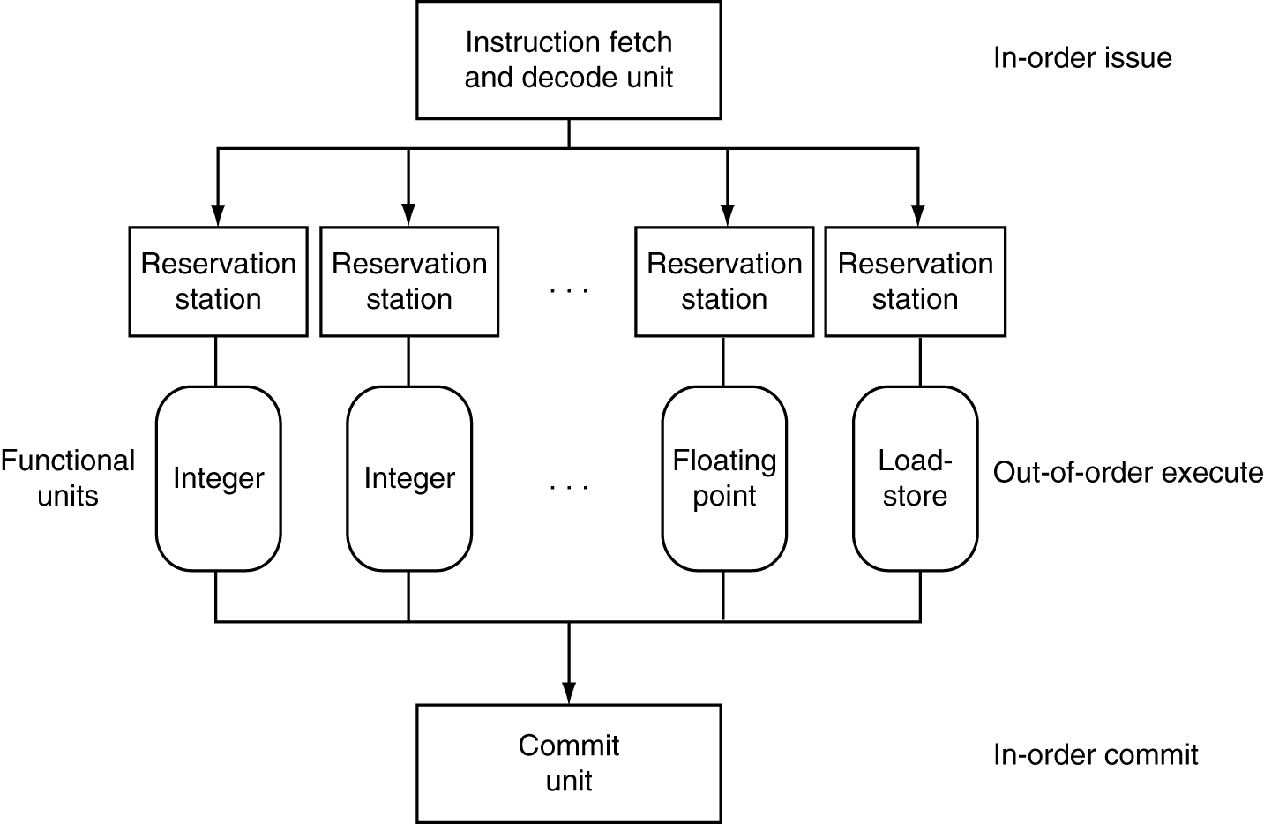
Dynamic Multiple Issue

Slide 26
Effectiveness of OoO Superscalar
It was awesome, but then it stopped improving
Limiting factors?
  Programs dependencies
  Memory dependence detection → be conservative
    e.g. Pointer Aliasing: A[0] += 1; B[0] *= 2;
  Hard to expose parallelism
    Still limited by the fetch stream of the static program
  Structural limits
    Memory delays and limited bandwidth
  Hard to keep pipelines full, especially with branches

Slide 27
Improving IPC via ILP TLP
Exploiting Thread-Level parallelism
Hardware multithreading to improve utilization:
  Multiplexing multiple threads on single CPU
  Sacrifices latency for throughput
  Single thread cannot fully utilize CPU? Try more!
  Three types:
    Course-grain (has preferred thread)
    Fine-grain (round robin between threads)
    Simultaneous (hyperthreading)
Notes:
CGMT: Course-grain (has preferred thread)
FGMT: Fine-grain (round robin between threads)
SMT: Simultaneous (hyperthreading)
Fine grained multithreading (FGMT)
Switch on each cycle
Pros: Can hide very short stalls
Cons: Slows down every thread
Coarse grained multithreading (CGMT)
Switch only on quite long stalls
Pros: removes need for very fast switches
Cons: flush pipeline, short stalls not handled
Symmetric multithreading (SMT)
Leverages multi-issue pipeline with dynamic instruction scheduling and ILP
Exploits functional unit parallelism better than single threads
Always running multiple instructions from multiple threads
No cost of context switching
Uses dynamic scheduling and register renaming through reservation stations
Can use all functional units very efficiently

Slide 28

What is a thread?
Process: multiple threads, code, data and OS state
Threads: share code, data, files, not regs or stack

Slide 29
Standard Multithreading Picture
Time evolution of issue slots
  Color = thread, white = no instruction
time
4-wide
Superscalar
CGMT
FGMT
SMT
  Insns from multiple threads coexist
  Switch to thread B on thread A L2 miss
  Switch threads every cycle
Notes:
CGMT: Course-grain (has preferred thread)
FGMT: Fine-grain (round robin between threads)
SMT: Simultaneous (hyperthreading)
Fine grained multithreading (FGMT)
Switch on each cycle
Pros: Can hide very short stalls
Cons: Slows down every thread
Coarse grained multithreading (CGMT)
Switch only on quite long stalls
Pros: removes need for very fast switches
Cons: flush pipeline, short stalls not handled
Symmetric multithreading (SMT)
Leverages multi-issue pipeline with dynamic instruction scheduling and ILP
Exploits functional unit parallelism better than single threads
Always running multiple instructions from multiple threads
No cost of context switching
Uses dynamic scheduling and register renaming through reservation stations
Can use all functional units very efficiently

Slide 30
Power Efficiency
Q: Does multiple issue / ILP cost much?
A: Yes.
→ Dynamic issue and speculation requires power
CPU | Year | Clock Rate | Pipeline Stages | Issue width | Out-of-order/ Speculation | Cores | Power
i486 | 1989 | 25MHz | 5 | 1 | No | 1 | 5W
Pentium | 1993 | 66MHz | 5 | 2 | No | 1 | 10W
Pentium Pro | 1997 | 200MHz | 10 | 3 | Yes | 1 | 29W
P4 Willamette | 2001 | 2000MHz | 22 | 3 | Yes | 1 | 75W
UltraSparc III | 2003 | 1950MHz | 14 | 4 | No | 1 | 90W
P4 Prescott | 2004 | 3600MHz | 31 | 3 | Yes | 1 | 103W

Slide 31

Moore’s Law
Dual-core Itanium 2
K10
Itanium 2
K8
P4
Atom
Pentium
486
386
286
8088
8080
4004
8008
Notes:
NVIDIA GF100 has 3B transistors

Slide 32
Why Multicore?
Moore’s law
  A law about transistors
  Smaller means more transistors per die
  And smaller means faster too
But: Power consumption growing too…

Slide 33
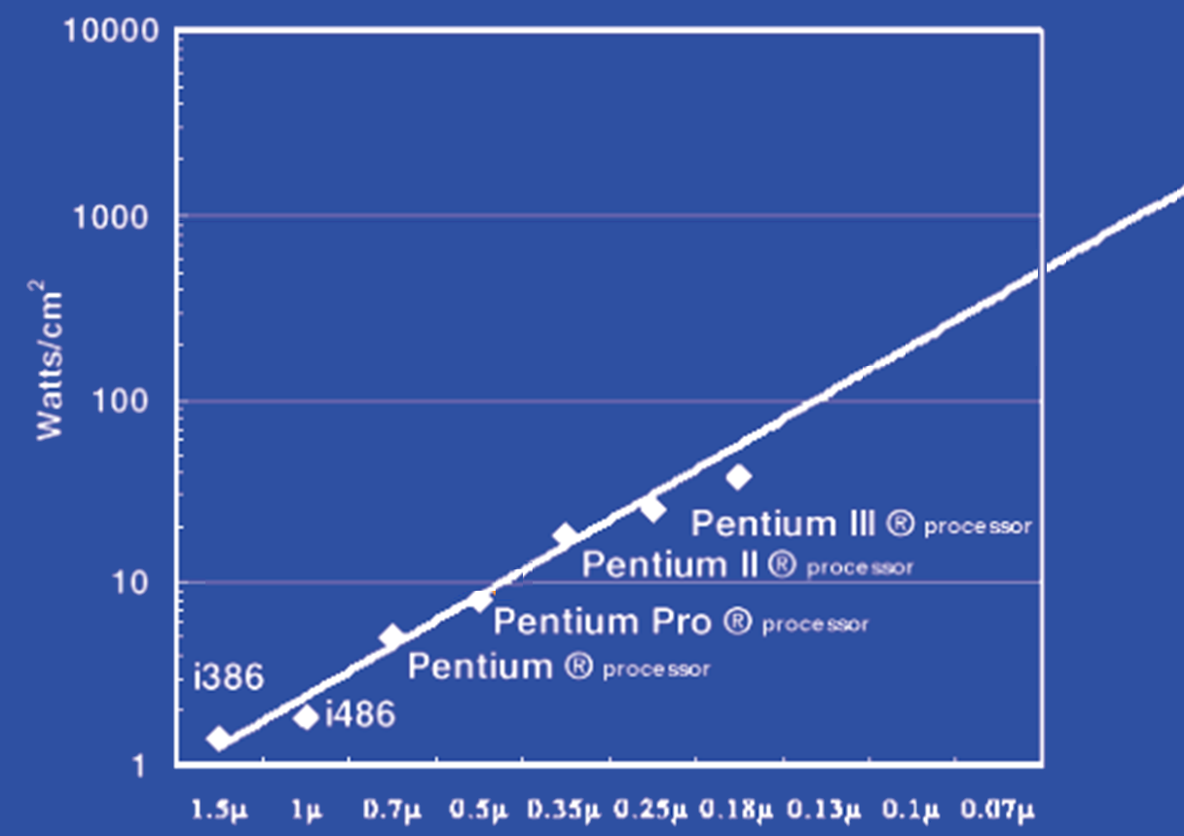
Power Limits
Surface of Sun
Rocket Nozzle
Nuclear Reactor
Xeon
Hot Plate
180nm
32nm
Notes:
Intel Westmere: 32 nm = 0.032u, 130W / 240mm^2 = 54 W/cm^2

Slide 34
Power Wall
Power = capacitance * voltage² * frequency
In practice: Power ~ voltage³
Reducing voltage helps (a lot)
... so does reducing clock speed
Better cooling helps
The power wall
  We can’t reduce voltage further
  We can’t remove more heat
Lower Frequency

Slide 35
Why Multicore?
Performance
1.2x
Single-Core
Overclocked +20%
Power
1.7x
Performance
1.0x
Power
Single-Core
1.0x
Performance
0.8x
1.6x
Single-Core
Underclocked -20%
Dual-Core
Underclocked -20%
Power
0.51x
1.02x

Slide 36
Power Efficiency
Q: Does multiple issue / ILP cost much?
A: Yes.
→ Dynamic issue and speculation requires power
CPU | Year | Clock Rate | Pipeline Stages | Issue width | Out-of-order/ Speculation | Cores | Power
i486 | 1989 | 25MHz | 5 | 1 | No | 1 | 5W
Pentium | 1993 | 66MHz | 5 | 2 | No | 1 | 10W
Pentium Pro | 1997 | 200MHz | 10 | 3 | Yes | 1 | 29W
P4 Willamette | 2001 | 2000MHz | 22 | 3 | Yes | 1 | 75W
UltraSparc III | 2003 | 1950MHz | 14 | 4 | No | 1 | 90W
P4 Prescott | 2004 | 3600MHz | 31 | 3 | Yes | 1 | 103W
Core | 2006 | 2930MHz | 14 | 4 | Yes | 2 | 75W
Core i5 Nehal | 2010 | 3300MHz | 14 | 4 | Yes | 1 | 87W
Core i5 Ivy Br | 2012 | 3400MHz | 14 | 4 | Yes | 8 | 77W
UltraSparc T1 | 2005 | 1200MHz | 6 | 1 | No | 8 | 70W
Those simpler cores did something very right.

Slide 37
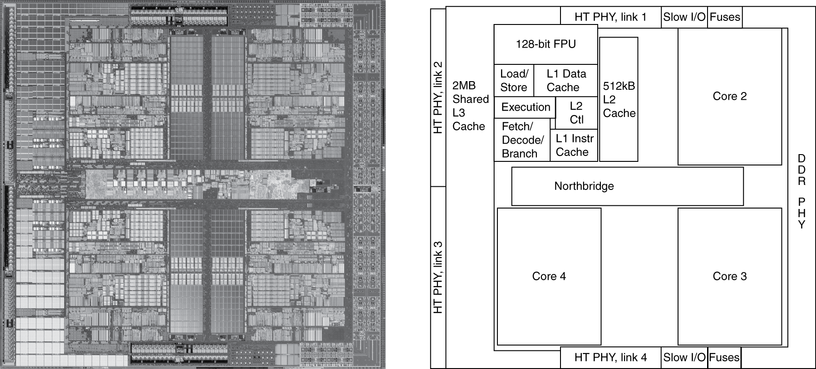
Inside the Processor
AMD Barcelona Quad-Core: 4 processor cores

Slide 38
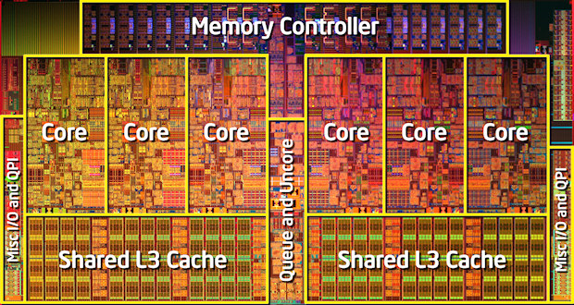
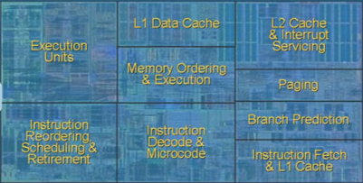
Inside the Processor
Intel Nehalem Hex-Core
4-wide pipeline

Slide 39
Hyperthreading
vs. HT
Multi-Core vs. Multi-Issue
Programs:
Num. Pipelines:
Pipeline Width:
Hyperthreads
  HT = MultiIssue + extra PCs and registers – dependency logic
  HT = MultiCore – redundant functional units + hazard avoidance
Hyperthreads (Intel)
  Illusion of multiple cores on a single core
  Easy to keep HT pipelines full + share functional units
N | 1 | N
N | 1 | 1
1 | N | N
Notes:
HT = MultiIssue + extra PCs and registers – dependency logic
HT = MultiCore – redundant functional units + hazard avoidance

Slide 40
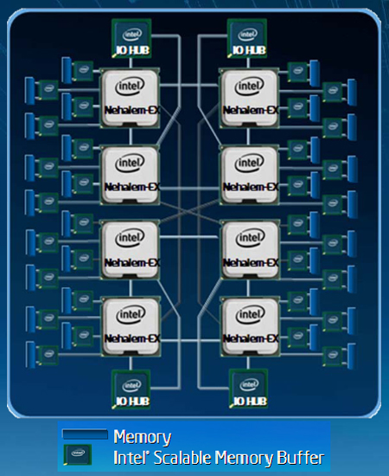
Example: All of the above
8 die (aka 8 sockets)
4 core per socket
2 HT per core
Note: a socket is a processor,
where each processor may
have multiple processing
cores, so this is an example
of a multiprocessor multicore
hyperthreaded system
Notes:
MultiCore: 8 processors dies * 8 cores per processor die
Hyperthreading: 2 HT per core
Dynamic Multi-Issue: 4 issue
Pipeline: 16 stages

Slide 41
Parallel Programming
Q: So lets just all use multicore from now on!
A: Software must be written as parallel program
Multicore difficulties
  Partitioning work
  Coordination & synchronization
  Communications overhead
  How do you write parallel programs?
    ... without knowing exact underlying architecture?
Notes:
Or hyperthreads

Slide 42
Work Partitioning
Partition work so all cores have something to do

Slide 43
Load Balancing
Load Balancing
Need to partition so all cores are actually working

Slide 44
Amdahl’s Law
If tasks have a serial part and a parallel part…
Example:
step 1: divide input data into n pieces
step 2: do work on each piece
step 3: combine all results
Recall: Amdahl’s Law
As number of cores increases …
  time to execute parallel part?
  time to execute serial part?
  Serial part eventually dominates
goes to zero
Remains the same

Slide 45
Amdahl’s Law
Notes:
Underclocking messes up the ratios completely. Work through a 8x slowdown example.

Slide 46
Parallelism is a necessity
Necessity, not luxury
Power wall
Not easy to get performance out of
Many solutions
Pipelining
Multi-issue
Hyperthreading
Multicore

Slide 47
Parallel Programming
Q: So lets just all use multicore from now on!
A: Software must be written as parallel program
Multicore difficulties
  Partitioning work
  Coordination & synchronization
  Communications overhead
  How do you write parallel programs?
    ... without knowing exact underlying architecture?
SW
Your
career…
HW
Notes:
Most is software, but hardware can help:
- communications (fast core-to-core interconnect)
- coordination and synchronization primitives (next time)

Slide 48
Big Picture: Parallelism and Synchronization
How do I take advantage of parallelism?
How do I write (correct) parallel programs?
What primitives do I need to implement correct parallel programs?

Slide 49
Topics: Goals for Today
Understand Cache Coherency
Synchronizing parallel programs
  Atomic Instructions
  HW support for synchronization
How to write parallel programs
  Threads and processes
  Critical sections, race conditions, and mutexes

Slide 50
Parallelism and Synchronization
Cache Coherency Problem: What happens when to two or more processors cache shared data?

Slide 51
Parallelism and Synchronization
Cache Coherency Problem: What happens when to two or more processors cache shared data?
i.e. the view of memory held by two different processors is through their individual caches.
As a result, processors can see different (incoherent) values to the same memory location.

Slide 52
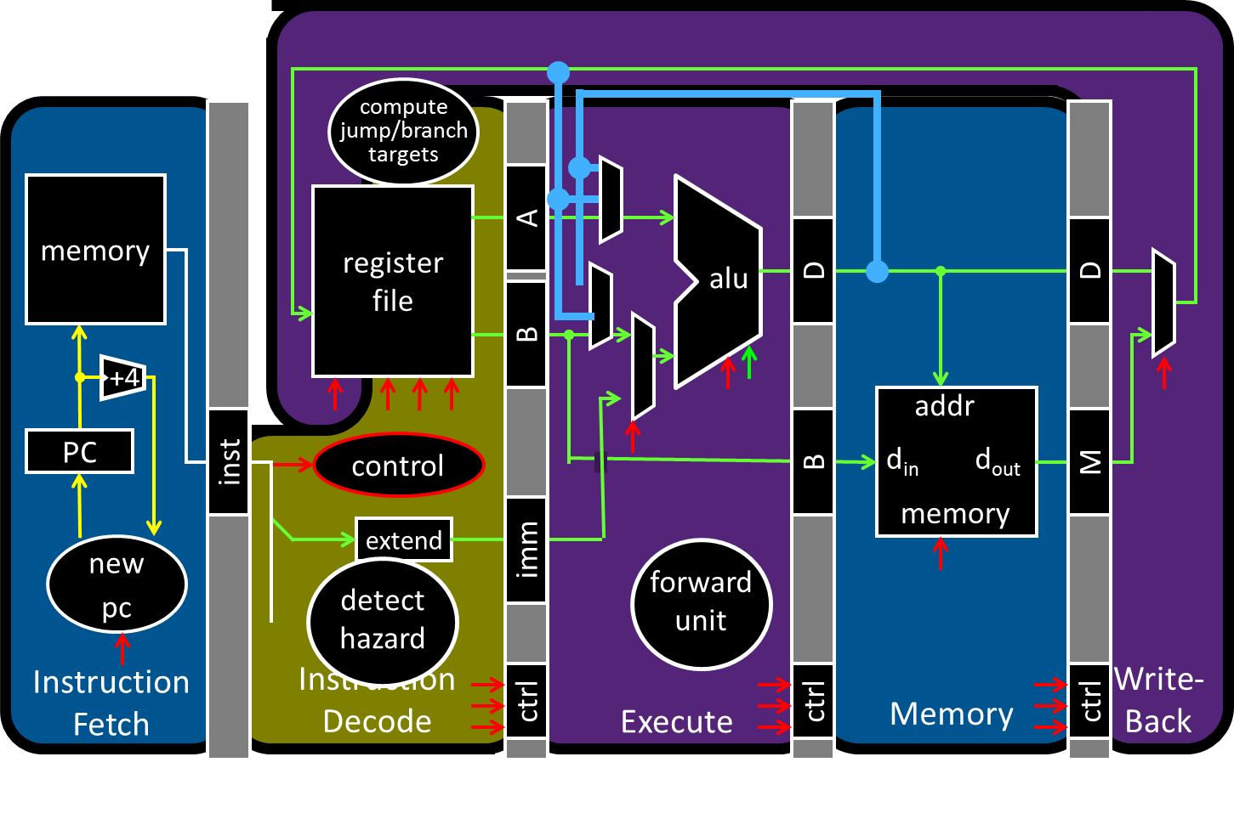
Parallelism and Synchronization

Slide 53
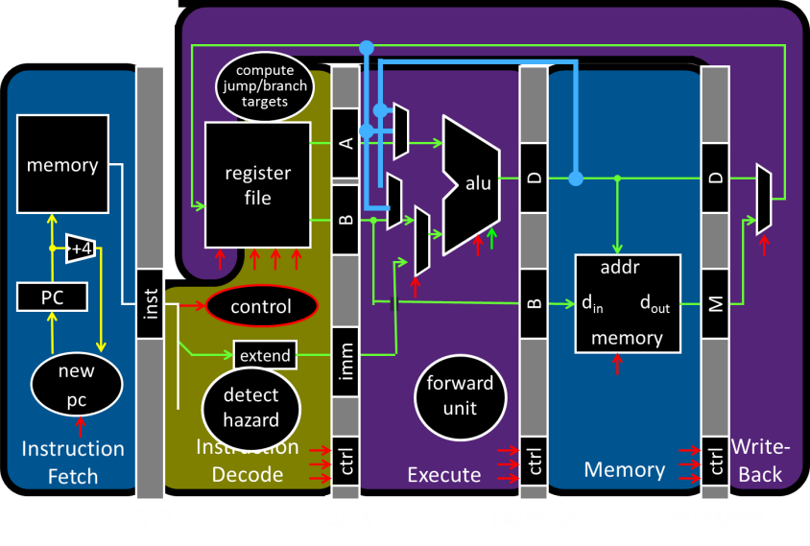
Parallelism and Synchronization
Each processor core has its own L1 cache

Slide 54
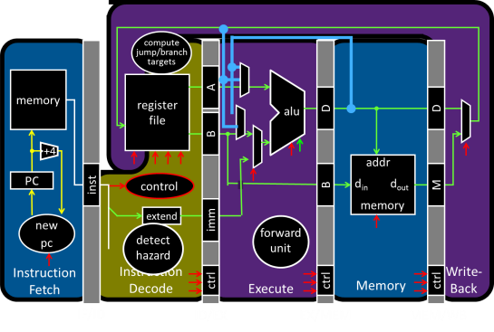
Parallelism and Synchronization
Each processor core has its own L1 cache

Slide 55
Parallelism and Synchronization
Each processor core has its own L1 cache
Core0
Core1
Core2
Core3
Cache
Cache
Cache
Cache
Interconnect
Memory
I/O

Slide 56
Shared Memory Multiprocessors
Shared Memory Multiprocessor (SMP)
  Typical (today): 2 – 4 processor dies, 2 – 8 cores each
  HW provides single physical address space for all processors
  Assume physical addresses (ignore virtual memory)
  Assume uniform memory access (ignore NUMA)
Core0
Core1
Core2
Core3
Cache
Cache
Cache
Cache
Interconnect
Memory
I/O
Notes:
How do they share data? How do they coordinate? How do they scale?

Slide 57
Shared Memory Multiprocessors
Shared Memory Multiprocessor (SMP)
  Typical (today): 2 – 4 processor dies, 2 – 8 cores each
  HW provides single physical address space for all processors
  Assume physical addresses (ignore virtual memory)
  Assume uniform memory access (ignore NUMA)
Core0
Core1
...
...
...
CoreN
Cache
Cache
Cache
Interconnect
Memory
I/O
Notes:
How do they share data? How do they coordinate? How do they scale?

Slide 58
Cache Coherency Problem
Thread A (on Core0) Thread B (on Core1)
for(int i = 0, i < 5; i++) { for(int j = 0; j < 5; j++) {
x = x + 1; x = x + 1;
} }
What will the value of x be after both loops finish?
Core0
Core1
...
...
...
CoreN
Cache
Cache
Cache
Interconnect
Memory
I/O
Notes:
How do they share data? How do they coordinate? How do they scale?

Slide 59
Cache Coherence Problem
Suppose two CPU cores share a physical address space
  Write-through caches
Time step | Event | CPU A’s cache | CPU B’s cache | Memory
0 |  |  |  | 0
Core0
Core1
...
...
...
CoreN
Cache
Cache
Cache
Interconnect
Memory
I/O

Slide 60
Two issues
Coherence
What values can be returned by a read
Consistency
When a written value will be returned by a read

Slide 61
Coherence Defined
Informal: Reads return most recently written value
Formal: For concurrent processes P₁ and P₂
  P writes X before P reads X (with no intervening writes)
  ⇒ read returns written value
    (preserve program order)
  P₁ writes X before P₂ reads X
  ⇒ read returns written value
    (coherent memory view, can’t read old value forever)
  P₁ writes X and P₂ writes X
  ⇒ all processors see writes in the same order
    all see the same final value for X
    Aka write serialization
    (else P_{A} can see P₂’s write before P₁’s and P_{B} can see the opposite; their final understanding of state is wrong)
Notes:
second case: for some definition of “before”
third case: see relativity
complication: clocks are not synchronized across cores
1 light nanosecond = 30cm, so 3GHz can do 1 instruction per 10cm

Slide 62
Cache Coherence Protocols
Operations performed by caches in multiprocessors to ensure coherence
  Migration of data to local caches
    Reduces bandwidth for shared memory
  Replication of read-shared data
    Reduces contention for access
Snooping protocols
  Each cache monitors bus reads/writes

Slide 63
Snooping
Snooping for Hardware Cache Coherence
  All caches monitor bus and all other caches
  Bus read: respond if you have dirty data
  Bus write: update/invalidate your copy of data
Snoop
Snoop
...
Snoop
Core0
Core1
...
...
CoreN
Snoop
Cache
Snoop
Cache
Snoop
Cache
Interconnect
Memory
I/O
Notes:
In reality: very complicated, lots of corner cases

Slide 64
Invalidating Snooping Protocols
Cache gets exclusive access to a block when it is to be written
  Broadcasts an invalidate message on the bus
  Subsequent read in another cache misses
    Owning cache supplies updated value
Time Step | CPU activity | Bus activity | CPU A’s cache | CPU B’s cache | Memory
0 |  |  |  |  | 0
1 | CPU A reads X
2 | CPU B reads X
3 | CPU A writes 1 to X
4 | CPU B read X

Slide 65
Writing
Write-back policies for bandwidth
Write-invalidate coherence policy
  First invalidate all other copies of data
  Then write it in cache line
  Anybody else can read it
Permits one writer, multiple readers
In reality: many coherence protocols
  Snooping doesn’t scale
  Directory-based protocols
    Caches and memory record sharing status of blocks in a directory

Slide 66
Takeaway: Summary of cache coherence
Informally, Cache Coherency requires that reads return most recently written value
Cache coherence hard problem
Snooping protocols are one approach

Slide 67
Next Goal: Synchronization
Is cache coherency sufficient?
i.e. Is cache coherency (what values are read) sufficient to maintain consistency (when a written value will be returned to a read). Both coherency and consistency are required to maintain consistency in shared memory programs.

Slide 68
Is Cache Coherency Sufficient?
Thread A (on Core0) Thread B (on Core1)
for(int i = 0, i < 5; i++) { for(int j = 0; j < 5; j++) {
LW $t0, addr(x) LW $t0, addr(x)
ADDIU $t0, $t0, 1 ADDIU $t0, $t0, 1
SW $t0, addr(x) SW $t0, addr(x)
} }
Very expensive and difficult to maintain consistency
Core0
Core1
...
...
...
CoreN
Cache
Cache
Cache
Interconnect
Memory
I/O
Notes:
Is cache coherence enough? Maybe?
read (1) 40 read (3) 40
Inc (2) 41 inc (4) 41
Write (5) 41 write (6) 41
second case: for some definition of “before”
third case: see relativity
complication: clocks are not synchronized across cores
1 light nanosecond = 30cm, so 3GHz can do 1 instruction per 10cm

Slide 69
Synchronization
  Threads
  Critical sections, race conditions, and mutexes
  Atomic Instructions
    HW support for synchronization
    Using sync primitives to build concurrency-safe data structures
  Example: thread-safe data structures
  Language level synchronization
  Threads and processes

Slide 70
Programming with Threads
Need it to exploit multiple processing units
…to parallelize for multicore
…to write servers that handle many clients
Problem: hard even for experienced programmers
  Behavior can depend on subtle timing differences
  Bugs may be impossible to reproduce
Needed: synchronization of threads

Slide 71
Programming with threads
Within a thread: execution is sequential
Between threads?
  No ordering or timing guarantees
  Might even run on different cores at the same time
Problem: hard to program, hard to reason about
  Behavior can depend on subtle timing differences
  Bugs may be impossible to reproduce
Cache coherency is not sufficient…
Need explicit synchronization to make sense of concurrency!

Slide 72
Programming with Threads
Concurrency poses challenges for:
Correctness
  Threads accessing shared memory should not interfere with each other
Liveness
  Threads should not get stuck, should make forward progress
Efficiency
  Program should make good use of available computing resources (e.g., processors).
Fairness
  Resources apportioned fairly between threads

Slide 73
Example: Multi-Threaded Program
Apache web server
void main() {
setup();
while (c = accept_connection()) {
req = read_request(c);
hits[req]++;
send_response(c, req);
}
cleanup();
}
Notes:
Use fork
Use threads

Slide 74
Example: web server
Each client request handled by a separate thread (in parallel)
  Some shared state: hit counter, ...
(look familiar?)
Timing-dependent failure ⇒ race condition
  hard to reproduce ⇒ hard to debug
Thread 52
read hits
addiu
write hits
Thread 205
read hits
addiu
write hits
Thread 52
...
hits = hits + 1;
...
Thread 205
...
hits = hits + 1;
...
Notes:
What happens when two threads execute concurrently?
sequential with threads
between threads is unsynchronized

Slide 75
Two threads, one counter
Possible result: lost update!
Timing-dependent failure ⇒ race condition
  Very hard to reproduce ⇒ Difficult to debug
hits = 0
T1
T2
time
LW (0)
LW (0)
ADDIU/SW: hits = 0 + 1
ADDIU/SW: hits = 0 + 1
hits = 1

Slide 76
Race conditions
Def: timing-dependent error involving access to shared state
Whether a race condition happens depends on
  how threads scheduled
  i.e. who wins “races” to instruction that updates state vs. instruction that accesses state
Challenges about Race conditions
  Races are intermittent, may occur rarely
  Timing dependent = small changes can hide bug
A program is correct only if all possible schedules are safe
  Number of possible schedule permutations is huge
  Need to imagine an adversary who switches contexts at the worst possible time

Slide 77
Critical sections
What if we can designate parts of the execution as critical sections
  Rule: only one thread can be “inside” a critical section
Thread 52
read hits
addi
write hits
Thread 52
CSEnter()
read hits
addi
write hits
CSExit()
Thread 205
read hits
addi
write hits
Thread 205
CSEnter()
read hits
addi
write hits
CSExit()
Notes:
Show picture

Slide 78
Critical Sections
To eliminate races: use critical sections that only one thread can be in
  Contending threads must wait to enter
T1
T2
time
CSEnter();
  Critical section
CSExit();
CSEnter();
  # wait
  # wait
  Critical section
CSExit();
T1
T2

Slide 79
Mutexes
Q: How to implement critical sections in code?
A: Lots of approaches….
Mutual Exclusion Lock (mutex)
lock(m): wait till it becomes free, then lock it
unlock(m): unlock it
safe_increment() {
pthread_mutex_lock(&m);
hits = hits + 1;
pthread_mutex_unlock(&m);
}

Slide 80
Mutexes
Only one thread can hold a given mutex at a time
Acquire (lock) mutex on entry to critical section
  Or block if another thread already holds it
Release (unlock) mutex on exit
  Allow one waiting thread (if any) to acquire & proceed
pthread_mutex_init(&m);
pthread_mutex_lock(&m);
# wait
# wait
  hits = hits+1;
pthread_mutex_unlock(&m);
pthread_mutex_lock(&m);
  hits = hits+1;
pthread_mutex_unlock(&m);
T1
T2

Slide 81
Next Goal
How to implement mutex locks?
What are the hardware primitives?
Then, use these mutex locks to implement critical sections, and use critical sections to write parallel safe programs

Slide 82
Synchronization
Synchronization requires hardware support
  Atomic read/write memory operation
  No other access to the location allowed between the read and write
  Could be a single instruction
    E.g., atomic swap of register ↔ memory (e.g. ATS, BTS; x86)
  Or an atomic pair of instructions (e.g. LL and SC; MIPS)

Slide 84
Synchronization in MIPS
Load linked: LL rt, offset(rs)
Store conditional: SC rt, offset(rs)
  Succeeds if location not changed since the LL
    Returns 1 in rt
  Fails if location is changed
    Returns 0 in rt
Any time a processor intervenes and modifies the value in memory between the LL and SC instruction, the SC returns 0 in $t0, causing the code to try again.
i.e. use this value 0 in $t0 to try again.

Slide 85
Synchronization in MIPS
Load linked: LL rt, offset(rs)
Store conditional: SC rt, offset(rs)
  Succeeds if location not changed since the LL
    Returns 1 in rt
  Fails if location is changed
    Returns 0 in rt
Example: atomic incrementor
Time Step | Thread A | Thread B | Thread A $t0 | Thread B $t0 | Memory M[$s0]
0 |  |  |  |  | 0
1 | try: LL $t0, 0($s0) | try: LL $t0, 0($s0)
2 | ADDIU $t0, $t0, 1 | ADDIU $t0, $t0, 1
3 | SC $t0, 0($s0) | SC $t0, 0 ($s0)
4 | BEQZ $t0, try | BEQZ $t0, try

Slide 86
Mutex from LL and SC
Linked load / Store Conditional
m = 0; // m=0 means lock is free; otherwise, if m=1, then lock locked
mutex_lock(int *m) {
while(test_and_set(m)){}
}
int test_and_set(int *m) {
old = *m;
*m = 1;
return old;
}
LL Atomic
SC
Notes:
LL just like LW
SC jus like SW, but overwrites src register with 1 “success” or 0 “fail”

Slide 87
Mutex from LL and SC
Linked load / Store Conditional
m = 0; // m=0 means lock is free; otherwise, if m=1, then lock locked
mutex_lock(int *m) {
while(test_and_set(m)){}
}
int test_and_set(int *m) {
LI $t0, 1
LL $t1, 0($a0)
SC $t0, 0($a0)
MOVE $v0, $t1
}
try:
BEQZ $t0, try
Notes:
LL just like LW
SC jus like SW, but overwrites src register with 1 “success” or 0 “fail”

Slide 88
Mutex from LL and SC
Linked load / Store Conditional
m = 0; // m=0 means lock is free; otherwise, if m=1, then lock locked
mutex_lock(int *m) {
while(test_and_set(m)){}
}
int test_and_set(int *m) {
try:
LI $t0, 1
LL $t1, 0($a0)
SC $t0, 0($a0)
BEQZ $t0, try
MOVE $v0, $t1
}
Notes:
LL just like LW
SC jus like SW, but overwrites src register with 1 “success” or 0 “fail”

Slide 89
Mutex from LL and SC
Linked load / Store Conditional
m = 0;
mutex_lock(int *m) {
test_and_set:
LI $t0, 1
LL $t1, 0($a0)
BNEZ $t1, test_and_set
SC $t0, 0($a0)
BEQZ $t0, test_and_set
}
mutex_unlock(int *m) {
*m = 0;
}
Notes:
LL just like LW
SC jus like SW, but overwrites src register with 1 “success” or 0 “fail”

Slide 90
Mutex from LL and SC
Linked load / Store Conditional
m = 0;
mutex_lock(int *m) {
test_and_set:
LI $t0, 1
LL $t1, 0($a0)
BNEZ $t1, test_and_set
SC $t0, 0($a0)
BEQZ $t0, test_and_set
}
mutex_unlock(int *m) {
SW $zero, 0($a0)
}
This is called a
Spin lock
Aka spin waiting
Notes:
LL just like LW
SC jus like SW, but overwrites src register with 1 “success” or 0 “fail”

Slide 91
Mutex from LL and SC
Linked load / Store Conditional
m = 0;
mutex_lock(int *m) {
Time Step | Thread A | Thread B | ThreadA $t0 | ThreadA $t1 | ThreadB $t0 | ThreadB $t1 | Mem M[$a0]
0 |  |  |  |  |  |  | 0
1 | try: LI $t0, 1 | try: LI $t0, 1
2 | LL $t1, 0($a0) | LL $t1, 0($a0)
3 | BNEZ $t1, try | BNEZ $t1, try
4 | SC $t0, 0($a0) | SC $t0, 0 ($a0)
5 | BEQZ $t0, try | BEQZ $t0, try
6
Notes:
LL just like LW
SC jus like SW, but overwrites src register with 1 “success” or 0 “fail”

Slide 92
Mutex from LL and SC
Linked load / Store Conditional
m = 0;
mutex_lock(int *m) {
test_and_set:
LI $t0, 1
LL $t1, 0($a0)
BNEZ $t1, test_and_set
SC $t0, 0($a0)
BEQZ $t0, test_and_set
}
mutex_unlock(int *m) {
SW $zero, 0($a0)
}
This is called a
Spin lock
Aka spin waiting
Notes:
LL just like LW
SC jus like SW, but overwrites src register with 1 “success” or 0 “fail”

Slide 93
Mutex from LL and SC
Linked load / Store Conditional
m = 0;
mutex_lock(int *m) {
Time Step | Thread A | Thread B | ThreadA $t0 | ThreadA $t1 | ThreadB $t0 | ThreadB $t1 | Mem M[$a0]
0 |  |  |  |  |  |  | 1
1 | try: LI $t0, 1 | try: LI $t0, 1
2
3
4
5
6
7
8
9
Notes:
LL just like LW
SC jus like SW, but overwrites src register with 1 “success” or 0 “fail”

Slide 94
Now we can write parallel and correct programs
Thread A Thread B
for(int i = 0, i < 5; i++) { for(int j = 0; j < 5; j++) {
x = x + 1; x = x + 1;
} }
mutex_lock(m); mutex_lock(m);
mutex_unlock(m); mutex_unlock(m);
Notes:
Can be done using lock,
Also can be done using atomic increment.

Slide 95
Alternative Atomic Instructions
Other atomic hardware primitives
- test and set (x86)
- atomic increment (x86)
- bus lock prefix (x86)
- compare and exchange (x86, ARM deprecated)
- linked load / store conditional
(MIPS, ARM, PowerPC, DEC Alpha, …)
Notes:
hardware implementation: lock bus while read-modify-write cycle happens, very expensive

Slide 96
Synchronization
Synchronization techniques
clever code
  must work despite adversarial scheduler/interrupts
  used by: hackers
  also: noobs
disable interrupts
  used by: exception handler, scheduler, device drivers, …
disable preemption
  dangerous for user code, but okay for some kernel code
mutual exclusion locks (mutex)
  general purpose, except for some interrupt-related cases
Notes:
device drivers if interrupts always go to same core

Slide 97
Summary
Need parallel abstractions, especially for multicore
Writing correct programs is hard
Need to prevent data races
Need critical sections to prevent data races
Mutex, mutual exclusion, implements critical section
Mutex often implemented using a lock abstraction
Hardware provides synchronization primitives such as LL and SC (load linked and store conditional) instructions to efficiently implement locks

Slide 98
Next Goal
How do we use synchronization primitives to build concurrency-safe data structure?

Slide 99
Attempt#1: Producer/Consumer
Access to shared data must be synchronized
  goal: enforce datastructure invariants
// invariant:
// data is in A[h … t-1]
char A[100];
int h = 0, t = 0;
// producer: add to list tail
void put(char c) {
A[t] = c;
t = (t+1)%n;
}
head
tail
1
2
3
Notes:
draw picture
invariant broken just before last/first increments
needs: make the list into a ring buffer, add code in writer to wait if list is full

Slide 100
Attempt#1: Producer/Consumer
Access to shared data must be synchronized
  goal: enforce datastructure invariants
// invariant:
// data is in A[h … t-1]
char A[100];
int h = 0, t = 0;
// producer: add to list tail
void put(char c) {
A[t] = c;
t = (t+1)%n;
}
head
tail
1
2
3
4
// consumer: take from list head
char get() {
while (h == t) { };
char c = A[h];
h = (h+1)%n;
return c;
}
Notes:
draw picture
invariant broken just before last/first increments
needs: make the list into a ring buffer, add code in writer to wait if list is full

Slide 101
Attempt#2: Protecting an invariant
// invariant: (protected by mutex m)
// data is in A[h … t-1]
pthread_mutex_t *m = pthread_mutex_create();
char A[100];
int h = 0, t = 0;
// producer: add to list tail
void put(char c) {
pthread_mutex_lock(m);
A[t] = c;
t = (t+1)%n;
pthread_mutex_unlock(m);
}
// consumer: take from list head
char get() {
pthread_mutex_lock(m);
while(h == t) {}
char c = A[h];
h = (h+1)%n;
pthread_mutex_unlock(m);
return c;
}
Notes:
bug: can’t do busy waiting inside mutex… what to do?

Slide 102
Guidelines for successful mutexing
Insufficient locking can cause races
  Skimping on mutexes? Just say no!
Poorly designed locking can cause deadlock
  know why you are using mutexes!
  acquire locks in a consistent order to avoid cycles
  use lock/unlock like braces (match them lexically)
    lock(&m); …; unlock(&m)
    watch out for return, goto, and function calls!
    watch out for exception/error conditions!
  P1: lock(m1);
  lock(m2);
  P2: lock(m2);
  lock(m1);
Circular
Wait

Slide 103
Attempt#3: Beyond mutexes
Writers must check for full buffer
& Readers must check if for empty buffer
  ideal: don’t busy wait… go to sleep instead
char get() {
acquire(L);
char c = A[h];
h = (h+1)%n;
release(L);
return c;
}
head
last==head
empty

Slide 104
Attempt#3: Beyond mutexes
Writers must check for full buffer
& Readers must check if for empty buffer
  ideal: don’t busy wait… go to sleep instead
char get() {
acquire(L);
while (h == t) { };
char c = A[h];
h = (h+1)%n;
release(L);
return c;
}
char get() {
acquire(L);
char c = A[h];
h++;
release(L);
return c;
}

Slide 105
Attempt#4: Beyond mutexes
Writers must check for full buffer
& Readers must check if for empty buffer
  ideal: don’t busy wait… go to sleep instead
char get() {
do {
acquire(L);
empty = (h == t);
if (!empty) {
c = A[h];
h = (h+1)%n;
}
release(L);
} while (empty);
return c;
}
Notes:
Works, but wasteful sin will spin wait

Slide 106
Language-level Synchronization

Slide 107
Condition variables
Use [Hoare] a condition variable to wait for a condition to become true (without holding lock!)
wait(m, c) :
  atomically release m and sleep, waiting for condition c
  wake up holding m sometime after c was signaled
signal(c) : wake up one thread waiting on c
broadcast(c) : wake up all threads waiting on c
POSIX (e.g., Linux): pthread_cond_wait, pthread_cond_signal, pthread_cond_broadcast

Slide 108
Attempt#5: Using a condition variable
wait(m, c) : release m, sleep until c, wake up holding m
signal(c) : wake up one thread waiting on c
cond_t *not_full = ...;
cond_t *not_empty = ...;
mutex_t *m = ...;
void put(char c) {
lock(m);
while ((t-h) % n == 1)
wait(m, not_full);
A[t] = c;
t = (t+1) % n;
unlock(m);
signal(not_empty);
}
char get() {
lock(m);
while (t == h)
wait(m, not_empty);
char c = A[h];
h = (h+1) % n;
unlock(m);
signal(not_full);
return c;
}

Slide 109
Monitors
A Monitor is a concurrency-safe datastructure, with…
  one mutex
  some condition variables
  some operations
All operations on monitor acquire/release mutex
  one thread in the monitor at a time
Ring buffer was a monitor
Java, C#, etc., have built-in support for monitors

Slide 110
Java concurrency
Java objects can be monitors
  “synchronized” keyword locks/releases the mutex
  Has one (!) builtin condition variable
    o.wait() = wait(o, o)
    o.notify() = signal(o)
    o.notifyAll() = broadcast(o)
  Java wait() can be called even when mutex is not held. Mutex not held when awoken by signal(). Useful?

Slide 111
More synchronization mechanisms
Lots of synchronization variations…
(can implement with mutex and condition vars.)
Reader/writer locks
  Any number of threads can hold a read lock
  Only one thread can hold the writer lock
Semaphores
  N threads can hold lock at the same time
Message-passing, sockets, queues, ring buffers, …
  transfer data and synchronize

Slide 112
Summary
Hardware Primitives: test-and-set, LL/SC, barrier, ...
… used to build …
Synchronization primitives: mutex, semaphore, ...
… used to build …
Language Constructs: monitors, signals, ...

